Slide 1
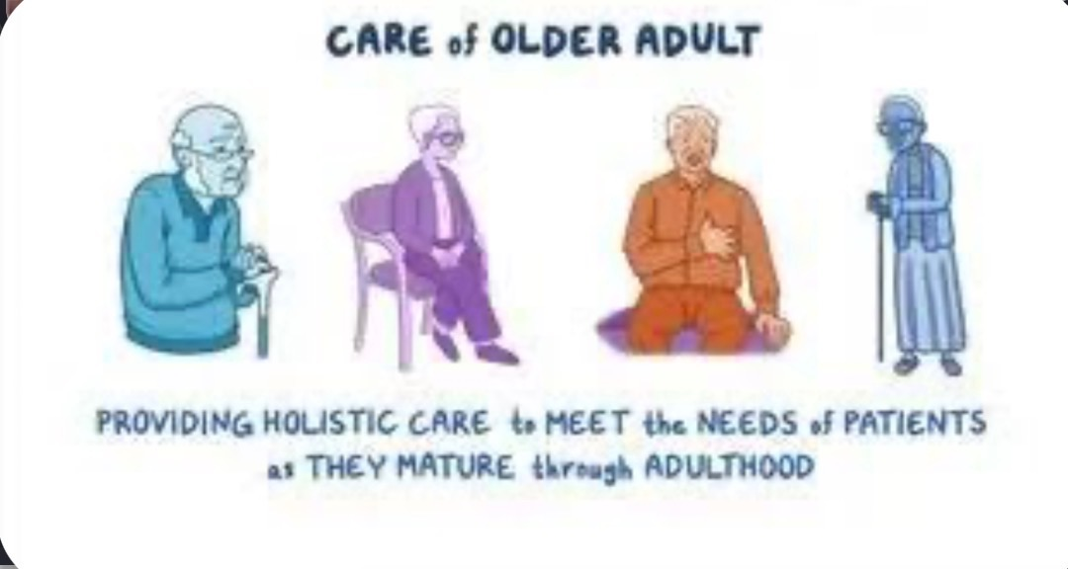
Older adult care
Amna Hussain - ID number (2319523)
Module - Empowering the older person (BMHP6027)
Lecturer - Parese Ahmed, Kennedy Obohwemu and Robert
Nartowski
component 1 - individual presentation (PowerPoint with voice over).

Slide 2
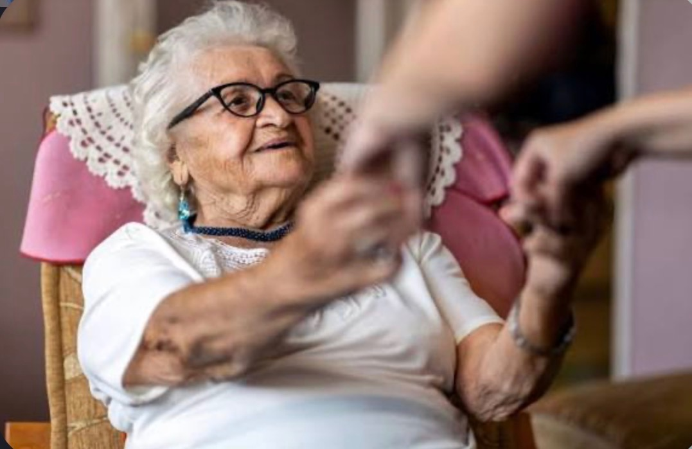
Introduction
Ageing populations are increasing in the UK.
Older people often live with frailty, multimorbidity, and social care needs. This presentation critically evaluates care, empowerment, support needs, interventions and UK policy.

Slide 3

Who Are Older People?
• Later life is associated with diverse health and social experiences. Needs vary according to health status, socioeconomic circumstances, culture and support networks (WHO, 2020).

Slide 4
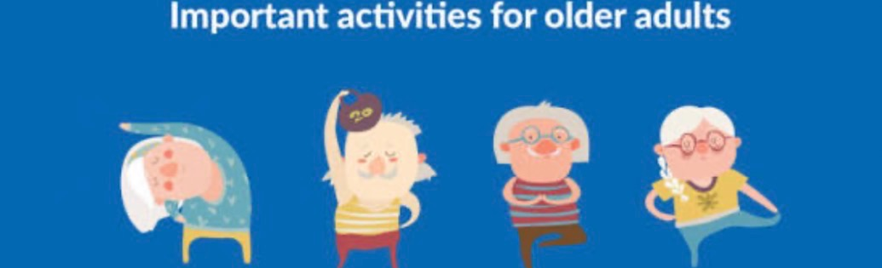
Physical care needs
﻿﻿• Chronic disease management
﻿﻿• Frailty prevention
﻿﻿• Falls prevention
﻿﻿• Nutrition and hydration
﻿﻿• Medication optimisation
sure Evidence shows frailty is associated with adverse outcomes (Clegg et al., 2013).

Slide 5

Psychological and emotional needs
Psychological and Emotional Needs
• Mental wellbeing is essential for healthy ageing. Depression, anxiety, bereavement and cognitive decline can affect quality of life, early support improves out comes.

Slide 6
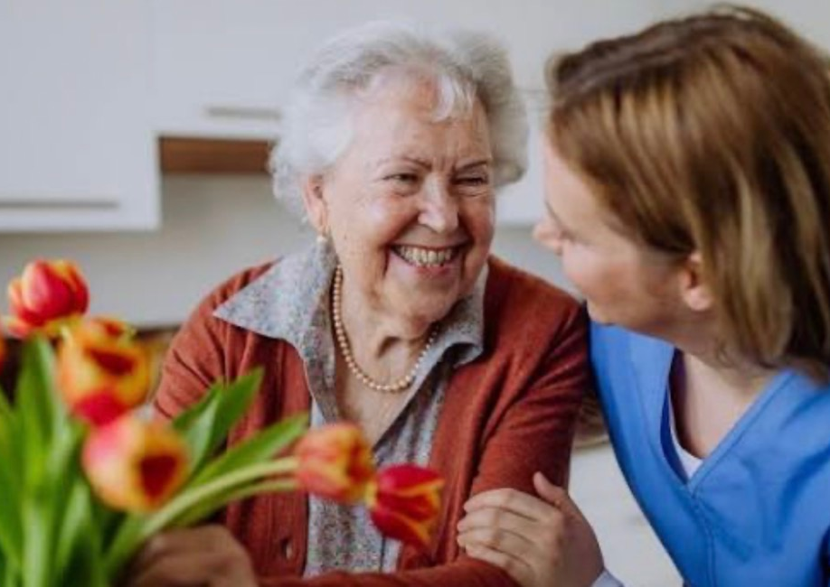
Social support needs
• Loneliness and social isolation increase mortality risk and worsen health outcomes (Holt-Lunstad et al., 2015). Community engagement and social prescribing are important interventions.

Slide 7

empowerment and Person-Centred
Care
• Person-centred care promotes dignity, autonomy, choice and shared decision-making. Empowerment improves satisfaction and health outcomes (McCormack & McCance, 2017).

Slide 8

Maintaining functional ability
• WHO emphasises functional ability rather than disease alone. Mobility, cognition and participation are key indicators of healthy ageing (WHO,2020).

Slide 9

Theoretical Perspectives
• Active Ageing Theory and Person-Centred
Care Theory support participation, independence and wellbeing. Strengths include empowerment; limitations include unequal access to resources (WHO 2017);
McCormack & McCance (2017).

Slide 10
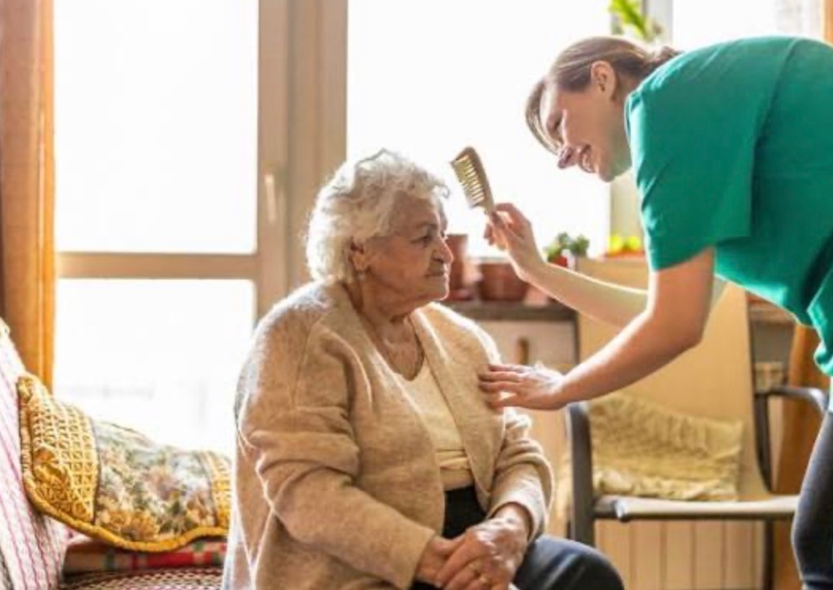
Uk policy framework
• Care Act 2014, NHS Long Term Plan and Ageing Well Programme promote prevention, integration and personalised care (Care Act
(2014); NHS England , (2019)

Slide 11
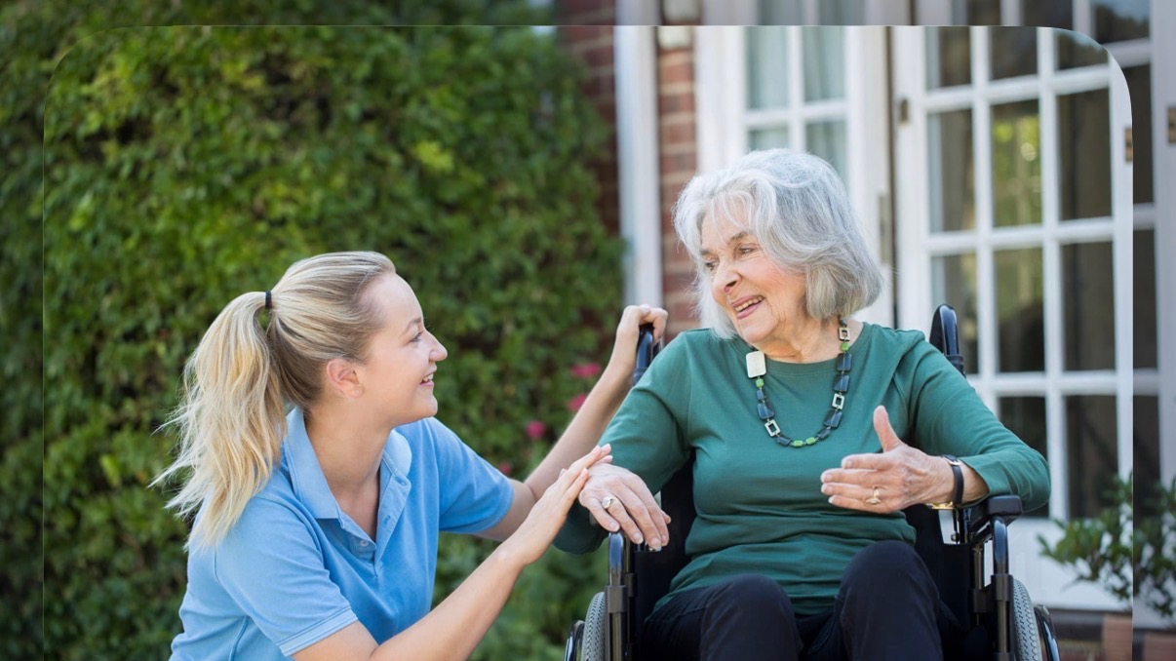
Integrated Care Approaches
• Integrated Care for Older People (ICOPE) encourages multidisciplinary assessment and coordinated services. Evidence suggests improved outcomes and continuity of care Cesari et al. (2022); WHO (2019).

Slide 12

Effectiveness of interventions
• Exercise programmes, falls prevention, rehabilitation and self-management support improve independence and reduce hospital admissions (Briggs et al, 2018).

Slide 13

Assistive technology
• Telehealth, smart-home systems and mobility aids can support independence. However, digital exclusion may increase inequalities (NHS, England, 2019).

Slide 14
Challenges to Independence
• Frailty, poverty, ageism, workforce shortages, fragmented services and housing problems reduce independence and functional ability.

Slide 15
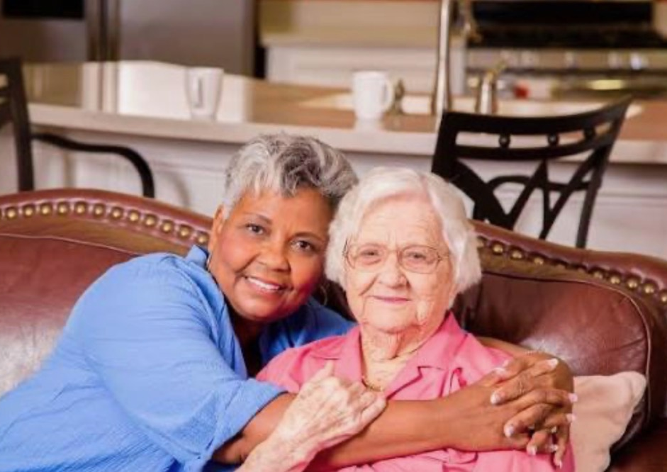
Critical Evaluation of Current
Provision
• Current UK services support many older
people, but funding pressures, staff shortages and regional variation limit effectiveness.
Integration remains inconsistent (Care Act
(2014); NHS England (2019).

Slide 16

Recommendations
﻿﻿• Invest in prevention
﻿﻿• Strengthen social care funding
﻿﻿• Expand multidisciplinary teams
﻿﻿• Improve digital inclusion
﻿﻿• Increase co-production with older people,
Beard et al. (2016); WHO, (2018)

Slide 17
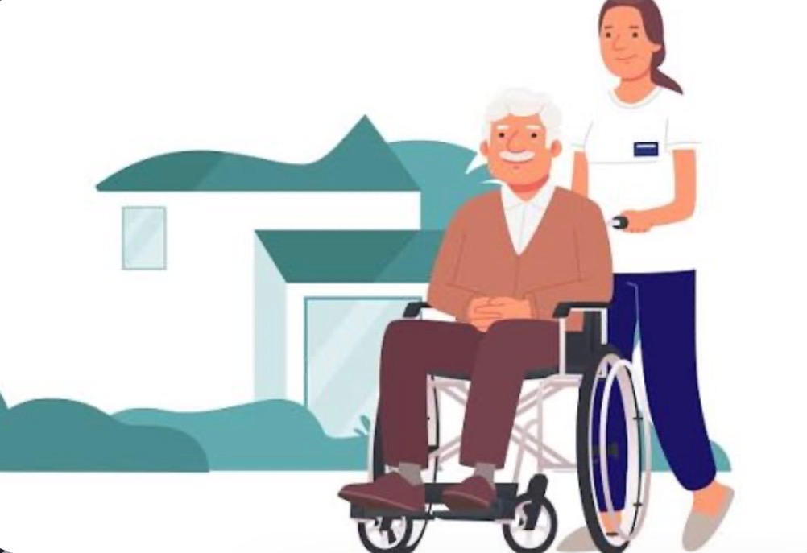
Conclusion
• Older people require holistic, person-centred and integrated support. Maintaining independence, choice and functional ability should remain central to policy and practice ( Beard et al, 2016; WHO (2020).

Slide 18
References
﻿﻿Beard et al. (2016);
﻿﻿Briggs et al. (2018);
﻿﻿Care Act (2014);
﻿﻿Cesari et al. (2022);
﻿﻿Clegg et al. (2013);
﻿﻿Holt-Lunstad et al. (2015);
﻿﻿McCormack & McCance (2017);
﻿﻿NHS England (2019);
﻿﻿Prince et al. (2015);
﻿﻿WHO (2017, 2018, 2019, 2020).

