Slide 1




What are the factors contributing to the increase in depression among Asian people leaving in uk?(17-55)
Module Code:LCHS7008
Practice-Based Research
Student Name:Zohara Riyaasat
Student Id:2435331

Slide 2

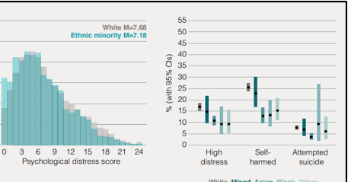
Prevalence
Studies show that psychological distress affects 1 in 4 young people aged 17, with ethnic minorities disproportionately impacted (Murthy, 2022).
NHS reports indicate that Asian women aged 16 to 24 years experience higher rates of common mental disorders than their White counterparts and are 5 times more vulnerable to self-harm than men (Karasz et al., 2019).
According to Naito et al. (2020), cultural stigma, the lack of access to culturally sensitive services and underreporting are helping to develop the mental health crisis in Asian communities that should be identified through specific research and intervention.
Differences in distress by ethnicity
(Source: Patalay and Fitzsimons, 2020)
Title one

Slide 3
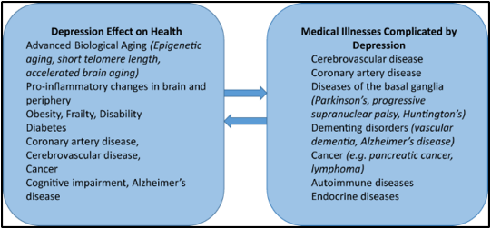
Quality of Life about Depression
(Source: Alexopoulos, 2019)
The language and cultural barrier denies Asians access to an early psychological intervention, which causes them to suffer longer, and there is more chance of committing self-harm (Coelho et al., 2022).
Depression, among the members of the UK population of Asians, severely affects their productivity, poor relationships, and causes social isolation (Ha et al., 2024).
The level of education and level of employment is impacted by depression with no culturally responsive care and untreated symptoms, particularly in younger adults (Buchanan, 2021).

Slide 4

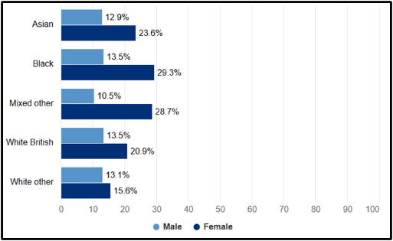
Rationale
Percentage of adults experiencing a common mental disorder
(Source: GOV.UK, 2020)
Current interventions of mental health care provision to Asians in the UK are not usually culturally competent, which results in misdiagnosis or disengagement (Prajapati and Liebling, 2022).
Migration trauma, intergenerational conflict, racism, and cultural stigma are some of the stressors unique to Asian communities of the UK that increase the risk of depression (Frost, 2020).
The study will address clinical gaps that is critical in understanding depression among Asian population in UK aged 17-55 to propose appropriate strategies.

Slide 5

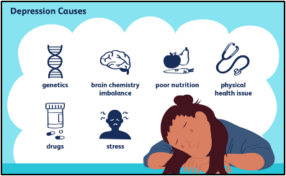
Research aims and objectives
(Source: Schimelpfening, 2022)
Aim:
The research will seek to find out the reasons why there is an increased morbidity of depressive cases in Asian individuals aged between 17 and 55 years in the UK.
Objectives
To determine the effects of depression on both quality of life and social functioning.
To assess socio-cultural, economic, and systemic determinants of causing depression in Asians.
To recommend culturally responsive policies and practices of approaching depression treatment and reform.

Slide 6
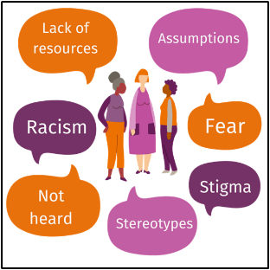
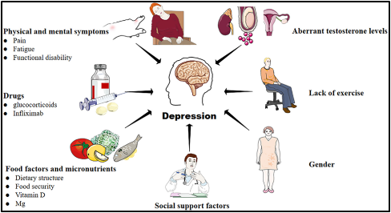

Research questions
(Source: Maternal Mental Health Alliance, 2023)
(Source: Liu et al., 2023)
Which are the major socio-cultural and systemic determinants of depression among Asian individuals aged 17-55 in the UK and how can the culturally responsive interventions enhance mental health outcomes?

Slide 7

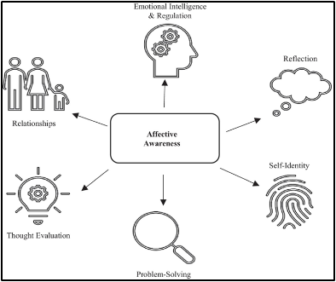
Research impact
(Source: Beames et al., 2021)
The outcomes of the research will inform culturally competent mental health policies and practices for Asians in the UK.
Findings may influence NHS training, community outreach, and funding priorities
This will highlight the lived experiences of Asian individuals and disparities in ethnic mental health support to design inclusive services and reduce stigma.

Slide 8
References
1. Alexopoulos, G.S. (2019). Mechanisms and treatment of late-life depression. Translational psychiatry, 9(1), p.188. https://doi.org/10.1038/s41398-019-0514-6
2. Beames, J.R., Kikas, K. and Werner-Seidler, A. (2021). Prevention and early intervention of depression in young people: an integrated narrative review of affective awareness and Ecological Momentary Assessment. BMC psychology, 9(1), p.113. https://doi.org/10.1186/s40359-021-00614-6
3. Buchanan, A. (2021). Effects of Culturally Responsive Treatment and Perceptions of Clinicians Cultural Responsiveness in Treating Depression for Latinx and Asian Americans. Palo Alto University. https://search.proquest.com/openview/43f5a72cb3bb1826f5114a9fd4976736/1?pq-origsite=gscholar&cbl=18750&diss=y
4. Coelho, H., Price, A., Kiff, F., Trigg, L., Robinson, S., Coon, J.T., Coon, J. and Anderson, R. (2022). Experiences of children and young people from ethnic minorities in accessing mental health care and support: rapid scoping review. Health and Social Care Delivery Research, 10(22), pp.1-74. https://doi.org/10.3310/XKWE8437
5. Frost, D.M. (2020). Hostile and harmful: Structural stigma and minority stress explain increased anxiety among migrants living in the United Kingdom after the Brexit referendum. Journal of Consulting and Clinical Psychology, 88(1), p.75. https://discovery.ucl.ac.uk/id/eprint/10084064/9/Frost_Frost%202019%20JCCP%20PrePub%20NfD.pdf
6. GOV.UK (2020). Common mental disorders. [online] www.ethnicity-facts-figures.service.gov.uk. Available at: https://www.ethnicity-facts-figures.service.gov.uk/health/mental-health/adults-experiencing-common-mental-disorders/latest/ [Accessed 10 Oct. 2025].
7. Ha, J.W.Y., Yip, W., Ge, L., Yap, C.W. and Pereira, M.J. (2024). Association of social isolation and depressive symptoms with workplace productivity loss in a multi-ethnic Asian study. Scientific Reports, 14(1), p.22145. https://doi.org/10.1038/s41598-024-73272-4
8. Karasz, A., Gany, F., Escobar, J., Flores, C., Prasad, L., Inman, A., Kalasapudi, V., Kosi, R., Murthy, M., Leng, J. and Diwan, S. (2019). Mental health and stress among South Asians. Journal of immigrant and minority health, 21(Suppl 1), pp.7-14. https://doi.org/10.1007/s10903-016-0501-4
9. Liu, N., Yan, W., Su, R., Zhang, L., Wang, X., Li, Z., Qin, D. and Peng, J. (2023). Research progress on rheumatoid arthritis-associated depression. Frontiers in behavioral neuroscience, 16, p.992223. DOI:10.3389/fnbeh.2022.992223
10. Maternal Mental Health Alliance (2023). Barriers to accessing services | Maternal Mental Health Alliance. [online] maternalmentalhealthalliance.org. Available at: https://maternalmentalhealthalliance.org/amv-toolkit/breaking-barriers/access-perinatal-mental-health-services/barriers/ [Accessed 10 Oct. 2025].
11. Murthy, V.H. (2022). The mental health of minority and marginalized young people: An opportunity for action. Public Health Reports, 137(4), pp.613-616. https://doi.org/10.1177/00333549221102390
12. Naito, T., Chin, J., Kim, T.U., Veera, S., Jeannette, M. and Lomiguen, C.M. (2020). Further reduction in help-seeking behaviors amidst additional barriers to mental health treatment in Asian populations: a contemporary review. Cureus, 12(11). DOI: 10.7759/cureus.11455
13. Patalay, P. and Fitzsimons, E. (2020). Mental ill-health at age 17 in the UK. [online] Available at: https://cls.ucl.ac.uk/wp-content/uploads/2020/11/Mental-ill-health-at-age-17-%E2%80%93-CLS-briefing-paper-%E2%80%93-website.pdf. [Accessed 10 Oct. 2025]
14. Prajapati, R. and Liebling, H. (2022). Accessing mental health services: A systematic review and meta-ethnography of the experiences of South Asian service users in the UK. Journal of racial and ethnic health disparities, 9(2), pp.598-619. https://doi.org/10.1007/s40615-021-00993-x
15. Schimelpfening, N. (2022). 9 Most Common Causes of Depression. [online] Verywell Mind. Available at: https://www.verywellmind.com/common-causes-of-depression-1066772 [Accessed 10 Oct. 2025].

