Slide 1
BMSW6104
Strategic Management for SMEs
Week 2
Analysing The Strategic Environment
(Macro-Environment Analysis)

Slide 2
Learning Objectives
Explain why it is important to study the environment of the organisation
Outline the main environmental influences on the organisation and relate the degree of change to prescriptive and emergent strategic approaches
Analyse the broad macro-environment of organisations in terms of political, economic, social, technological, ecological and legal factors (PESTEL)

Slide 3
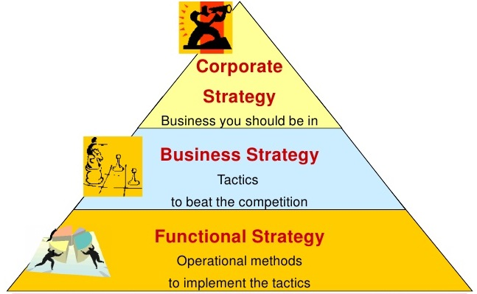
Last Week - Levels of Strategy
Corporate-level strategy is concerned with the overall scope of an organisation and how value is added to the constituent businesses of the organisational whole.
Business-level strategy is about how the individual businesses should compete in their particular markets.
Functional strategies are concerned with how the components of an organisation deliver effectively the corporate- and business-level strategies in terms of resources, processes and people.

Slide 4
Last Week - Core Areas of Strategic Management
The three core areas of strategic management are:
  Strategic analysis. The organisation, its mission and objectives have to be examined and analysed.
  Strategy development. The strategy options have to be developed and then selected. To be successful, the strategy is likely to be built on the particular skills of the organisation and the special relationships that it has or can develop with those outside – suppliers, customers, distributors and government.
  Strategy implementation. The selected options now have to be implemented. There may be major difficulties in terms of motivation, power relationships, government negotiations, company acquisitions and many other matters.

Slide 5
Why Studying the Competitive Environment is Important?
In strategy, the environment means everything and everyone outside the organisation: competitors, customers, suppliers plus other influential institutions such as local and national governments.
A study of the environment will provide information on the nature of competition as a step to developing sustainable competitive advantage.
Sustainable competitive advantage is an advantage over competitors that cannot easily be imitated.
Organisations will perceive opportunities that might be explored and threats that need to be contained.

Slide 6
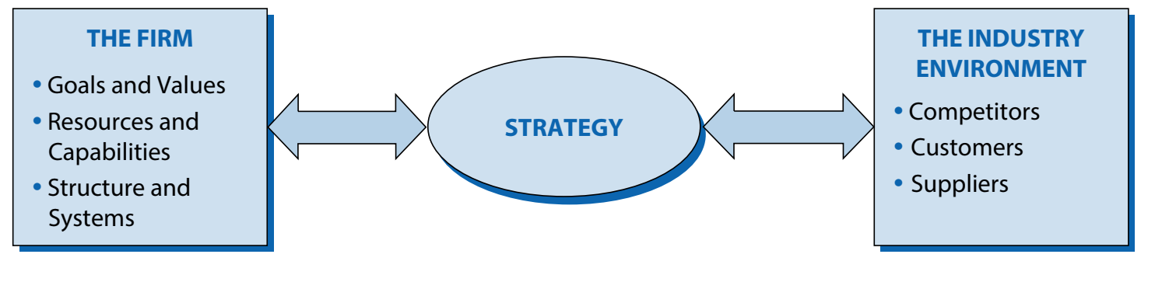
The Basic Framework for Strategy Analysis
Strategy as a link between the firm and its environment.

Slide 7
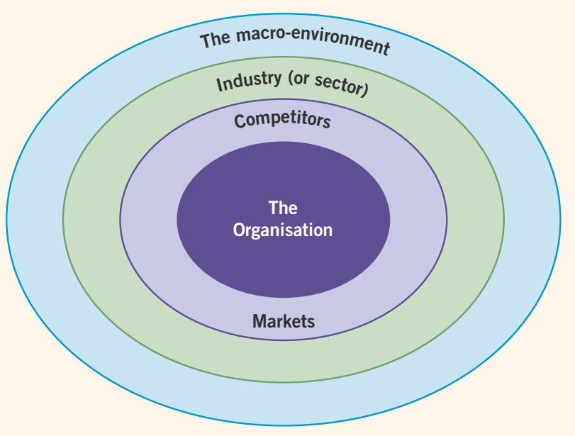
Layers of the Business Environment
Macro-environmental changes can often seem too big, complex or unpredictable for managers to grasp.
The market environment consists mainly of suppliers, customers and competitors. These are environmental participants with whom interactions are primarily economic.
The nonmarket environment involves primarily the social, political, legal and ecological factors, but can also be impacted by economic factors.

Slide 8
Foreign environment
(uncontrollable)
Political/legal
forces
Economic
forces
Domestic environment
(uncontrollable)
Political/
legal
forces
Competitive
structure
Cultural
forces
Competitive
Forces
Analysing the Strategic Environment
Internal Factors
(controllable)
Environmental
uncontrollables
country market A
Geography
and
Infrastructure
Economic climate
Environmental
uncontrollables
country market B
Level of
Technology
Structure of
distribution
Environmental
uncontrollables
country market C
Notes:
1

Slide 9
Foreign environment
(uncontrollable)
The strategic managers must deal with two levels of uncontrollable uncertainty
Political/legal
forces
E
Domestic environment
(uncontrollable)
Political/
legal
forces
Competitive
structure
Analysing the Strategic Environment
Cultural
forces
Competitive
Forces
Analysing the Strategic Environment
Internal Factors
(controllable)
Environmental
uncontrollables
country market A
Geography
and
Infrastructure
Economic climate
Level of
Technology
Environmental
uncontrollables
country market B
Structure of
distribution
Environmental
uncontrollables
country market C
Notes:
2

Slide 10
Foreign environment
(uncontrollable)
The strategic managers must deal with two levels of uncontrollable uncertainty
Political/legal
forces
E
Domestic environment
(uncontrollable)
Each foreign country in which a company operates adds its own unique set of uncontrollables
Political/
legal
forces
C
Cultural
forces
Analysing the Strategic Environment
Internal Factors
(controllable)
Environmental
uncontrollables
country market A
Geography
and
Infrastructure
Economic climate
Level of
Technology
Environmental
uncontrollables
country market B
Structure of
distribution
Environmental
uncontrollables
country market C
Notes:
3

Slide 11
Foreign environment
(uncontrollable)
Political/legal
forces
Economic
forces
Domestic environment
Political/
legal
forces
Competitive
structure
Cultural
forces
Competitive
Forces
Internal Factors
Analysing the Strategic Environment
Controllables
such as 7Ps
Environmental
uncontrollables
country market A
Geography
and
Infrastructure
Economic climate
Environmental
uncontrollables
country market B
Level of
Technology
Environmental
uncontrollables
country market C
Structure of
distribution
Notes:
4

Slide 12
Foreign environment
(uncontrollable)
Political/legal
forces
Economic
forces
Domestic uncontrollables
Competitive structure
Political/legal forces
Marketing
(controllable)
Cultural
forces
Competitive
Forces
Price
Product
Analysing the Strategic Environment
Promotion
Channels of
distribution
Environmental
uncontrollables
country market A
Geography
and
Infrastructure
Economic climate
Level of
Technology
Environmental
uncontrollables
country market B
Structure of
distribution
Environmental
uncontrollables
country market C
Notes:
5

Slide 13
Foreign uncontrollables
Political/legal
forces
Economic
forces
Domestic environment
(uncontrollable)
Political/
legal
forces
Competitive
structure
Competitive
Forces
Analysing the Strategic Environment
Cultural
forces
Internal Factors
Environmental
uncontrollables
country market A
Geography
and
Infrastructure
Economic climate
Level of
Technology
Environmental
uncontrollables
country market B
Structure of
distribution
Environmental
uncontrollables
country market C
Notes:
6

Slide 14
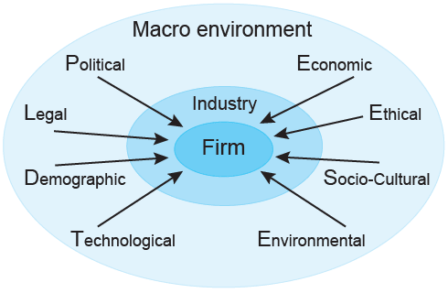
Macro Environment
Analysing the Strategic Environment

Slide 15
The Basics of Strategic Environment
Environmental analysis can usefully begin with a basic assessment of the market definition and size, the market growth and the market share.
Market definition is important because it will determine the size and scope of the strategic opportunity. Market definition will be defined by a consideration of customers and the availability of substitute products.
Market growth is commonly estimated early in any strategic analysis because of its importance with regard to the growth objectives of an organisation.
A basic estimate of market share can be used to estimate whether an organisation has a significant share of a market as a starting point in exploring the strategic implications.

Slide 16
PEST/PESTEL Analysis
PEST/PESTEL analysis is a simple and effective tool used to identify the key external forces that might affect an organisation.
These forces can create both opportunities and threats for an organisation.
The aim of doing PEST/PESTEL is to:
    find out the current external factors affecting an organisation;
    identify the external factors that may change in the future;
    to exploit the changes (opportunities) or defend against them (threats) better than competitors would do.

Slide 17

What factors are included in a PEST/PESTEL analysis?

Slide 18

Discussion
What do you think are the most external factors in your country influencing businesses? Why?
How do you think companies should respond to these external factors to achieve their organisational objectives?

Slide 19
How to perform the analysis?
The process of carrying out PEST/PESTEL analysis should involve as many managers as possible to get the best results. It includes the following steps:
Step 1. Gathering information about political, economic, social and technological changes + any other factor(s).
Step 2. Identifying which of the PEST/PESTEL factors represent opportunities or threats.

Slide 20

Step 1: Gathering PEST, PESTEL Information
In order to perform PEST/PESTEL (or any other variation of it), managers have to gather as much relevant information as possible about the firm’s external environment. Nowadays, most information can be found on the internet relatively easy, fast and with little cost.

Slide 21




Political Factors
Government stability and likely changes
Bureaucracy
Corruption level
Freedom of press
Tax policy (rates and incentives)
Regulation/de-regulation
Trade control
Import restrictions (quality and quantity)
Tariffs
….

Slide 22




Economic Factors
Growth rates
Inflation rate
Interest rates
Exchange rates
Unemployment trends
Labour costs
Stage of business cycle
Credit availability
Trade flows and patterns
Level of consumers’ disposable income
….

Slide 23

Social Factors
Health consciousness
Education level
Attitudes toward imported goods and services
Attitudes toward work, leisure, career and retirement
Attitudes toward product quality and customer service
Attitudes toward saving and investing
Lifestyles and population growth rate
Buying habits
Religion and beliefs
Attitudes toward “green” or ecological products
…..

Slide 24

Technological Factors
Basic infrastructure level
Rate of technological change
Spending on research & development
Technology incentives
Legislation regarding technology
Technology level in your industry
Communication infrastructure
Access to latest technology
Internet infrastructure and penetration
…..

Slide 25

Environmental Factors
Weather
Climate change
Laws regulating environment pollution
Air and water pollution
Recycling
Waste management
Endangered species
Attitudes toward “green” or ecological products
Attitudes toward and support for renewable energy
…..

Slide 26

Legal Factors
Discrimination law
Copyright, patents / Intellectual property law
Consumer protection and e-commerce
Employment law
Health and safety law
Data Protection
Environmental Law
Education Law
…..

Slide 27

Step 2: Identifying Opportunities and Threats
Gathering information is just a first important step in doing PEST/PESTEL analysis. Once it is done, the information has to be evaluated.
It is essential to identify which PEST/PESTEL factors represent the opportunities or threats for the organisation.

Slide 28
Key Drivers for Change
Key drivers for change are the environmental factors likely to have a high impact on industries and sectors, and the success or failure of strategies within them.
Key drivers translate macro-environmental factors to the level of the specific industry or sector.
Without a clear sense of the key drivers for change, managers will not be able to take the strategic decisions that allow for effective responses to environmental changes.
It is important that an organisation’s strategists consider each of the key drivers for change, looking to minimise threats and, where possible, seize opportunities.

Slide 29



Case Study
Senior management of Motorrad section at BMW plc has identified that there is a strategic need for launching a factory to produce motorbikes and reduce the cost of production and delivery time in the UK market. They are unsure that this strategic decision will be the best decision based on the current business environment of the UK. They want you to analyse the general environment surrounding the organisation by applying a PESTEL analysis framework and provide your suggestion on this strategic decision.

Slide 30

Any Questions?
Thank You ☺

Slide 31
Sources:
Barney, J. B. & Hesterly, W. S., 2015. Strategic Management and Competitive Advantage: Concepts and Cases. 5 ed. Essex: Pearson Education Limited.
Grant, R. M., 2018. Contemporary Strategy Analysis. 10 ed. NJ : John Wiley & Sons, Inc.
Hill, C. W. L., Schilling, M. A. & Jones, G. R., 2017. Strategic Management, Theory. 12 ed. Boston: Cengage Learning.
Johnson, G. et al., 2017. Exploring Corporate: Text and Cases. 11 ed. Harlow: Pearson Education Limited.
Lynch, R., 2015. Strategic Management. 7 ed. Harlow: Pearson Education Limited.
Campbell, D., Stonehouse, G. & Houston, B., 2002. Business Strategy: An Introduction. 2 ed. Oxford: Butterworth-Heinemann.
Rugman, A. M. & Collinson, S., 2012. International Business. 6 ed. Essex: Pearson Education Limited.
Unicef, 2015. SWOT and PESTEL. [Online] Available at: https://www.unicef.org/knowledge-exchange/files/SWOT_and_PESTEL_production.pdf [Accessed 28 08 2019].

