Slide 1


Facilitating change and managing quality outcomes in health ecosystems
BMHP6028
Dr Heather M Davies
Room IQ316, Swansea IQ Building
Heather,davies@uwtsd.ac.uk
University of Wales Trinity Saint David
Week 2 – 05.02.2026

Slide 2

Table of contents:
Types of changes
  Cultural change
  Behavioural change
  Organisational change
Explore the drivers and barriers to change in healthcare
Commissioning process
WEEK 1
WEEK 2
WEEK 3
WEEK 4
WEEK 5
WEEK 6
WEEK 7
WEEK 8
WEEK 9
WEEK 10
Types of change & drivers to change
Introduction to Health Ecosystems and Change Management

Slide 3
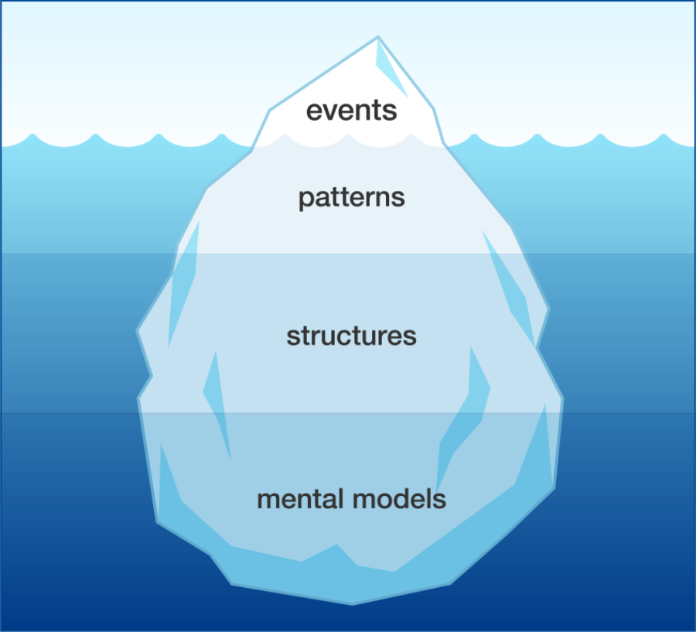
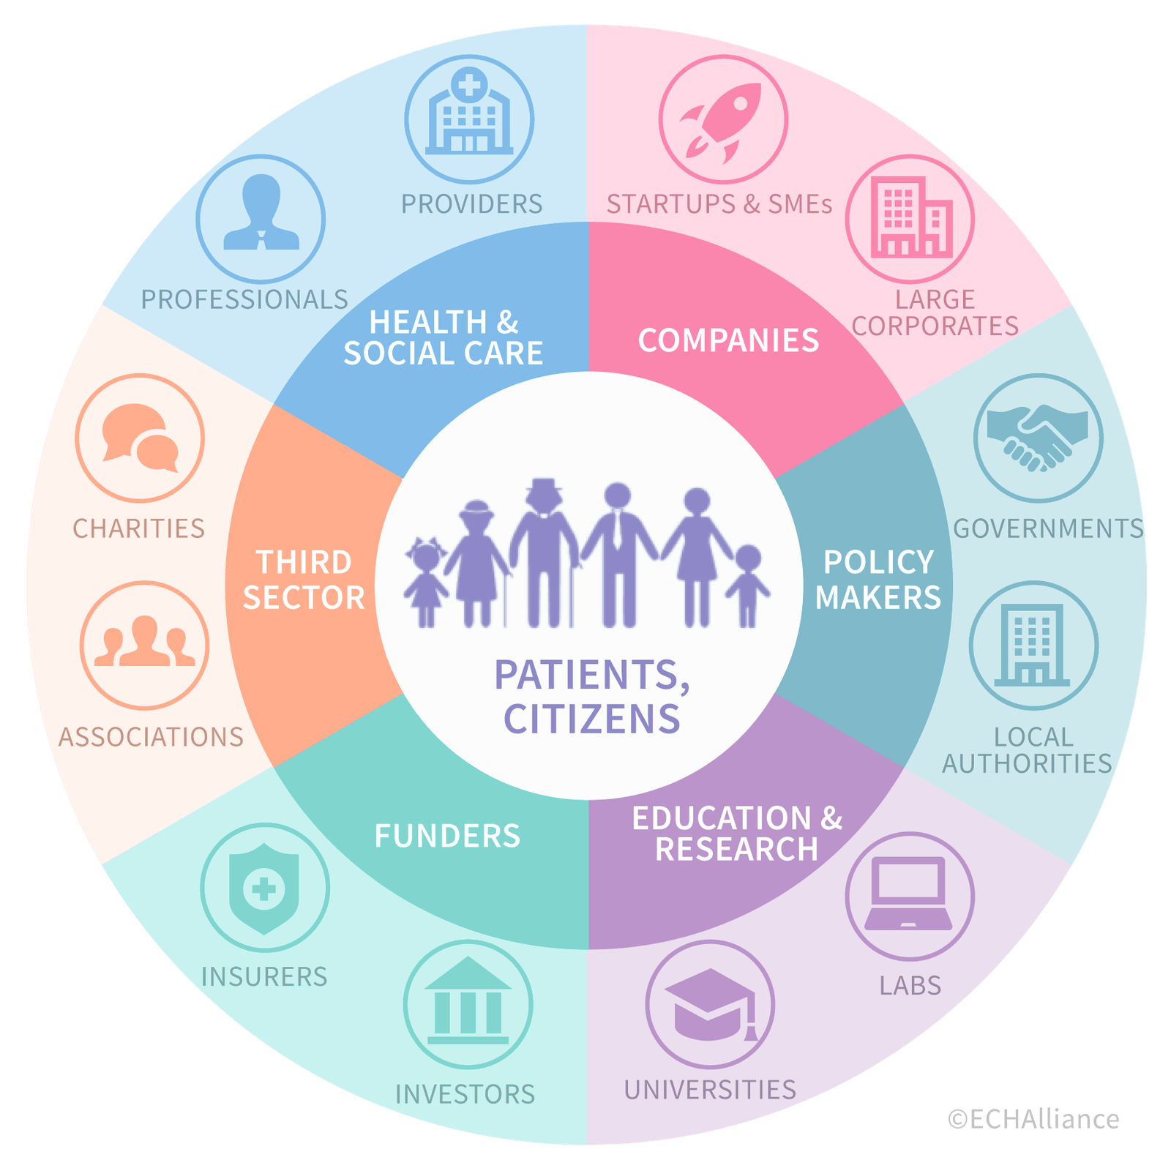





Summary of week 1
Healthcare ecosystem in UK
Iceberg model
Healthcare ecosystem
NHS Funding
Private Sector
CARE QUALITY COMMISSION (CQC)
NHS IMPROVEMENT
MEDICINES AND HEALTHCARE PRODUCTS REGULATORY AGENCY (MHRA)
Primary Care
Secondary Care
Tertiary Care
Community Health Services
Education
Workforce
Understanding culture change
Identifying potential issues
Holistic approach to leadership
Research

Slide 4
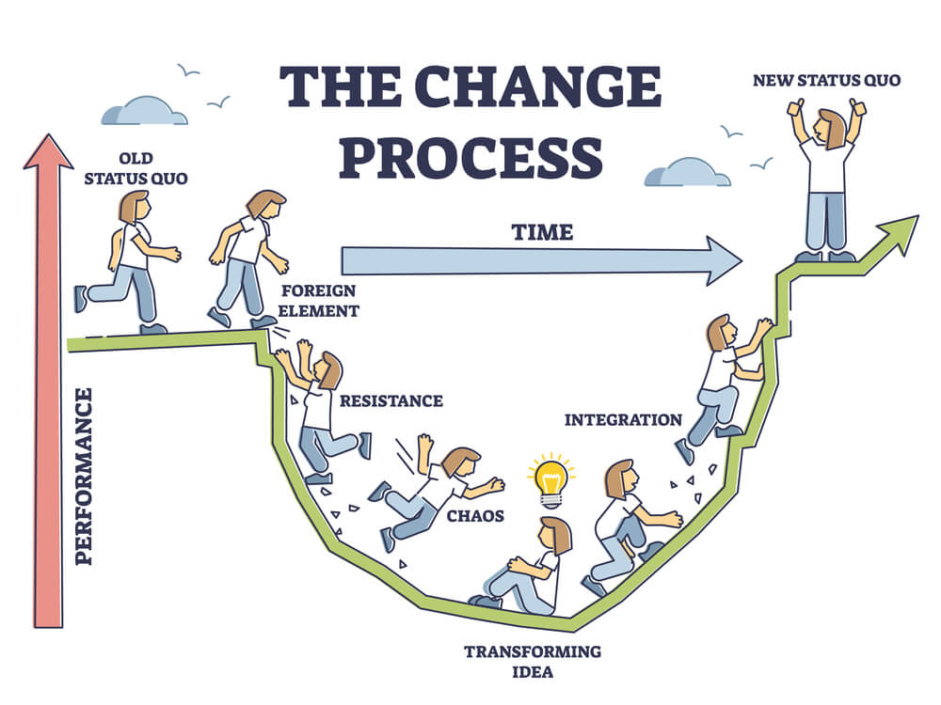
Introduction to Healthcare Change Management: Challenges
Resistance to change among healthcare professionals
Technology and processes integration into existing systems
Diversity of stakeholders
Resource limitations
Complex hierarchies and siloed departments
Staff turnover, change fatigue, burnout

Slide 5
INDIVIDUAL WORK
Find possible solutions to each of the main challenges within healthcare settings:
Resistance to change among healthcare professionals
Technology and processes integration into existing systems
Diversity of stakeholders
Resource limitations
Complex hierarchies and siloed departments
Staff turnover, change fatigue, burnout
Introduction to Healthcare Change Management: Solutions
15 mins

Slide 6
Introduction to Healthcare Change Management: Solutions
CHALLENGES
SOLUTIONS
Resistance to change among healthcare professionals
Technology and processes integration into existing systems
Diversity of stakeholders
Resource limitations
Complex hierarchies and siloed departments
Staff turnover, change fatigue, burnout
Transparent and two-ways communication
Continuous trainings
Engaging stakeholders early
Thoughtful distribution of human and financial resources
Leadership commitment and collaboration
Proactive workforce planning

Slide 7
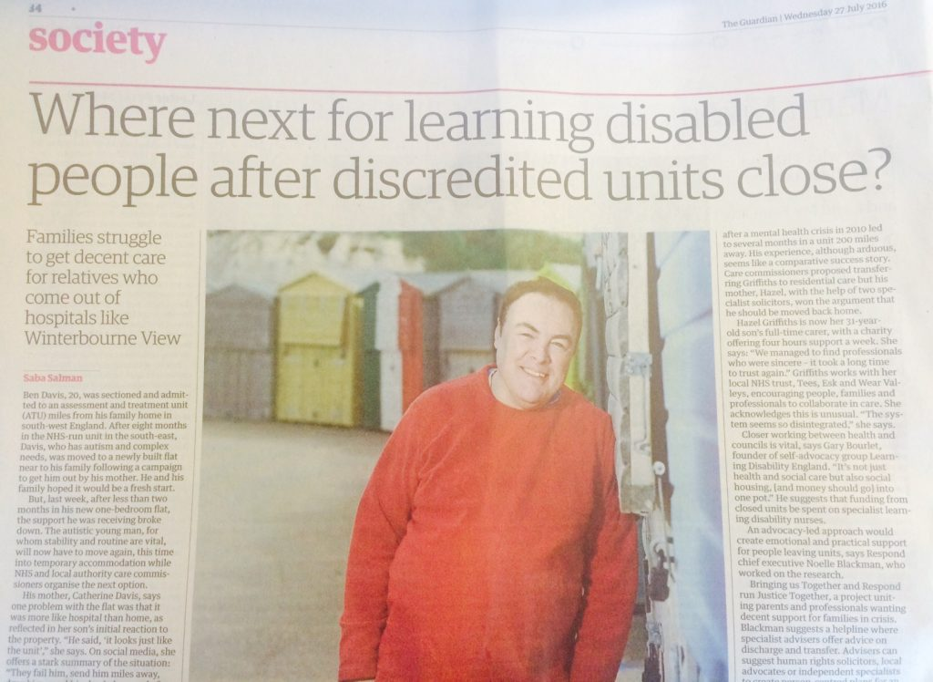




Why is facilitating change important in healthcare?

Slide 8
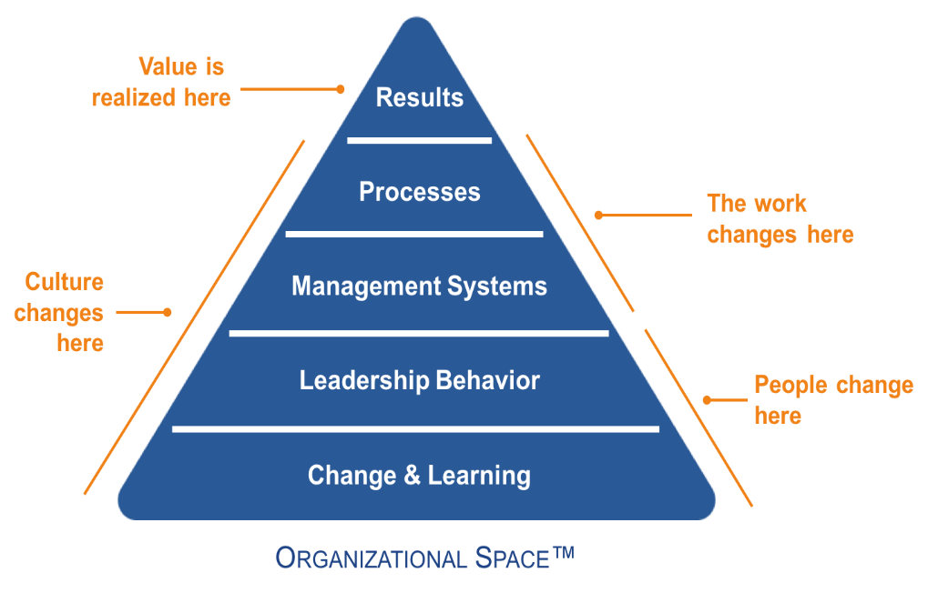
Why is facilitating change important in healthcare?
Increased employee engagement and smoother change adoption
Reduced resistance and improved morale during transitions
Minimised disruption and downtime during implementations
Higher success rate for change initiatives
Enhanced agility and adaptability in a dynamic and complex environment

Slide 9
Types of change
From a physician-centred culture to a patient-centred approach. Encouraging teamwork between doctors, nurses, and allied health professionals, shared decision-making with patients.
Implementation of hand hygiene campaign to reduce infections. Healthcare develop a habit of sanitising hands before and after patient contact, improving patient safety.
  Transitions from paper-based medical records to HER. New workflows, staff training, IT infrastructure upgrades to ensure smooth adoption and minimise disruption to patient care.
Cultural change
Behavioural change
Organisational change
Transformation of a society’s values, beliefs, norms, and behaviours over time.
Modification of individual or group actions, habits, or responses over time.
Process by which a company or institution modifies its structure, strategies, processes, culture, or operations to adapt to internal and external influences..
Quality outcomes

Slide 10
Cultural change
Behavioural change
Organisational change
NHS ‘Learning from Deaths’ Initiative
The ‘5 Moments for Hand Hygiene’
NHS Foundation Trust’s use of
Integrated Care Models
The NHS introduced the Learning from Deaths initiative to shift the culture around patient deaths and the review process. The initiative aimed to create a culture of openness and transparency, focusing on learning from each death to improve care and prevent future tragedies.
In response to rising healthcare-associated infections (HAIs), the NHS launched the "5 Moments for Hand Hygiene" campaign to promote handwashing and prevent infection. The campaign was designed to change the behavior of healthcare professionals, ensuring that hand hygiene was practiced at crucial moments in patient care.
The Salford Royal NHS Foundation Trust in Greater Manchester implemented an integrated care model to improve patient outcomes, particularly for those with long-term conditions such as diabetes and heart disease. The organizational change focused on providing more coordinated care across primary, secondary, and community services.
Key elements of change:
Encouraging healthcare professionals to discuss patient deaths openly and use them as learning opportunities.
Ensuring that all patient deaths are reviewed, regardless of the cause.
Promoting a shift away from blame and towards systemic improvements.
Key elements of change:
Training and awareness programs for staff on the importance of hand hygiene at key points (e.g., before patient contact, after body fluid exposure).
Use of posters, training videos, and other visual aids to remind staff about the 5 key moments.
Monitoring compliance through audits and feedback loops.
Key elements of change:
Restructuring the organization to create multidisciplinary teams that included GPs, hospital doctors, nurses, social workers, and other specialists.
Establishing shared electronic health records to ensure all team members had access to patient information in real-time.
Focusing on patient-centred care by involving patients in care planning and decision-making.
Outcome:
This initiative helped to break down the stigma around mortality reviews and fostered a culture of continuous learning and patient safety. It also improved clinical practice by identifying patterns and areas for improvement, contributing to better overall care quality.
Outcome:
The campaign led to a significant improvement in hand hygiene compliance across NHS settings, resulting in a reduction in the transmission of healthcare-associated infections. Behavioural change was achieved through continuous education, monitoring, and positive reinforcement.
Outcome:
The integrated care model improved patient satisfaction and reduced hospital readmissions. By ensuring better coordination and continuity of care, Salford Royal achieved better health outcomes for patients with long-term conditions, as well as reduced strain on hospital resources.

Slide 11
CASE STUDY: NHS 111 and Urgent Care System Integration
Cultural Change
The NHS promoted a culture of accessible, patient-centred care, with a focus on triaging cases to the right level of care (GP, urgent care, A&E).
Behavioural Change
Healthcare professionals needed to adapt their practices to ensure that patients using the NHS 111 service received the right guidance quickly. Call handlers were trained to assess symptoms and direct patients accordingly.
Organisational Change
NHS 111 integrated multiple healthcare services and streamlined the referral process, reducing unnecessary emergency department visits and improving care coordination.
OUTCOME:
The NHS 111 service helped reduce pressure on emergency departments and GP practices, enabling more efficient use of healthcare resources. It improved access to care and reduced waiting times for patients, resulting in better patient outcomes. The system’s success required behavioural shifts among healthcare professionals to adapt to new ways of triaging and directing patients.

Slide 12
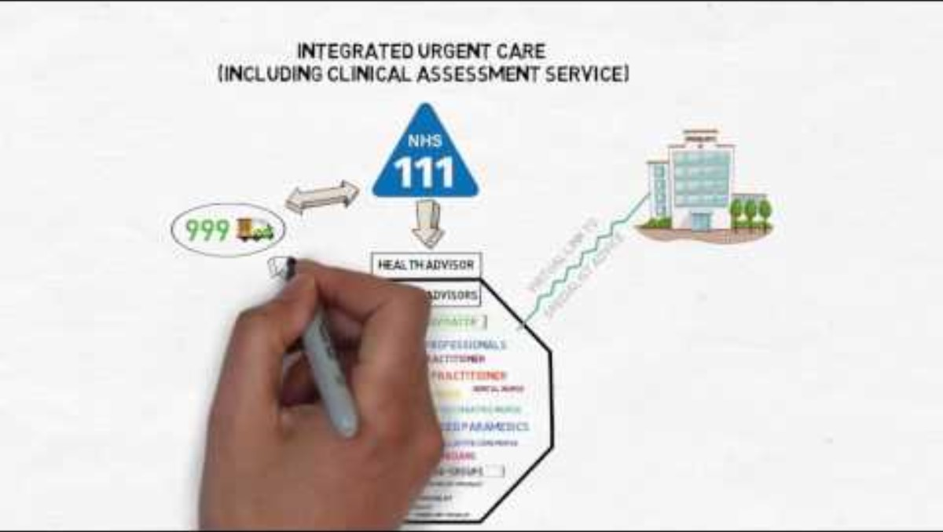

Slide 13
GROUP WORK: Learning from failure
30 mins
Consider the recent case: Herefordshire Children's Services Failures case of 2022.
Search for the investigation report on internet (report, videos)
List the key points about the failures
List the recommendations
Is there any other “change” you would suggest to prevent similar failures?
Build the Iceberg model for this case study highlighting the formal aspects (events above the water line) and the hidden aspects (patterns below the water line).

Slide 14
CASE STUDY: Herefordshire Children's Services Failures
Context: in 2022, an Ofsted inspection uncovered “widespread and serious failures” in Herefordshire Children's Services. The department was rated as “inadequate” due to significant deterioration in the quality of social work practice, high staff turnover, and a lack of effective leadership, leading to concerns about the welfare of children in care and their families. This prompted the appointment of a government-appointed commissioner to investigate and address the issues.
KEY FAILURES
RECOMMENDATIONS
LEADERSHIP and MANAGEMENT
The service suffered from poor leadership, with a lack of clear direction and oversight. This deficiency contributed to inconsistent practices and a failure to address known issues effectively.
LEADERSHIP OVERHAUL
Appoint experienced leaders to provide clear direction and improve oversight within the service.
IMPROVEMENT BOARD AND PLAN
Establish a multi-agency Improvement Board to oversee the development and implementation of a comprehensive Improvement plan targeting identified weaknesses.
DECISION-MAKING and OVERSIGHT
There was a pattern of poor decision-making, insufficient management oversight, and a lack of focus on the needs of children, leading to drift and delay in case handling.
STAFF RECRUITMENT AND RETENTION
Develop strategies to recruit and retain qualified staff, reducing vacancies and turnover to ensure stability and consistency in servicer provision.
STAFFING CHALLENGES
High vacancy rates and significant turnover among the staff and managers resulted in instability and inconsistency in service delivery.
ENHANCED QUALITY ASSURANCE
Implement robust quality assurance processes to monitor practice standards, ensuring timely interventions and support for children and families.
QUALITY ASSURANCE
The service lacked robust quality assurance mechanisms, leading to inadequate monitoring and evaluation of practice standards.
PERFORMANCE MONITORING
Regularly review performance data to identify areas needing improvement and to track progress against the Improvement plan.

Slide 15
Leading and managing in Contemporary Health and Social care
Duty Care Manager
(DCM)
Care Interventions
Organisation and management of care
Training and educating colleagues and students
Teaching and promoting health and wellbeing
Using research and evidence-based practice
Leadership
The DCM in healthcare is responsible for overseeing the daily operations of a healthcare facility, ensuring high-quality care, and managing staff during their shift.
Patient safety
Staff coordination
Regulatory compliance
(Health and Social Care Act)
Planning
Organising
Directing /
Guiding
Supervising /Monitoring
Management process
(Goope, 2017)

Slide 16
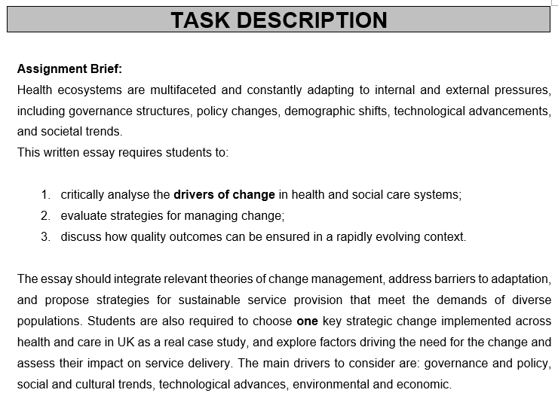
What are the
DRIVERS OF CHANGE?

Slide 17
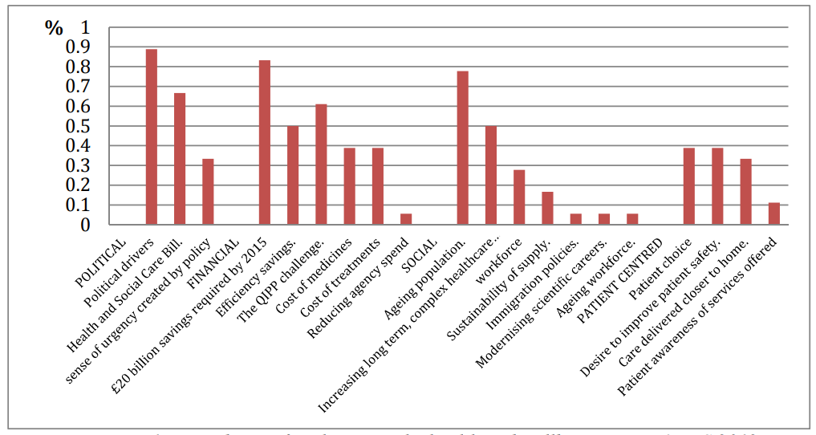
Key drivers:
Governance and Political
Social and Cultural
Technological advances
Environmental
Economic factors
For example, the introduction of the NHS in 1948 drastically changed the healthcare delivery in the UK. Political ideologies about public versus private provision also shape policy directions.
For example, there is growing awareness and advocacy for mental health services. This trend drives policies towards more inclusive and supportive mental health care
For example, EHRs streamline patient data management. telemedicine expands access to care, particularly in remote areas.
For example, practitioners need to prepare for age-related conditions like dementia. They must cope with chronic disease, which are more common in older adults.
For example, economic recessions can tighten funding, impact service quality and accessibility. On the other hand, economic growth can lead to more investment in healthcare technologies and facilities.
(Sinha)

Slide 18
Policy and legislation play a crucial role in shaping health and social care services, ensuring they remain effective, safe, and responsive to public needs. These changes often focus on improving service delivery, integrating care, safeguarding patients, and addressing inequalities.
Main policies in UK
Health and Care Act 2022
The NHS long-term plan
Promote a more integrated, patient-centered approach to care.
Address staffing challenges and workforce sustainability.
Improve funding distribution and efficiency.
Enhance safeguarding measures for children, vulnerable adults, and those lacking mental capacity.
Children and Social Work Act 2017
The Equality Act 2010
Mental Capacity Act 2019

Slide 19

From Policy to Practice
Step 1: Identify needs of the local community
Step 2:
Agree priorities and outcomes
Step 3:
Develop services
Step 4:
Monitor, review and evaluate
Commissioning process
Commissioning relates to the way in which the NHS and local authorities use the financial resources available to the to improve the health and wellbeing of their populations. Also, commissioning is fundamental to the achievement of high-quality services that represent value for money.

Slide 20

CASE STUDY: EMRTS Cymru
Need for rapid access to advanced medical care, especially in remote and rural areas of Wales.
NEEDS ASSESSMENT: the Welsh Government identified gaps in pre-hospital critical care services, particularly concerning response times and access in underserved regions.
SERVICE DESIGN: a collaborative model was proposed, integrating air and road resources to deliver consultant-led critical care. The service aimed to reach 95% of the Welsh population within 30 mins during its operational hours.
FUNDING ALLOCATION: an initial capital investment of nearly £2million was allocated in 2014-2015, with an ongoing annual budget of approximately £3 million to support the service’s operations.
IMPLEMENTATION:
the service started with bases in Swansea and Welshpool, later expanding to Caernarfon Airport to enhance coverage in North Wales. Staffing included consultant doctors, and critical care practitioners, using both helicopters and rapid response vehicles.
CONTEXT: The Emergency Medical Retrieval and Transfer Service Cymru (EMRTS Cymru) was established in 2015. This service was developed through a partnership between the Welsh Government, NHS Wales, and the Wales Air Ambulance Charity to enhance pre-hospital critical care and improve patient outcomes across the country. Prior to EMRTS Cymru creation, there was a recognised need for rapid access to advanced medical care, especially in remote and rural areas of Wales.

Slide 21


Slide 22
References
NHS England » Learning from deaths in the NHS
Bristol heart scandal – Telegraph
Baby Peter 'was failed by all agencies' - BBC News
Mid Staffordshire scandal highlights NHS cultural crisis
N. Gopee, J. Galloway. “Leadership and Management in healthcare”, 3rd edition. SAGE, 2017.
T. Sinha, C. Welch. “Sustaining operations improvement in healthcare: drivers for change in the UK health and wellbeing sector”. Retrieved from: Microsoft Word - full_paper_v6_180412
health-and-care-act-2022-summary-and-additional-measures-impact-assessment.pdf
The Health And Care Act 2022 | The King's Fund
What Is Commissioning And How Is It Changing? | The King's Fund

