Slide 1


Domestic Abuse
Notes:
By the end of this lesson, you will be able to:
Define Domestic Abuse
Explain Police Officers first response actions in relation to Golden Hour enquiries
Summarise the impact of Domestic Abuse on victims
State the behaviours displayed by victims of domestic Abuse
Summarise the measures used by police to safeguard victim of Domestic Abuse
Describe Domestic Violence Protection Notices (DVPNs) and Domestic Violence Protection Orders(DVPOs)
Potential offences committed in relation to Domestic Abuse
Common Assault/Battery (S39 CJA 1988), Assault Occasioning Actual Bodily Harm (s47 ABH OAPA 1861), Unlawful Wounding (s20 OAPA 1861), Wounding with Intent/ Inflicting GBH (S18 OAPA 1861), Murder, Criminal Damage – Threats to cause damage, Conspiracy Offences, The Protection from Harassment Act 1997 is intended to prevent harassment ('stalking') and other similar unsocial conduct, S2 Harassment, S2A Stalking, S4 – Harassment in fear of Violence, S4A – Stalking in fear of Violence, Rape, Sexual Assault, Violence to secure entry, Threats to kill, Witness intimidation, Malicious Communications, Theft, Revenge Porn, Controlling or Coercive Behaviour in intimate or familial relationships.

Slide 2

Definition of Domestic Abuse
“Any incident or pattern of incidents of controlling, coercive or threatening behaviour, violence or abuse between those aged 16 or over who are or have been intimate partners or family members regardless of gender or sexuality.
This can encompass, but is not limited to, the following types of abuse: psychological, physical, sexual, financial or emotional”
(Family members are defined as mother, father, son, daughter, brother, sister and grandparent whether directly related, in-laws or step family).
Notes:
Domestic Abuse
Any incident or pattern of incidents of controlling, coercive or threatening behaviour, violence or abuse between those aged 16 or over who are or have been intimate partners or family members regardless of gender or sexuality. This can encompass, but is not limited to, the following types of abuse: psychological, physical, sexual, financial or emotional
Controlling behaviour is: a range of acts designed to make a person subordinate and/or dependent by isolating them from sources of support, exploiting their resources and capacities for personal gain, depriving them of the means needed for independence, resistance and escape and regulating their everyday behaviour.
Coercive behaviour is: an act or pattern of acts of assault, threats, humiliation and intimidation or other abuse that is used to harm, punish, or frighten their victim
Family Members
Family members are defined as mother, father, son, daughter, brother, sister and grandparents, whether directly related, in-laws or step family
High Risk Victim
There are identifiable indicators of risk of serious harm. The potential event could happen at any time and the impact would be serious. Serious Risk of Harm "A risk which is life threatening and or traumatic and from which recovery, whether physical or psychological can be expected to be difficult or impossible".
Medium Risk Victim
There are identifiable indicators of risk of serious harm. The offender has the potential to cause serious harm but is unlikely to do so unless there is a change in circumstances, for example, failure to take medication, loss of accommodation, relationship breakdown, drugs or alcohol abuse.
Standard Risk Victim
Current evidence does not indicate likelihood of causing serious harm.
Repeat victim
A repeat victim is someone who has reported two or more domestic abuse incidents to the police within a rolling 12-month period, accepting that this could an incident and/or a crime.
Repeat perpetrator
A repeat perpetrator is someone who has been reported to the police as having committed or threatened domestic abuse against the same victim more than once in the last rolling 12- month period. This includes current or former intimate partners and family members.
Serial perpetrator
A serial perpetrator is someone who has been reported to the police as having committed or threatened domestic abuse against two or more victims. This includes current or former intimate partners and family members.

Slide 3
First Response
What do you need to know prior to attending an incident of Domestic abuse?
Notes:
What do you need to know: Location of caller? Location of incident? Injuries? Weapons? Children? Offender? Previous incidents? Warning signals?

Slide 4
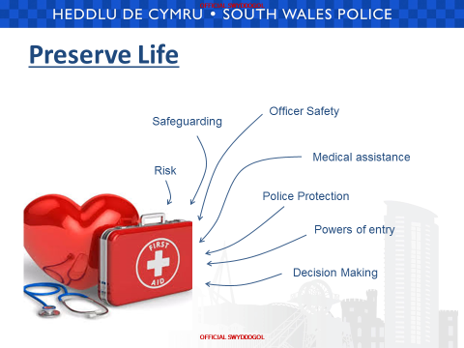

Slide 5
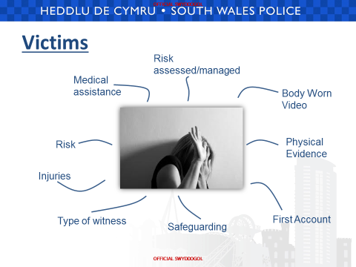

Slide 6
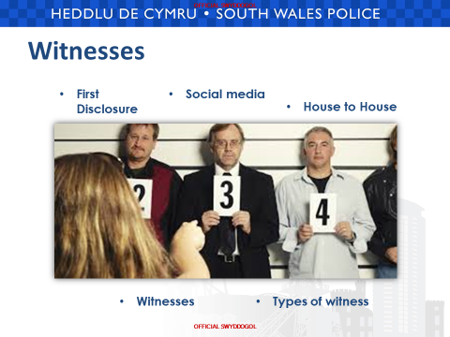

Slide 7
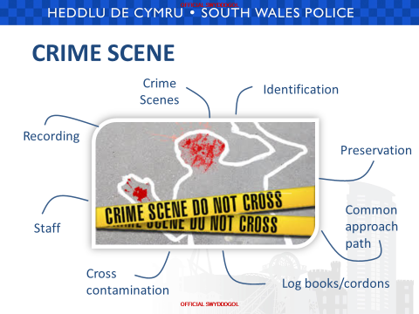

Slide 8
Identifying Suspects
Are there any suspects identified at this early stage?
What do I need to do to preserve material relating to them (e.g. medical exam)?
Where are they now?
Searches
Intelligence checks – are there premises or vehicles I need to search
Do I have enough grounds for arrest and is it necessary for me to do so now?

Slide 9
What do you consider to be the differences between ‘Domestic Abuse’ and ‘Stranger Violence’?
Notes:
GOLDEN HOUR:
Testimony of victims and witnesses can be obtained while the offence is still fresh in their mind.
Physical evidence secured and not disposed of or lost to the investigation.
Suspects located earlier, maximising opportunities to recover property and forensic evidence.
CCTV footage and other data can be collected before it is deleted.
Scenes are identified and secured before they become contaminated.
Interview of suspect, CPS advice and Charge/Remand completed sooner.
(Reducing time, money and safe guarding victim/witnesses)
Corroborative evidence obtained (Injuries, demeanour, first accounts etc.)
Improve levels of response & investigation to deliver an excellent service to the public (FORCE PRIORITY)
House to house.
Separate/Positive Action
Repeat victim
A repeat victim is someone who has reported two or more domestic abuse incidents to the police within a rolling 12-month period, accepting that this could an incident and/or a crime.
Repeat perpetrator
A repeat perpetrator is someone who has been reported to the police as having committed or threatened domestic abuse against the same victim more than once in the last rolling 12- month period. This includes current or former intimate partners and family members.
Serial perpetrator
A serial perpetrator is someone who has been reported to the police as having committed or threatened domestic abuse against two or more victims. This includes current or former intimate partners and family members.

Slide 10
Domestic Abuse v Stranger Abuse
Victim and abuser known to each other
Domestic abuse behind closed doors
Lack of evidence
Domestic abuse gives the offender access to the victim
Might not report abuse
Blame herself
Children maybe abused
Breach of trust
Stranger violence treated more seriously
Stranger violence usually a one off
Stranger violence gives the victim a place of safety - home
Notes:
GOLDEN HOUR:
Testimony of victims and witnesses can be obtained while the offence is still fresh in their mind.
Physical evidence secured and not disposed of or lost to the investigation.
Suspects located earlier, maximising opportunities to recover property and forensic evidence.
CCTV footage and other data can be collected before it is deleted.
Scenes are identified and secured before they become contaminated.
Interview of suspect, CPS advice and Charge/Remand completed sooner.
(Reducing time, money and safe guarding victim/witnesses)
Corroborative evidence obtained (Injuries, demeanour, first accounts etc.)
Improve levels of response & investigation to deliver an excellent service to the public (FORCE PRIORITY)
House to house.
Separate/Positive Action
Repeat victim
A repeat victim is someone who has reported two or more domestic abuse incidents to the police within a rolling 12-month period, accepting that this could an incident and/or a crime.
Repeat perpetrator
A repeat perpetrator is someone who has been reported to the police as having committed or threatened domestic abuse against the same victim more than once in the last rolling 12- month period. This includes current or former intimate partners and family members.
Serial perpetrator
A serial perpetrator is someone who has been reported to the police as having committed or threatened domestic abuse against two or more victims. This includes current or former intimate partners and family members.

Slide 11
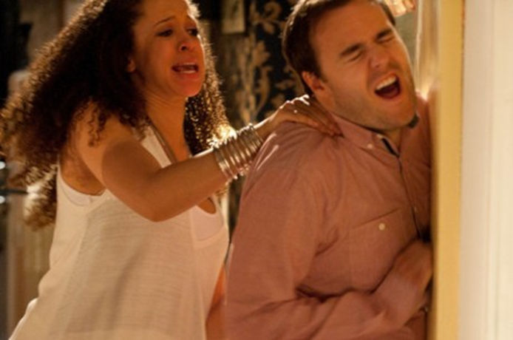
Barriers to Reporting
One off
Public humiliation
Not believed
Loss of children
Wong outcome
What happens when the police leave
Can’t accept name domestic violence
The victim’s own fault
Fear, criticism, ostracised, blamed by family
Not a police matter
Notes:
Barriers present for all victims especially for the following:
Substance Misuse, disabled, male (1-4female)/1-6 Male), mental health, learning disability, young, old, professional, sex workers, Gay (LGBT), black and ethnic minorities.

Slide 12

People like other animals are conditioned to form bonds as a survival mechanism
Repeat Victims – Trauma Bonds?
Notes:
That’s why the young of species are so cute –they need help to survive, they need to bond quickly to survive.
Survival overrides logical thought in the brain.
Could this be a reason that Domestic abuse victims do not report incidents and go back to the perpetrators of the abuse?
The next slide looks at Stockholm's syndrome as one possible explanation for this
(Zoe Lodrick ,Psychotherapist, taken from her website www.zoelodrick.co.uk )

Slide 13
Stockholm Syndrome (Van der Kolk 1996)
Positive feelings towards the victimiser
Negative feelings towards potential rescuers
Develops after 4 days of captivity
Traumatised people lead traumatic and traumatising lives (Van der Kolk and McFarlane, 1996)
Notes:
Stockholm Syndrome adopted after a 1973 Bank siege in Sweden resulting in the hostages protecting the criminals who had taken them captive, resisting rescue and ultimately refusing to give evidence against the hostage takers.
Stockholm syndrome trauma bonds result in the victim experiencing positive feelings towards the victimiser,negative towards potential rescuers and an inability to engage in behaviour assisting detachment or release. (Carnes 1997)
It develops after just 4 days of captivity within which the victim fears for their life, is isolated from other people and is subject to cruelty interspersed by small kindnesses.
Hostage situations are relatively rare yet the described conditions are frighteningly common in domestic situations (HERMAN 1992)(taken from www.zoelodrick.co.uk)
Traumatised victims may present as the perpetrator when you attend a call as they may be shouting, screaming and appear to be the agressor it is important not to forget that traumatised people act in aggressive ways and may be aggressive towards you because of that whilst the perpetrator of the DV may be calm and reasonable.

Slide 14
DASH Model
Domestic Abuse, Stalking, Harassment (including Honour-Based Abuse)
Risk identification, Assessment and Management

Slide 15
The risk model seeks to :
Help front line practitioners & specialist staff identify high risk domestic abuse, stalking and harassment and ‘honour’-based abuse
Help staff to identify dangerous and serial perpetrators
Decide which cases should be referred to MARAC, and what other support might be required. A completed form becomes an active record.
Offer a common tool to agencies that are part of the MARAC process and provide a shared understanding of risk in relation to DASH and ‘honour’-based abuse
Enable agencies to make defensible decisions based on the evidence from extensive research of cases, including domestic homicides and ‘near misses,’ which underpins most models of risk assessment.

Slide 16
PNN: Public Protection Notification
Notes:
Hand out PPN forms for students to look at the hard copy. Go through the completion of the PPN explaining that we will go into the questions later. Re-inforce to officers that ALL the boxes on the PPN MUST be completed. This is to assist partners when the PPN is sgared. E.g Education, Social Services, Health, Midwifery.
The PPN has drop down boxes so you need to ensure that you identify the correct type of incident at the top of the form so the relevant type of incident will be populated to be completed.
***Please highlight to student that the PPN form is to be completed for DA, Stalking and Harassment, Vulnerable Adults, Child Protection, HBA & FGM.***
One PPN could include more than one area of concern ie, domestic abuse and child protection.
No police jargon to be used in the summary, as this form is shared with partner agencies. Officers not to enter on the summary ‘see oel for update’
The PPN is soon to be rolled out on Samsung devices and will allow you to complete the PPN at the scene. However the 27 questions are available on the Samsung device for to view and ask the questions.
This is the current PPN form. This can be accessed on NICHE and on the Samsungs
MUST NOT SCAN DASH OR PPN
OFFICERS RESPONSIBLE FOR PRIMATY RISK ASSESSMENT
PPU – SECONDARY RISK ASSESSMENT (withdrawal S9, visits, Marac referrals)

Slide 17
STANDARD – Current evidence does not indicate likelihood of causing serious harm.
MEDIUM – there are identifiable indicators of risk of serious harm. Offender has potential to cause serious harm but unlikely unless there is a change of circumstances.
HIGH – there are identifiable indicators of risk of serious harm, which could happen at anytime.
Notes:
Standard (approx. 60-70% of Incidents) - Current evidence does not indicate a likelihood of Serious Harm.
Medium - There are identifiable indicators of risk of Serious Harm. The Perp has the potential to cause Serious Harm but is unlikely to do so unless there is a change in circumstances.
High (approx 10-15% of Incidents) - There are identifiable indicators of risk of Serious Harm. The potential event could happen at any time and the impact would be serious (all High Risks go to MARAC - Multi-Agency Risk Assessment Conference).
Trainer to facilitate why there is NO Low Risk Category.
Officers must always consider: Who is at risk? Look at the context of the behaviour, how the Risk Factors interact and the Victim’s perception of Risk - Don’t forget that others may also be at Risk (children, relatives, friends, work colleagues etc.).
Risk of harm cannot be completely removed. Decisions on Risk Identification, Assessment and Management do not always prevent harm and will never be infallible, but they should always be justifiable, defensible and documented.
Decisions are considered to be defensible if a reasonable person acting in the same professional capacity, at the same time and with the same available information would have
made the same decision.

Slide 18
A PPN form must be submitted in every Domestic Abuse and Stalking and Harassment incident
The PPN is used to update partner agencies and share information they may be aware of in order for them to provide further assistance to the victims and other vulnerable persons

Slide 19
The PPN lists 27 questions which are used to identify, assess & manage risk in relation to Domestic Abuse.
All 27 questions must be asked for every DASH incident.
All decisions and actions must be recorded, reviewed and updated.
The risk identification process remains dynamic and must be kept under review.
You have responsibility for the risk until it is handed over to the oncoming shift or specialist staff.

Slide 20
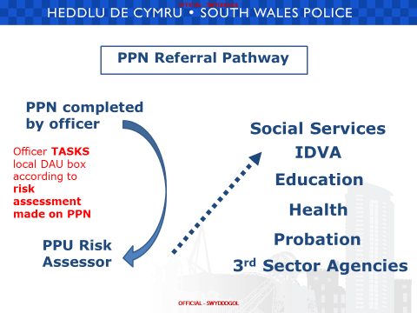

Slide 21
There are 18 Specific
HIGH RISK questions
Notes:
In addition, highlight to officers the need to use professional judgement - a person who engages in an activity with competence and skill and being able to make an informed decision based on a balanced viewpoint.
There may be occasions where the victim may be at higher risk than the risk tool suggests.
Such situations may include:
• There are extreme levels of fear.
• Cultural barriers to disclosure such as in cases of ‘honour based violence’ and female genital mutilation.
• Extreme levels of control and/or isolation.
• Obsessive stalking behaviour.
• Where the perpetrator is abusing more than one partner.
• Fear of loss of financial support, or losing children, house etc.
• Remind the delegates that if they are not so experienced – and therefore not so confident with their professional judgement, they should speak to a supervisor or someone more experienced in this area - a specialist/domestic abuse officer, for example.
• Using the sum total of your knowledge, experience and skill, you have concerns about this person’s risks and the risk of serious harm is high. A question the delegates should ask themselves here would be “What do I feel that I cannot walk away from?”

Slide 22
Additional Safeguarding Measures
Police watch
Cocoon watch
MARAC
Clare’s Law
Domestic Violence Protection Notices
Domestic Violence Protection Orders
Notes:
POLICE WATCH
Police Watch provides a visible police presence to both victim and the perpetrator and involves police patrols within the vicinity of the victim’s home or the location of the incident. The patrols are carried out on a regular basis, initially for a period of six weeks immediately following reported incidents. This period can be extended at the discretion of the Sector/Divisional Inspector.
Police Watch has been shown to be an effective measure in reducing repeat victimisation in domestic abuse cases.
When dealing with incidents of domestic abuse, attending officers will deal with the incident in line with force policy and take a robust stance.
The options available through police watch will either be regular visits to the victim or patrols of the area. This must be reviewed on a fortnightly basis. COCOON WATCH (See also Police Watch)
Cocoon watch scheme request the help and support of neighbours, family and relevant agencies in protecting the victim by contacting the police immediately if further incidents occur.
Where a further incident occurs during the period of ‘Police Watch’ then Cocoon Watch is implemented with the informed consent of the victim. Cocoon watch should not be used where there is any reason to suspect that neighbours and/or family may be involved, or if the victim may feel more at risk by neighbours being informed, Eg, revealing the sexual orientation of a victim could place them at risk of homophobic abuse.

Slide 23
What is MARAC?
A MULTI AGENCY CONFERENCE
MARAC is a gathering of agencies who aim to:
Safeguard adult victims
Make links with other Public Protection Agencies in relation to children, perpetrators and vulnerable adults.
To safeguard agency staff .
To address the behaviour of perpetrators
Notes:
This is achieved by an information sharing and action planning process at MARAC.
To make this work case management and specialist support is needed, before, during and after the meeting.
Who is involved?
The statutory Agencies involved are:
Police
Probation
Social Services
Housing
Health
Education
IDVA
Voluntary Agencies include:
Womens Services Kaleidoscope
Victim Support BAWSO
Llamau Services Social Landlords

Slide 24
DOMESTIC VIOLENCE
DISCLOSURE SCHEME
Clare’s Law
Notes:
Named after Clare Wood who was murdered in 2009 by her partner, who had three previous convictions under the Protection from Harassment Act 1997. Clare was unaware of his horrific history of violence against women, which included the kidnapping at knifepoint of one of his ex-girlfriends.
Clare’s father campaigned for information to be disclosed to potential victims about the history of a partner, so they can make an informed decision about the relationship.
The Domestic Violence Disclosure Scheme was piloted by four forces for 14 months including GMP, Wiltshire, Nottinghamshire and Gwent during 2012 – 2013.
Criteria:
The Person at Risk MUST reside in the Police area in which they are applying
The Person at risk MUST be in a current relationship with the subject (potential abuser) – states ‘Intimate Relationship’ – Relationship between two people which may be reasonably characterised as being physically and emotionally intimate.
Right to Ask:
Applications are made via a number of methods including ringing 101, attending at a police station, speaking to an officer/member of police staff in the street or via email asking about specific information on ‘their partner’s’ previous violent offending.
Applications can be made from a partner or by a third party i.e a neighbour/relative or friend
Risk Assessment:
If it is identified there is an immediate/imminent risk of harm to the applicant (or other person) action must be taken immediately by the Police to safeguard those at risk. A record needs to be kept of action taken
Right to Know
Indirect information is received by Police which may impact the safety of the victim
Indirect information may come from an investigation.
Information can also be received from partner agencies, intelligence sources and either the victim or offender coming into police contact
Minimum Checks are made on both parties – Intelligence
Referral to a local decision making forum (MARAC)
Disclosure Decision

Slide 25
Domestic Violence Protection Notices & Domestic Violence Protection Orders
DVPNs and DVPOs were introduces by the Crime and Security Act 2010
They enable the Police to put in place protection for the victim in the immediate aftermath of a domestic violence incident.
Under DVPOs, the perpetrator can be prevented from returning to a residence and from having contact with the victim for upto 28 days.
This allows the victim a level of “breathing space” to consider their options, with the help of support agencies
Notes:
DVPNs & DVPOs are not intended to be an alternative sanction to the Criminal Justice process - They are not an “either or.”
Neither are they a panacea for all the ills of DA and are not always appropriate.
They can also be used in relation to familial DV - As per the DA definition…

Slide 26
DVPN – issued by the Police to provide emergency protection to the victim. Includes prohibitions and must be heard by a Magistrates Court within 48 hours.
DVPO – police then apply at the Court for a DVPO. Prohibitions are extended for a period between 14-28days.
Notes:
DVPOs were initially implemented as a one year pilot in the West Mercia, Wiltshire and Greater Manchester Police areas.
DVPOs fill a gap in providing protection to victims by enabling the Police and Magistrates to put in place protection in the immediate aftermath of a DV incident.
With DVPOs, a perp can be banned with immediate effect from returning to a residence and from having contact with the victim for up to 28 days, allowing the victim time to consider their options and get the support they need.
Before the scheme, there was a gap in protection, because Police couldn’t charge the perp for lack of evidence and so provide protection to a victim through bail conditions, and because the process of granting Injunctions took time.
We will look at each in turn

Slide 27
Domestic Violence Protection Notice
An authorising Officer (Supt. Or above) may authorise a DVPN under S24 where:
The perpetrator is 18 years or over
There are reasonable grounds for believing that the perpetrator has been violent towards or has threatened violence towards the victim on this occasion AND
The issue of the DVPN is necessary to protect the victim from violence or a threat of violence by the perpetrator.
The victim and the perpetrator do not have to live together
This is a victimless process – a DVPN does not require the consent of the victim
Notes:
DVPNs are not an alternative to charge - We must always seek a substantive charge and conviction where possible! DVPNs can be considered where a perp is arrested and NFAd, cautioned or bailed without conditions, on a case-by-case basis. This is not just for High Risk victims - During the pilot 87% of DVPNs were issued in Standard Risk cases.
A DVPN must be considered at the earliest stage of the proceeding by the OIC, Custody Sergeant, and PPU staff
An arrest is not a pre-requisite to a DVPN. Circumstances can occur where a referral is made by a third party e.g. MARAC, IDVA, Housing, social services (To PPU - DAU).
DVPNs can also be used for inter-familial DA and ex-intimate partners.
The first DVPN applied as part of the Hampshire pilot was for an 18yr boy causing problems for his mother.

Slide 28
Domestic Violence Protection Notice
A DVPN must in all cases contain a provision to prohibit the perpetrator from molesting the person for whose protection it is issued.
Where the IP and perpetrator live at the same address the DVPN can:-
Require the perpetrator to leave the address
Prohibit the perpetrator entering the address
Prohibit the perpetrator evicting or excluding the victim.
Prohibit the perpetrator from coming within a specified distance of the premises
Notes:
Molestation – this is not defined in the legislation. The lack of definition is quite deliberate, to define the word may allow loopholes to be exploited.
Dictionary definition – the action of pestering or harassing someone in an aggressive or persistent manner.
Molestation can be either specific acts, general or both.
It is and ‘umbrella’ term. EG, an exclusion zone preventing the perpetrator from coming within X metres of an address, a provision not to contact the victim either in person, through text, letter or phone or any other means (including all social and digital media), not to intimidate, harass or pester (and must not instruct, encourage or in any way suggest that any other person should do so).
It is perfectly acceptable to frame the provisions in a preventative way in order to protect the victim.

Slide 29
Investigating Officer
Once the investigating Officer is satisfied that a DVPN is necessary they will:-
Complete the relevant DVPN form, AO authorisation form and compile any other supporting documentation.
Take reasonable steps to obtain any representations made by the perpetrator.
Submit to their supervisor to quality assure.
Submit to the AO for authorisation.
REMEMBER THERE IS NO POWER TO DETAIN SOMEONE IN CUSTODY TO SERVE A DVPN

Slide 30
Authorising Officer
Superintendent rank or above:
The AO must have reasonable grounds to believe:-
The perpetrator has been violent or threatened violence towards a victim.
The DVPN is necessary to protect the victim from further violence.
AO must consider:-
The welfare of persons under 18 years.
The opinion of the victim.
The opinion of other associated person who lives at the premises
Any representations made by the perpetrator.
The AO must take reasonable steps to establish these opinions, however consent is not required.
Notes:
The AO can be an ACTING Supt.
VIOLENT: Does this therefore mean that DVPNs are only applicable to DV, not DA?
The Oxford English definition of Violence is: Behaviour involving physical force intended to hurt, damage, or kill someone or something.
Definition of AP under S.62 Family Law Act 1996: Married or were married, cohabitants or former cohabitants, live/lived in the same house (not as tenant, lodger, employee, etc), relatives, agreed to marry, have a child (parent or parental responsibility) who lives in the premises to which the DVPN would relate.
This will also include civil partners, people who have entered into a civil partnership agreement and people who have had an intimate personal relationship with each other which is or was of a significant duration.
The decision needs to be justifiable under the ECHR : Proportionate, legal and necessary
Proportionality…..is a DVPN an appropriate response given the events involving the victim and perpetrator.
Is a DVPN necessary to protect the victim. From experience some victims actually moved away from the area, or to a refuge, so were relatively safe in another community and there was little evidence that the perp had the means or ability to locate them. As such necessity test not met. Perp could have been remanded on other charges such as breach of licence, so again if committed to custody not necessary.
Need here to consider previous antecedents / intelligence / history of the perp. Use DASH Risk Assessment from the victim and also assess their vulnerability and ability to protect themselves and any children.
By authorising the DVPN the AO must be satisfied that the notice and the terms of the notice are both Necessary and Proportionate. Such as where it is not possible to safeguard the victim by alternatives which would constitute a lesser interference with the perps rights.
Third consideration - is it Legal?
Whilst the DVPN is enshrined in the Crime and Security Act and so gives you the legal basis for the notice, it is important that consideration is given to the Human Rights of the perpetrator. Authorising a DVPN engages Article 8 of the European Convention on Human Rights. A person would usually have the right to a “free and uninterrupted family life”.
It may also engage Article 3, the right to be “free from inhuman or degrading treatment.” The Home Office guidance gives the example of a perpetrator having nowhere to live, not having shelter from the elements or basic hygiene facilities etc. This situation maybe heightened if the perpetrator has a medical condition requiring treatment.

Slide 31
DVPN issue: Investigating Officer
Served on the perpetrator in person and in writing.
Only a constable can serve a DVPN
The DVPN is treated as a summons for the perpetrator to attend court.
The 48 hours starts from the moment of service on the perpetrator not authorisation by the AO.
Perpetrator to receive the DVPN perpetrator leaflet.
Do not give the perpetrator a copy of the AO form.
Ensure PPN is submitted and relevant unit updated via task and phone call(office hours)
Update NICHE and PNC
There is a power of arrest if there are reasonable ground for believing that the perpetrator is in breach of the DVPN (there is no attached power of entry).
Notes:
Dependant on force SWP will commence or update and existing Domestic Abuse Record, contact the victim, safeguard and refer to local support agencies (Eg, Women’s Aid, IDVA), issue the victim with a victim leaflet, refer to MARAC if appropriate, document the safety plan on the DAR if DVPO is issued. Review case prior to DVPO expiry, make a home visit etc.
SWP referral to VSS for all cases where consent is given and on professional judgement, complete referral to voluntary perpetrator scheme (where available).
Gwent procedures?
Breach of DVPN – a constable may arrest without warrant if reasonable grounds for believing that the perpetrator has breached the DVPN. The perp must be RIC and brought before a Magistrates court which will hear the application for a DVPO within 24hours from the time of arrest for Breach. Update NICHE occurrence created when the DVPN was issued. The court may adjourn and RIC. 24hours does not include Sundays or Bank Holidays.

Slide 32
DVPO Application
Application for DVPO must be heard by a Magistrates Court no later than 48hours after the DVPN was served on the perpetrator
If magistrates adjourn the hearing then the DVPN will continue in effect until the hearing.
Victimless process.
Admissibility of hearsay.
Satisfied on the balance of probabilities.
The DVPO application must state the period for which it is to be in force (14-28days).
The DVPO application must include prohibitions.
Notes:
If the perp doesn’t attend the DVPO Hearing, it will be carried out in their absence.
Victims need to be kept updated.
If the DVPO is contested it will be adjourned for a Full Hearing which should occur later that day or the next day (allowing for Legal Services to attend to “prosecute”) - The DVPN stays in force until the Full Hearing takes place.
DVPO case file –front sheet, case summary, witness statements, previous convictions of the perpetrator, copy of the AO for the DVPN
The OIC MUST task the Occurrence to PNC so they can place a marker when the DVPN is issued.
PNC MUST be tasked when the DVPO is issued so the marker can be continued.
If there is a “no contact/approach” condition in the DVPN and the victim attends the Hearing with the perp - Arrest the perp for Breach of the DVPN!

Slide 33
Breach of DVPO
A constable may arrest without warrant if there are reasonable grounds for believing that the perpetrator has breached the DVPO.
The perpetrator must be RIC and brought before a Magistrates Court within 24hours for time of arrest for the breach.
Courts may adjourn and RIC
24hours does not include Sundays or Bank Holidays.
Dealt with as a Contempt of Court under S.63 magistrates Court Act.
Fine or imprisonment (£50 each day breached or two months).
Notes:
If the perp doesn’t attend the DVPO Hearing, it will be carried out in their absence.
Victims need to be kept updated.
If the DVPO is contested it will be adjourned for a Full Hearing which should occur later that day or the next day (allowing for Legal Services to attend to “prosecute”) - The DVPN stays in force until the Full Hearing takes place.
DVPO case file –front sheet, case summary, witness statements, previous convictions of the perpetrator, copy of the AO for the DVPN
The OIC MUST task the Occurrence to PNC so they can place a marker when the DVPN is issued.
PNC MUST be tasked when the DVPO is issued so the marker can be continued.
If there is a “no contact/approach” condition in the DVPN and the victim attends the Hearing with the perp - Arrest the perp for Breach of the DVPN!

Slide 34

Panorama:
Domestic Abuse Caught on Camera
Notes:
Click onto hyperlink ,play Panorama upto 17mins 45 secs
Group activity 4 – see handout

Slide 35


