Slide 1

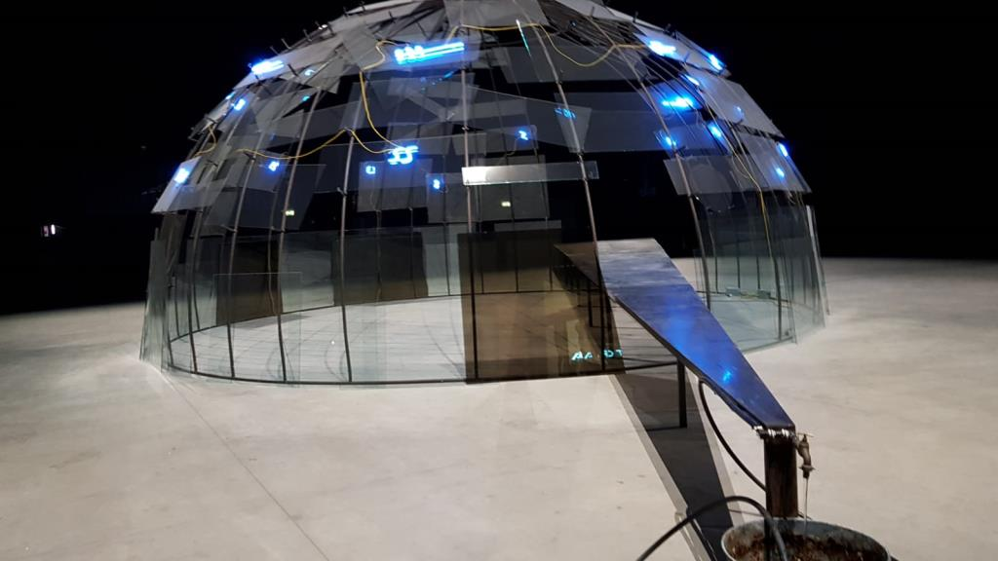
CELESTE RETREATS
Module Name : Digital Skills for Personal and Professional Growth ( BMSW4008).
Module Lead : Philippa Fitzgerald
Student : Edit-Lakme Azmi (2412715)
AI Acknowledgement : I confirm that I have not presented any AI generated materials as my own work.
I confirm that I have copies of my drafts, notes, and other resources I used, which I may be asked to provide in evidence.
This Photo by Unknown Author is licensed under CC BY-SA

Slide 2


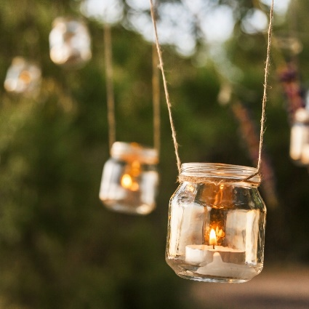
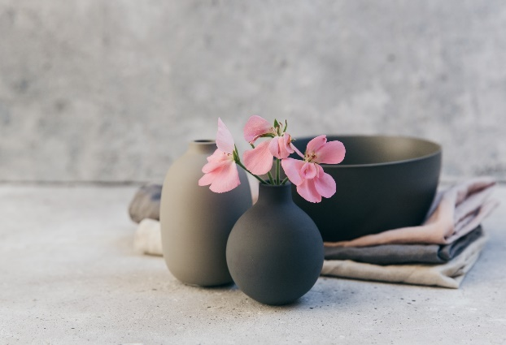

Table of contents
Introduction;
Designing the questionnaire;
Research;
Analysing the data;
Graphics;
Website design;
Reflection;
Skills.

Slide 3
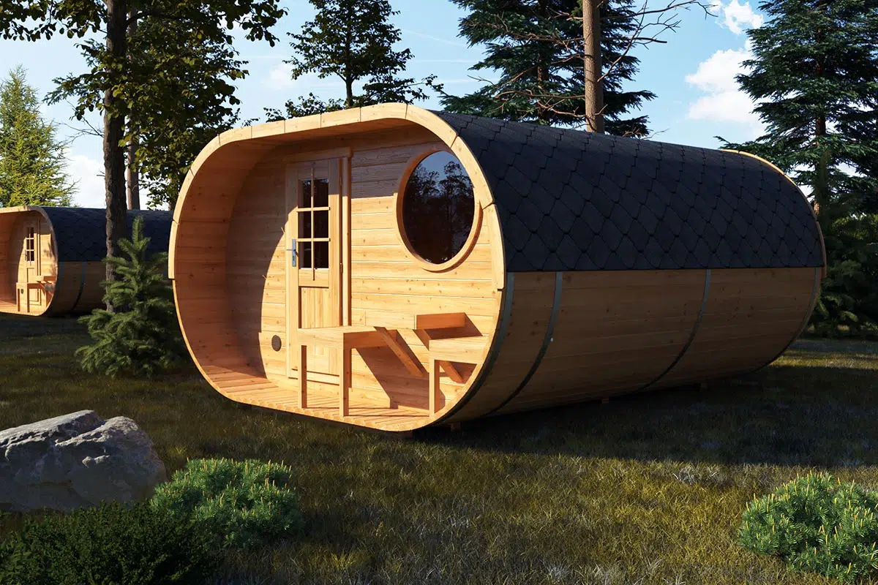
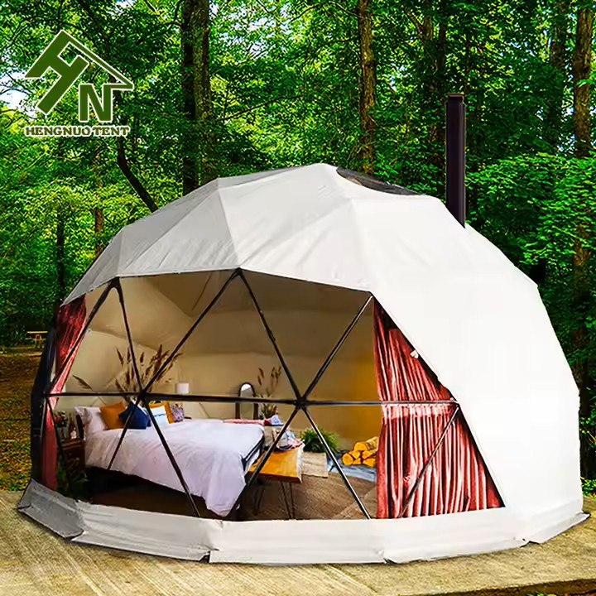
Introduction
CELESTE RETREATS :
A conceptual luxury accommodation brand redefining short getaways in the UK.
Offers unique, design-led stays: glass igloos, tinny houses, floating pods.
Combines luxury, nature, and local experiences.
Designed for experience-seeking travellers who value authenticity and comfort.
Targets young professionals and couples looking for quick, memorable escapes.
Focused on seasonal travel trends, visual aesthetics.

Slide 4
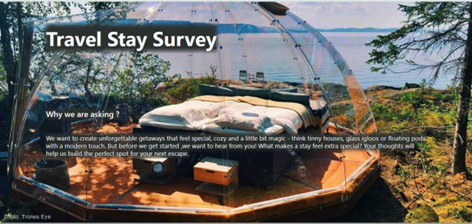
Designing the questionnaire

Slide 5
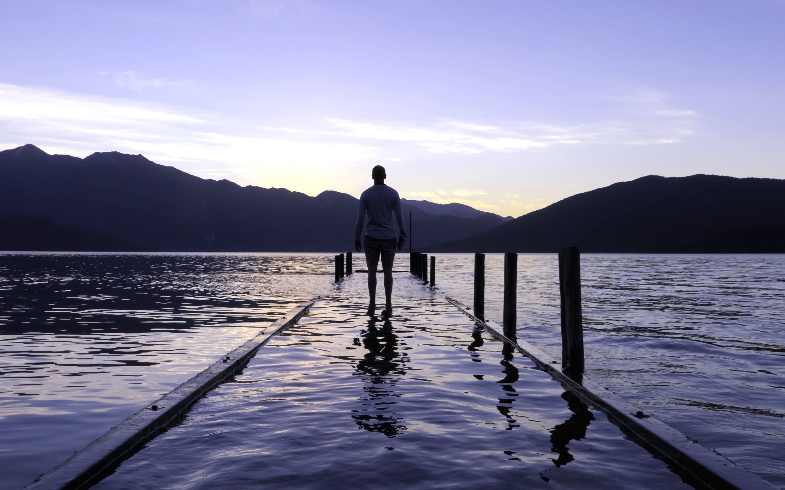
Research
Travel frequency ;
Preferred accommodation types ;
Factors (private chef, views, privacy);
Price expectation;
Online reviews .

Slide 6
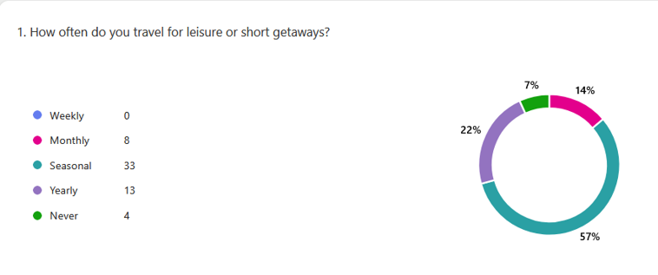
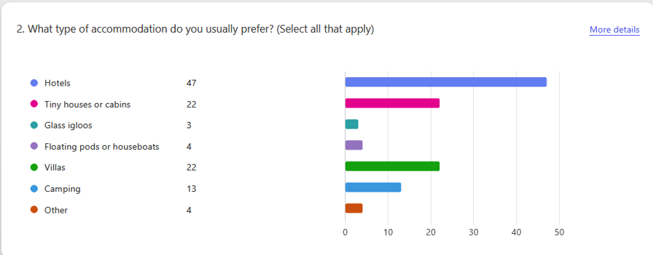

Slide 7
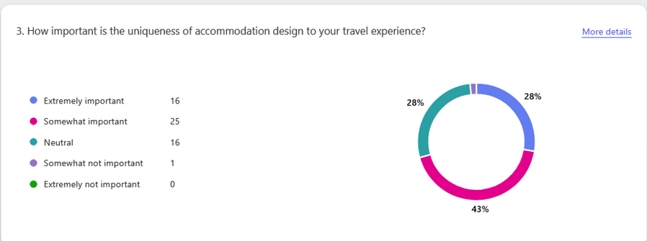
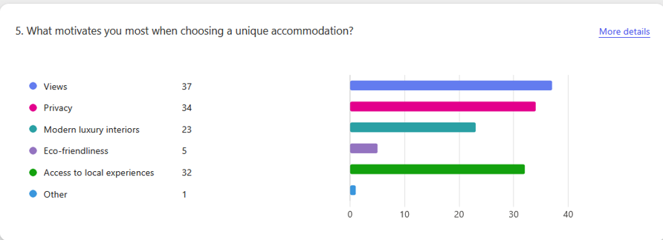
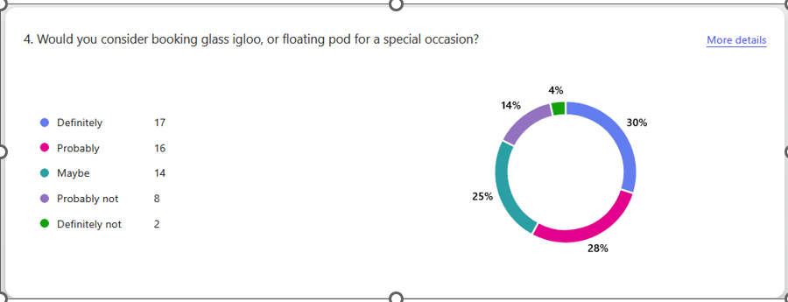

Slide 8
ANALYSING THE DATA
58 respondents.
44 showed interest in cabins or villas;
Scenic views, privacy, and local experiences ranked highest;
Pricing : £150–£300/night;
46 respondents rely on online reviews;
17 people said they would book for a special occasion;
41 people book through Booking.com;
28 preferred 2–3-night stays.

Slide 9
Graphics

Slide 10
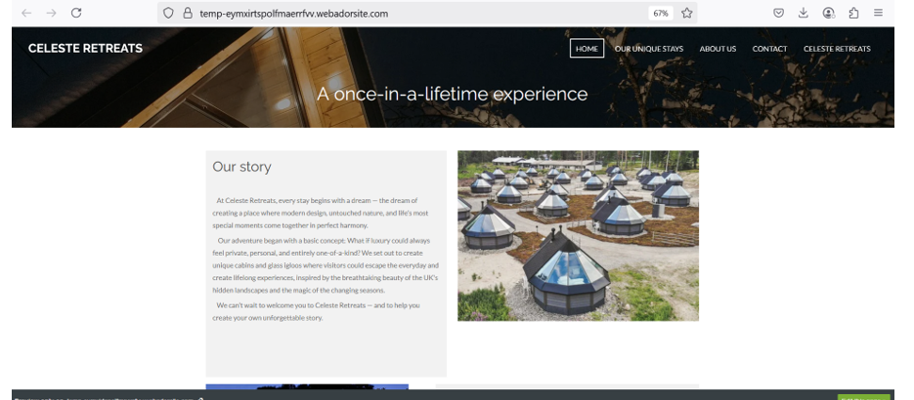
Website design

Slide 11
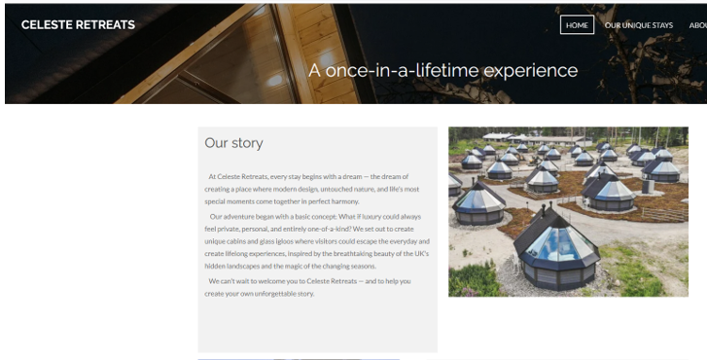
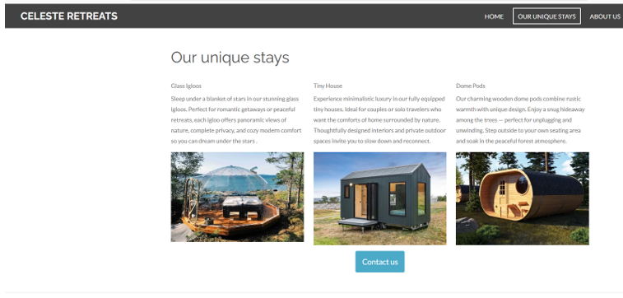
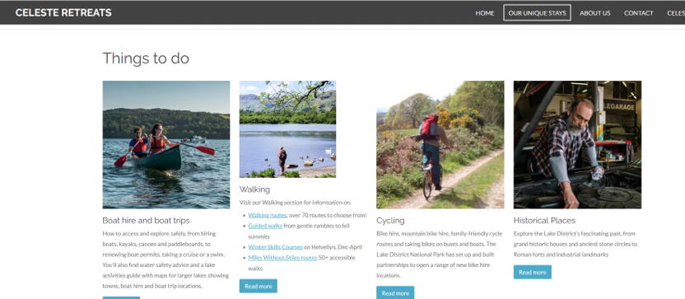
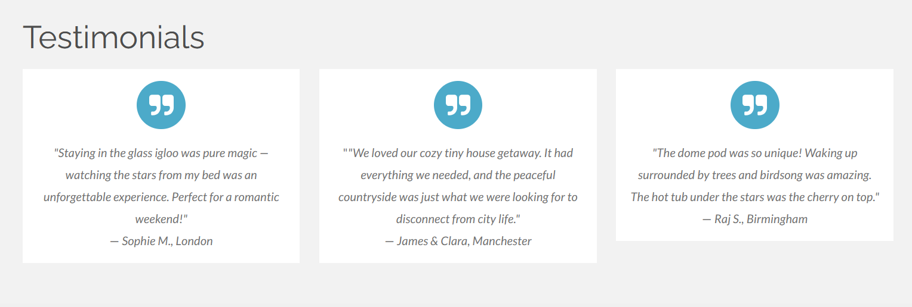

Slide 12
Key points:
44 people showed interest in cabins and villas, I ensured my homepage showcases high-quality images and descriptions of these types of properties ;
focus is on scenic views, privacy, and authentic local experiences;
simple, user-friendly layout because 46 people rely on online reviews;
I added a testimonials section, with guest reviews ;
Contact form so users can easily reach out;
“Our story” and “history” to give the brand a personal, trustworthy identity.

Slide 13
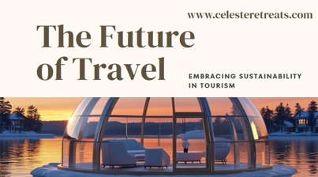
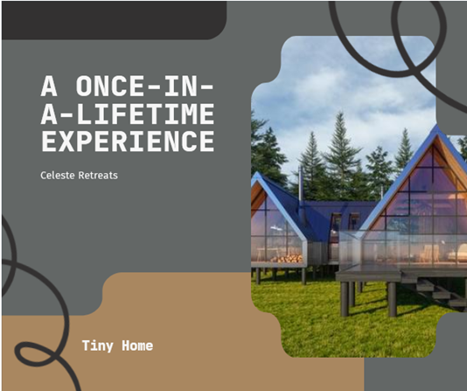
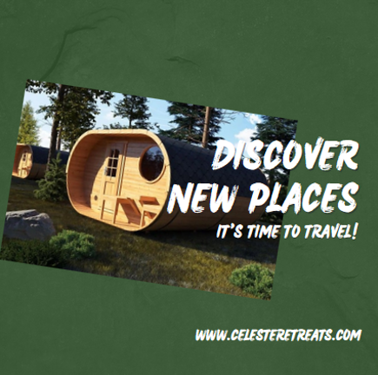
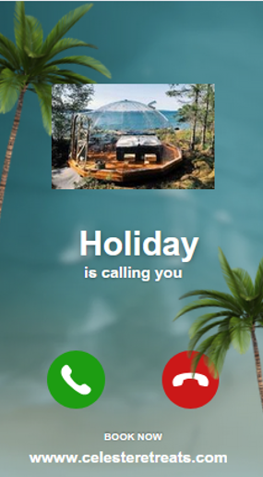

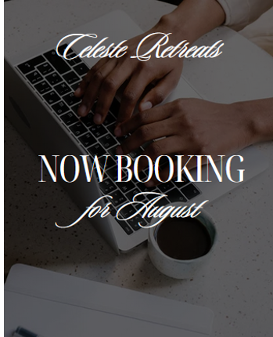
Marketing Materials

Slide 14

Reflection
I've discovered during this project how important consumer intelligence is to the creation of a brand or service. I've learned the importance of data-driven decision-making by creating a questionnaire, analysing 58 replies, and using the results to shape my website, advertisements, and video commercial. I learned throughout the process that research influences every strategic and creative choice, from price and user experience to visual design, rather than just providing information.

Slide 15
New skills I have developed
Skills I need to develop
Designed and distributed a questionnaire;
Market research ;
Built a website;
Created marketing content;
Improved communication and presentation skills;
Created an ad.
Advanced digital marketing tools;
Video editing;
Social Media Strategy;
Negotiation techniques;
Budget.

Slide 16
Advert:
https://www.youtube.com/watch?v=8dWHLT44Zxg

Slide 17
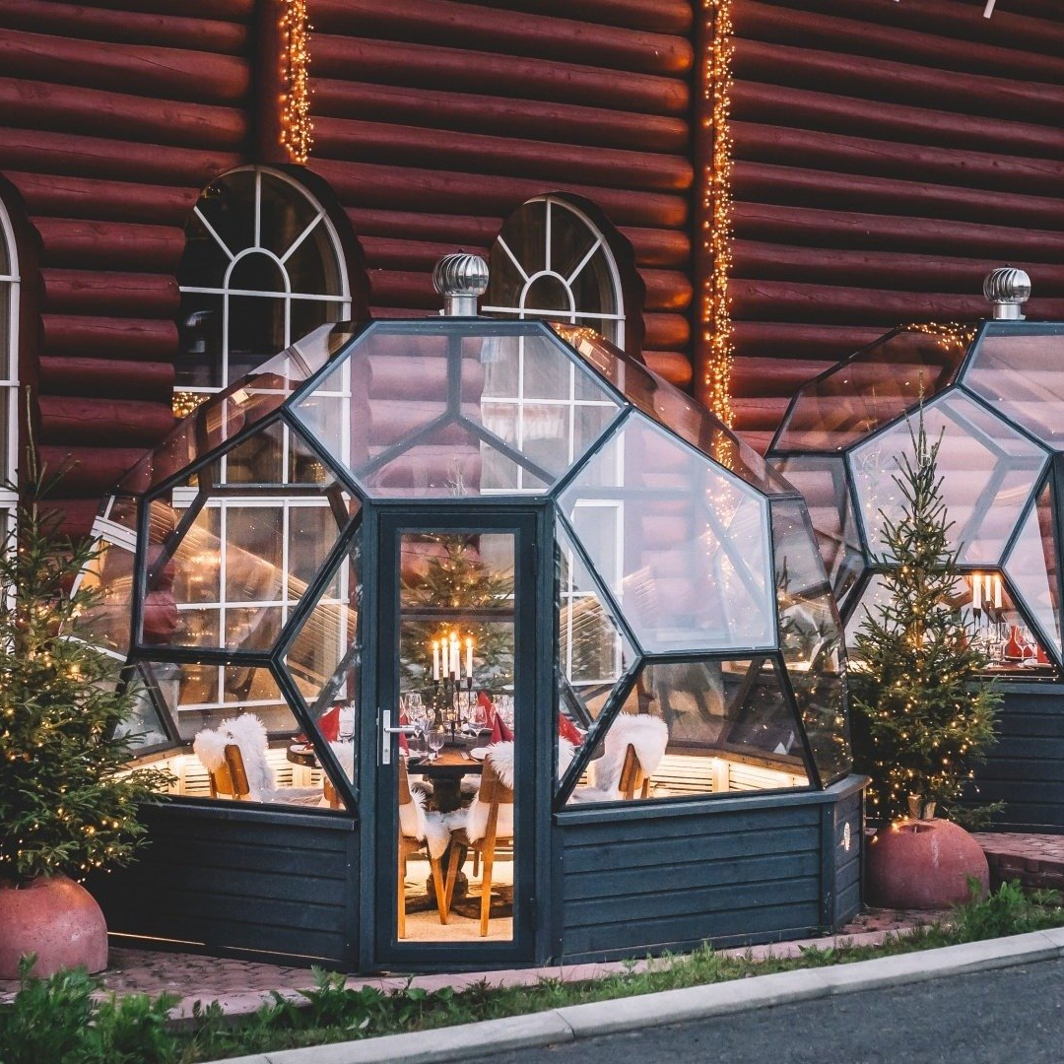
Thank You

Slide 18
References:
https://www.arte.go.it/event/mario-merz-igloos/
https://leviniglut.net/glass-igloos-lapland-finland/
https://www.santaclausholidayvillage.fi/glass-igloo
https://fredstinyhouses.com.au/

