Slide 1
Sport, Physical Activity and Society
Lecture
Race, Ethnicity & Sport

Slide 2

Use this website to complete the following tasks
https://phw.nhs.wales/services-and-teams/observatory/data-and-analysis/

Slide 3
Tasks
Group 1- review the results in relation to physical activity and sport in the following report:
Secondary School Children's Health and Well-being Dashboard: School Health Research Network (SHRN) Survey Data

Slide 4
Tasks
Group 2- review the results in relation to childhood obesity, what does it tell us?:
Child Measurement Programme (CMP) Dashboard

Slide 5
Tasks
Group 3- review the results in relation to healthy weight and the pandemic, what does it tell us?:
Proportion of children with a healthy weight comparable to pre-pandemic levels but issues remain

Slide 6
Tasks
Group 4- review the results in relation to life expectancy and inequalites, what does it tell us?:
Inequalities in life expectancy increased while inequalities in healthy life expectancy remained stable.

Slide 7

Healthy start
Boys
Girls
7

Slide 8
Context
Sport privileges certain groups above others: white over black, men over women, rich over poor, able bodied over disabled.
Jeanes et al. (2016):
What do you think about this statement?

Slide 9
Race and Sport
Why study this?
How could an improved understanding of this benefit you as a sports manager?

Slide 10
Race and Sport
Race and sport are intertwined in a number of important ways.
Entire sports are racialized e.g. 2/3rds of US pro basketball and NFL players are African Americans. Whilst swimming and gymnastics are dominated by white athletes.
Beliefs about racial prowess in sport impact on the experiences of athletes and their post career trajectories.
“’Race’ and racism are normalized in modern sport,” Spracklen (2015, p.166).

Slide 11
Question
What was unique about the Olympic 100m make final?
What was unique about the Olympic 50m Female swimming breaststroke final?

Slide 12
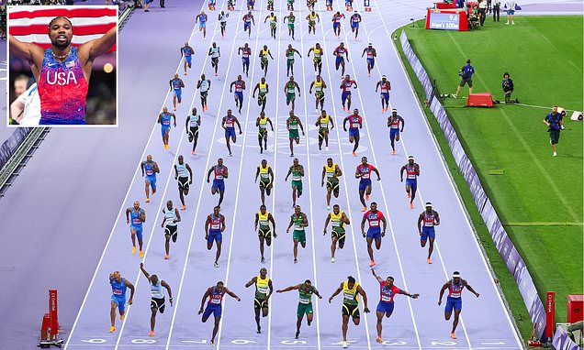

Slide 13
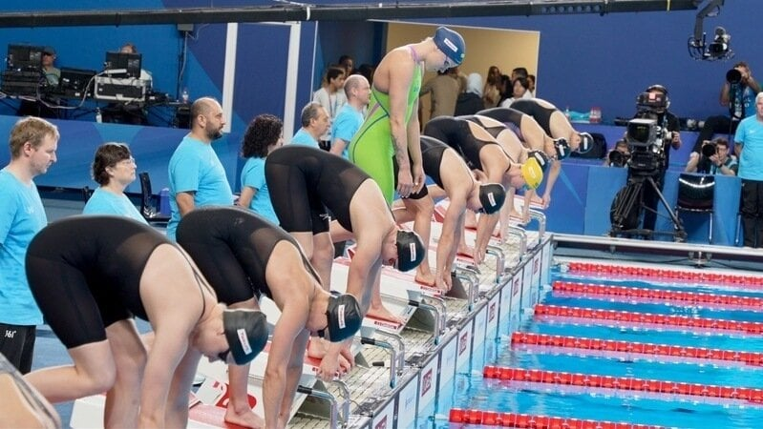

Slide 14
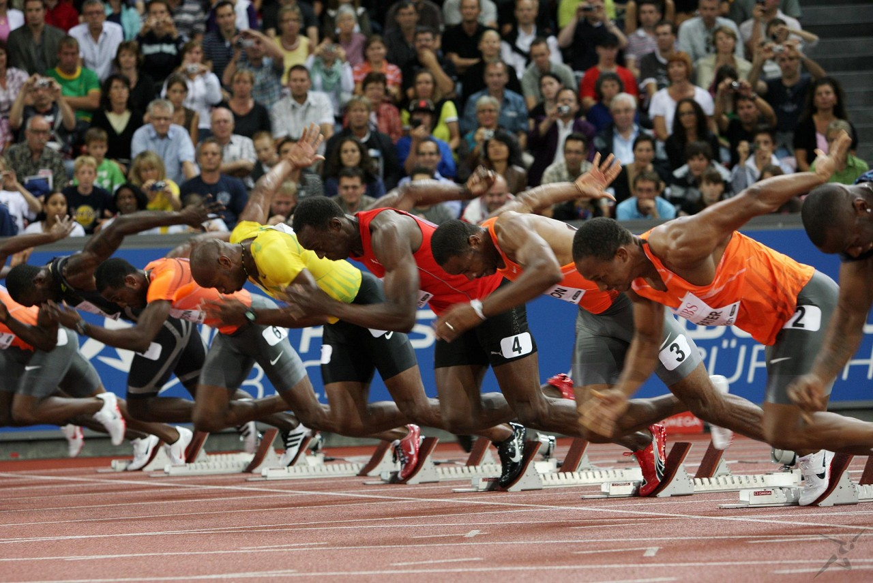
How can we explain the dominance of black athletes in sprinting and white athletes in swimming?

Slide 15
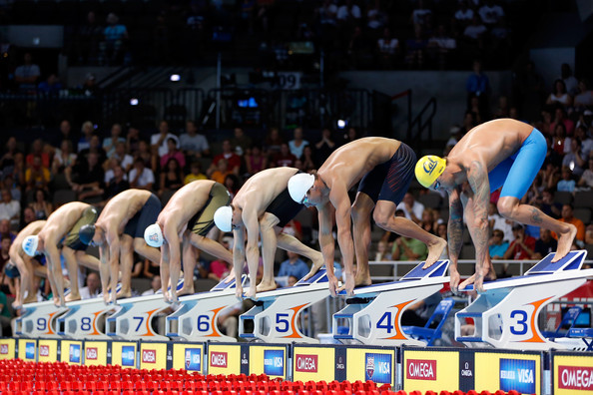
What racial stereotypes in sport can you think of?
Can you think of contrary examples?

Slide 16
Google Scholar Task
Use google scholar to research good quality reports that may support why black athletes are faster than white
Use the cited by tab to expand your search and to collect more evidence
Create a Harvard reference and in text citation for this source- view support resource / examples

Slide 17
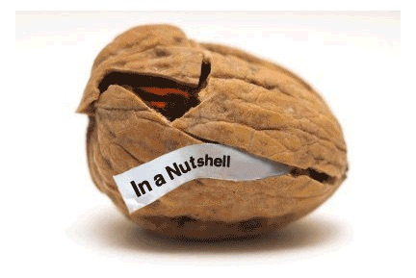
Therefore, “race might have an impact in sport, but its impact is social, not genetic,” Marjoribanks & Farquharson (2012, p.43).

Slide 18
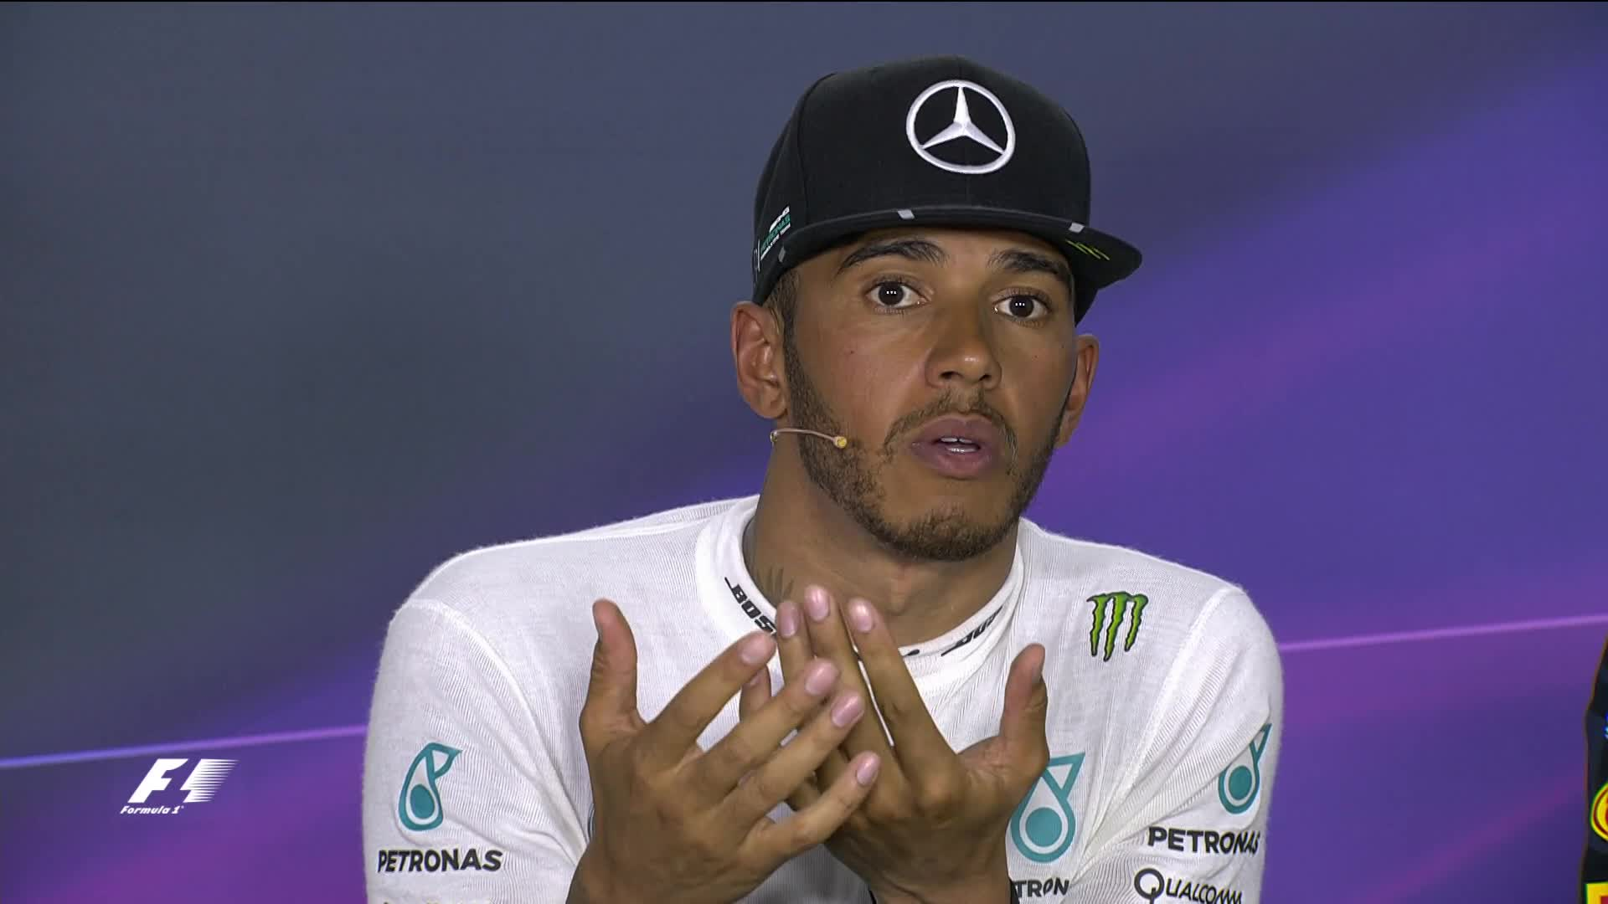

Slide 19
Naturally talented?
There is no evidence that people with dark skin are inherently better athletically than those with lighter skin.
The Human Genome Project has definitively stated that differences within so-called racial groups are in fact greater than those between groups (Spracklen, 2015).
Conversely, there is a great deal of evidence that social structures around sport reinforce racial stereotypes around sporting prowess.
Black people have only dominated certain sports at certain periods in history e.g. Jews dominated basketball in 1930s America and boxing in 1930s England (Spracklen, 2015).

Slide 20
Persistent Myths
Myths about the superiority of Black athletes have consequences for sport.
Marjoribanks & Farquharson (2012, p.44-45).

Slide 21
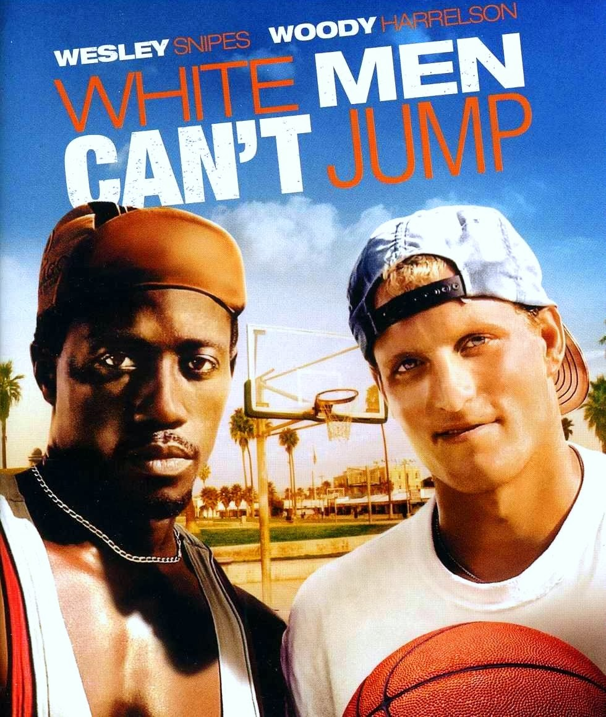
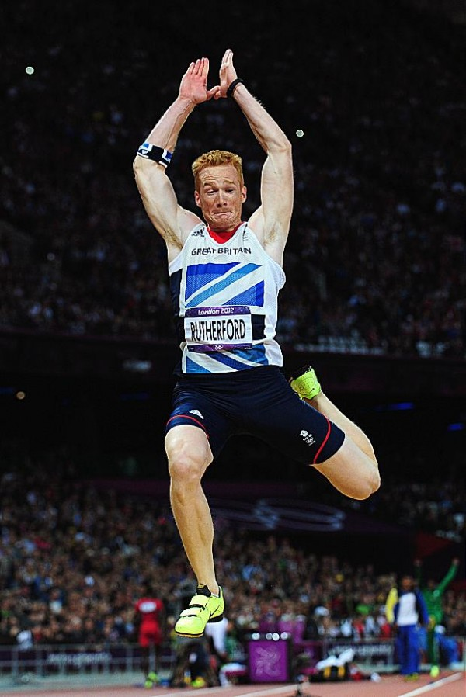

Slide 22
How many black outside halves can you name?
What about black quarter backs?
What about black football managers?

Slide 23
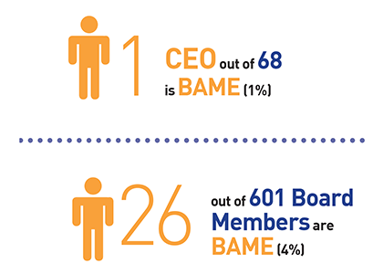
Black, Asian and Minority Ethnic representation across 68 sports boards including NGBS
Sporting Equals (2016)

Slide 24

Wafula Strike is the only Black board member among major sports in the UK representing UK Athletics and only 3% of board members identify as Black across the 130 Sport England and UK Sport funded bodies.
In contrast, around 30% of professional players of the UK’s most popular sport, football, are Black.
(Deloitte, 2021)

Slide 25

FA strategy 2024-2028

Slide 26
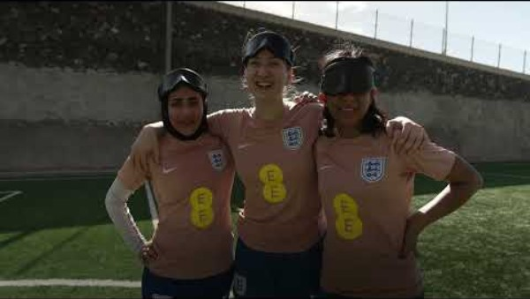

Slide 27
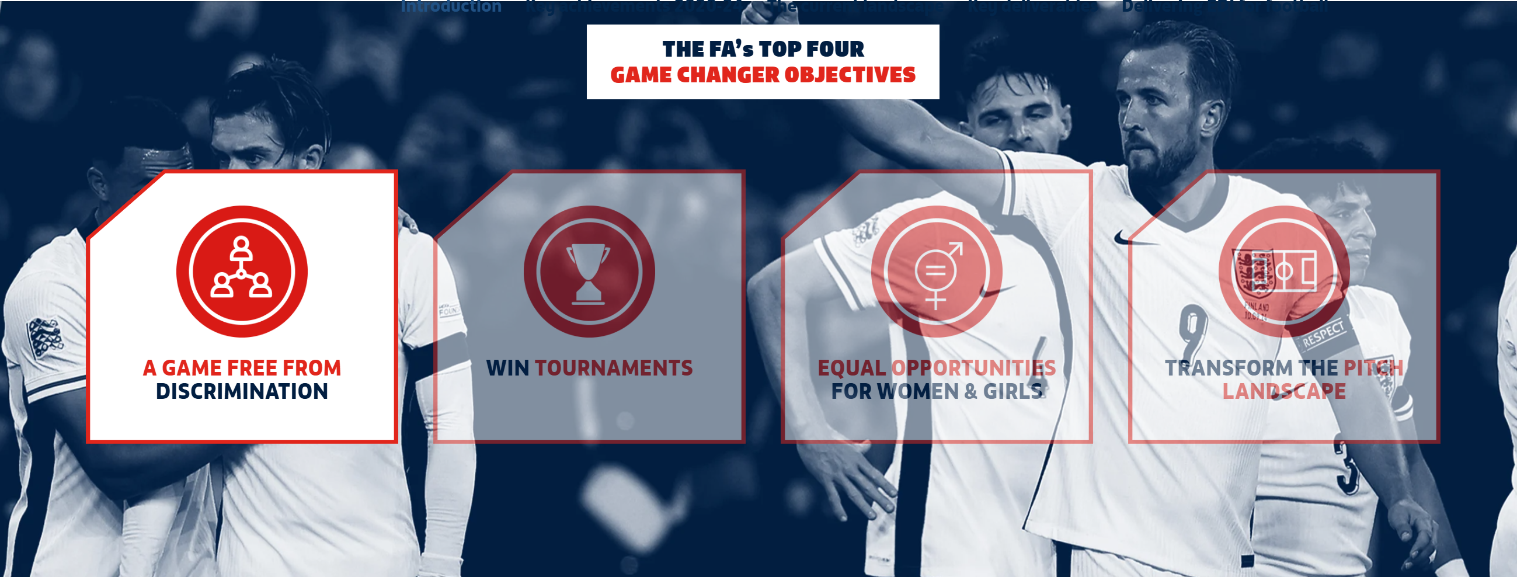

Slide 28
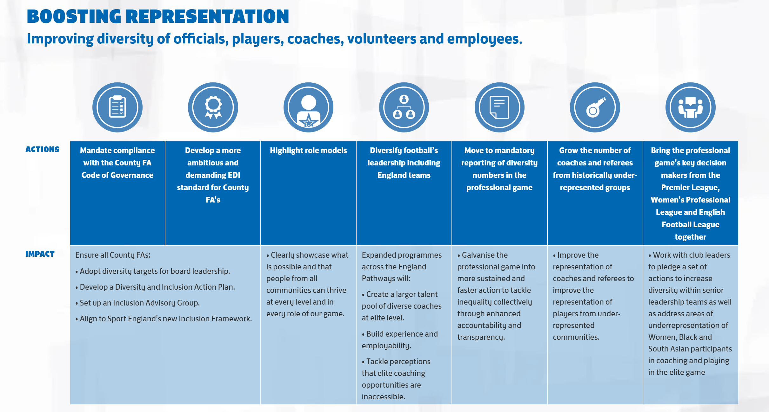

Slide 29
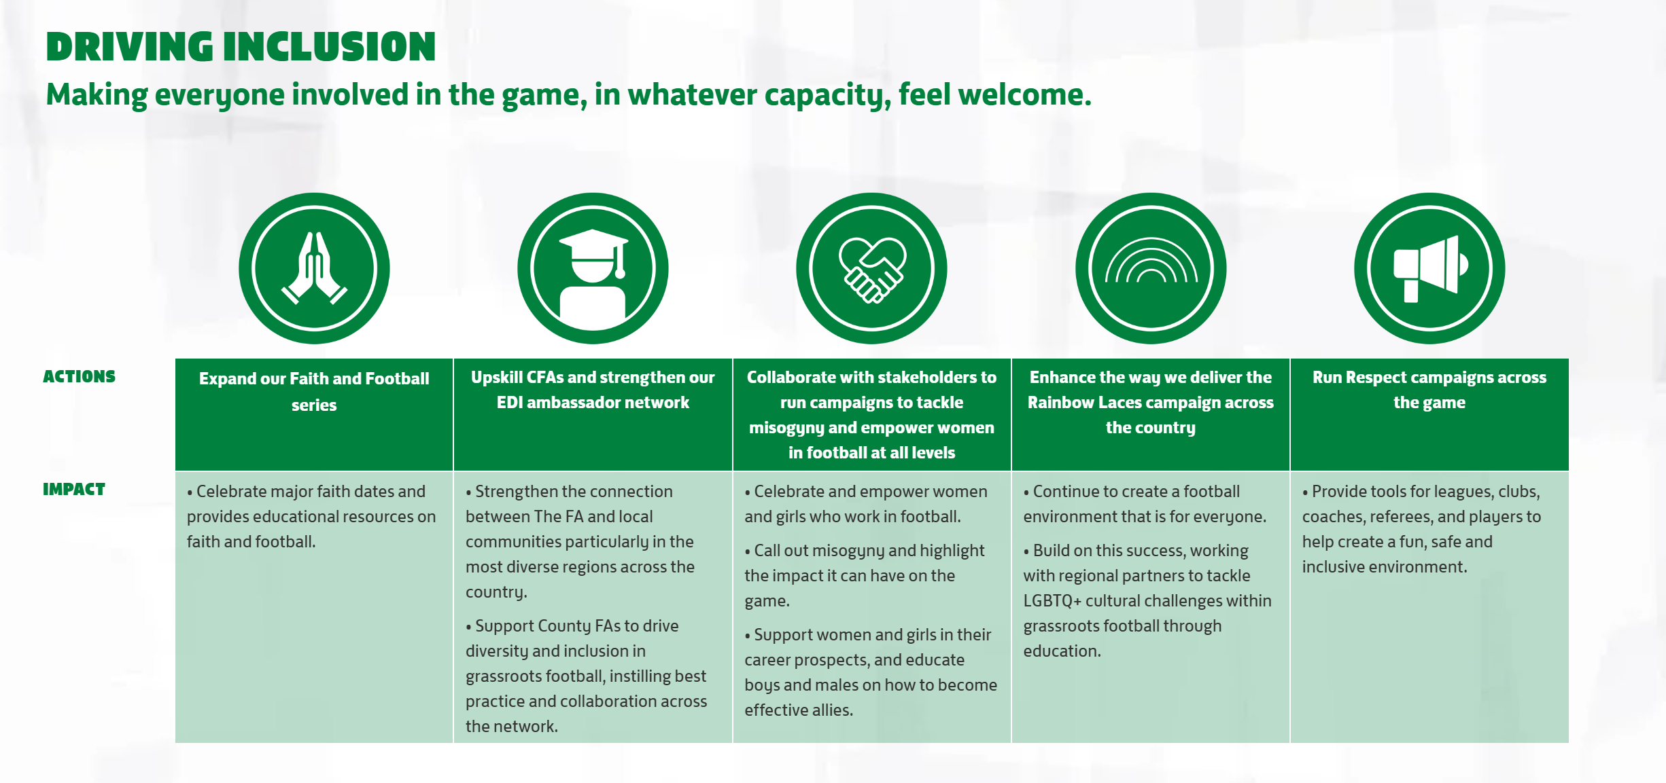

Slide 30
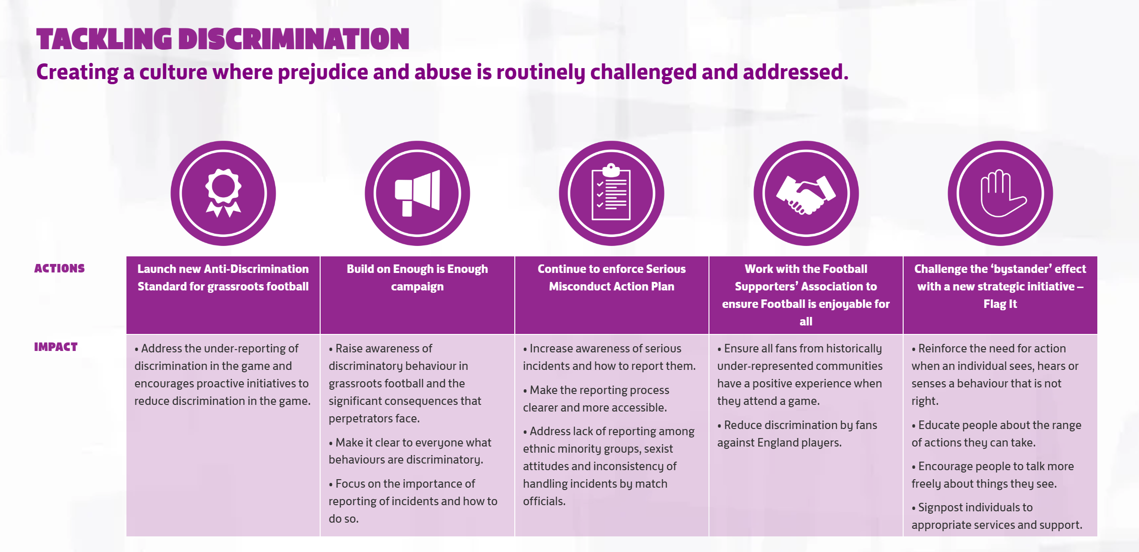

Slide 31
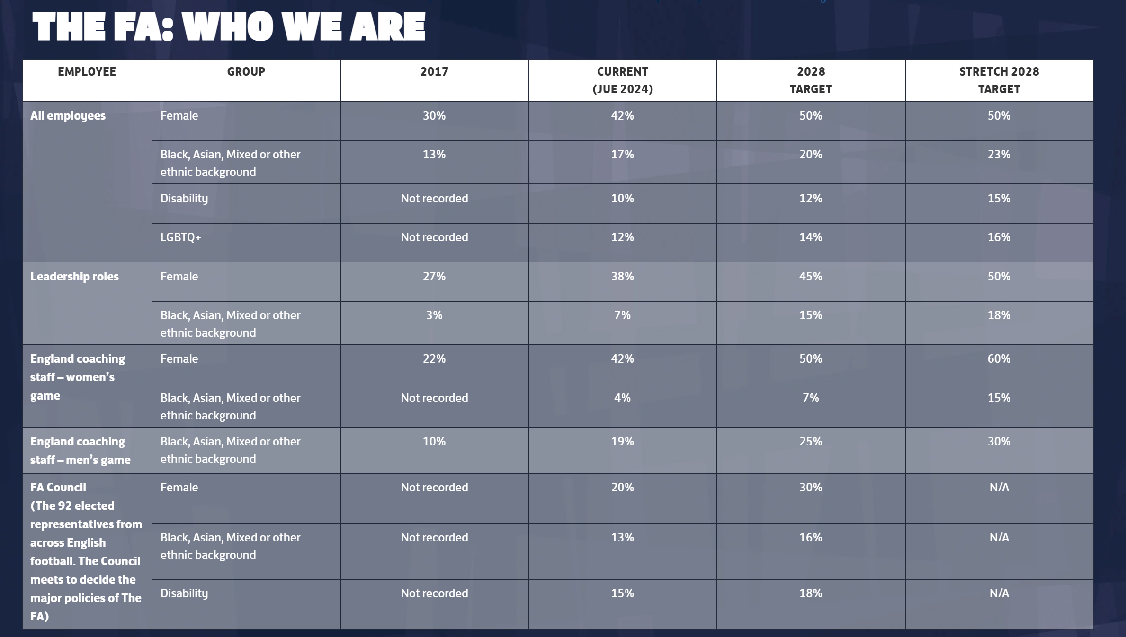

Slide 33
Sport England, 2019

Slide 34
Sport England, 2019

Slide 35
Sport England, 2019

Slide 36

Sociological imagination is an ability to see the context which shapes your individual decision making, as well as the decisions made by others. But the reason why it's useful is because it allows us to better identify and question various aspects of society, as opposed to passively living within it.
What is sociological imagination? (2021) National University. Available at: https://www.nu.edu/blog/what-is-sociological-imagination/

Slide 37

Using your sociological imagination, discuss in pairs why people from some ethnic minority groups are more likely to be inactive than the general population? Can you find data in the recent Sport Wales School Survey to support your discussion?
(Try to consider historical, cultural and structural factors, and try to be critical)

Slide 38
Barriers to Participation (inclusion)
Key influences include:
  Disposable income
  Levels of education attainment
  Occupational status
  Social class
  Culture
  Ethnicity
  Gender
  Age
  Ability and disability
(Hylton and Totten, 2013)

Slide 39
Influences can also be categorised into:
Physical barriers e.g. location of facilities
Economic barriers e.g. affordability
Motivational barriers e.g. image of activity
Cultural barriers e.g. conflict with codes, customs and conventions inherent in an activity
Political barriers e.g. feelings of alienation, or lack of ownership over, the existing choice of provision.
Sports development strategies have to overcome these barriers.
Hylton and Totten (2013)

Slide 40
Inequality and discrimination
Inequality in sport and society can be caused through discriminatory practices and processes, which can occur intentionally or unintentionally at 3 different levels:
Individual (micro) e.g. stereotyping and stigmatising disabled people
Institutional/cultural (meso) e.g. sports centre doesn’t have inclusive policies and practices in place.
Societal (macro) e.g. disabled people seen as patients, who are somehow defective or impaired.
Hylton and Totten, 2013

Slide 41
Group 1/2- Peoples needs and leisure demands– Torkildsen's Sport and Leisure Management (2010)
Review the chapter from page 39-53 Highlight the key themes and use the whiteboard to create a visual of some of the key points that can influence the development of sport and PA.

Slide 42
Group 3/4- Activity intervention project - Against the Wall : Poor, Young, Black, and Male, (Elijah Anderson & Cornel West, 2009)
2. Review chapter 10 page 147-162 Highlight the key themes and use the whiteboard to create a visual of some of the key points that can influence the development of sport and PA.

Slide 43
A2
Task 1
There is a gender imbalance in sports and physical activity participation with more boys participating in sport and physical activity, critically analyse this statement and identify possible reasons for this imbalance / challenge the statement. On concluding provide recommendations to increase participation. (1000 Words).
Weighting 50%
Task 2
There has been strong evidence suggesting children and young people with disabilities face more barriers to sports participation. Carry out research to support or challenge this statement and highlight the key barriers that children with disabilities face and the possible solutions. (1000 words).
Weighting 50%

Slide 44
Next week- final in person lecture before xmas- assignment feedback
Week 11- (week after)- Support session for writing A2
Any questions?
Thanks for listening.

