Slide 1
Management, Organisational Behaviour and Digital Change (BMHP4024) – Week 1
Jan Howells-Johnson

Slide 2


Slide 3

Introductions
Jan Howells-Johnson
j.howells-johnson@uwtsd.ac.uk

Slide 4
Today’s Session
By the end of today’s session students should be able to:
Understand the aim of this module
Understand the assessment requirements
Have an understanding of the structure of the NHS in Wales

Slide 5
Module Aim
To ensure understanding of the drivers, technologies and skills needed to transform services in the public health and care sector

Slide 6
Learning Objectives
Upon the successful completion of this module, the student should be able to:
Demonstrate an understanding of what drives staff performance, service user experience, and the skills and knowledge required by health and care managers
Analyse how emergent technologies are being used in the modern workplace, the impact on staff and service users and potential future implications

Slide 7
Group Task
Discuss in your groups what you think the learning aim and objectives mean to you and what you expect to learn

Slide 8
Scheme of work

Slide 9
Assignment 1
3000 word written assignment
Split into 2 parts
Deadline Friday 2nd August 2024 at 11:55pm
Turnitin
Description and link for submission on Moodle
100% weighting

Slide 10
Assignment 1 – Part 1
Part 1 – Organisational Culture and People Management (1500 words)
Students must write a 1500 words on the impact of organisational culture and management on staff within the health and care setting. You must consider the following:
Organisational cultures and behaviour
Leadership and management themes
People management themes

Slide 11
Assignment 1 – Part 2
Part 2 – Technology and Change (1500 words)
In this section students must write 1500 words on the impact technology is having on the modern health and care setting. Students must ensure they research and discuss the following:
Real world examples of technologies/software applications currently used in the Health and Care settings in the United Kingdom
The benefits and challenges of implementation and use of new and emerging technologies in the Health and Care setting

Slide 12
What does the National Health Service look like?
Public Service
Comprises NHS England, NHS Scotland, NHS Northern Ireland and NHS Wales
Devolved
Control own strategies and budget
Funded from taxes

Slide 13
Health and Care Wales
2 x NHS Trusts (Velindre NHS Trust, Welsh Ambulance Service Trust)
7 x Health Boards
Public Health Wales
Digital Health and Care Wales
Health Education and Improvement Wales
NHS Wales Shared Services Partnership
Social Care Wales

Slide 14
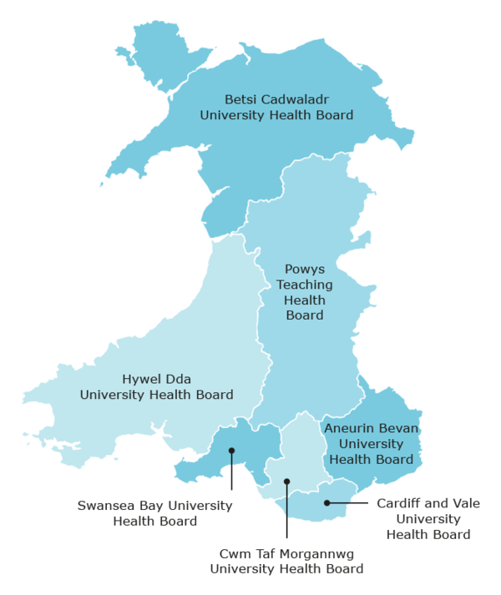

Slide 15
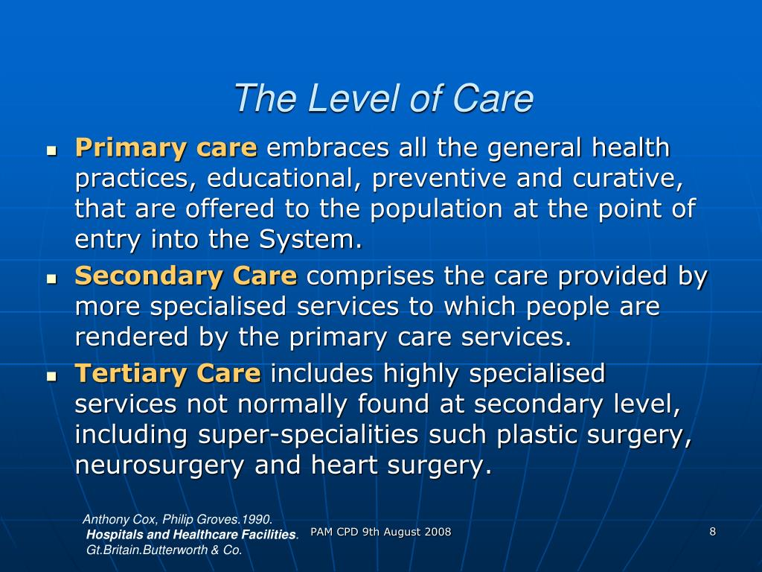

Slide 16

How is the Health Service Governed?
Government Policy
Strategy
Frameworks
Legislation
Standards

Slide 17
Group work
In your groups discuss:
Did you know any of this information previously?
Did it challenge your understanding of the health service?
Why is it important to understand this?
What are the benefits of this structure?
What are the limitations and challenges?

