Slide 1
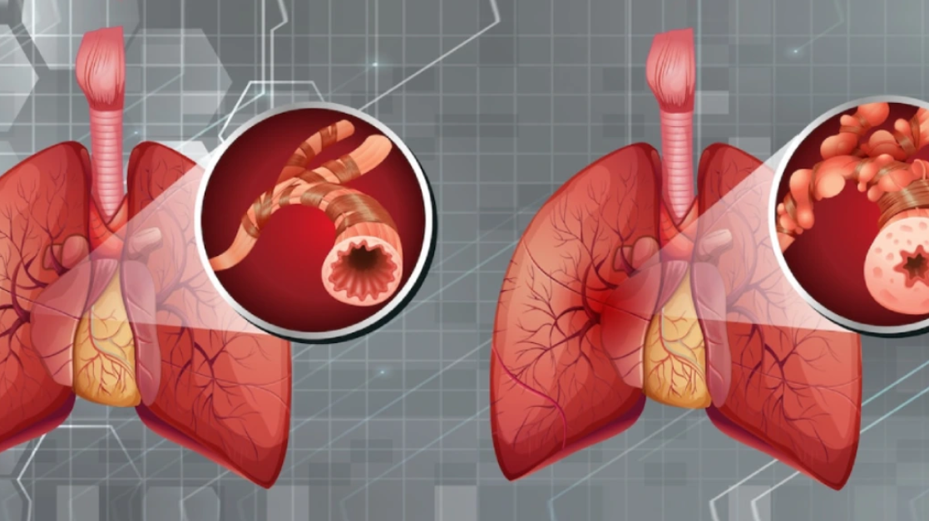

Care Planning for Chronic Obstructive Pulmonary Disease
Student Name: Liliana Tofan
Student ID: 2008331

Slide 2
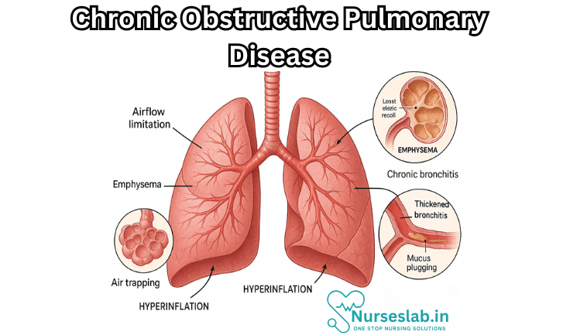
Introduction
The reasons behind chronic obstructive pulmonary disease comprise relentless progressive airflow constriction in the world (Agarwal et al., 2023).
It is classified as one of the chronic respiratory diseases, which affects populations.
This presentation displays a fictional patient and a recommended plan of care.
The objective is to give a guideline care plan for COPD.
COPD
(Source: Nurseslab, 2025)
Notes:
COPD causes progressive airflow congestion that is irreversible in the globe and has significant implications for respiratory functions. It is classified in the group of chronic respiratory diseases, which affects populations. In this presentation, an imaginary patient and a proposed evidence-based plan of care are introduced.

Slide 3
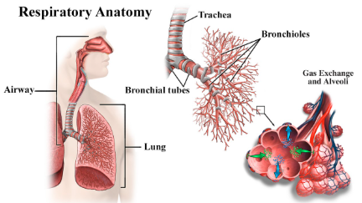
Respiratory System Overview
The respiratory system allows the exchange of gases between the bloodstream and the air.
It comprises superior passages and lower airways that assist in breathing (Cleveland Clinic, 2024).
The trachea, bronchi, bronchioles, alveoli, and lungs are some of the important structures of the thoracic region.
The ventilation mechanics are ensured overall due to airway patency and elastic recoil.
Respiratory System
(Source: nhlbi, 2022)
Notes:
The respiratory system facilitates the exchange of gases between air and blood, which helps in the necessary metabolism of the cells. It comprises upper passages and lower airways. The most important structures are the trachea, bronchi, bronchioles, alveoli, and lungs of the thorax. Ventilation is ensured through airway patency and elastic recoil.

Slide 4
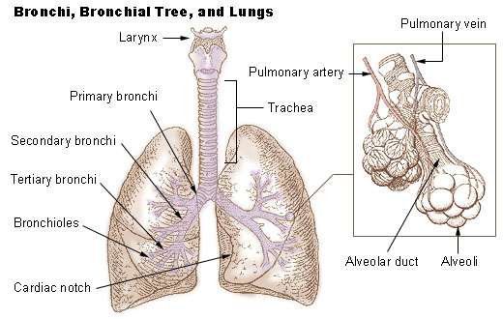
Lung Anatomy
The bronchial tree conducts inhaled air deeply into pulmonary regions.
Bronchioles repeatedly branch distributing airflow toward peripheral alveolar sacs areas.
Alveoli provide extensive surfaces allowing rapid diffusion of respiratory gases.
Dense capillary networks surround alveoli enabling continuous oxygen uptake efficiently.
Lung Anatomy
(Source: National Cancer Institute, 2019)
Notes:
The bronchial acts as the conduit of the inhaled air that reaches deep into the pulmonary areas, further divided into smaller bronchioles. The airflow is directed to the peripheral alveolar sacs by bronchioles. Alveoli offer large amounts of diffusion surfaces. Alveoli are covered by dense networks of capillaries that ensure the smooth, constant supply of oxygen.

Slide 5
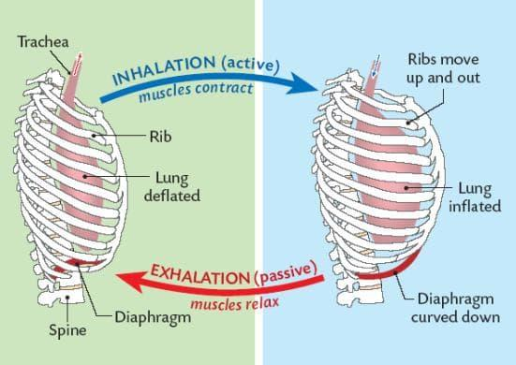
Normal Physiology of Breathing
During inspiration, the diaphragm contracts and enhances thoracic volume to facilitate the passage of air.
Intercostal muscles draw up the ribs, which help in the expansion of the chest during ventilation cycles (Patel et al., 2022).
Oxygen diffuses through the membranes of the alveoli into the system of the pulmonary circulation.
During the process of breathing, carbon dioxide is transported out of the blood into the alveoli.
Physiology of Breathing
(Source: Fiveable, 2025)
Notes:
The process of inspiration is a shortening of the diaphragm and the elevation of the ribs due to the activity of the intercostal muscles, increasing thoracic volume. Oxygen diffusion into the bloodstream of the lungs occurs through the alveolar walls. Carbon dioxide as an expiratory gas, is transferred out of the blood to the alveoli. These coordinated functions maintain the ventilation and normal gas in the blood.

Slide 6
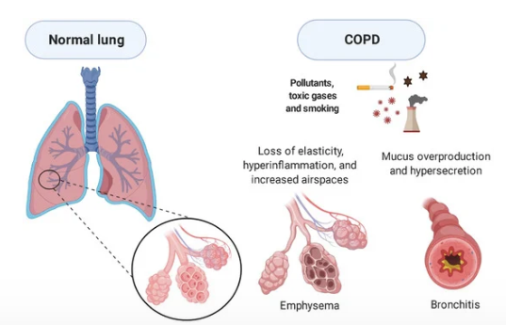
Pathophysiology of COPD
Prolonged airway inflammation constricts the airways, severely hindering the passage of expiratory air.
Hypersecretion of the excess mucus blocks the bronchi and the smaller passages of conducting airways (Widysanto and Mathew, 2025).
Smaller bronchioles decrease the airflow and make breathing significantly more difficult every day.
The destruction of the alveolar walls decreases the surface area and the elastic ability to recoil.
Pathophysiology of COPD
(Source: Rodrigues et al., 2021)
Notes:
In COPD, these inflammations of the airways cause constrictions of the passages and blockage of expiratory air. Excessive production of mucus hypersecretes and blocks the bronchi and smaller airways. Breathing is made more difficult because of the reduced bronchioles. Damage to the alveolar walls decreases the surface area and the elasticity of recoil, which restricts the effective exchange of gases.

Slide 7
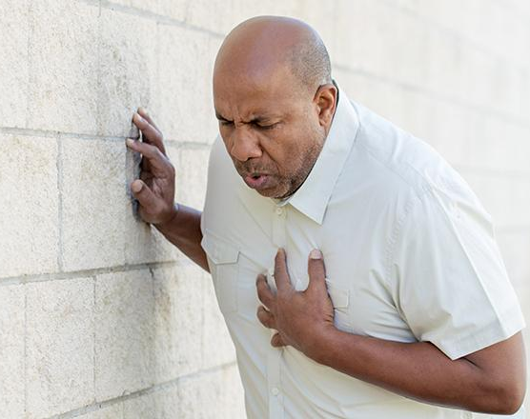
Functional Impact of COPD
An exchange impairment reduces the oxygen levels in the arteries during systemic circulation.
The patients complain of breathlessness and fatigue with lower exercise tolerance levels (Caruso, 2025).
Weakened immunity exposes the body to infections, and recovery time is very high.
The everyday life is restricted and becomes less independent and of a higher quality of life.
Notes:
Disrupted gas exchange reduces the level of arterial oxygen in the entire circulation of the body, causing breathlessness and fatigue. Limited daily activity is caused by decreased exercise tolerance. There is a high risk of infection extending recovery times. The deterioration of functions leads to decreased independence and adverse changes in the overall quality of life.

Slide 8

Fictional Patient Profile
Mr. A is a sixty-five-year-old male.
He lives with his wife and is often provided with informal domestic help.
He is a retired factory worker and has had extensive exposure to industries.
His chronic obstructive pulmonary disease is moderate and was clinically diagnosed recently.
Notes:
Mr. A is a sixty-five-year-old male patient identified with moderate chronic obstructive pulmonary disease. He resides with his wife and is informally supported. He is a retired factory man who has had substantial industrial exposure.

Slide 9
Lifestyle and Risk Factors
He smoked cigarettes for nearly forty years continuously.
An occupational exposure to dust and a sedentary lifestyle contributed to the slow aggravation of airway inflammation.
His BMI was 29, which showed that he was overweight.
In the last year, he had had two clinically significant exacerbations.
Notes:
He had a history of smoking cigarettes over a period of about forty years and exposure to occupational dust. He has a sedentary lifestyle and has a body mass index of 29. In the past year, he had two clinically significant exacerbations.

Slide 10
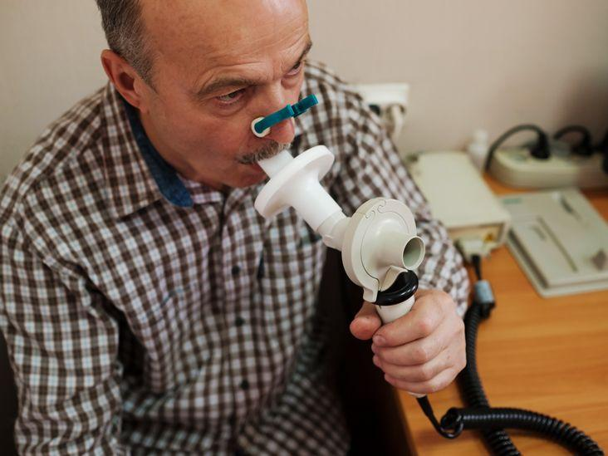
Routine Health Data in Care Planning
Spirometry shows low FEV1 to FVC ratios that are evidence of airflow obstruction (Backman et al., 2024).
The oxygen saturation levels are averaged at 91%, indicating resting hypoxaemia.
The status of overweight that affects levels of breathlessness is confirmed by body mass index.
Past exacerbation history assists in modulating the treatment that is being followed to observe frequency and prevention in the future.
COPD spirometry
(Source: MedicalNews Today, 2021)
Notes:
The spirometry shows lower FEV1 and FVC ratios, which indicate airflow obstruction. Oxygen saturation is at an average of 91%, which shows mild resting hypoxaemia. Overweight status is confirmed by body mass index. The history of exacerbation informs treatment change, the rate of monitoring, and future prevention measures.

Slide 11
Identified Care Needs
Mucus has blocked the airways and has made clearance difficult (Dietrich, 2023).
There is shortness of breath, which is limiting physical activity.
Breathlessness causes anxiety and makes breathing difficult.
Flare-ups can be triggered by smoking or infections.
Quitting smoking will prevent the disease from progressing.
Notes:
The buildup of mucus makes the clearance of the airway ineffective in Mr Brown, which limits the flow of oxygen. This causes breathlessness, which further results in anxiety. Smoking and past infections can increase the risk of flare-ups, and quitting smoking will reduce the progression of the disease.

Slide 12
Overall Aims of the Care Plan
Improvement of breathing and gas exchange in the lungs through treatment.
Reduction of flare-ups with vaccines.
Pulmonary rehab to build tolerance for exercise (NHS England, 2024).
Self-management and personal plans for empowerment of the individual.
Notes:
The aim of the care plan is to improve breathing and gas exchange through various treatments. Flare-ups will be reduced through vaccination. Tolerance for exercise will be built through the rehab for the pulmonary system. Education related to self-management will empower the individual. These steps will help in the improvement of the quality of life of an individual with COPD.

Slide 13
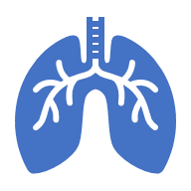



Medical Management
Bronchodilator inhalers can open up airways and help with breathing (Tytler, 2026).
Corticosteroids are added to bronchodilators in case of exacerbations.
Proper training related to the usage of an inhaler can ensure effectiveness.
Regular reviews related to medication check use and barriers.

Slide 14
Non-Pharmacological Care
Pulmonary rehab will be done through exercise and education to improve the function of the lungs (NHS England, 2024).
Referral for cessation of smoking can prevent COPD from progressing.
Breathlessness can be managed through breathing exercises.
Energy and weight can be maintained through nutritional support.
Influenza and pneumococcal vaccinations provide protection against infections.
Notes:
Pulmonary rehabilitation can be done through exercise and providing education related to the function of the lungs. Cessation of smoking can be helpful in preventing COPD from progressing. Breathing exercises can be helpful while dealing with breathlessness. Nutritional support can help in maintaining weight and energy. Various vaccinations can be helpful as protection against infections.

Slide 15
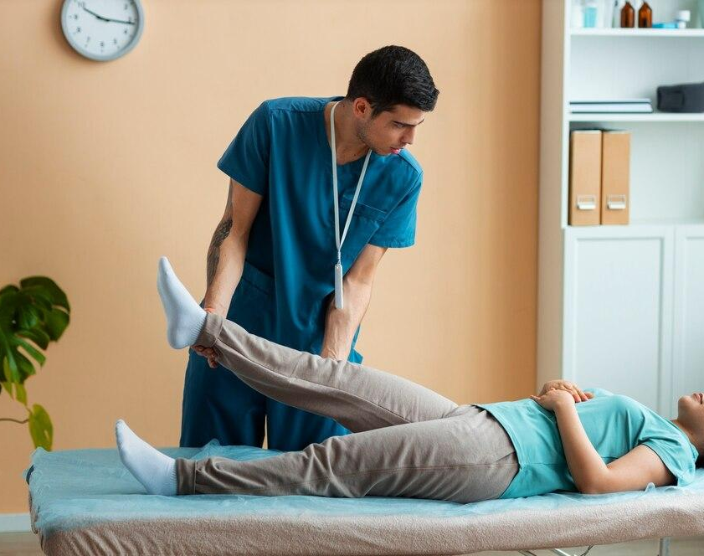
Monitoring, Communication & MDT
Function of the lung and levels of oxygen can be tracked by spirometry and SpO₂ checks.
Breathlessness and triggers should be tracked regularly.
Clinical checks should be scheduled on a regular basis.
Physiotherapy and input from a dietician can improve health and mobility.
Shared decision-making can improve personalised care (Barradell et al., 2023).
(Source: MRC, 2024)
Notes:
Regular spirometry and checks of oxygen saturation can be done to track the functioning of the lungs. There should also be regular tracking of breathlessness and triggers. There should be clinical checks performed on a regular basis. Physiotherapists and dieticians can also help in the improvement of health. Personalised care can be enhanced through shared decision-making.

Slide 16
Ethical Considerations & Conclusion
Mr Brown should provide consent after being informed of the care decisions.
The personal health data should be protected (HCPC, 2024).
Provide care specific to the personal needs of the individual.
Respecting the patient's autonomy and involving him in the decision-making process.
Notes:
Ethical practices should involve gaining consent from Mr Brown, who is informed about the procedure. The data related to the health of the patient should be protected. The patient's autonomy should be respected, and the patient should be involved in the process of making decisions. Care should be provided according to the needs of the patient.

Slide 17
Reference
Agarwal, A.K., Raja, A. and Brown, B.D. (2023) Chronic obstructive pulmonary disease (COPD), National Library of Medicine. Treasure Island (FL): StatPearls Publishing.
Amador, C., Varacallo, M. and Weber, C. (2023) Anatomy, Thorax, Bronchial, PubMed. Treasure Island (FL): StatPearls Publishing.
Backman, H., Lowie, Mannino, D.M. and Magnus Ekström (2024) ‘Severity of Airflow Obstruction Based on FEV1/FVC Versus FEV1 Percent Predicted in the General U.S. Population’, American Journal of Respiratory and Critical Care Medicine [Preprint]. Available at: https://doi.org/10.1164/rccm.202310-1773oc.
Barradell, A. et al. (2023) ‘Systematic review of shared decision-making interventions for people living with chronic respiratory diseases’, BMJ Journals, 13(5).
Caruso, S. (2025) Impaired gas exchange nursing diagnosis & care plan, NurseTogether. Available at: https://www.nursetogether.com/impaired-gas-exchange-nursing-diagnosis-care-plan/ (Accessed: 21 February 2026).
Cleveland Clinic (2024) Respiratory System: Functions, Facts, Organs & Anatomy, Cleveland Clinic. Cleveland Clinic. Available at: https://my.clevelandclinic.org/health/body/21205-respiratory-system (Accessed: 21 February 2026).
Dietrich, A. (2023) COPD Nursing Care Plan, Nurse.com. Available at: https://www.nurse.com/clinical-guides/chronic-obstructive-pulmonary-disease-copd/ (Accessed: 19 February 2026).
Fiveable (2025) The Process of Breathing | Anatomy and Physiology I Class Notes | Fiveable, Fiveable. Available at: https://fiveable.me/anatomy-physiology/unit-22/3-process-breathing/study-guide/oe2Sz6Yq9gIM9Ca3 (Accessed: 21 February 2026).
HCPC (2024) Consent and confidentiality, HCPC. Available at: https://www.hcpc-uk.org/standards/meeting-our-standards/confidentiality/guidance-on-confidentiality/consent-and-confidentiality/ (Accessed: 18 February 2026).
MedicalNews Today (2021) COPD spirometry: What it is and how it works, www.medicalnewstoday.com. Available at: https://www.medicalnewstoday.com/articles/copd-spirometry (Accessed: 21 February 2026).
MRC (2024) The Role of Physiotherapy in Relieving Chronic Pain and Improving Mobility - rehabe india, Mrc. Available at: https://rehabindia.org/blog/the-role-of-physiotherapy-in-relieving-chronic-pain-and-improving-mobility/ (Accessed: 19 February 2026).
National Cancer Institute (2019) Bronchi, Bronchial Tree, & Lungs | SEER Training, National Cancer Institute. Available at: https://training.seer.cancer.gov/anatomy/respiratory/passages/bronchi.html (Accessed: 21 February 2026).
nhlbi (2022) How the Lungs Work - The Respiratory System , www.nhlbi.nih.gov. National Heart, Lung, and Blood Institute. Available at: https://www.nhlbi.nih.gov/health/lungs/respiratory-system (Accessed: 21 February 2026).
NHS England (2024) NHS England» Respiratory high impact interventions, www.england.nhs.uk. Available at: https://www.england.nhs.uk/ourwork/prevention/secondary-prevention/respiratory-high-impact-interventions/ (Accessed: 21 February 2026).
Nurseslab (2025) Chronic Obstructive Pulmonary Disease (COPD) - Nurseslab, Nurseslab. Available at: https://nurseslab.in/nursing-notes/disease/copd/ (Accessed: 21 February 2026).
Patel, N., Chong, K. and Baydur, A. (2022) ‘Methods and Applications in Respiratory Physiology: Respiratory Mechanics, Drive and Muscle Function in Neuromuscular and Chest Wall Disorders’, Frontiers in Physiology, 13, pp. 1–17. Available at: https://doi.org/10.3389/fphys.2022.838414.
Rodrigues, S. de O., Cunha, C.M.C. da, Soares, G.M.V., Silva, P.L., Silva, A.R. and Gonçalves-de-Albuquerque, C.F. (2021) ‘Mechanisms, pathophysiology and currently proposed treatments of chronic obstructive pulmonary disease’, Pharmaceuticals, 14(10), p. 979. Available at: https://doi.org/10.3390/ph14100979.
Tytler, K. (2026) Latest NICE COPD Guidance Summary (2026) | iatroX, iatroX Guidelines. iatroX. Available at: https://www.iatrox.com/guidelines/copd (Accessed: 20 February 2026).
Widysanto, A. and Mathew, G. (2025) Chronic bronchitis, National Library of Medicine. StatPearls Publishing.

