Slide 1




Technology
Help or hinderance?
The impact of Social Media on children's (under 18) Health and Well-Being

Slide 2
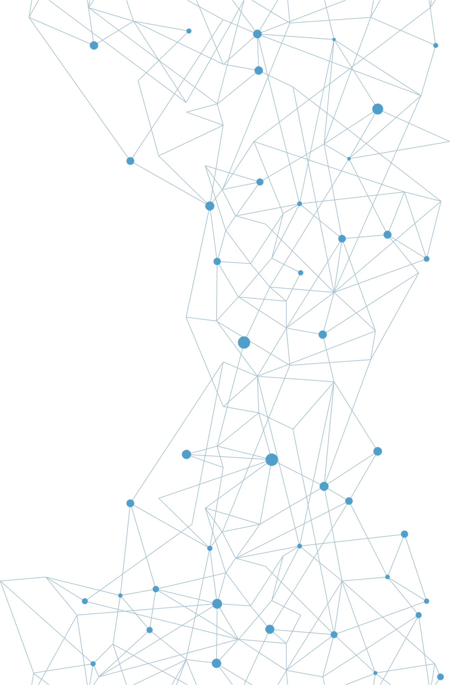
Table Of
Content
IZA
Social media and Youth
Statistics on usage
Average daily screen time
Technology use during COVID-19
Life stories
Critical perspective for healthy media use
Guidelines and best practices
01.
02.
BEC
Back to basics - What is health and well-being?
Social skills and Interpersonal relationships
Is it all bad news?
Platform – not for trains
Opportunities
Positives
03.
CAROLINA
Use of technology in different countries
Stats/Screen Time
Country Based Report Cards
Physical Health: Negative and Positives
Sleep Disturbances
04.
RIA
Mental health impact in children and teens
Mental struggle – anxiety, depression and self
Esteem
The negatives of technology
Cyberbully, grooming and inappropriate content

Slide 3








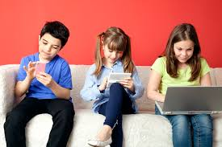
Social Media and Youth
Definition of social media
Online platforms and applications that allow users to create, share, and interact with content (Li, Larimo and Leonidou, 2021)
Instagram, Facebook, Twitter, Pinterest, TikTok, Snapchat, Youtube
Platforms to communicate, create, join, collaborate, socialize, share, play, buy and sell, and learn (Zerman, 2022)
Why is social media popular among youth?
Connection
Entertainment
Expression
(Lozano-Blasco, Mira-Aladrén and Gil-Lamata, 2023)

Slide 4

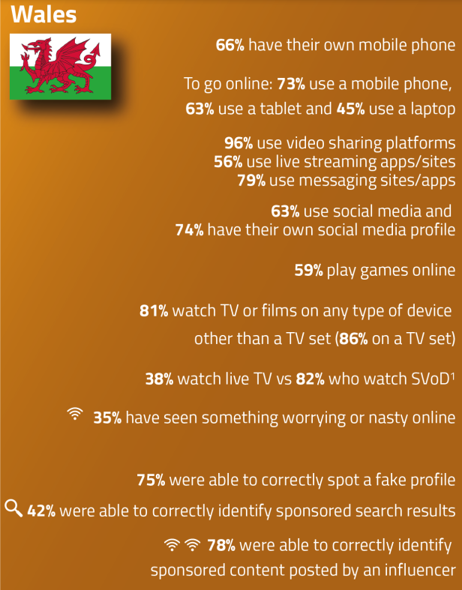
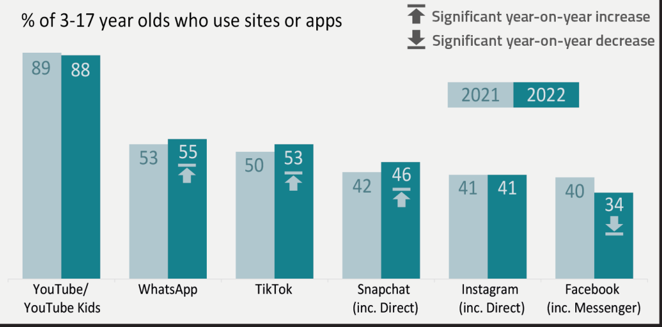
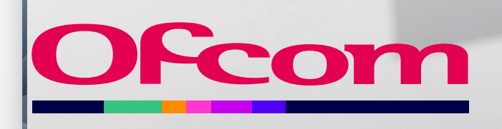
Statistics on usage
OFcom organization:
’Children's online behaviors and understanding’’ survey -6,795 children aged 8-17
'Children's online knowledge and understanding' survey - 2,087 children
'Parents only' survey -2,526 parents of children 3-17
97% of children aged 3-17 / 87% for 3-4 year olds went online
(OFcom, 2023)

Slide 5
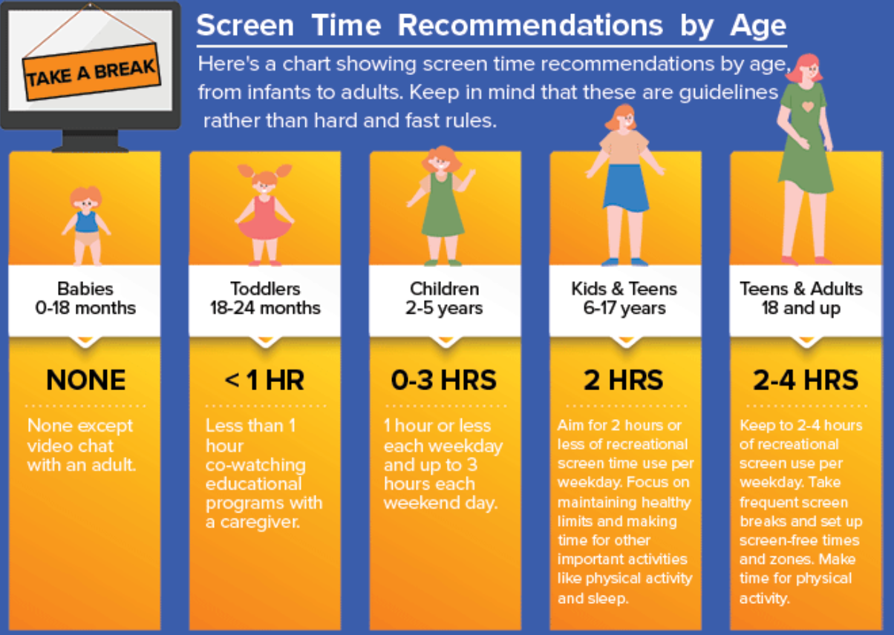
Average daily screen time
Systematic review and meta-analysis findings:
Guidelines:
Children younger than 2 years = AVOID screen time
Children 2 to 5 years = NO MORE than 1 hour
!! Only 1 in 4 children younger than 2 years and 1 in 3 children
aged 2 to 5 years met screen time guidelines !!
Limitations to the study:
Did not take sociodemographic factors into account
Content ( eg. educational) and context (eg. co-viewing) of screen use
(McArthur, Volkova and Tomopoulos, 2022)

Slide 6





Increased technology use during COVID-19
!!Disturbances in BRAIN functioning ---> Changes in NEUROplasticity!!
!!Radiofrequency radiations --> brain tumor risk factor in children!!
(Limone and Toto, 2021)
Educational platforms during Covid:
Zoom, Google Classroom, Microsoft Teams
Increased prevalence of technology use in children
Virtual learning -->primary mode of education = increased screen time
(Mesce et al., 2022)
52% increase in screen time (84 minutes)
Screen time from 2 hours to 4 hours per day
110 minutes/day in 12 to 18 years of age
66 minutes/day in preschoolers
65 minutes/day in middle school children
(Madigan et al., 2022)

Slide 7
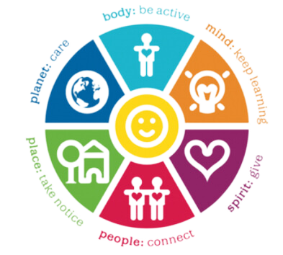
Back to basics - What is health and well-being?
01
HEALTH
02
WELL-BEING
"Health is a state of complete physical, mental and social well-being and not merely the absence of disease or infirmity" (WHO, 2024)
According to Jarden and Roache (2023), a common definition used to describe well-being comes from Michaelson et al (2012), as follows:
“wellbeing can be understood as how people feel and how they function both on a personal and social level, and hfaced with on a day-to-day ow they evaluate their lives as a whole”.
Wheel of Wellbeing (2013)
BEC
Notes:
Health
Being able to address a child's health and well-being, you must first be able to understand what it is. The definition given by WHO for health is "a state of complete physical, mental and social well-being and not merely the absence of disease or infirmity" - A common misconception is that health means purely diet or exercise, however, many other aspects make up the overall "picture of health". Well-being focuses on a person's feelings and thoughts throughout a variety of situations that we, as humans, are faced with everyday.
Wheel of Wellbeing
The wheel of well-being represents body, mind,spirit, people and planet. This was developed following funding from the lottery and formed back in 2008 as part of the Well London Programme.
It covers a number of aspects including self-help, being part of a community as well as a section regarding public health incorporating local and national government.
It is a great resource available to anyone who wishes to enhance their health journey – it is online and free.

Slide 8


03
MENTAL HEALTH
04
EMOTIONAL WELL-BEING
WHO (2024) describe mental health as being fundamental to our general well-being and is a state that enables a person to manage the stresses that life can bring, have an impact in their community, as well as the ability to learn and work well.
Mental Health can also be said to contribute to an ability to react, feel, live and think (Mind, 2017).
Many aspects make up emotional well-being such as achieving a sense of purpose and/or meaning, holding supportive relationships and cope with and manage emotions (CDC, No Date).
Good mental health and emotional health can form a sense of self-worth or belonging in life, achieve objectives, improve self-esteem and confidence, allow for positive feelings among many other benefits, including towards physical health (NHS, 2022)
BEC
Notes:
Mental Health
Mental health has been spoken about more and more in recent years. It is very much at the forefront of a lot of campaigns and healthcare initiatives. Mental health can have a profound effect on a person and the way they are able to react to situations. When thinking about children, it can affect how they are able to communicate to adults whether that be in an education setting or at home with loved ones. Social media can now be used in order to access the help and information a child may require if they are struggling with their own mental health but do not wish to talk to anyone who is physically around them at the moment. Conversely, There is a lot on the internet and, more specifically on social media, that can hinder a child's mental health from cyberbullying, to body or social comparison (such as a child is showing off about something expensive).
Emotional well-being
Being able to regulate emotions is an important life skill. For children, being able to interpret and regulate your emotions to be able to manage and cope with life growing up, learning new skills and growth is very important. Social media has an ability to help a child's emotional wellbeing by connecting them to family and friends, to be able to communicate and feel part of a team or community as well as helping them learn how to regulate emotions in certain situations. However, social media has the ability to severely damage a child's emotions and de-regulate what has been learned to date.

Slide 9
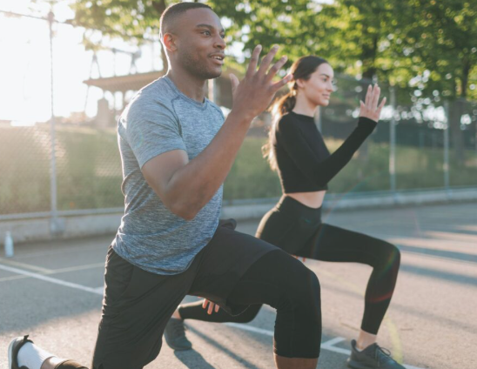
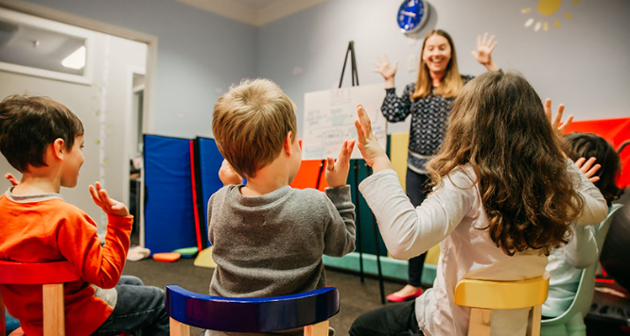
05
SOCIAL SKILLS
06
PHYSICAL HEALTH
Being able to communicate in an effective manner is somewhat essential to day-to-day life. Although complex in nature, social skills such as being able to assess a persons behaviour means that, especially as a younger person, you are able to interact with one another effectively (Soto-Icaza et al, 2015)
Your body's condition, health condition, injury or illness all describe a person's physical health (Manchester University NHS Foundation Trust, 2024)
Social skills, physical health, mental and emotional well-being in varying forms are all significantly important when considering what, if any, impact social media may havev on children and their day-to-day lives.
BEC
Notes:
Social Skills
As a child, learning social skills is part of growing up. Social skills allows children to acknowledge adult and other children's behaviour and respond accordingly. It also allos them to interact with other people in an appropriate manner and convey their own thoughts and feelings appropriately. Social media is able to develop and/or hinder a child's social skills, depending on the way in which this resource is used and thought of.
Physical Health
Physical health is well known these days as the body's health, condition and whether you are suffering from an illness. Children develop their physical health as they grow and they encounter various illnesses that are in the world. Social media is able to enhance a child's affinity with improving physical health but may also place a disproportionate spotlight on physical appreance.

Slide 10
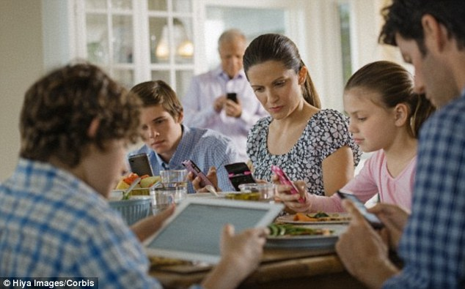
Statistics
• Over 95% of adults own a smartphone in the U.S
• 88% of adults own a smartphone device in Australia
• Study revealed that 70% of adults use their phones while having meals with their family and friends.
• A study in children between the ages of 3 and 5 in the United States showed that kids spent at least three hours on their smart device. In 2014, 75% of four year-olds in the U.S owned their own smartphone or tablet.
• Children under the age of 5 have spent over 75 minutes watching TV per day
(Sources 3 & 8)
Notes:
Social Skills
As a child, learning social skills is part of growing up. Social skills allows children to acknowledge adult and other children's behaviour and respond accordingly. It also allos them to interact with other people in an appropriate manner and convey their own thoughts and feelings appropriately. Social media is able to develop and/or hinder a child's social skills, depending on the way in which this resource is used and thought of.
Physical Health
Physical health is well known these days as the body's health, condition and whether you are suffering from an illness. Children develop their physical health as they grow and they encounter various illnesses that are in the world. Social media is able to enhance a child's affinity with improving physical health but may also place a disproportionate spotlight on physical apperance.
Summery
All aspects just mentioned need to be understood in order to properly assess the effects technology, specifically social media, has on children, their development and behaviour.

Slide 11


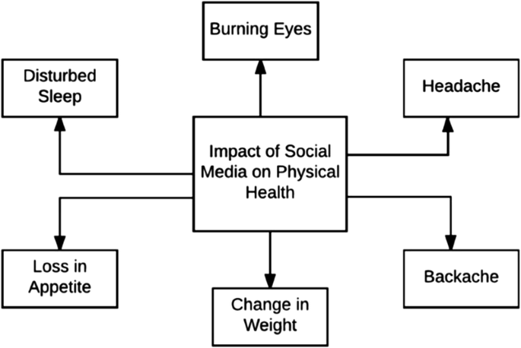
Physical Health Problems
-Higher Body Mass Index
-Not meeting physical activity recommendations
-"Selfie" culture across social media platforms: Body dissatisfaction leading to disordered eating behaviours
-Obesity
(Sources 2, 4, 5, 6, 7, 10, 12, 13, 14, & 15)

Slide 12
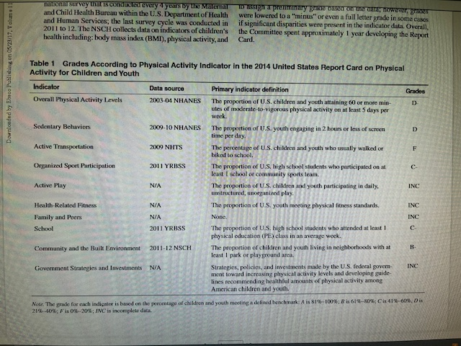
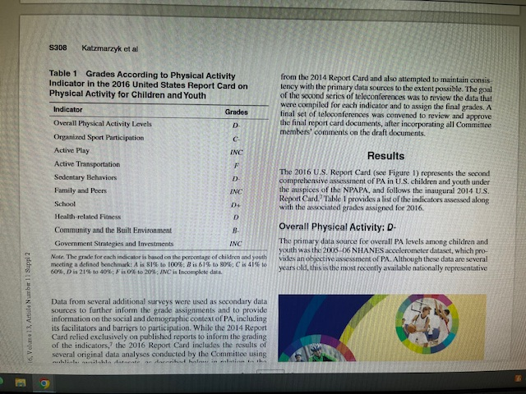
Notes:
Social Skills
As a child, learning social skills is part of growing up. Social skills allows children to acknowledge adult and other children's behaviour and respond accordingly. It also allos them to interact with other people in an appropriate manner and convey their own thoughts and feelings appropriately. Social media is able to develop and/or hinder a child's social skills, depending on the way in which this resource is used and thought of.
Physical Health
Physical health is well known these days as the body's health, condition and whether you are suffering from an illness. Children develop their physical health as they grow and they encounter various illnesses that are in the world. Social media is able to enhance a child's affinity with improving physical health but may also place a disproportionate spotlight on physical appreance.

Slide 13
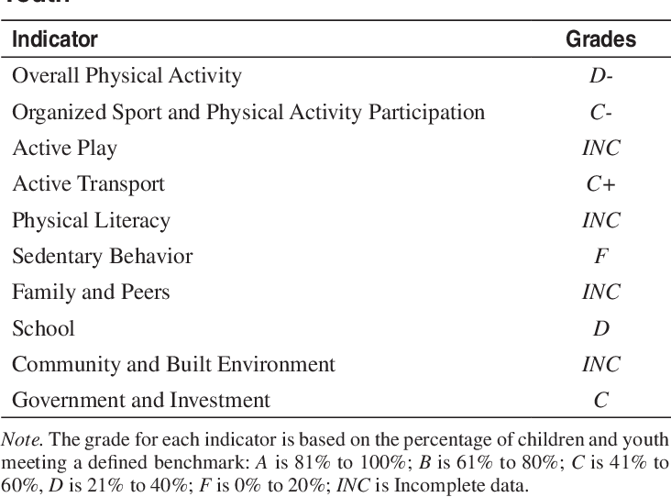
South Korea Report Card
Notes:
Social Skills
As a child, learning social skills is part of growing up. Social skills allows children to acknowledge adult and other children's behaviour and respond accordingly. It also allos them to interact with other people in an appropriate manner and convey their own thoughts and feelings appropriately. Social media is able to develop and/or hinder a child's social skills, depending on the way in which this resource is used and thought of.
Physical Health
Physical health is well known these days as the body's health, condition and whether you are suffering from an illness. Children develop their physical health as they grow and they encounter various illnesses that are in the world. Social media is able to enhance a child's affinity with improving physical health but may also place a disproportionate spotlight on physical appreance.

Slide 14
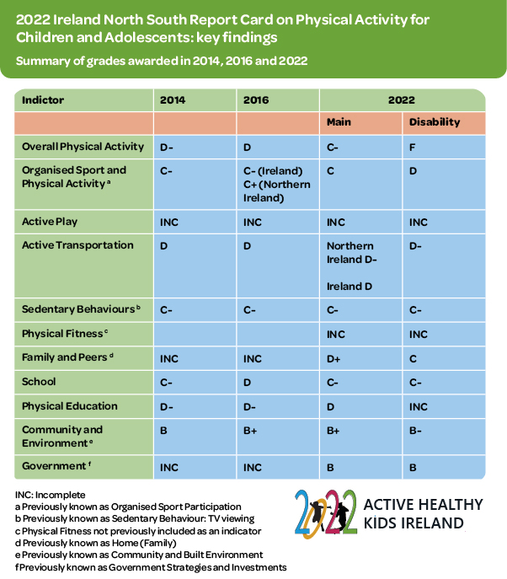
Ireland Report Card
Notes:
Social Skills
As a child, learning social skills is part of growing up. Social skills allows children to acknowledge adult and other children's behaviour and respond accordingly. It also allos them to interact with other people in an appropriate manner and convey their own thoughts and feelings appropriately. Social media is able to develop and/or hinder a child's social skills, depending on the way in which this resource is used and thought of.
Physical Health
Physical health is well known these days as the body's health, condition and whether you are suffering from an illness. Children develop their physical health as they grow and they encounter various illnesses that are in the world. Social media is able to enhance a child's affinity with improving physical health but may also place a disproportionate spotlight on physical appreance.

Slide 15
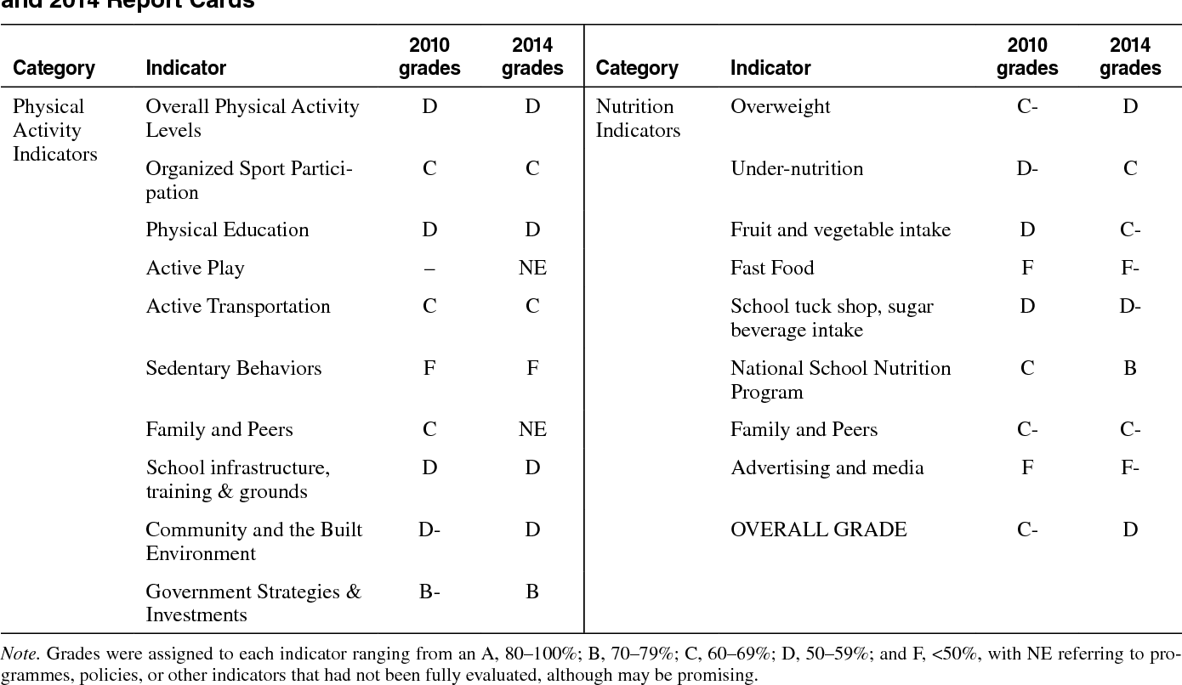
South Africa Report Card
Notes:
Social Skills
As a child, learning social skills is part of growing up. Social skills allows children to acknowledge adult and other children's behaviour and respond accordingly. It also allos them to interact with other people in an appropriate manner and convey their own thoughts and feelings appropriately. Social media is able to develop and/or hinder a child's social skills, depending on the way in which this resource is used and thought of.
Physical Health
Physical health is well known these days as the body's health, condition and whether you are suffering from an illness. Children develop their physical health as they grow and they encounter various illnesses that are in the world. Social media is able to enhance a child's affinity with improving physical health but may also place a disproportionate spotlight on physical appreance.

Slide 16


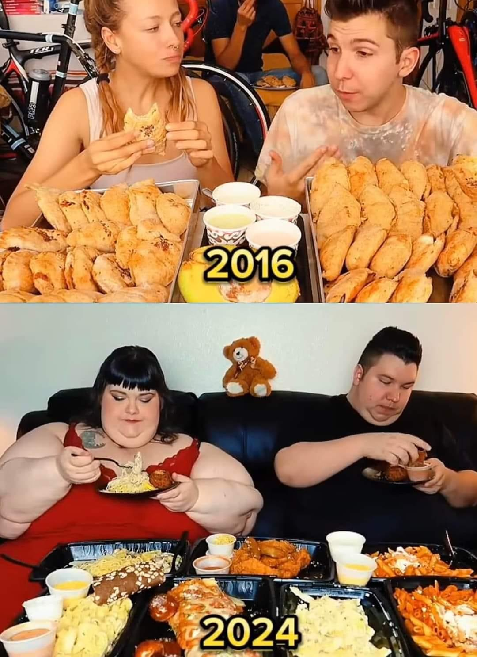
https://www.youtube.com/watch?v=3RMe0Gj-vLo
The "perfect" picture
Selfie culture
MODEL
Celebrity
Notes:
Social Skills
As a child, learning social skills is part of growing up. Social skills allows children to acknowledge adult and other children's behaviour and respond accordingly. It also allos them to interact with other people in an appropriate manner and convey their own thoughts and feelings appropriately. Social media is able to develop and/or hinder a child's social skills, depending on the way in which this resource is used and thought of.
Physical Health
Physical health is well known these days as the body's health, condition and whether you are suffering from an illness. Children develop their physical health as they grow and they encounter various illnesses that are in the world. Social media is able to enhance a child's affinity with improving physical health but may also place a disproportionate spotlight on physical appreance.

Slide 17

Excessive screen time can lead to poor sleep quality
Children experienced more tiredness throughout the day when staying up on their phone at night
Time taken away from total restful hours
Eye strain, pain, redness
Sleep Disturbances
(Sources 1, 9, & 11)
Young ones spend nights on their mobile device out of fear of not being informed of the latest news on their socials
Exposure to long periods of time on media can cause sensitivity to light and irritation
Headaches can worsen, may even develop into migraines

Slide 18
Positives on Physical Health
Seeing others be physically active and eating nutrient rich foods can be appealing
Group activities with those of similar interests can make things more fun and therefore motivate others
Social media can provide a sense of belonging which improves self-esteem, leading to better decision-making on habits
Development of cognitive and physical skills in sport and activity
Learn how to make S.M.A.R.T goals
Instructors and content creators can appropriately educate their audience to the benefits of pursuing a healthy lifestyle

Slide 19


Mental Health impact in Children and teens
Constant exposure to smartphones, computers, TVs, tablets, and gaming consoles can significantly affect children and teens' mental health. It can lead to increased stress, anxiety, behavioural issues, reduced social skills, and sleep problems.
A large study by researchers from Yale's Department of Psychiatry and Columbia's School of Nursing analysed screen use in over 5,100 children. They found that kids who spent the most time on digital devices showed higher levels of depression, anxiety, social isolation, aggression, defiance, and bullying, effects that lasted up to two years. The study noted that these mental health issues were linked to changes in brain development caused by screen use.
Another study found that teens aged 14-17 who were heavy screen users were twice as likely to be diagnosed with depression or anxiety, receive treatment from a mental health professional, or take medication for psychological or behavioural problems.
These findings highlight the serious and lasting impact of excessive screen time on the developing mental health issues (Nexus Health Systems, 2024).

Slide 20

Mental Health Impact in children and teens
The combination of excessive screen time, social comparison, and digital validation can create a harmful environment for children and teens leading to mental health struggles like depression, anxiety, and low self-esteem.
SELF-ESTEEM
BODY IMAGE
ANXIETY
DEPRESSION
LINKS
STATS
Too much time spent online — especially on social media — can impact kids' self-esteem and make them feel sad and anxious, Seeing friends or influencers constantly posting about exciting activities can make teens feel left out or excluded, leading to anxiety about missing social experiences. (Child Mind Institute, 2021).
Seeing posts on social media can cause an individual to start Feeling bad about themselves can contribute to depression. Social media may also take away time from activities that boost well-being, such as exercise and hobbies(Hoge, Bickham and Cantor, 2017).
Constant exposure to idealised and often unrealistic body images of models on social media. including sites such as Instagram, TikTok, Twitter, YouTube, and Snapchat. can lead to feelings of discouragement and shame among teenagers when it comes to body image (Krzymowski, 2024).
Teens are constantly exposed to highly edited and filtered images of beauty, success, and lifestyle. Comparing themselves to these idealised versions can make them feel they don’t measure up, lowering their self-esteem(Auld, 2019).
Video on social media and mental health- https://www.youtube.com/watch?v=Z1BpYDkGoAs
Self esteem and body issues- https://www.youtube.com/watch?v=z2T-Rh838GA
1 in 5 children and young people aged 8 to 16 and 23.% of 17 to 19-year-olds were identified as having a mental disorder mental in 2023.
Also 12% of 17 to 19-year-olds were identified with an eating disorder in 2023, compared to just 0.8% in 2017. (NHS England, 2023)

Slide 21
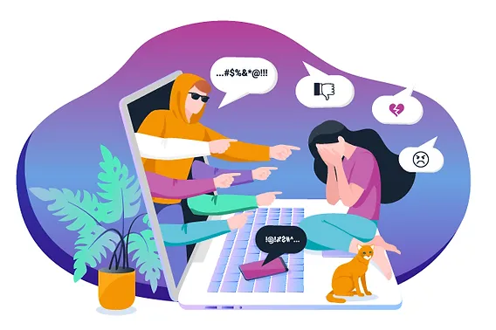

Cyberbullying
is a type of bullying that occurs through technology, like social media, texts and emails. Cyberbullying can include:
- sending threatening or abusive text messages
- creating and sharing embarrassing images or videos
- trolling – the sending of menacing or upsetting messages on social networks, chat rooms or online games
-excluding children from online games, activities or friendship groups
-shaming someone online (NSPCC, 2016).
Dangers of technology
Online predators
Online predators looking to groom children online often visit social media websites that are popular with young people and will pretend to be their age. The adult may try to secure their trust with fake profile pictures, by pretending to share similar interests, by offering gifts to the child or by complimenting the child. Online grooming may be difficult to detect because it often occurs while a child is home and simply using the computer or another technology device (Kraut, 2023).
)
Inappropriate content
Inappropriate content can come in many forms, from inaccurate information, to content that may lead teens and children to unlawful behaviour. Children with unsupervised access to the internet can stumble across this content or it could even be sent to them directly by another child. Content that contains profanity or vulgar language, promotes vandalism, crime, racism, eating disorders, or suicide, as well as pictures, videos, or games promoting violence or cruelty toward people or animals (InternetMatters, 2019).

Slide 22

Social Skills and Interpersonal Relationships
The use of the internet and social media can effect a child's social skills and interpersonal relationships. From cyberbullying to addiction – it all plays a part.
BEC
Notes:
social skills and interpersonal relationships are very important as children grow and develop to set them up for future adult life.
FOMO, social media addiction, face to face communication, useful resources, dependence, a sense of community and stranger danger are all aspects of the internet and social media that need to be considered when looking at whether they are useful tools to children.

Slide 23
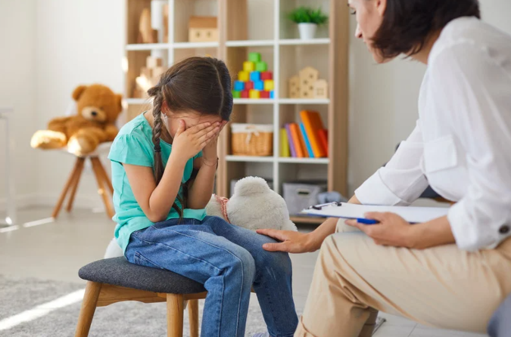
Social Skills and Interpersonal Relationships cont.
Using technology instead of communicating face-to-face may be a way in which young people may remove some forms of social anxiety (Pierce, 2009)
Assumed that children are able to engage in what the internet has to offer, it is assumed that children will be able to do this – not always the case (Livingstone, 2011)
BEC
Notes:
Depression and anxiety links with the young are more at the forefront in a lot of mental health campaigns in recent years. Anxiety has been prevalent among youth for many reasons and the introduction of technology into those complex feelings do not seem necessarily enhance communication skills but, in fact, can make a younger person feel more comfortable using this technology to communicate rather than engaging in face-to-face communication (Pierce, 2009).
There are benefits and drawbacks with the use of the internet including social media. The ability to engage in the resources that the internet has to offer but, on the other hand, there are some that believe this resource is narrow and only find it useful in limited circumstances (Livingstone, 2011).

Slide 24
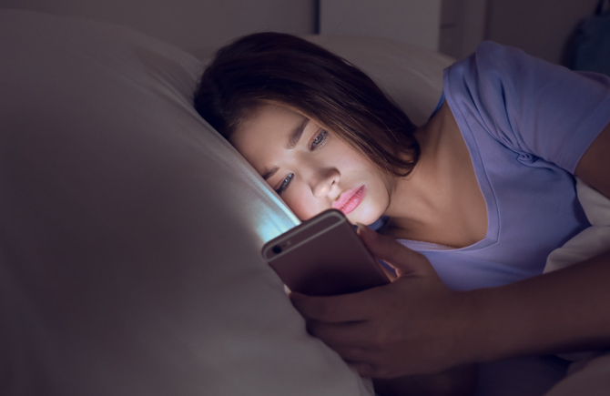
Social Skills and Interpersonal Relationships cont.
Addictive behaviours such as smoking or drinking has been seen to increase among female youth when they fall victim to cyber bullying (Nikolaou, 2022).
Social media addiction is very real and a serious compulsion for some (Griffiths, 2000; Starcevic, 2013 and Hou et al, 2019).
Social media addiction has a strong connection to the fear of missing out (Bloemen and Connick, 2020)
BEC
Notes:
Addictive behaviours such as smoking or drinking may not always be thought of to be associated with the use of the internet or social media. This can be attributed to the ability to fall victim to cyberbullying among young people. The prevalent use of the internet or social media has been seen to increase among female youth when they fall victim to cyber bullying (Nikolaou, 2022).
Using social media to excess and displaying a possible compulsion to use social media is known as social media addiction (Griffiths, 2000; Starcevic, 2013; Hou et al, 2019).
FOMO or fear of missing out is a term used by youngsters to describe when something is happening that they are not involved with, the subsequent 'fear' or feeling related to that event, if they were not involved.
a connection has been made with fomo and an internet, specifically social media, addiction (Bloemen and Connick, 2020)

Slide 25

Social Skills and Interpersonal Relationships cont.
Children are becoming dependent upon social media and this is becoming a harmful obsession (Choudhary and Baskaran, 2022)
Some groups have benefitted from social media such as LGBTQ+ to enable them to connect to likeminded others and access information (Craig et al, 2021)
BEC
Notes:
Social networking or social media sites may be turning into an obsession for some younger people. The amount in which they are using social media correlates to the increase in thier dependence upon them in regards to their general use as well as the content which is on these sites (Choudhary and Baskaran, 2022).
The LGBTQ+ community has benefitted from social media to enhance their well-being in being able to use it to connect to others, access information and explore their identity (Craig et al, 2021).

Slide 26

Is it all bad news?
NO!!
It is not all doom and gloom!!
Believe it or not there are some positives associated with social media use for children.
Social media has enabled people to bridge the geographical gap that has previously existed, facilitate local community interactions, information sharing and engagement between people wh
stranger danger exists online as well as in person and allows people to connect to children online whether they know them or not. it also allows classmates, friends and relatives to connect more easily ((Siddiqui and Singh,2016)o live far or near to one another (Dwivedi et al, 2018).
BEC
Notes:
Although it may seem it – it is not all doom and gloom when it comes to technology.
There are some positives that come from the use of social media by children but we only tend to hear about the negatives from varying media outlets.
In research by Dwivedi et al they were able to see that social media has enabled people to bridge the geographical gap that has previously existed, facilitate local community interactions, information sharing and engagement between people who live far away from one another or, indeed, are local.
stranger danger is nothing new and has always been a feature of the internet and social media. however, youngsters are now able to access more
Information and people than ever before. This then means that they are able to interact with people who are not already known to them or within their lives as friends of school mates (siddiqui and singh,2016) . This will obviously have positives and negatives of its own.

Slide 27
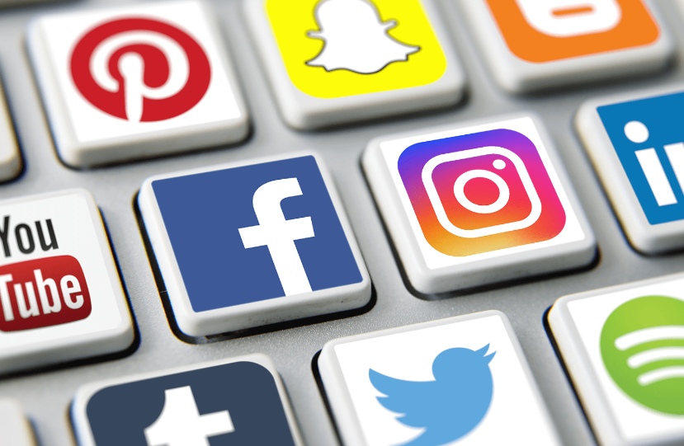
Platform... not for trains
Social media facilitates communication with differing social circles, gain or understand other peoples' opinions and create content Ersoy (2019).
The emerging capabilities of social media allow for increased creativity (Peppler and Dahn, 2022).
It can be said that social media is a platform for self-expression and if a person is able to be themselves online, instead of portraying a false persona, it may enhance their well-being (Bailey et al, 2020)
BEC
Notes:
According to Ersoy (2019), social media facilitates communication between differing social circles and helps them gain or understand other peoples' opinions which also helps different social circles create content that can then be used online.
Being creative is a large part of children's lives and with the use of technology and social media, children are now able to let their creative juices flow. Social media and its huge capabilities is allowing this creativity to flourish.
Self-expression, particularly among children who are still establishing their own personalities, is very important in life. Although a rather controversial subject, being able to express yourself online is also an important part of modern life.
As I am sure we are all aware, social media gives some people the ability to live a life online that does not actually reflect real life. However, Bailey et al has found that being able to be yourself online and not engaging in showcasing a false persona will, in fact, enahnce your well-being.

Slide 28
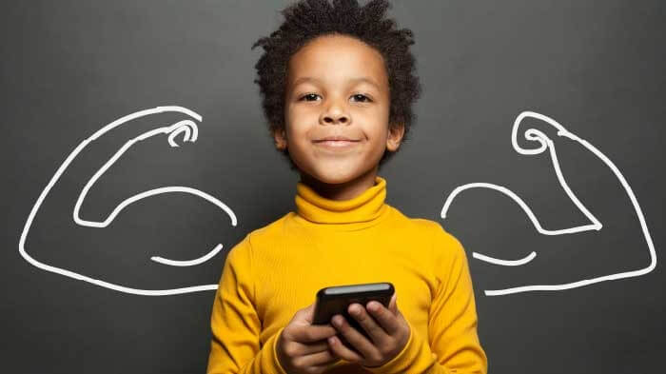
Opportunities
Online communities, and the use of these, has increased over time which may enhance learning and connection to content or people that they may not have been able to access previously Sweet et al (2020).
Marginalised groups can create communities to enable them to have a voice and be heard (Butkus, 2023)
Although the link between isolation and the internet is widely documented, the use of social media may actually increase youth inclusion (Unterfrauner, 2009)
BEC
Notes:
Sweet et al (2020) shows that online communities have increased significantly in time and proportion over the last decade, enabling information to be shared among users, facilitating an enhancement of education or learning and also connect with differing communities that would be of particular interest to them.
In modern society, the norms for cultural, institutional and social ideologies have been tested and marginalised groups have been able to create communities to voice their opinions, feelings and more using social media platforms (Butkus, 2023).
The use of technology, including social media, may be able to be used as a way in which marginalised groupings are able to feel less isolated and youth inclusion may increase (Unterfrauner, 2009)
.

Slide 29
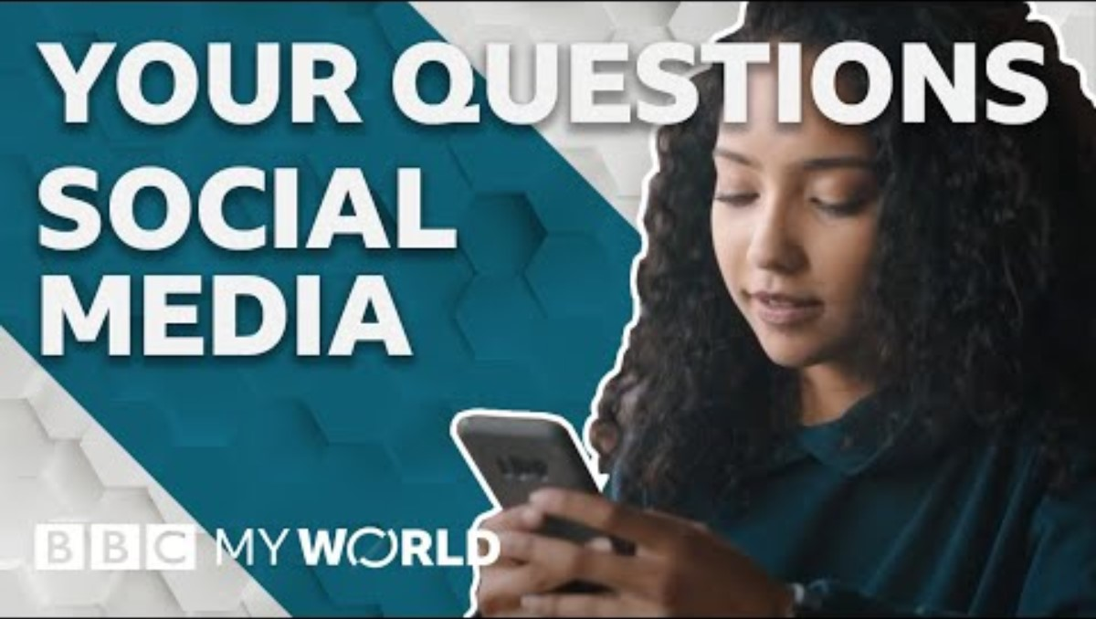
Positives – There are some
Social media/internet plays an fundamental role in the everyday lives of children and youth and enhancing their mental wellbeing. (Vaingankar et al, 2022)
The ease in which children are able to feel connected, create communities and form relationships online is a positive that has come out of social media use (Allen et al, 2014)
(BBC My World, 2020)
BEC
Notes:
The lives of children is so very different these days with the use of the internet which children encounter on an extremely regular basis throughout their general day-to-day lives and has the ability to enhance their well-being (Vaingankar at al, 2022).
The creation of communities, relationships and feelings of more connectedness are all positive to human lives but the use of social media has an ability to enhance these aspects when used by children (Allen et al, 2014).

Slide 30
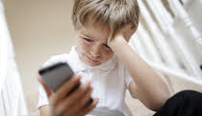
On the ground
''My son was in Year 6 of primary school when he got his phone - purely to have when playing out so I could track him and contact him without worry. He will be 13 in January. He is not allowed on Facebook, however he is on Snapchat, Instagram and WhatsApp. Both myself and my husband have added him as friends. Also, we have an understanding that we check his phone every couple of days. Good job we do, as he had messages from his so-called friend telling him to go and kill himself. He didn’t tell us as he didn’t want to worry us. It’s all sorted now through school and my son now knows he has to mention anything that is bad so it can be sorted. The phone has been a godsend in high school when he walked to and from school as others were attacking him after school. In the end, I now have to drive him as he is too scared. All in all, I think having a phone is a good thing but social media definitely a no no!" (Williams, 2019)
Negative
"I started using social networking when I was around 10 or 11 years old. I met my boyfriend online and found some support and strategies for mental health and addiction problems which have helped me to an extent. However, I have been exposed to things I shouldn’t have seen from a young age, for example, men and women sending me sexual content on the internet and people attempting to groom me." (Fresh Start in Education, no date)
IZA & BEC

Slide 31
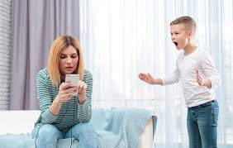
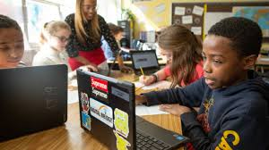
Critical perspective on parental and educational role for healthy media use
Parental role:
Consistency = parents reliance on technology
Over-restrictive measures or insufficients monitoring (Chassiakos et al., 2016)
Screen time limits = screens are also essential for education and entertainment
(Al-Samarraie et al., 2022)
Educational role:
Safe usage = theoretical
School add screen time
(Montag et al., 2024)

Slide 32


Guidelines/Best practices: Parents and Education
PARENTAL ROLES
EDUCATIONAL ROLES
incorporate media literacy programs
policies of smartphone use
empower children to recognize benefits and pitfalls of social media
engage offline opportunities
(Chassiakos et al., 2016)
model healthy social media behavior
participate in co-activities
engage offline opportunities /enhance parent-child interactions
(Montag et al., 2024)
(Al-Samarraie et al., 2022)

Slide 33
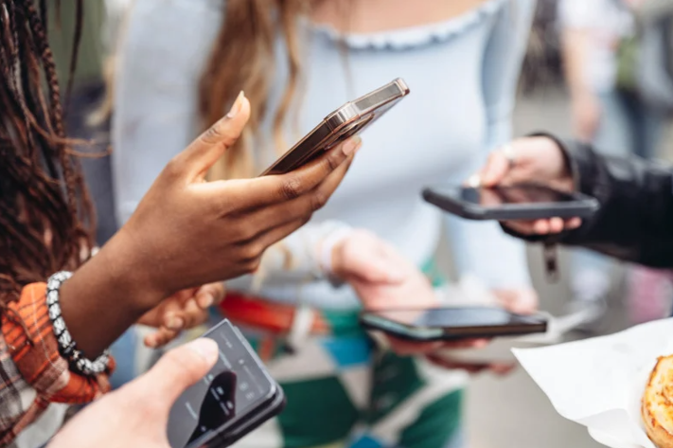
Future Trends and Conclusions
Steps to help put boundaries in place:
Open communication
Education
Parental Controls
Safe Browsing
Cyber Etiquette
Lead by example
Stay Informed
(Fresh Start in Education Ltd, no date)
BEC
Notes:
Fresh start in education explains some boundaries that could be followed to help use the internet and social media safely and effectively.

Slide 34
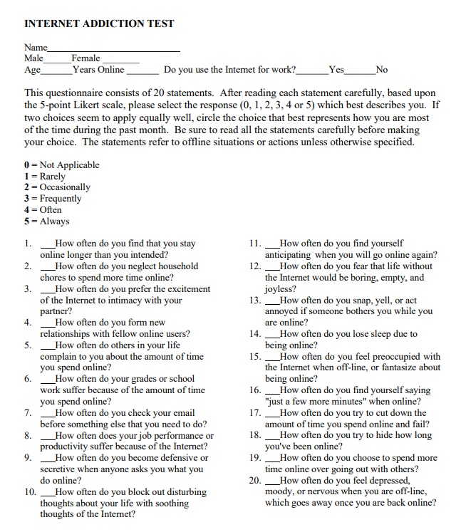
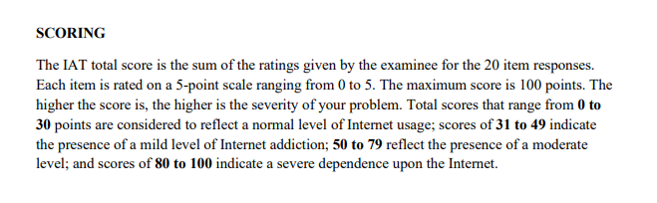
(Faraci et al., 2013)

Slide 35
References 1 - Bx
Allen, K. A., Ryan, T., Gray, D. L., McInerney, D. M. and Waters, L. (2014) ‘Social Media Use and Social Connectedness in Adolescents: The Positives and the Potential Pitfalls, The Australian Educational and Development Psychologist 31(1), pp. 18-31. DOI: 10.1017/edp.2014.2. (Accessed on: 3rd December 2024)
Bailey, E.R., Matz, S.C., Youyou. W. and Lyengar, S. S. (2020) 'Authentic self-expression on social media is associated with greater subjective well-being', Nat Commun, 11(1), pp. 4889. Available at: DOI: 10.1038/s41467-020-18539-w
BBC My World (2020). Available at: https://www.youtube.com/watch?v=DnKpnojwz2M (Accessed: 29th November 2024)
Bloemen, N. and Coninck, D. D. (2020) ‘Social Media and Fear of Missing Out in Adolescents: The Role of Family Characteristics’, Social Media + Society, 6(4). DOI: https://doi.org/10.1177/2056305120965517 (Accessed on: 3rd December 2024)
Centers for Disease Control and Prevention (No Date) About Emotional Well-Being. Available at: https://www.cdc.gov/emotional-well-being/about/index.html Accessed on: 29th November 2024)
Choudhary, P. and Baskaran, K. (2022) ‘The impact of Social Networking Sites among Modern Youth’, 2022 Interdisciplinary Research in Technology and Management, pp. 1-6. DOI: 10.1109/IRTM54583.2022.9791522. (Accessed on: 3rd December 2024)
Dvivedi, Y.K., Kelly, G., Janssen, M., Rana, N. P., Slade, E.L. and Clement, M. (2018) 'Social Media: the Good, the Bad and the Ugly', Inf Syst Front, 20, pp. 419-423. Available at: https://doi.org/10.1007/s10796-018-9848-5
Fresh Start in Education Ltd (No Date). Available at: https://freshstartineducation.co.uk/social-media-the-good-the-bad-and-the-ugly/. (Accessed: 29th November 2024)

Slide 36
References 2 - Bx
Jarden, A. and Roache, A. (2023) ‘What is Wellbeing?’, Int J Environ Res Public Health, 20(6), pp. 5006. Available at: doi: 10.3390/ijerph20065006
Hou, Y., Xiong, D., Jiang, T., Song, L. Wang, Q. (2019) ‘Social Media addiction: Its impact, mediation, and intervention’, Journal of Psychological Research on Cyberspace, 13(1). DOI: https://doi.org/10.5817/CP2019-1-4. (Accessed on: 3rd December 2024)
Marschalek, i., Unterfrauner, E. and Fabian, C. M. (2009) ‘Social inclusion of Young Marginalised People through online mobile communities’, 2009 International Multiconference on Computer Science and Information Technology, pp. 367-373, doi: 10.1109/IMCSIT.2009.5352698
Manchester University NHS Foundation Trust (2024)
Michaelson, J., Mahony, S. and Schifferes, J. (2012) ‘Measuring wellbeing: a guide for practitioners’, New Economics Foundation, https://pmc.ncbi.nlm.nih.gov/articles/PMC10049282/#B13-ijerph-20-05006)
Mind (2017) Mental Health Problems. Available at: https://www.mind.org.uk/information-support/types-of-mental-health-problems/mental-health-problems-introduction/about-mental-health-problems/?gad_source=1&gclid=Cj0KCQiAr7C6BhDRARIsAOUKifirSicxUACM8oTwThgAI4m-z4E-uiKryUVTqMedLnhpohuB7CgXiwgaAhcHEALw_wcB (Accessed on: 29th November 2024)
National Health Service (2022) 5 Steps to Mental Wellbeing. Available at: https://www.nhs.uk/mental-health/self-help/guides-tools-and-activities/five-steps-to-mental-wellbeing/ (Accessed on: 29th November 2024)
Nikolaou, D. (2021) ‘Bullying, cyberbullying, and youth health behaviors’, Kyklos, 75(1), pp. 75-105. DOI: https://doi.org/10.1111/kykl.12286. (Accessed on: 3rd December 2024)

Slide 37
References 3 - Bx
Peppler, K. and Dahn, M., 2022. Social media and creativity. In The Routledge International handbook of children, adolescents, and media (pp. 219-226). Routledge.
Pierce, T. (2009) ‘Social anxiety and technology: Face-to-face communication versus technological communication among teens’, Computers in Human Behavior, 25(6), pp. 1367-1372. DOI: https://doi.org/10.1016/j.chb.2009.06.003. (Accessed on: 3rd December 2024)
Siddiqui, S. and Singh, T. (2016) ‘Social Media its Impact with Positive and Negative Aspects’, International Journal of Computer Applications Technology and Research, 5(2), pp. 71-75, ISSN. 2319-8656. (Accessed on: 3rd December 2024).
Soto-Icaza, P., Aboitiz, F. and Billeke, P. (2015) 'Development of social skills in children: neural and behavioural evidence for the elaboration of cognative models', Front Neurosci, 9. DOI: 10.3389/fnins.2015.00333
Sweet, K. S., LeBlanc, J. K., Stough, L. M. and Sweany, N. W. (2019) ‘Community building and knowledge sharing by individuals with disabilities using social media’, Journal of Computer Assisted Learning, 36(1), pp. 1-11. DOI: https://doi.org/10.1111/jcal.12377. (Accessed on: 3rd December 2024)
Vaingankar, J,. A., Dam, R. M. V., Samari, E., Chang, S., Seow, E., Chua, Y. C., Luo, N., Verma, S. and Subramaniam, M. (2022) 'Social Media-Driven Routes to Positive Mental Health Amount Youth: Qualitative Enquiry and Concept Mappying Study', JMIR Pediatr Parent, 5(1). DOI: 10.2196/32758
Wheel of Wellbeing (2013) Wheel of Wellbeing. Available at: https://www.wheelofwellbeing.org/ (Accessed on: 31st October 2024)

Slide 38
References 4 - Bx
World Health Organisation (2024) Constitution. Available at: https://www.who.int/about/governance/constitution (Accessed on: 25th November 2024)
World Health Organisation (2024) Mental Health. Available at: https://www.who.int/health-topics/mental-health#tab=tab_1 (Accessed on: 29th November 2024)

Slide 39
References -Iza
Al-Samarraie, H., Bello, K.A., Alzahrani, A.I., Smith, A.P. and Emele, C. (2022) ‘Young users' social media addiction: causes, consequences and preventions’, Information Technology & People, 35(7), pp. 2314-2343. Available at: https://doi.org/10.1108/ITP-11-2020-0753
Faraci, P., Craparo, G., Messina, R. and Severino, S. (2013) ‘Internet Addiction Test (IAT): which is the best factorial solution?’, Journal of Medical Internet Research, 15(10), article number 2935. Available at: https://doi.org/10.2196/jmir.2935
Li, F., Larimo, J. and Leonidou, L.C. (2021) ‘Social media marketing strategy: definition, conceptualization, taxonomy, validation, and future agenda’, Journal of the Academy of Marketing Science, 49, pp.51-70. Available at: https://doi.org/10.1007/s11747-020-00733-3
Limone, P. and Toto, G.A. (2021) ‘Psychological and emotional effects of Digital Technology on Children in Covid-19 Pandemic’, Brain Sciences, 11(9), article number 1126. Available at: https://doi.org/10.3390/brainsci11091126
Lozano-Blasco, R., Mira-Aladrén, M. and Gil-Lamata, M. (2023) ‘Social Media Influence on Young People and Children: Analysis on Instagram, Twitter and YouTube’, Comunicar: Media Education Research Journal, 31(74), pp. 117-128. Available at: https://doi.org/10.3916/C74-2023-10
Madigan, S., Eirich, R., Pador, P., McArthur, B.A. and Neville, R.D. (2022) ‘Assessment of changes in child and adolescent screen time during the COVID-19 pandemic: a systematic review and meta-analysis', JAMA Pediatrics, 176(12), pp.1188-1198.Available at: https://jamanetwork.com/journals/jamapediatrics/fullarticle/2798256#:~:text=1188%2D1198.%20doi%3A-,10.1001/jamapediatrics.2022.4116,-Key%20Points
McArthur, B.A., Volkova, V., Tomopoulos, S. and Madigan, S. (2022) ‘Global prevalence of meeting screen time guidelines among children 5 years and younger: a systematic review and meta-analysis', JAMA Pediatrics, 176(4), pp.373-383. Available at: https://jamanetwork.com/journals/jamapediatrics/fullarticle/2789091#:~:text=February%2014%2C%202022.-,doi%3A10.1001/jamapediatrics.2021.6386,-Corresponding%20Author%3A
Mesce, M., Ragona, A., Cimino, S. and Cerniglia, L. (2022) ‘The impact of media on children during the COVID-19 pandemic: A narrative review’, Heliyon, 8(12), article number 12489. Available at: https://doi.org/10.1016/j.heliyon.2022.e12489
Montag, C., Demetrovics, Z., Elhai, J.D., Grant, D., Koning, I., Rumpf, H.J., Spada, M.M., Throuvala, M. and van den Eijnden, R. (2024) ‘Problematic social media use in childhood and adolescence’, Addictive Behaviors, 153, article number 107980. Available at: https://doi.org/10.1016/j.addbeh.2024.107980
OFcom (2023) Children and parents: Media use and attitudes. Available at: https://www.ofcom.org.uk/siteassets/resources/documents/research-and-data/media-literacy-research/children/childrens-media-use-and-attitudes-2023/childrens-media-use-and-attitudes-report-2023.pdf?v=329412 (Accessed: 21 November 2024).
Reid Chassiakos, Y.L., Radesky, J., Christakis, D., Moreno, M.A., Cross, C., Hill, D., Ameenuddin, N., Hutchinson, J., Levine, A., Boyd, R. and Mendelson, R. (2016) ‘Children and adolescents and digital media’, Pediatrics, 138(5), pp. 1-18. Available at: https://doi.org/10.1542/peds.2016-2593
William, K. (2019) ‘The disturbing stories from parents which shine a light on what social media is doing to our kids’, North Wales Live, 28 December. Available at: https://www.dailypost.co.uk/news/north-wales-news/disturbing-stories-parents-shine-light-17436710 (Accessed: 25 November 2024).
Zerman, S. (2022) ’Definition and functionality of social media’, AB Ozturk, and M. Hancer, Digital Marketing and Social Media Strategies for Tourism and Hospitality Organizations. Wolvercote, Oxford: Good Fellow Publishers. Available at: https://goodfellowpublishers.com/free_files/Chapter%201-32eb06cc8230ace7f9ec0b78658eb370.pdf (Accessed: 21 November 2024).

Slide 40
References – Ria
Auld, S. (2019). Social media and low self-esteem. [online] Australian Christian College. Available at: https://www.acc.edu.au/blog/social-media-low-self-esteem/.
Child Mind Institute. (2021). Screen Time & Technology. [online] Available at: https://childmind.org/topics/screen-time-technology/.
Hoge, E., Bickham, D. and Cantor, J. (2017). Digital Media, Anxiety, and Depression in Children. Pediatrics, [online] 140(2), pp.S76–S80. doi:https://doi.org/10.1542/peds.2016-1758g.
InternetMatters. (2019). What parents need to know about inappropriate content | Internet Matters. [online] Available at: https://www.internetmatters.org/issues/inappropriate-content/learn-about-it/.
Krzymowski, J. (2024). The Link Between Social Media and Body Image Issues Among Youth in the United States. [online] Ballard Brief. Available at: https://ballardbrief.byu.edu/issue-briefs/the-link-between-social-media-and-body-image-issues-among-youth-in-the-united-states.
Dove US (2021). Dove | Reverse Selfie | Have #TheSelfieTalk. [online] www.youtube.com. Available at: https://www.youtube.com/watch?v=z2T-Rh838GA.
Kraut, M. (2023). Children and Grooming / Online Predators | Child Crime Prevention & Safety Center. [online] childsafety.losangelescriminallawyer.pro. Available at: https://childsafety.losangelescriminallawyer.pro/children-and-grooming-online-predators.html.
NSPCC (2016). Bullying and cyberbullying. [online] NSPCC. Available at: https://www.nspcc.org.uk/what-is-child-abuse/types-of-abuse/bullying-and-cyberbullying/.
Nexus Health Systems (2024). Excessive Screen Time & Mental Health Issues | Nexus Health Systems. [online] nexushealthsystems.com. Available at: https://nexushealthsystems.com/excessive-screen-time-mental-health-issues/.
NHS England (2023). One in five children and young people had a probable mental disorder in 2023. [online] www.england.nhs.uk. Available at: https://www.england.nhs.uk/2023/11/one-in-five-children-and-young-people-had-a-probable-mental-disorder-in-2023/.
sarahpullen (2022). What to do if your child is a cyber bully. [online] Swish Fibre Ltd. Available at: https://www.swishfibre.com/post/what-to-do-if-your-child-is-a-cyber-bully.
‌

Slide 41
Carolina
Buda, G. et al. (2021) ‘Possible Effects of Social Media Use on Adolescent Health Behaviors and Perceptions’, Psychological reports, 124(3), pp. 1031–1048. Available at: https://doi.org/10.1177/0033294120922481.
2) Children and teens more physically active but inequalities remain, Ireland North and south report card finds. Ulster University. (2023, July 28). https://www.ulster.ac.uk/news/2022/august/children-and-teens-more-physically-active-but-inequalities-remain
3) Cinquetti, M. et al. (2023) ‘Role of social media use in onset of functional gastrointestinal disorders in children’, Clinical and experimental pediatrics, 66(6), pp. 226–232. Available at: https://doi.org/10.3345/cep.2022.00843.
4) Dentro, K.N. et al. (2014) ‘Results from the United states’ 2014 report card on physical activity for children and youth’, Journal of physical activity & health, 11 Suppl 1(s1), pp. S105–S112. Available at: https://doi.org/10.1123/jpah.2014-0184.
5) Derenne, J. and Beresin, E. (2018) ‘Body Image, Media, and Eating Disorders—a 10-Year Update’, Academic psychiatry, 42(1), pp. 129–134. Available at: https://doi.org/10.1007/s40596-017-0832-z.
6) Draper, C., Basset, S., Villiers, A. de, Lambert, E. V., & Group, the H. W. (2014, January 1). Results from South Africa’s 2014 report Card on physical activity for children and Youth. Human Kinetics. https://journals.humankinetics.com/view/journals/jpah/11/s1/article-pS98.xml
7) Dunlop, S., Freeman, B. and Jones, S.C. (2016) ‘Marketing to Youth in the Digital Age: The Promotion of Unhealthy Products and Health Promoting Behaviours on Social Media’, Media and communication (Lisboa), 4(3), pp. 35–49. Available at: https://doi.org/10.17645/mac.v4i3.522.
8) Howie, E.K., McNally, S. and Straker, L.M. (2020) ‘Exploring the Reliability and Validity of the TechU-Q to Evaluate Device and Purpose Specific Screen Use in Preschool Children and Parents’, Journal of child and family studies, 29(10), pp. 2879–2889. Available at: https://doi.org/10.1007/s10826-020-01787-1.
9) Jain, S. et al. (2023) ‘Prevalence and Determinants of Excessive Screen Viewing Time in Children Aged 3-15 Years and Its Effects on Physical Activity, Sleep, Eye Symptoms and Headache’, International journal of environmental research and public health, 20(4), pp. 3449-. Available at: https://doi.org/10.3390/ijerph20043449.
10) Katzmarzyk, P.T. et al. (2016) ‘Results From the United States of America’s 2016 Report Card on Physical Activity for Children and Youth’, Journal of physical activity & health, 13(11 Suppl 2), pp. S307–S313. Available at: https://doi.org/10.1123/jpah.2016-0321.
11) Lund, L. et al. (2021) ‘Electronic media use and sleep in children and adolescents in western countries: a systematic review’, BMC public health, 21(1), pp. 1–1598. Available at: https://doi.org/10.1186/s12889-021-11640-9.
12) Rosen, L.D. et al. (2014) ‘Media and technology use predicts ill-being among children, preteens and teenagers independent of the negative health impacts of exercise and eating habits’, Computers in human behavior, 35, pp. 364–375. Available at: https://doi.org/10.1016/j.chb.2014.01.036.
13) Song Y;Yang HI;Lee EY;Yu MS;Kang MJ;Kang HJ;Song W;Kim Y;Park H;Lee HJ;Suh SH;Spence JC;Jeon JY; (n.d.). Results from South Korea’s 2016 report card on physical activity for children and Youth. Journal of physical activity & health. https://pubmed.ncbi.nlm.nih.gov/27848733/
14) Tam, C.S. and Ravussin, E. (2012) ‘Energy balance: An overview with emphasis on children’, Pediatric blood & cancer, 58(1), pp. 154–158. Available at: https://doi.org/10.1002/pbc.23375.
15) Wilksch, S.M. et al. (2020) ‘The relationship between social media use and disordered eating in young adolescents’, The International journal of eating disorders, 53(1), pp. 96–106. Available at: https://doi.org/10.1002/eat.23198.

