Slide 1
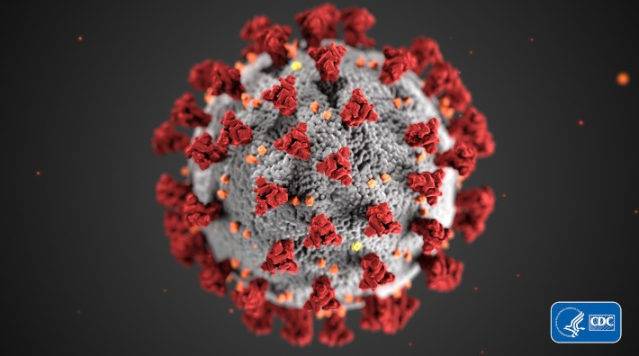
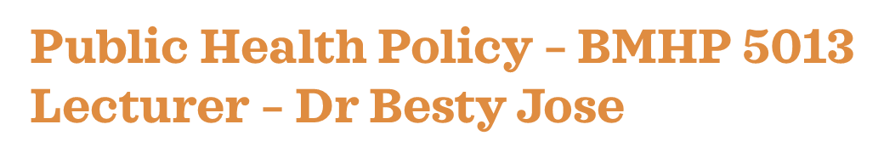
Harun Boksh – 1809605
Rashid Khan – 1809620
Mohammed Belal Ahmed – 1810818
Naazneen Ara – 1810991
Ferdows Jahan Jesi - 1810819
Public Health Policy Presentation

Slide 2
Coronavirus and the BAME GROUP
Introduction by Harun Boksh

Slide 3
An overview of Covid-19 (Coronavirus)
By Harun Boksh
EMERGENCE (COVID-19 & IP 2020).
TRANSMISSION
PEOPLE AT HIGHER RISKS (WHO 2020)

Slide 4
An overview of our target group - People From Ethnic Backgrounds (BAME)
By Harun Boksh
Why people from ethnic backgrounds BAME are negatively affected by covid
(Ahmed ,2020)
(National Institute for Health and Care Excellence 2013).
(Trivedy et al.2020).

Slide 5
Impact of Covid-19 on people from ethnic backgrounds (BAME).
By Harun Boksh
Examining possible reasons why covid 19 is negatively affecting the BAME community. (Siddique et al. 2020).

Slide 6
Purpose of our presentation
By Harun Boksh

Slide 7
the incidence of covid 19 to the bame group
Naazneen Ara
GEOGRAPHICAL DISTRIBUTION
Males in England London had the highest rates followed by the north west, north east, and the west midlands. Southwest had the lowest
Females in England the northeast and the northwest had a higher diagnosis than London but the death rates were the highest in London.
Some of the areas identified as suitable for alternative measures to lockdown include Huntingdon, Bath, Brighton Pavilion, Halifax, Lincoln, Milton Keynes, West Aberdeenshire, and Inverness. (Regional ethnic diversity, 2020)
By contrast, hot spot areas include all London boroughs (across Greater London and Central London), as well as areas in and around major cities such as Birmingham, Manchester, Newcastle and Leeds. (Regional ethnic diversity, 2020)
(De Montfort University Leicester, 2020)

Slide 8
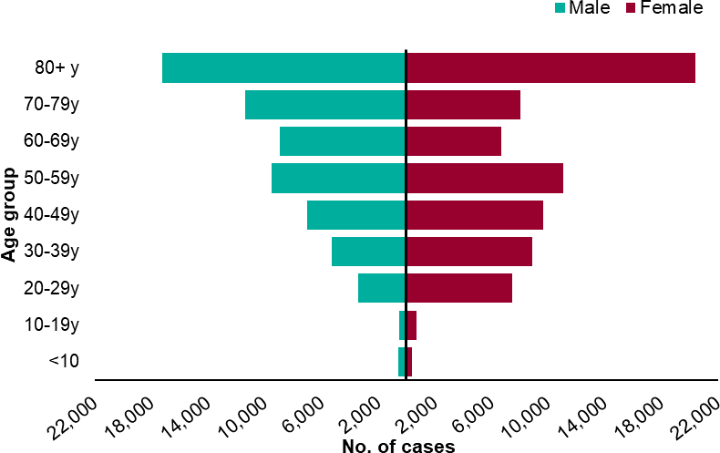
)
TRENDS
Although there is currently insufficient data to determine the exact mechanism between ethnicity and increased Covid-19 death rates, it is important that BAME people, particularly those of black ethnicity, should be considered a risk group for increased death due to Covid-19 in the UK and the US. This will help guide a more appropriate public health response to Covid-19 both at a community and national level. (Razaq et al.2020)
Not all population affected, Death rates from COVID-19 were higher for Black and Asian ethnic groups when compared to White ethnic groups (Razaq et al.2020)
Old age affected (Rasaq et al. 2020)
Males affected. A government review found that the highest age standardised diagnosis rates of COVID-19 per 100,000 population were in people of Black ethnic groups (486 in females and 649 in males) and the lowest were in people of White ethnic groups (220 in females and 224 in males). (Razaq et al.2020) (Wall,2020)
An analysis of survival among confirmed COVID-19 cases showed that, after accounting for the effect of sex, age, deprivation and region, people of Bangladeshi ethnicity had around twice the risk of death when compared to people of White British ethnicity. People of Chinese, Indian, Pakistani, Other Asian, Caribbean and Other Black ethnicity had between 10 and 50% higher risk of death when compared to White British. (Gov, 2020)
(Razaq et al. 2020)
(Razaq et al. 2020)

Slide 9
( Razaq et al, 2020)
INCIEDENT RATES
The UK has a large and diverse Black, Asian and Minority Ethnic community (BAME), which account for around 14% of the population in England and Wales. Worryingly there is early evidence of an association between ethnicity and COVID-19 incidence and adverse health outcomes. For example, observational data from the Intensive Care National Audit and Research Centre, show a third of COVID-19 patients admitted to critical care units are from BAME groups. There are also concerns that healthcare and other key workers who belong to BAME groups are particularly at risk. (Razaq et al. 2020)
(Razaq et al. 2020)

Slide 10
Causes and impacts OF COVID TO THE BAME GROUP
Multi family and multi generational household leading to increase risk of transmission
Living in crowed conditions
Experiencing more poverty which can lead to poorer health generally
Co mobility exposure risks such as diabetes, renal conditions such as kidney diseases, kidney failure, high blood pressure
there is disproportionate BAME employment in lower band key worker roles who either work in high exposure care environments or are unable to implement safe social distancing due to their roles
(World Health Organisation, 2020)
(World Health organization, 2020)

Slide 11
SPREAD
Globally, as of 2:45pm CEST, 11 October 2020, there have been 37,109,851 confirmed cases of COVID-19, including 1,070,355 deaths, reported to WHO.
(World Health Organisation, 2020)
(World Health Organisation, 2020

Slide 12

relevant theories and conspiracies
5g conspiracy (Spring, Wendling, 2020)
Virus escaping from a Chinese lab (Haynes, 2020)
Covid was created as a biological weapon (Haynes, 2020)

Slide 13
Ferdows Jesi
Two key agencies that were involved with the BAME group during covid19
Public Health England (PHE)
Role
Public Health England exists to protect and improve the nation’s health and wellbeing and reduce health inequalities. They do this through world-leading science, research, knowledge and intelligence, advocacy, partnerships, and the delivery of specialist public health services (public Health England, 2013).
Responsibility
making the public healthier and reducing differences between the health of different groups by promoting healthier lifestyles, advising government, and supporting action by local government, the NHS, and the public. (Public Health England, 2013)
protecting the nation from public health hazards. (Public Health England, 2013)
preparing for and responding to public health emergencies. (Public Health England, 2013)
improving the health of the whole population by sharing our information and expertise, and identifying and preparing for future public health challenges (Public Health England, 2013)

Slide 14
Department of Health and Social Care (DHSC)
Role
They support ministers in leading the nation’s health and social care to help people live more independent, healthier lives for longer. The Department of Health and Social Care (DHSC) is a ministerial department, supported by 15 arm’s length bodies and several other agencies and public bodies (Davies et.al. 2014)
Responsibility
supporting and advising our ministers: they help them shape and deliver policy that delivers the government’s objectives
accountability: they always make sure the department and their arm’s length bodies deliver on their agreed plans and commitments. (Davies et.al.2014)
acting as guardians of the health and care framework: they make sure the legislative, financial, administrative and policy frameworks are fit for purpose and work together. (Davies et.al.2014)
Priorities
keep people safe, leading global health and international relations including EU Exit. (NHS Scotland,2016).
keep people healthy and independent in their communities, supporting the transformation of NHS primary, community and mental health services, and local authority public health and adult social care. (NHS Scotland,2016).
support the NHS to deliver high quality, safe and sustainable hospital care and secure the right workforce (NHS Scotland,2016).

Slide 15
Barriers/limitations
Lack of local mental health champions or local community involvement in service development
Fragmentation and cross sectoral responsibility for promoting mental health and wellbeing and preventing mental ill-health.
Limited incentives in multiple sectors to invest in promotion and mental ill-health prevention
Lack of awareness of value of promoting mental health, wellbeing, and mental ill-health prevention (Public Health England, 2019).
Recommendation
There are few recommendations to improve the agencies facilities to support BAME people the agencies should:
Actions to build partnerships across sectors, such as co-locating staff in the same premises or local consultation to achieve early multi-sector buy-in.
Development of cross-sectoral actions as part of health & wellbeing strategi.
Ensuring mental health and wellbeing is well covered in Joint Strategic Needs Assessments (Regan & Elliot, et.al. 2016).
(Public Health England, 2019).

Slide 16
Mohammad Belal Ahmed
LOCKDOWN POLICY
The effects of lockdown on the BAME community.
· Spread of infection
· Housing
· Deprivation
· Education
(GOV UK,2020)

Slide 17
(world economic forum,2020)
The economical effects on the BAME community.
· Loss of earning due to COVID-19 (world economic forum,2020)
· Job loss (world economic forum,2020)
· Financial hardship (world economic forum,2020)

Slide 18
The mental health effect on the BAME community.
· The constraints of quarantine.(Nuffield foundation,2020)
· Face to face support. (Nuffield foundation,2020)
· Physical and mental health. (Nuffield foundation,2020)
· Depression and anxiety. (Nuffield foundation,2020)
Policy to protect BAME staff in the NHS
· Death of staff. (NHS,2020)
· Protection for Dr and nurse. (britishMedicalAssociation,2020)

Slide 19
CONCLUSION
SUMERRISE THE EFFECTS OF CORONAVIRUS ON THE BAME GROUP
Overview of covid-19 effects on (BAME) community
Geographical effects on BAME community
Conspires and theories
(COVID-19: understanding the impact on BAME communities, 2020)
(GOV.UK. 2020.)

Slide 20
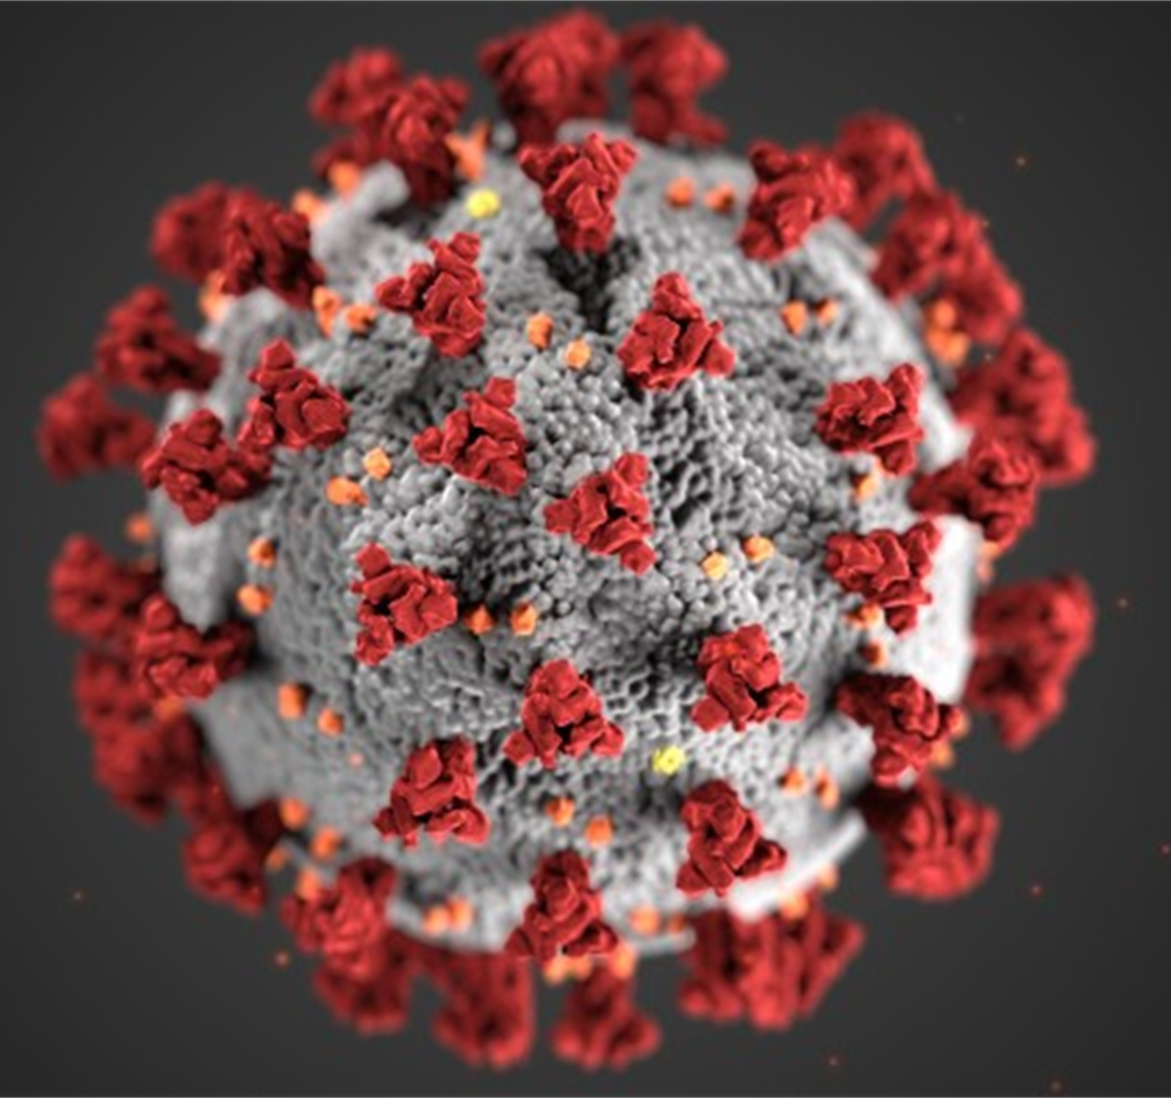
Overview of agencies and policies
Recommendation and policies to protect ethnic minority groups
Implementing a plan for the community
(Sky News 2020)
(

Slide 21

How to stay safe and follow government guidelines
Keeping the future safe
(How is COVID-19 affecting children and young people in BAME communities?, 2020)

Slide 22

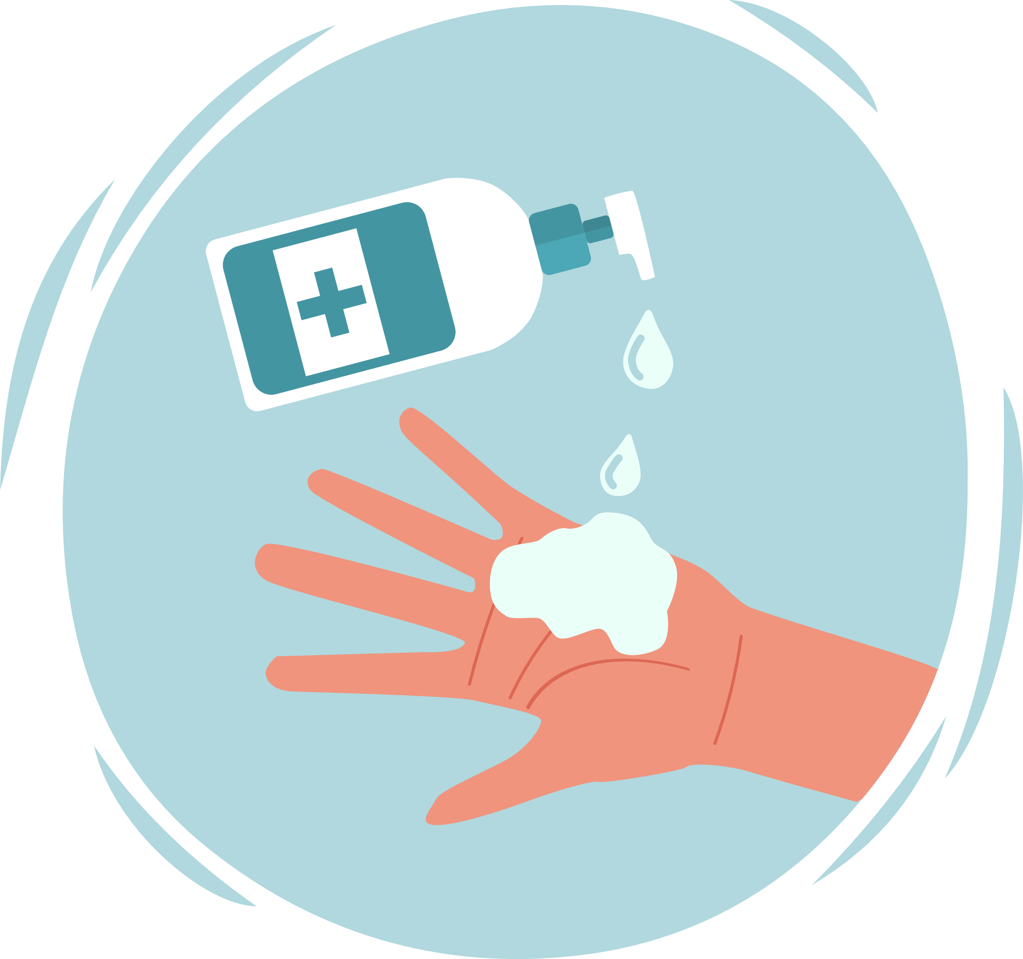






Coronavirus health and safety tips
Wash your hands often
Use hand
sanitizer
Wear a mask
Don’t touch your face
Cover your sneezes
and coughs
Avoid close
contact
Use your own supplies
​Clean your electronics

Slide 23
References
Ahmed M.H. Black and Minority Ethnic (BAME) (2020). Alliance Against COVID-19: One Step Forward. J. Racial and Ethnic Health Disparities (7) pg. 822–828 available at: https://doi.org/10.1007/s40615-020-00837-0(accessed 6th October)
bma.org,(2020). Available at: https://www.bma.org.uk/advice-and-support/covid-19/your-health/covid-19-risk-assessment (Accessed 15th October 2020)
Cambridgeshire County Council (2015). Public Mental Health Strategy 2015 - 2018, Cambridge, Cambridgeshire County Council.
COVID-19 & IPC overview (2020). Available at: https://www.cdc.gov/coronavirus/2019-ncov/hcp/non-us-settings/overview/index.html (accessed 6th October, 2020).
Davies, S. C., Mehta, N. & Murphy, O. (eds.) (2014). Annual Report of the Chief Medical Officer 2013, Public Mental Health Priorities: Investing in the Evidence, London: Department of Health.
De Montfort University Leicester (2020). Research shows 25% of Britain could have avoided lockdown during COVID-19 crisis. Available at: https://www.dmu.ac.uk/about-dmu/news/2020/june/research-shows-25-of-britain-could-have-avoided-lockdown-during-covid-19-crisis.aspx (Accessed at 10th October, 2020)
GOV.UK. 2020. COVID-19: Understanding The Impact On BAME Communities. [online] Available at: https://www.gov.uk/government/publications/covid-19-understanding-the-impact-on-bame-communities [Accessed 15 October 2020].
Haynes, D (2020). Coronavirus: Former M16 boss says theory COVID-19 came from Wuhan lab must not be dismissed as conspiracy. Available at: https://news.sky.com/story/former-head-of-mi6-says-theory-coronavirus-was-made-in-wuhan-lab-must-not-be-dismissed-as-conspiracy-12021693(Accessed 10th October, 2020)

Slide 24
Intensive Care National Audit and Research Centre (2020). ICNARC report on COVID-19 in critical care. Available at:https://www.icnarc.org/Our-Audit/Audits/Cmp/Reports ( Accessed 6thOctober, 2020).
National Institute for Health and Care Excellence (NICE) (2013). BMI: preventing ill health and premature death in black, Asian, and other minority ethnic groups. London: NICE.
NHS Scotland (2016). Good mental health for all, Edinburgh, NHS Scotland. Office of Northamptonshire Police and Crime Commissioner 2016. Press release: Stephen Mold reveals key appointments within Office of Police and Crime Commissioner. http://www.northantspcc.org.uk/stephen-mold-reveals-key-appointmentswithin-office-police-crime-commissioner/, (Accessed at 15th October 2020)
NHS,(2020) Available at: https://www.england.nhs.uk/coronavirus/workforce/addressing-impact-of-covid-19-on-bame-staff-in-the-nhs/ Bmj journals, (2020). https://ebmh.bmj.com/ (Accessed 15th October 2020)
Nuffield foundation,(2020). Available at: https://www.nuffieldfoundation.org/news/depression-and-anxiety-higher-amongst-those-from-black-asian-and-minority-ethnic-backgrounds-during-lockdown (Accessed 15th October 2020)
Razaq A, Harrison D, Karunanithi S, Barr B, Asaria M, Routen A, & Khunti K (2020). BAME COVID-19 DEATHS – What do we know? Rapid Data & Evidence Review. Available at: https://www.cebm.net/covid-19/bame-covid-19-deaths-what-do-we-know-rapid-data-evidence-review/ (Accessed 8th October, 2020)
RCPsych, (2010). No health without public mental health: the case for action. Parliamentary Briefing.
Regan, M., Elliot, I. & Goldie, I. (2016). Better mental health for all. A public health approach to mental health improvement, London, Faculty of Public Health and Mental Health Foundation.
Sky News. 2020. Coronavirus: 'Urgent Action' Needed To Protect BAME Groups From COVID-19, Scientists Say. [online] Available at: https://news.sky.com/story/coronavirus-urgent-action-needed-to-protect-bame-groups-from-covid-19-scientists-say-12020432 [Accessed 15 October 2020].
References

Slide 25
Siddique H (2020). British BAME Covid-19 death rate 'more than twice that of whites'. Available at:https://www.theguardian.com/world/2020/may/01/british-bame-covid-19-death-rate-more-than-twice-that-of-whites (Accessed 7th October 2020).
Spring M, Wendling M (2020). How Covid-19 myths are merging with the QAnon conspiracy theory. Available at: https://www.bbc.co.uk/news/blogs-trending-53997203 (Accessed 10th October, 2020).
The Institute for Fiscal Studies (1 May 2020) - Are some ethnic groups more vulnerable to COVID-19 than others? Available from: https://www.ifs.org.uk/inequality/chapter/are-some-ethnic-groups-more-vulnerable-to-covid19-than-others/ (Accessed 15th October 2020)
Trivedy C, Mills I & Dhanoya O (2020). The impact of the risk of COVID-19 on Black, Asian and Minority Ethnic (BAME) members of the UK dental profession. Br Dent J (228), pg. 919–922. Available at:https://doi.org/10.1038/s41415-020-1781-6
University of Leicester, (2020). Available at: https://le.ac.uk/news/2020/july/lockdown-effects-on-bame-communities Gov uk,(2020). https://www.gov.uk/coronavirus (Accessed 15th October 2020)
Wall, A (2020) Understanding the increased Covid-19 risk in men and BAME communities. Available at:https://www.nursinginpractice.com/clinical/understanding-the-increased-covid-19-risk-in-men-and-bame-communities/ Accessed 8th October, 2020).
WHO (2020) Transmission of SARS-CoV-2: implications for infection prevention precautions. Available at :https://www.who.int/publications/i/item/modes-of-transmission-of-virus-causing-covid-19-implications-for-ipc-precaution-recommendations(accessed 6th October)
WHO (2020) Infection prevention and control during health care when novel coronavirus disease (COVID-19) is suspected or confirmed. Available at: www. https://www.who.int/publications/i/item/WHO-2019-nCoV-IPC-2020.4 (accessed 6th October 2020).
World economic forum,(2020). Available at: https://www.weforum.org/agenda/2020/07/black-asian-minority-groups-lockdown-covid19-coronavirus/ (Accessed 15th October 2020)
World Health Organization (2020). WHO Coronavirus Disease (COVID-19) Dashboard. Available at: https://covid19.who.int/ (Accessed 10th October, 2020)

