Slide 1


BA Computer Games Design
Three Year Undergraduate Programme

Slide 2



TODAY’S PRESENTATION
Course Overview
Course Structure
Skills You Will Learn
Graduate Job Pathways
Contact Us
BA Computer Games Design

Slide 3
BA Computer Games Design
Course Overview

Slide 4
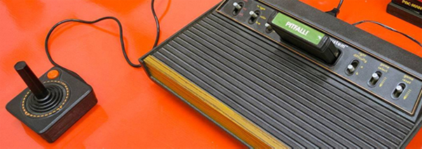
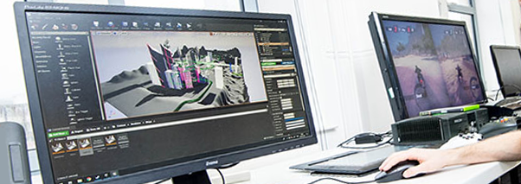
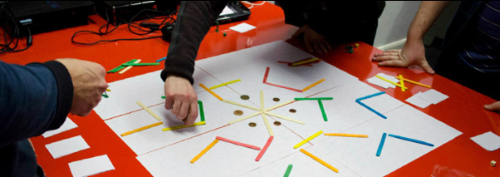
OVERVIEW
The BA Computer Games Design course equips students with the essential skills and practices used within the Games Industry along with the ability to academically analyse and evaluate your own game ideas and designs.
BA Computer Games Design

Slide 5
OVERVIEW
This programme gives priority to the creative exploration of computer games design.
You will be given all the necessary knowledge to develop new and innovative work in the fields of character creation, 3D graphics, animation, character and environment modelling, texturing, interface design, and concept art.
BA Computer Games Design

Slide 6
OVERVIEW
Games mechanics and rule systems are explored often using paper-based concept mock-ups.
You are encouraged to explore and develop your ideas in and around the subject area in a series of thought-provoking contextual study modules that aim to develop skills that are required in life.
BA Computer Games Design

Slide 7
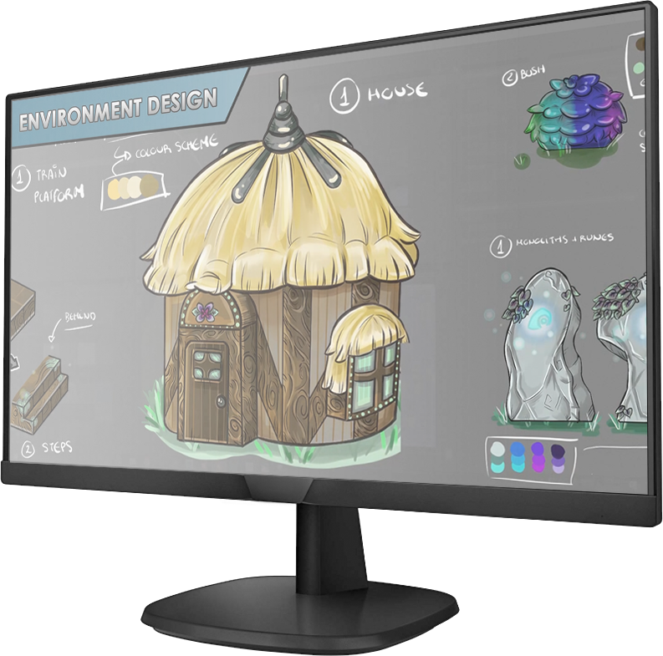
OVERVIEW
BA Computer Games Design showreel
BA Computer Games Design
Notes:
NOTE: VIDEO IS NOT INCLUDED IN PRESENTATION – OBTAIN FILE LOCALLY & PLAY IN A SEPARATE WINDOW!

Slide 8
BA Computer Games Design
Course Structure

Slide 9
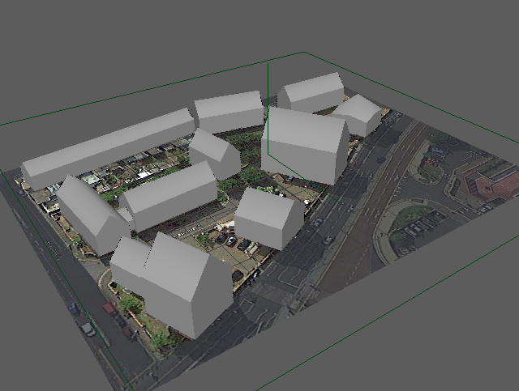
COURSE STRUCTURE
Year 1
Semester 1
Games Design & History
Creative Practice
Learning in the Digital Era
Semester 2
Introduction to Character Animation
Environment and Level Design
Contemporary Challenges: Making a Difference
BA Computer Games Design

Slide 10
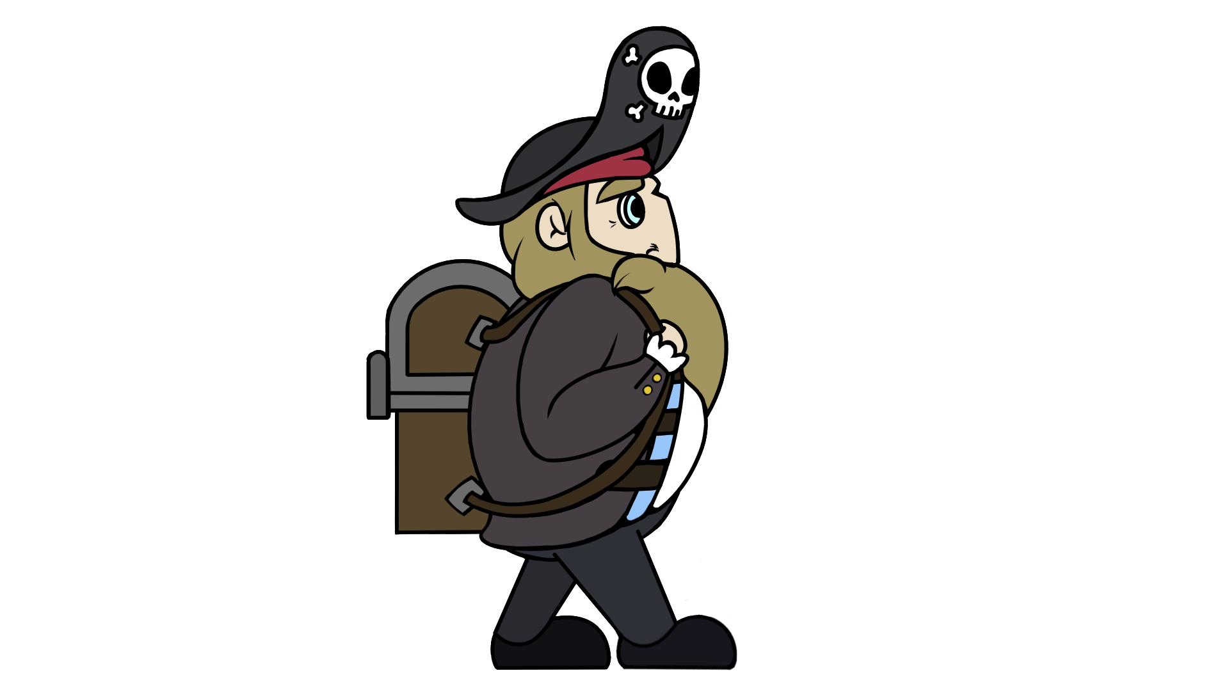
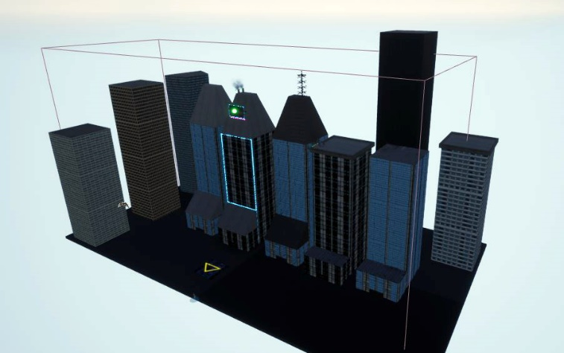
COURSE STRUCTURE
Year 2
Semester 1
Games Design & Asset Creation 1
The Game Designer’s Context
Changemakers: Creativity & Value Creation
Semester 2
Game Design & Asset Creation 2
Indie Game Development
Changemakers: Building Your Brand for Sustainable Employment
BA Computer Games Design

Slide 11
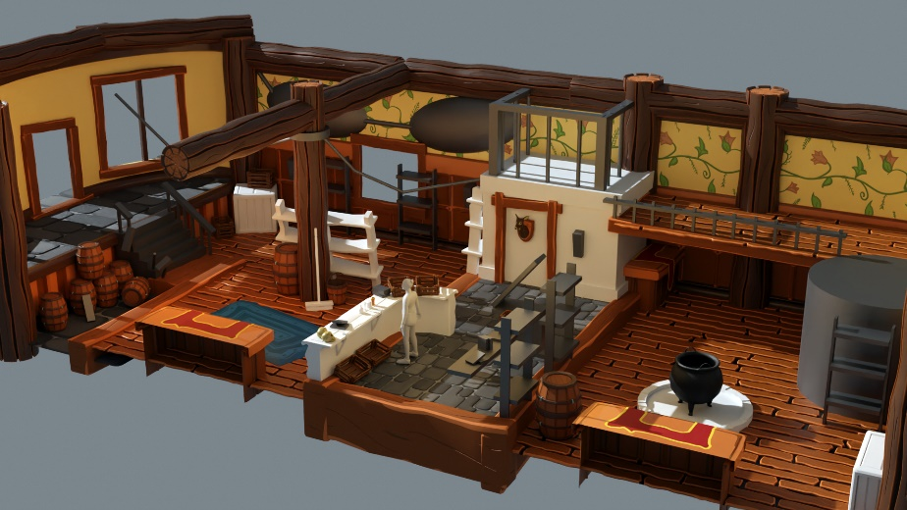
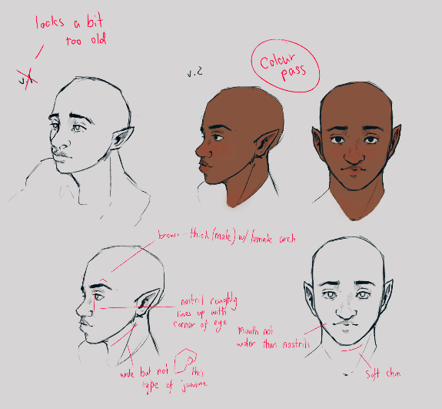
COURSE STRUCTURE
Year 3
Semester 1
Independent Project (Phase 1)
Advanced Character Animation
User Experience Design
Semester 2
Independent Project (Phase 2)
Emerging Trends
Personal Portfolio Development
BA Computer Games Design

Slide 12
BA Computer Games Design
Skills you will learn

Slide 13
SKILLS YOU WILL LEARN
Digital Art Techniques
3D Modelling
Character Development
Rigging/Animating
Game Testing
Game Engine Implementation
Game Design Theory
Team Skills
Confidence Building
Portfolio Development
Self-promotion Skills
Research and analytical thinking
BA Computer Games Design

Slide 14

SKILLS YOU WILL LEARN
The course is also part of Sony Interactive Entertainment’s Global Academic Programme, PlayStation®First. This exciting partnership gives our Computer Games Design students access to PlayStation development tools; the same professional hardware used by game studios around the world to create ground-breaking games on PlayStation.
BA Computer Games Design

Slide 15
BA Computer Games Design
Graduate Job Pathways

Slide 16




GRADUATE JOB PATHWAYS
Our graduates have gone on to work with prominent and successful companies such as:
Rockstar North
Electronic Arts
Criterion
Creative Assembly
Traveller's Tales
BA Computer Games Design
Notes:
being involved with the development of Burnout Dominator, the Harry Potter series, Grand Theft Auto V, Halo Wars 2, Little Big Planet, Alien Isolation and the Lego Star Wars series.

Slide 17

OUR ALUMNI
David Alden
Technical Concept Artist Rockstar North
I wouldn't be where I am now without my time in the Computer Game Design course, which gave me the skills and language to communicate my ideas and methods within the industry, for giving me an amazing knowledge base to build upon, and for the confidence to put my work and myself into the Games industry to continue my career as a Games Artist.
BA Computer Games Design

Slide 18

OUR ALUMNI
Dan Brewer
Senior Designer Creative Assembly
Since I graduated from UWTSD I was lucky enough to start my career as a Designer at Supermassive Games in Guildford before joining Creative Assembly as a senior designer. On the two years that we worked on Halo Wars 2, I took a key role in delivering the core gameplay and multiplayer experience. To this day, I’m enjoying my time at Creative Assembly, everyday using key skills that I picked up during my time at UWTSD.
BA Computer Games Design

Slide 19
BA Computer Games Design
Contact Us

Slide 20
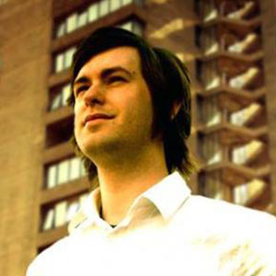
CONTACT
Programme Manager for BA Computer Games Design
Rich Morgan
richard.morgan1@uwtsd.ac.uk
Course Website
BA Computer Games Design
https://www.uwtsd.ac.uk/art-design/games-design/
BA Computer Games Design

Slide 21
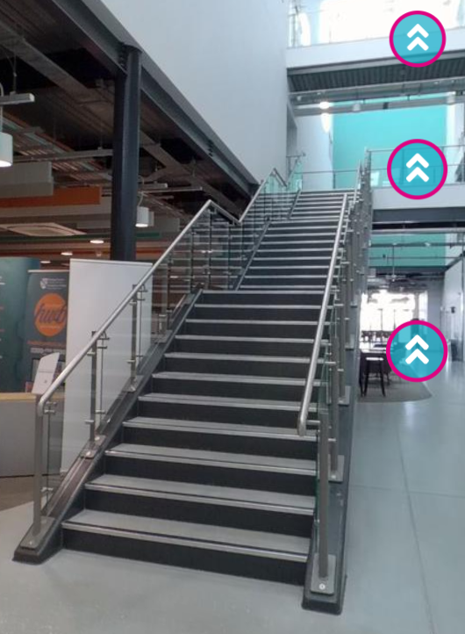
UWTSD VIRTUAL TOUR
Swansea SA1 Campus
IQ Building
https://uwtsdiq.digitise.tours/tour/IQ/0_outside_iq
BA Computer Games Design

Slide 22
BA Computer Games Design
Three Year Undergraduate Programme

