Slide 1

Methods and Search Strategy Academic Poster
Student name: Nazdar Sami
Student ID: 2122282
Module name: Independent Project
Module code:(BMHP6020_BIRM)

Slide 2
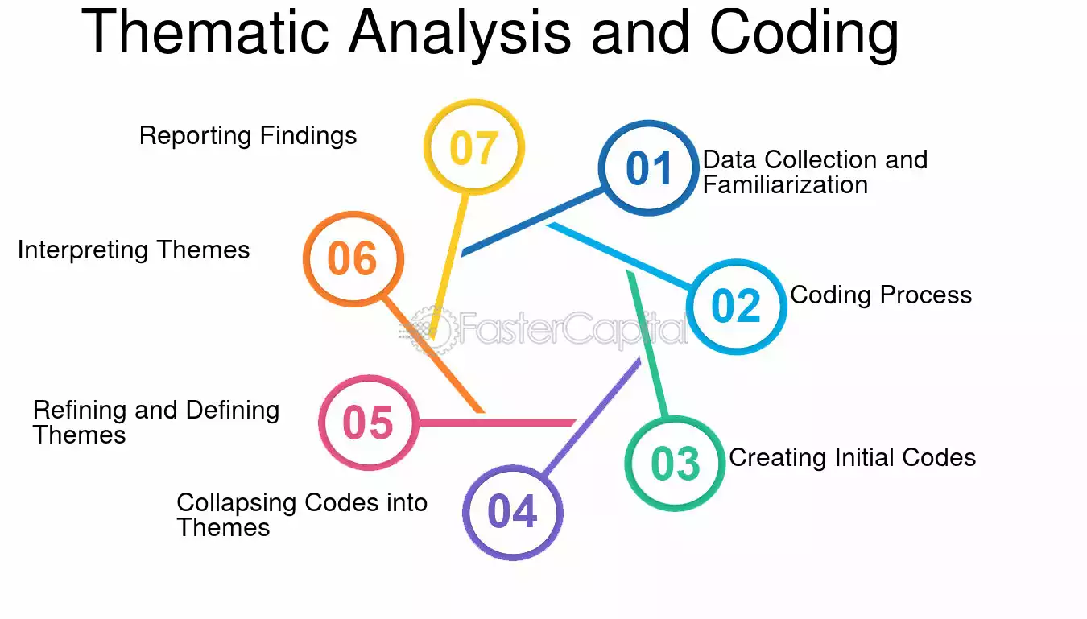
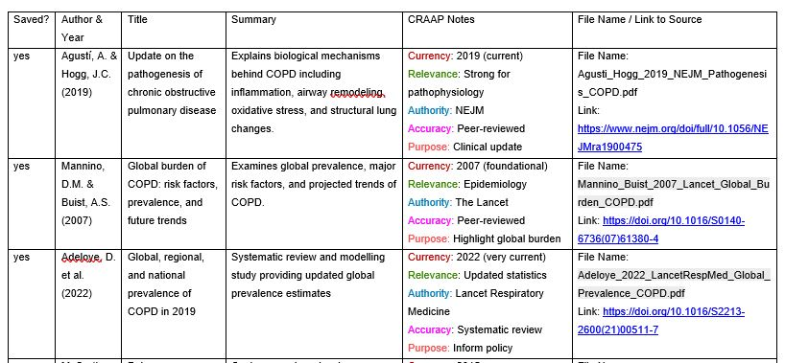
The Effects of Chronic Obstructive Pulmonary Disease (COPD) on the Physical Health of Older Individuals in the United Kingdom
01 Introduction and Research Aim
This poster delineates the methodological framework employed in this independent research endeavour. The research employed a desk-based, secondary analysis to thoroughly investigate the physical impacts of Chronic Obstructive Pulmonary Disease (COPD) on elderly individuals in the United Kingdom. Secondary research facilitates the integration of existing academic literature, governmental documents, and clinical evidence to derive significant findings without the necessity of gathering primary data. The objective of the research was to rigorously analyse the impact of COPD on mobility, functional capacity, and physical independence among older adults in the setting of UK healthcare. A systematic and transparent process was employed to guarantee academic rigour and reproducibility (Braun and Clarke, 2006).
Figure 1 — Overview of Research Focus
This graphic depicts the three fundamental elements of the study: COPD, elderly individuals in the UK, and its effects on physical health.
02 Search Strategy
This poster outlines the methodological approach utilised in this independent research project. The study utilised a desk-based, secondary analysis to comprehensively examine the physical effects of Chronic Obstructive Pulmonary Disease (COPD) on older adults in the United Kingdom. Secondary research enables the synthesis of existing scholarly literature, official publications, and clinical evidence to extract meaningful conclusions without the need for original data collection. The aim of the research was to thoroughly examine the effects of COPD on mobility, functional capacity, and physical independence in older persons within the context of UK healthcare. A rigorous and transparent methodology was utilised to ensure academic rigour and reproducibility (Braun and Clarke, 2006).
03 Searching for Information
Academic sources were obtained from esteemed databases such as PubMed, Google Scholar, and the online library of the University of Wales Trinity Saint David. PubMed was emphasised for clinical and medical studies about COPD diagnosis and management (Celli and Wedzicha, 2019), whereas Google Scholar facilitated wider multidisciplinary enquiries. Filters were implemented to limit findings to peer-reviewed research published in the past decade, authored in English, and centred on human subjects. UK-based research was preferred when feasible to ensure policy relevance (NICE, 2019). A systematic source tracking table was established to document authorship, methodology, and principal findings, thereby improving transparency and organization.
Figure 3 – CRAAP Test Evaluation Criteria screenshot
Figure 2 – Thematic Analysis and Coding Framework
This chart illustrates the three primary themes discerned by thorough thematic classification of the literature.

Slide 3
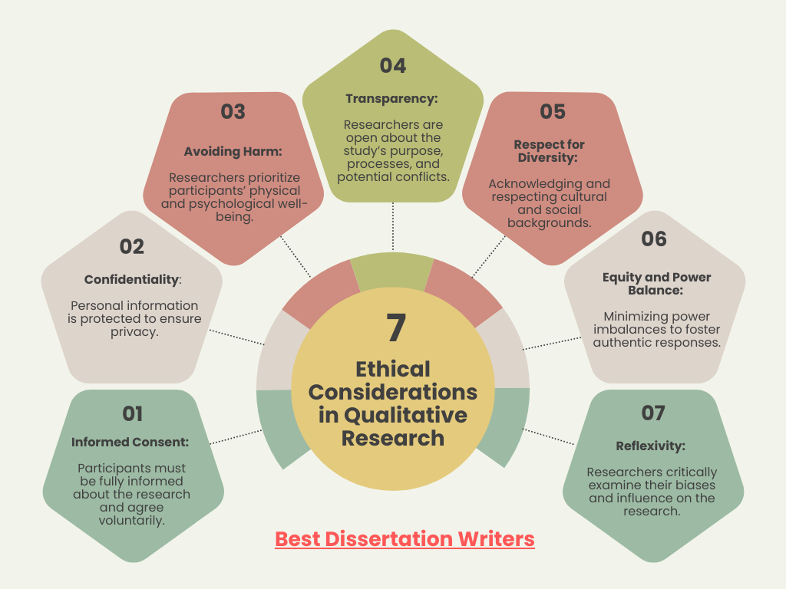
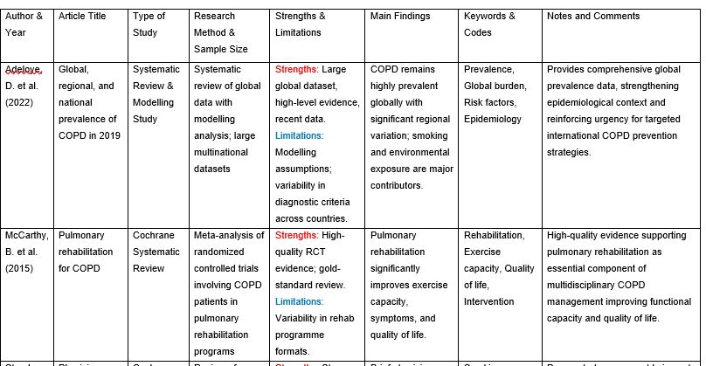
05 Research Validation and Analysis
Validation in secondary research denotes the assessment of the credibility, relevance, and reliability of chosen sources. This study employed the CRAAP test to evaluate Currency, Relevance, Authority, Accuracy, and Purpose (Blakeslee, 2004). Peer-reviewed journal papers and national clinical guidelines were prioritised to guarantee academic rigour. Thematic analysis was employed to systematically discover recurring patterns within the literature, adhering to recognised qualitative methodologies (Braun and Clarke, 2006). This analytical method facilitated the categorisation of linked concepts into cohesive themes, establishing the basis for the findings in Chapter 4. Despite its rigour, secondary analysis is contingent upon the availability and extent of published material.
Figure 4 – Research Validation and Analysis ProcessThis figure summarises the structured stages followed in the secondary research process, from search strategy to results synthesis.
06 Inclusion Criteria
Secondary research validation assesses source trustworthiness, relevance, and reliability. This study assessed Currency, Relevance, Authority, Accuracy, and Purpose using the CRAAP test (Blakeslee, 2004). For academic rigour, peer-reviewed journal papers and national clinical guidelines were emphasised. Following qualitative methods, thematic analysis identified repeated patterns in the literature (Braun and Clarke, 2006). This analytical technique classified connected concepts into cohesive themes, establishing the basis for Chapter 4's conclusions. Secondary analysis relies on resource availability and scope notwithstanding its rigour.
07 Exclusion Criteria
Sources were omitted if they were opinion-based, non-academic, obsolete, or not accessible in full text. Articles published over a decade ago were typically excluded unless deemed seminal or foundational. Studies concentrating solely on drug efficacy, devoid of any mention of physical functioning, were excluded due to their misalignment with the research aims. Non-English publications have been eliminated to guarantee precise interpretation. This exclusion approach improved clarity and precluded the incorporation of irrelevant or methodologically deficient evidence (Celli and Wedzicha, 2019).
08 Ethical Considerations
Ethics in secondary research pertains to upholding academic integrity, ensuring transparency, and exercising appropriate utilisation of published data. This study did not involve direct human participants; hence, official ethical approval was unnecessary. Nevertheless, ethical values were maintained through precise Harvard referencing, the prevention of plagiarism, and the impartial selection of sources. The results were conveyed transparently and without distortion. Incorporating a variety of opinions in the literature mitigated bias. Compliance with established academic norms enhanced the reliability and credibility of the research process (Braun and Clarke, 2006).
Figure 5 - Ethical Considerations in Secondary Research
This figure delineates the fundamental ethical standards employed to guarantee transparency, integrity, and appropriate utilisation of released data.
Results summery table screenshot
https://bestdissertationwriter.com/ethical-considerations-in-qualitative-research/

Slide 4
References
Adeloye, D., Song, P., Zhu, Y., Campbell, H., Sheikh, A. and Rudan, I., 2022. Global, regional, and national prevalence of, and risk factors for, chronic obstructive pulmonary disease (COPD) in 2019: a systematic review and modelling analysis. The Lancet Respiratory Medicine, 10(5), pp.447–458.
Blakeslee, S., 2004. The CRAAP test. LOEX Quarterly, 31(3), pp.6–7.
Braun, V. and Clarke, V., 2006. Using thematic analysis in psychology. Qualitative Research in Psychology, 3(2), pp.77–101.
Celli, B.R. and Wedzicha, J.A., 2019. Update on clinical aspects of chronic obstructive pulmonary disease. New England Journal of Medicine, 381(13), pp.1257–1266.
Garcia-Aymerich, J., Lange, P., Benet, M., Schnohr, P. and Antó, J.M., 2006. Regular physical activity reduces hospital admission and mortality in chronic obstructive pulmonary disease: a population based cohort study. Thorax, 61(9), pp.772–778.
National Institute for Health and Care Excellence (NICE), 2019. Chronic obstructive pulmonary disease in over 16s: diagnosis and management (NG115). Available at: https://www.nice.org.uk/guidance/ng115 (Accessed: 23 November 2025).
Soriano, J.B., Kendrick, P.J., Paulson, K.R., Gupta, V., Abrams, E.M., Adedoyin, R.A., Adhikari, T.B., Advani, S.M., Agrawal, A., Ahmadian, E. and Alahdab, F., 2020. Prevalence and attributable health burden of chronic respiratory diseases, 1990–2017: a systematic analysis for the Global Burden of Disease Study 2017. The Lancet Respiratory Medicine, 8(6), pp.585–596.
Faster Capital, (n. date), The Process Of Thematic Analysis, Available At: https://fastercapital.com/topics/the-process-of-thematic-analysis.html/1 (Accessed on 25 Feb. 2026).
Bestdiss ertation writer, (2024), 7 Crucial Ethical Considerations in Qualitative Research You Must Know to Avoid Pitfalls, Available At: https://bestdissertationwriter.com/ethical-considerations-in-qualitative-research/ (Accessed on 25 Feb. 2026).

