Slide 1
Psychology & Counselling:
TEN Minute Tutorials:
Identifying a Research Idea
Presented by Dr ceri Phelps

Slide 2
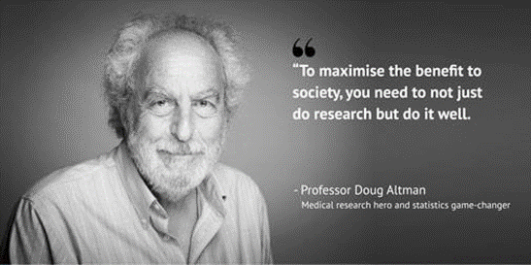
Doing “good” research

Slide 3
Ideas for Research: Getting Started
Often seems overwhelming
Don’t be (too) overwhelmed by the amount of information already out there
Pick a topic that interests you:
  By group e.g. racial group, firemen, lay public
  By behaviours e.g. binge-drinking, memory recall
  By topic e.g. prejudice, mental health

Slide 4
Ideas for Research: Getting Started
Read up on your topic
  But not too much! Get a solid background, but you will never be able to read everything that might be relevant
  Make notes as questions occur to you
  Try to focus
Keep an open mind
  Let your reading show you the way
  Think in a critical manner:
  Why did they do it that way?
  How can I add to what has already been done?
Focus
  Don’t try to cover too much ground at once - some questions may have to wait

Slide 5
“Doing” primary research
Wide range of methods to use when doing research e.g:
Talking to people (interviews, discussion groups)
Giving people questionnaires (measuring attitudes, feelings, health etc.)
Intervention research (implementing something new and seeing if it works)
Experimental research (testing or manipulating things in a controlled setting)

Slide 6
Choice of study design
Qualitative or quantitative?
Applied or Experimental?
Online study?

Slide 7
Think about the questions you want to ask
Choosing appropriate questions/measures for your study is another vital aspect of study design
Need to think carefully about what it is you actually want to measure (think about your operational definition!) and what the best way of measuring this is....
Measures capturing psychological constructs are expected to be reliable and valid.

Slide 8
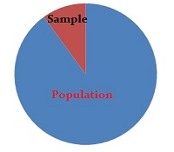
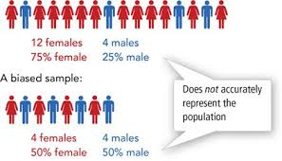
THINK ABOUT WHO YOU WANT YOUR PARTICIPANTS TO BE (Choosing your target population & representative sample)

Slide 9

What is the “evidence gap” you are trying to fill?
Any research study can only be viewed as a piece of a mosaic – the pattern only emerges when standing and looking at the whole evidence base of existing research

Slide 10

FINALLY – SET YOURSELF AN ACHIEVABLE PROJECT AND BE OPEN ABOUT IT LIMITATIONS!

