Slide 1
Amran Nur 2210674
Ashlene Barnes 2208278
Jamie Jones 2210063
How do students use technology to collaborate at UWTSD?
Ashlene

Slide 2
Introduction
The purpose of this presentation is to find out from our students on campus if they believe the question at hand to be effective to them and their learning here on campus, the question we will be asking is :
Is there a need to provide training on how to use technology to collaborate at UWTSD?
amran

Slide 3
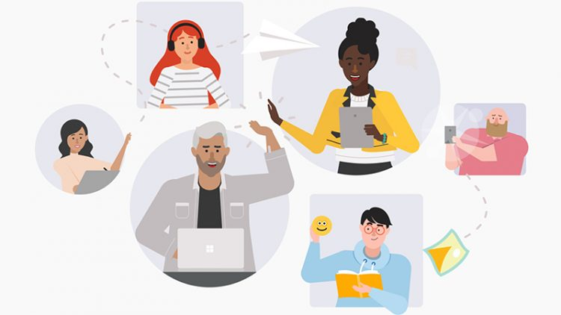
Verner (2019)

Slide 4
Rationale
According to an article on the BBC ‘Students need to learn digital skills in school to help them be more employable in the future, the education secretary has said’. BBC (2016)
According to an article on the BBC ‘ It becomes a race between digital skills and technology: the faster it advances, the quicker we have to update our skills’ Zhou (2022)
Article on the BBC called ' Is technology transforming schools' states ''Great teacher use technology to do even greater things, they use the technology as a bridge'' Jones (2012)
jamie

Slide 5
Proposed Method
Do you feel able to use MS Teams to collaborate with others at UWTSD? Yes Or No
Would you like to have some training on how to use the OneDrive to collaborate with other? Yes Or No
Would you like to have training on how to use MS Teams to collaborate with others?
Rank these applications in order according to which you would like to have training on how to use? MS Teams, OneDrive Ms Word, Whatsapp and Moodle.
I feel that I am able to use a range of different digital tools to collaborate. Strongly Agree Agree Disagree Strongly Disagree
We will be asking students on campus, in a survey by using MS Word.
Amran

Slide 6
Ethical Consideration
Consent
Data Protection
Integrate
Confidentiality
Anonymously
Different genders
Diversity
ashlene

Slide 7
Research Timetable
Week 7- Collect data from students on campus, using a survey.
Week 8 Analyse Data discus within our group
Week 9 & 10 Write a full final Report
Jamie

Slide 8
Hypothesis
Our Hypothesis is training on how to use technology is paramount and there is a definite need for it here at UWTSD, Without this knowledge we believe it will make learning very difficult for students.
Amran

Slide 9
Reference List
BBC (2016)‘Pupils more employable learning digital skills in schools’
http://news.bbc.co.uk/today/hi/today/newsid_9781000/9781006.stm
Rory Cellan Jones (2012) 'Is technology transforming schools'
https://www.bbc.co.uk/news/uk-wales-politics-37429889.amp
Jared Verner (2019) UCCS adopts Microsoft Teams as designated collaboration platform – UCCS Communique
Ying Zhou (2022) ‘ Why digital literacy is now a workplace non-negotiable’
https://www.bbc.com/worklife/article/20220923-why-digital-literacy-is-now-a-workplace-non-negotiable
Ashlene

