Slide 1
Wellbeing and Performance
Julie Thomas

Slide 2
By the end of today’s session you will have:
A good understanding of how managers can support the wellbeing of their staff
A good awareness of how wellbeing affects performance
An enhanced appreciation of the importance of emotional intelligence skills in maintaining wellbeing

Slide 3
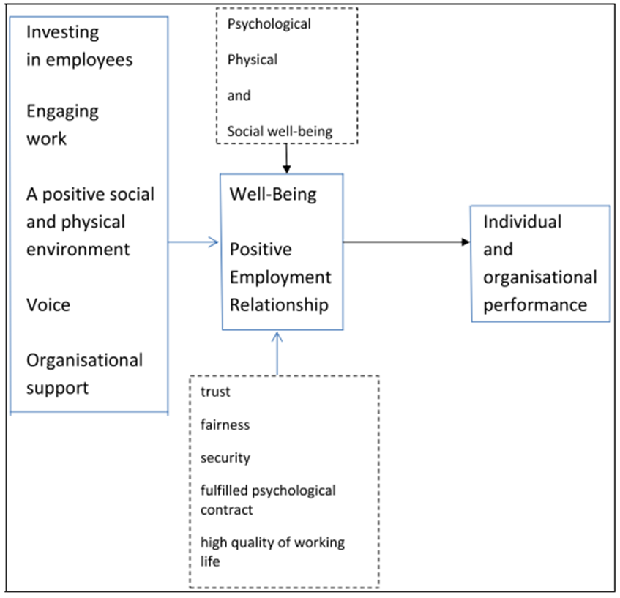
HR Practices that Promote Wellbeing - Guest (2017)

Slide 4
6 Steps to help your team thrive in work (CIPD, 2020)
Get to know your team better
Lead by example to promote healthy working habits
Review workloads, duties and responsibilities
Reflect on your own management style
Discourage presenteeism in your team
Manage the mental health of your team while remote working

Slide 5
Four Core EI Skills (Bradberry, 2020)
Self-Awareness is your ability to accurately perceive your emotions and stay aware of them as they happen.
Self-Management is your ability to use awareness of your emotions to stay flexible and positively direct your behaviour.
Social Awareness is your ability to accurately pick up on emotions in other people and understand what is really going on.
Relationship Management is your ability to use awareness of your emotions and the others’ emotions to manage interactions successfully.

Slide 6
Activity
Read the CIPD Document.
Critically analyse the importance of having strong emotional intelligence skills to carry out each step successfully
Keep your notes to underpin points in your assignment

Slide 7
Role of Emotional Intelligence
Managers and employees need to be aware of their emotions and ability to regulate them. They need to practice self-care.
They need to use this awareness to manage their relationships with other people.
Managers have the ability to influence employees wellbeing – they can use their EI skills to provide the right support for individuals.
Employees with good EI skills will be more resilient, suffer less stress and have an enhanced sense of wellbeing.

Slide 8
Group Activity
Search the library catalogue for articles that link wellbeing and performance/productivity – what are their conclusions?
Search the internet for wellbeing initiatives and find good organisational examples, where the business benefits are discussed.
Report back your findings.

Slide 9

This year’s theme is movement: moving more for our mental health.

Slide 10
Mental Health Awareness Week - 2024
This year the theme is ‘movement’.
How is your employer supporting this theme? If they are not, how could they support it?
What wellbeing initiatives would you like to see introduced at your work?

Slide 11
Increasing Resilience
‘Bounce-backability’
Ability to recover quickly from set-backs, manage stress
Change the narrative – write about your experiences, think about the positives that have come out of it
Face our fears – expose yourself in small doses to experiences that you fear, e.g. public speaking
Practice self-compassion – recognise your feelings (be mindful); recognise that others sometimes feel that way; be kind to yourself (ask yourself, how would you treat a friend who was feeling this way?)
Meditation
Cultivate forgiveness – let go of grudges
(Newman, 2016)

Slide 12
Activity – Practising Gratitude
One way of building resilience and coping with life’s ups and downs is to recognise what’s good about your life right now.
Name three things that you are currently grateful for – e.g. your warm house.
Every night, look back on the day and think about what you’re specifically grateful for – e.g. that you felt well, that your children seemed to have a good day in school, that you made a customer smile.
Building up a reservoir of good thoughts, helps you deal with the bad times. We’ll come back to this in the session on ‘positive psychology’.

Slide 13
Resources
CIPD and Mind People Managers’ Guide to Mental Health
CIPD: Getting the most out of remote working top tips
Acas: Supporting mental health in the workplace

