Slide 1
Why does the NHS need to change

Slide 2
The Welsh Assembly Government's One Wales Strategy document determined that the delivery of the NHS in Wales needed redesign to improve health outcomes and ensure that the NHS delivers care effectively with its partners.
Since then the Prudent healthcare Agenda has been produced

Slide 3
Why is this important?
The period from 2015 to 2020 is likely to be the most challenging ever faced by the NHS. The Conservative Government is attempting to deliver significant reforms, most notably through changes to enable seven-day working. All of this is being attempted at a time of financial constraint, while simultaneously implementing the recommendations of the Five Year Forward View, which is ambitious even when taken in isolation. How the NHS responds to these reforms and challenges will be critical to its long-term success.

Slide 4
Nuffield Trust
What will we offer?
There has never been a more important time for
independent scrutiny of government policies and the
performance of the system.
1

Slide 5
We will continue to provide this, as well as opportunities for policymakers,
practitioners and others to come together to develop solutions.
Our focus will be on improving the quality of policy-making by
providing evidence-based analysis, asking insightful questions and
providing a challenging view. Our independence puts us in an important
space to challenge orthodox thinking and hold policy-makers to account.
Our focus extends beyond England into the UK where we have a
history of providing comparative analyses of the performance of the
four UK health services. We will continue to provide this.
Find out more about our projects in this area:
www.nuffieldtrust.org.uk/reform

Slide 6
Challenges
A growing older population,
More people living with chronic conditions,
Challenges in providing timely, effective and cohesive services in rural locations,
Increasing obesity rates and
Low levels of physical activity,
Service targets and a challenging financial climate, are just some of the major challenges
.

Slide 7
NHS need to provide:
more care closer to people’s homes and more self-care programmes to help people live more independent lives,
provide more joined up services between health and social care, and increasingly focus on public health, creating a wellness service, rather than a sickness service.
It means a shift in the balance of care, looking at whole systems rather than just hospitals. There is a strong emphasis on public health and long-term planning. (Source:NHS in Wales: Why we are changing the structure. Welsh Assembly Government October 2009)

Slide 8
For its part, the Labour party - both in Cardiff and Westminster - has repeatedly defended its record by claiming it is difficult to compare the NHS in England with its counterpart in Wales.

Slide 9
Comparisons between England and Wales are difficult but some can be made.
Last year the Nuffield Trust and Health Foundation published a study taking the long view of NHS performance across the four countries using around 20 comparable indicators of performance, from patient satisfaction to ambulance response times.

Slide 10
The overall conclusion was that performance across all four countries had improved at more or less similar rates over the 2000s as a result of the huge boost in funding when government investment in the NHS doubled in cash terms in all countries.
No one country consistently lagged behind or outperformed another, once relative starting points were taken into account.

Slide 11
However, England and Wales differ in many ways as countries, and since 1999 their two health services have been separately run. So it shouldn't be very surprising that there are some important differences. They flow from four factors:

Slide 12
The structure and management of the service
Wales doesn't have the "purchaser-provider split" - the internal market where parts of the English NHS buy services from other parts. Instead the Welsh NHS operates through integrated health boards. Unlike England, it makes very little use if any of the private sector. However, our conclusion in the Four Countries report was that much as this kind of structure is debated and focused on by analysts and politicians, it has very little impact on relative performance. Of much greater importance are:

Slide 13
Population differences
The Welsh population is older, sicker and has more deprivation than the population of England. All these factors affect people's health and therefore mean greater demands on the Welsh health service. Any comparisons need to take this into account. There is also an inherent unfairness in comparing performance for a population of three million with that for one of 54 million.

Slide 14
So comparing Wales with an English region is likely to be fairer, although not straightforward, which is why we used the North East of England as a comparator in our report where possible. Its population characteristics are much closer to those of the devolved countries than England as a whole.

Slide 15
Policy priorities
The devolved government in Wales has used its powers to set different priorities and a different tone from its London counterpart. It has emphasised prevention and public health more than England. Meanwhile, it came later to introducing goals on waiting times, and over the last decade it did not adopt the emphasis of the English NHS on enforcing these through "targets and terror", as the English performance management regime has become known.

Slide 16
Investment decisions
Difficult decisions have been required since 2010 and the start of austerity.
Different approaches have been adopted. England (and Scotland) have protected NHS spending which has seen some small real terms growth over the last four years.
Not so in Wales, where health spending has been cut in real terms by 4.3% between 2009/10 and 2012/13, although there have now been further cash injections in 2014/15 and planned for 2015/16 to reverse this trend.

Slide 17
On the other hand, England has cut government grants to local authorities, resulting in a 16% reduction in funding for social care for the over 65s - a cause of some anxiety. In Wales, local authority spending has held up, although this is now planned to change. Wales has chosen to prioritise its spending differently within the health sector, adopting policies like free prescriptions and car parking.

Slide 18
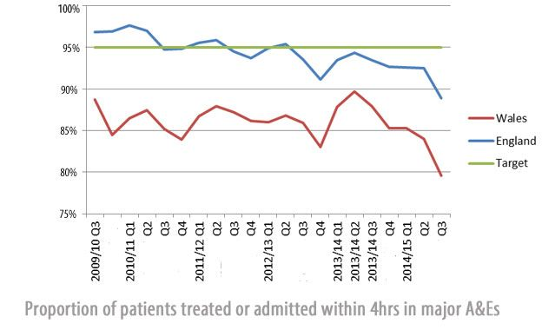
The collective impact of different populations, policy choices and investment decisions on recent performance can be seen in the following graphs.
Since 2010, Welsh performance on waiting times for planned hospital admissions, A&E, and ambulance response times has deteriorated significantly, more so than in England, although A&E performance and ambulance response times have been falling there too.

Slide 19
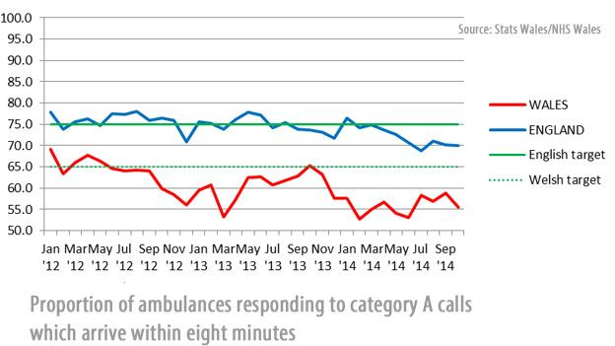

Slide 20
The collective impact of different populations, policy choices and investment decisions on recent performance can be seen in the following graphs.
Since 2010, Welsh performance on waiting times for planned hospital admissions, A&E, and ambulance response times has deteriorated significantly, more so than in England, although A&E performance and ambulance response times have been falling there too.
Since 2010, Welsh performance on waiting times for planned hospital admissions, A&E, and ambulance response times has deteriorated significantly, more so than in England, although A&E performance and ambulance response times have been falling there too.

Slide 21
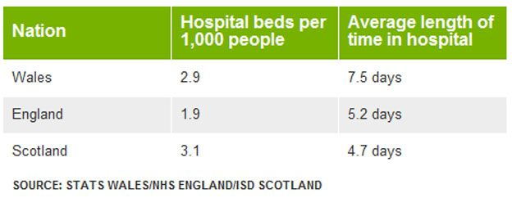

Slide 22
Both facts suggest that there may be significant scope for Wales to improve how people flow through the system, saving patients' time and increasing efficiency.
These figures suggest that despite its different decisions focused more outside hospitals, Wales has not so far moved ahead on reducing reliance on inpatient care and treating more people at home.

Slide 23
The prospects for the Welsh and English health services will continue to depend on population pressures, policy choices and, perhaps critically over the coming five years of austerity, investment decisions and the continued ability of the service to make savings.

Slide 24
Between 2009/10 and 2012/13 (the latest year for which comparable figures are available) Wales was the only country in which total identifiable health spending fell, from £6.28bn in 2009/10 to £6.01bn in 2012/13 (at 2012/13 prices).

Slide 25
In contrast spending in England rose slightly from £101.6bn to £102.2bn.
In both countries spending per head fell, reflecting growing populations, but that in Wales fell by 5.4% (from £2,066 to £1,954 per head at 2012/13 prices), compared with only 1.8% in England.

Slide 26
The picture may be even worse for Wales. The graph below examines how spending per head changes if it is adjusted for the different age groups in the population.
For example, if we know that a 30-year old tends to need 40% more healthcare than a 16-year old, we count the 30-year old as 40% more "population" among whom spending needs to be divided up.

Slide 27
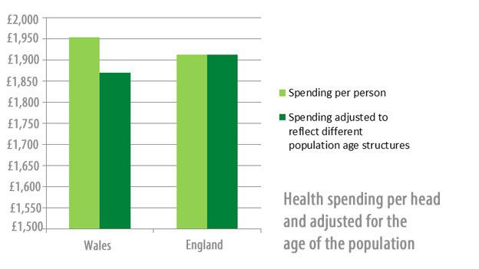

Slide 28
After allowing for Wales' older population, it appears to spend less than England per "age adjusted person".
Notably, the NHS in Wales spends considerably less per person than North East England or Scotland, which have somewhat comparable populations. The gap with Scotland may be partly explained because the Barnett formula, which distributes funding across the devolved governments, does not take into account similarities or differences in population need.

Slide 29
It is hard not to conclude that such relative spending trends have had an adverse impact on service delivery, despite the savings made and the continued investment in social care.

Slide 30
Edwards, N. (2015) The Challenges of Change in the NHS in Wales. Nuffield Trust.:

