Slide 1

Social Transitions in Adolescence
Lecture 6

Slide 2
Aim of the Lecture
Amcanion y Ddarlith
Discuss some of the social transitions that occur during adolescence.
Discuss theories relevant to the social transitions.
Discuss cultural/historical differences in social transitions.
Explore elements of social transition such as financial freedom and access to technology

Slide 3
Historical View of Adolescence
Barn Hanesyddol am Lencyndod
Aristotle claimed that there were specific time periods of human development – infancy, the first seven years of life; boyhood (note, gender specific) age seven to puberty and young manhood, puberty to age 21 years.
Aristotle described this final period as a time when youth – whom he regarded as unstable, impatient and lacking in self control, need to replace these negative characteristics with more positive ‘adult’ ones of self control, self determination.

Slide 4
Along with the biological and cognitive changes of puberty, changes in social roles and status constitute yet another universal feature of development during adolescence.

Slide 5
TASK
In pairs – 5 minutes
Make a list of some of the social relationships a young person may encounter.

Slide 6
Social relationships
Youth workers
Teachers
Religious leaders
Neighbours
Health-workers – doctors, dentists, psychologists etc.
Sports coaches/music teachers etc.
Employers and work colleagues
Shop-keepers
Best friends
Close friends
Acquaintances
Peer groups
Crowds
Intimate relationships
Siblings
Parents/step-parents etc.
Extended family – cousins, grandparents,
aunts/uncles

Slide 7

The transition to social independence
In adolescence, there is a need to begin to develop skills of getting to know strangers and people in a wider social network.
There are a number of challenges in doing this which include:
Transport to places where other people are
Trusting new people
Trusting your own judgement instead of relying on adults to tell you who is OK
Facing up to being new or uncertain about the rules and norms of a new group
Being willing to learn new things and to change
Learning how to be sensitive and responsive to different people – developing social skills and empathy
Deciding on your own values and assessing the value of social influence
Sharing personal issues and coping with rejection or betrayal, risking making mistakes, coping with a feeling of exposure

Slide 8

Friendship
In pairs discuss what are some of the functions of friendship?

Slide 9
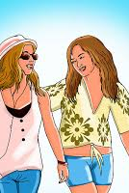
Friendship
Functions of friendship
Companionship
A reliable alliance
Help
Intimacy
Self-validation
Emotional security
Mendelson and Aboud (1999)

Slide 10
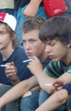


Popularity and friendship
Many different routes to popularity, fitting in and being accepted – can include:
Similar grades, similar interests
Having social skills and empathy towards others, confidence without being conceited
Anti-social behaviour can be bonding
Shared attitudes towards school or education
For boys, athletic prowess and competence, or being physically strong and aggressive
Attractiveness for girls
Sharing behaviours such as smoking or alcohol use, being similar on mental health issues (eg. equally depressed)
We are more subject to peer group influence in early adolescence and move towards more independence of thought as we get older

Slide 11
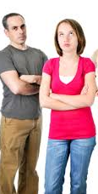
Young people’s relationship with parents
May be influenced by whether or not parents have had time for them as they were growing up, affecting whether they turn towards others in adolescence
Parents important re: career and educational choices; friends re: fashion, leisure and social dilemmas (Hendry et al, 1993)
Parents may be more influential on core values (Cotterell, 2007)
The stability and continuity that parents can offer well into the twenties makes a huge difference to young people’s journey into adulthood. (Graber and brooks-Gunn, 1996).
If parental support is low, peer influence will be stronger, and there are likely to be more problem behaviours, anxiety and depression.

Slide 12
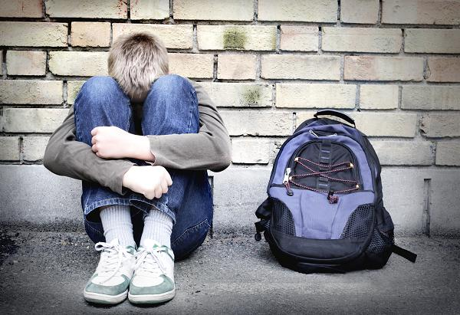
Being alone
Young people who are on their own will be so for a variety of reasons:
Some who cope well – young people get better at handling loneliness as they get older
Some who have moved location and come into new school or neighbourhood
Some who become more sociable as they mature
Some who have few social skills and become withdrawn
Some who are aggressive eg, boys with ‘hostile attributional bias’ or as girls, with ‘relational aggression’ (manipulative, verbally bullying etc) (Crick and Dodge, 1994,1996)
Some who become targets of bullies in a cycle of victimisation (Graham and Juvonen, 1998)
Some who have unusual behaviours, mental health problems, disabilities or deformities
Rejection is likely to be associated with depression, anxiety, low self-esteem and poor academic performance.
Teaching social skills and how to read non-verbal behaviour cues, and bringing young people together to learn to understand each other can be helpful.

Slide 13

Social identity theory
Tajfel’s (1978) research into prejudice and stereotyping suggested that when people feel under threat (such as when young people are undergoing a transition and feel vulnerable) they are keen to belong to a high-status group and may denigrate others in the ‘out-group’.

Slide 14
Gender, culture and social support
Girls more likely to seek help for problems and stress, more likely to be dependent on close friends and parents for help even when these relationships are part of the difficulty
Boys and young men likely to be at risk because they don’t seek help and bottle things up
(Coleman, 2011)

Slide 15
Social identities
Transitions to adult social identities will vary in how difficult they are
Sexual and gender identity which goes against family expectations – such as coming out as gay or becoming a parent at a young age can be challenging, depending on the nature of the family, peer and neighbourhood support, including housing and finance.

Slide 16
Social Transitions
Relationships with Parents
Rise in conflicts between parents and adolescents
Usually over ‘everyday’ issues such as Chores.
  Why?

Slide 17

Social Transitions
Newidiadau Cymdeithasol
Steinberg (1990) – only 5-10% of families experience a substantial deterioration in parent/child relationship at this stage.
More distress to the parent than the teenager (Dekovic, 1999)

Slide 18
Social Transitions
Newidiadau Cymdeithasol
One plausible explanation for this conflict is the change in social role both anticipated by the parent and perceived by the adolescent.

Slide 19
Changes in Social Status
Newidiadau o ran Statws Cymdeithasol
Steinberg (1993) two-sided alteration in status.
Adolescent is given certain privileges and rights normally reserved for adult members of society
However these increased powers and freedom are generally accompanied by increased expectations for self-management, personal responsibility and social participation.
This double shift is found in all societies across a variety of interpersonal, political, economic and legal arenas.

Slide 20
Changes in Interpersonal Status
Changes in interpersonal status
Seen as they are entering the last stage of an apprenticeship into adulthood, so responsibilities altered.
  More chores (especially for males) – preparation for their role as breadwinner
  University
  Expectations of course, the spiralling cost of setting up home may mediate against total independence.

Slide 21
Let’s consider the previous lectures
Several studies have shown adolescence to be beginning earlier – physically and socially
However in terms of social transitions in contemporary society, these are taking place significantly later.
  e.g. Work – could leave school at 15 in the 1960’s
Does this mean social transitions have an impact on the timing of adolescence?

Slide 22
Changes in Political Status
In one sense ‘coming of age’ meant attaining the right to vote – now in the UK and in the USA it is 18, but was 21 years.
Was viewed as an important symbol of adulthood – now???

Slide 23
Legal Status
Age of criminal responsibility?
Freedom to sign legal documents?
Driving licence?
Marriage – same or opposite sex?
Sexual consent?
Alcohol?

Slide 24
Rites of passage to adulthood
Apart from legal and political status, Western cultures do not ‘celebrate’ this transition period.
In some cultures religious ceremonies/rituals take place to mark the transition to young adulthood, sexual maturation
  Bar Mitzvah
  Bart Mitzvah
  Head shaving
  Circumcision (males and females)
  Separation ceremonies

Slide 25
Other markers – School
Move from primary to secondary school
Can be seen as both positive and negative (Dowling, 1980)
Moreover, a move from being ‘a senior’ from primary school to a new school surrounded by what appears to be teenagers who appear to be a lot older and crucially more confident may lead to strain and a loss of esteem (Wall, 1977) and according to Rice (1999) give rise to truancy and behavioural challenges in a school environment.

Slide 26

Other markers – Entering work
Obtaining work has a massive impact on a young person’s self-esteem and independence (Prause and Dooley, 1997).

Slide 27
Annett (2009) ‘Whatever work younger people may have contributed as children, adolescence is a time when work expectations grow more serious, as the adolescent prepares to take their place as full members – which always means, working members, of their culture.’

Slide 28
Jones (1995) & Coles (1995)
The school to work transition, where an individual leaves full-time education and enters the labour market.
The domestic transition in which young person attains (relative) independence from their family of origin.
The housing transition, involving a permanent move away from parental home.

Slide 29
All very well, but what about those who for whatever reason are unable to move out of home.
  e.g. require care for illness or disability, don’t have the necessary finances etc
  Coleman & Hendry (1999).

Slide 30

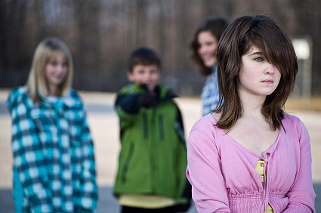
Transitional Markers /
Marcwyr Newidiadau
Transfer to secondary school / Symud i’r ysgol uwchradd
Changes in family relationships / Newidiadau o ran perthnasau teuluol
Identity formation / Ffurfio hunaniaeth
Employment /Cyflogaeth

Slide 31
Transitional Markers /
Marcwyr Newidiadau
Cognitive development/ Datblygiad gwybyddol
Greater personal freedom – social lifestyle / Mwy o ryddid personol – ffordd gymdeithasol o fyw
Greater leisure time / Mwy o amser hamdden

Slide 32
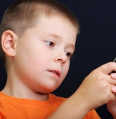
92% of 11-12 year olds and 95% of 15-16 year olds own a mobile phone
Childwise Monitor, 2010-11

Slide 33
A 2020 report, based on a survey of 2,167 UK five- to 16-year-olds, said 53% of youngsters owned mobile phones by around the age of seven.
It said that by age 11, 90% had their own device, and phone ownership was “almost universal” once children were in secondary school.
Of those questioned, 39% said they could not live without their phone – up from 33% last year. Teenagers aged 15 and 16 were most concerned about being without their phone, the report found.
57% of all the children surveyed said they always slept with their phone by their bed, while the same proportion admitted they did not know what they would do if they lost their device.

Slide 34
Media use among 5-15s in 2020 by Nation
Wales
‘62% have their own tablet
And 62% their own smartphone
To go online – 70% use a laptop, 67% a tablet and 67% a smartphone’
(Ofcom, 2021)

Slide 35
Safety and young people
Work
Risk of being exploited through long hours or not being given appropriate breaks
Risks travelling to and from workplaces eg. of missing buses or trains, being delayed leaving work etc.
Dangers of using equipment or substances without safety guards or appropriate training or supervision
Risks of making mistakes through lack of instruction, misperception, pressure of work, or lack of supervision
Risk of being bullied or abused (eg. by older people)
Risk of immaturity and naivety, not anticipating dangers

Slide 36
Long-term unemployment
One in three long-term unemployed young people have contemplated suicide
Long-term unemployed young people are also more than twice as likely as their peers to believe they have nothing to live for.
Devastating symptoms of mental illness
http://www.princes-trust.org.uk/

Slide 37
TASK
In small groups –
Have a discussion about the benefits and risks of technology for young people

Slide 38
Benefits of technology
Access to global network and information
Research and educational resources
Online study
Social networks for people who have less access to outside world – young people without money, transport, who are ill or have disabilities etc.
Opportunity to build links with others who share specific interests or experiences (eg. of discrimination, unusual hobbies, gay contacts etc).
Privacy for finding out about health concerns and information about sex and substance abuse
Possibilities for career information and job-seeking
Making friends
Games and fun
Creating digital content, (eg. You-tube)
Encyclopedic and reference source for general information
Help with presentation of work, eg, spell check, online referencing and power-point etc.
Access to maps, travel info, weather, routes and tickets to plan journeys and make travelling safer

Slide 39
Risks of technology
Possible access to unsuitable sites if parents (and other adults) are not supervising including self-harm, suicide and anorexia sites, violence and sex, racist, sexist and hate material, use of alcohol and drugs
Addiction to porn at young ages and negative effect on later sexual relationships
Grooming and abuse of young people for risky activities
Damage to brain
Isolation and social withdrawal, reduction in social skills
Cyberbullying
Sexting
Identity theft
Creating habits of easy online purchases and risk of debt
Gambling and gaming becoming obsessions
Illegal downloading
Financial scams
Damage to longer-term reputation through encouragement to put up material not properly thought through
Breach of privacy and personal safety
Poor sleep, tiredness, depression for heavy users of internet

Slide 40
Dangers online
One in three 11-18 year olds in the UK have been the victim of a cyberbullying, with teenage girls up to four times more likely to be victims than boys."
Beatbullying, 2009
“Only 50% of children encountering harmful or inappropriate content say they did something about it.”
DCFS Staying Safe Survey, 2009
http://www.safenetwork.org.uk/help_and_advice/Pages/safer_internet_use.aspx

Slide 41
Dangers online
Around one in five children aged 10 to 15 years in England and Wales (19%) experienced at least one type of online bullying behaviour in the year ending March 2020, equivalent to 764,000 children.
Nearly three out of four children (72%) who had experienced an online bullying behaviour experienced at least some of it at school or during school time.
Based on latest police recorded crime data, it's estimated an average of 1 online abuse offence against a child was recorded every 16 minutes in England and Wales (2020).

Slide 42
How do we respond as a Profession
Discussion
How can we respond as youth worker to these issues we’ve discussed today?
What is the key role we play in supporting young people?
Think about the ways in which Covid-19 has impacted young people’s use of media and technology

