Slide 1

Great British Railways
Author
Elsiddig Ibrahim/ 2024641
Feb 2023
University of Wales T. S. D
Business School/ MBA Programme
Lecturer: Marie Pitson
Change and Stability Management/ BMMB 7000

Slide 2
Outline
Introduction
Background
Change in BR’s: Transformation & Development
Private Sector’s Investment VS Gov. Subsidy
Kurt Lewin Force Field Analysis
Conclusion
References

Slide 3
Introduction
British Railways considered to be the backboned of UK industry & economy since 1607. (1948-1997) owned by the state
It has a railways network of more than 23,000 route miles and employing more than million people
It were consist of many private companies (120) before it nationalisation in 1948 and the creation of British Railways (BR’s).
1955 a modernisation plan (Change) announced to scrap 19,000 steam locomotives & 3,000 miles of rural railways were closed and more freight traffic been lost for road transport and new technology.
BR were running at loss to taxpayers and the deficit kept growing year on year (£300,000 per day). BR’s brought back to privatisation again in 1997.
Since Sep 2018 it operates under its new name ‘’Great British Railways’’.

Slide 4
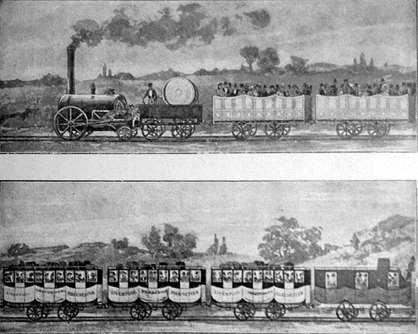
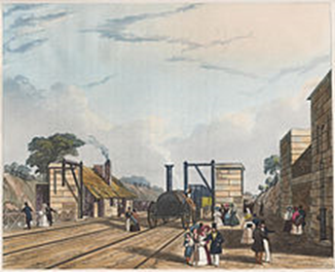
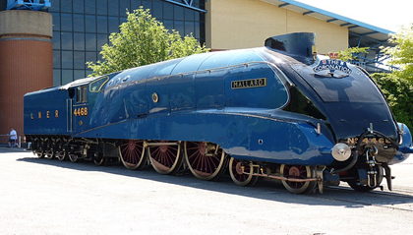
Background
The first signalling 1831
The history of British’s Railways goes back to the early 17th century
1804 the first steam Locomotive in the world to run on railway, from the iron mines at Penydarren to Merthyr-Cardiff, invented by Richard Trevithick’s.
In 15 September 1831, Liverpool and Manchester Railway (L&MR) was the first inter-city railway in the world,‘’Signalling’’.
July 3rd 1938 officially the fastest steam locomotive, reaching 126 mph (203 km/h) Flying Scottish man.
In the 20th century steam railways became the foundation stones that shaped Britain's industrial revolution.
Famous Locomotive Engineers who help to transform British’s Railways; George Churchward, Duglad Drummond, Richard Maunsell, Sir William Stanier, Charles Collett, Robert Stephenson (The Father of the railways) George Stephenson (1814 the first to built steam locomotive from stationery steam engine), Joseph Locke, Sir Nigel Gresley, and Oliver Bulleid.

Slide 5
Change In BR’s: Transformation & Development
Change: Is a process of transitioning the scope of the business to meet specific changing requirements.
Lewin (Lewin, 1947) stated that everything including an organization was under a pair of opposite forces which led it to be in a state of dynamic equilibrium
BR’s been established In 1934 out of the big four grouping (120 company): Great Western Railway, London & North Eastern and London, Midland & Scottish Railway and Southern Railway.
During World War II, the government took control. In 1948 British’s Railways were nationalised.
In 1955 Modernisation Plan (change)for BR‘s was authorised."First Generation" DMUs were built between 1956 and 1963, electrification, light railways, HS Train.ect..
In 1963 Dr Richard Beeching Report resulted in 2,500 stations closure and 4,000 miles of railway and 68,000 jobs loss due to scrap steam Locomotive. Change to diesel. etc
The railway Act of 1993 brought an end to 45 years of nationalisation 1997-(Change) and back to private sector again, started the era of Train Operating Company such as; Great Western Railway, LE, LM etc.
UK government invested heavily in infrastructure this allowed change to happen and make the future looks brighter for Britain’s Railways than it was 80 years ago.
Britain lags behind many European & Asian countries , HS1, HS2, £80bn. So there was need for change

Slide 6
Private Sector Investment VS Gov. Subsidy
Since privatisation, the amount of investment has increased , from £698m in 1994–95 to £6.84bn in 2013–14(Network improvements, electrification, signalling on the Cambrian Coast Line ‘’paid for by the Welsh Government’’, the Northern Hub, the Thameslink Programme, and High Speed 2 paid by England.
After Hatfield rail crash in 2000, extra safety investment and subsidies have since been brought under control. Rail subsidies have increased from £2.9 billion in 1992–93 to £7.7 billion in 2018–19.
Although subsidy per journey has fallen from £3.85 per journey to £2.19 per journey as in 2014–18 funding varied from "£1.41 per passenger journey in England to £6.51 per journey in Scotland and £8.34 per journey in Wales.

Slide 7
Kurt Lewin Force Field Analysis
Driving Forces:
The motive for profit by private sector
To put an end to state funding scheme
Dr Beech report, for the sake of change
Modernisation and the needs to fulfil of life style at the 21st century
Creating more jobs and safe time and money and life's
Catch up with forefront countries in the world with advance Railways technology
Remove Railways from short-term political control- to long term strategic plan
In September 2020, the government permanently got rid of the rail franchising system.
On 20 May 2021, the government announced that the operation of the railways, the rail network will be partly renationalised.
Resistance Forces:
Businessmen against scrap of steam Locomotives
Trade unions dispute for increasing wages
Railway preservation movement led by Tom Rolt, saved Talyllyn Railway from closure in west Wales, to became the first scheme in the world.
Green movement activists against coal production and steam trains
Politian against high cost projects Channel Tunnel, HS1 HS2, the conservative government 1984
Local landowners, farmers, environment protection activists, HS1, HS2
Campaigns against Railway accidents due to high speed
Taxpayers-privatisation is benefiting overseas Gov-rather than UK Gov
It was a planned change

Slide 8
Conclusion
Analysis of the change has been conducted using Lewins model, and concluded that the driving forces overweigh the resistance forces, this allow the process of change to happen. However, a leadership and charismatic personality and power have played big role in the process of decision making to transform Great British Railways. ‘’Beech report’’ to overcome resistance
Change management process been achieved with less disruptions.
One of the benefits promoted for privatisation is that it would remove railways from short-term political control which damaged an industry like the railways, which had long-term investment requirements
One of the driving forces for change to privatisation is that the railway service could be delivered more efficiently with low costs in the private sector.

Slide 9
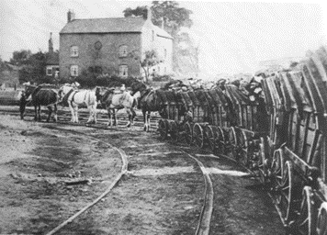
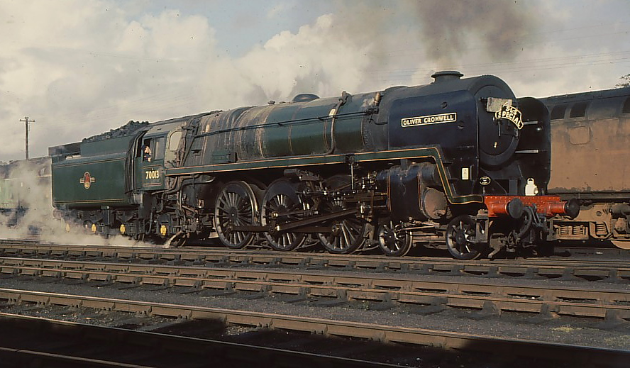
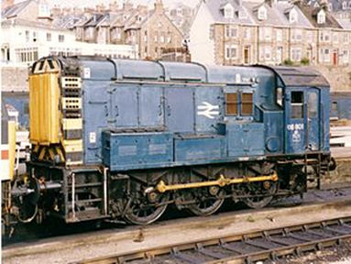
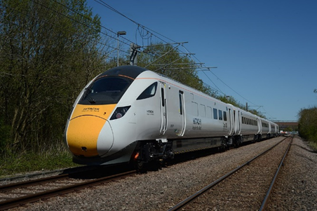
Conclusion
Criticism from the public that private companies are owned by the state-owned transport or other nations, franchises are owned either in part or in full by foreign governments; Abellio ‘’Dutch government's Nederlandse Spoorwegen’’, Arriva by the German government's ‘’Deutsche Bahn’’, the French government's SNCF and the Hong Kong government owning 75% of MTR Corporation. This resistance been overcome by scrap franchises.
Change in GBR management strategy led to a series of benefits such as;
i) There has been an increase in the use of the railways for passenger services; ii) employment has remained stable in the industry; and iii) there has been an increase in productivity’’.

Slide 10
References
  Lewin, M. (1992). ‘The impact of Kurt Lewin’s life on the place of social issues in his work’. Journal of Social Issues, 48, 2, 15–29. Lewis, R. (1994). ‘From chaos to comply
  Back, K. W. (1992). ‘This business of topology’. Journal of Social Issues, 48, 2, 51–66.
Holmes (1998). Charismatic and strong leader”
Cameron, E. and Green, M. (2015). Making sense of change management: a complete guide to the models, tools and techniques of organizational change. 4th ed. London: Kogan
Hodges, J. & Roger , G., 2015. Sustaining Change in Organizations. 1 ed. London: Sage Publications Ltd.
Lewin, K., 1947. Frontiers in Group Dynamics. Human Relations, 1 6, pp. 5-41.
Julian Holland (2015). History of Britain’s Railways. First edition
Greenfield, A. (2008), The 5 Forces of Change: A Blueprint for Leading Successful Change, New York: Management Books
Kotter, J. P. (2009) Leading Change, Mass :Harvard Business Essentials
Rail electrification plans scrapped by government - BBC News". BBC News. 20 July 2017.

Slide 11
Cameron, E. & Green, M. (2020), Making Sense of Change Management: A Complete Guide to the Models, Tools and Techniques of Organisational Change, 5th edition, London: Kogan Page
"Transport Select Committee Report June 2018" (PDF).
Cardiff electric services go live". Railway Gazette International. 7 January 2020. Retrieved 19 May 2020.
Great Western electric operation extends west". International Railway Journal. 31 December 2018. Retrieved 19 May 2020.
Integrated Rail Plan for the North and Midlands" (PDF). UK Government. 18 November 2021.
Spades in ground as government delivers on rail investment promise for North and Midlands". GOV.UK. Retrieved 21 December 2021.
Main works on next stage of Midland Main Line electrification due to begin". RailBusinessDaily. 21 December 2021. Retrieved 21 December 2021.
Rail industry welcomes progress on Midland Mainline electrification". www.riagb.org.uk. Retrieved 21 December 2021.
"Railways: Electrification:Written question - 219526". UK Parliament. Retrieved 27 February 2019.
"Electrification Cost Challenge Report". www.riagb.org.uk. Retrieved 14 March 2019.

