Slide 1

Lecture 10
The jewish war
Email: j.keady@uwtsd.ac.uk

Slide 2
Roman Occupation
Created tension particularly at Passover Festival
Temple a focus point for tension
Financial disparity
Quirinius’ Census – Roman census

Slide 3
Roman Governors
Quirinius’ Census 6CE
Prefects (military official) Procurators (financial)
6-9 Coponius 44-45 Fadus
9-12 Abmivulus 46-48 Alexander
12-15 Rufus 48-52 Cumanus
15-26 Gratus 52-60 Felix
26-36 Pontius Pilate 61-62 Festus
36-37 Marcellos 62-64 Albinus
37-41 Marullus 64-66 Florus
(41-44 Agrippa)

Slide 4
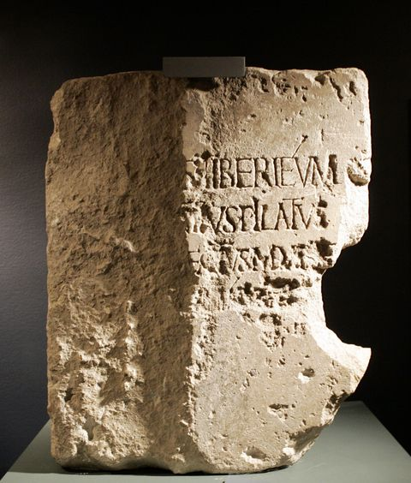
The Pilate stone
The translation from Latin to English for the inscription reads:
  To the Divine Augusti [this] Tiberieum
  ...Pontius Pilate
  ...prefect of Judea
  ...has dedicated [this]
It was discovered at the archaeological site of Caesarea Maritima in 1961. The artifact is particularly significant because it is an archaeological find of an authentic 1st-century Roman inscription mentioning the name "[Pont]ius Pilatus".

Slide 5
BUT now Pilate…introduced Caesar's effigies, which were upon the ensigns, and brought them into the city; whereas our law forbids us the very making of images; on which account the former procurators were wont to make their entry into the city with such ensigns as had not those ornaments. Pilate was the first who brought those images to Jerusalem, and set them up there; which was done without the knowledge of the people, because it was done in the night time; but as soon as they knew it, they came in multitudes to Caesarea, and interceded with Pilate many days that he would remove the images; and when he would not grant their requests, because it would tend to the injury of Caesar, while yet they persevered in their request, on the sixth day he ordered his soldiers to have their weapons privately, while he came and sat upon his judgment-seat, which seat was so prepared in the open place of the city, that it concealed the army that lay ready to oppress them; and when the Jews petitioned him again, he gave a signal to the soldiers to encompass them routed, and threatened that their punishment should be no less than immediate death, unless they would leave off disturbing him, and go their ways home. But they threw themselves upon the ground, and laid their necks bare, and said they would take their death very willingly, rather than the wisdom of their laws should be transgressed; upon which Pilate was deeply affected with their firm resolution to keep their laws inviolable, and presently commanded the images to be carried back from Jerusalem to Caesarea. (Josephus, Antiquities 18.3.1)

Slide 6
Pilate
Temple money for aqueduct (Antiquities 18.3.2// War 2.175-177)
There were some present at that very time who told him about the Galileans whose blood Pilate had mingled with their sacrifices (Luke 13.1)

Slide 7
Pilate’s Samaritan Massacre
BUT the nation of the Samaritans did not escape without tumults. The man …bid [the people] to get together upon Mount Gerizzim, which is by them looked upon as the most holy of all mountains, and assured them, that when they were come thither, he would show them those sacred vessels which were laid under that place, because Moses put them there…but Pilate prevented their going up, by seizing upon file roads with a great band of horsemen and foot-men, who fell upon those that were gotten together in the village; and when it came to an action, some of them they slew, and others of them they put to flight, and took a great many alive, the principal of which, and also the most potent of those that fled away, Pilate ordered to be slain.
But when this tumult was appeased, the Samaritan senate sent an embassy to Vitellius, a man that had been consul, and who was now president of Syria, and accused Pilate of the murder of those that were killed…and ordered Pilate to go to Rome, to answer before the emperor to the accusations of the Jews. So Pilate, when he had tarried ten years in Judea, made haste to Rome, and this in obedience to the orders of Vitellius, which he durst not contradict; but before he could get to Rome Tiberius was dead. (Antiquities 18.4.1-2)

Slide 8
The passing of wind that caused a massacre!?
…the Jews' ruin came on; for when the multitude were come together to Jerusalem, to the feast of unleavened bread, and a Roman cohort stood over the cloisters of the temple…one of the soldiers pulled back his garment, and cowering down after an indecent manner, turned his breech to the Jews, and spoke such words as you might expect upon such a posture. At this the whole multitude had indignation, and made a clamor to Cumanus, that he would punish the soldier; while the rasher part of the youth, and such as were naturally the most tumultuous, fell to fighting, and caught up stones, and threw them at the soldiers. Upon which Cumanus was afraid lest all the people should make an assault upon him, and sent to call for more armed men, who, when they came in great numbers into the cloisters, the Jews were in a very great consternation; and being beaten out of the temple, they ran into the city; and the violence with which they crowded to get out was so great, that they trod upon each other, and squeezed one another, till ten thousand of them were killed. (War 2.14.6)

Slide 9
Continuing Tension
Radicalisation in 50s and 60s / ‘us’ and ‘them’ mentality grows stronger
Rise of the Sicarii (dagger men) – splinter group of Jewish zealots
Jonathan, the High Priest murdered supposedly by Romans (Ant 20.8.10//War 2.13.3)

Slide 10
Jewish War
Only one source Josephus
First part of war in both Antiquities and War
Latter part only one account (in War)
Tension with Greeks
Florus’ raid on Temple (War 2.14.6-9) – statue
Refusal of foreign donations to Temple
Sacrifices for Emperor cease.

Slide 11
Cessation of sacrifice for Emperor
And at this time it was that some of those that principally excited the people to go to war made an assault upon a certain fortress called Masada. They took it by treachery, and slew the Romans that were there, and put others of their own party to keep it. At the same time Eleazar, the son of Ananias the high priest, a very bold youth, who was at that time governor of the temple, persuaded those that officiated in the Divine service to receive no gift or sacrifice for any foreigner. And this was the true beginning of our war with the Romans; for they rejected the sacrifice of Caesar on this account; and when many of the high priests and principal men besought them not to omit the sacrifice, which it was customary for them to offer for their princes, they would not be prevailed upon. These relied much upon their multitude, for the most flourishing part of the innovators assisted them; but they had the chief regard to Eleazar, the governor of the temple. (War 2.17.2)

Slide 12
Jewish War
Internal divisions within Jerusalem
Upper class v Zealots and Sicarii
Sicarii set up in Temple
And he was teaching them and saying to them, “Is it not written, ‘My house shall be called a house of prayer for all the nations’? But you have made it a den of bandits (lēstōn).” (Mark 11.17)
Simon b. Giora (Jewish military leader during the revolt) set up as Messianic King
Many left the city of Jerusalem during this time

Slide 13
Many left the city
But when you see Jerusalem surrounded by armies, then know that its desolation has come near. Then let those who are in Judea flee to the mountains, and let those who are inside the city depart, and let not those who are out in the country enter it, for these are days of vengeance, to fulfil all that is written. (Luke 21.20-22)
But the people of the church in Jerusalem had been commanded by a revelation, vouchsafed to approved men there before the war, to leave the city and to dwell in a certain town of Perea called Pella. (Eusebius, History 3.5.3)

Slide 14
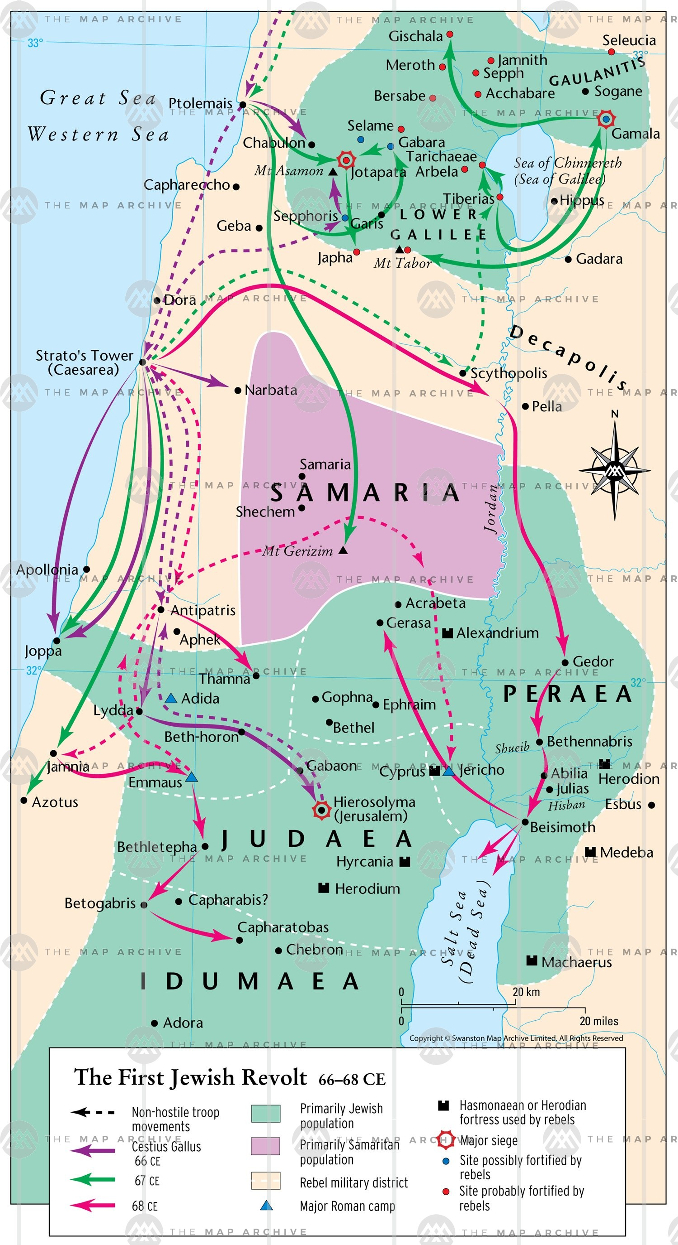
Jewish War
Nero appoints Vespasian to lead the offensive
Vespasian and Titus (his son) arrive in Spring 67CE
with 60,000 troops
Meets little resistance except in fortified areas
Yodfat falls after a seven week siege by Roman forces
in 67 CE, during the Great Revolt
Josephus is taken captive (War 3.8.8)
Port of Joppa taken, July 67
Tiberius captured, August 67
Tarchaeae and Gamala taken by October 67
Gishala: John escapes to Jerusalem (War 4.2.1-5)
Surge stops for the winter

Slide 15
Spring 68CE-Summer 69CE
Judea taken with little resistance
Death of Nero June 68 CE
Year of four emperors
Vespasian resumes offensive on his own initiative in June 69 CE
Proclaimed emperor in July 69 CE
Titus continues the attack

Slide 16
Jerusalem
Civil war
Zealots seized control of the Temple
Ananus, the High Priest, deposed
Food supply destroyed in civil war and 600,000 starve.
Titus breaches the walls

Slide 17
Destruction of the Temple
As for the priests, some of them plucked up from the holy house the spikes that were upon it, with their bases, which were made of lead, and shot them at the Romans instead of darts. But then as they gained nothing by so doing, and as the fire burst out upon them, they retired to the wall that was eight cubits broad, and there they tarried; yet did two of these of eminence among them, who might have saved themselves by going over to the Romans, or have borne up with courage, and taken their fortune with the others, throw themselves into the fire, and were burnt together with the holy house; their names were Meirus the son of Belgas, and Joseph the son of Daleus. (War 6.5.1)

Slide 18
Romans take the city
AND now the Romans, upon the flight of the seditious into the city, and upon the burning of the holy house itself, and of all the buildings round about it, brought their ensigns to the temple and set them over against its eastern gate; and there did they offer sacrifices to them, and there did they make Titus imperator with the greatest acclamations of joy. (War 6.6.1)

Slide 19
Josephus War 6.407
Often in their raids, on entering the houses for loot they would find whole families dead and the rooms filled with the victims of famine, and then, shuddering at the sight, they would leave empty-handed. Yet, while they pitied those who had perished, they did not feel the same way for the living, but running through everyone who fell in their way, they choked the narrow streets with corpses and deluged the whole city with blood, so that many of the fires were extinguished by the slaughter.

Slide 20
Triumphal Procession
So Titus…took up a resolution to go to Rome by sea. And as he was accompanied by two legions…as for the leaders of the captives, Simon and John, with the other seven hundred men, whom he had selected out of the rest as being eminently tall and handsome of body, he gave order that they should be soon carried to Italy, as resolving to produce them in his triumph.
…On the top of every one of these pageants was placed the commander of the city that was taken, and the manner wherein he was taken. Moreover, there followed those pageants a great number of ships; and for the other spoils, they were carried in great plenty. But for those that were taken in the temple of Jerusalem, they made the greatest figure of them all; that is, the golden table, of the weight of many talents; the candlestick also, that was made of gold… Now the last part of this pompous show was at the temple of Jupiter Capitolinus, whither when they were come, they stood still; for it was the Romans' ancient custom to stay till somebody brought the news that the general of the enemy was slain. This general was Simon, the son of Gioras, who had then been led in this triumph among the captives; a rope had also been put upon his head, and he had been drawn into a proper place in the forum, and had withal been tormented by those that drew him along; and the law of the Romans required that malefactors condemned to die should be slain there. (War 6.5.3-6)

Slide 21
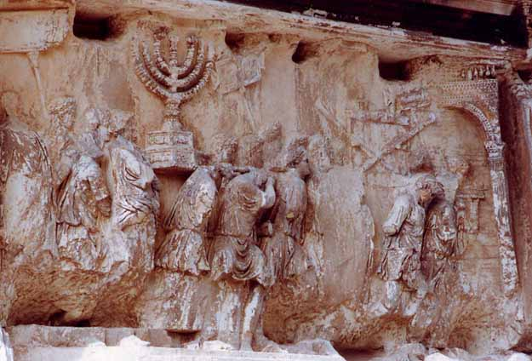
Victory Procession / Arch of Titus

Slide 22
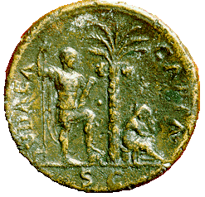
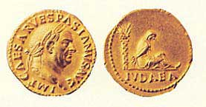
Judea Capta

Slide 23
Causes of the War
Historical memory of an independent Israel under native rule
Roman misrule
Social and economic pressures
Religious tradition: apocalypticism and messianism
Poor relations with neighbouring cities
Failure of Jewish upper classes

Slide 24
Masada
Besieged in 72CE
Zealots and Sicarii had continued raids in surrounding country
Last pocket of resistance against the Romans
Eleazar Ben Yair – leader of the Jewish rebels
Romans built a siege ramp to ram their way into the fort
https://www.youtube.com/watch?v=_t38sBuQ7pQ

Slide 25
Eleazar b. yair
However, neither did Eleazar once think of flying away, nor would he permit any one else to do so; but when he saw their wall burned down by the fire, and could devise no other way of escaping, or room for their further courage, and setting before their eyes what the Romans would do to them, their children, and their wives, if they got them into their power, he consulted about having them all slain… “Since we, long ago, my generous friends, resolved never to be servants to the Romans, nor to any other than to God himself, who alone is the true and just Lord of mankind, the time is now come that obliges us to make that resolution true in practice…Let our wives die before they are abused, and our children before they have tasted of slavery; and after we have slain them, let us bestow that glorious benefit upon one another mutually, and preserve ourselves in freedom, as an excellent funeral monument for us. But first let us destroy our money and the fortress by fire; for I am well assured that this will be a great grief to the Romans, that they shall not be able to seize upon our bodies, and shall fall of our wealth also; and let us spare nothing but our provisions; for they will be a testimonial when we are dead that we were not subdued for want of necessaries, but that, according to our original resolution, we have preferred death before slavery.” (War 7.8.6)

Slide 26
Masada
Now for the Romans, they expected that they should be fought in the morning, when, accordingly, they put on their armour…but saw nobody as an enemy, but a terrible solitude on every side, with a fire within the place, as well as a perfect silence. So they were at a loss to guess at what had happened. At length they made a shout...the women heard this noise, and came out of their under-ground cavern, and informed the Romans what had been done, as it was done…yet did they not easily give their attention to such a desperate undertaking, and did not believe it could be as they said; they also attempted to put the fire out, and quickly cutting themselves a way through it, they came within the palace, and so met with the multitude of the slain, but could take no pleasure in the fact, though it were done to their enemies. Nor could they do other than wonder at the courage of their resolution, and the immovable contempt of death which so great a number of them had shown, when they went through with such an action as that was. (War 7.9.2)

Slide 27
Sicarii
it was not long ere they were caught also, and brought back, whose courage, or whether we ought to call it madness, or hardiness in their opinions, every body was amazed at. For when all sorts of torments and vexations of their bodies that could be devised were made use to them, they could not get any one of them to comply so far as to confess, or seem to confess, that Caesar was their lord; but they preserved their own opinion, in spite of all the distress they were brought to, as if they received these torments and the fire itself with bodies insensible of pain, and with a soul that in a manner rejoiced under them. But what was most of all astonishing to the beholders was the courage of the children; for not one of these children was so far overcome by these torments, as to name Caesar for their lord. So far does the strength of the courage [of the soul] prevail over the weakness of the body. (War 7.10.1)

Slide 28
Roman Inscription
(Arch of Titus)
The Senate and the Roman people to the Imperator Titus Caesar Vespasian Augustus, son of the deified Vespasian, ponitifex maximus…father of his country, their princeps, because under the direction and plans and auspices of his father he subdued the Jewish people, destroyed the city of Jerusalem, previously either attacked in vain by generals, kings, peoples, or completely unassailed.

