Slide 1
Context other than a school where learning can take place.
Kirsty Jenkins

Slide 2
4 Site
Dylan Thomas Centre
Swansea Museum
West Glamorgan Archive Service
Glyn Vivian

Slide 3
Dylan Thomas Centre
Permanent ‘Love the words’ Exhibit
Interactive
Bilingual
Accessible

Slide 4
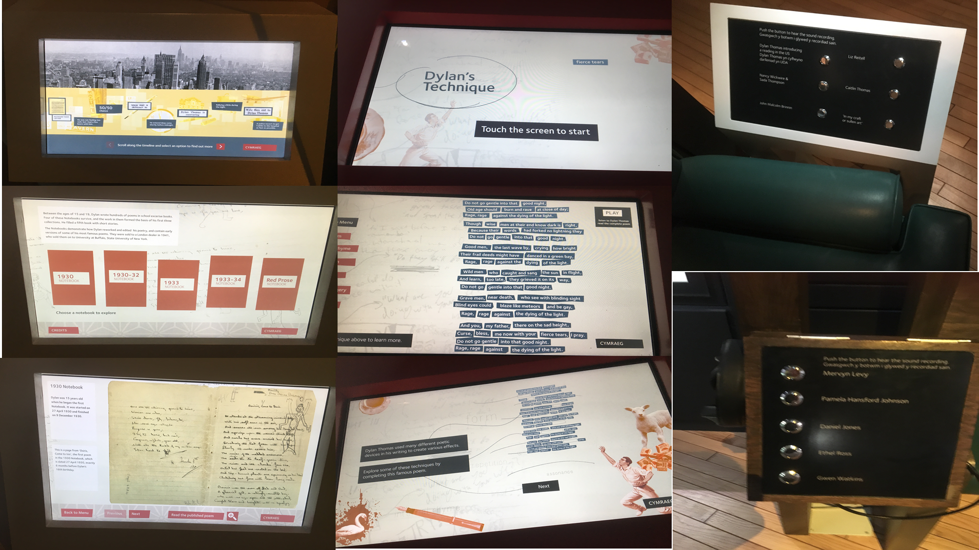

Slide 5
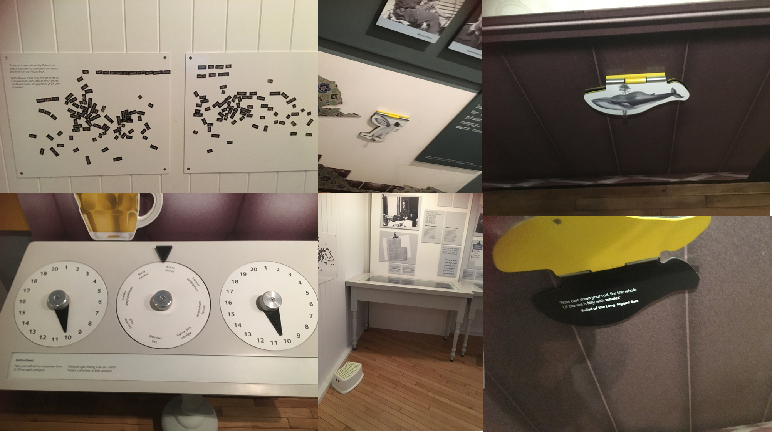

Slide 6
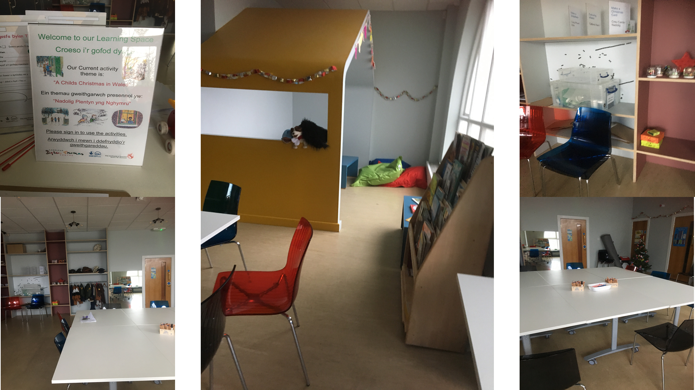

Slide 7
West Glamorgan Archive Service
Original documents
School trips
Downloadable programmes for schools
Online exhibits

Slide 8
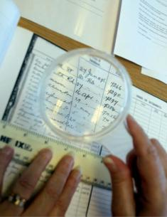
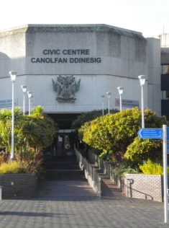

Slide 9
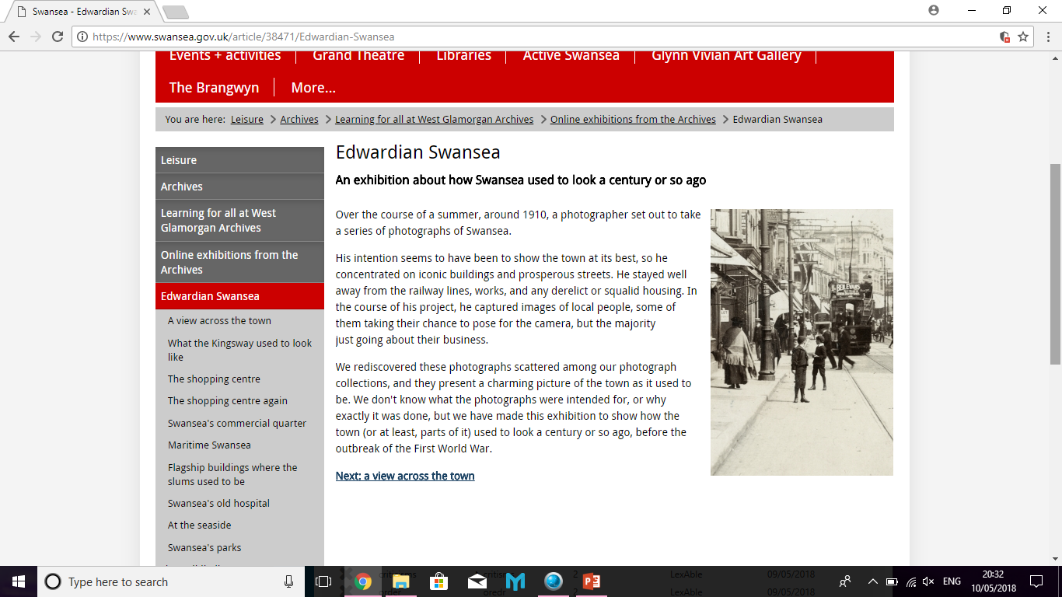
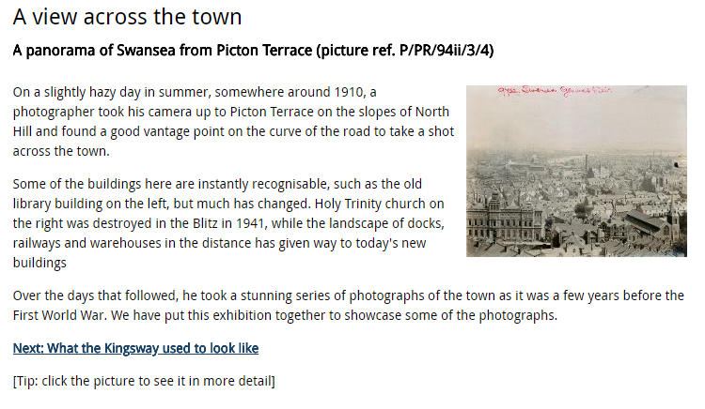
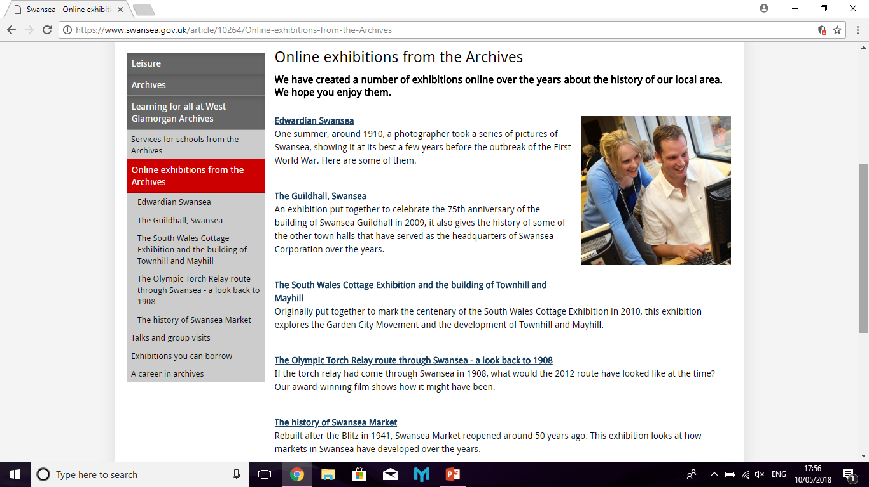
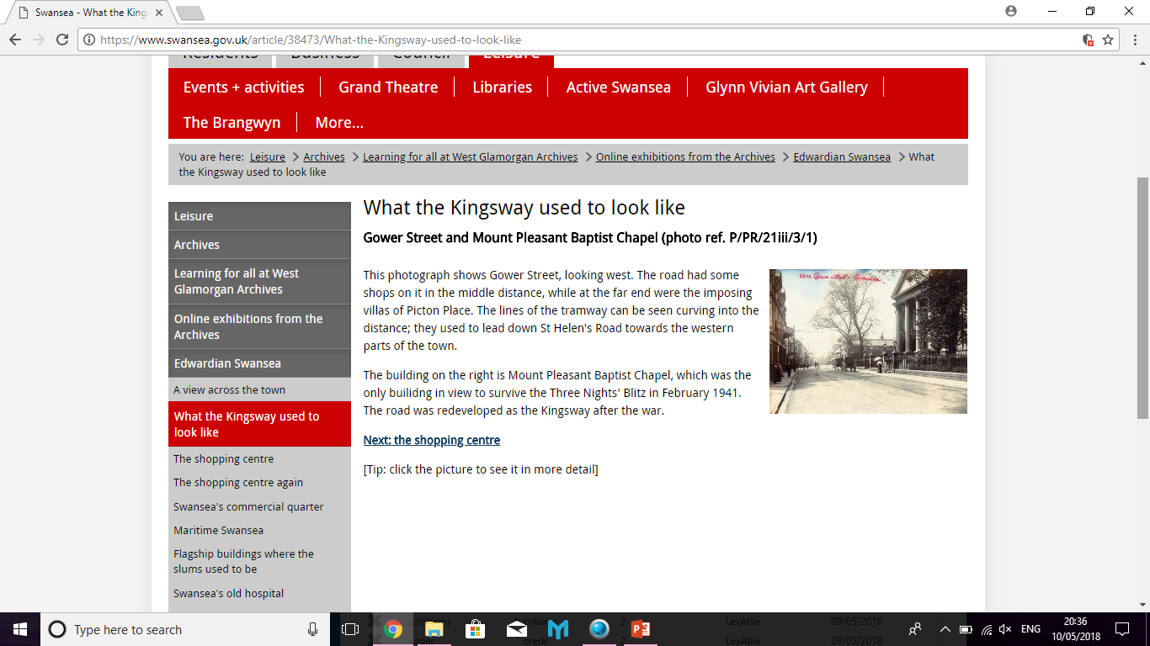
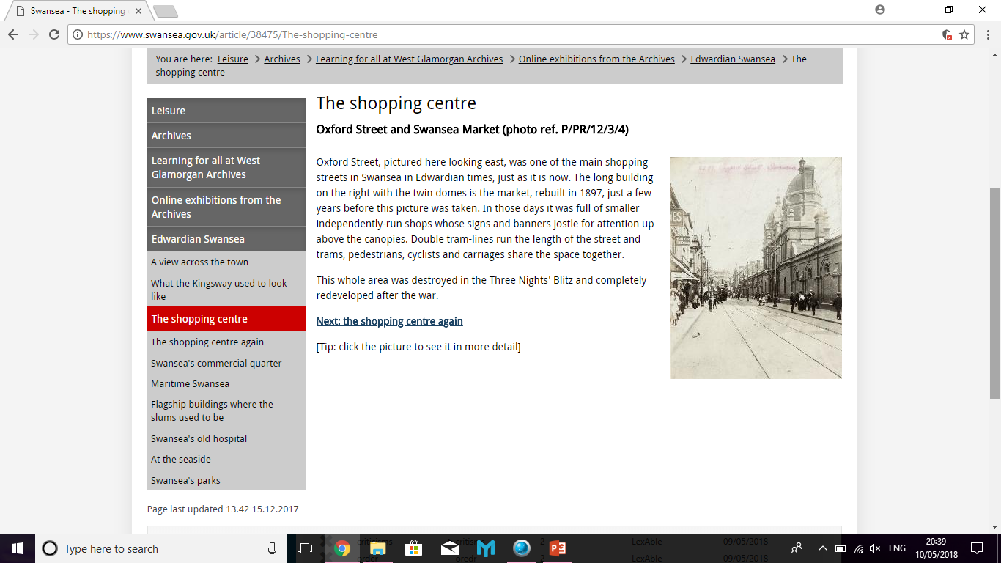
https://www.swansea.gov.uk/article/10264/Online-exhibitions-from-the-Archives

Slide 10


