Slide 1
Personal Evaluation – to support your academic progress, we are interested to read your own assessment of this work as a measure of your own effort and in order that we may comment on your strengths and weaknesses. Please ensure you complete tIhis assessment before submitting your work.
What do you consider are the best aspects of this piece of work? | I feel that my best aspect of my work was the content, I found it very enjoyable.
Which aspects do you consider could have been improved in this piece of work? | I could have included more books.
What have you found most satisfying whilst undertaking this submission? | As I have enjoyed researching for this presentation. it has made it very interesting to put together. The information I have discovered will always be invaluable to me in my future career.

Slide 2
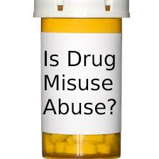
Samantha Moon
Image 1: https://www.drugrehab.us/news/is-prescription-drug-misuse-abuse/
sjss4001
Notes:
https://www.drugrehab.us/news/is-prescription-drug-misuse-abuse/

Slide 3
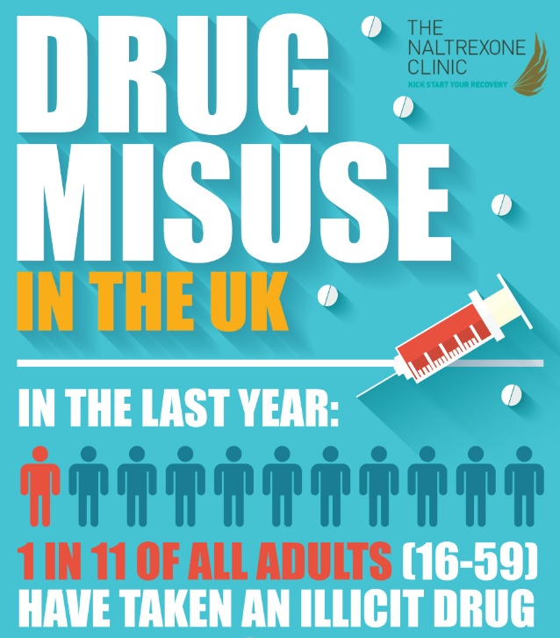
Describe what you consider to be the most effective strategies currently available to support a drugs misuser’s inclusion in society.
Image 2: https://www.slideshare.net/theabstinenceclinic/drug-misuseinfographic
Notes:
Today I am going to describe the above.
18.9% of young people aged 16-24 have taken an illicit drug. 3.1 % of adults have taken class A Drugs.
https://www.slideshare.net/theabstinenceclinic/drug-misuseinfographic

Slide 4
A definition of a vulnerable adult
‘A vulnerable adult is a patient who is or may be for any reason unable to take care of him or herself, or unable to protect him or herself against significant harm or exploitation’.
(University Hospital Southampton NHS Foundation Trust,2014)
Notes:
http://www.uhs.nhs.uk/HealthProfessionals/Clinical-law-updates/Whatismeantbyavulnerableadult.aspx

Slide 5
Most substance misusers are often in denial about having a drug addiction
They become challenging and hard to reach
Becoming hard to reach often makes them defiant and criminal
They become labelled as “ Druggies or alcoholics”
They have a stigmatised identity
Addaction.org.uk, ()
Notes:
Being hard to reach makes its harder for people to get through to them, this often results in stereo-typing ,and individuals being prejudice.
Some services may have a stereo-type attitude that they have met one drug user or alcoholic, that they have met them all.

Slide 6
Substance Misusers can relate to being vulnerable
They are at risk of exploitation
They may possibly commit crime so that they can eat. This could range from burglary, fraud or shop lifting.
The market value of goods stolen could be between £2-2.5 billion each year.
According to drug wise ‘some research studies show that a lot of acquisitive crime (stealing) is committed by dependant users, trying to pay for their drugs’.
Although not all users steal to pay for their substance.
(drugwise.org.uk, 2017).
Notes:
Exploitation could be that a drug abuser has no money to purchase more drugs or needs to pay a debt off for any previous drugs they have had, they could be put in a situation where they are sexually exploited or the fact that they have no money for food
Drugwise – accessed 17/02/2018

Slide 7
The Labelling theory....
Is a theory of how the self-identity and behaviour of individuals may be determined or influenced by the terms used to describe or categorise them.
It holds that defiance is not inherent to an act, but instead focuses on the majority criticising them negatively , labelling those seen as deviant from standard cultural norms
(Becker, 1963)
Notes:
“The labelling theory was created by Howard Becker in 1963. the Labelling theory takes the view that people become criminals when they accept the label as a personal identity.”

Slide 8
Strategies available for substance misuse
Training for service providers, to help them better understand issues and to overcome prejudice
Providing a safe place where substance misusers can go without feeling that they are being judged or oppressed
Therapy sessions and workshops, creating positive relationships and educating the individuals about the consequences and impact that the misuse could have on them.
Changing friends and associates in that particular circle to prevent relapse.
Notes:
From what we have already discussed, the most obvious strategies for me are education and training, therapy and work shop sessions

Slide 9
HM Government Drug Strategy
In 2010 we set out a clear and balanced approach to tackle substance misuse.
We put local communities at the heart of public health agenda.
HM Government shifted focus to recovery. Recognising wider support needed to achieve and sustain a life free from drugs and crime.
Acting at the earliest opportunity to prevent people who have mental health conditions from using substances.
Gov.uk, (2017)
Notes:
Published 2017 www.gov.uk: 2017 Drug stratergy accessed 17/02/18

Slide 10
The social learning theory (SLT)
Addiction is shaped by biological, psychological and social factors.
The social learning theory (SLT) suggests that addiction is rooted in the way we observe and learn from our peers and role models.
Treatment based on this theory can help you to break out of negative thought and behavioural patterns.
drugrehab.org, ()
Notes:
According to drugrehab.org the social learning theory suggests that ones environment causes one’s behaviour an sadly we do not just learn from the positive influences of people whom we admire, and that the negative influences throughout our lives have the capacity to shape us too.
The old cliche “ do as I say and not as I do” doesn’t always hold, especially when it comes to substance misuse. For addiction specialists One of the oldest debates in psychology, nature versus nurture.
http://www.drugrehab.org/social-learning-theory-slt-addiction-treatment/
Accessed 17/02/18 15.54

Slide 11
Local Support Networks
DDAS – the Dyfed Drug and Alcohol service is an integrated substance misuse service that operates across Dyfed in Wales. The service was Launched in 2015.
Drug aid Wales offers several training courses to organisations or groups.
Training offered by drug aid ranges from dependence, addiction and recovery to alcohol awareness to substance misuse and mental health
All Wales drugs and alcohol helplines offer 24 hour advice on substance misuse, alcohol and drugsinformation.
Kaleidoscopeproject.org.uk
Notes:
DDAS is in partnership with kaleidoscope project . Kaleidoscopeproject.org.uk
Training offered by drug aid ranges from dependence, addiction and recovery to alcohol awareness to substance misuse and mental health

Slide 12
Reference List
Image 1: https://www.drugrehab.us/news/is-prescription-drug-misuse-abuse/(Accessed 10/03/2018)
Image 2: https://www.slideshare.net/theabstinenceclinic/drug-misuseinfographic(Acessed 18/02/2018)
Addaction () https://www.addaction.org.uk/ (Accessed 09/03/2018)
Becker,H (1963) Outsiders : studies in the sociology of deviance. Free P; Collier Macmillan 1966
DDAS –Kaleidoscope Project (2015)http://www.kaleidoscopeproject.org.uk/our-services/ddas/ (Accessed 05/03/2018)
DrugWise (2017) How much crime is drug related? http://www.drugwise.org.uk/how-much-crime-is-drug-related/ (Accessed 15/02/2018)
HM Government (2017) 2017 Drug strategy https://www.gov.uk/government/uploads/system/uploads/attachment_data/file/628148/Drug_strategy_2017.PDF (Accessed 17/02/18 )
Learning Theory Of Addiction Treatment http://www.drugrehab.org/social-learning-theory-slt-addiction-treatment/ (Accessed 17/02/18 )

Slide 13
university of Southampton (2014) What does vulnerable adult mean? http://www.uhs.nhs.uk/HealthProfessionals/Clinical-law-updates/Whatismeantbyavulnerableadult.aspx (Accessed 20/02/2018)

