Slide 1

ACADEMIC AND EMPLOYABILITY SKILLS (BMSW44001_LON)
STUDENT: DANIELA AMBROS 2115350
LECTURER:LIZETA DEMETRIOU

Slide 2
OVERVIEW
HR MANAGER - duties and responsibilities
Understanding the world of work
Employability skills
Academic skills
SWOT Analysis
Time Management Tool & Principle

Slide 3

HR MANAGER
Keep under control the recruitment process till the onboarding
Manage a business system by attending the meetings
Ensuring that the company acts in accordance with legal regulations
Standing in front of the human resources team and training them
Management of possible complaints and disciplinary proceedings
Monitoring all aspects related to the employee
Design and coordinate all types of training where necessary
Establishing and reviewing employee benefits and pay rate
(uk.indeed.com,2021)

Slide 4
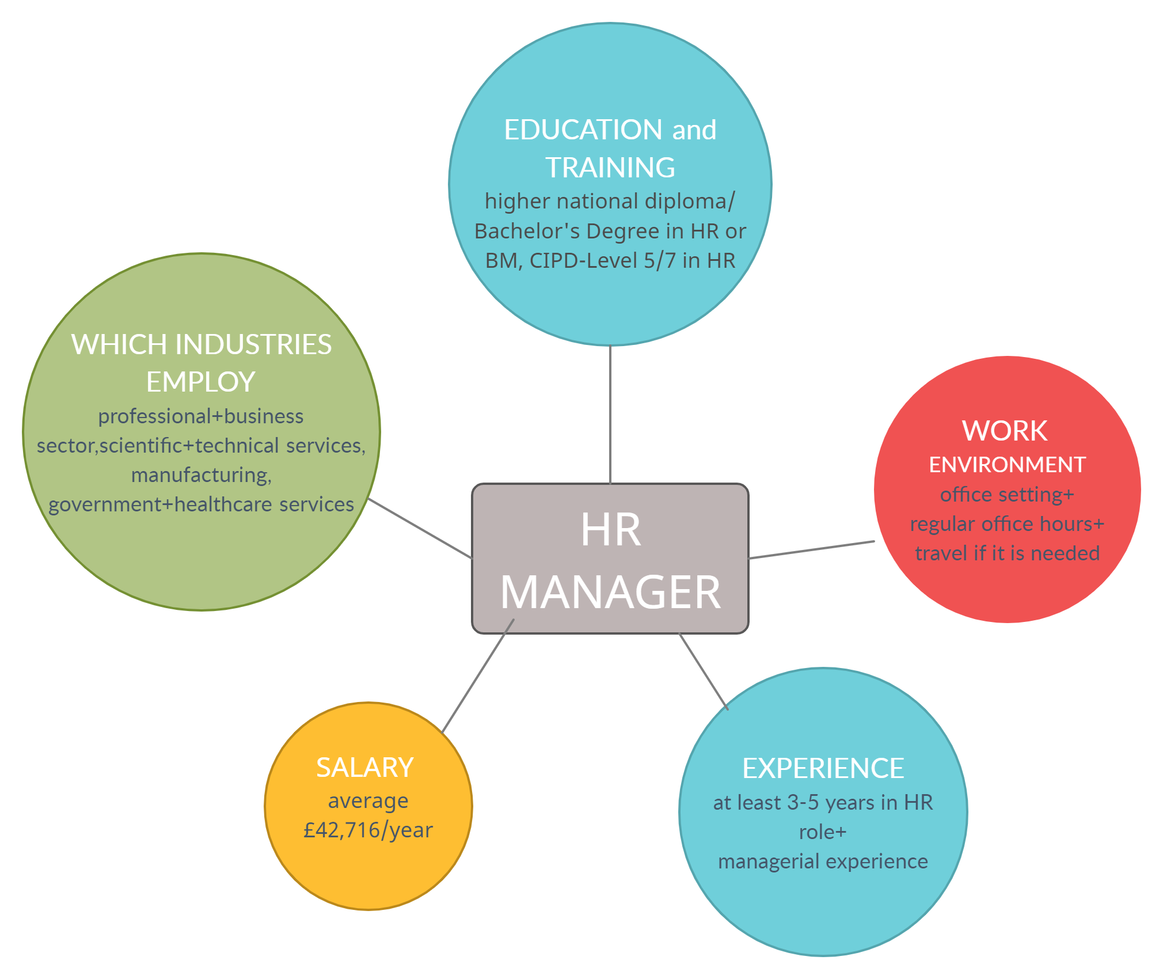
Understanding the world of work

Slide 5
EMPLOYABILITY SKILLS
PROBLEM SOLVING
COMMUNICATION
PLAN & ORGANISE
LEADERSHIP
ADDING VALUE
BEEN A ROUNDED
PERSON

Slide 6
ACADEMIC SKILLS
ANALYSIS
ACADEMIC WRITING
PUBLIC SPEAKING
RESEARCH

Slide 7
SWOT ANALYSIS
STRENGHTS
Highly Organised, reliable
Good administrative skills
Language skills
Experience-HR Administrator
WEAKNESSES
Lack of self-confidence
Not being able to say no
Over thinking - extra cautious
OPPORTUNITIES
Prominent job
Work with skilled people
Gain experience,
demonstrate my abilities
THREATS
High number of professionals – job competitiveness
New technologies and apps - crucial

Slide 8

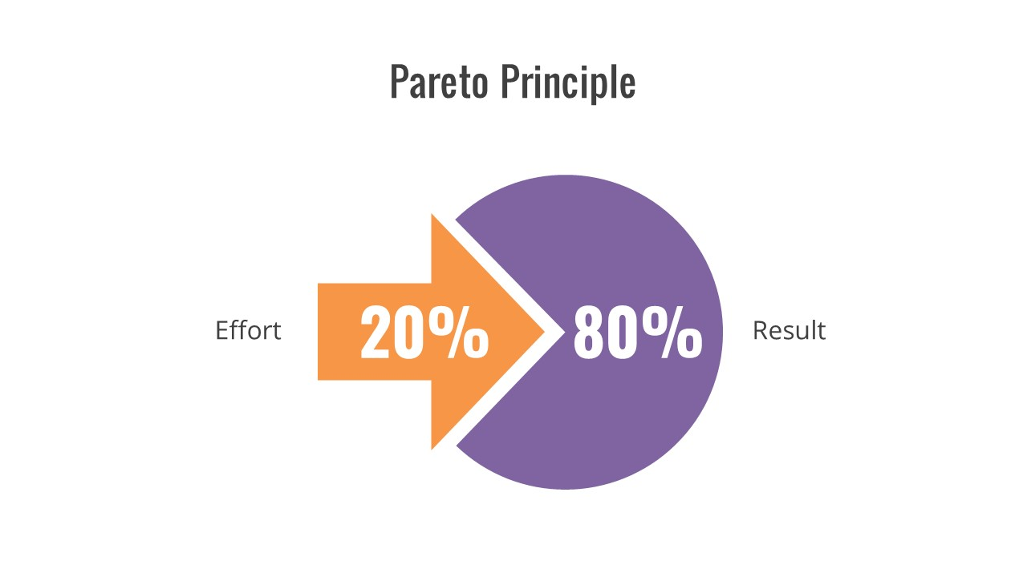
TIME MANAGEMENT TOOL & PRINCIPLE
DO: Important – Urgent jobs. Need to be done by the HR Manager.
DECIDE: Important but not urgent. Need to be done as early as possible.
DELEGATE: Not important – extremely urgent.
DELETE: Neither urgent nor important.
According to the Pareto Principle the''80% of your results comes from 20% of your action''(Costarella R.,2017)

Slide 9
REFERENCES
Costarella, R.(2017)'Time Management Advice To Help You Get Ahead', Productivity Center. Available at: https://www.calendar.com/blog/time-management-advice-get-ahead/ ( Accessed:6 December 2021)
Indeed (2021) 'HR Manager', Job description. Available at: https://uk.indeed.com/hire/job-description/hr-manager (Accessed: 2 December 2021)
Calaby, L.(no date)'Human Resources (HR) Manager job description' Advice. Available at: https://www.totaljobs.com/advice/human-resources-hr-manager-job-description#what-are-the-skills-needed-to-be-a-hr-manager (Accessed: 29 November 2021)
•Entrepreneur Handbook (2019) ‘7 proven time management tips for busy managers’. Available at: https://entrepreneurhandbook.co.uk/7-proven-time-management-tips-for-busy-office-managers/ Accessed: 17 November 2021)
•Mindtools (2019) ‘What Is Time Management?’ Available at: https://www.mindtools.com/pages/article/newHTE_00.htm (Accessed: 11 November 2021)
Kos, B.(2021)'The Eisenhawer matrix-A popular priotization framework' Spica[Blog]. Available at: https://www.spica.com/blog/the-eisenhower-matrix (Accessed: 29 October 2021)

