Slide 1
SPARKLE CLEAN
BUSSINES PLAN -GROUP PRESENTATION BMSW4006
CLAUDIA POPA – 2126835
KRISTINE DIDZUS – 2130588
GHEORGHE CACALICEANU - 2126586

Slide 2
BUSSINES OVERVIEW :
Our cleaning company, Sparkle Clean, provides high-quality commercial and residential cleaning services to clients in Birmingham, Uk . Our mission is to provide excellent cleaning services that exceed our clients' expectations. Our target market is homeowners and businesses that value cleanliness and professionalism. Our competitive advantage is our commitment to using eco-friendly products and our highly trained staff.

Slide 3

Sparkle Clean - LOGO

Slide 4
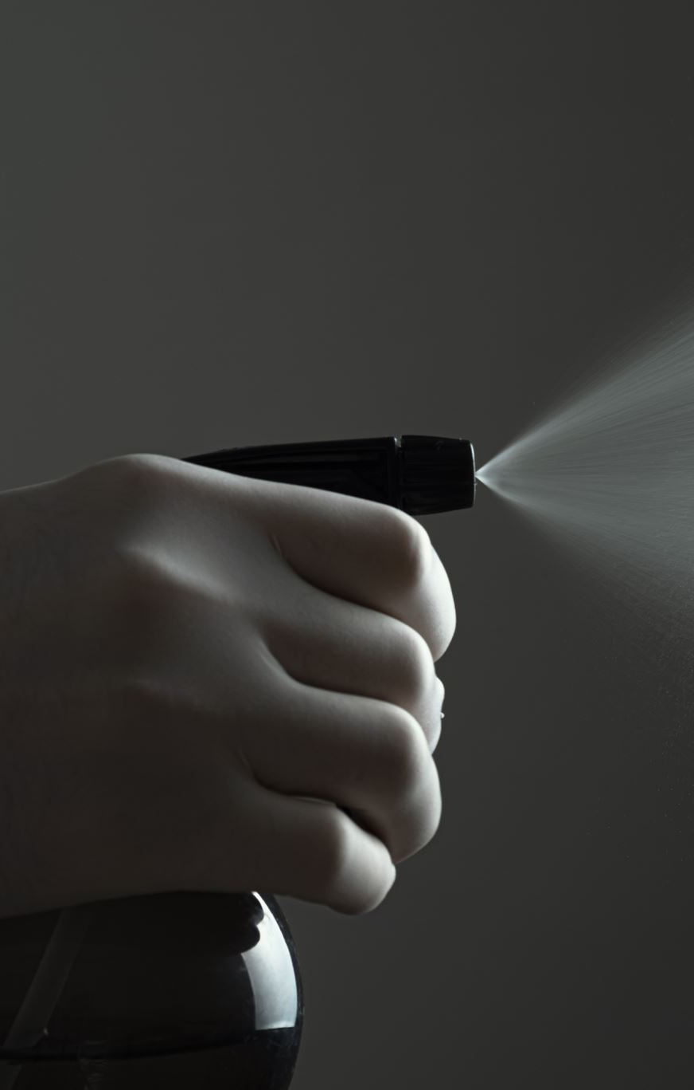
PRODUCT AND SERVICES:
Sparkle Clean offers a wide range of commercial and residential cleaning services :
  -DOMESTIC CLEANING
  - COMERCIAL CLEANING
  - GENERAL CLEANING
  - END OF TENANCY CLEANING
  - BUILDERS CLEANING
  - WINDOWS CLEANING
  - CARPET CLEANING
  - PRESSURE WASHING
  - LAUNDRY CLEANING
  - DISINFECTETION AND SANITIZATION
  - GREEN CLEANING

Slide 5
MARKET AUDIT
Our marketing and sales strategy will focus on targeting potential customers through online and offline channels. We will build a website and create social media accounts to promote our services and engage with potential customers. We will also use search engine optimization (SEO) techniques to improve our website's visibility on search engines. In addition, we will distribute flyers and brochures in local neighbourhoods and businesses to reach potential customers. We will also participate in local community events and sponsor local organizations to build brand awareness and reputation.

Slide 6
COMPETITORS
There are a lots of competitors in the cleaning service space. We will do a research and convince our clients that our services are better.
If there is need it, we can do strategic alliances.

Slide 7
SWOT Analysis
Strengths | Weaknesses
Highly skilled and trained staff | Limited market recognition
Use of eco-friendly products | Limited geographic reach and customer base
Offering a range of services including deep cleaning and specialized cleaning | Dependence on manual labour, which could limit scalability and increase costs
Competitive pricing and discounts to loyal customers | Higher price compared to competitors
Positive brand reputation and customer satisfaction Flexible scheduling option | Limited advertising budget

Slide 8
SWOT Analysis
Opportunities | Threats
Growing demand for eco-friendly and sustainable cleaning services | Intense competition from established and emerging cleaning companies
Increasing focus on workplace safety and hygiene. | Regulatory changes and licensing requirements in the cleaning industry
Expansion into adjacent markets such as office cleaning, post-construction cleaning, and vacation rental cleaning | Changes in consumer preferences and shifting market trends
Growing market for elderly care cleaning services | Increasing minimum wage and labour costs
Development of new and innovative cleaning technologies | Economic downturns that could impact consumer spending on cleaning services

Slide 9
How to work out the business weakness and how to attack the treats ?

Slide 10
We will work out our weakness and attack the treats providing periodic training for our staff , making sure that they are on the top with technology and eco-friendly product.
Asking feedback from clients and work out if there is need it.
As our services can be more expensive than some other companies, we will try to sign contracts with offices and big companies as they have more recourses.
Strategic alliances - to cover new area and expand our business.

Slide 11
PESTLE Analysis
Political factors that could benefit or impact the business, such as gouvermnent regulation related to eco-friendless.
Economic factors - inflation (could affect expenses / revenue)
Social factors - increasing awareness of eco-friendliness .
Technological - new and more efficient equipment and products
Legal factors - safety standards , insurance , employment regulations.
Environmental factors – We providing Green Cleaning ( safe and non-toxic products ).

Slide 12
Marketing plan
TARGET MARKET – HOMEWOWNERS AND BUSINESS
Focus on building relationship with potential customers
Online and offline marketing channels ( building website , social media accounts)
Sponsoring local organizations to build brand reputation
Offline marketing – distributing flyers and brochures

Slide 13
Management and organization
Claudia Popa (60%) - founder / trainer
Kristine Diduzs (20%) - founder/ sale and marketing – Birmingham office
Gheorghe Cacaliceanu (20%) - founder/trainer /driver
Team members – professional cleaners

Slide 14
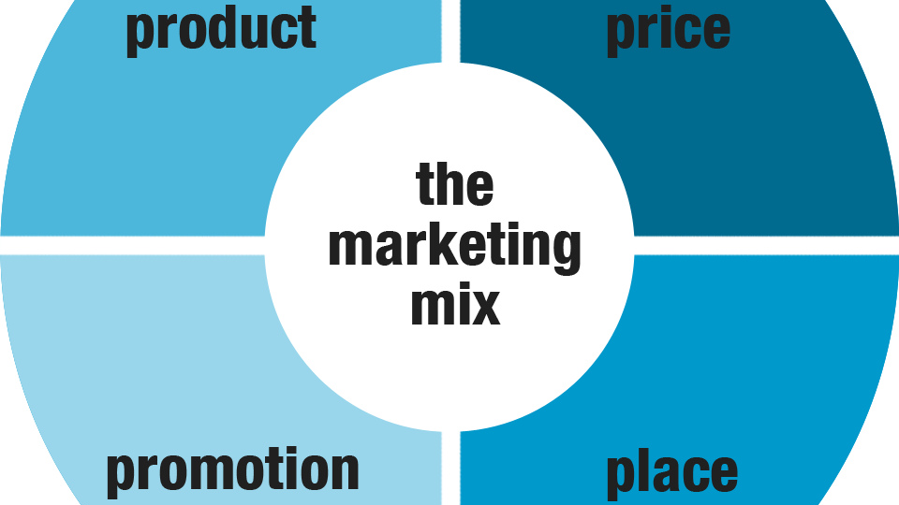
4Ps of Marketing
Product / service – cleaning
Price – from 18£ (profit margin 10£ )
Promotion - discount/ free hours
Place – Online or in store

Slide 15
Competitors analyses
 | Competitor 1 | Competitor 2 | Competitor 3 | Sparkle Clean
Product quality | 5 | 4 | 7 | 10
Pricing | 7 | 8 | 5 | 8
Place | 3 | 2 | 5 | 6
Promotion | 3 | 1 | 6 | 9.5
Positioning | 5 | 7 | 8 | 7
Reputation | 4 | 6 | 6 | 8
People | 6 | 3 | 6 | 9
Partnership | 1 | 3 | 8 | 10

Slide 16
References :
Bunderson, Gaye. "Have Your Business Plan in Hand Before Seeking $$$." Idaho Business Review, 31 January 2005.
Read more: https://www.referenceforbusiness.com/management/Bun-Comp/Business-Plan.html#ixzz7v0JBSm4C
Entrepreneur Magazine's Creating a Successful Business Plan (4th ed.). (1999). Irvine, CA: Entrepreneur Media Inc. (REF HD 62.7 .E58)
Rule, R. C. (2004). Rule's book of business plans for startups: Creating a winning plan that you can take to the bank. Irvine, CA: Entrepreneur Press. (HD 62.5 .R85 2004)
Timmons, J. A., Spinelli, S., & Zacharakis, A. (2004). Business plans that work: A guide for small business. New York: McGraw-Hill. (HD 30.28 .T5766 2004)

