Slide 1

BMSP6013 Project Management
Assignment 2
Lorraine Coombes (1911597)

Slide 2
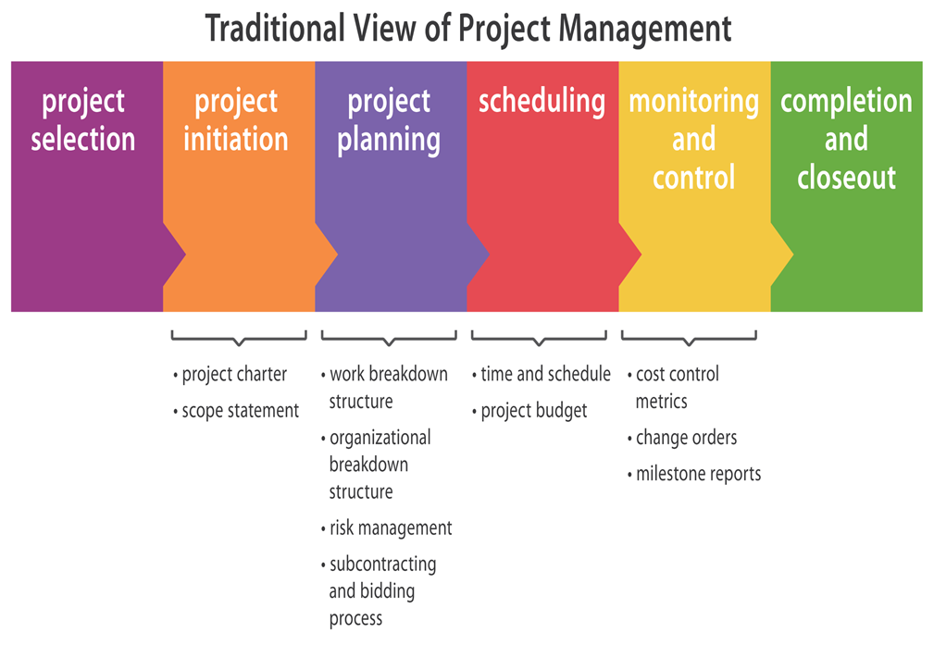
What is project management
(Russell, Pferdehirt & Nelson, 2022)

Slide 3
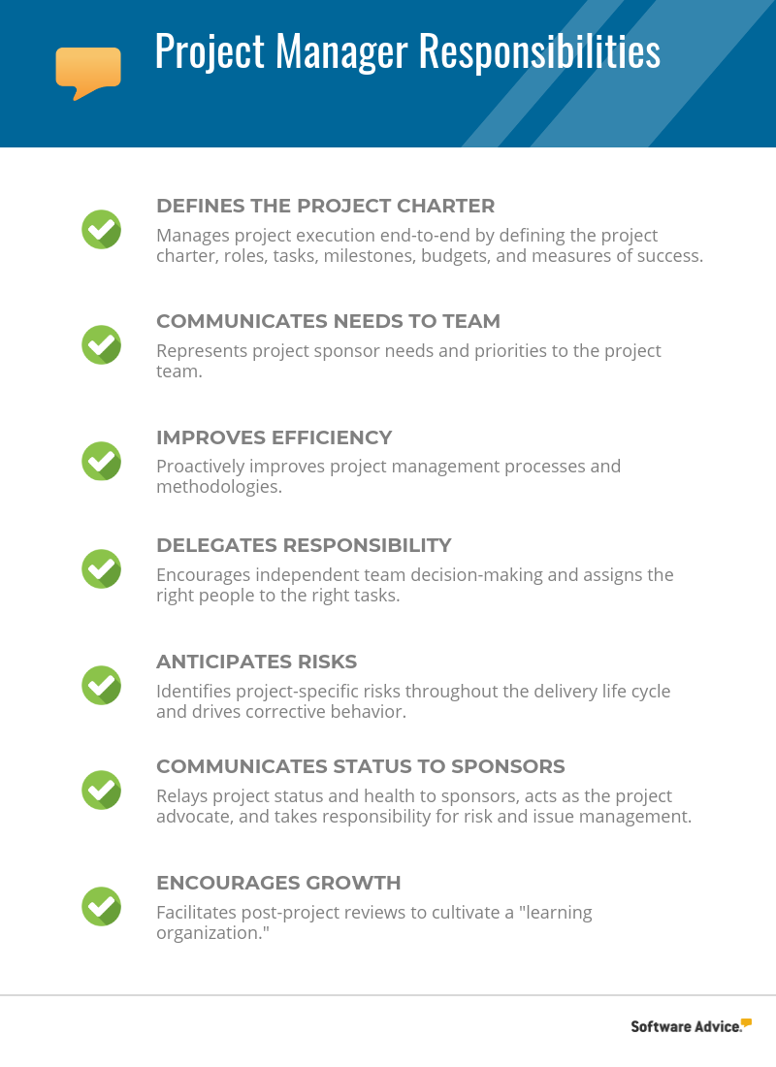
Role of a project manager
(Taylor, 2019)

Slide 4
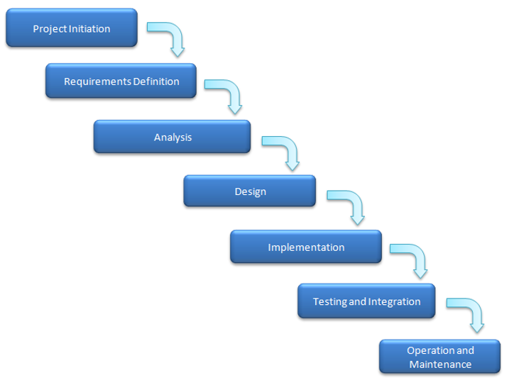
Importance of project management methodology. Waterfall
(Trajkovski, 2018)

Slide 5
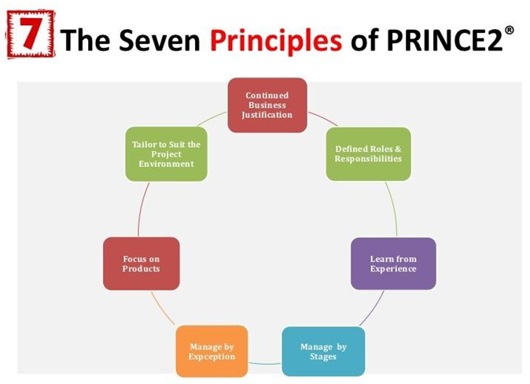
Prince 2
(Global Edulink, 2018)

Slide 6
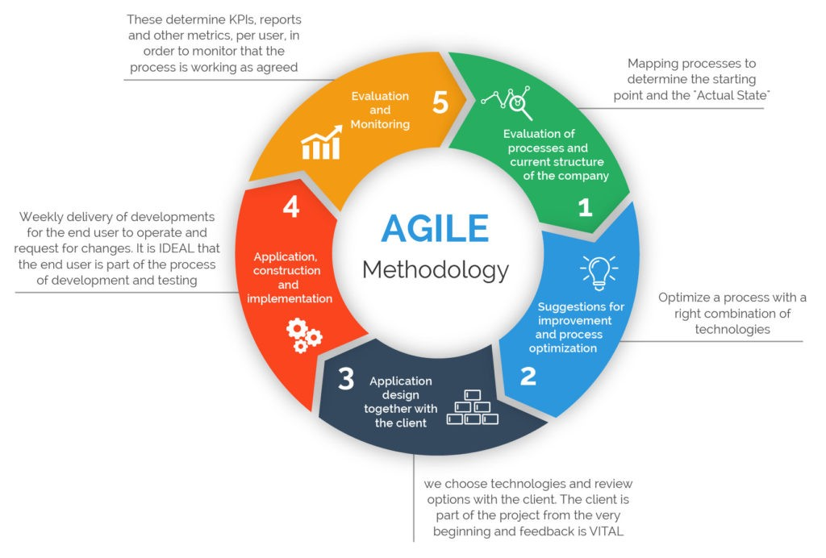
Agile
(Reddy, 2019)

Slide 7
Summary
Finding the correct approach for the project and the individuals involved is critical because of the impact and efficiency it will have. To adapt to the project, you can blend techniques. The waterfall method is more conventional, yet it is primarily employed in software development. Waterfall allows you to have more influence over the passage of time. At the main level, this reduces the loss of vital data and requirements. The downside is that the waterfall is quite rigid.
Agile was originally designed for projects that required a high level of ease of implementation of execution. The aim is on developing long-term solutions that give better results. Agile uses short delivery cycles, referred to as "sprints," to accomplish this. Agile is probably best suited to projects that demand reduced control and more time spent communicating within a shifting group. (Perkowska, 2021)
The Prince 2 method focuses on breaking down projects into stages that are achievable and controlled. Prince2 is made up of four interdependent components: Principles, Themes, Processes, and Tailoring to the project's needs. There are seven elements that serve as the foundation for a project; implementing all seven principles to a project is one of the requirements for it to be considered a 'PRINCE2 project.’ (Solus Informatics Pvt Ltd., 2019)

Slide 8
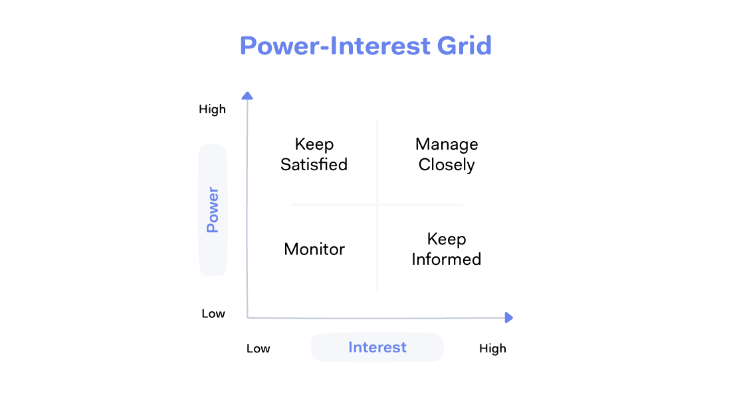
Stakeholders
The sorts of stakeholders in project management that you may need to consider vary based on the type of project and industry, however, here are a few examples of stakeholders in project management that you may need to consider:
Manager of the project
Members of the team Managers
Managers of resources Executives
Management at the top
Owners of businesses
Investors
Sponsors
Financiers Suppliers
Consultants
Customers
Customers/clients
("Project Stakeholders - Who Are They & Why Are They Important?", 2022)

Slide 9
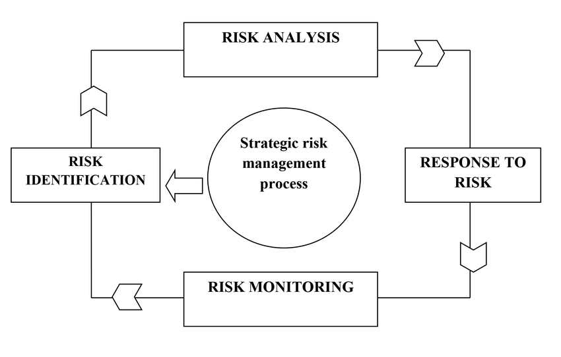
Risk Management
(Richert-Kaźmierska, 2014)

Slide 10
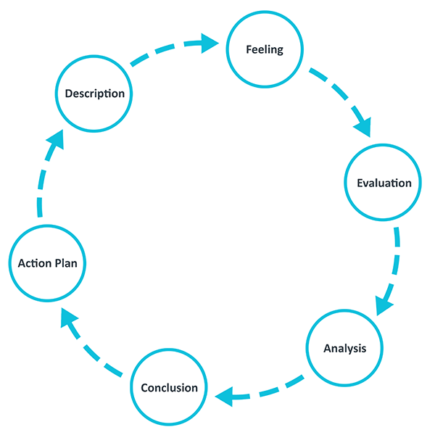
Gibbs reflective model.
("Gibbs' Reflective Cycle", 2020)

Slide 11
Gibbs reflective model.
Description of the experience:
The project management module covered several topics which included: What is project management, the different types of project management methodology (Waterfall, Prince2, Agile), Gantt Chart, project initiation, soft skills, and social media in project management.
Feelings and thoughts about the experience:
I enjoyed reading and researching about all the different aspects of project management and felt I had gained more knowledge in doing so.
Evaluation of the experience, both good and bad:
The module itself provided a decent introduction to project management. I was particularly interested in project management methodology since it was fascinating to see how it has evolved and changed through time, and how it will continue to change in the future. However, I thought that the lack of collaboration from other students detracted from my learning experience. I also wished I had had more time to study the module in depth.

Slide 12
Gibbs reflective model
Analysis to make sense of the situation:
The application of information, skills, tools, and procedures to project activities in order to achieve project requirements is known as project management. This lesson has provided me with some knowledge as well as the many tools and strategies that I may use when starting a project. Project management, from my viewpoint, is not simple and requires collaboration with stakeholders to get a positive end. In order to obtain optimum results, a professional project manager should have both experience and knowledge of the project field they are working on.

Slide 13
Conclusion
Conclusion about what I learned and what I could have done differently:
After studying this module, I believe that project management can be effective or unsuccessful depending on how it is carried out. There is no reason for it to fail if you use a decent methodology that is appropriate for the project and have the right stakeholders on your team. However, circumstances change throughout a project, but if you can alter your strategy, you can still succeed. In the end, it all comes down to completing the job on time and on budget.
Action plan for how I would deal with similar situations in the future, or general changes I might find appropriate.
If I had the opportunity to be associated with a project in the future, I would hope to reflect on my learning experience and information gained in order to be able to contribute in some way to the project, with the ultimate goal of being the next project manager in the future.

Slide 14
References
Trajkovski, N. (2018). Successfully Managing a Waterfall Project with Individual Work by Agile Teams - MPUG. Retrieved 26 April 2022, from https://www.mpug.com/successfully-managing-waterfall-project-individual-work-agile-teams/
Gibbs' Reflective Cycle. (2020). Retrieved 3 May 2022, from https://www.ed.ac.uk/reflection/reflectors-toolkit/reflecting-on-experience/gibbs-reflective-cycle
Global Edulink. (2018). Is Taking Prince2 Training Online Better For a Project Management Career: Yes or No?. Retrieved 26 April 2022, from https://medium.com/@GlobalEdulinkUK/is-taking-prince2-training-online-better-for-a-project-management-career-yes-or-no-7f1c1d059eec
Project Stakeholders - Who Are They & Why Are They Important?. (2022). Retrieved 28 April 2022, from https://www.teamwork.com/project-management-guide/project-stakeholders/
Perkowska, Z. (2021). The Most Popular Project Management Methodologies -. Retrieved 4 May 2022, from https://soldevelofoundation.org/the-most-popular-project-management-methodologies-3/?gclid=EAIaIQobChMI_6G30dXG9wIVyrHtCh0swA-WEAAYAyAAEgI_8vD_BwE
Reddy, S. (2019). Agile Project Management Methodology — Manifesto, Frameworks and Process. Retrieved 26 April 2022, from https://medium.com/@sudarhtc/agile-project-management-methodology-manifesto-frameworks-and-process-f4c332ddb779
Richert-Kaźmierska, A. (2014). Strategic-risk-management-cycle. Retrieved 3 May 2022, from https://www.researchgate.net/figure/Strategic-risk-management-cycle_fig2_278242868
Solus Informatics Pvt Ltd. (2019). Agile vs Waterfall vs Prince2 (Advantages and Disadvantages). Retrieved 4 May 2022, from https://www.linkedin.com/pulse/agile-vs-waterfall-prince2-advantages-disadvantages-solus
Taylor, D. (2019). Construction vs Project Management: What's the Difference? | Software Advice. Retrieved 26 April 2022, from https://www.softwareadvice.com/resources/construction-management-vs-project-management/

