Slide 1
Digital Skills and Research Methods
LCHS4007
Component 1: Group Presentation
Programme: Certificate of Higher Education Skills for the Workplace (Health & Social Care)
Lecturer: <Koushik Modak>
Submission: Monday 13th July 2026
Group Member Names: [Kadeem Kofi Osei-Wusu] | [Elsa De Sousa ] | [Isha Kargbo] | [Celina Cabral Mane] | [Leticia Paquete Ramos ]
Student IDs: [2543493] | [2542716] | [2542091] | [2417328] | [2544943]
Notes:
COVER SLIDE
Replace all [Name] and [ID] placeholders with your group members' real names and student ID numbers. Do not change the module title, lecturer name or submission date.

Slide 2
Acknowledgement of the Use of AI
I acknowledge that I did not use AI tool to support my work using the prompt(s):
"[Describe exactly what you asked the AI to do - e.g., Please check the following text for readability, grammar and syntax.]"
I confirm that I have NOT presented any AI-generated text as my own work.
I confirm I have copies of my drafts, notes and other resources used before and after the use of AI tools, which I may be asked to provide as evidence.
📌 If you did NOT use AI in your work, replace the text above with: 'No generative AI tools were used in the preparation of this presentation.'
Notes:
Each group member should include their own AI acknowledgement statement on this slide — or one shared statement for the group. See the assessment brief for which AI uses are permitted (research and proofreading are allowed; writing and structuring are not).

Slide 3
Contents
1.
Introduction – Case Study Overview
All members
2.
Task 1: Staff Communication → [MS Tool]
[Kadeem Kofi Osei-Wusu]
3.
Task 2: Secure File Storage & Sharing → [MS Tool]
Elsa de Sousa Pontes]
4.
Task 3: Care Documentation → [MS Tool]
[Isha Kargbo ]
5.
Task 4: Staff Scheduling / Rotas → [MS Tool]
(Celina Cabral Mane)
6.
Task 5: Staff Training → [MS Tool]
[Leticia Paquete Ramos ]
7.
Conclusion & Recommendations
[All Members]
8.
References
Notes:
Update each row with the correct MS 365 tool name and the student presenting that section.

Slide 4
introduction
what it does and who it supports
Provides high-quality, person-centred care for the elderly
Providing compassionate support and daily living activities
Administrative assistance to promote dignity, independence, well-being, and quality of life
Staff work on a rota basis, between the two buildings within our care home. , each with specific roles and responsibilities

Slide 5
Task 1: Staff Communication
Recommended Tool: Microsoft Teams Presenter: [Kadeem Kofi] | [2543493]
What does this task involve at Riverdale? Describe the specific task in 2-3 sentences, applied to the nursing home setting. Staff communication at nursing homes is essential. Microsoft teams esures all parties are communicating this ensures everyone understands the communication that needs to be understood by all parties (Microsoft 2023)
Why is Microsoft Teams the most suitable tool for this task? Justify your choice with at least one academic or credible source (Author, Year).
Microsoft teams is one of the most suitable avenues to communicate because it allows communication to be effectively understood by everyone and to store and reflect to for more information (Microsoft2024)
How does Microsoft Teams improve efficiency or communication at Riverdale? Give 2–3 specific examples using real features of the tool.
Microsoft improves and ensures effective information is understood by all parties efficiently and throughly where information can be reflected on for future reference Microsoft teams is also a reliable software with good security (Microsoft 2023)
What are the advantages of using Microsoft Teams in this context? (e.g. accessibility, collaboration, cost). Cite a source. The advantages of using Microsoft teams are vast including communicating in real time collaborating worldwide (Microsoft 2022)
What are the limitations of using Microsoft Teams here? (e.g. internet dependency, staff training, licensing). Cite a source.
The limitations of Microsoft teams is internet dependency as anything can happen (Microsoft 2026)
)Microsoft Teams suits nursing home staff communication because it combines several functions in one platform Instant messaging ,Video calling,File sharing & integration with Office 365 ,Mobile app access
⏱ You have up to 5 minutes to present this slide. You will be asked individual questions by the assessor afterwards.
Notes:
INDIVIDUAL SECTION — Task 1: Staff Communication | Tool: Microsoft Teams
Replace the red bullet instructions with your own written content. Every factual claim must have an in-text Harvard citation (Author, Year). Present this section for up to 5 minutes. You will be asked individual questions by the assessor afterwards — make sure you can expand on every point you put on this slide.

Slide 6

Benefits & Limitations: Microsoft Teams at Riverdale
Benefits
Limitations
Microsoft Teams suits nursing home staff communication because it combines several functions in one platform:
• Instant messaging & channels
• Video calling
• File sharing & integration with Office 365 –
• Mobile app access
The limitations of Microsoft teams is internet dependency as anything can happen
(Microsoft, 2026)
Notes:
Extended benefits and limitations slide for Task 1. Can be presented as part of the 5-minute slot or used as a reference during Q&A.

Slide 7
Secure File Storage & Sharing
{Elsa De Sousa} {2542716}
What does this task involve at Riverdale?
Staff have to share and store resident's policies , documents and care plans safely
The most recent records must be accessible to carers, nurses, and administrators who operate in two buildings without making duplicate copies.
Why is the best tool?
OneDrive offers safe cloud storage allowing authorised personnel to view data from different places
It allows real-time collaboration and automatic saving, which results in minimising the danger of losing critical information (Microsoft, 2025).

Slide 8
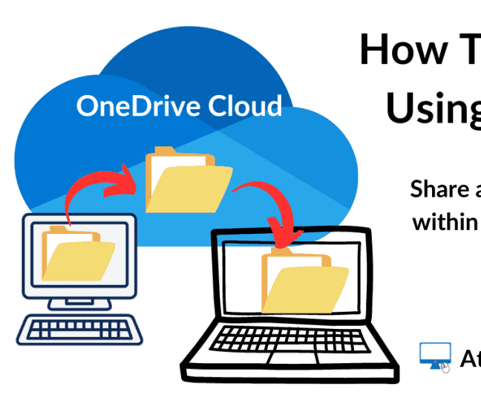
Secure File Storage & Sharing {Elsa De Sousa}
How does Onedrive Improve Efficiency
Documents are accessible to staff from both buildings
Modifications are automatically stored
Via the use of permission settings, files can be shared in a secure manner
It is possible to restore prior versions of documents by using the version history feature

Slide 9
Secure File Storage & Sharing {Elsa De Sousa}
Benefits
Limitations
encryption to ensure the safety of cloud storage (Microsoft, 2025)
Makes easy to collaborate and share files
Can be use on mobiles, tablets or personal computers
Reduce the number of duplicates documents
It is necessary to have a reliable connection to the internet
Training is necessary for staff members in order to use sharing permissions effectively
Storage is limited and depends on the organization's Microsoft 365 licence (Laudon & Laudon, 2022).

Slide 10
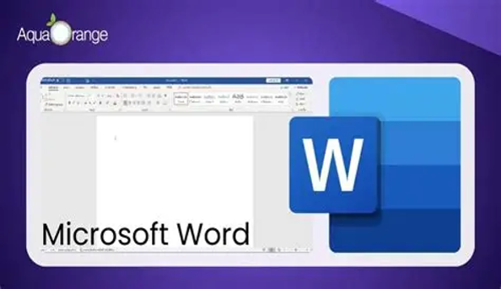
Task 3: Care Documentation
Recommended Tool: Microsoft Word Presenter: Isha Kargbo | 2542091
What does this task involve at Riverdale? Describe the specific task in 2-3 sentences, applied to the nursing home setting. At Riverdale Nursing Home, Microsoft Word is used to create accurate and professional documentation.
Why is Microsoft Word the most suitable tool for this task? Justify your. choice with at least one academic or credible source (Author, Year). With Microsoft Word:
Helps staff quickly draft reports, initial assessments, and discharge summaries
Create policies and procedures and care plans easily.
(UMATechnology, 2025)
How does Microsoft Word improve efficiency or communication at Riverdale? Give 2–3 specific examples using real features of the tool.
Inserting images.
Microsoft Word allows seamless collaboration among staff members, like real-time editing.
Crafting table and presenting data
(Monterey, 2023)
(Google, 2023)
⏱ You have up to 5 minutes to present this slide. You will be asked individual questions by the assessor afterwards.
Notes:
INDIVIDUAL SECTION — Task 3: Care Documentation | Tool: Microsoft Word
Replace the red bullet instructions with your own written content. Every factual claim must have an in-text Harvard citation (Author, Year). Present this section for up to 5 minutes. You will be asked individual questions by the assessor afterwards — make sure you can expand on every point you put on this slide.

Slide 11
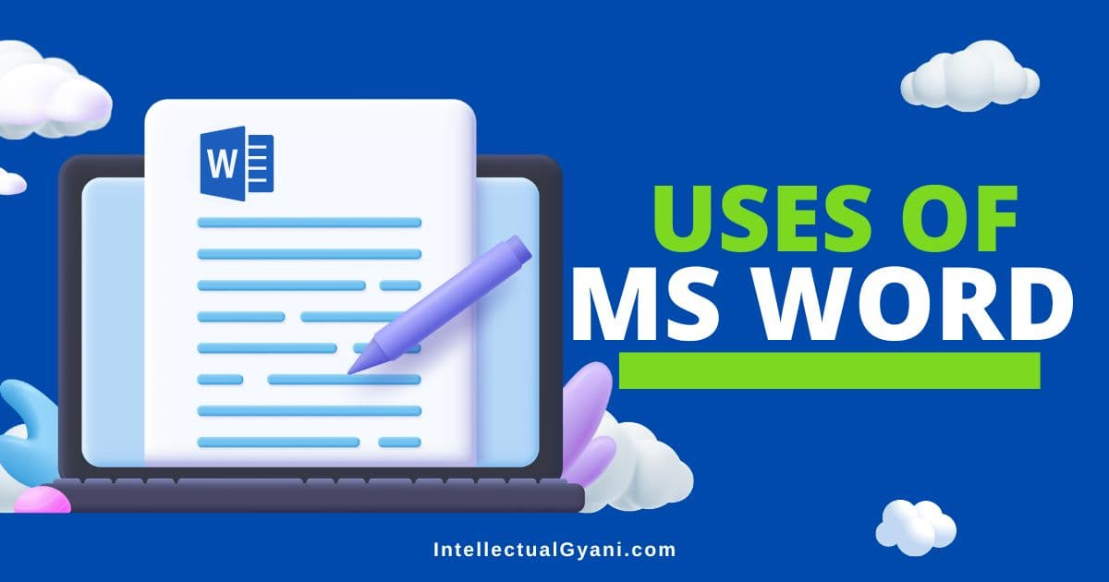
Task 3: Care Documentation
Recommended Tool: Microsoft Word Presenter: Isha Kargbo 2542091
What are the advantages of using Microsoft Word in this context? (e.g. accessibility, collaboration, cost). Cite a source.
Collaborative features: Microsoft Word enhances collaboration through real-time co-authoring, Track Changes and comments
Easy file sharing and storage: Integration with Microsoft OneDrive allows secure cloud storage, seamless file sharing, and remote access across devices.
It provides a cost-effective solution for our specific needs What are the limitations of using Microsoft Word here? (e.g. internet dependency, staff training, licensing). Cite a source. Microsoft Word has some limitations, including:
Reduced performance with very large files
Limited access to cloud features and collaboration tools without an internet connection.
(freenology, 2025)
(Interlectualgyani ,2025)
⏱ You have up to 5 minutes to present this slide. You will be asked individual questions by the assessor afterwards.
Notes:
INDIVIDUAL SECTION — Task 3: Care Documentation | Tool: Microsoft Word
Replace the red bullet instructions with your own written content. Every factual claim must have an in-text Harvard citation (Author, Year). Present this section for up to 5 minutes. You will be asked individual questions by the assessor afterwards — make sure you can expand on every point you put on this slide.

Slide 12
MICROSOFT TOOL
4.Microsoft Teams – Shifts
In plain English: Shifts is a digital rota staff check on their phone, instead of a paper timetable pinned to the staff-room wall.
• Shifts is a scheduling app within Microsoft Teams designed for frontline and shift-based workforces (Microsoft, 2026).
• Managers can build rotas, publish open shifts, and let staff request swaps or time off through the app.
• Smart scheduling can match available staff to open shifts based on hours, availability and constraints (Microsoft, 2026).
• All staff can view the current rota from their phone rather than a printed notice board.

Slide 13
Microsoft Teams – Shifts: Benefits & Limitations
BENEFITS
LIMITATIONS
+ Reduces time managers spend manually building and re-
issuing paper rotas each week.
–
Staff without a work smartphone or comfortable using
apps may struggle to check their rota.
+ Staff can view, request changes to, or swap shifts from
their phone, improving flexibility.
–
Automated matching still needs manager oversight to
reflect staff skills and resident needs.
+ Automated scheduling can help respect rest-period and
maximum-hours constraints.
–
System downtime could leave staff without access to the
current schedule.

Slide 14
Benefits & Limitations: MS Word at Riverdale
Benefits
Limitations
With Microsoft Word, you can:
Visuals: (Images, Clip Art)
Proofreading
Easily create and access consent forms
Do document Formatting
(TechBloat, 2025)
Complex Interface-usability hurdles
Compatibility Issues: Security Risks
Limited Offline Access
Time required to learn and use the tools
(freenology, 2025)
Notes:
Extended benefits and limitations slide for Task 1. Can be presented as part of the 5-minute slot or used as a reference during Q&A.

Slide 15

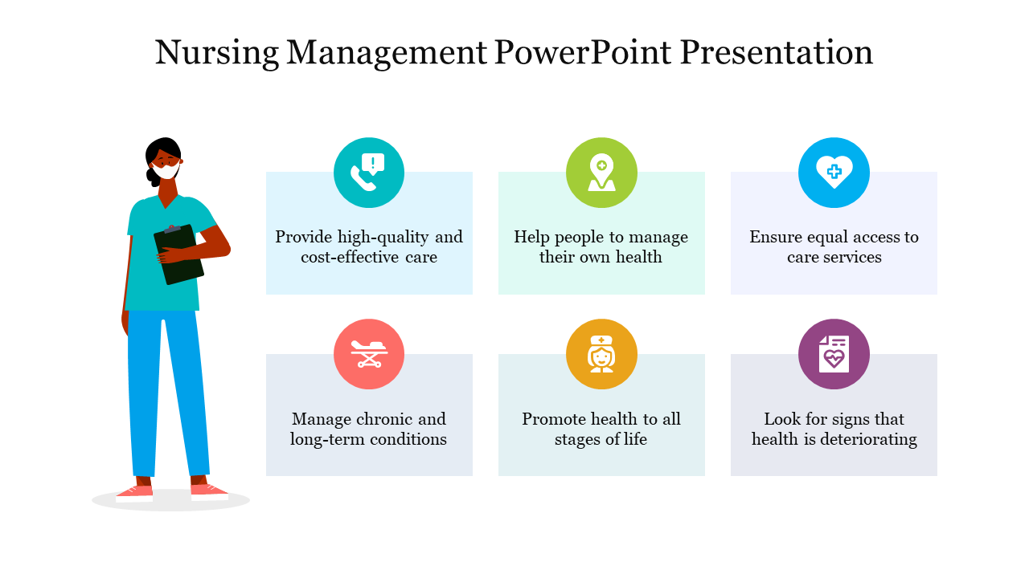
Task 5: Staff Training
Recommended Tool: Microsoft PowerPoint Presenter: [Leticia Paquete Ramos] | [2544943]
What does this task involve at Riverdale?
Microsoft PowerPoint, at Riverdale Nursing Home is used to make presentations for staff meeting, for example, health and safety new procedures, how to protect the vulnerable individual and ourselves while in duty, the importance of personal protective equipment (PPE) that is used to prevent spread of infections and how to dispose.
It can also be used during consultation or conferences to communicate new policies and procedures, care plans, and announcements.
Why is Microsoft PowerPoint the most suitable tool for this task?
PowerPoint is considered the most appropriate tool because it gives people the power to share information easily suing images, videos, animations, and other multimedia, making it easier to elaborate important information for staff to understand.
It also allows staff to engage during the meeting and to share attractive presentations. (Richard E. Mayer, 2021)
⏱ You have up to 5 minutes to present this slide. You will be asked individual questions by the assessor afterwards.
Notes:
INDIVIDUAL SECTION — Task 5: Staff Training | Tool: Microsoft PowerPoint
Replace the red bullet instructions with your own written content. Every factual claim must have an in-text Harvard citation (Author, Year). Present this section for up to 5 minutes. You will be asked individual questions by the assessor afterwards — make sure you can expand on every point you put on this slide.

Slide 16

Task 5: Staff Training
Leticia Paquete Ramos (2544943)
How does Microsoft PowerPoint improve efficiency or communication at Riverdale?
With Microsoft Teams or OneDrive staff can access or share additional information easily, for example, new policies and procedures, and the latest training elements without printing any documents. Members can also work together on the same presentation, leave any real time feedbacks or any changes.
Sometimes, reading staff training documents can make everything much difficult to learn but with Videos or images demonstrating manually step by step how the handle procedures

Slide 17
Benefits & Limitations: MS PowerPoint at Riverdale
Benefits
Limitations
Time management (Microsoft, 2023)
Real time feedback Jayadi et al. (2024)
Easy to understand
Improves communications
Poor presentation design
Due to the lack of understanding how to use PowerPoint can result in poor quality of presentation design especially for someone that doesn’t have any skill or experience using Microsoft or any other tool.
Technical issues
Software or internet problems can also interrupt the presentation while the staff training is happening.
(Mayer, 2001)
Notes:
Extended benefits and limitations slide for Task 1. Can be presented as part of the 5-minute slot or used as a reference during Q&A.

Slide 18

Staff Scheduling/Rotas
{Celina Mane} [2417328]
What is involved in this Riverdale task?
Entails allocating shifts for nurses, administrative personnel, senior carers, and carers across two buildings
To overseeing yearly leave, sick leave, and shift changes
Good rotas assist the seamless operation of the nursing home and preserve continuity of care
What makes Microsoft Excel the best tool?
Builds well-organised and transparent rotas using tables, rows, and columns,
Assists in the staff’s coordination across both buildings
Used to record working hours, annual leave, sick leave, and shift changes
Helps workforce planning and lowers scheduling errors
Share digital schedules with employees in both buildings
Cut down on paperwork, and support the maintenance of appropriate staffing levels (O’Connell et al., 2024)

Slide 19
Staff Scheduling/Rotas {Celina Mane} [2417328]
Benefits
Limitations
Excel's benefits include its ability to facilitate cooperation through shared files
Easy to update schedules
Organise staff information
It saves time by maintaining rotas using formulas and automated computations.
(O’Connell et al., 2024).
Excel does have certain restrictions
Version-control problems may occur when numerous users modify the same file
Staff may need training to utilise the software efficiently
Manual updates are required when changes occur
Internet access and Microsoft 365 access may also be necessary for sharing documents.
(Shaw et al., 2020).

Slide 20
Summary: Benefits & Limitations of Recommended Tools
Workplace Task | MS 365 Tool | Key Benefit | Key Limitation
Staff Communication | Teams | [Add benefit + citation] | [Add limitation + citation]
File Storage & Sharing | OneDrive | [encryption to ensure the safety of cloud storage (Microsoft, 2025)] | [Storage is limited and depends on the organization's Microsoft 365 licence (Laudon & Laudon, 2022). ]
Care Documentation | Word | [Font Customisation] (learn.microsoft, 2025) | [Compatibility Issues: Security Risks] (learn.microsoft, 2025)
Staff Scheduling / Rotas | Excel | [It saves time by maintaining rotas using formulas and automated computations ] (O’Connell et al., 2024) | [Internet access and Microsoft 365 access may also be necessary for sharing documents. (Shaw et al., 2020). ]
Staff Training | PowerPoint | [Real-time feedback Jayadi et al. (2024) ] | [Software or internet problems can also interrupt the presentation while the staff training is happening. (Mayer, 2001)]
Notes:
GROUP SLIDE — Fill in each row using content from each member's individual section. Keep benefit and limitation to one concise sentence each, with a citation.

Slide 21
Conclusion
In conclusion
Microsoft 365 is the most suitable tool for the workplace, study and research purposes, serving as a valuable tool in the medical field, streamlining processes, enhancing documentation, and facilitating communication among healthcare professionals. Its versatile features adapt well to the specific needs of healthcare,….
Microsoft Word is good for the nursing home as we can make documents
At the nursing home Microsoft Excel is good as it allows us to create spreadsheets
Microsoft’s software PowerPoint is used within the facility to present suggestions and get information across fast
Microsoft Teams allows all parties to communicate worldwide instantly
OneDrive allows all parties to have access to the storage
Notes:
SHARED GROUP SLIDE — ideally delivered together. Replace every red bullet with your group's actual conclusions. Do not be generic — refer directly to Riverdale and the five tools your group evaluated.

Slide 22
References
{Isha Kargbo-2542091} {Elsa De Sousa 2542716}
List all sources cited in this presentation in alphabetical order by author surname.
Use UWTSD Harvard Referencing style throughout. Minimum 4 credible academic sources across the group.
Laudon, K.C. and Laudon, J.P. (2022) Management Information Systems: Managing the Digital Firm. 17th edn. Harlow: Pearson.​
Microsoft (2025) OneDrive cloud storage. Available at: https://www.microsoft.com/en-gb/microsoft-365/onedrive/online-cloud-storage (Accessed: 6 July 2026). Microsoft (2025) OneDrive documentation. Available at: https://learn.microsoft.com/en-us/onedrive/ (Accessed: 6 July 2026).​ At Home Computer (2023) How to share files using OneDrive [Image]. Available at: https://athomecomputer.co.uk/wp-content/uploads/2023/03/How-To-Share-Files-Using-OneDrive-1024x536.png (Accessed: 9 July 2026)
Isha Kargbo-2542091} Monterey, T. (2023). Microsoft Word as a Productivity Tool: Unveiling Its Impact and Benefits – ictsd.org. Ictsd.Org. https://www.ictsd.org/microsoft-word-as-a-productivity-tool-unveiling-its-impact-and-benefits/ [Accessed 10 July 2026].
TechBloat. (2025, January 18). How Is Microsoft Word Used In The Medical Field - TechBloat. TechBloat. https://www.techbloat.com/how-is-microsoft-word-used-in-the-medical-field.html [Accessed 10 July 2026].
UMATechnology. (2025, January 18). How Is Microsoft Word Used In The Medical Field - UMA Technology. UMA Technology. https://umatechnology.org/how-is-microsoft-word-used-in-the-medical-field/#google_vignette [Accessed 10 July 2026].
web.dgaps@gmail.com (2025). Advantages and Disadvantages of Microsoft Word: Pros vs Cons. [online] freenology.com. Available at: https://freenology.com/advantages-and-disadvantages-of-microsoft-word/ [Accessed 10 July 2026].
Notes:
Remove the example formats above and replace with your group's actual reference list. Every source cited with (Author, Year) anywhere in the slides must appear here. References must be in alphabetical order.

Slide 23
References
{Leticia Ramos} {2544943}
Ainun Jariyah A1, Andi Anto Patak2*, Lely Novia3 . (2025). The Impact of Microsoft PowerPoint Online ‘Rehearse with Coach’ Feature in Improving BEC Students’ Presentation Skills. https://eprints.unm.ac.id/36613/1/Artikel%20Microsoft%20Rehearse%20with%20Coach%20-%20Ainun.pdf
SlideUpLift. (2023). Advantages and Disadvantages of Using PowerPoint for Presentations. [online] Available at: https://slideuplift.com/blog/advantages-and-disadvantages-of-using-powerpoint-for-presentations/ [Accessed 11 July 2026].
Notes:
Remove the example formats above and replace with your group's actual reference list. Every source cited with (Author, Year) anywhere in the slides must appear here. References must be in alphabetical order.

Slide 24
References
[Kadeem Kofi Osei-Wusu] 2543498 [Celina Cabral Mane] 2417328
(Kadeem Kofi Osei-Wusu)2543498 Microsoft (2024) (online) security guide. Available at: https://learn.microsoft.com/en-us/microsoftteams/teams-security-guide (Accessed: 10 July 2026).
(Kadeem Kofi Osei-wusu)2543498 Microsoft (2026) What's new in Microsoft Teams. Microsoft Support. Available (online)https://support.microsoft.com/en-us/teams/platform/what-s-new-in-microsoft-
teams (Accessed: 13 July 2026).
16Thank You
[Celina Cabral Mane] 2417328
O’Connell, M., Barry, J., Hartigan, I., Cornally, N. and Saab, M.M. (2024). The impact of electronic and self‐rostering systems on healthcare organisations and healthcare workers: A mixed‐method systematic review. Journal of Clinical Nursing, 33(7). doi:https://doi.org/10.1111/jocn.17114.
Shaw, R., Stroo, M., Fiander, C. and McMillan, K. (2020). Selecting Mobile Health Technologies for Electronic Health Record Integration: Case Study. Journal of Medical Internet Research, 22(10), p.e23314. doi:https://doi.org/10.2196/23314.
Irvin, S.A. and Brown, H.N. (1999). Self-scheduling with Microsoft Excel. Nursing economic$, [online] 17(4), pp.201–6. Available at: https://pubmed.ncbi.nlm.nih.gov/10711163/ [Accessed 11 July 2026].
Notes:
Remove the example formats above and replace with your group's actual reference list. Every source cited with (Author, Year) anywhere in the slides must appear here. References must be in alphabetical order.

Slide 25
THANK YOU VERY MUCH FOR LISTENING
Question & Discussions.

