Slide 1
Developing Innovation and
Creativity for Business Advantage
Week 6 (Part 2)
The Internet and eCommerce

Slide 2
Recap
Week 1 (Introduction to DIB)
Week 2 (Creativity, Innovation, and Entrepreneurship".
Week 3: Part 1: Concepts & techniques of innovation & creativity & Part 2: New-Product Development and Product Life-Cycle Strategies
Week 4: Part 1: Concepts & techniques of innovation & creativity & Part 2: New-Product Development and Product Life-Cycle Strategies
Week 5: Part 1: Innovation, Growth & Competition & Part 2: Open and Closed Innovation
Week 6: Part 1: Disruptive Innovations & Part 2: Innovation Impulses
This week we will look at:
Part 1: Digital Revolution
Part 2: Innovative eBusines
Part 3: Digital Marketing

Slide 3
History
1950s: cold war initiative: the US Advanced Research Project Agency (ARPA) wanted a telecommunications network that could survive nuclear war
1969 – 70s: academics develop ARPANET with public funding to develop first connected network nodes, using packet switching technology
1970s – 80s: network expands (mostly academic/government users); technology changes and eventually TCP/IP adopted as the underlying protocol
1980s – 1990s: Personal computers arrive; basic eMail available: information repositories proliferate (Usenet); international connections grow (Europe, Asia)

Slide 4
History
1990s – 00: transition from public to commercial utility (via ISPs); HTML and browsers become available (www); dot com boom
2000 – today: exponential growth of internet globally

Slide 5
The Internet today…
  An essential utility for knowledge sharing
  A platform for commerce, public service, healthcare, education, entertainment, communication and much more
  An essential business tool
  But... usage / access varies greatly:
      by age
      by location
      by education
      by social group

Slide 6
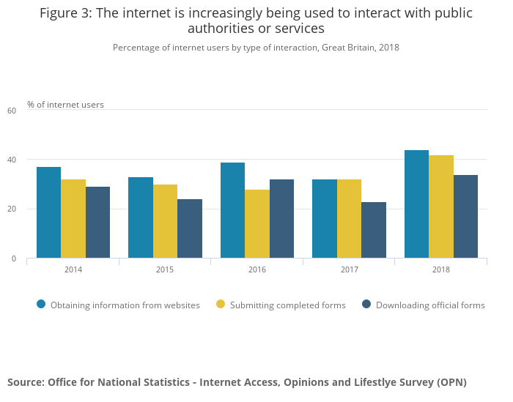

Slide 7
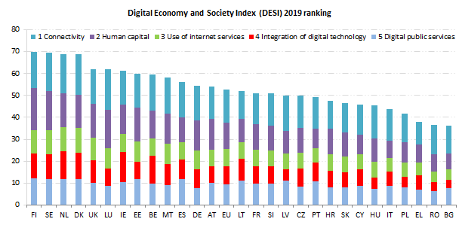
Development of Internet in Europe
https://ec.europa.eu/digital-single-market/en/use-internet

Slide 8
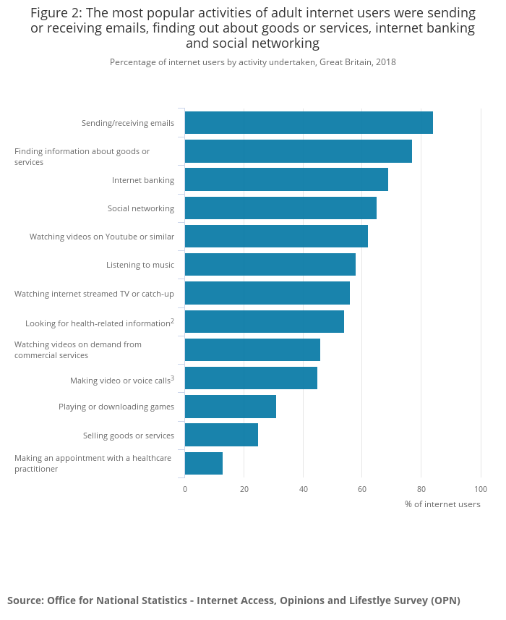

Slide 9
eCommerce
  commercial transactions conducted electronically on the Internet
  buying and selling good and services
  transmitting funds electronically
  agreeing contracts electronically
  marketing and promoting goods and services online
  online ticketing and reservations
  online brokerage
  …and much more…
  definitions
  B2B – business to business ecommerce
  B2B – business to consumer ecommerce
  C2C – consumer to consumer ecommerce
  mCommerce – mobile ecommerce

Slide 10
eCommerce infrastructure-
what’s needed to make eCommerce work?
  Some obvious stuff…
    technology – the technical infrastructure: networks, switches, routers, access devices…
    search – ability to find products and services
    payment – mechanisms to pay for online transactions
    platforms – storefronts and channels to access markets & promote products
    logistics – systems to allow the distribution of goods and services globally

Slide 11
eCommerce infrastructure- what’s needed to make eCommerce work?
  Some less obvious stuff…
    productivity – tools to facilitate timely and accurate exchange of information
    legal – legislation to underpin online contracts
    governance – rules, resource allocation (e.g. IP), addresses, security…

Slide 12








eCommerce infrastructure
eCommerce infrastructure favours large scale players (network effect)

Slide 13

eCommerce productivity

Slide 14
eCommerce platforms
an information technology solution that allows retailers to build ‘storefronts’
Web
Mobile
Store
App
Partner
eCommerce platform
storefronts (or channels) are ways/routes for retailers to present their products to customers (online, in-store, mobile, social media, broadcast…)

Slide 15

eCommerce platforms

Slide 16
eCommerce legislation
EU Electronic Commerce Directive, 2002 applies to consumer contracts concluded by electronic means over distance
Consumer Protection (Distance Selling) Regulations 2000 – applies to goods and services sold over the radio, internet, digital television, mail order, phone, fax
Consumer Contracts Regulations, 2014 – applies to online contracts entered into after 13 June 2014
Electronic Signature Directive (2011) - establishes the legal framework at European level for electronic signatures and certification services
Electronic Money Institutions Directive – allows banks and building societies to issue electronic money

Slide 17
eCommerce – EU jurisdiction
  Brussels Convention - for consumer and supplier in different EU countries:
  B2C: if contract does not specify jurisdiction then contract is under law of the country where consumer is based
  Consumer can sue supplier in own country; supplier must go to consumer’s country to sue
  In B2B contracts, jurisdiction usually indicated clearly. Otherwise, contract is under law of the country where supplier is legally registered
  Country of Origin Principle: ISPs have to comply with the law of the EU state in which they are legally registered
  An EU member state has no responsibility with respect to service providers established in other EU countries

Slide 18
eCommerce – Taxation and Data Protection
  Taxation
  Direct tax due only in country where business is legally registered
  Indirect Tax (VAT) - digitally delivered products (software, music, books, …) are considered as services
  Payment of VAT depends on: where, what, to whom goods and services are sold
  Data Protection
  Customer must be allowed access to their data
  Customer can refuse certain use/processing of their data
  Customer can prohibit their data to be used for direct marketing
  Data cannot be xferred to non-EU country where law is “inadequate”
  EU commission specifies level of protection that is ‘adequate’

Slide 19
EU Single Digital Market
  European Single Digital Market (DSM)
  Currently laws covering digital products and services are fragmented across Europe (e.g. Netflix must negotiate country-by-country streaming deals)
  Digital Single Market Strategy adopted in May 2015 is designed to address this and is built on three pillars:
  better access for consumers and businesses to digital goods and services across Europe
  creating the right conditions and a level playing field for digital networks and innovative services to flourish
  maximising the growth potential of the digital economy.

Slide 20
eCommerce infrastructure – cloud computing
Much of eCommerce (and enterprise computing) is conducted using ‘cloud’ computing
The “cloud” is a collection of related technologies that includes:
  global connectivity - the internet
  virtualisation – millions of computers that provide computing ‘on-demand’
  dynamic provisioning of CPU using software-defined components
  fully automated operation (‘dark’ data centres)
  multi-tenancy – allows many users to use the same version of software
Cloud computing treats IT as a commodity or utility
  server is in the “cloud”
  client is on the desktop/mobile/device
  network is (usually) the Internet

Slide 21
eCommerce infrastructure – cloud computing
Infrastructure as a Service (IaaS): virtualised computing resources (hardware, software, servers, storage) provided over the Internet (AWS, Azure, Rackspace…)
Platform as a Service (PaaS): resources and tools provided over the Internet that allow customers to develop, run, and manage applications (Force.com, Bluemix, Pivotal CF…)
Software as a Service (SaaS): software applications provided over the Internet (gMail, Salesforce, Workday…)
Business as a Service (BaaS): complete business processes provided over the Internet (benefits administration, billing, complaint management…)

Slide 22
References
    http://sixrevisions.com/resources/the-history-of-the-internet-in-a-nutshell/
    http://www.theguardian.com/technology/interactive/2009/oct/23/internet-arpanet
    http://www.oft.gov.uk/about-the-oft/legal-powers/legal/distance-selling-regulations/
    http://europa.eu/legislation_summaries/information_society/l24118_en.htm
    http://www.fsa.gov.uk/Pages/About/What/International/emoney/index.shtml
    http://ec.europa.eu/internal_market/e-commerce/index_en.htm
    http://en.wikipedia.org/wiki/LICRA_v._Yahoo
    http://www.cdt.org/
    http://dash.harvard.edu/bitstream/handle/1/4455262/Zittrain_Future%20of%20the%20Internet.pdf?sequence=1
Dr. BRIAN GANNON
E: b.gannon@bbk.ac.uk
LI: http://lnkd.in/QDXaH6

