Slide 1

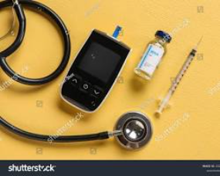

NAME: ZAINEB RAJPAR
STUDENT NUMBER: 2421792
PROGRAMME: BSc HEALTH AND SOCIAL CARE
MODULE: INTRODUCTION TO PHYSIOLOGY
MODULE CODE: BMHIP5023
LECTURER: ROBERT NARTOWSKI
ASSIGNMENT TITLE: COMPONENT 2 POWERPOINT PRESENTATION

Slide 2
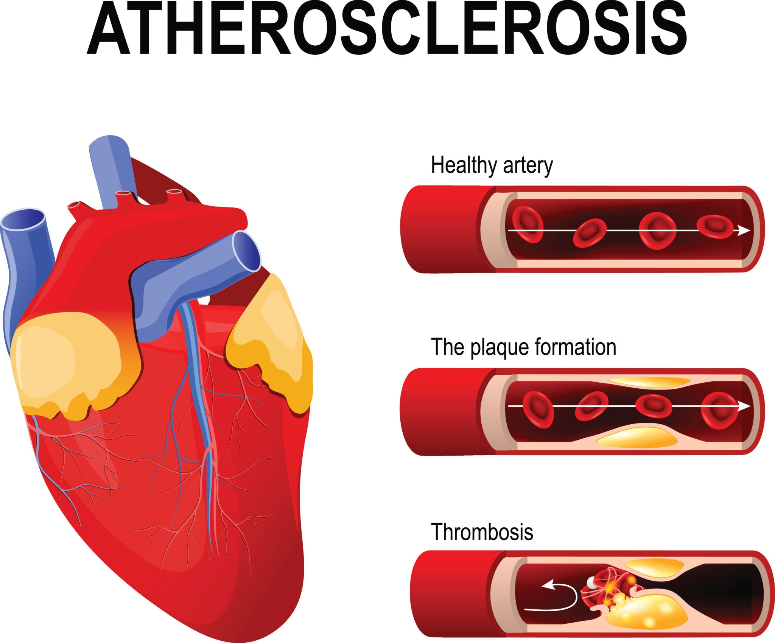
Integrated Care for Co-morbid Cardiovascular Disease and Diabetes
A Clinical and Holistic Approach to Patient Management
Nice(2023)

Slide 3
CONTENT PAGE
Anatomy & Physiology: Cardiovascular System
Anatomy & Physiology: Endocrine System (Pancreas)
Pathophysiology: CVD and Stroke
Pathophysiology: Type 2 Diabetes Mellitus
Patient Profile: "Arthur Miller"
Risk Factor Analysis: Lifestyle & Clinical Evidence
Care Plan: Clinical Monitoring & Care Routine
Care Plan: Communication & Multidisciplinary Team (MDT)
Ethical Considerations
Conclusion & Recommendations
References (Slide 1)

Slide 4
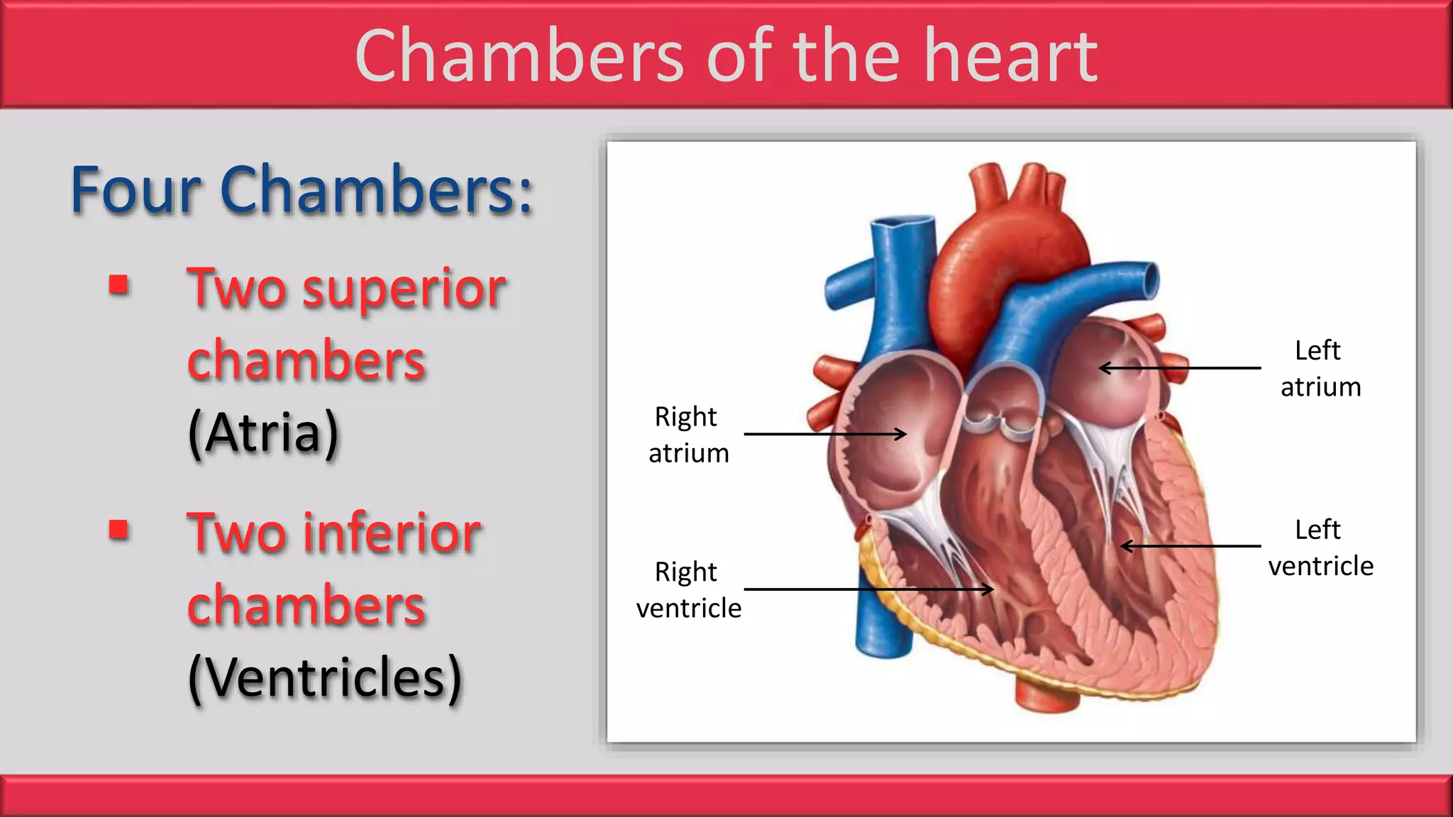
diagram of the hearts
4 chambers and the systemic/pulmonary circulation loops
(NHS 2024)
Cardiovascular Anatomy & Physiology
Heart Structure: Four chambers (atria/ventricles) responsible for systemic and pulmonary circulation.
Blood Vessels: Arteries, veins, and capillaries maintain blood pressure and nutrient exchange.
Function: Delivery of O2 and the removal of metabolic waste (CO2).
. (NHS,2024)

Slide 5
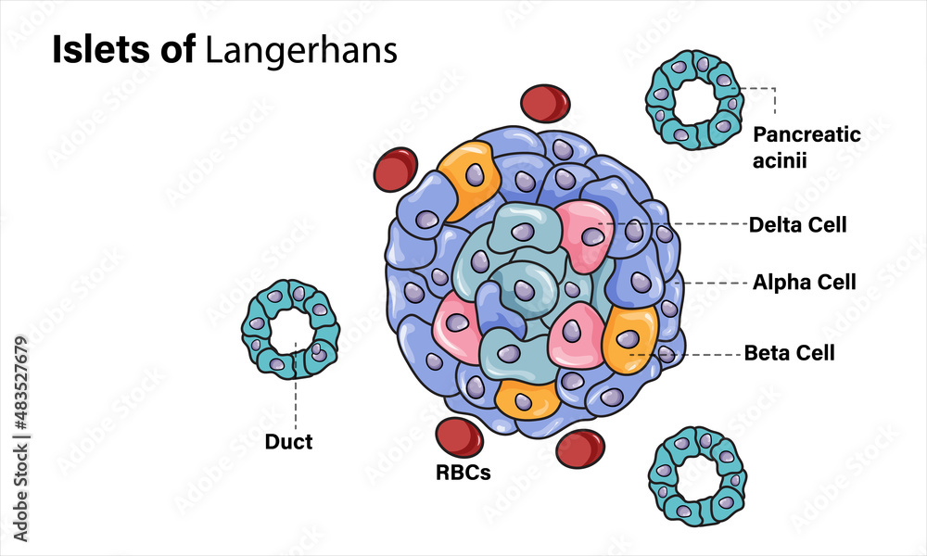
Endocrine Anatomy & Physiology (Diabetes)
The Pancreas: Specifically, the Islets of Langerhans
ALPHA & BETA CELLS : Production of Glucagon and Insulin to regulate blood glucose levels.
HOMEOSTASIS: Insulin facilitates glucose uptake into cells via GLUT4 transporters, maintaining blood sugar between 4.0–7.0 mmol/L (fasting).
Endocrine System
(Davies et al., 2022).

Slide 6
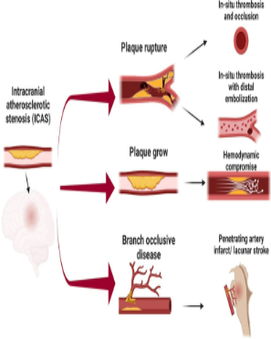
Pathophysiology: CVD and Stroke
Atherosclerosis: Buildup of plaque in arterial walls, narrowing the lumen.
Ischaemic Stroke: Occurs when a clot blocks blood flow to the brain, leading to rapid neuronal death due to hypoxia.
(NICE, 2023)
.
Pathophysiology: Stroke
Atherosclerosis leads to plaque rupture
and ischaemic events
.
(British Heart Foundation, 2024; NICE, 2022)

Slide 7
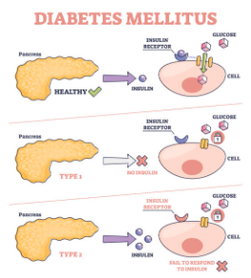
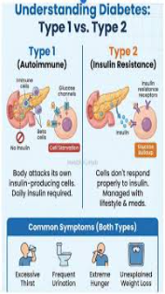
Pathophysiology: Type2 Diabetes(T2DM)
Insulin Resistance: Cells fail to respond to insulin, leading to
hyperglycemia.
Microvascular Damage: High glucose levels damage the endothelial
lining, accelerating cardiovascular complications (Diabetes UK,2025)

Slide 8
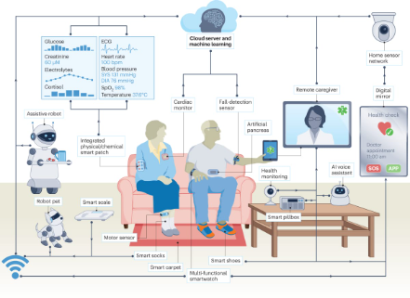
Patient Profile: Arthur Miller
Name: Arthur Miller (Fictional)
Age: 64 Height : 5.9 ft Weight : 79 kilo
Residence: BIRMINGHAM
Occupation: Accountant
Diagnosis: T2DM, Hypertension, and History of
Transient Ischaemic Attack (TIA).
Social Context: Lives alone, sedentary lifestyle,
smoker (10/day).
Clinical Goal: Reduce HbA1c and manage blood
pressure to prevent a major stroke.
(NHS,2024)

Slide 9
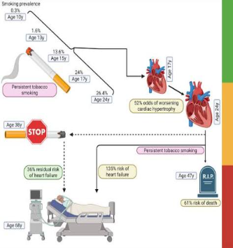
Risk Factors & Evidence-Based Recommendations
Smoking: Increases arterial stiffness. Recommendation:
Refer to NHS Stop Smoking services.
Diet: High sodium and saturated fats. Recommendation: Adoption of the
DASH or Mediterranean diet (NICE, 2023).
Physical Inactivity: Increases insulin resistance.
Recommendation: 150
minutes of moderate activity/week
Risk Factors & Experimental Evidence
Smoking increases arterial stiffness; structured exercise reduce
HbA1c by 0.6%.
(Public Health England, 2021; Davies et al., 2022).

Slide 10
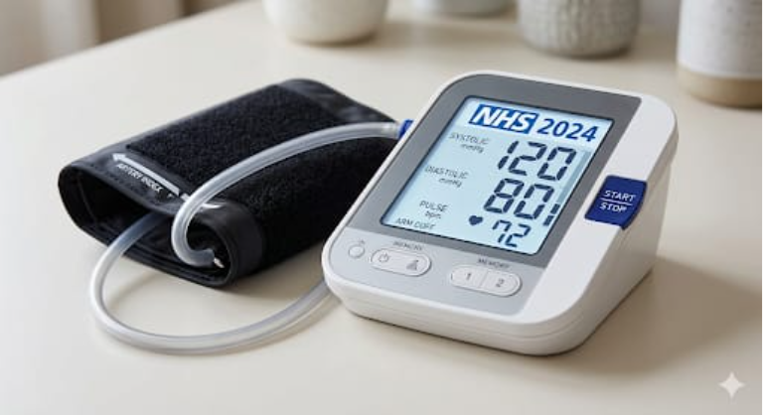
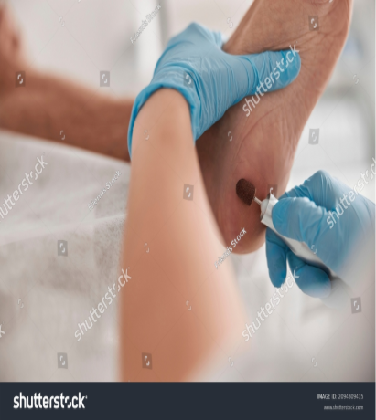
Care Plan: Monitoring & Routine
Blood Glucose: Regular monitoring of HbA1c
(Target: 48 mmol/mol or 6.5%)
Blood Pressure: Target below 140/90 mmHg
(130/80 mmHg if diabetic complications exist).
Care Plan & Monitoring
Content: Standardised BP targets
(<140/90 \{mmHg}) and
HbA1c (48 \{mmol/mol\})
Foot Care: Daily inspection to prevent diabetic ulcers.
.
(NICE, 2023; NHS England, 2023)

Slide 11
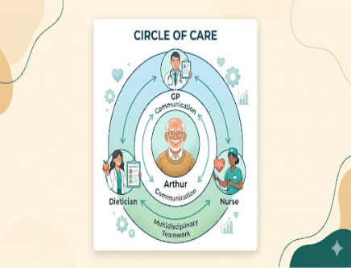
Care Plan: Communication & MDT
Shared Decision Making: Involving Arthur in goal setting to improve adherence
MDT Members: GP, Diabetic Nurse Specialist,
Dietitian, and Physiotherapist.
Communicaation Tool: Use of SBAR
(SITUATION, BACKGROUND,
ASSESSMENT, RECOMMENDATION)
during handovers.

Slide 12

Ethical Considerations
Autonomy: Respecting Arthur's right to
refuse certain lifestyle changes while
ensuring informed consent.
Beneficence: Acting in his best interest
to prevent stroke
.
Confidentiality: Adhering to GDPR and
NHS Data Protection
standards regarding his clinical
Records NHS England (2023)

Slide 13

Conclusion
Managing CVD and Diabetes requires an integrated
Approach.
Early intervention in lifestyle risk factors is the most cost
-effective way to prevent stroke (NHS, 2024))
.
(NHS, 2024)

Slide 14
REFERENCES:
British Heart Foundation (2024). Stroke and its relationship with Diabetes. [online] Available at: https://www.bhf.org.uk/informationsupport/conditions/stroke [Accessed 9 Mar. 2026]
.
Davies, M.J., et al. (2022). 'Management of Hyperglycemia in Type 2 Diabetes, 2022. A Consensus Report by ADA and EASD', Diabetes Care, 45(11), pp. 2753–2786. Available at: https://diabetesjournals.org/care/article/45/11/2753/147671/Management-of-Hyperglycemia-in-Type-2-Diabetes [Accessed 9 Mar. 2026].
Diabetes UK (2025). Diabetes and Heart Disease. [online] Available at: https://www.diabetes.org.uk [Accessed 9 Mar. 2026].
England (2021). Health matters: preventing cardiovascular disease. [online] Available at: https://www.gov.uk/government/publications/health-matters-preventing-cardiovascular-disease [Accessed 9 Mar. 20
NICE (2021). Atrial fibrillation: diagnosis and management (NG196). [online] Available at: https://www.nice.org.uk/guidance/ng196 [AccessedPublic Health England (2021). Health matters: preventing cardiovascular disease. [online] Available at: https://www.gov.uk/government/publications/health-matters-preventing-cardiovascular-disease [Accessed 9 Mar. 20
NICE (2022). Stroke and Transient Ischaemic Attack in Over 16s (NG128). [online] Available at: https://www.nice.org.uk/guidance/ng128 [Accessed 9 Mar. 2026].
NICE (2023). Type 2 Diabetes in Adults: Management (NG28). [online] Available at: https://www.nice.org.uk/guidance/ng28 [Accessed 9 Mar. 2026].
NHS England (2023). The NHS Long Term Plan: Cardiovascular Disease. [online] Available at: https://www.longtermplan.nhs.uk/areas-of-work/cardiovascular-disease/ [Accessed 9 Mar. 2026].
NHS (2024). Cardiovascular Disease Prevention. [online] Available at: https://www.nhs.uk/conditions/cardiovascular-disease/ [Accessed 9 Mar. 2026].
Stroke Association (2023). Risk factors for stroke: Diabetes. [online] Available at: https://www.stroke.org.uk/what-is-stroke/are-you-at-risk/diabetes [Accessed 9 Mar. 2
Umanath, K. and Lewis, J.B. (2022). 'Update on Diabetic Nephropathy: Core Curriculum 2022', American Journal of Kidney Diseases, 79(6), pp. 884-897. Available at: https://www.ajkd.org/article/S0272-6386(22)00514-6/fulltext [Accessed 9 Mar. 2026].
World Health Organization (2023). Global report on hypertension. [online] Available at: https://www.who.int [Accessed 9 Mar. 2026].
Umanath, K. and Lewis, J.B. (2022). 'Update on Diabetic Nephropathy: Core Curriculum 2022', American Journal of Kidney Diseases, 79(6), pp. 884-897. Available at: https://www.ajkd.org/article/S0272-6386(22)00514-6/fulltext [Accessed 9 Mar. 2026].

Slide 15
THANK YOU

