Slide 1

Student name –Farhat Jabeen(2330976)
Lecturer name-Kennedy Obohwemu
Module name-Psychological Classifications and Provisions
Module code-BMHP6029
Assignment Title-Component 1: Individual Presentation (Academic Poster)

Slide 2
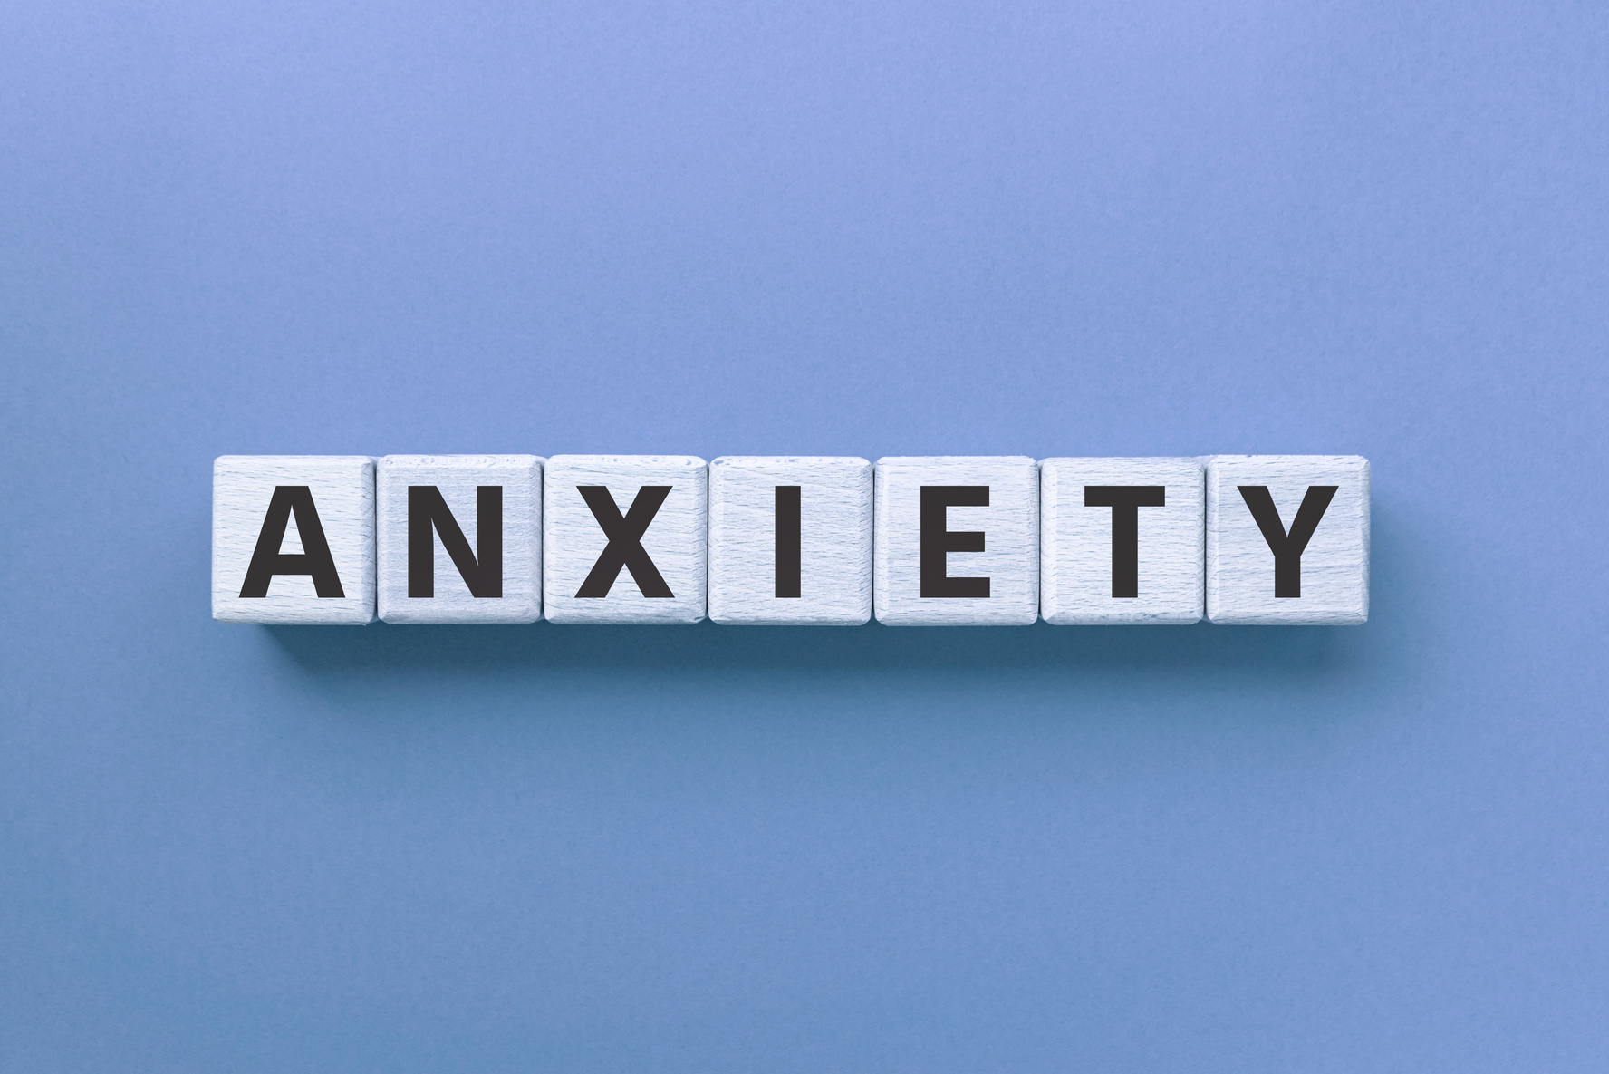

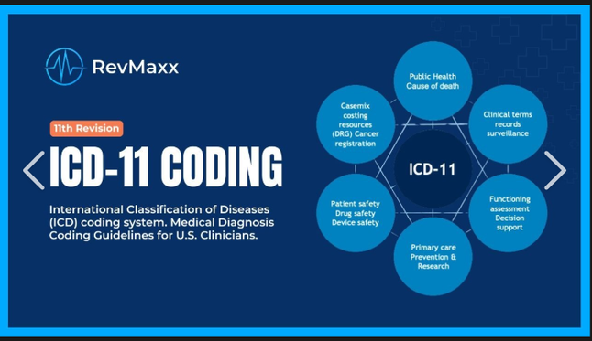
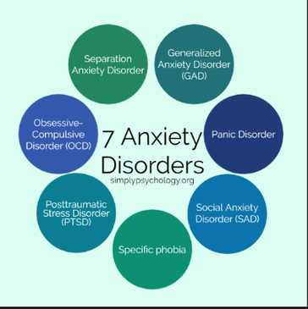
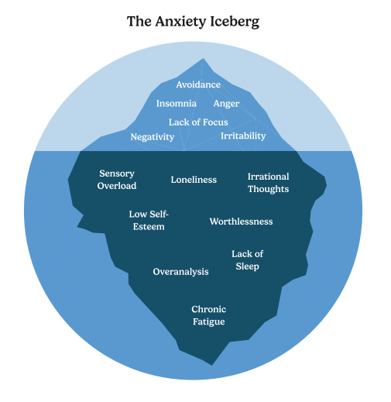

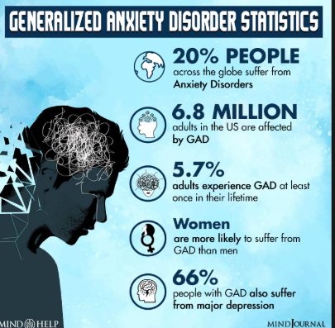
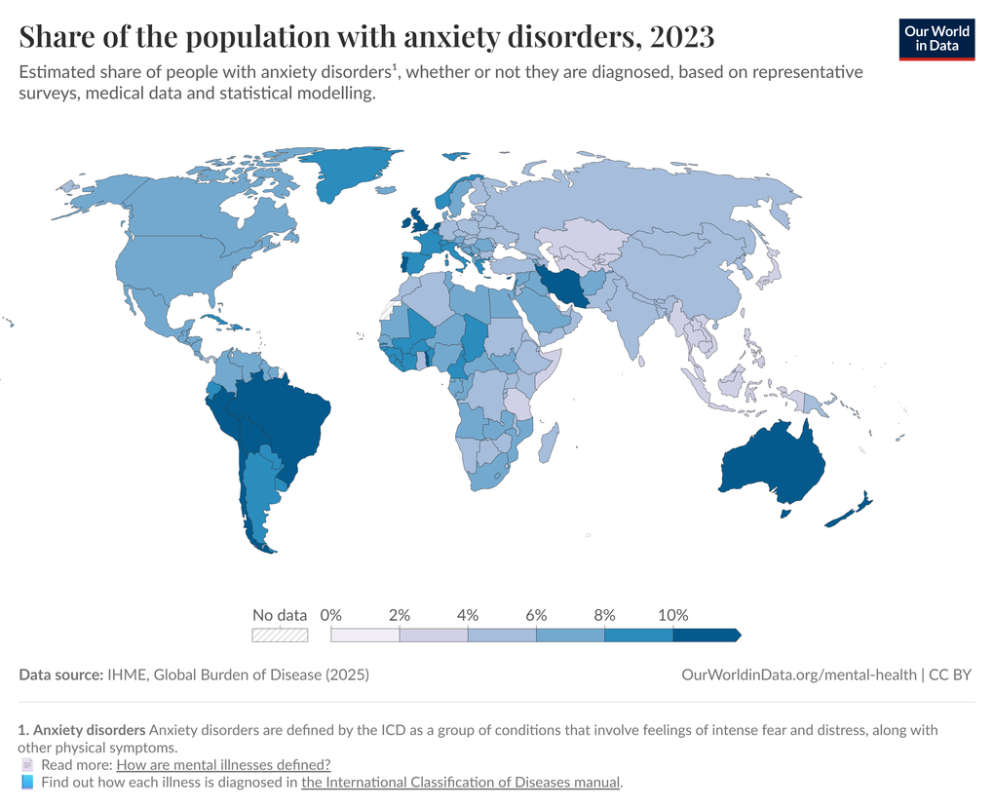

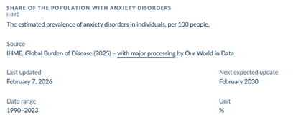
GENERALISED ANXIETY DISORDER (GAD)
(ICD-11 ANXIETY OR FEAR-RELATED DISORDER)
INTRODUCTION
Social, Cultural and Political Influence
What Is Anxiety Disorder?
Cultural beliefs shape how anxiety is experienced and expressed, and can affect help‑seeking and stigma (Kirmayer et al., 1995)
Political conditions such as instability and limited mental health policies can affect stress levels and access to treatment (Crocq, 2017).
Anxiety is a mental state characterised by excessive fear, worry, and related behavioural disturbances that can impair daily functioning (World Health Organization, 2019).
Types Of Anxiety
GAD is influenced by social isolation, unemployment, and weak social relationships, which can increase anxiety symptoms (Bala et al., 2026)
Generalised
Anxiety Disorder (GAD)
Social Anxiety Disorder
Treatment
Panic Disorder
Treatment for Generalised Anxiety Disorder (GAD) commonly includes psychological therapies and medication. Cognitive Behavioural Therapy (CBT) is widely used to help individuals manage worrying thoughts, while medications such as antidepressants can reduce symptoms. Lifestyle changes and self‑help strategies may also support recovery (National Institute for Health and Care Excellence, 2020).
Health-Related Anxiety
Specific Phobias
Generalised Anxiety Disorder (GAD) is a mental health condition that falls under the broader category of anxiety or fear-related disorders in the International Classification of Diseases (ICD‑11)
Recommendations
Solutions for Generalised Anxiety Disorder (GAD) include psychological therapy, medication, and lifestyle changes. Cognitive Behavioural Therapy (CBT) helps manage negative thoughts, while antidepressants reduce symptoms. Relaxation and exercise can also support recovery (National Institute for Health and Care Excellence, 2020).
Historical and contemporary understanding
Anxiety has been understood differently over time; in the 19th century, it was described using terms like panophobia and neurasthenia to represent general and persistent worry (Crocq, 2017). Generalised anxiety disorder (GAD) involves ongoing and excessive worry about everyday situations (American Psychiatric Association, 2013).(Darwin, 1872; Barlow, 2002)
Critical Analysis
Conclusion
  Diagnostic limitations (Ruscio, 2002).
  Social vs individual focus (Behar et al., 2009)
  Inequality issue (Bessell, 2026)
  Treatment critique (Behar et al., 2009)
  Stigma impact (Behar et al., 2009)
  Causes (theory limitation) (Newman et al., 2013
Generalised Anxiety Disorder (GAD) is a common and chronic condition that causes excessive worry and affects daily life. It is widely recognised in diagnostic systems and impacts a significant portion of the population, highlighting the need for effective awareness and treatment (World Metrics, 2026; World Health Organization, 2024).

Slide 3
REFERENCES
American Psychiatric Association (2013) Diagnostic and statistical manual of mental disorders (DSM-5). 5th edn. Washington, DC: American Psychiatric Association.
Andrews, G., Hobbs, M., Borkovec, T.D., Beesdo, K., Craske, M.G., Heimberg, R.G., Rapee, R.M. and Ruscio, A.M. (2010) ‘Generalized worry disorder: a review of DSM-IV generalized anxiety disorder and options for DSM-V’, Depression and Anxiety, 27(2), pp. 134–147.
Bala, J., Newson, J.J. and Thiagarajan, T.C. (2026) ‘Contribution of social determinants to symptoms of generalized anxiety disorder’, PLOS Mental Health, 3(3), e0000552. Available at: https://doi.org/10.1371/journal.pmen.0000552 (Accessed: 2 June 2026).
Behar, E., DiMarco, I.D., Hekler, E.B., Mohlman, J. and Staples, A.M. (2009) ‘Current theoretical models of generalized anxiety disorder (GAD): conceptual review and treatment implications’, Journal of Anxiety Disorders, 23(8), pp. 1011–1023.
Berrios, G.E. (1999) ‘Anxiety disorders: a conceptual history’, Journal of Affective Disorders, 56, pp. 83–94.
Bessell, S. (2026) ‘Resisting, remembering, reclaiming: GAD in the twenty-first century’, in Gender and Development: Perspectives from Australia and the Pacific. Singapore: Springer Nature Singapore, pp. 29–51.
Crocq, M.A. (2017) ‘The history of generalized anxiety disorder as a diagnostic category’, Dialogues in Clinical Neuroscience, 19(2), pp. 107–116. Available at: https://doi.org/10.31887/DCNS.2017.19.2/macrocq (Accessed: 2 June 2026).
Examples-of.net (n.d.) Generalized anxiety disorder. Available at: https://examples-of.net/generalized-anxiety-disorder/ (Accessed: 2 June 2026).
Gross, C. and Hen, R. (2004) ‘The developmental origins of anxiety’, Nature Reviews Neuroscience, 5, pp. 545–552.
Kirmayer, L.J., Young, A. and Hayton, B.C. (1995) ‘The cultural context of anxiety disorders’, Psychiatric Clinics of North America, 18(3), pp. 503–521.
Marshall, R.D. and Klein, D.F. (2003) ‘Conceptual antecedents of the anxiety disorders’, in Nutt, D. and Ballenger, J. (eds.) Anxiety Disorders. Oxford: Blackwell Publishing, pp. 1–22.
Mind Help (2022) Generalized anxiety disorder statistics [Image]. Available at: https://mind.help/wp-content/uploads/2022/06/Generalized-anxiety-disorder-statistics.jpg (Accessed: 3 June 2026).
National Institute for Health and Care Excellence (2020) Generalised anxiety disorder and panic disorder in adults: management. Available at: https://www.nice.org.uk/guidance/cg113 (Accessed: 2 June 2026).
Newman, M.G., Llera, S.J., Erickson, T.M., Przeworski, A. and Castonguay, L.G. (2013) ‘Worry and generalized anxiety disorder: a review and theoretical synthesis of evidence on nature, etiology, mechanisms, and treatment’, Annual Review of Clinical Psychology, 9(1), pp. 275–297.
Ruscio, A.M. (2002) ‘Delimiting the boundaries of generalized anxiety disorder: differentiating high worriers with and without GAD’, Journal of Anxiety Disorders, 16(4), pp. 377–400.
Shutterstock (n.d.) Composite collage image of young man irritated [Photograph]. Available at: https://www.shutterstock.com/image-photo/composite-collage-image-young-man-irritated-2288163183 (Accessed: 3 June 2026).

