Slide 1


Why I am an ideal candidate for this job!
Stacy burgess

Slide 2
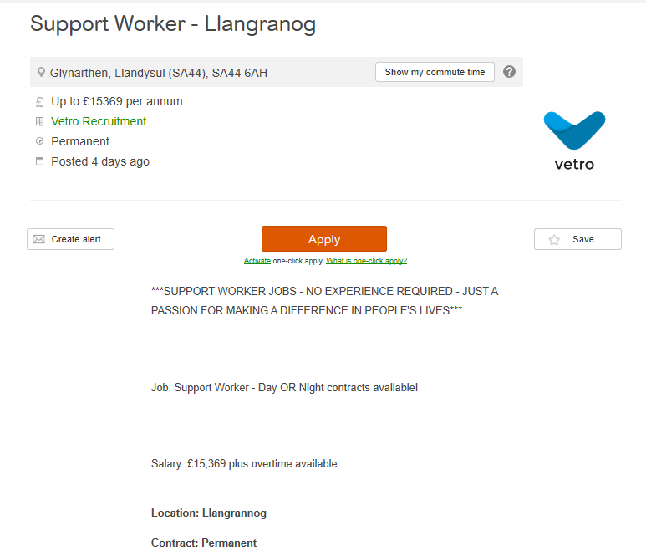


Slide 3
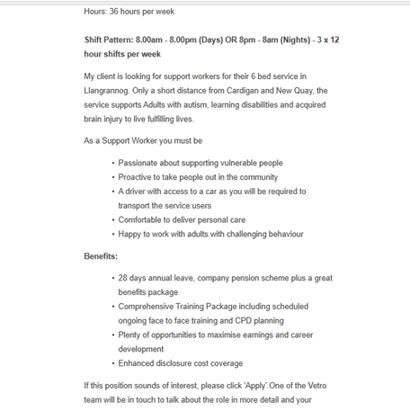

Slide 4
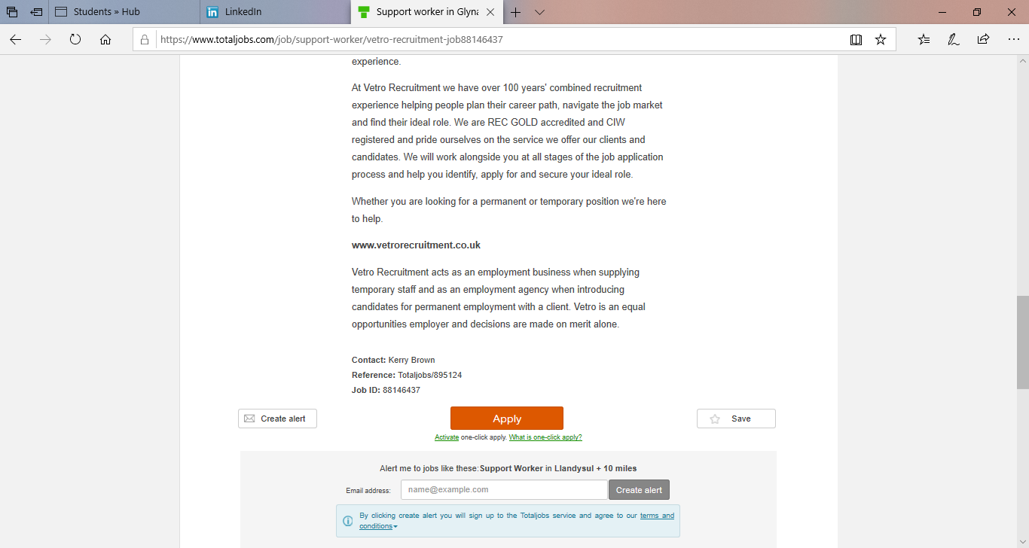
Total Jobs, 2019

Slide 5
My skills and understanding learnt though-out reading and studying for my degree
My degree in BA Social Studies has development my skills and understanding throughout the course. The modules studied and completed within my degree helped me become more aware regarding communities, mental health, disabilities, perceptions within society, identity and how I have develop personally and professionally.
I believe my main skills include;
Communication; verbally and non verbally
And people skills;

Slide 6
Communication skills
According to the Business Dictionary (no date) communication skills is ‘the ability to convey information to another effectively and efficiently’.
I believe I obtain communication skills, verbally and non-verbally, which has been improved throughout my degree. Using the STAR technique as an example of my communication skills
Situation - homecare worker
Task - provide personal care while keeping his confidence, dignity and conducting with respect. Communication was difficult.
Approach – Understand his movements and patience.
Results – efficient and effective communication and improved services provided (Cheary, no date).
I know basic sign language; however this is something I am desired to enhance and develop (West, 2018).

Slide 7
People Skills
According to the Business Dictionary (no date) people skills is ‘a set of skills enabling a person to get along with others, to communicate ideas effectively, to resolve conflicts and to achieve personal or business goals’.
I believe I obtain people skills as communication and people skills are closely linked, which was just explained; throughout my degree I believe my people skills have enhanced.
Situation – Two students and myself almost failing assignment due to one student
Task – Show evidence working as a team
Approach – Reach out to the student and ease her work load
Result – Completion of the assignment and better communication (Cheary, no date).
Obtaining people skills whilst working with autistic adults is extremely important as explained in the job description I would be dealing with challenging behaviours the National Autistic Society (2017) enhances this giving steps on how to deal with certain situations.

Slide 8
Improvements
Throughout my degree I have developed and enhanced many different skills
However, there are some skills and understanding I would like to develop further such as;
My sign language qualification;
Critical thinking;
And assertiveness
I would like to develop these skills and understanding as I believe they can help develop me personally and professionally within employability and future pathways. Critical thinking can benefit me by assisting me in presenting my thoughts and ideas and gaining more control of my learning (LinkedIn, 2015). Assertiveness can also benefit me by improving my thoughts and ideas and improving my decision making skills (Mayo Clinic, 2017).

Slide 9
Conclusion
Overall I believe that I would be an ideal candidate in becoming a supportive worker for autistic adults due;
My passion for helping people;
My qualifications in sign language, health and social care and a part degree in BA social studies;
And; finally, because of the skills and understanding I have obtained throughout the years

Slide 10
References
Business Dictionary (no date) Communication skills. Available at: http://www.businessdictionary.com/definition/communication-skills.html (Accessed: 15th October 2019).
Business Dictionary (no date) people skills. Available at: http://www.businessdictionary.com/definition/people-skills.html (Accessed: 15th October 2019).
Cheary, M. (no date) STAR technique: What you need to know. Available at: https://www.reed.co.uk/career-advice/star-technique-what-you-need-to-know/ (Accessed: 15th October 2019).
LinkedIn (2015) What are the Importance and Benefits of “Critical Thinking Skills”?. Available at: https://www.linkedin.com/pulse/what-importance-benefits-critical-thinking-skills-islam (Accessed: 15th October 2019).
Mayo Clinic (2017) Healthy Lifestyle Stress management. Available at: https://mayoclinic.org/healthy-lifestyle/stress-management/in-depth/assertive/art-20044644 (Accessed: 15th October 2019).
National Autistic Society (2016) Autism. Available at: https://www.autism.org.uk/about/what-is/asd.aspx (Accessed: 15th October 2019).

Slide 11
References
National Autistic Society (2017) Communicating. Available at: https://www.autism.org.uk/about/communication/communicating.aspx (Accessed: 15th October 2019).
Total Jobs (2019) Support worker – Llangranog. Available at: https://www.totaljobs.com/job/support-worker/vetro-recruitment-job88146437 (Accessed: 5th October 2019).
West, E. (2018) My Autism and Sign Language. Available at: https://www.britishdeafnews.co.uk/autism-sign-language/ (Accessed: 15th October 2019).

