Slide 1




Staff shortage in the NHS
Cleide Gloria – 2121286
Problem Solving and Decision Making (BMSW4004_BIRM)
Nicholas Worthington

Slide 2

Table of Content
Introduction
Rationale decision matrix
Evaluating Information for Effective Decision Making
Pestel analysis
Fishbone diagram analysis
Reason for sickness absence
Evaluation for alternatives solutions for absenteeism
Effectiveness and Implementation of Decision-Making Strategy
Measuring the effectiveness
Conclusion
References

Slide 3
Introduction
Management and organisations are working hard to create a more positive workplace for their staff and themselves.
Wide ranges of internal and external elements, both beneficial and negative, are affecting management in today's fast-paced business environment.
Sometimes management is difficult, but they always do their best to find a solution.
Notes:
The managerial decision-making process can be simplified by engaging in teamwork, group meetings, diagnostic sessions, etc. This ppt focuses on a different managerial issue and an alternative decision-making technique for improving the effectiveness of the NHS as a whole and solving the problem of staff shortage in NHS.

Slide 4
Rationale decision matirx:
Problems describe a challenging situation for business, but successful problem-solving and follow-up decision-making can yield positive results. Managing a business or a company's workplace presents its unique challenges. The term "rational decision-making" is used to describe this method. The stages are:
Figure out what is wrong
Reasons why there is a problem existing
Decide how to fix the issue
Considering several approaches to the issue
Alternatives Methods that should be implemented
Evaluation
Procedure and execution review
Notes:
Managerial decisions and maintaining a good working environment necessitate efficient concern and decision-making skills (Haendler and Frysak, 2018). The nature of a situation might change depending on who is experiencing it and who is in charge. The proliferation of new business possibilities and organisational subunits has created many challenges. Based on efficient problem-solving standards, top-level executives can assess the current state of affairs in light of their stated objectives for the company's development.

Slide 5
Evaluating Information for Effective Decision Making:
Managers may make better managerial and organisational decisions and solve problems more efficiently through the systematic procedure of analysing and interpreting evidence.
Given that, NHS is a UK medical organisation; its leadership must assess the efficacy of its decision-making processes in light of the challenges they face (Wang and Byrd, 2017).
Notes:
The five W's are presented below from a management point of view to help evaluate the situation, identify the accountable parties in the respective departments, and reach a decision. What causes employees to the left the job? In what ways were staff not agreeing to a shift? When may they expect a workable answer to this issue? What fundamental and operational changes can the employees help the organisation make? Since I work as a consultant in NHS, I feel compelled to bring up the issue.

Slide 6
Pestle analysis
Political Factors
Healthcare laws, alterations in tax law, and safeguards for patients all play a role in ensuring that people get the care they need. Healthcare spending by the governments is susceptible to shifts in taxation policy (Raadschelders and Whetsell, 2018).
Economic Factors:
Numerous economic concerns, such as unemployment, inflation, and rate of interest, will affect the ability to provide adequate services. These shifts can affect people's discretionary spending habits, affecting government budgets (Ahmady and Shahbazi, 2020).
Notes:
Political Factors
Healthcare laws, alterations in tax law, and safeguards for patients all play a role in ensuring that people get the care they need. Healthcare spending by the governments is susceptible to shifts in taxation policy (Raadschelders and Whetsell, 2018). A plus is that it may make higher subsidy levels possible. The opposite is also true; this can be a reason for alarm. With ever-evolving healthcare costs and coverage options, political shifts can impact citizens' access to healthcare and their ability to pay for it.
Economic Factors:
Numerous economic concerns, such as unemployment, inflation, and rate of interest, will affect the ability to provide adequate services. These shifts can affect people's discretionary spending habits, affecting government budgets (Ahmady and Shahbazi, 2020). If unemployment rates rise, fewer people can buy products made by industries that create medical devices. Similarly, fewer individuals will be eligible for healthcare benefits that are tied to employment.

Slide 7
Pestle analysis
Social Factors:
Keeping up with shifting population dynamics and societal priorities is essential in the healthcare industry. Concerns, attitudes, and societal practices are commonalities amongst certain people.
Technological Factors:
Remedies in the healthcare sector are improving because of technical developments. Improvements in patient care are made possible by technological advances in medical equipment.
Notes:
Social Factors:
Keeping up with shifting population dynamics and societal priorities is essential in the healthcare industry. Concerns, attitudes, and societal practices are commonalities amongst certain people. Problems may arise if doctors and hospitals treat members of the public and are unaware of these diseases (Slade, 2017). Furthermore, professionals should be alert to emerging trends in their field.
Technological Factors:
Remedies in the healthcare sector are improving because of technical developments. Improvements in patient care are made possible by technological advances in medical equipment. To give just one instance, modern hearing aids are equipped with technology to improve their effectiveness, making it possible to hear with more clarity and less interference from the environment. The evolution of apps is facilitating quicker treatment for patients. There has been a rise in the use of applications that link physicians with monitoring patients.

Slide 8
Pestle analysis
Environmental Factors
The healthcare industry can receive environmental and financial benefits from implementing environmental principles. Many medical facilities are now investigating how to earn Certification for green building practices, and waste management plans are under investigation.
Legal Factors
If NHS does not adhere to the latest legal requirements for the healthcare industry. As part of their overall plan, NHS must think about the possible legal ramifications of things like pending cases, Compliance requirements, hospital acquisitions, and much more and any long-term strategy
Notes:
Environmental Factors
The healthcare industry can receive environmental and financial benefits from implementing environmental principles. Many medical facilities are now investigating how to earn Certification for green building practises, and waste management plans are under investigation. A company's leadership in environmentally sustainable operations exemplifies social responsibility, an integral aspect of NHS and keeping the staff in the organisation.
Legal Factors
If NHS does not adhere to the latest legal requirements for the healthcare industry. As part of their overall plan, NHS must think about the possible legal ramifications of things like pending cases, Compliance requirements, hospital acquisitions, and much more and any long-term strategy

Slide 9
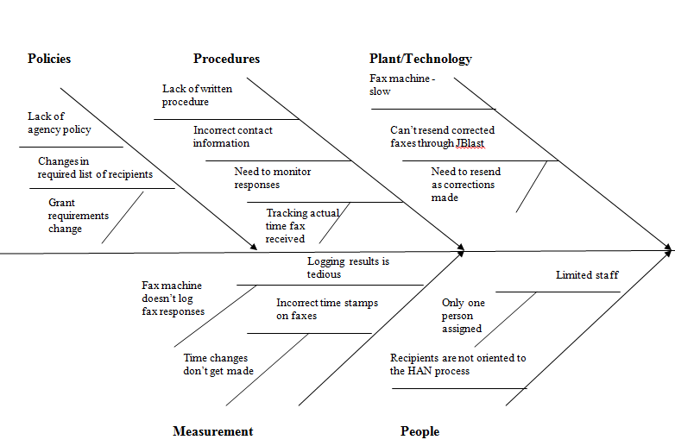
Fishbone diagram analysis
Notes:
Teams can use a fishbone diagram to graphically map out the reasons for an issue or condition instead of just the indications. It facilitates organisational agreement on the nature of the issue and its root causes by separating the two (Zhang et al., 2018). Some aspects go into the process of evaluating options and fixing issues. These considerations play a major role in evaluating the soundness of managerial decisions about the problem and its proposed solution. Staff and employee happiness can be increased by being attentive to staff members wants and needs. There is a difficulty that I observed, and whether or not it has anything to do with the firm's ability to keep staff and employees happy relies on several different things within the business itself. An investigation into the internal communications of the relevant managers and key departments is required to address the issue properly.

Slide 10

Reason for sickness Absence
Anxiety
Stress
Depression
Other psychiatric illnesses

Slide 11
Evaluation for alternatives solutions for absenteeism
In management and organisational psychology, absenteeism is a well-studied phenomenon that has existed for some time. Alkhatib (2019) Academics have studied absenteeism in the workplace since at least the 1950s, intending to reduce its negative consequences on businesses' performance and bottom lines. The following are some of the several approaches that NHS should adopt for dealing with a shortage of staff:
Provide remote work and flexible schedules
Encouragement for regular attendance
Boost Participation among Staff Members
Notes:
The following are some of the several approaches that NHS should adopt for dealing with a shortage of staff:
1. Provide remote work and flexible schedules
When firms give their workers more say over their schedules, absenteeism drops. The development of remote working is a more particular example. It's been proven repeatedly that working from home is beneficial: Staff morale and mental stress decrease, and production and productivity rise.
2. Encouragement for regular attendance
The best method to encourage workers to show up for work consistently is to offer incentives to those who do. However, be aware of this and realise that there could be completely good causes for missing, such as diseases. Thus, the incentive program must not punish staff who have been granted leave.
3. Boost Participation among Staff Members
Increasing employee participation is a proven strategy for fostering a more dedicated and enthusiastic workforce (Raadschelders and Whetsell, 2018). This requires a well-functioning communication medium enabling staff to stay abreast of corporate news, make suggestions, report issues, etc. It also involves spending money on programs that help workers grow professionally. Employees will be able to hone their craft and become more invested in the company's success in this way.

Slide 12
Effectiveness and Implementation of Decision-Making Strategy:
NHS can find the possible solutions down here:
1. Sharing the issue and its reason with shareholders, investors, and management is a priority.
2. Establish contact with the department head to explain the issue.
3. Analyse and assess alternative approaches and methods for maximum efficiency.
4. The strategic process ensures that the management's system components align with the company's overarching objectives and goals.
5. Staff members' needs and wants should be prioritised, and rewards systems should be appropriate to keep them in the organisation.
Notes:
The actions of managers and the effectiveness of their organisations are key factors in the realisation of decisions. As a revitalised healthcare organisation, NHS can only develop and expand by investing in its employees and providing them with a better environment. Managers, staff, patients, and future employees and investors have a say in the corporation's final decisions and strategy implementations (Zhang et al., 2018). Staff shortage is now a problem, but it can be fixed with the right decision-making approach, an analysis of finances, listening, and taking care of the staff members.

Slide 13

Measuring the effectiveness:
A monitoring system's efficiency will impact methods and techniques for problem-solving and organisational decision-making.
Feedback from the staff members
Setting a Generalised KPI Key Performance Indicator
Notes:
1. Feedback from the staff members:
All staff conversations and emails will be recorded and logged so management can examine the most frequently asked questions. After that, employee and staff feedback should be saved for easy access. A manager should develop any necessary adjustments to the customer service department's tactics and strategy based on feedback from satisfied staff members.
2. Setting a Generalised KPI Key Performance Indicator:
An employee's KPIs will show how they stack up against their colleagues and help them evaluate how well they are doing on the job. Key performance indicators will be established following organisational goals and managerial judgment. Workers' performance evaluations will help the service department provide better service (Wang and Byrd, 2017). Management will utilise key performance indicators and KPIs in various ways to assess whether or not sufficient care has been provided. Management should make decisions followed by the problem statement, and key performance indicators will be evaluated based on how those decisions were implemented

Slide 14
Conclusion
The staffing shortage in NHS, can be remedied by taking the necessary measures and employing the appropriate methods. Management will be able to make an informed decision based on various internal and external considerations, increasing the likelihood of a successful resolution and achieving long-term goals for the business, such as improved levels of caregiving.

Slide 15
References:
AHMADY, S. & SHAHBAZI, S. 2020. Impact of social problem-solving training on critical thinking and decision making of nursing students. BMC nursing, 19, 1-8.
ALKHATIB, O. J. A framework for implementing higher-order thinking skills (problem-solving, critical thinking, creative thinking, and decision-making) in engineering & humanities. 2019 Advances in Science and Engineering Technology International Conferences (ASET), 2019. IEEE, 1-8.
CHEN, Y.-Y., LI, C.-M., LIANG, J.-C. & TSAI, C.-C. 2018. Health information obtained from the internet and changes in medical decision making: questionnaire development and cross-sectional survey. Journal of medical Internet research, 20, e9370.
COTTON, D. 2017. The Smart Solution Book: 68 Tools for Brainstorming, Problem Solving, and Decision Making, Elex Media Komputindo.
HAENDLER, T. & FRYSAK, J. Deconstructing the Refactoring Process from a Problem-solving and Decision-making Perspective. ICSOFT, 2018. 397-406.

Slide 16


