Slide 1


BA COMPUTER GAMES DESIGN/BA ANIMATION & VFX
Visual Studies
What is Art? Exploring Meaning in Games & Animation

Slide 2

Visual Studies
What is Art? Exploring Meaning in Games & Animation
What is Art?
Introduction: The Nature of Art

Slide 3


Visual Studies
What is Art? Exploring Meaning in Games & Animation
What is Art?
Art is the intentional creation of something that expresses or evokes emotion, meaning, or aesthetic value
It can be subjective and interpreted differently by each viewer.

Slide 4
Visual Studies
What is Art? Exploring Meaning in Games & Animation
Art can be considered a form of…
Communication
Expression
Storytelling

Slide 5
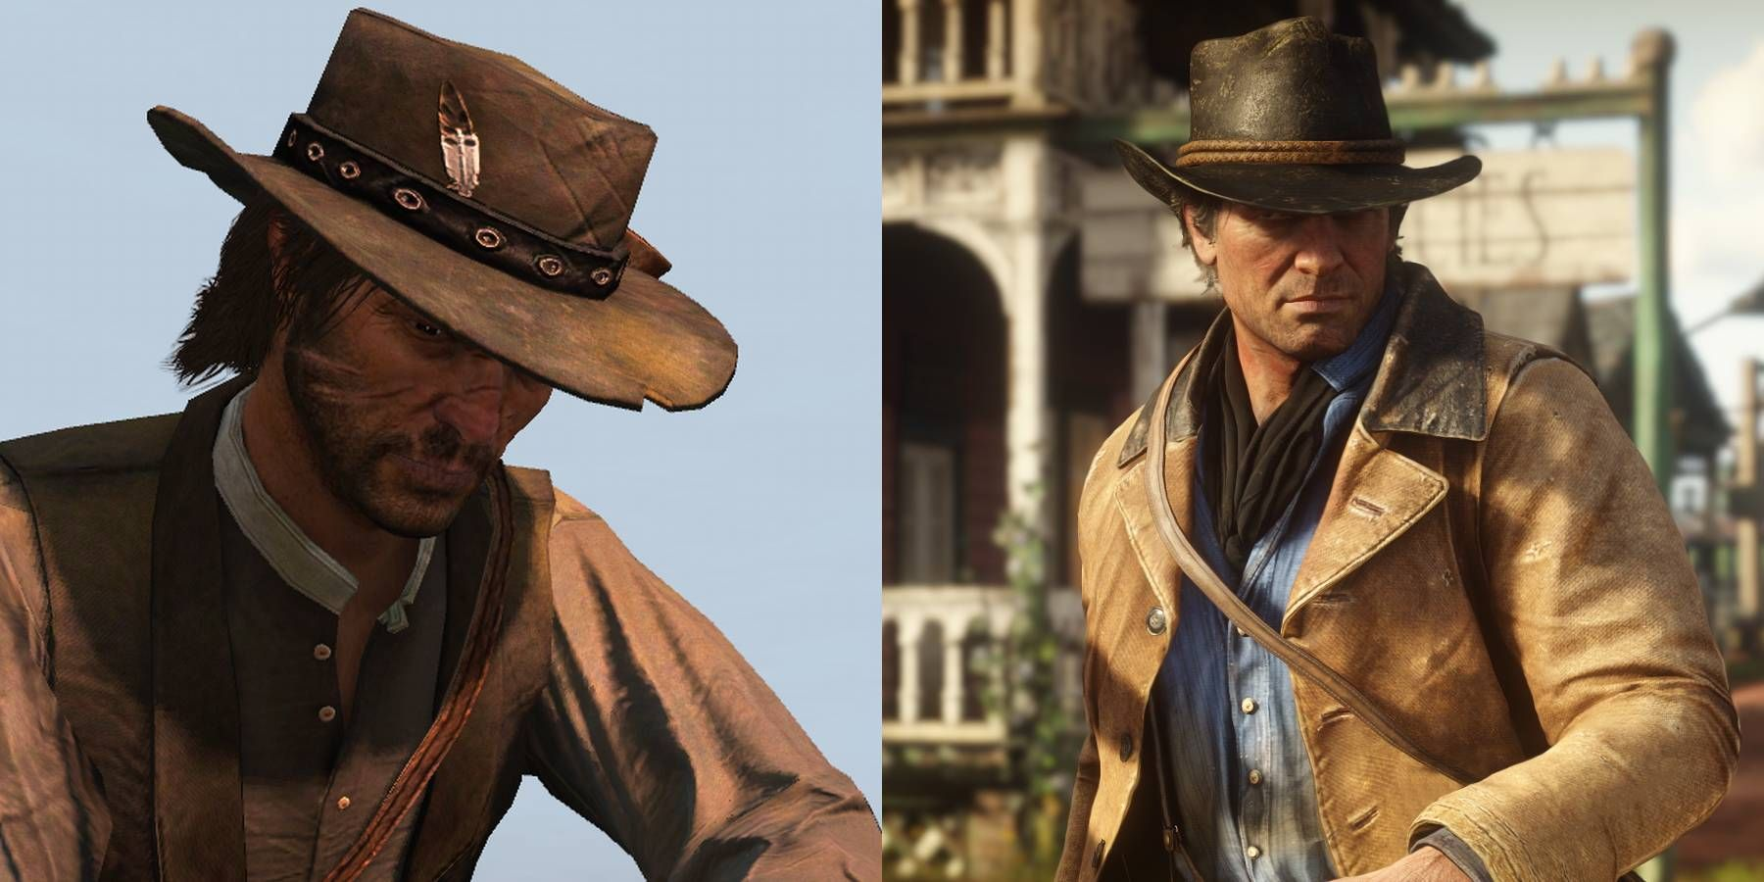
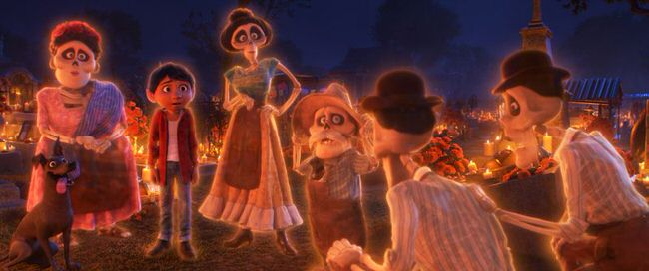
Visual Studies
What is Art? Exploring Meaning in Games & Animation
Art as a Form of Expression
Art allows individuals to communicate emotions, ideas, and beliefs through various mediums, including visual, auditory, or interactive forms like games and animation.
This Photo by Unknown Author is licensed under CC BY-NC-ND

Slide 6

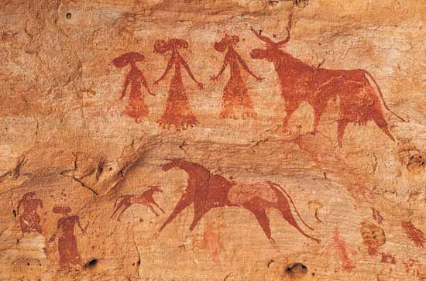
Visual Studies
What is Art? Exploring Meaning in Games & Animation
Art as Communication
Art can serve as a universal language, transcending cultural and linguistic barriers.
Games and animation offer unique ways to communicate narratives and ideas through interactivity and visual storytelling.

Slide 7
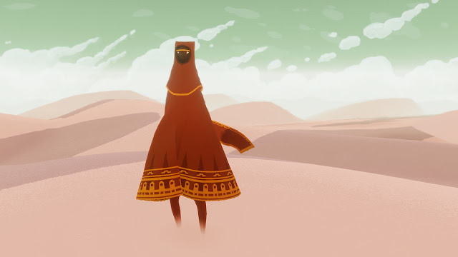
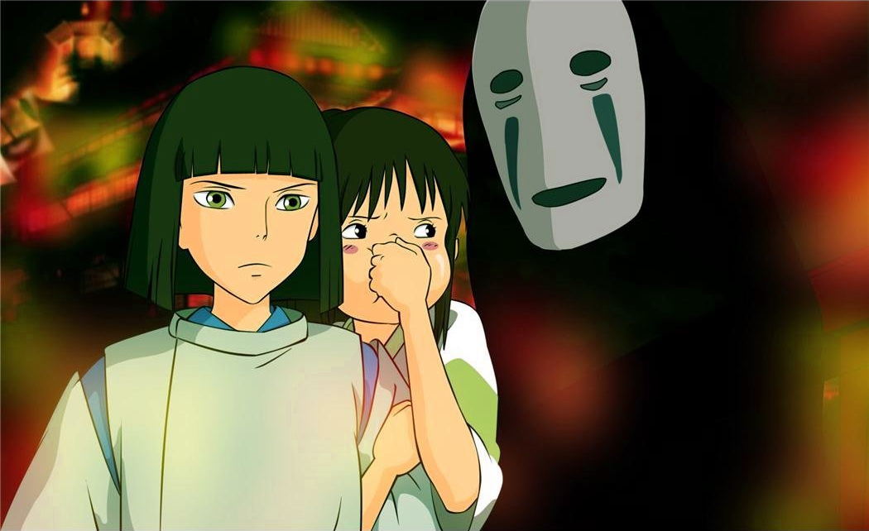
Visual Studies
What is Art? Exploring Meaning in Games & Animation
Art as a tool for Storytelling
Through design, music, and narrative, art tells stories..
In games and animation, art builds worlds, conveys emotion, and drives engagement through storytelling techniques.

Slide 8
Visual Studies
What is Art? Exploring Meaning in Games & Animation
What is Art?
Historical Perspectives

Slide 9
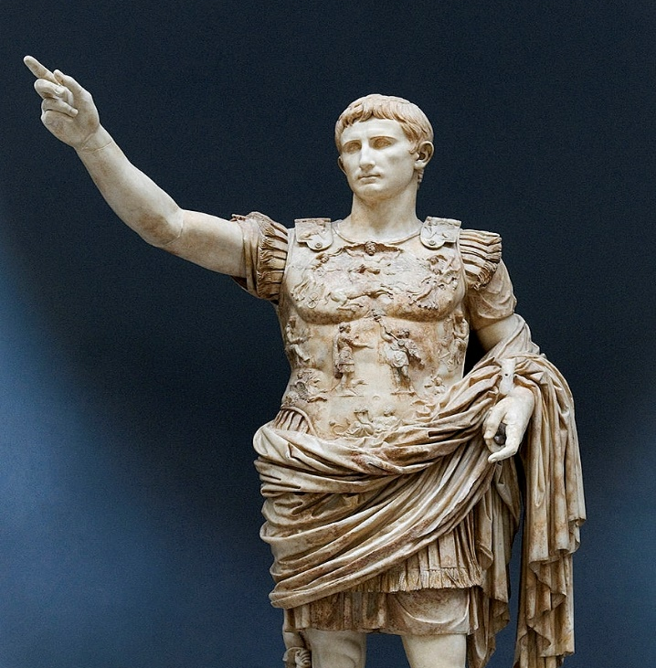
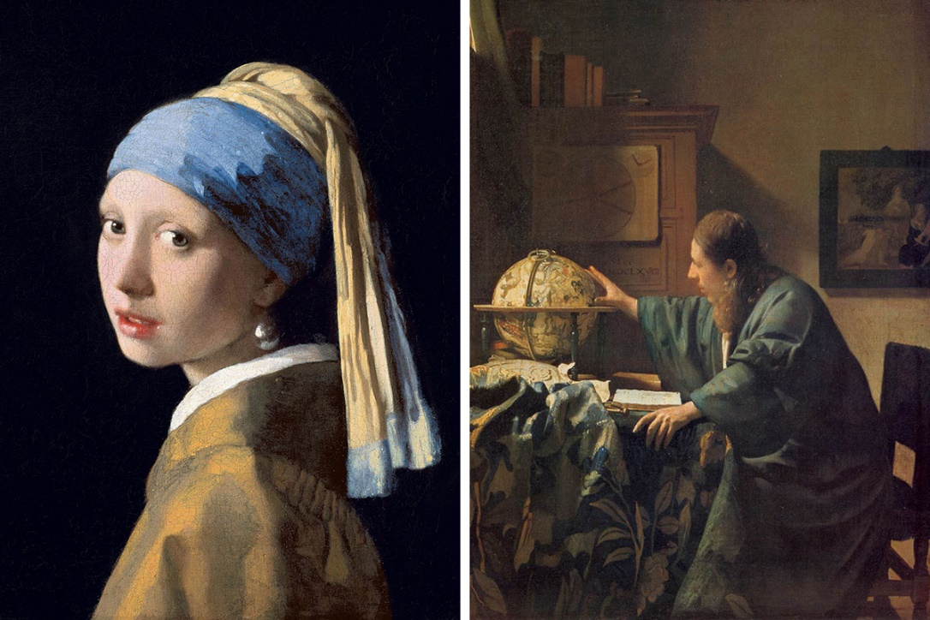
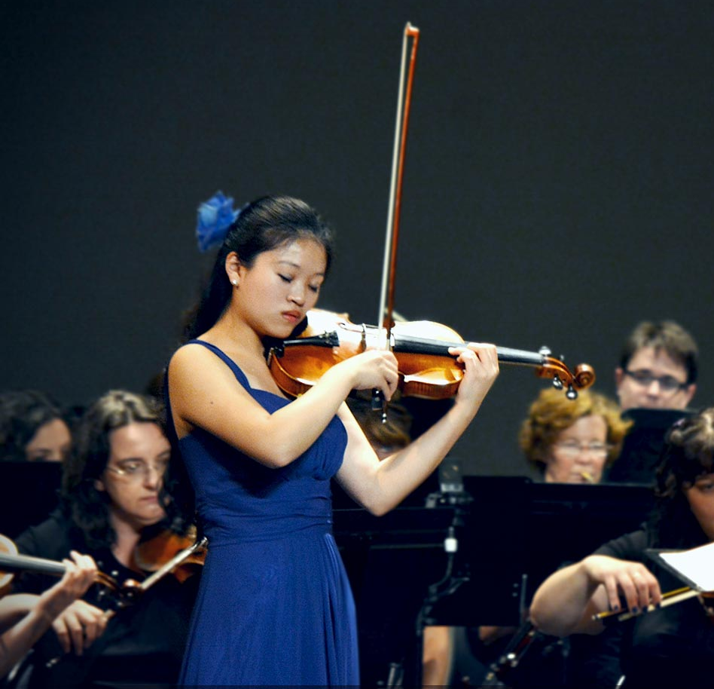
Visual Studies
What is Art? Exploring Meaning in Games & Animation
Traditional Art Forms
Historically, art encompassed forms such as painting, sculpture, and music, each serving distinct cultural and societal roles, from religious symbolism to political expression.

Slide 10
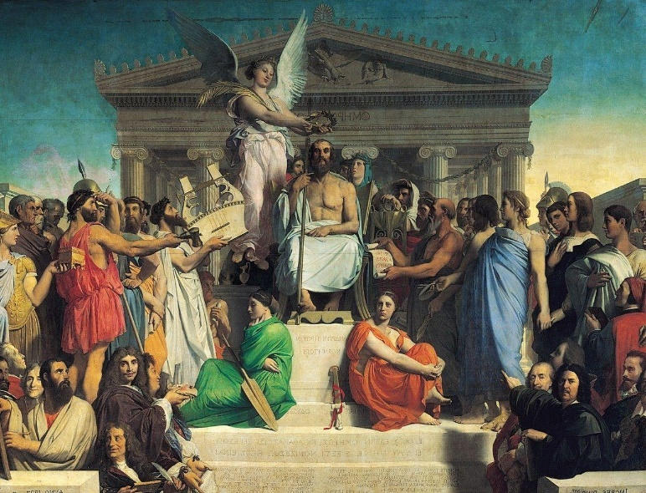
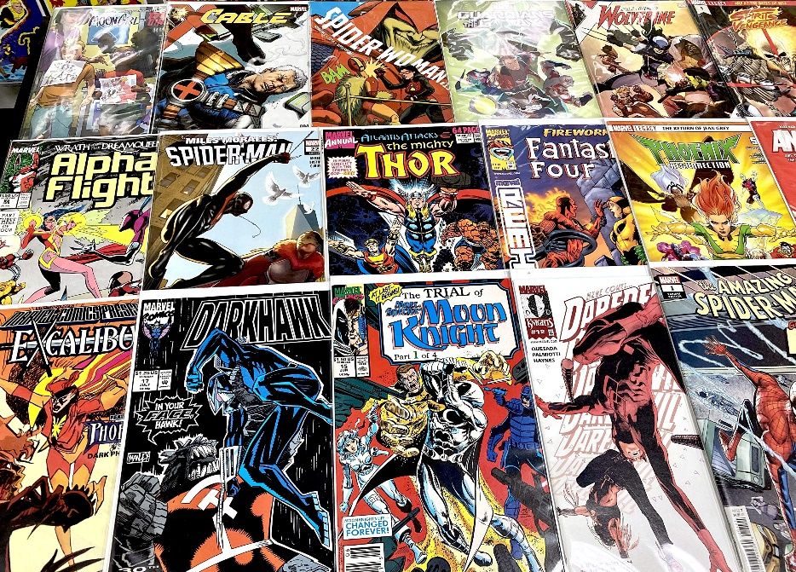
Visual Studies
What is Art? Exploring Meaning in Games & Animation
High Art vs. Popular Art
Traditional views distinguished "high art" (e.g., classical painting) from "popular art" (e.g., comics, street art).
Today, games and animations challenge these distinctions as they gain recognition as forms of artistic expression.

Slide 11
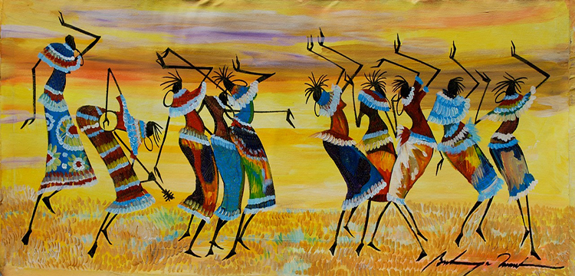
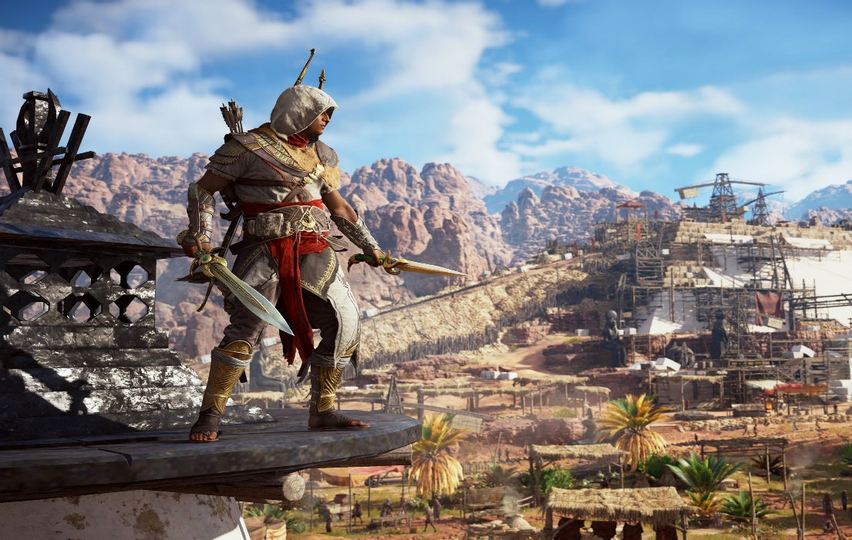
Visual Studies
What is Art? Exploring Meaning in Games & Animation
Art in Different Cultures
Across different cultures, art reflects values, beliefs, and historical context.
Games and animations often incorporate cultural elements, shaping both visual styles and narrative themes.

Slide 12
Visual Studies
What is Art? Exploring Meaning in Games & Animation
Discussion Point:
How have traditional art forms influenced modern digital media like games and animation?

Slide 13
Visual Studies
What is Art? Exploring Meaning in Games & Animation
What is Art?
Art in Games and Animation

Slide 14
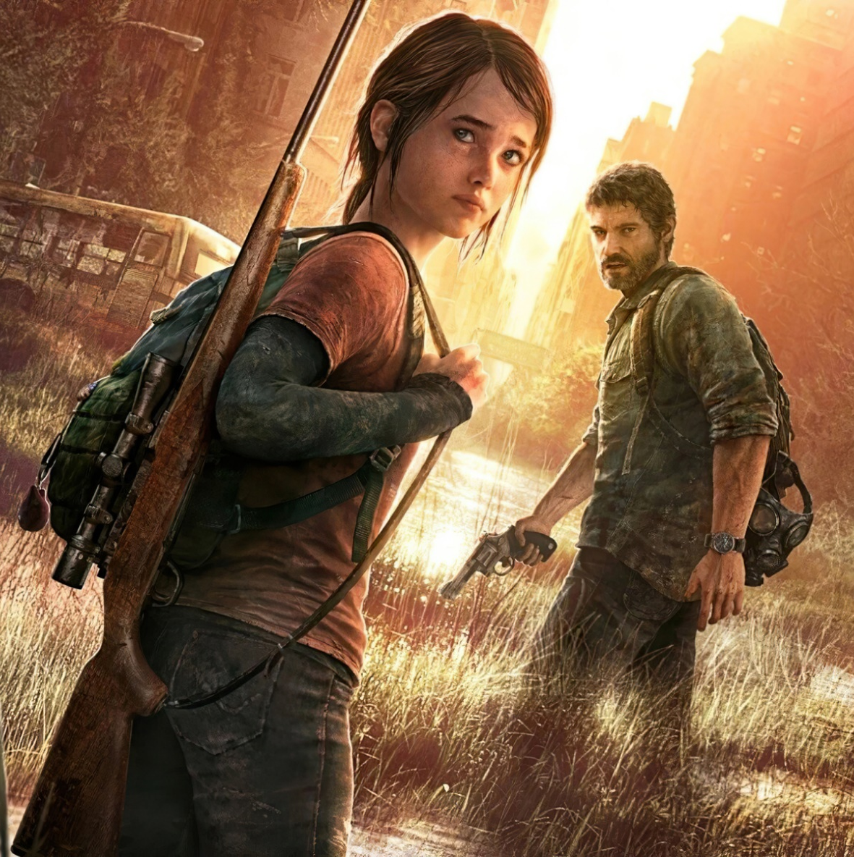
Visual Studies
What is Art? Exploring Meaning in Games & Animation
Games as Art
Games integrate visual design, music, and storytelling to create experiences that evoke emotion and provoke thought.
Titles like The Last of Us are recognized for their narrative depth and artistic merit.

Slide 15
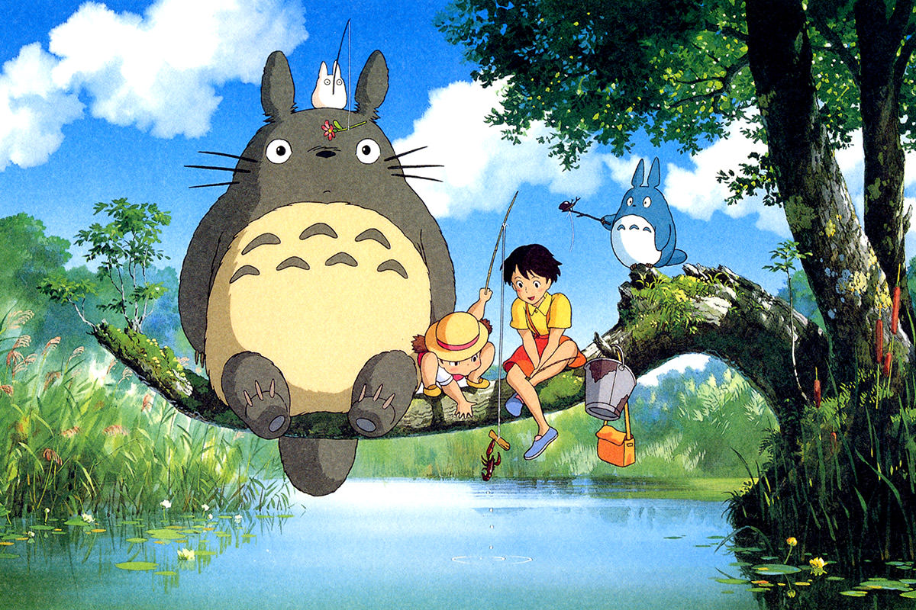
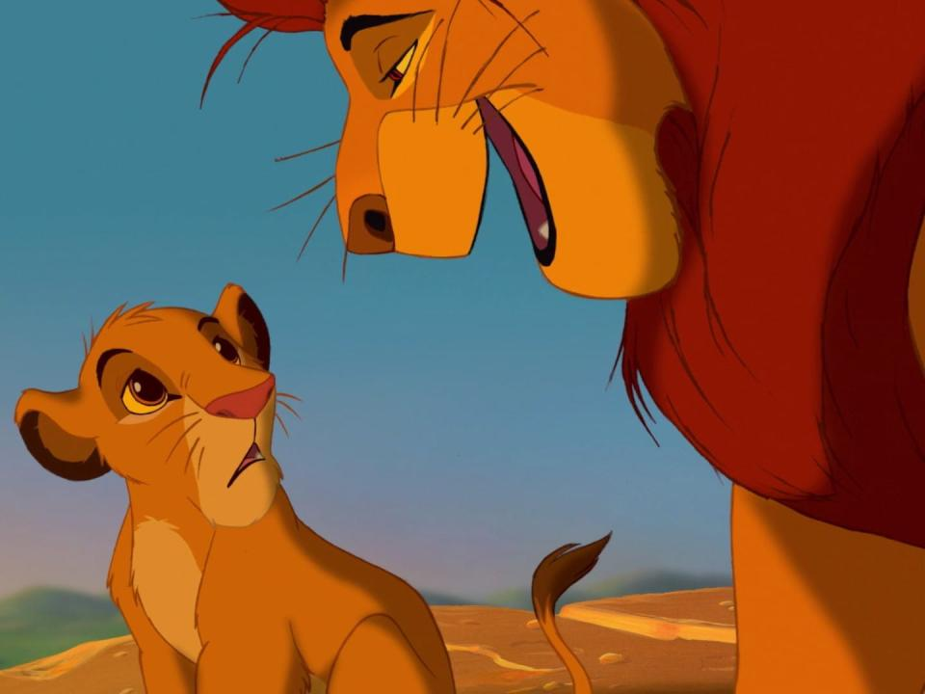
Visual Studies
What is Art? Exploring Meaning in Games & Animation
Animation as Art
Animation employs both visual style and narrative structure to communicate themes and emotions.
Films like The Lion King or My Neighbor Totoro use animation to tell powerful stories that resonate globally.
This Photo by Unknown Author is licensed under CC BY-NC-ND

Slide 16
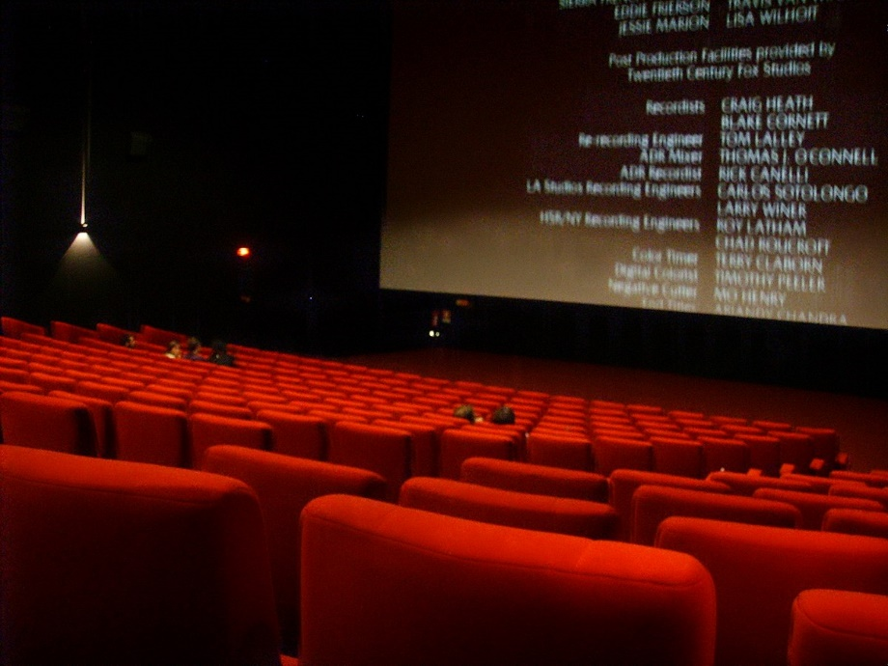
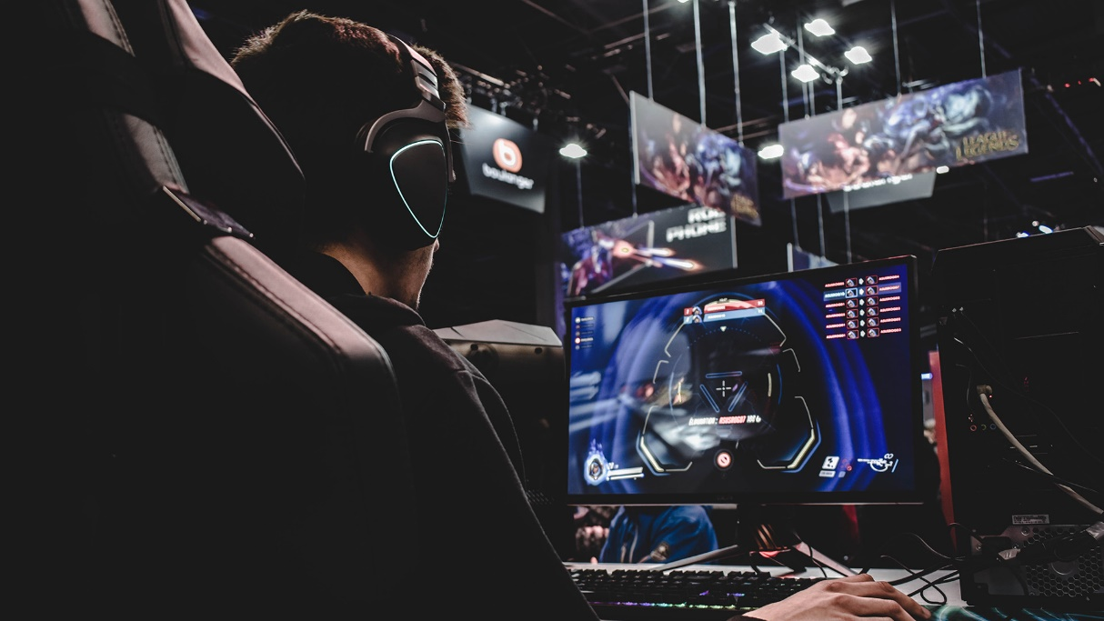
Visual Studies
What is Art? Exploring Meaning in Games & Animation
Blurring the Line Between Art and Entertainment
The distinction between art and entertainment is increasingly blurred. Games and animations, once seen primarily as entertainment, now hold cultural and artistic significance.
This Photo by Unknown Author is licensed under CC BY-SA

Slide 17
Visual Studies
What is Art? Exploring Meaning in Games & Animation
Discussion Point:
Are games and animations a form of art? What specific examples support this view?

Slide 18
Visual Studies
What is Art? Exploring Meaning in Games & Animation
What is Art?
The Role of the Artist in Games and Animation

Slide 19
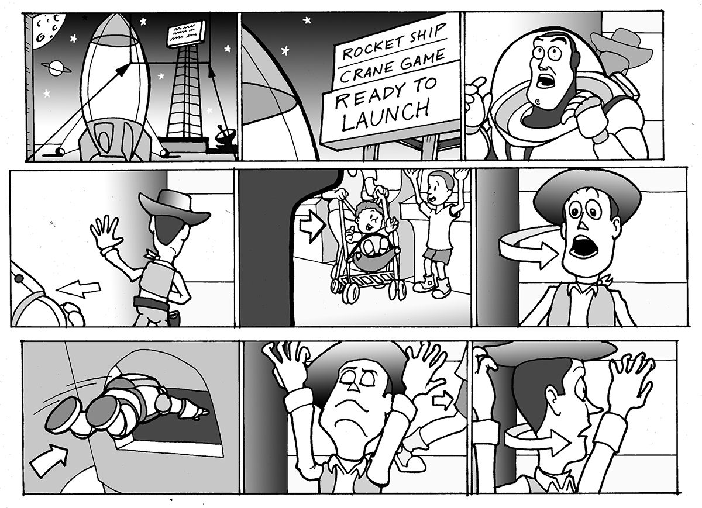
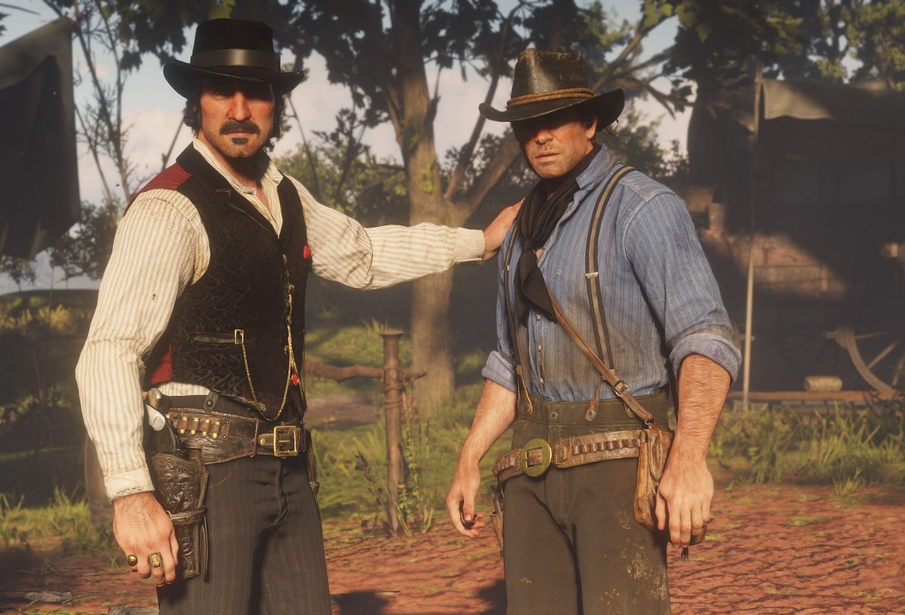
Visual Studies
What is Art? Exploring Meaning in Games & Animation
Artists as Storytellers
In both games and animation, artists are essential in shaping the narrative.
Whether through character design or world-building, the artist’s role is central to conveying emotion and story.

Slide 20
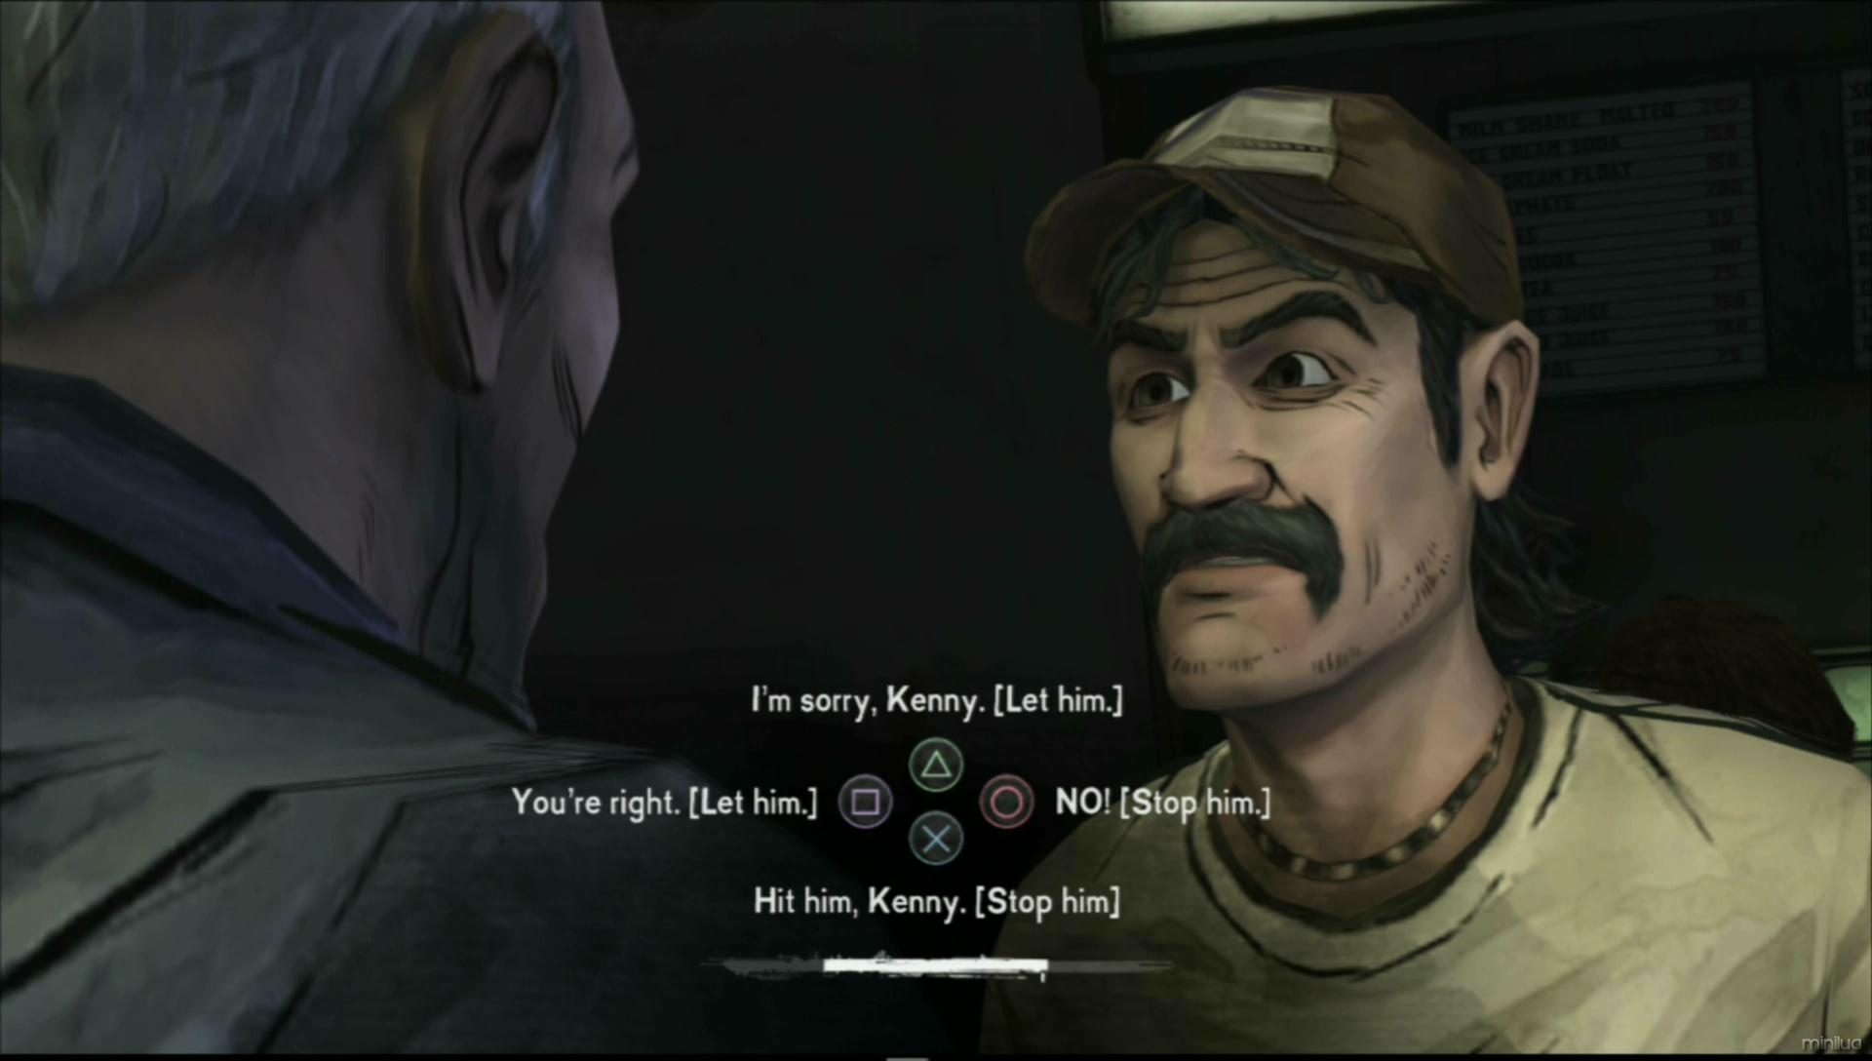
Visual Studies
What is Art? Exploring Meaning in Games & Animation
Shaping the Player or Audience Experience
The choices made by artists, from character appearance to environmental design, profoundly influence how the audience or player experiences the story and interacts with the world.

Slide 21


Visual Studies
What is Art? Exploring Meaning in Games & Animation
The Collaborative Nature of Art in Media
Unlike traditional art forms, games and animation are inherently collaborative, requiring artists to work with writers, designers, and programmers to bring complex visions to life.

Slide 22
Visual Studies
What is Art? Exploring Meaning in Games & Animation
Discussion Point:
How does collaboration between artists and other professionals impact the artistic direction of games and animation?

Slide 23
Visual Studies
What is Art? Exploring Meaning in Games & Animation
What is Art?
The Evolution of Art in Games and Animation

Slide 24
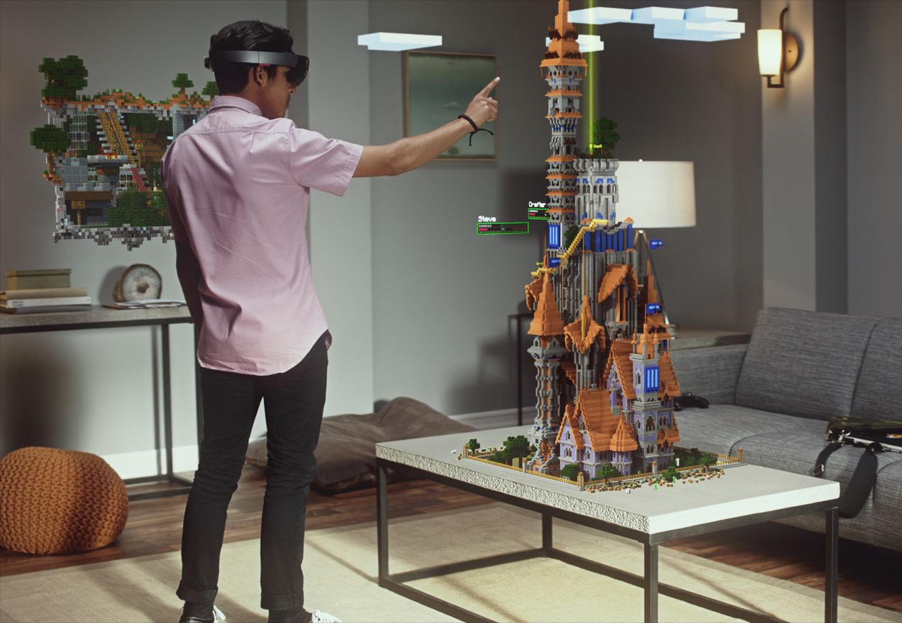
Visual Studies
What is Art? Exploring Meaning in Games & Animation
Technological Advancements
As technology evolves, so does the potential for more complex, immersive, and visually stunning works in both games and animation.
This has expanded the scope of what is considered art in digital media.

Slide 25
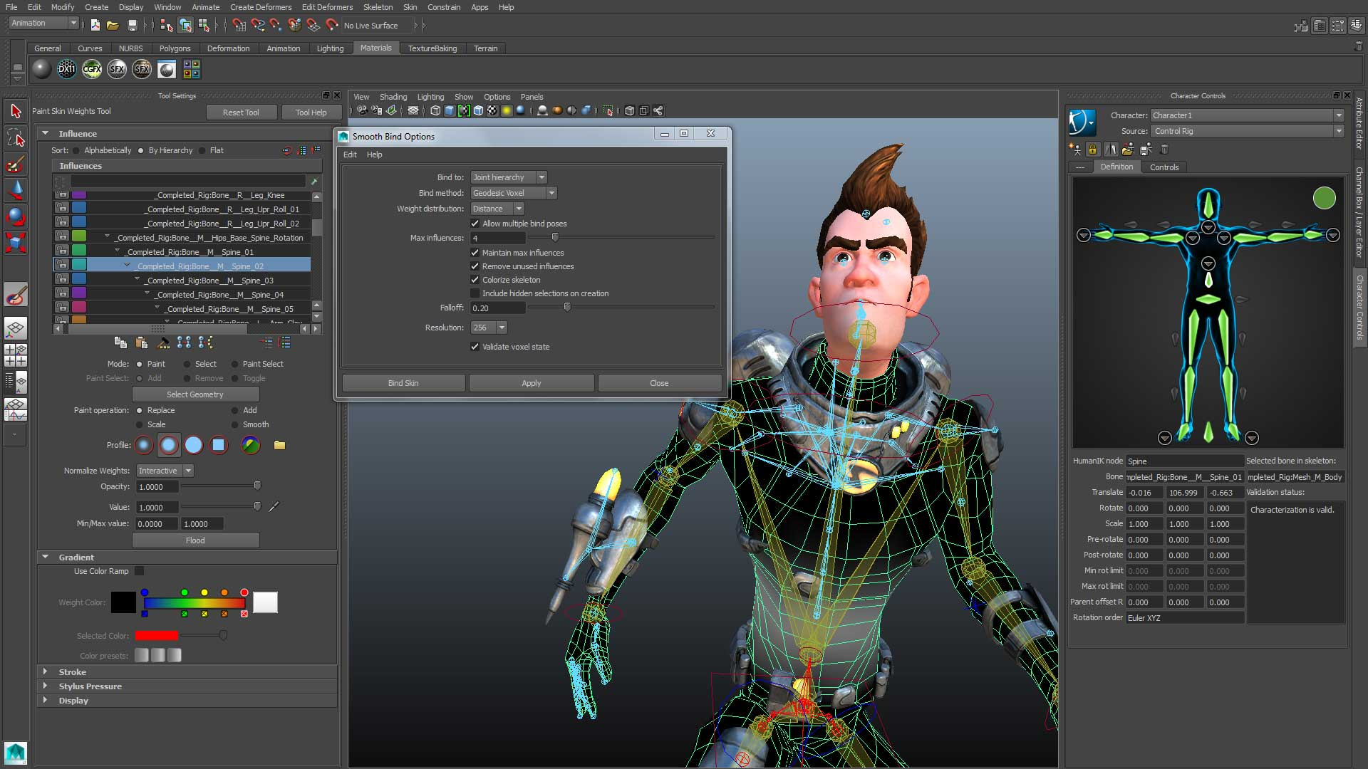
Visual Studies
What is Art? Exploring Meaning in Games & Animation
The Impact of 3D & Interactive Art
The development of 3D modelling and interactive design has revolutionized the way stories are told, allowing for deeper engagement with art through interactivity and immersion.

Slide 26
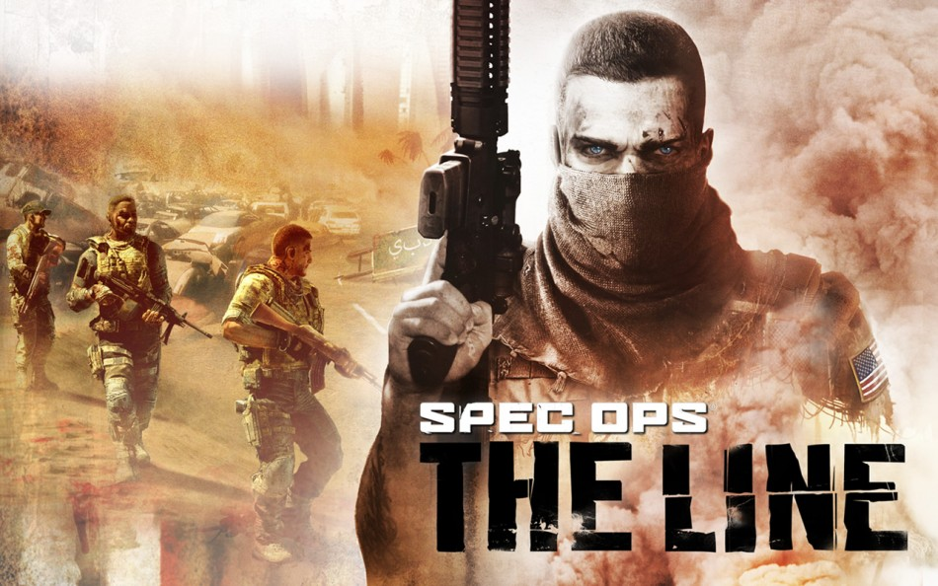
Visual Studies
What is Art? Exploring Meaning in Games & Animation
Art for Social Change
Games and animations are increasingly being used as platforms for social commentary, tackling themes like identity, politics, and ethics, influencing both artistic expression and public discourse.

Slide 27
Visual Studies
What is Art? Exploring Meaning in Games & Animation
Discussion Point:
How do new technologies influence artistic expression in the fields of games and animation?

Slide 28
Visual Studies
What is Art? Exploring Meaning in Games & Animation
What is Art?
The Future of Art in Games & Animation

Slide 29
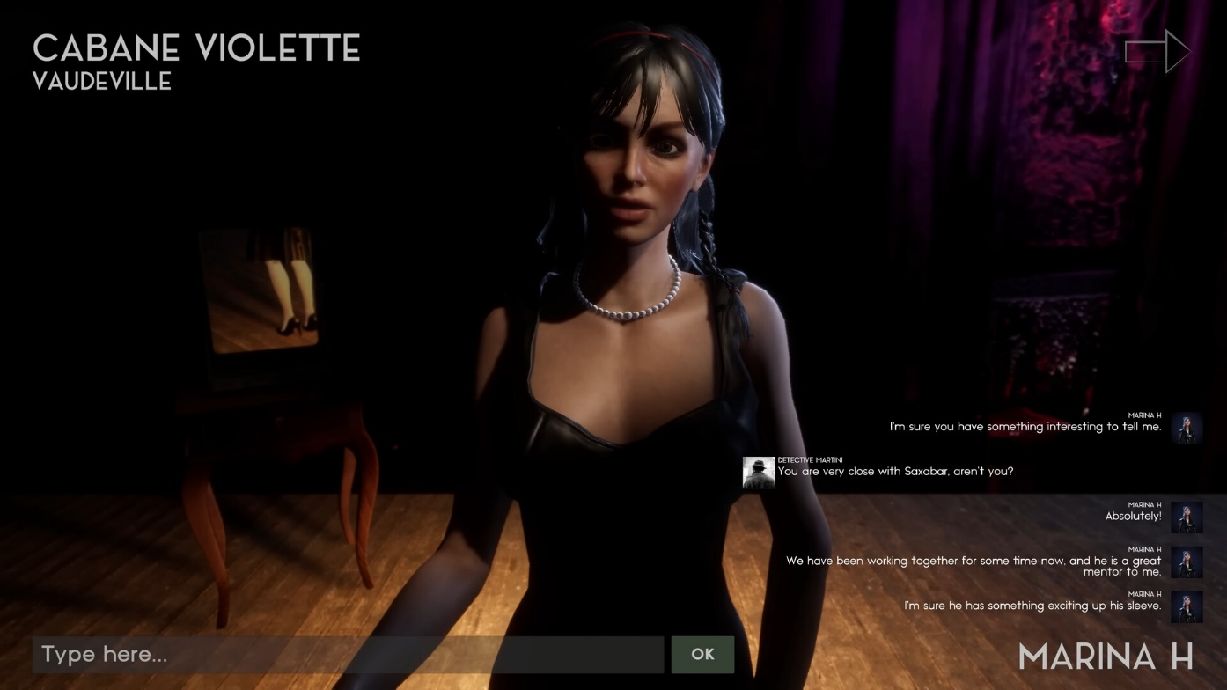
Visual Studies
What is Art? Exploring Meaning in Games & Animation
Interactive Storytelling
The future may see even more integration of art and interactivity, with games and animations allowing users to shape narratives in more dynamic ways.
For Example, Vaudeville (left) is a narrative based mystery game in which the characters use an A.I. model to dynamically react to your questioning.

Slide 30

Visual Studies
What is Art? Exploring Meaning in Games & Animation
Virtual Reality and Beyond
With the advent of virtual reality, artists have new opportunities to create immersive worlds, offering viewers and players direct interaction with their creations.

Slide 31
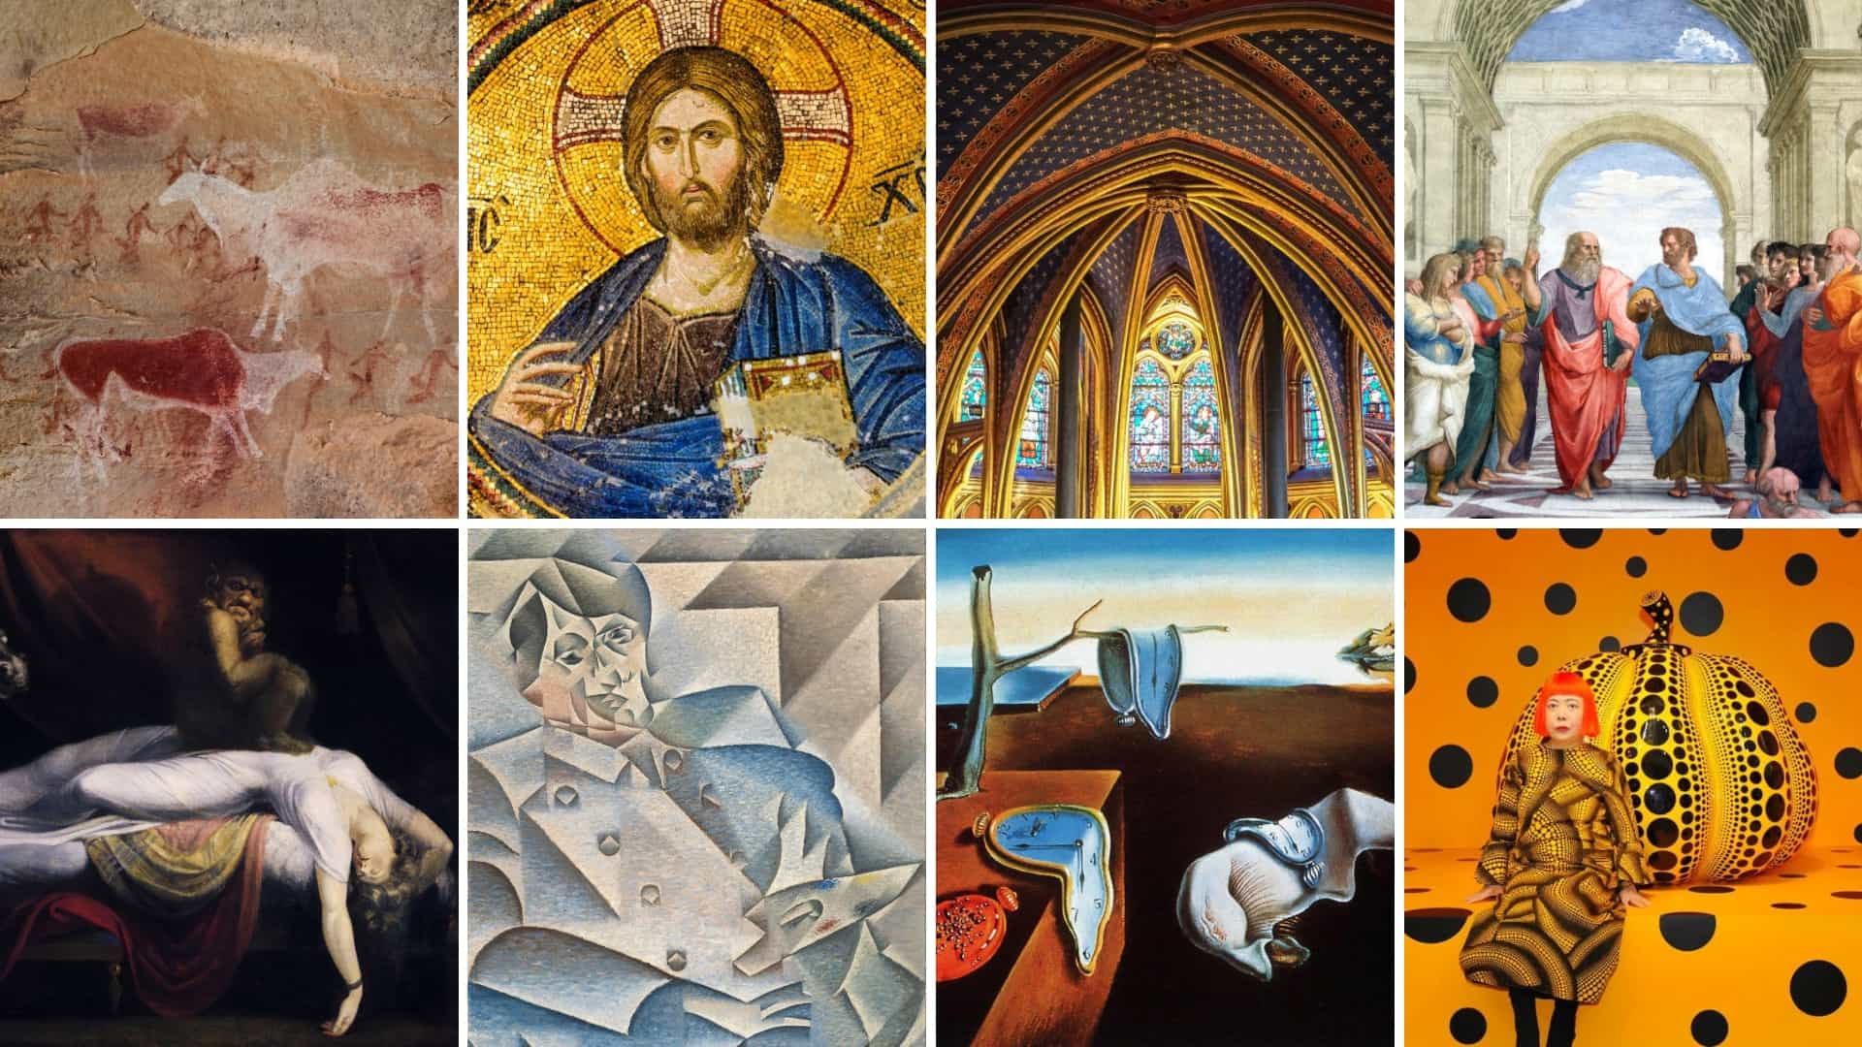
Visual Studies
What is Art? Exploring Meaning in Games & Animation
New Aesthetic Movements
Just as past centuries brought new art movements, the digital age is likely to give rise to its own artistic schools of thought, with games and animations at the forefront.

Slide 32
Visual Studies
What is Art? Exploring Meaning in Games & Animation
Discussion Point:
What future innovations might redefine art in the digital age?

Slide 33
Visual Studies
What is Art? Exploring Meaning in Games & Animation
What is Art?
Conclusion: The Evolving Definition of Art

Slide 34
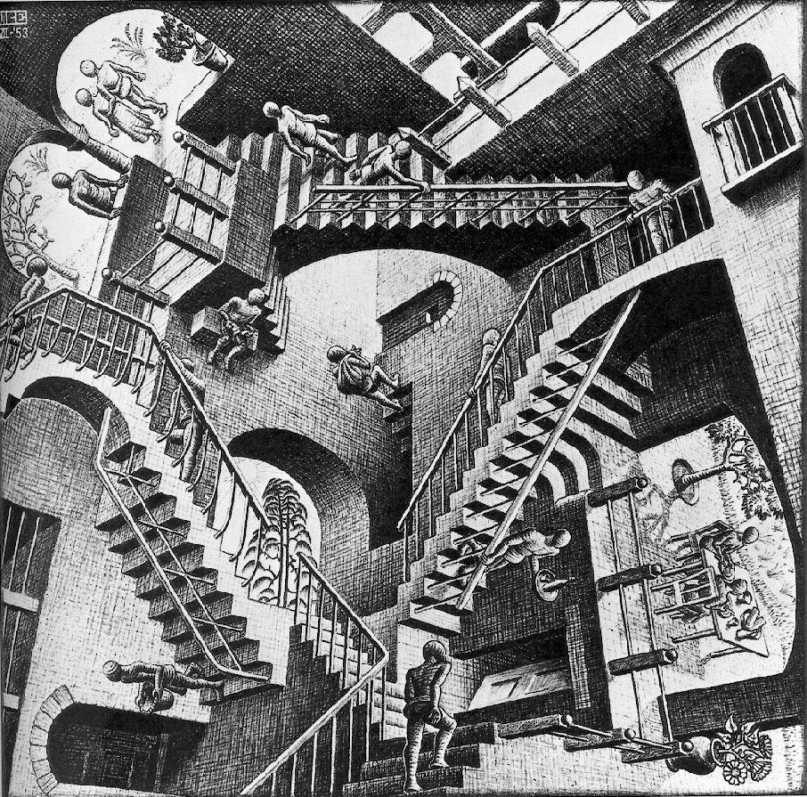
Visual Studies
What is Art? Exploring Meaning in Games & Animation
Art as a Fluid Concept
The definition of art evolves with time, influenced by cultural, social, and technological changes.
What once was not considered art may be viewed differently in the future.
This Photo by Unknown Author is licensed under CC BY-NC-ND

Slide 35
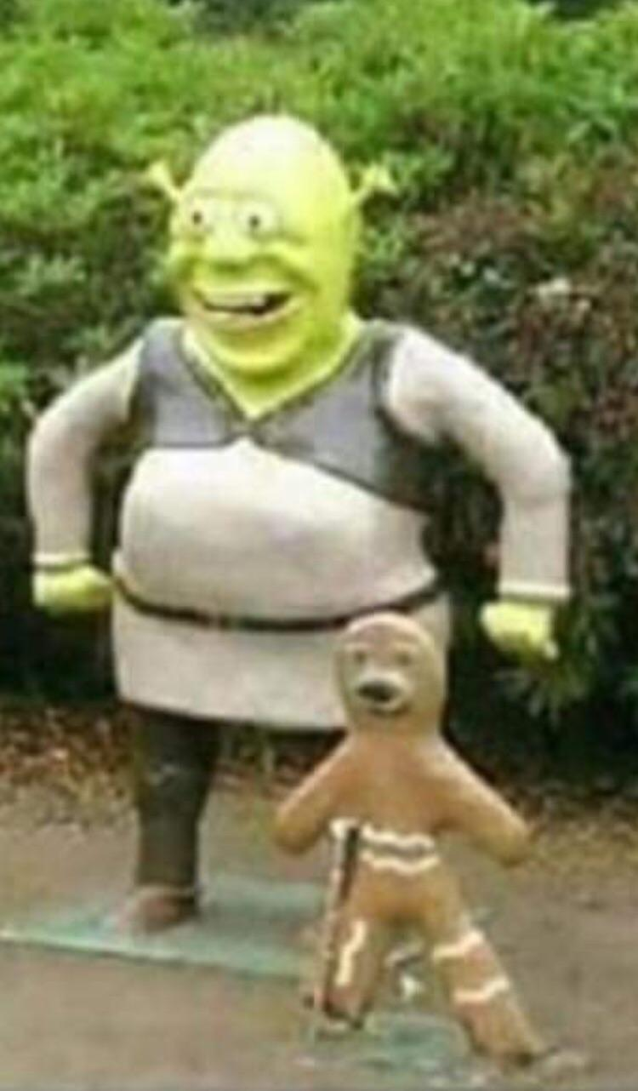
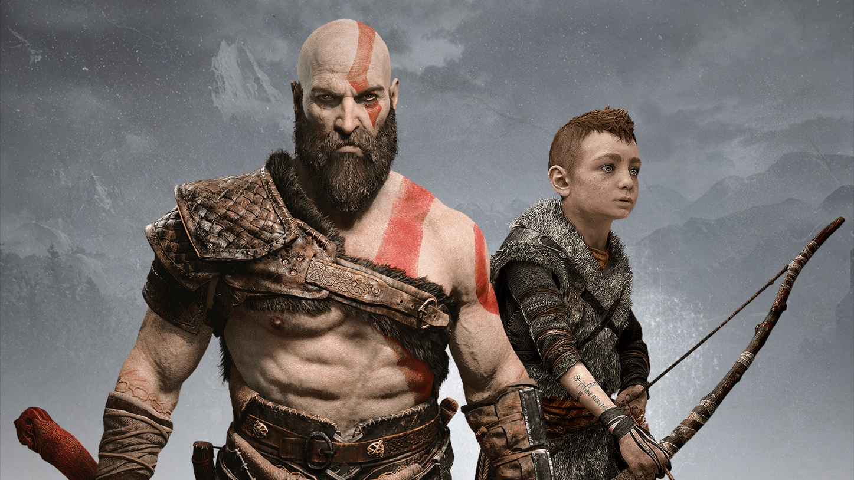
Visual Studies
What is Art? Exploring Meaning in Games & Animation
Games and Animation as Art Forms
With their ability to evoke emotion, tell stories, and reflect societal values, games and animations have secured a place as respected forms of modern art.

Slide 36
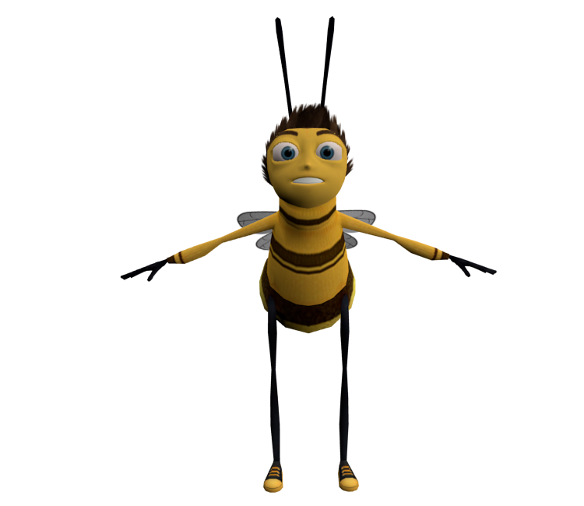
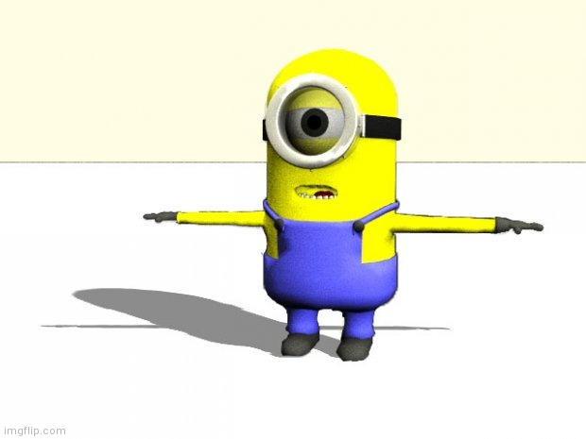
Visual Studies
What is Art? Exploring Meaning in Games & Animation
Closing Thoughts
As technology and culture continue to evolve, so too will our understanding and appreciation of art within games and animation.

Slide 37
Visual Studies
What is Art? Exploring Meaning in Games & Animation
ANY QUESTIONS?

Slide 38
Visual Studies
What is Art? Exploring Meaning in Games & Animation
Remember:
SAVE YOUR WORK
AND SAVE IT OFTEN!

