Slide 1
Global Youth Work

Slide 2

Aims: to Explore
Our own perceptions..
Why do we need to think Globally?
How do issues effect us locally?
What is our role as Youth Workers ?

Slide 3
What is Global Youth Work?
Outline what you understand as Global Youth Work?
Discuss why as Youth Workers we should engage in such education?

Slide 4
Global Youth Work
Gwaith Ieuenctid Byd-eang
“Global youth work is essentially good youth work, which responds to young people’s changing circumstances.
It also recognises that globalisation increasingly influences young people’s lives and environments, creating new opportunities, challenges and concerns.
Global youth work aims to enable young people to develop the knowledge and skills to tackle these new issues and explore their own connections with the wider world.” DEA (2007, p.21)

Slide 5


Consider the following
What are the global issues we are faced with at present ?
How might they effect you on a daily basis?

Slide 6
See : Global Risks Report 2024 World Economic Foundadtion
Global Risks Report 2024 | World Economic Forum | World Economic Forum (weforum.org)

Slide 7
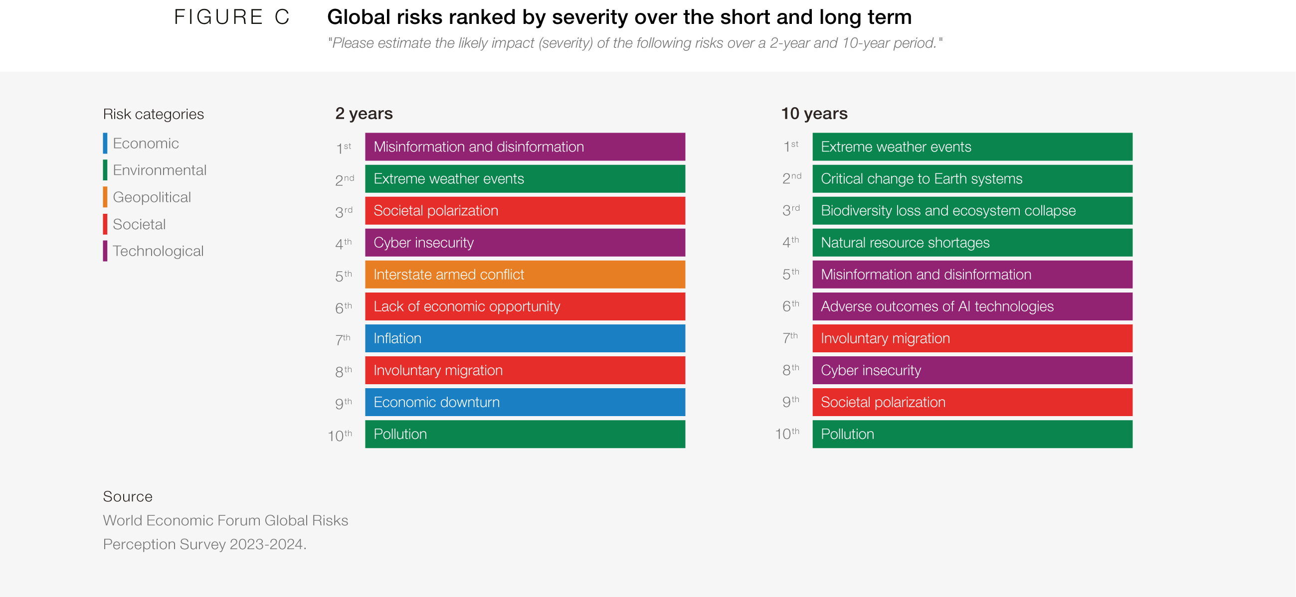

Slide 8
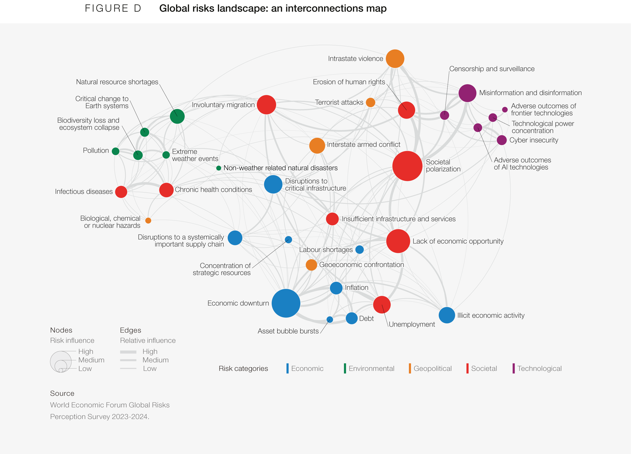

Slide 9

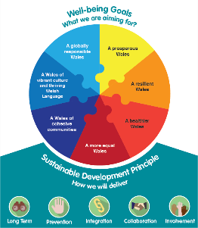
Well-being of Future Generations (Wales), Act 2015

Slide 10
Personal Issues
Materion Personol
How as Youth workers can you work with this?
Read attached Article (on Moodle)
https://www.theguardian.com/education/thinkglobal/story/0,,2276680,00.html?gusrc=gpd?gusrc=gpd
Young people have different starting points.
Some young people’s views and backgrounds will correspond with powerful social groups.
Others will see things from the perspective of those on the margins of society with little or no access to resources or decision making.
(DEA, 2007, p. 24)

Slide 11
DEA Research (1995)
In order to gain the skills and confidence to take action to create a better future, young people need not only an understanding of their local circumstances but of how the global community functions and of how inequalities are perpetuated, locally and globally.
Therefore young people’s concerns about the wider world need to be seen in the context of their own images of themselves and their future in society.
The report recommended that youth workers needed guidance on how to develop local-global links and perspectives in their work with young people. (DEA, 2007 ,p.22)

Slide 12
Why youth perceived to be limited?
They inherit prejudices
They are not aware
They are not connected or organised
They may lack information
Power structures limit their participation
Youth are perceived as lazy, ignorant, violent, etc.

Slide 13
Why youth are powerful?
Youth are more open to change
Youth are future-oriented
Youth are idealistic
Youth are creative and innovative
Youth are courageous
Youth are knowledgeable of their peer’s realities
Youth have energy and time
(Del Felice and Wisler, 2007)

Slide 14
10 key principles of |Global Youth Work
Starts from young people’s experiences and encourages their personal, social and political development.
Works to informal education principles and offers opportunities that are educational, participative, empowering and designed to promote equality of opportunity.
Is based on an agenda that has been negotiated with young people.
Engages young people in critical analysis of local and global influences on their own lives and communities.
Encourages an understanding of the world based on the historical process of globalisation.

Slide 15
10 key principles of |Global Youth Work
Recognises that the relationships between, and within, the North and South are characterised by inequalities caused by globalisation.
Promotes the values of justice and equity in personal, local and global relationships.
Encourages an understanding of, and appreciation for, diversity, locally and globally.
Sees the people and organisations of both the North and South as equal partners for change in a shared and interdependent world.
Encourages action that builds alliances to bring about change.

Slide 16
Group Activity
Evaluate and reflect on the ten key principles of Global Youth Work in relation to the Youth Work in Wales: Principles and Purposes.

Slide 17
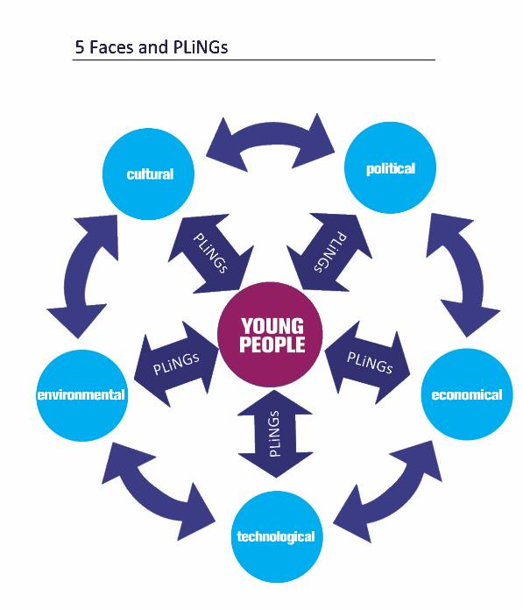

Sallah, M. (2014) Global Youth Work: Provoking Consciousness and Taking Action, Lyme Regis: Russell House Publishing.

Slide 18

Examples of activities
Food

Slide 19
Breakfast
Brecwast
“By the time you have finished your breakfast you will have depended on half of the world.”
Martin Luther King

Slide 20
"While the farmers growing cereal grains - wheat, oats, corn - earn negative returns and are pushed close to bankruptcy, the companies that make breakfast cereals reap huge profits. In 1998, cereal companies Kellogg's, Quaker Oats, and General Mills enjoyed return on equity rates of 56%, 165% and 222% respectively. While a bushel of corn sold for less than $4, a bushel of corn flakes sold for $133 ... Maybe farmers are making too little because others are taking too much." (Shiva, 2000)

Slide 21
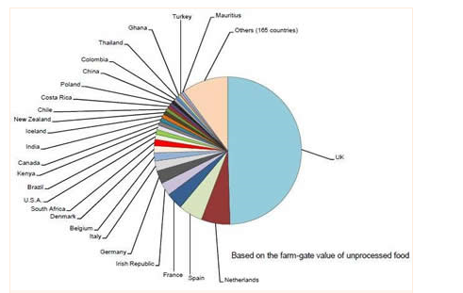
Your food is global
Bwyd Byd-eang
Global Food Security

Slide 22

The Coffee Chain Game (Oxfam)
Full instructions as a PDF on Moodle .
Start by discussing who drinks Coffee,
Perhaps bring in different Coffees to taste
Then start with the quiz found in the resource…
See how you get on with the quiz….

Slide 23

The Coffee Chain Game (Oxfam)
 | Initial proportion | Negotiated proportion | Actual proportion
Farmers
Exporters
Shippers
Roasters
Retailers
£2,35

Slide 24
Coffee Trail
Llwybr Coffi
Watch / Gwyliwch
BBC Two This World
The Coffee / Rea Trail with Simon Reeve
https://www.bbc.co.uk/iplayer/episode/b03q9r9n/this-world-the-tea-trail-with-simon-reeve

Slide 25
Critical Understandings
ESDGC in a youth work context starts from the young people’s experiences:
  encourages a critical understanding of the links between their lives and histories with those in their community and others throughout the world,
  making the connections between society, economy, the environment and politics.
  It reflects on attitudes and values, and develops skills to enable active participation in creating a more just and sustainable world.
How can this be achieved?
How does this relate to definitions of sustainability?
Why is this important?

Slide 26
ESDGC in youth work
Recognises the links between our own lives and those of people throughout the world
Recognises histories, both our own and those of others throughout the world
Seeks to include black and minority ethnic (BME) perspectives locally and throughout the world
Is concerned with needs and rights of both the present and future generations
Addresses the relationship between power, resources and human rights
Enables young people to understand the global forces which shape their lives
Equips young people to participate in decision making and take action for change
Enables young people to question, to think critically, and to empathise
(Welsh Assembly Government, 2007, pp.7-8)

Slide 27
Role of youth work practitioner
The role of the youth work practitioner isn’t to be an expert, but to develop their skills and knowledge alongside young people.
The youth work practitioner is a facilitator of a learning journey, which not only starts from young people’s experiences, but is actively driven by their interests and concerns.
Engaging in ESDGC in youth work can, or even should be as much an educational process for the practitioner as it is for the young person, and this is why training and support for youth work practitioners is crucial.
(Welsh Assembly Government, 2007, pp.9)

Slide 28
Difficult to engage
CONSIDER THE CHALLENGES AND HOW YOU WOULD OVERCOME THESE CHALLENGES
If a young person is finding it difficult to engage then alternative approaches or methods need to be pursued.
It is the practitioner’s responsibility to adapt their technique to suit the needs of the individual or group being worked with.
This is where participative methods and peer learning work really well, as young people understand how to make the learning relevant and engaging for their own lives and those of their peers.
(Welsh Assembly Government, 2007, p.19)

Slide 29
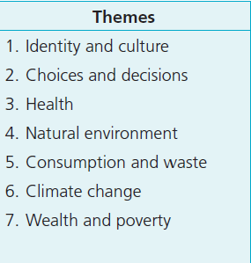
Themes
(Welsh Assembly Government, 2007, p.20)

Slide 30
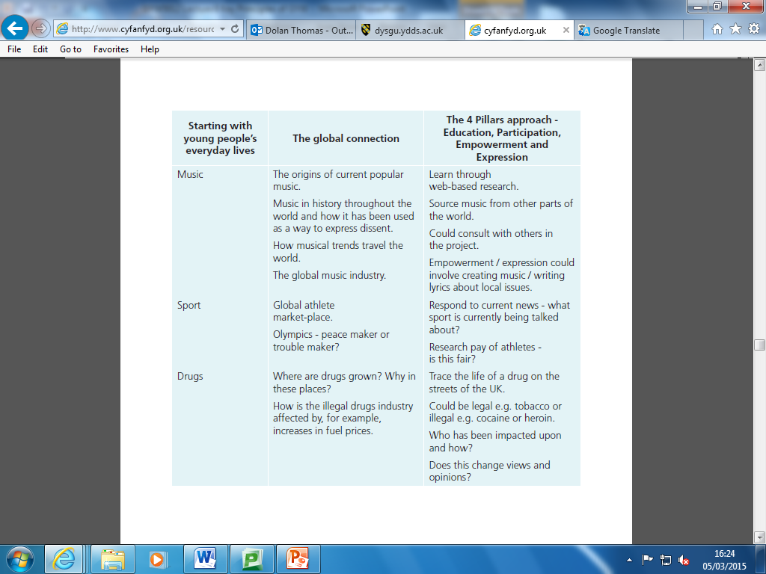
Starting Points
(Welsh Assembly Government, 2007, p.26)

Slide 31
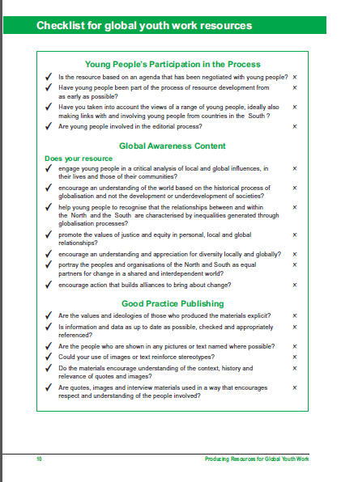
Producing Resources for Global Youth Work
DEA (2000, p.10)

Slide 32
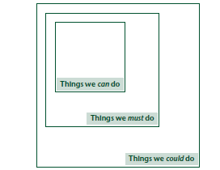
Feedback
Adborth
Try this activity….
(DEA 2002, p.35)

Slide 33
Llyfryddiaeth
Bibliography
DEA, (2002) An Exploration of Black Perspectives in Global Youth Work. London: DEA Oxford
DEA, (2007) Global Youth Work. London: DEA Oxford.
Global Food Security, Your food is global http://www.foodsecurity.ac.uk/food/food-global.html (Accessed: 27 February 2015)
Freire, P. (1993) Pedagogy of the oppressed. New rev. 20th-Anniversary ed. New York: Continuum.
Sallah, M. (2008) The State of Global Youth Work in British HEIs. Leicester: De Montfort University.
Shiva, V. (2000) Poverty and Globalisation http://news.bbc.co.uk/hi/english/static/events/reith_2000/lecture5.stm (Accessed: 27 February 2015)
Welsh Government (2015) Program for Government
http://wales.gov.uk/about/programmeforgov/about?lang=en
(Accessed: 09/02/15)

