Slide 1
MBA
Financial Management
Week 2
Income Statements

Slide 2
Week Outline
- Key concepts, examples, and family analogy
The Income Statement
Key concepts
Examples

Slide 3
The Income Statement Overview
Also known as the Profit & Loss (or PnL, P&L) statement
Measures results of firm’s operations over a specific period.
Formula: Sales − Expenses = Profits

Slide 4
Key Terms (1 of 2)
Revenue (Sales)
  Money derived from selling the company’s product or service (e.g. Bakery’s monthly income from bread sales)
Cost of Goods Sold (COGS) or Cost of Sales (COS)
  The cost of producing or acquiring the goods or services to be sold (e.g. Cost of flour, sugar, and labor for a bakery)

Slide 5
Key Terms (2 of 2)
Operating Expenses
  Expenses related to marketing and distributing the product or service, general administrative expenses and depreciation expense (e.g. Rent, utility bills, advertisement)
Financing Costs
  Interest paid on a loan
Tax Expenses
  Amount of taxes owed, based upon taxable income

Slide 6
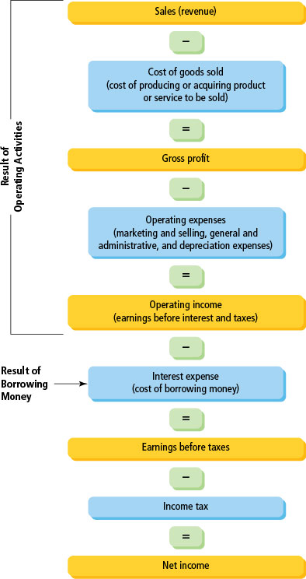
Income Statement Structure
Revenue – COGS = Gross Profit
Gross Profit – Operating Expenses = Operating Income (EBIT)
Operating Income – Interest Expense = Earnings before taxes
Earnings before taxes – Income Tax = Net Income

Slide 7

Activity
Can you rank the items of income statement in a correct order?
Check “Week 2 What is the order of income statement?” in Tile: Week 2 - Income Statement | Financial Management (LCMB7002_LON) | Home
Take out your phone and scan the QR code from Vevox!

Slide 8
Common-Sized Income Statement
Converts income statement figures into percentages of sales
Next, we will read an income statement in real life.
Thinking the following question when you are reading: Why do we need to convert figures into percentage numbers?
See Table 1

Slide 9
Table 1. Tesco Plc Income Statement (2023) (1 of 4)
Blank | £m | Percentage of Sales
Sales | 65,762 | 100% | Blank
Cost of goods sold | (61,005) | –92.77% | Blank
Impairment (loss)/reversal on financial assets | (67) | -0.10%
Gross profit/(loss) | 4,690 | 7.13% | Gross Profit Margin

Slide 10
Table 1. Tesco Plc Income Statement (2023) (2 of 4)
Blank | £m | Percentage of Sales | Blank
Operating expenses | Blank | Blank | Blank
Administrative expenses | (2,060) |  | Blank
Total operating expenses | (2,060) | –3.13% | Blank
Operating income (earnings before interest and taxes) | 2,630 | 4.00% | Operating profit margin

Slide 11
Table 1. Tesco Plc Income Statement (2023) (3 of 4)
 | £m | Percentage of Sales
Share of post-tax profits of joint ventures and associates | 8 | 0.01% | Blank
Finance income | 85 | 0.13%
Finance costs | (647) | -0.98% | Blank
Earnings before taxes (taxable income) | 2,076 | 3.16% | Blank
Taxation | (442) | -0.67% | Blank
Net income (earnings available to common shareholders) | 1,634 | 2.48% | Net profit margin

Slide 12
Table 1. Tesco Plc Income Statement (2023) (4 of 4)
Additional information:
Number of shares outstanding (millions) | 16,258.71
Earnings per share (net income/number of shares) | 10.05p
Dividends paid to shareholders (£m) | 1,772.20
Dividends per share | 10.90p
Question: Why are dividends greater than earnings?

Slide 13
Tesco Plc Profit-to-Sales Analysis
Item | Amount (£m) | % of Sales
Sales | 65,762 | 100%
COGS | (61,005) | -92.77%
Gross Profit | 4,690 | 7.13%
Operating Income (EBIT) | 2,630 | 4.00%
Net Income | 1,634 | 2.48%
  Gross profit margin: 4,690/65,762=7.13%.
  Operating profit margin: 2,630/65,762=4.0%.
  Net profit margin: 1,634/65,762=2.48%.

Slide 14
Common-Sized Income Statement
Converting income statement figures into percentages of sales is a kind of common-size analysis. It can bring:
  Comparability across companies and industries
  Trend analysis over time
  Highlighting unusual fluctuation
  Insight into which components drive changes in profitability

Slide 15
Independent Study

Slide 16
Task 1
Using your chosen company’s annual reports (last 5 years), extract the full income statement data into an Excel spreadsheet. Include revenue, COGS, gross profit, operating expenses, net income, and any other relevant line items.
Submit to Tile: Week 2 – Independent Study | Financial Management (LCMB7002_LON) | Home:
  All 5 annual reports of the selected company in pdf format;
  Excel file with one worksheet named “IS_5yr” containing the extracted data.
Online text: Write a note of AI usage.

Slide 17
Task 2
Read Week 2 – Task 2: Excel Practice in Tile: Week 2 - Independent Study | Financial Management (LCMB7002_LON) | Home.
Learn some basic Excel skills related to Financial Management.

Slide 18
References and Reading List
Atrill, P., & McLaney, E. (2017). Chapter 3. Accounting and Finance for Non-Specialists (10th Edition, pp. 72-112). Pearson Education. ISBN: 9781292135601.
Berk, J. and DeMarzo, P. (2020). Corporate Finance (5th Global Edition). Pearson Education. ISBN: 9781292304151.
Keown, A.J., Martin, J.D., and Petty, J.W. (2024). Foundations of Finance (10th Global Edition). Pearson Education. ISBN: 9781292742168.

