Slide 1


Personal Development
“the unexamined life is not worth living” (Socrates)

Slide 2

“’The engine’ that drives us”
(Bager-Charleson, 2012)
A third-person perspective on one’s professional life
Integrating our personal experiences and development
What drives us and why?
What are our strengths and weaknesses?
What impact do we have on clients?
How are we affected by clients?

Slide 3

Who, what and why am I?:
Self-awareness
Self-discovery
The self in action
Attitudes to others
Values – informing our behaviour and prejudices (implicitly and explicitly)
Self-knowledge
And ultimately … Self-acceptance

Slide 4
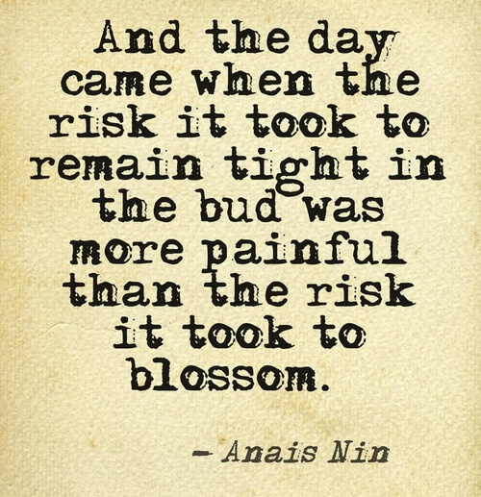

The process:
Learning to relate in a meaningful manner
Communicating at depth
Changing and growing
Learning to facilitate these processes in clients

Slide 5
exercise
You are near a door … get up and go through the door. From the moment you stand on the threshold turn yourself into your own object of attention. What do you look like, standing there? How do you walk? What, if you knew nothing about yourself, could be gathered of you, your character, your background, your purpose just there at that minute? If there are people in the room whom you must greet, how do you greet them? How do your attitudes to them vary? Do you give any overt sign that you are fonder of one, or more aware of one, than the rest?
Try to capture your impressions of yourself in the doorway. Write down as much as you can. (based on Brande,1996)

Slide 6
How do your values inform your principles? Consider the following:
How do you want or like to be treated?
How do you want or like to treat others?
What does it mean to respect someone?
What is the best way to respect you?
What will help you cooperate with the people in this group?
What does it mean to be physically and emotionally safe?
What does it mean to take risks physically and emotionally?
What does it mean to be present in the group?
What can you do or say to help this group work together?
What does it mean to tell the truth?
What do you feel are the consequences of telling the truth?

Slide 7



Group Contract

