Slide 1
Module Code: LCHS7006
Module Name: Quality Assurance and Service Improvements
Programme: MSc Public Health and Social Care in Practice
Lecturer Name: Christopher Mafuva
Presented by: Manasvi Patel
Student ID: 2520168
The Bristol Royal Infirmary Inquiry (UK): Bristol inquiry Report (2001)

Slide 2

Introduction
Since 1984 to 1995 Bristol Royal Infirmary Inquiry was the major case study related to the failures in paediatric cardiac surgery (Bristol, 2001)
The case study defines how the major surgery failure leads to high mortality rates (Bristol, 2001)
The study defines the quality assurance and patient safety purpose of the research (Bristol, 2001)
The focus of the study defines root cause, leadership policy, and service improvement (Bristol, 2001)
(Source: Bristol, 2001)

Slide 3

Outline the problem
The major problem of the case study is high mortality in pediatric cardiac surgery since 1984 to 1995 (Bristol, 2001).
The case study defines the poor-quality assurance and clinical governance issues due to delayed response towards safety concern (Walshe and Offen, 2001)
The case scenario focuses on inadequate monitoring and auditing issue which has created accountability towards the preventable harm and loss of public trust (Maclean, 2001)
(Source: Maclean, 2001)

Slide 4

Outline the root causes of the problem
The root cause of the problem is lack of clinical leadership and accountability which leads to poor communication and unstructured organisational culture (Walshe and Offen, 2001)
The study defines inadequate clinical audit and performance monitoring tracker which leads to delay in action and safety challenges (Maclean, 2001)
The study also defines the staffing shortage and fragmented pediatric services (Bristol, 2001)
(Source: Walshe and Offen, 2001)

Slide 5
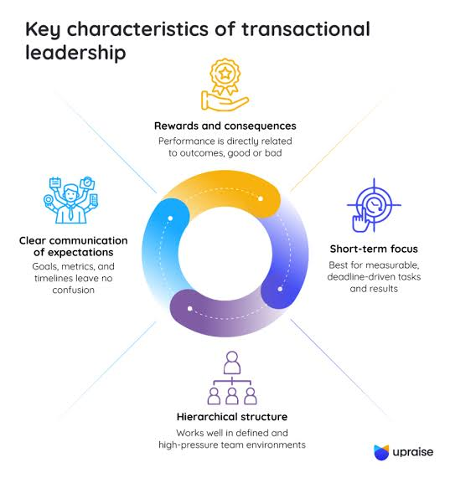
Transactional leadership Strategies for enacting change
Aljumah (2023) articulated transactional leadership helps to set clear objectives and performance standards for an organisation
Bristol can follow the clinical outcome through regular audits with transactional leadership (Bristol, 2001)
Transactional leadership focuses on defining roles and responsibilities with reward compliance and evidence-based practices (Dong, 2023)
Bristol can address poor performance and take timely corrective actions through transactional leadership for multidisciplinary coordination (Bristol, 2001)
(Source: Dong, 2023)

Slide 6

Elaborate the theories or models: Swiss Cheese Model
Organisational Defences
Supervision
Preconditions
Unsafe Acts
The Swiss cheese odel layer 1 Organisational Defences evaluate the weak governance and patient safety culture (Shabani et al. 2024)
The layer 2 Supervision evaluate oversight of inadequate managerial process (Wiegmann et al. 2022)
The layer 3 Preconditions demonstrate How lack of communication has limited the competency of staff (Shamsujjoha et al. 2025)
Layer 4 defines Unsafe Acts which leads to create continuation towards high surgical practises due to lack of poor outcomes (Lewandowski et al. 2023)
(Source: Wiegmann et al. 2022)

Slide 7
Elaborate the theories or models: Donabedian Model
Structure
Process
Outcome
Structure is the first stage of the Donabedian model that defines inadequate governance and resource issues can create specialist facility challenges (McCullough et al. 2023)
Process is the second stage that defines poor clinical decision making and limited audit can create challenges for monitoring (Yang et al. 2025)
Outcome is a last stage that evaluates high infant mortality rate and possible patient harm can reduce the public confidence (McCullough et al. 2023)
(Source: Yang et al. 2025)

Slide 8
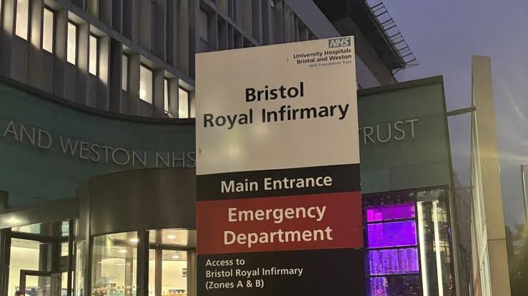
Analyse the policy issues and how they influence service delivery
Nunes et al. (2023) stated weak clinical governance and accountability framework can create limited transparency in the healthcare which leads to challenge the clinical reporting
Bristol must focus on poor patient and family involvement related decisions which can challenge the inadequate regulatory issues and performance monitoring challenges (Bristol, 2001)
The study must focus on the policy issues related to the inquiry to improve NHS quality and patience safety
(Source: Bristol, 2001)

Slide 9

Impact of these root causes and policy issues on the quality, efficiency, and equity of health and care service provision
Howick et al. (2024) stated quality can be evaluated through increased clinical errors and avoidable patient deaths
Efficiency can be managed by developing the delayed decision-making process and ineffective resource utilisation issues (Osman et al. 2025)
Equity can be balanced with inconsistency towards the safe environment and high quality paediatric cardiac care (Chowdhury et al. 2024)

Slide 10
Kurt Lewin’s Change Management Theory for preparing workforce for change in the situation
Unfreeze
Unfreeze defines awareness and develop patient safety by changing needs for change (Amina et al. 2022)
Change
Change focuses on clinical governance of Bristol and defines multidisciplinary teamwork with evidence-based practices (Rosdiana and Aslami, 2022)
Refreeze
Refreeze can embed new policies in Bristol and develop accountability towards patient safety (Amina et al. 2022)
(Source: Rosdiana and Aslami, 2022)

Slide 11
Apply PDSA for change and explain how you would apply this to your situation
Plan helps to identify how patient safety can become an issue and how to improve the objectives (Abuzied et al. 2023)
Do helps to focus on the implementation of clinical governance at Bristol with staff training and standardized protocol (Bugnitz and Sandberg, 2025)
Study evaluates the overall findings and reinforces mortality rates and stuff feedback (Huang et al. 2025)
Act focuses on possible intervention and standardized practices for Bristol
(Source: Abuzied et al. 2023)

Slide 12
Structure of the report Component 2
Introduction
Initiatives of quality improvement
Implementation of change management models
Evaluation and analysis methods
Recommendation for future development
Conclusion
Introduction
Initiatives of quality improvement
Implementation of change management models
Evaluation and analysis methods
Recommendation for future development
Conclusion
(Source: Developed by Author)

Slide 13
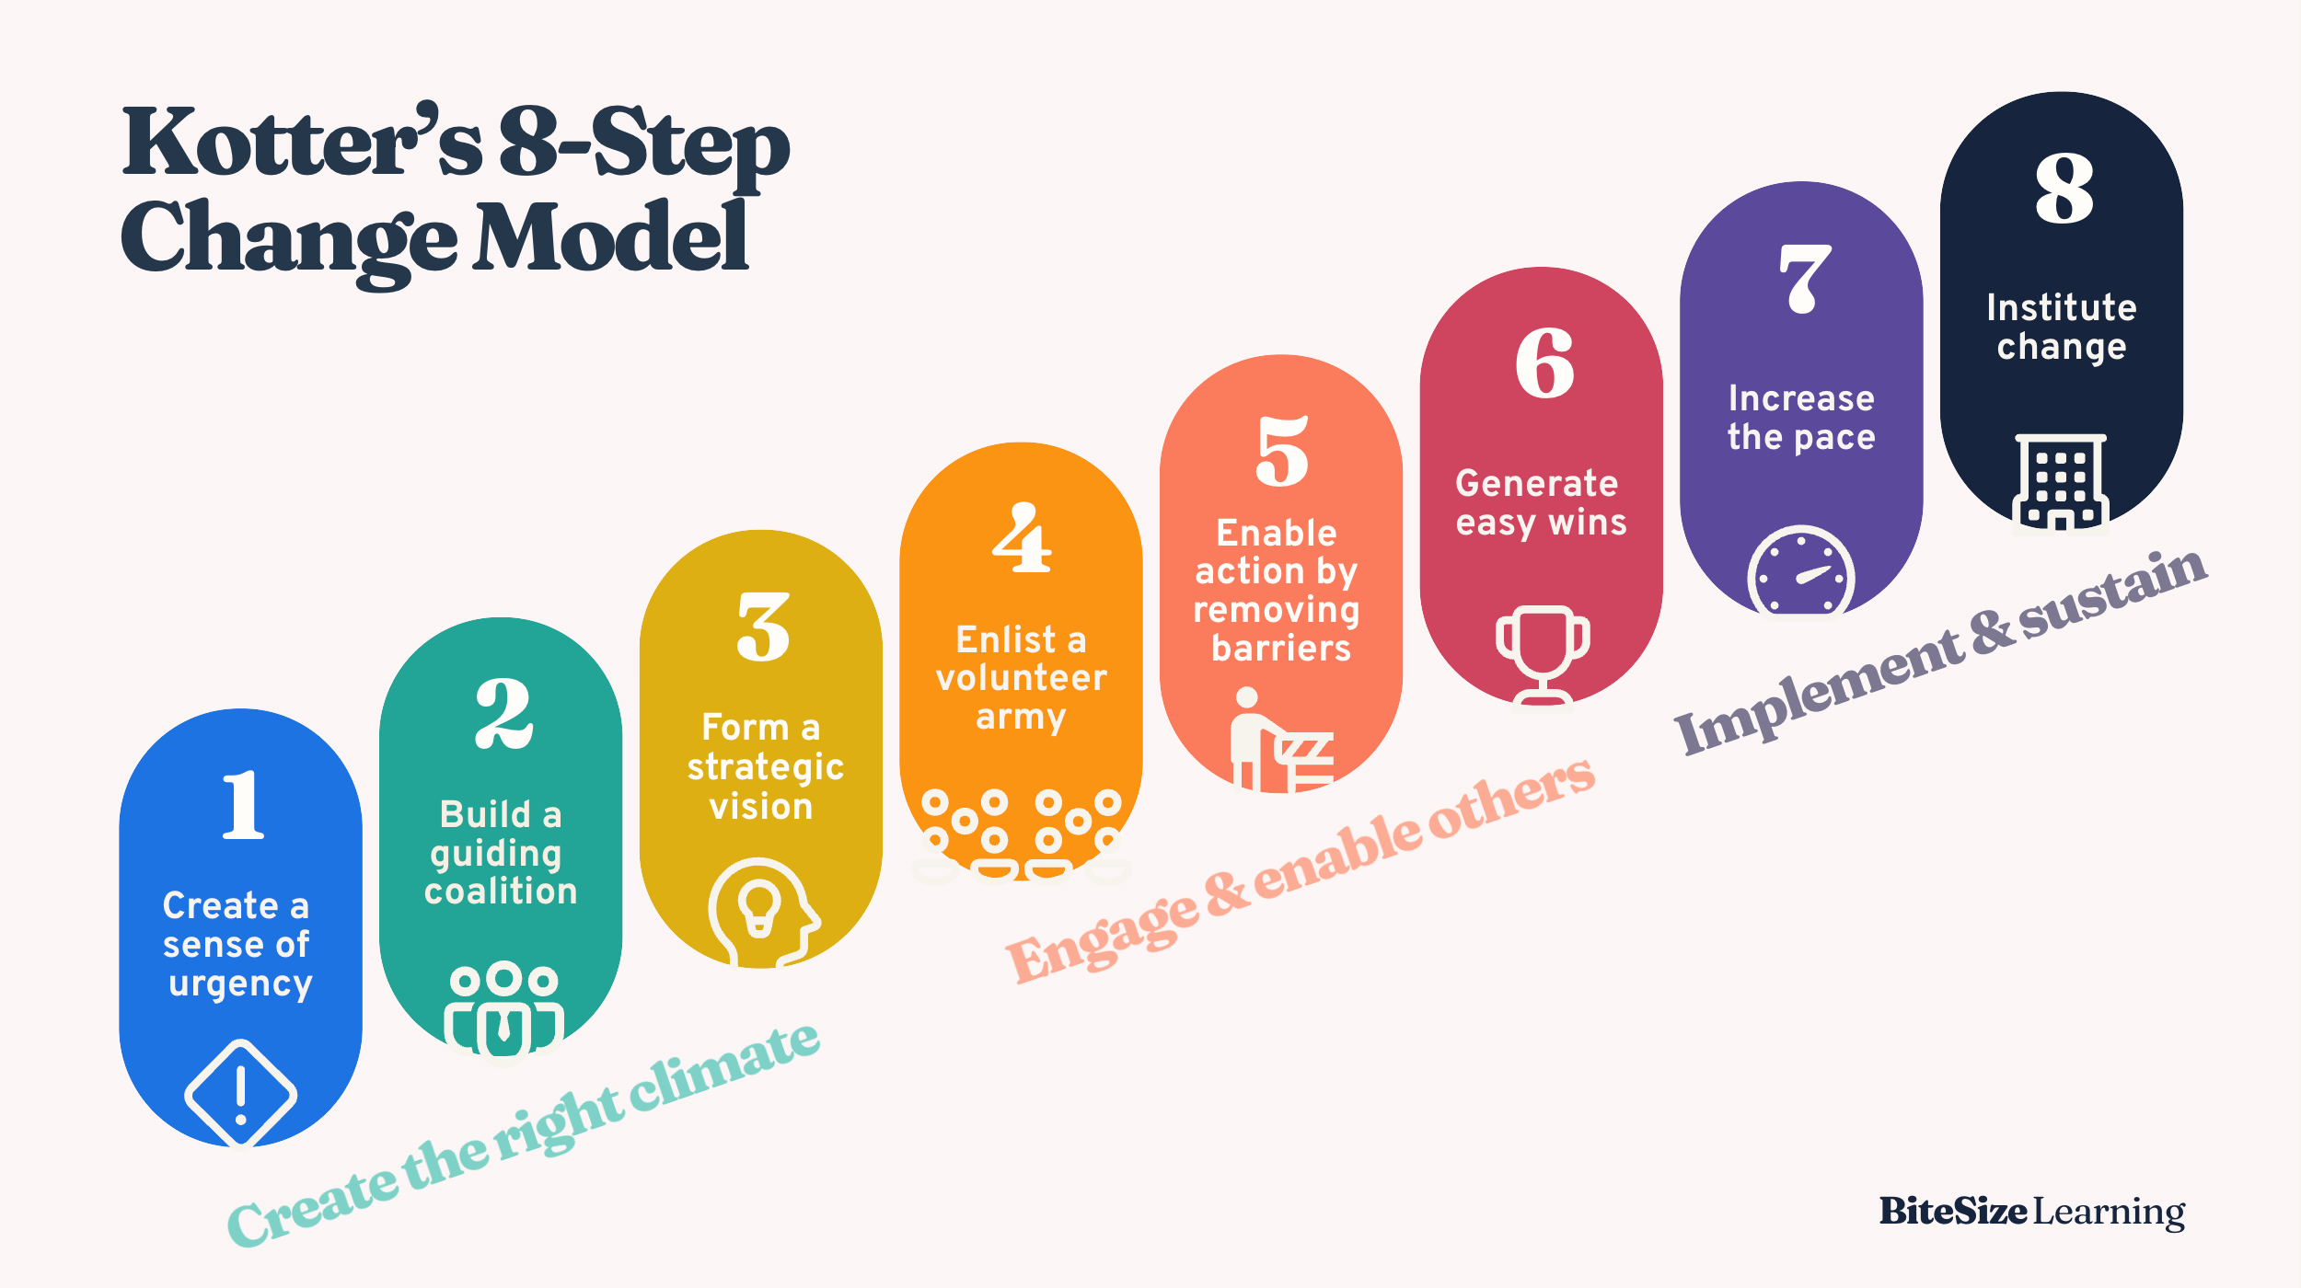
Outline potential barriers and ways to address them through Kotter’s Model
Resistance to change can be developed through the step of urgency by Kotter (Graves et al. 2023)
Poor communication can be developed with shared vision process (Davitkovic and Mihaylov, 2024)
Weak leadership can be managed by guiding coalition (Kang et al. 2022)
Staff disengagement can be empowered through action empowerment (Graves et al. 202)
Sustainability can be developed through anchor towards change in culture (Davitkovic and Mihaylov, 2024)
(Source: Davitkovic and Mihaylov, 2024)

Slide 14

Conclusion
After the assessment it can be highlighted Bristol has faced a systematic healthcare failure
The changes in leadership governance and policy reformation have essentially impacted the quality improvement process
The continuous learning can strengthen the NHS Service delivery process
(Source: Bristol, 2001)

Slide 15
References
Kang, S.P., Chen, Y., Svihla, V., Gallup, A., Ferris, K. and Datye, A.K., 2022. Guiding change in higher education: An emergent, iterative application of Kotter’s change model. Studies in Higher Education, 47(2), pp.270-289. https://doi.org/10.1080/03075079.2020.1741540
Lewandowski, J., Ma, Y., Yang, J. and Zhang, C., 2023. Quantum oppenheimer-snyder and swiss cheese models. Physical Review Letters, 130(10), p.101501. https://doi.org/10.1103/PhysRevLett.130.101501
Maclean, M., 2001. Doctors, parents and the law-organ retention after paediatric cardiac surgery at the Bristol Royal Infirmary. Child & Fam. LQ, 13, p.399. https://heinonline.org/hol-cgi-bin/get_pdf.cgi?handle=hein.journals/chilflq13&section=39
McCullough, K., Andrew, L., Genoni, A., Dunham, M., Whitehead, L. and Porock, D., 2023. An examination of primary health care nursing service evaluation using the Donabedian model: A systematic review. Research in nursing & health, 46(1), pp.159-176. https://doi.org/10.1002/nur.22291
Nunes, C., Gomes, P. and Santana, J., 2023. Transparency, accountability, and governance: a literature review in the context of public hospitals. Revista de Administração Pública, 57, pp.e2022-0238. https://www.scielo.br/j/rap/a/XnsgHpcpWgfvQNN9YHPgmGN/?lang=en
Osman, C., Twum, F.O., Boateng, P.A. and Owusu, J., 2025. Decision-making speed and organizational effectiveness among West African institutions: A systematic literature review. International Journal of Research in Social Science and Humanities (IJRSS) ISSN: 2582-6220, DOI: 10.47505/IJRSS, 6(3), pp.86-99. https://doi.org/10.47505/IJRSS.2025.3.9
Rosdiana, N. and Aslami, N., 2022. The main models of change management in Kurt Lewin's thinking. Jurnal Akuntansi, Manajemen Dan Bisnis Digital, 1(2), pp.251-256. https://jurnal.unived.ac.id/index.php/jambd/article/view/2446
Shabani, T., Jerie, S. and Shabani, T., 2024. A comprehensive review of the Swiss cheese model in risk management. Safety in extreme environments, 6(1), pp.43-57. https://link.springer.com/article/10.1007/s42797-023-00091-7
Shamsujjoha, M., Lu, Q., Zhao, D. and Zhu, L., 2025, March. Swiss cheese model for ai safety: A taxonomy and reference architecture for multi-layered guardrails of foundation model based agents. In 2025 IEEE 22nd International Conference on Software Architecture (ICSA) (pp. 37-48). IEEE. https://doi.org/10.1109/ICSA65012.2025.00014
Walshe, K. and Offen, N., 2001. A very public failure: lessons for quality improvement in healthcare organisations from the Bristol Royal Infirmary. BMJ Quality & Safety, 10(4), pp.250-256. https://www.healthaffairs.org/doi/10.1377/hlthaff.23.3.103
Wiegmann, D.A., Wood, L.J., Cohen, T.N. and Shappell, S.A., 2022. Understanding the “Swiss Cheese Model” and its application to patient safety. Journal of patient safety, 18(2), pp.119-123. https://doi.org/10.1109/ICSA65012.2025.00014
Yang, J., Liu, F., Yang, C., Wei, J., Ma, Y., Xu, L., Xie, J. and Wang, J., 2025. Application of Donabedian Three‐Dimensional Model in Outpatient Care Quality: A Scoping Review. Journal of nursing management, 2025(1), p.6893336. https://pubmed.ncbi.nlm.nih.gov/40313787/
Abuzied, Y., Alshammary, S.A., Alhalahlah, T. and Somduth, S., 2023. Using FOCUS-PDSA quality improvement methodology model in healthcare: process and outcomes. Global Journal on Quality and Safety in Healthcare, 6(2), pp.70-72. https://doi.org/10.36401/JQSH-22-19
Aljumah, A., 2023. The impact of extrinsic and intrinsic motivation on job satisfaction: The mediating role of transactional leadership. Cogent Business & Management, 10(3), p.2270813. https://doi.org/10.1080/23311975.2023.2270813
Amina, A., Kassem, A. and Sleem, W., 2022. Applying Lewin's change management theory to improve patient's discharge plan. Mansoura Nursing Journal, 9(2), pp.335-348. https://journals.ekb.eg/article_295591_2e01c440a7769101b9fd53066f06f65c.pdf
Bristol, 2001. Report of the Public Inquiry into children’s heart surgery at the Bristol Royal Infirmary 1984-1995. [Online] Available at: https://www.bristol-inquiry.org.uk/final_report/the_report.pdf [Accessed on 17th July 2026]
Bugnitz, C. and Sandberg, K.C., 2025. Creating effective PDSA cycles. Current Problems in Pediatric and Adolescent Health Care, p.101759. https://doi.org/10.1016/j.cppeds.2025.101759
Chowdhury, D., Elliott, P.A., Asaki, S.Y., Amdani, S., Nguyen, Q.T., Ronai, C., Tierney, S., Levy, V.Y., Puri, K., Altman, C.A. and Johnson, J.N., 2024. Addressing disparities in pediatric congenital heart disease: a call for equitable health care. Journal of the American Heart Association, 13(13), p.e032415. https://doi.org/10.1161/JAHA.123.032415
Davitkovic, M. and Mihaylov, M., 2024. Kotter's model for managing organizational change in an information technology context. Knowledge-International Journal, 67(1), pp.59-63. https://www.ceeol.com/search/article-detail?id=1294073
Dong, B., 2023. A systematic review of the transactional leadership literature and future outlook. Academic Journal of Management and Social Sciences, 2(3), pp.21-25. https://pdfs.semanticscholar.org/8158/5768e874415ebf8b69fee2520929c0e283cb.pdf
Graves, L., Dalgarno, N., Van Hoorn, R., Hastings-Truelove, A., Mulder, J., Kolomitro, K., Kirby, F. and van Wylick, R., 2023. Creating change: Kotter’s change management model in action. Canadian medical education journal, 14(3), p.136. https://pmc.ncbi.nlm.nih.gov/articles/PMC10351637/
Howick, J., Bennett-Weston, A., Solomon, J., Nockels, K., Bostock, J. and Keshtkar, L., 2024. How does communication affect patient safety? Protocol for a systematic review and logic model. BMJ open, 14(5), p.e085312. https://doi.org/10.1136/bmjopen-2024-085312
Huang, Z., Bi, Y., Zhang, K., Hu, B., Su, Z., Tai, C. and Luan, X., 2025. PDSA-FL: A Poisoning-Defense Secure Aggregation in Federated Learning. IEEE Transactions on Information Forensics and Security. https://doi.org/10.1109/TIFS.2025.3588324

