Slide 1
CertHE Applied Leadership and Management in the Workplace
Module: BMSK4012
Enterprise and Intrapreneurship

Slide 2
​
Session 4

Slide 3
Business Identities
Sole Trader
Partnership
Limited Liability Partnerships
Limited Companies
Franchises
Social enterprises, co-operatives and charities
Notes:
https://www.gov.uk/business-legal-structures/overview

Slide 4

Business Identities

Slide 5

Pros of operating as a sole trader
Usually only a small amount of capital is required to start the business
You are entitled to all the profits that are made by the business
You do not have to answer to anyone else and can keep overall control of the business
There is little bureaucracy involved so changes can be made quickly
You have less paperwork to deal with regarding legislation and tax.

Slide 6
Cons of operating as a sole trader
Can become isolated as there is no one to share the running of the business with
You will probably have to work long hours and it will be difficult to take time off
The level of finance available can be limited, depending on the type of business, which may stifle the development of the business

Slide 7
Cons of operating as a sole trader
Businesses with greater access to funding may have an advantage over you
You are solely responsible for any losses the business incurs, i.e. you have unlimited liability.
There is no distinction between personal and business putting your home and personal possessions at risk if you are unable to repay your debts.

Slide 8

Pros of forming a partnership
No need to produce audited accounts
Tax and National Insurance payments are generally lower than for a limited company
Increased capital available for investment
Shared management responsibilities
Shared risks and losses
Partners can bring a variety of different skills and experience to the business
They are easy to set up as they are not incorporated or registered
Partnerships cannot be taken over by other businesses

Slide 9

Cons of forming a partnership
There is unlimited liability and each partner is personally responsible for the debts of the partnership
Problems can occur when there are disagreements between partners
An individual can make a business decision without informing the other partners
Partnerships must be dissolved on death, resignation or bankruptcy of a partner

Slide 10
Pros of forming a limited liability partnership
Retains the flexibility of a partnership as opposed to the well-defined structure of a limited company
LLPs do not have to be dissolved on the resignation, death or bankruptcy of a member
There is limited personal liability for members
Tax and National Insurance contributions are lower than for a limited company

Slide 11
Pros of forming a limited liability partnership
Shared risks and losses
Members can bring a variety of different skills and experience to the business
Limited liability partnerships cannot be taken over by other businesses
Increased capital available for investment
Shared management responsibilities

Slide 12
Cons of forming a limited liability partnership
Formation is more complex and costly than that of a partnership
Most limited liability partnerships need to produce audited accounts
More administration overheads, e.g. informing Companies House of changes to members and designated members
Problems can occur when there is disagreements with other members

Slide 13

Pros of forming a limited company
Limited liability of the owners of the business
Ability to raise finance by selling shares in the business
Employees are able to own a share in the business
Suppliers are sometimes more willing to deal with a limited company
Can continue to trade if one of the members leaves
The company name is protected

Slide 14

Cons of forming a limited company
A wide range of complex and detailed legislation must be complied with, which is not applicable to sole traders and partnerships
Compulsory disclosure of company information
Credit is more difficult to obtain (especially when the business is starting up)

Slide 15
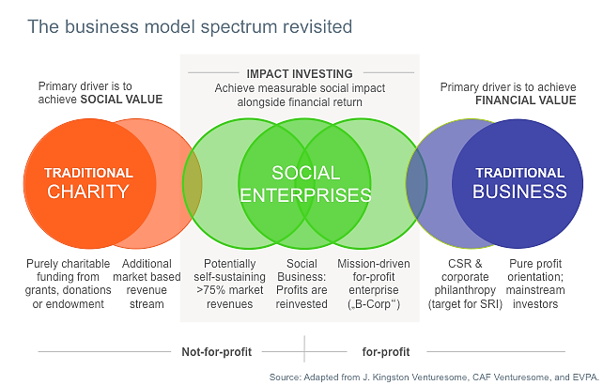
Social Enterprise

Slide 16
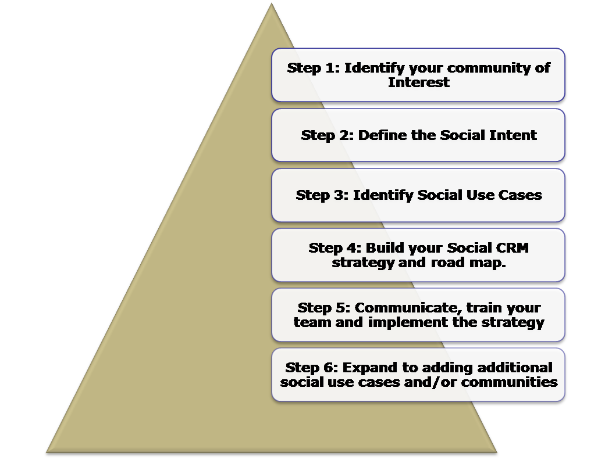
Social Enterprise

Slide 17
Further Research
Consider what will be your business’ legal identity and Why?

