Slide 1

Name: Mohammed Ali Hayder
Hospitality & Guest Services
of
Bulgari Hotel
ID: 2210332
Lecturer Name: Charlotte Joyner
Module: Hospitality & Guest BMIH4003

Slide 2
03
About Bulgari Hotel hotel brand
04
Main Consumers
Nature, Scope & Role of the Guest Services by the Bulgari Hotel
TABLE OF CONTENTS
05
04
Facilities of Bulgari Hotel
04
Considerations
04
Summary

Slide 3
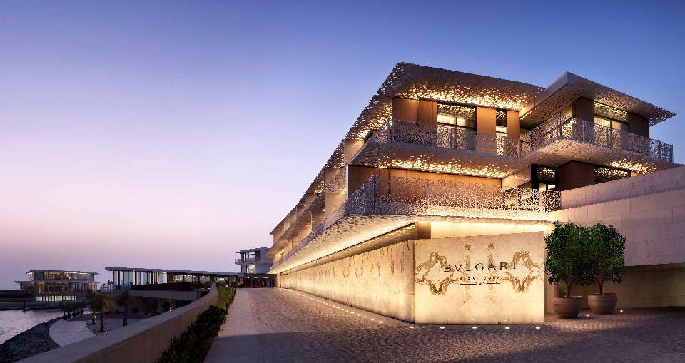
About Bulgari Hotel hotel brand
Bulgari Hotels & Resorts is a luxury hotel brand that operates several properties worldwide. Their locations include:
Bulgari Hotel London in London, United Kingdom
Bulgari Hotel Milan in Milan, Italy
Bulgari Hotel Paris in Paris, France
Bulgari Resort Bali in Bali, Indonesia
Bulgari Resort Dubai in Dubai, United Arab Emirates
Bulgari Resort & Residences in the Maldives
These hotels are generally located in prime locations and are known for offering luxurious amenities and high-end service.
Source: Google

Slide 4

Main Consumers
The primary consumers of Bulgari Hotels & Resorts are high-end travelers, including affluent individuals and business travelers, looking for luxury accommodations and exclusive experiences. They typically have a high disposable income, appreciate the finer things in life, and look for a high level of comfort, service, and exclusivity.
Source: Google

Slide 5
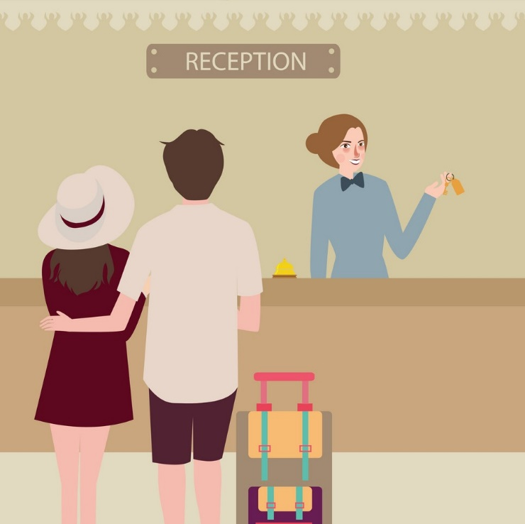
Nature, Scope & Role of the Guest Services by the Bulgari Hotel
Source: Google
Bulgari Hotels & Resorts provide luxurious guest services that cater to guests' needs and preferences, with a wide range of amenities and services, including accommodation, dining, wellness, and entertainment.
These services aim to enhance guests' experience and make their stay as comfortable and enjoyable as possible, making their stay memorable and encouraging them to return.
The role of guest services is to make guests feel at home and ensure satisfaction with their stay.

Slide 6

Facilities of Bulgari Hotel
Bulgari Hotels & Resorts provide a wide range of guest services and facilities to ensure guests have a luxurious and comfortable stay. Some of the key services and facilities offered include:
Room and Suite Accommodations
Dining
Spa and Wellness
Fitness
Business
Entertainment
Concierge
Transport &
Other
These services and facilities provide guests with a luxurious, comfortable, and convenient stay, intending to make the guest's experience as enjoyable as possible.
Source: Google

Slide 7
Consideration
Guest services play a critical role in the hospitality industry, as they ensure guests have a positive experience during their stay. In general, the role and function of guest services include:
Providing information to guests
Handling guest requests and complaints
Coordinating with other hotel departments
Providing concierge services
Supporting front office operations
Overall, the role and function of guest services are to ensure that guests have a positive experience during their stay at the hotel and that any issues or concerns are addressed promptly and efficiently.
Source: Google

Slide 8

Summary
Source: Google
For a hotel to maintain its image and encourage repeat business, outstanding hospitality and guest services are expected. This means providing courteous and helpful service, maintaining neat and comfortable lodgings, providing a wide range of amenities, and providing a choice of facilities and services.

Slide 9
Au. S (2022) 33 Marriott Bonvoy Hotel Brands: Select, Premium, Luxury, Residences & More [Blog] 10 November, Available at: https://upgradedpoints.com/travel/hotels/marriott-bonvoy-hotel-brands/ (Accessed: 23 January 2023)
camthecolombian (2015) Hotel Review: Bulgari Hotel Residences London [Blog] 2 May, Available at: https://travelbykatie.com/2015/05/02/hotel-review-bulgari-hotel-residences-london/ (Accessed: 23 January 2023)
Howe N. (2022) Bulgari demonstrates limitless adventure in Parisian hotel [Blog] 23 February, Available at: https://www.luxurydaily.com/bulgari-demonstrates-limitless-adventure-in-parisian-hotel/ (Accessed: 23 January 2023)
Lacalle E. (2022) Five most frequent guest expectations in hotels and how to exceed them [Blog] 7 July, Available at: https://www.mews.com/en/blog/hotel-guest-expectations (Accessed: 23 January 2023)
Les Roches logo (2018) Why we recruit Les Roches students – Bulgari Hotels and Resorts [Blog] 7 November Available at: https://lesroches.edu/blog/recruit-students-bulgari-hotels-resorts/ (Accessed: 23 January 2023)
Petcu O. (2018) Bulgari Hotels & Resorts, the success behind the jeweller becoming a true luxury hotel brand [Blog] 24 November, Available at: https://cpp-luxury.com/bulgari-hotels-resorts-the-success-behind-the-jeweller-becoming-a-true-luxury-hotel-brand/ (Accessed: 23 January 2023)
Schlappig B. (2022) Review: Bulgari Hotel Milan, Italy [Blog] 10 April, Available at: https://onemileatatime.com/reviews/bulgari-hotel-milan/ (Accessed: 23 January 2023)
studycorgi (2020) The Dorchester and Bulgari Hotels: Service Quality [Blog] 29 December, Available at: https://studycorgi.com/the-dorchester-and-bulgari-hotels-service-quality/ (Access: 23 January 2023)
thegoodthebadandtheluxurious (2022) Review: Bulgari Paris [Blog] 22 February, Available at: https://thegoodthebadandtheluxurious.com/2022/02/22/review-bulgari-paris/ (Accessed: 23 January 2023)
Vendom.jobs (2020) INTERVIEW: Michael O’Neill, Company Director and human resources manager, Bvlgari Hotel London [Blog] 12 August, Available at: https://www.vendomtalents.com/en/news/interview-michael-o-neill-company-director-and-human-resources-manager-bvlgari-hotel-london (Accessed: 23 January 2023)
Reference

Slide 10
Thank You

