Slide 1
Developing a Business Plan :
Day 2

Slide 2
Learning objectives of this session
1.To start to develop a business plan for your business.
2.To examine the legal options available for a company structure.
3.To understand the practicalities required before committing to start a business.
4.To examine the basis on which you are going to compete.
5.To start developing a marketing plan.
6.To begin to understand the operational requirements of the business.

Slide 3
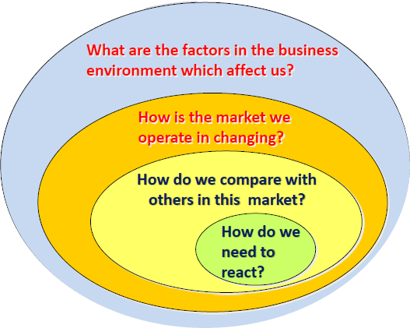
The world in which the company operates

Slide 4
Time to focus on the business and the way forward

Slide 5
A template for a Business Plan
• Summary of the business structure
• Outline of the product or service
• Analysis of markets and competition
• Sales and marketing plan
• Management structure
• Operations plan
• Financial forecasts
• Funding requirements
• Appendices

Slide 6
Topic 1 : What sort of company?
• What will be the legal status of the business?
• What will the business do?
• Where will the business be located?
• In what sector will the business be operating?
• When will the business start trading ?
The Business
The Product
The Market
Marketing Plan
Management
Financial Information
Funding
Appendicies

Slide 7
What are the choices a business has
in terms of its legal entity?

Slide 8
Legal Structures
Sole Trader
Partnership
Limited Liability Partnership
Limited Company

Slide 10
Types of business structures
Principal types of structure:
Sole Trader
Partnership
Co-operative
Company limited by guarantee
Private Limited Company
Public Limited Company
Franchise
All of the above structures can employ people.

Slide 11
Sole traders
A sole trader describes any business that is owned and controlled by one person - although they may employ workers. Individuals who provide a specialist service like plumbers, hairdressers or photographers are often sole traders.
Sole traders do not have a separate legal existence from the business.
In the eyes of the law, the business and the owner are the same.
As a result, the owner is personally liable for the firm's debts and may have to pay for losses made by the business out of their own pocket.
This is called unlimited liability.

Slide 12
Advantages of being a sole trader
Sole traders benefit from the following advantages:
Control – Sole traders maintain full control of their business.
Profit retention – Sole traders retain all the profits of their business.
Private data – Information about sole traders is kept private, unlike that of limited companies which is necessarily made public after registration with Companies House.
Part of the community – Often a small business, sole traders can offer a more personal service with local roots and ties.
Personal – Because there is no need to confer with other decision makers, sole traders can make decisions quickly and act on them swiftly, providing for the needs of their customers.

Slide 13
Disadvantages of being a sole trader
Liability– sole traders are not seen as a separate entity by the law. Therefore, they are subject to unlimited liability. This means if the business gets into debt, the business owner is liable. In the worst case, this may mean a person risks their home, personal savings and any other assets they have both in and outside of the business.
Finance – sole traders often find it difficult to raise finance to fund their business.
Reverse economies of scale – sole traders will be unable to take advantage of economies of scale in the same way as limited companies and larger corporations, who can afford to buy in bulk.
Decision making – all decisions must be made by the sole trader. There is no room for help by others. So the success or failure of the business rests on one person.

Slide 14
There are two main types of limited company:
A private limited company (ltd) is often a small business such as an independent retailer in a market town. Shares do not trade on the stock exchange.
A public limited company (plc) is usually a large, well-known business. This could be a manufacturer or a chain of retailers with branches in most city centres. Shares trade on the stock exchange.

Slide 15
4
Advantages of running your business as a limited company
1. Tax
The main advantage of running your business as a limited company is that you are likely to pay less personal tax than a sole trader.
2. Distinct Entity
A limited company is a completely separate entity from its owners. Everything from the company bank account, to ownership of assets and involvement in tenders and contracts is purely company business and separate from the interests of the company’s shareholders.
A sole trader and his/her business is treated as a single entity for tax and administrative purposes.

Slide 16
Continued……………………..
3. Limited Liability
As the name suggests, if you run a limited company, you are protected in case things go wrong. Assuming no fraud has taken place, you will not be personally liable for any financial losses made by your limited company.
Those running a business as self employed do not enjoy such protection from financial claims if things go wrong with their business.
4. Professional
In some businesses and industries, having a limited company can provide a more professional image.
5. Funding
Finding funding can be difficult for all types of businesses in the current climate. But because a limited company is a distinct entity from its owners it may be a little easier for a company to secure business finance than it is for their sole trader counterparts.

Slide 17
6. Naming
Once you register your company with Companies House, your company name is protected by law. No-one else can use the same name as you, or anything deemed to be too similar.
As a sole trader, it’s possible someone else could trade under the same name as you, and you couldn’t do anything about it. This could damage your business, and in some cases, result in you having to go through the costly and time-consuming effort of changing the name of your business.
7. Shareholders
A limited company can issue various classes of shares. This means you can easily sell stakes in the company, or transfer ownership of shares.

Slide 18
Disadvantages of setting up a Limited company
Audited annual returns and accounts have to be made to the Registrar of Companies. All these documents are available for public inspection
A private limited company is more expensive and time consuming to set up than a sole trader or partnership
Professional help will be needed to set up a private limited company
There is separation of ownership and control which means that the owners no longer make all the decisions
There are limited opportunities for economies of scale

Slide 20
Business Names, Logos and Licences
Regulated by Business Names Act 1985
Using your own name
Checking for names in use
Using a trading name
Consider domain names Trademarks Business
Trademarks
Registration, HMRC, Local authority, HSE

Slide 21
Protecting your Ideas/ Work
Trademarks
•Brand name
Products, processes, mechanisms and materials
•Inventions can be patented
•New and previously undisclosed
•Involves an inventive step
•Capable of industrial application
•Relates to visual appearance, style, colour and image
•Outward appearance is the main attraction
Registered Designs
Patents: www.patents.gov.uk

Slide 22
Regulatory Compliance
VAT
Insurance
Licences
Health and Safety
Premises
Terms and Conditions (trading and employment)

Slide 23
You must register for VAT with HM Revenue and Customs (HMRC) if your business’ VAT taxable turnover is more than £85,000.
When you register, you’ll be sent a VAT registration certificate. This confirms:
• your VAT number
• when to submit your first VAT Return and payment
• your ‘effective date of registration’ - this is the date you went over the threshold, or the date you asked to register if it was voluntary
Website : https://www.gov.uk/vat-registration/how-to-register

Slide 24
Your VAT responsibilities
From the effective date of registration you must:
• charge the right amount of VAT
• pay any VAT due to HMRC
• submit VAT Returns
• keep VAT records and a VAT account
You can also reclaim the VAT you’ve paid on certain purchases made before you registered.

Slide 25
What Insurance will I need?
Legal Requirements (compulsory)
•Vehicle insurance
•Employers liability if you employ people
Other forms of Insurance
•Public liability
•Product liability – if you sell, repair or supply
•Professional indemnity – for consultants
•Goods in transit, loss of money, fire etc
•Building and contents
•Personal insurances – such as pensions
•Health and life insurances

Slide 26
Do you need a licence?
•Theatre, child-minding, taxi service, nightclubs, pet kennels, adult shops etc
Local Authority
Environmental Health Dept
•Hotels, restaurants, tattooing, massage, acupuncture, abattoirs, etc
•Possession or sale of firearms, to work with children etc
Police
•Sale of alcohol, betting shops, gaming etc
Magistrates
•Bureau de change, money transmission, third party cheque cashing etc
HM Customs & Excise
•Lending money, debt collection, hiring, leasing, etc
Office of Fair Trading
•Building regulations, alterations, change of use etc
Planning Officer

Slide 27
Defining the basis for competition

Slide 28
Topic 1 : What sort of company?
• What does the product or service do?
• What advantages or benefits will customers gain?
• How can it be developed in the future?
• What are the key features of the industry?
• What are the hazards?
The Business
The Product
The Market
Marketing Plan
Management
Financial Information
Funding
Appendicies

Slide 29
Do you provide a Product or a Service?
• A product needs to be designed, tested, prototyped, approved, tooled for mass production, packaged and delivered
• A service needs to be able to meet the needs of customers better than any competitor (Does it have an USP?)

Slide 30
Unique Selling Proposition (USP)
•A USP helps you to differentiate your product/ service in the market
•It might be:
•Price
•Service
•Quality
•Uniqueness
•Better support
•Ease of use

Slide 31
Some examples of USPs:
Company | USP
Dyson | Revolutionary solution
Apple (Ipad) | Smarter / better design
BMW | Build quality
eBay | Accessability
Innocent | Healthier
Harley Davidson | Tribal
Stella Artois | More expensive

Slide 32
Assessing your product or service
Use the following template to assess your product or service:

Slide 34
What are we particularly good at ? Specifically (U.S.Ps) : 1. Short run colour litho. printing. 2. Fast turn-around work. 3. Quality of Digital vs. Litho. matching. 4. Profitable Digital business. 5. Digital ordering system. Generally : 1. Reputation for Customer service & Quality. 2. Excellent image of Corporate Social responsibility particularly with respect to Environmental credentials. 3. People who visit the site normally do business (90%): how can we get more people to visit the site? | Where are we vulnerable? Specifically for X: 1. Do not have an effective marketing strategy. 2. Website is not dynamic or up-to-date. 3. Little business done through Internet tools. 4. Succession planning could become an issue. 5. Intermittent ‘mistakes’ affect customer confidence. 6. Headcount to sales level in excess of industry Benchmarks Generally (true for the industry) : 1. Control of debt in current climate. 2. Takeover/mergers and acquisitions. 3. Danger of good people leaving the business because of economic uncertainty. 4. Continually reducing prices. 5. Move from print to electronic in the STM sector.
What opportunities can be exploited ? Short term : 1. To be seen as Printer of choice for the STM sector. 2. Offer (even if limited) Internet ordering facility. 3. Build on the success of the digital operation. 4. Become leaner in terms of resource deployment. 5. Greater penetration of the Public sector. 6. Exploit opportunities generated by failed competitors. 7. Create a far more dynamic and appealing website. Longer term : 1. Business to Business system links. 2. Explore opportunities for developing a Print management operation. | What are the threats to the business ? Internal : 1. Failure to exploit E-commerce and Internet trading opportunities whilst others are adopting such systems will result in X being seen as out-of-date. 2. Failing to systemise the issues that cause ‘mistakes’. External : 1. Currency fluctuations. 2. Credit and insurance withdrawal causing cash flow problems. (And the level of risk that can be exposed). 3. Price comparison websites will further exacerbate the issues highlighted above.

Slide 35
SWOT Analysis
Strengths • Experienced core sales team • Long serving employees with a vast amount of experience and knowledge • Positive culture , committed to continuous improvement • Proactively train employees • Minimum trade union influence • Experienced design department • Long standing customer base, reputation for Quality, service, and reacting to the customer needs. • Large storage area, can offer stock holding. • Two sites running one shift each, have the capacity to grow • Own transept fleet, flexibility with local deliveries and Call offs • Positive feedback from most visitors to site • We understand the need to grow and develop to survive in today's market • SPOCS, Fantastic system • Good at doing the best we can with the old machines we have | Weaknesses • Ageing workforce • Not all Managers share the same vision, and show poor "lead by example" This affects morale within the department • Board supplier (Abbey) poor quality product, logistically too far from site • Maintenance cost high due to past neglect • Machines running with faults due to resource (time and cost) • SPOCS /Network running slow, this frustrates all operators • Can over complicate simple tasks • Planner not set up over both sites • Process errors costs us time, money, and loss of customer trust. • Lack of innovation • We don’t advertise, or sell our "stocked items" on the open market • We don’t do any internet selling • Not using SPOCS to its full potential, due to lack operator knowledge, system issues and short cutting. • Most machines over both sites are old • Maintenance department over stretched
Opportunities • Identify what are our competitors USP? • Two sites running one shift each. Have the Capacity to expand 66%, • Advertise our "stocked items" on the open market • Be smarter with stock holding for current customers, we need room to offer this service to potential customers • Develop the delivery module in SPOCS for better economical use of our transport between two sites • Pro-actively sell our designs onto the open market • Look at Technological advances to better out USP • Create our own online shop • Get more visitors to site • BCR Accreditation will open doors for growth | Threats • Selling price constantly under pressure • Competitive market prices forcing us to cut prices to keep the work • Customers moving work abroad for economical reasons • Loss in trust from some of our long standing customers means they will look elsewhere • Competitors more Technological advanced than we are, and • Competitors gaining an advantage through investment in better Technology • Loosing focus on some areas due to lack of resource • Competitors can buy board from anywhere • Competitors have BRC, can offer a service we cant • Two sites with only enough work for one shift each, is this cost effective? • Losing our sales reps to competitors

Slide 36
Exercise 3
Undertake a SWOT analysis of your company

Slide 38
Where do we stand in the market?
What are we particularly good at ? | Where are we vulnerable?
What opportunities can be exploited? | Where are the threats to our ideas?

Slide 41
Benchmarking your product or service

Slide 42
types of company:
Stage 1 : Survivor. (Just!)
•Reactive , non-performance-based survival
Stage 2 : Yellow pages company.
• The company is neither sought nor avoided
• They have a reliable but uninspired operation
• They have a prevailing culture of “We’ve always done it like this.”
Stage 3 : You would recommend these.
• They have a reputation for meeting customers’ expectations
• Their operations are customer focused at all times
• A pro-active management looking for new ways to satisfy the customer
Stage 4 : World class company.
• Firm’s name is synonymous with service excellence
• They focus on delighting rather than satisfying customers
• They are continuously learning and seeking to improve their operations

Slide 45
Customer opinion surveys
(If you have sufficient resources)

Slide 48
General Comments made by every customer
Positive
Having a single point of contact in the Sales office is much better for ownership
Good response times to queries
Good rep. coverage
Negative
Not always being told when a delivery is going to be late
Pallet quality on delivery is sometimes poor
Price needs adjusting in comparison to market

Slide 50
Are X helpful, approachable and easy to deal with?
Total percentage in agreement with the statement – 93.7%
Best results ever achieved on this question
An increase of 18.7% on last year’s result

Slide 51
Do our lead-times meet your overall requirements
Total percentage in agreement with the statement – 77.2%
A huge increase on last year’s result by 43.9%

Slide 52
Does our material perform better than other suppliers for comparable grades?
Total percentage in agreement with the statement – 53.1%
The lowest it has been, a further drop on last year by 5.2%
It would need a 41.4% increase to make the highest score which was recorded in 2006

Slide 53
Customer expectations
•Customers have rising expectations
•They show less tolerance and a greater willingness to complain
•They have greater awareness of rights and less deference
•They generally have a greater level of sophistication that customers in the past

Slide 54
Developing a marketing plan

Slide 55
Topic 3 : The Market
• What will be the legal status of the business?
• What will the business do?
• Where will the business be located?
• In what sector will the business be operating?
• When will the business start trading ?
The Business
The Product
The Market
Marketing Plan
Management
Financial Information
Funding
Appendicies

Slide 57
Product –
The first of the Four Ps of marketing is product.
A product can be either a tangible good or an intangible service that fulfils a need or want of consumers.
Whether you sell custom wood products or provide luxury accommodation, it’s imperative that you have a clear grasp of exactly what your product is and what makes it unique before you can successfully market it.

Slide 58
Do you provide a Product or a Service?
• A product needs to be designed, tested, prototyped, approved, tooled for mass production, packaged and delivered
• A service needs to be able to meet the needs of customers better than any competitor (Does it have an USP?)

Slide 59
On what basis can we compete?
Competitive Factor | How important is this factor to the customer? | How do we compare on this factor with our competitors?
Price
Speed
Reliability
Quality
Innovation
IMPORTANCE : Score from 1 (low) to 10 (high)
PERFORMANCE : Score from 1 (lot worse) to 10 (much better)

Slide 64
Specific features analysis
Sometimes there may be special features about the product or service which will be the main driving forces for that particular market.

Slide 65
Identifying Attribute U.S.Ps
What is the business particularly good at? | Importance to the Business | Rarity | Difficulty of Imitation | Uniqueness Factor (I*R*D)
1.
2.
3.
4.
5.
6.
7.
8.
9.
10.
11.
12.
13.
1 – Low 3- Medium 5 - Important

Slide 66
Exercise 4
Map your main Products and Services portfolio using Customer Importance/Competitor competence grids.

Slide 68
Keeping an eye on your competitors is essential in business: it can help you to identify your own strengths and weaknesses.

Slide 69
Competition
•Everyone has competitors!
•Direct and indirect competitors
•Current and anticipated competitors
•Competitor strengths and weaknesses
•Your competitive advantages

Slide 70
Competitor analysis
•What will your competitors do in the future?
•Where do you have a competitive advantage?
•How will this change your relationship with our competition?

Slide 72
Competitor Analysis
• Which rival has the best strategy?
• Which rivals appear to have weak strategies?
• Which firms are poised to gain market share, and which ones seen destined to lose ground?

Slide 73
Categorising the Product Portfolio

Slide 74

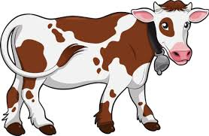

Boston Consulting Group Analysis
? | Question-marks need much cash, but generate little. Invest in promising question-marks and grow them into stars. Divest the others.
 | Stars both need and generate cash. Try to hold your market share because the reward will be conversion into cash cow.
 | Cash-cows need little cash and generate much. They are usually past stars. Milk them for what they are worth.
 | Poor dogs do not deserve investment as they generate little cash. If they do not deliver cash, divest them.

Slide 75

?
STARS
(Invest)
QUESTION MARKS
(Select the most promising)
Market Growth
DOGS
(dispose)
CASH COWS
(milk)
Market Share

Slide 77
?
STARS
(Invest)
QUESTION MARKS
(Select the most promising)
Market Growth
PAINTS (8%)
Plot your strategically important product/market groups on this grid
CASH COWS
(milk)
DOGS
(dispose)
Market Share

Slide 78
Exercise 6
Map your Products and Services portfolio using the Boston Matrix categories.

Slide 79
Market segmentation
Market segmentation is the process by which customers, in a mixture of markets can be grouped into smaller, more similar segments.

Slide 80
Market segmentation

Slide 81
Criteria for segmentation

Slide 82
Market segmentation : a summary
• Measurable
Size, purchasing power
• Accessible
Can be reached and served
• Substantial
Large and profitable enough
• Differentiable
Respond differently
• Actionable
Effective programmes can be developed
Requirements for effective
segmentation

Slide 83
Market segmentation
Market Segmentation
Geographic segmentation
Demographic segmentation
Psychographic segmentation
Behavioural segmentation

Slide 84
Market segment: …………………………………………….
Who are the customers in this market segment?
What do they need?
What are the minimum requriements for this segment?
How are the segment's needs and requirements met at present?
What differentiates us from(4)in what we can offer this segment?

Slide 85
The Target Market
Analyse & describe the target market segments in terms of:
  What is the size of the target market?
  Who are your customers? (M/F, age, income, etc.)
  Where are they located and are they accessible?
  How often do they buy or use the product?
  What key issues are important to them when they evaluate a purchasing decision? (Service?, Price?, Quality?, Branding?, Value for money?, Convenience?, Image?)
  How long does it take to make the decision to buy?
Describe how customer needs will be met by your product
Can a repeat sales cycle be established?
Are there barriers to entry?
Have you undertaken a competitor SWOT analysis?

Slide 86
Topic 3 : The Market
• Outline the plans for publicising and advertising your product or service
• How much will the marketing campaign cost?
• What is the most effective way of promoting the product?
• How will you distribute the service or product?
• How will your pricing models work?
The Business
The Product
The Market
Marketing Plan
Management
Financial Information
Funding
Appendicies

Slide 87
Marketing and Sales
Define your primary and secondary markets
Show some numbers
How will you find, sell, and retain customers?
Advertising and promotion budget

Slide 88
Ansoff’s Matrix (Product/Market Matrix)

Slide 89
How do we develop the business?
Market profile
Existing markets New markets

Slide 91
Price
Once a concrete understanding of the product offering is established we can start making some pricing decisions.
Price determinations will impact profit margins, supply, demand and marketing strategy.

Slide 92
Marketing Ps - Price
Price – The amount of money a business demands in exchange for its offerings
Willingness to pay – What customers are prepared to give in return for what they get.
Pricing decisions must also consider:
•Production, communication and distribution costs
•Profitability
•Competitors’ prices.

Slide 93
Pricing strategies
• Premium pricing
Uses a high price, but gives a good product/service exchange
e.g. Morgan cars, The Ritz Hotel
• Penetration pricing
Offers low price to gain market share, then increases the price
• Economy pricing
Placed at ‘no frills’, low price
e.g. Soups, spaghetti, beans

Slide 94
•Price skimming
Where prices are high - usually during introduction of product e.g new albums or films on release Ultimately prices will reduce to the ‘parity’
•Psychological pricing
To get a customer to respond on an emotional, rather than a rational basis
e.g. 99p not £1.01 from a ‘price point’ perspective
•Product line pricing
Rationale of a product range
e.g. Mars bar 32p. Four-pack 99p. Bite-size pack £1.29
•Pricing variations
‘Off-peak’ pricing and early booking discounts, etc.

Slide 97
Promotion
We’ve got a product and a price now it’s time to promote it.
Promotion looks at the many ways companies disseminate relevant product information to consumers and differentiate a particular product or service.

Slide 99
Types of Promotion
•Market research
•Customer service
•Advertising
•Targeting
•Packaging
•Pricing
•e-Marketing
•Target market
•Brochures
•Direct mail
•Billboards
•Community events
•Sponsorships
•Signage
•Delivery
•Distribution
•Branding
•Public relations
•Social media
•Competitive analysis
•Trade shows
•Word of mouth
•Internet
•Flyers
•Speaking engagements
•Yellow Pages
•Give-aways

Slide 101
What are the best ways to advertise your business without breaking the bank?

Slide 102
Get a Website
A real must in promoting your business is setting up a website.
If you simply can’t afford to fork out for a professional to custom-build your website, choose a company such as Wix, SquareSpace or Godaddy, all of whom offer tools and templates to make the task easier.
Get Listed
Once you have a website, register your business on search engine local directories?
You can get your business up on Google and Bing for free or on Yahoo for next to nothing if you sign up for their services. Yahoo Localworks charges a monthly fee and lists you in 50 different directories, such as Yelp, WhitePages, Bing, Yahoo Local and more.

Slide 104
Set Up Social Media Platforms
Create social profiles on platforms such as LinkedIn, Facebook, Google Plus, Twitter, Instagram and Pinterest?
Make sure you include a decent description, keywords and a link to your website.
Set up a simple database:
The backbone of all good marketing is about building a solid database of past, present and future customers (prospects) so you can keep in touch and communicate regularly via e-newsletters, emails and phone.

Slide 105
Email Newsletters
Sign up for an email service Send a monthly newsletter and/or promotional offers to customers and prospects for your business.
Tips:
1.Make sure you ask for permission before sending an email to the person in question.
2.Try and find a student who’s studying marketing and might need some hands-on experience.
Press Releases
Is there something unique about your business? Then publicise it. Decide which audiences are likely to be interested in your product or service, then send out press releases to local newspapers, magazines, radio stations and TV stations.
Be sure to post the press releases on online and don’t forget to include links to your website.

Slide 109
Marketing channel | Questions to ask | Advantages | Measurement | Cost
Email | Have you got a good quality email list with permission to get in touch? | Easy to target messages at segments; great for keeping in regular contact until customers are ready to buy | Email analytics can tell you everything you need to know about who has clicked on what. | Very low cost but doing it well takes time
Online marketing | Are you attracting enough people to your website? | SEO and pay-per-click advertising can help get your business to the top of search results | Google Analytics can help you measure the success of SEO and pay-per-click activity | The cost depends on how much outside expertise you need to bring in
Social media | Which social media sites are your customers using? | Social media helps you build relationships with customers and widen your reach | Everything is measured from followers to likes; use links and calls to action to drive traffic to your website | Social media sites are free but you have to factor in the cost of your time
Content marketing | Are you promoting your expertise? | Writing guides, blogs and case studies can help you build a strong reputation in your field | Include links in your content and measure traffic to your website; ask customers for feedback | Creating content takes time
PR | Do you need to raise your profile? | PR can give you exposure – whether you are looking for mentions in the business press or a local paper | Measure uplifts in sales or website traffic when you have had media coverage | Perseverance is the name of the game with PR so it can take time
Exhibitions and eve | Can you reach your customers in one place? | An opportunity for face-to-face contact with lots of motivated prospects | Collect data on everyone you meet, follow up on every lead and measure the results | Events are very costly but they offer big rewards
Advertising | Will it be seen by the right people? | Advertising in the press, directories or online can help you reach your target market | Monitor results from ads using dedicated email addresses, URLs and phone numbers | Costs vary
Direct mail and leafleting | Could letters and flyers get your business noticed? | Direct mail and flyers are making a comeback | Monitor results from flyers using dedicated PO Box numbers, email and web addresses and phone numbers | Potentially very cost-effective
Sponsorship | Can you improve your reputation by association? | Local firms can get great goodwill by sponsoring local charities or sports teams | Measurement is not easy but you can monitor overall results over the course of the sponsorship | Local sponsorship can be quid pro quo – such as paying for team kit in return for a logo

Slide 112
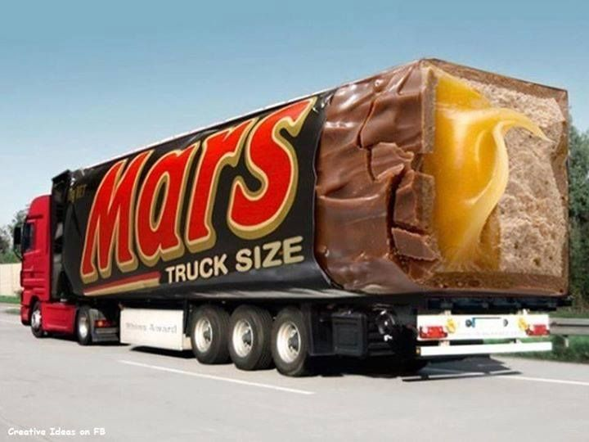

Slide 115
Topic 5 : Management
• What will be the legal status of the business?
• What will the business do?
• Where will the business be located?
• In what sector will the business be operating?
• When will the business start trading ?
The Business
The Product
The Market
Marketing Plan
Management
Financial Information
Funding
Appendicies

Slide 116
Logistical/Operational considerations:
• Where will the business be located?
• What are the advantages/disadvantages of this location?
• What production facilities are required?
• Make to Order or Make to Stock?
• How many employees are required?
• Who will be the main suppliers to the business?
• What are the likely bottlenecks in the supply chain?

Slide 117
Making Location Decisions
Analysis should follow 3 step process:
Step 1: Identify dominant location factors
Step 2: Develop location alternatives
Step 3: Evaluate locations alternatives

Slide 118
Factor Rating Example
Step 1: Identify the dominant factors
Step 2: Assign weights to factors reflecting the importance of each factor relative to the other factors (total = 100)
Step 3: Select a scale by which to evaluate each location relative to each factor (e.g., 100-point scale). Evaluate each alternative.
Step 4: For each factor, multiply the weight of the factor by the score for the factor and sum the result for each alternative.
Step 5: Select the alternative with the highest score.

Slide 119
A car repair company intends to open a new branch store. The following table contains information on two potential locations. Which is better?

Slide 121
Make to Order or Make to Stock?

Slide 122
Different product strategies for Pizza supply
What is the basis for competition (Price/Delivery/Service/Choice) for the 3 strategies?

Slide 123
Evaluating potential suppliers

Slide 125
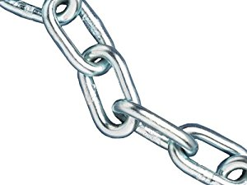
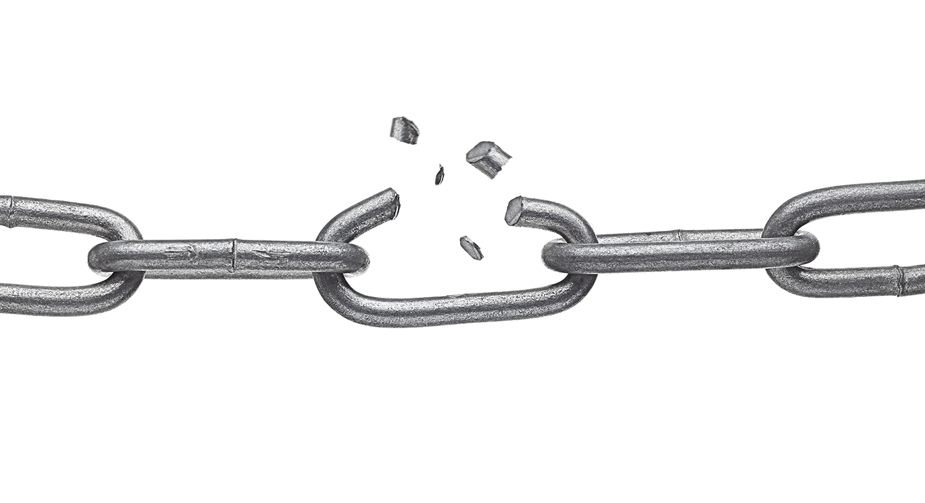
• Think of any business as a chain
• Each link in the chain represents a separate function
• If one link breaks the whole chain fails
• It is the linkages that bear the strain
• It is the strength of the linkages that determine how well the chain works
• Improving some of the links does not improve the chain

Slide 126
Significance of Bottlenecks
Maximum speed of the process is the speed of the slowest operation
Any improvements will be wasted unless the bottleneck is relieved

