Slide 1
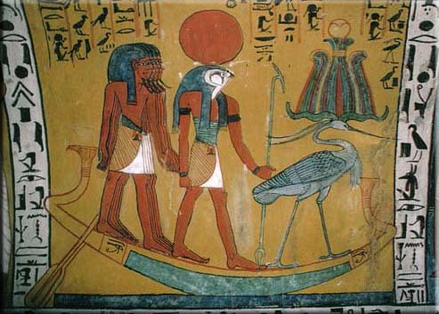
Pharaohs, Phoenicians, & Peoples of the Sea
Introduction: Early Civilisations of the East Mediterranean

Slide 2
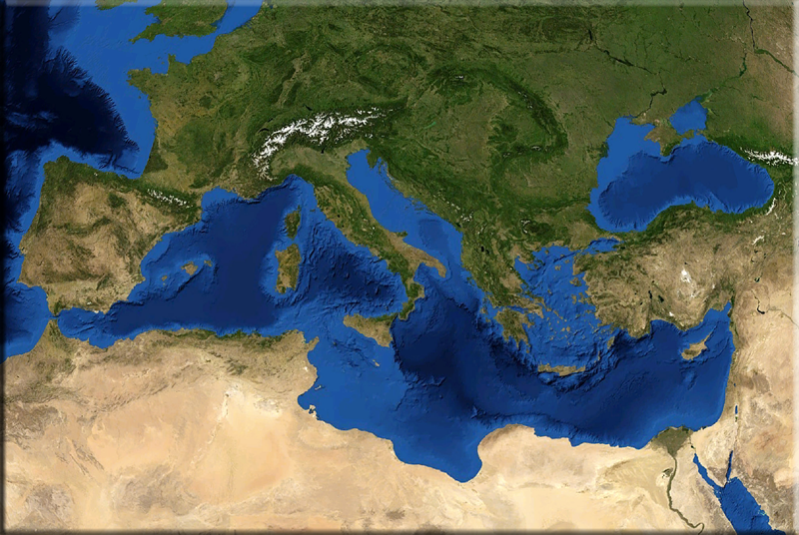
About the module
Looking at development of complex societies in the East Mediterranean:
  Urbanised communities
  Literate societies
  States & empires
Three regions:
  Egypt
  the Levant
  the Aegean
Time-frame:
  Bronze Age
  Early Iron Age

Slide 3
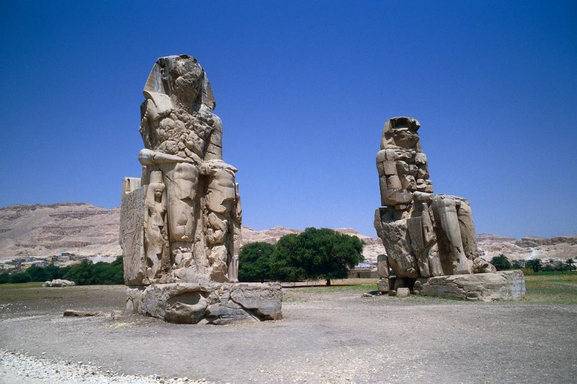
About the module
A) Pharaohs (ancient Egypt)
  State formation in Egypt
  Pharaohs and Pyramids
  Middle Kingdom Egypt
  New Kingdom
  Amarna Period
  Ramesside Egypt
  Third Intermediate Period

Slide 4
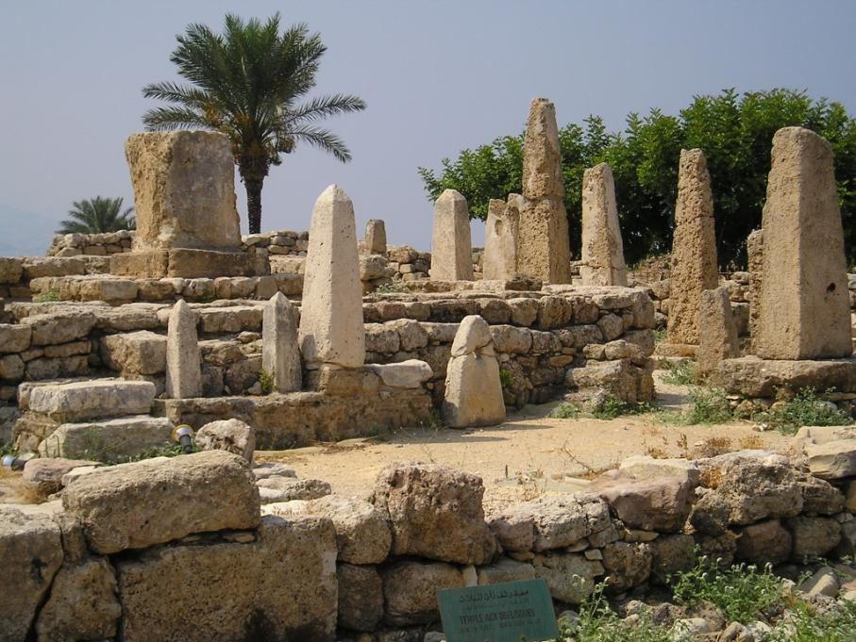
About the module
B) Phoenicians (ancient Near East)
  First towns in the East
  Palaces: Mari and Ebla
  The Middle Bronze Age Levant
  The Late Bronze Age Levant
  Late Bronze Age Cyprus
  Early Phoenician Colonies

Slide 5
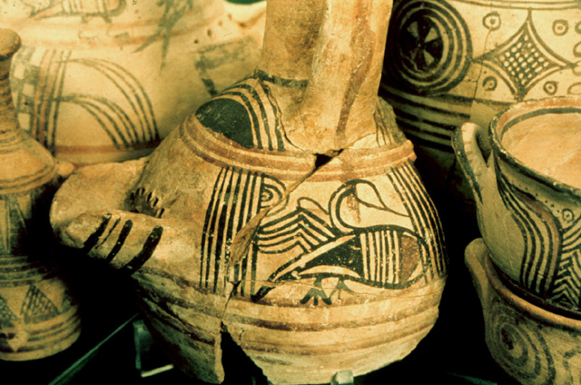
About the module
C) Peoples of the Sea (ancient Aegean)
  EBA Cyclades
  Minoan palaces
  Kingship in Mycenaean Greece
  The Trojan War
  Philistines
  Geometric Burials
  Lefkandi, Crete & Cyprus: emergence from the Dark Ages

Slide 6

Assessment
Portfolio (50%) DUE 29th March:
  1000-word object analysis
  1000-word site report
2-hour exam
Fieldtrip to the Ashmolean Museum
  Saturday 9th March

Slide 7
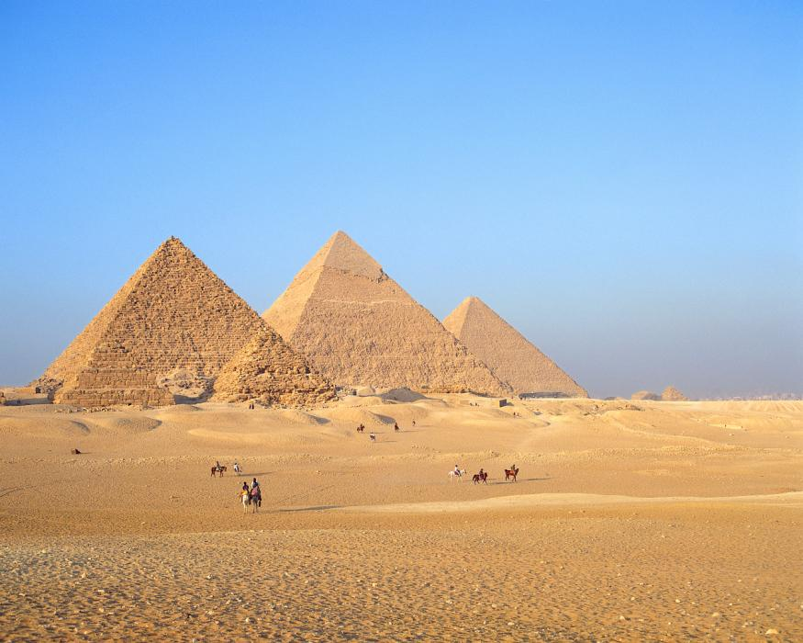
Early Civilisations
Defining civilisations…
“‘Early civilization’ is undeniably an evolutionary concept” (Trigger 2003: 40)
  Assumes less complex societies evolve into more complex ones
  How do we define complexity?

Slide 8
Early Civilisations
Hierarchical organisation
  Unequal divisions of power, wealth & social prestige
Small ruling class (the elite):
  Controls resources
  Manipulates ideology to maintain position
Full-time specialists (who serve ruling group)
Class displaces kinship as main organising principle

Slide 9
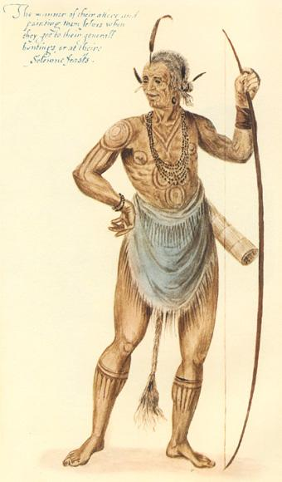
Cultural Evolution
Tylor (1871: Primitive Culture) different contemporary societies were at different stages of evolution
  “simpler” contemporary societies were thought to resemble ancient societies

Slide 10
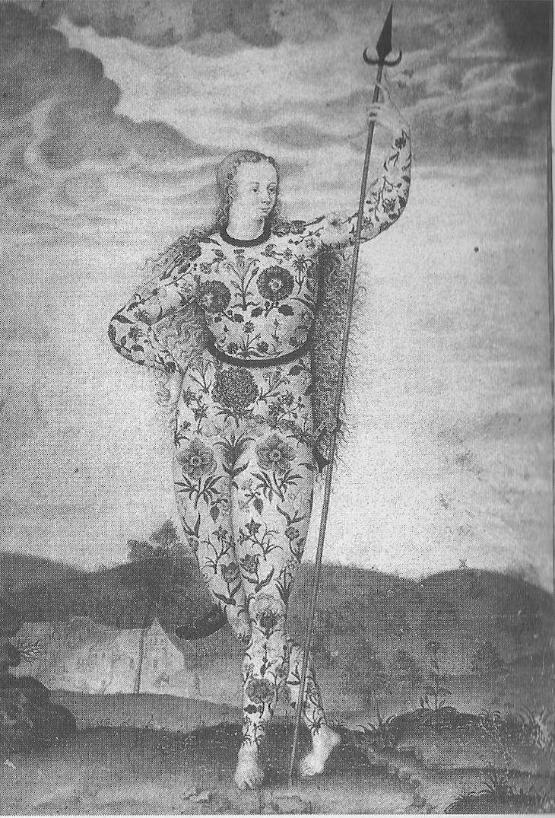
Cultural Evolution
Morgan (1877 Ancient Society) divided human culture into three separated stages:
  Savagery
  Barbarism
  Civilisation

Slide 11
Neo-Evolutionism
Elman Service: (1962: Primitive Social Organisation)
  Bands: hunter-gatherers
  Segmentary society: early Neolithic communities & nomadic pastoralists
  Chiefdoms: ranked societies with ceremonial/ritual centres
  Early states: development of economic bureaucracies

Slide 12
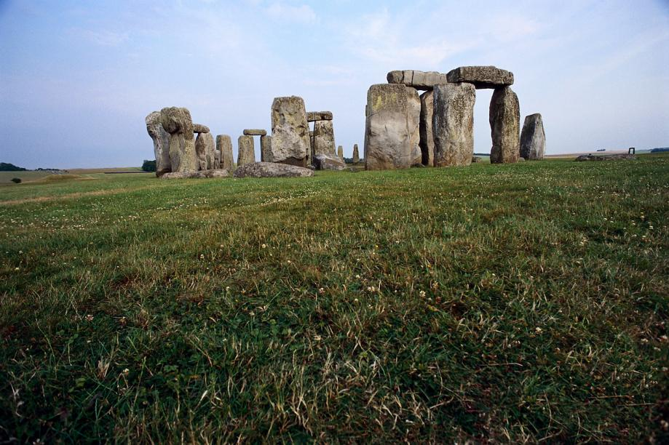
Attributes of Chiefdom
Kinship-based ranking, hereditary leader with religious duties
Cultic & religious elaboration
Specialisation of activities by members of community
Central accumulation of goods
Fortified centres & ritual centres
Large-scale monuments

Slide 13
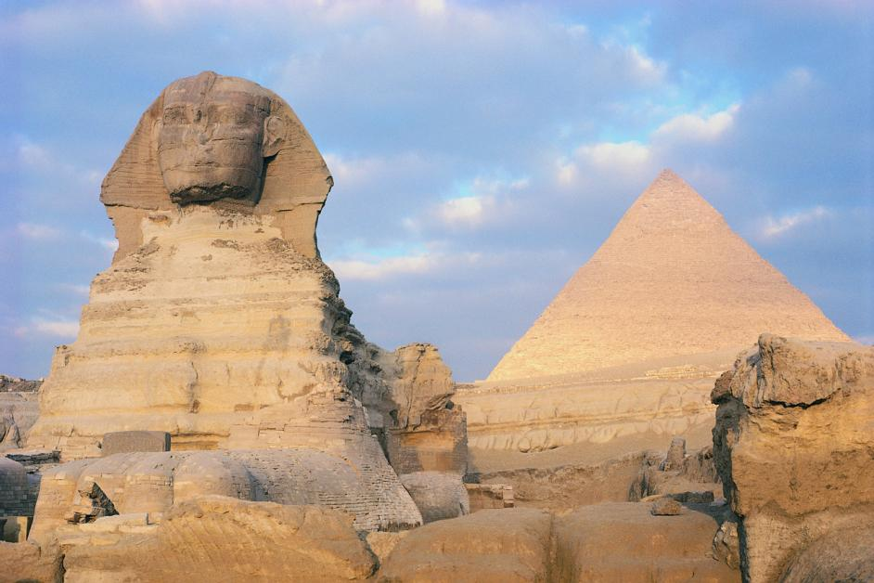
Attributes of Statae
Hierarchical society under king/emperor
Centralized bureaucracy, taxation, law codes
Craft specialisation
Urbanised society & complex settlement hierarchy
Priestly class
Monumental constructions
Evidence of growth, flux, collapse

Slide 14
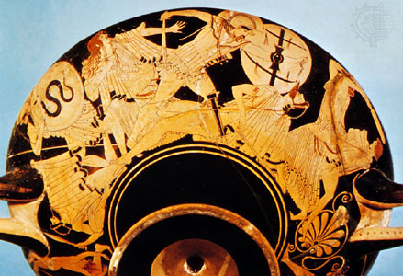
Decline and Fall
Evidence of growth, flux & collapse of civilisations can be charted historically & archaeologically
Developed a cyclical view of world cultures:
  Origins, zenith, fall
This process has become to be viewed as inevitable
Byrgos cup: sack of Troy

Slide 15
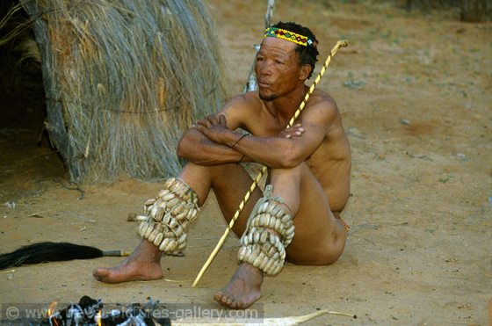
Problems
Descriptive not explanatory
Reductive view of the past:
  Tick box criteria to explain social change & ignores individual peculiarities
Ignores human action & choice: views evolutionary change as an inexorable process
  What about modern hunter-gatherer societies? Are they less evolved?

Slide 16
Summary
Archaeology in the Mediterranean has been constructed within an evolutionary framework
We are looking at the emergence of apparently complex, hierarchically organised societies in the 3rd & 2nd millennium BC
  & their subsequent disappearance
Urban centres, temples & palaces, literacy
Commonly characterised as “early civilisations”…
How useful is this model?

