Slide 1
BMSK5004
Managing Projects in the Organisation
Session 2-Introduction to Project Management
WEEK 1

Slide 2

What is a Project?
Please type your answer in the chat box and send.

Slide 3
Questions
Are you Currently Managing Projects?
If so, what are they?

Slide 4
Things to Ponder
The project Manager doesn’t really need to have a title of Project Manager.
Everyone Managers projects at their work or in their daily lives.
This course critically assess the reasons why certain projects are successful.
It also analyses the specific characteristics of people who lead projects and why they succeed in the projects the manage.
You don’t need a particular job title to manage a project.

Slide 5


Examples of Projects
Building Construction
Research Project

Slide 6
Or, to put it another way ….
A Project consists of …
Stakeholders
Unique
Products
Services
End
Start
Phases
Plan
Analyse
Design
Build
Test
Implement
Lifecycle
Notes:
Step quickly through the previous three definition slides and spend a little time defining a project using this diagram and then refre the learners back to the definitions.
A project consists of a series of activities which jointly produce a UNIQUE product or service for the organisation, client or customer. It has definite start and end dates and may be divided into one or more phases (the phases here are illustrative). The phases from the start to the end are known as the lifecycle.
It is conducted by people (the project team) and may use various other resources (equipment, materials, money!). It has various interested parties who will be impacted by the project (the stakeholders). Some stakeholders may work on the project, some may have control over the project, and some may receive or use the end product/service or may in some other way be impacted by the project, product or service produced (for example any competitor companies).
Some projects maybe initiated by receipt of a business case, some by the ‘receipt’ of an idea and building the business case may be a pre-planning stage. This largely depends on the organisation.
Some projects may be very similar in organisation, activities conducted, and products or services delivered but there must be some aspect which, even if minor, represents a significant difference or else this is not a project but an ‘operation’. Where projects are similar the lifecycle may be standardised and project management methodologies may superimposed. (See module …. Project Management Methodologies).
Some methodologies will place ‘gateways’ at the end of phases and a whiteboard example of different projects, phases and gateways may expand on this slide.
The lifecycle represented here is an example of a category of lifecycles known as ‘Cascade’ or ‘Waterfall’ lifecycles, as each phase is dependant on the completion of the previous phase. This course does not explore in detail lifecycles or methodologies, however the tools and techniques presented are most used (and most useful) in projects which are undertaken using a Cascade lifecycle.
Ask for examples or projects and stakeholders.

Slide 7

What is Project Management?
The art of organising, leading, reporting and completing a project through people

Slide 8
What is Project Management?
A project is a planned undertaking
A project manager is a person who causes things to happen
Therefore, project management is causing a planned undertaking to happen.

Slide 9
Management of Projects
Planning - goal setting, defining the project, team organization
Scheduling - relate people, money, and supplies to specific activities and activities to each other
Controlling - monitor resources, costs, quality, and budgets; revise plans and shift resources to meet time and cost demands

Slide 10
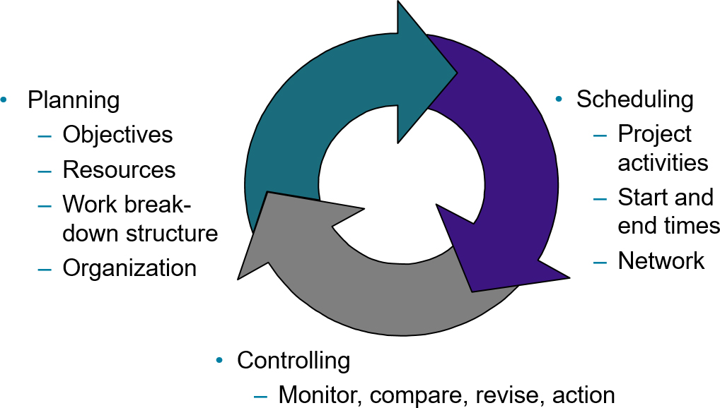
Project Management Activities

Slide 11
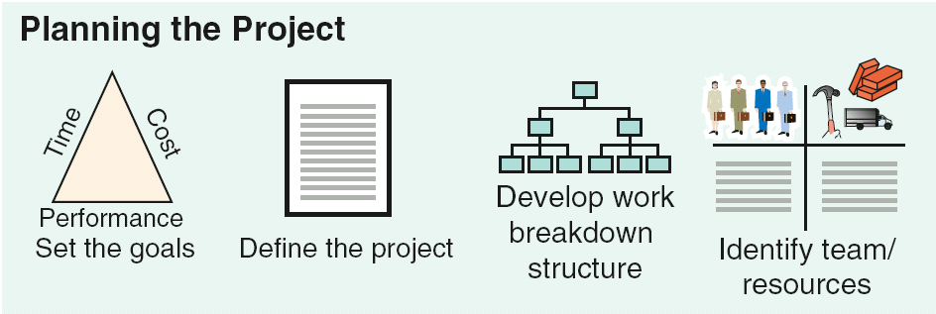
Figure 3.1 Project Planning, Scheduling, and Controlling (1 of 5)

Slide 12
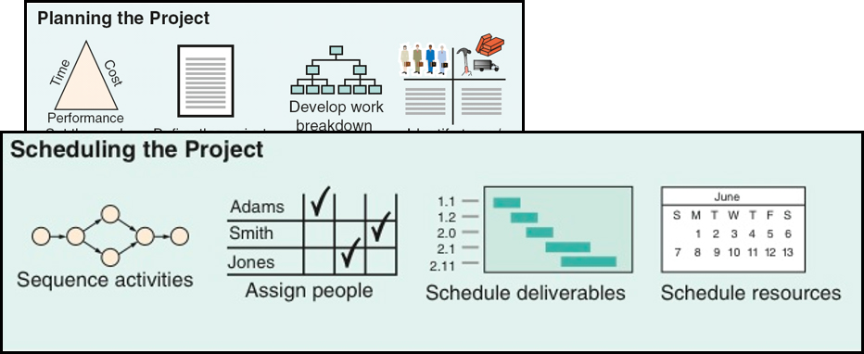
Figure 3.1 Project Planning, Scheduling, and Controlling (2 of 5)

Slide 13
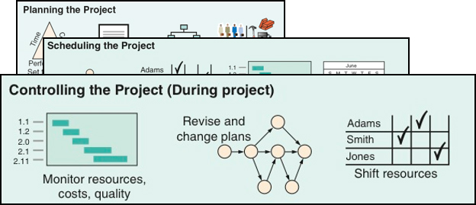
Figure 3.1 Project Planning, Scheduling, and Controlling (3 of 5)

Slide 14
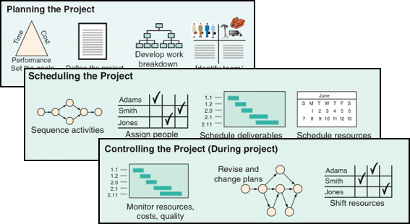
Figure 3.1 Project Planning, Scheduling, and Controlling (4 of 5)

Slide 15
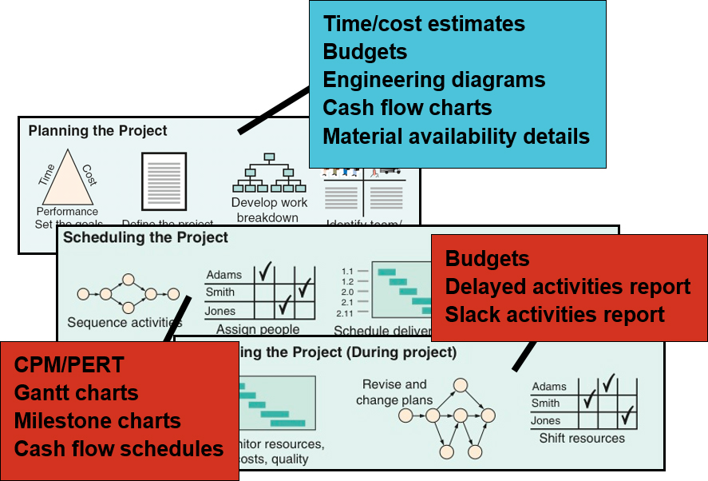
Figure 3.1 Project Planning, Scheduling, and Controlling (5 of 5)

Slide 16

Project Planning
Establishing objectives
Defining project
Creating work breakdown structure
Determining resources
Forming organization

Slide 17
Project Organization
Often temporary structure
Uses specialists from entire company
Headed by project manager
  Coordinates activities
  Monitors schedule and costs
Permanent structure called ‘matrix organization’

Slide 18
Project Organization Most Helpful When:
Work can be defined with a specific goal and deadline
The job is unique or somewhat unfamiliar to the existing organization
The work contains complex interrelated tasks requiring specialized skills
The project is temporary but critical to the organization
The project cuts across organizational lines

Slide 19
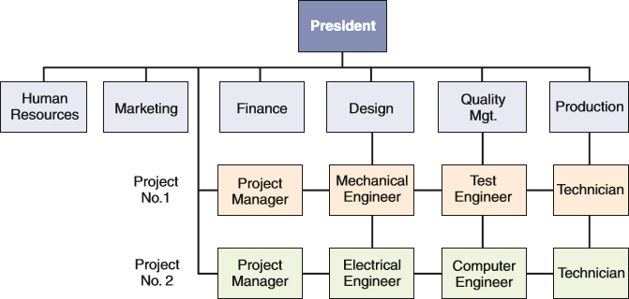
Figure 3.2 A Sample Project Organization

Slide 20
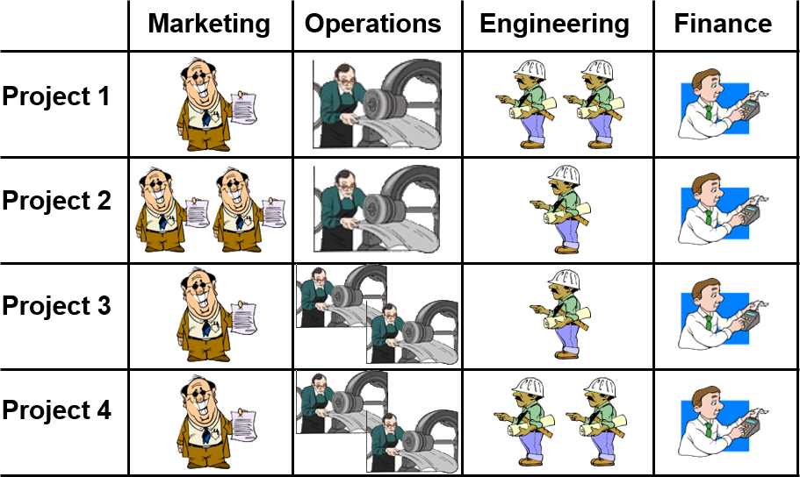
Matrix Organization

Slide 21
Work Breakdown Structure
Level
Project
Major tasks in the project
Subtasks in the major tasks
Activities (or “work packages”) to be completed

Slide 22
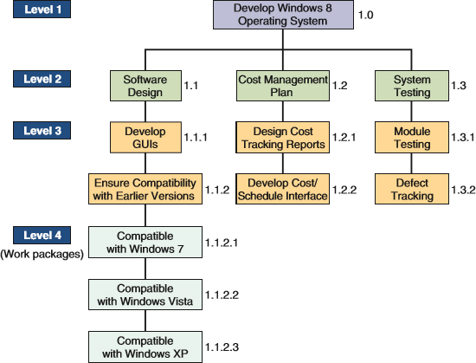
Figure 3.3 Work Breakdown Structure

Slide 23

Project Scheduling Techniques
Ensure that all activities are planned for
Their order of performance is accounted for
The activity time estimates are recorded
The overall project time is developed

Slide 24
Purposes of Project Scheduling
Shows the relationship of each activity to others and to the whole project
Identifies the precedence relationships among activities
Encourages the setting of realistic time and cost estimates for each activity
Helps make better use of people, money, and material resources by identifying critical bottlenecks in the project

Slide 25
Project Management Techniques
Gantt chart
Critical Path Method (C P M)
Program Evaluation and Review Technique (P E R T)

Slide 26
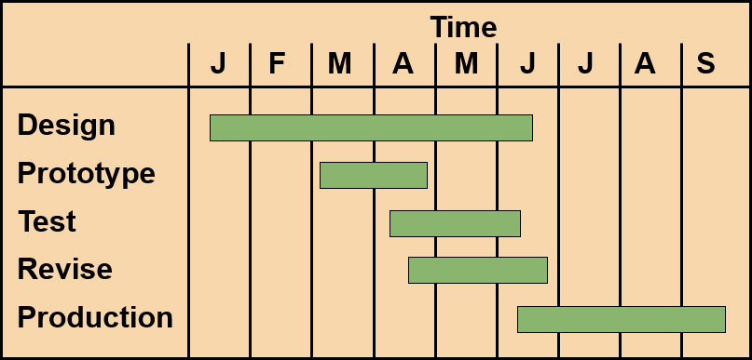
A Simple Gantt Chart

Slide 27
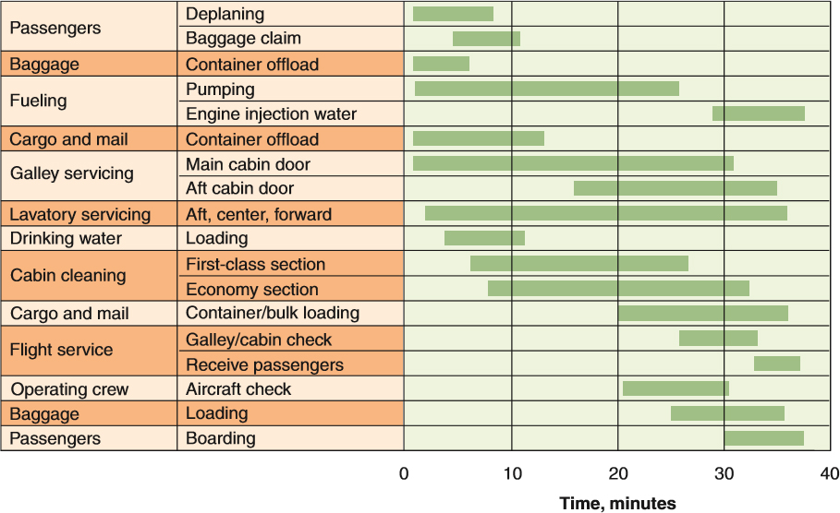
Service for a Delta Jet
Figure 3.4 Gantt Chart of Service Activities for a Delta Jet during a 40-Minute Layover

Slide 28
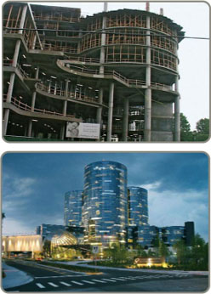
Project Controlling
Close monitoring of resources, costs, quality, budgets
Feedback enables revising the project plan and shift resources
Computerized tools produce extensive reports

Slide 29
Project Management Software
There are several popular packages for managing projects
  Oracle Primavera
  MindView
  H P Project
  Fast Track
  Microsoft Project

Slide 30
Project Control Reports
Detailed cost breakdowns for each task
Labor requirements
Cost and hour summaries
Raw materials and expenditure forecasts
Variance reports
Time analysis reports
Work status reports

Slide 31
Group Activity
Get into your breakout room:
Identify a project
Create a Work Breakdown Structure
Submit your Work Breakdown Structure on chat.

