Slide 1

Preparing for a competency – based Interview
Assessment preparation

Slide 2

Assessment 1
: One Element of The National Police Recruitment Process (Mock) Interview.
15 Minutes per person
Weighing : 50%
When: Week commencing 10th March 2025
Dates and times to be confirmed nearer the time.

Slide 3
What is a competency – based interview?
This is your opportunity to provide some examples of the key competencies and values from the policing competency and values framework.
You may be asked how you have dealt with past situations which highlight these key competencies and values.

Slide 4

College of Policing - 2024
The competency and values framework (CVF) provides clear expectations for everyone working in policing. It describes the behaviours required by you, as a police officer or member of staff, to be effective in your role and uphold the Code of Ethics

Slide 5
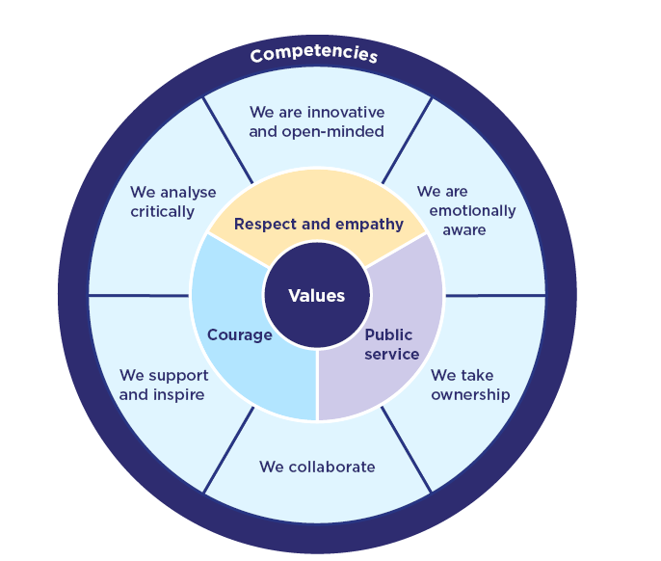
The CVF 2024
There are Three values
Six Competences
Each competency and value includes a list of example behaviours. These are examples and are not intended as a comprehensive list of all behaviours under the competency or value.
There will be many more ways of demonstrating the behaviour that falls within the competency or value area, as defined by the description.

Slide 6

Values
The three values in the CVF are derived from the ethical policing principles.
Courage
Respect and empathy
Public Service
Code of Ethics ethical policing principles | College of Policing

Slide 7
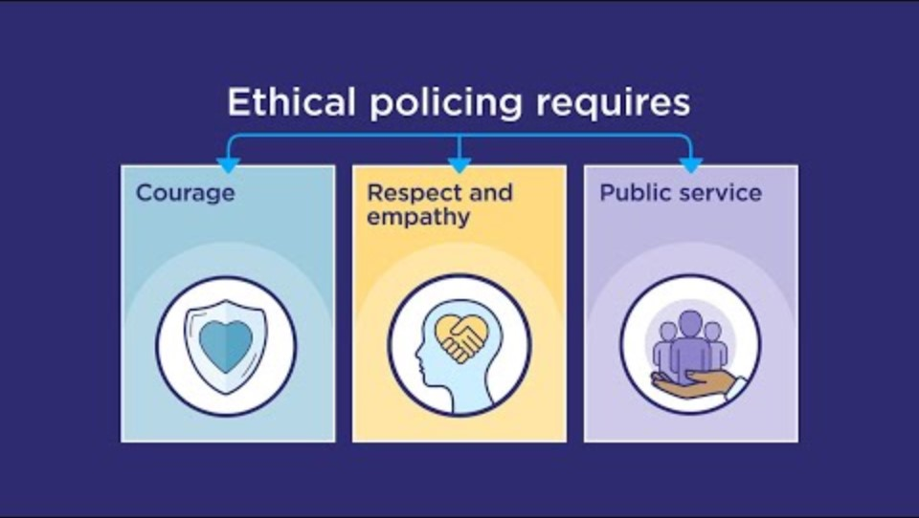
Please watch this short video

Slide 8
Competencies
There are six competencies in the CVF:
Emotionally Aware
Take Ownership
Collaborate
Support and Inspire
Critically Analyse
Be innovative and Open minded

Slide 9

Be prepared
To help you prepare for the assessment review each of the values and competencies.
Think of the meaning of each one.
Think of a situation where you have displayed these values and competencies.
You may wish to review the College of Policing Website and research each one
Competency and values framework (CVF) | College of Policing

Slide 10
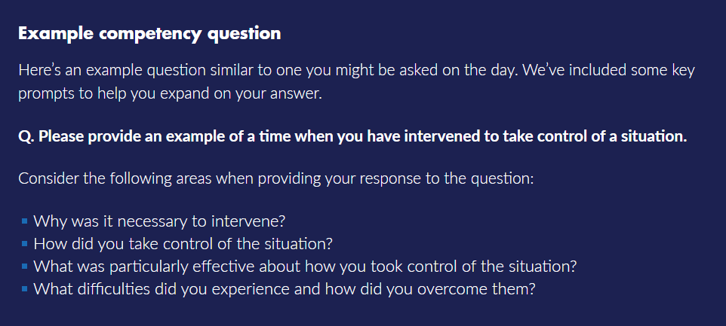
Notes:
What does the Competency-Based Interview (CBI) involve? | Join The Police

Slide 11

Be confident
Remember to consider each answer.
Take your time when answering.
Use the STAR Model to help structure the answer.

Slide 12


