Slide 1
NOSHEEN MANZOOR
2218718
MARKET MANAGEMENT
LCMB 7024
TAONGA KAONGA SOBERE-SNITHERS
COMPONENT 2 POSTER

Slide 2
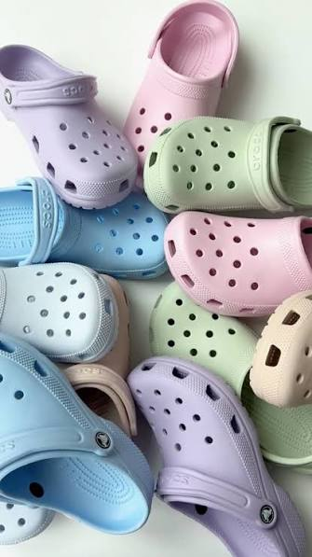

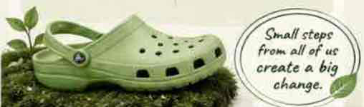

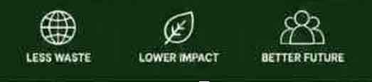
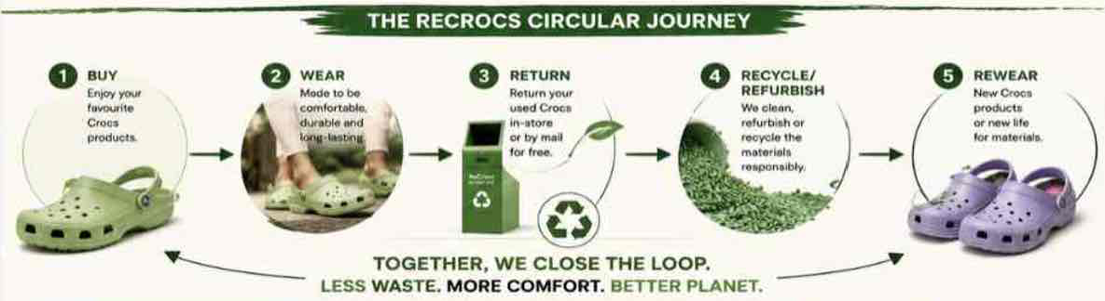
Crocs
COME AS YOU ARE
ABOUT CROCS
Crocs is a global leader in innovative, comfortable and versatile footwear loved in over 100 countries.
”We stand for comfort, individually and well expression for all” Crocs (2024).
ReCrocs
RETURN. RECYCLE. REWEAR.
A SUSTAINABLE STEP FORWARD
A sustainable brand extension by crocs
WHY SUSTAINABLITY MATTERS NOW
81% of global consumers believe companies should help improve the environment (Nielson, 2021)
A SUSTAINABE STEP FORWARD
Footwear contributes to millions of tonnes of waste each year.
WHY IT APPEALS TO THE MARKET
THE PERPOSE OF RECROCS
ReCrocs is a circular footwear program that makes it easy for customers to return their used Crocs. We recycle, repurpose or refurbish the returned footwear to create new products, reducing waste and keeping materials in use for longer.
According to Kara & Min (2024) consumers, especially Gen Z and Millennials, actively choose brands with strong sustainability values.
Easy & Convenient
Simple return process through stores or free mail-in, Sustainability made easy.
Rewards You
Earn discounts and loyalty points when you return your used Crocs.
BENEFITS FOR CROCS
BENEFITS FOR CUSTOMERS
Good for the planet
Reduce landfill. Waste and support a circular economy.
STRONGER BRAND IMAGE
Reinforces Crocs as a responsible and forward-thinking brand.
We recycle or refurbish them
You get rewards.
The planet benefits.
EXCLUSIVE DISCOUNTS ON YOUR NEXT PURCHASE
LOYALITY REWARDS FOR EVERY RETURN.
MAKE A POSITIVE IMPACT ON THE ENVIRONMENT
BE PART OF A SUSTAINABLE COMMUNITY
Return your used Crocs
INCRESED CUSTOMER LOYALITY
Rewards and meaningful action build long-term loyalty.
Stronger Connection
Consumers feel good supporting a brand that shares their values.
CIRCULAR ECONOMY LEADERSHIP
Keeps materials in use and reduce environmental impact.
BUSINESS GROWTH
Drives repeat purchases and attracts eco-conscious consumers and inventors.
Kara, A. and Min, M.K. (2024) “Gen Z consumers’ sustainable consumption behaviors: influencers and moderators,” International journal of sustainability in higher education, 25(1), pp. 124–142. Available at: https://doi.org/10.1108/IJSHE-08-2022-0263.
Zhang, N., Yang, C. and Wang, S. (2024) “Research progress and prospect of environmental, social and governance: A systematic literature review and bibliometric analysis,” Journal of cleaner production, 447. Available at: https://doi.org/10.1016/j.jclepro.2024.141489.
According to Zhang et al, (2024) Sustainability is no longer a trend it is a responsibility and a business imperative.
Notes:
https://cdn.statcdn.com/Statistic/1035000/1038504-blank-355.png
NielsenIQ (2018) Global consumers seek companies that care about environmental issues.

