Slide 1

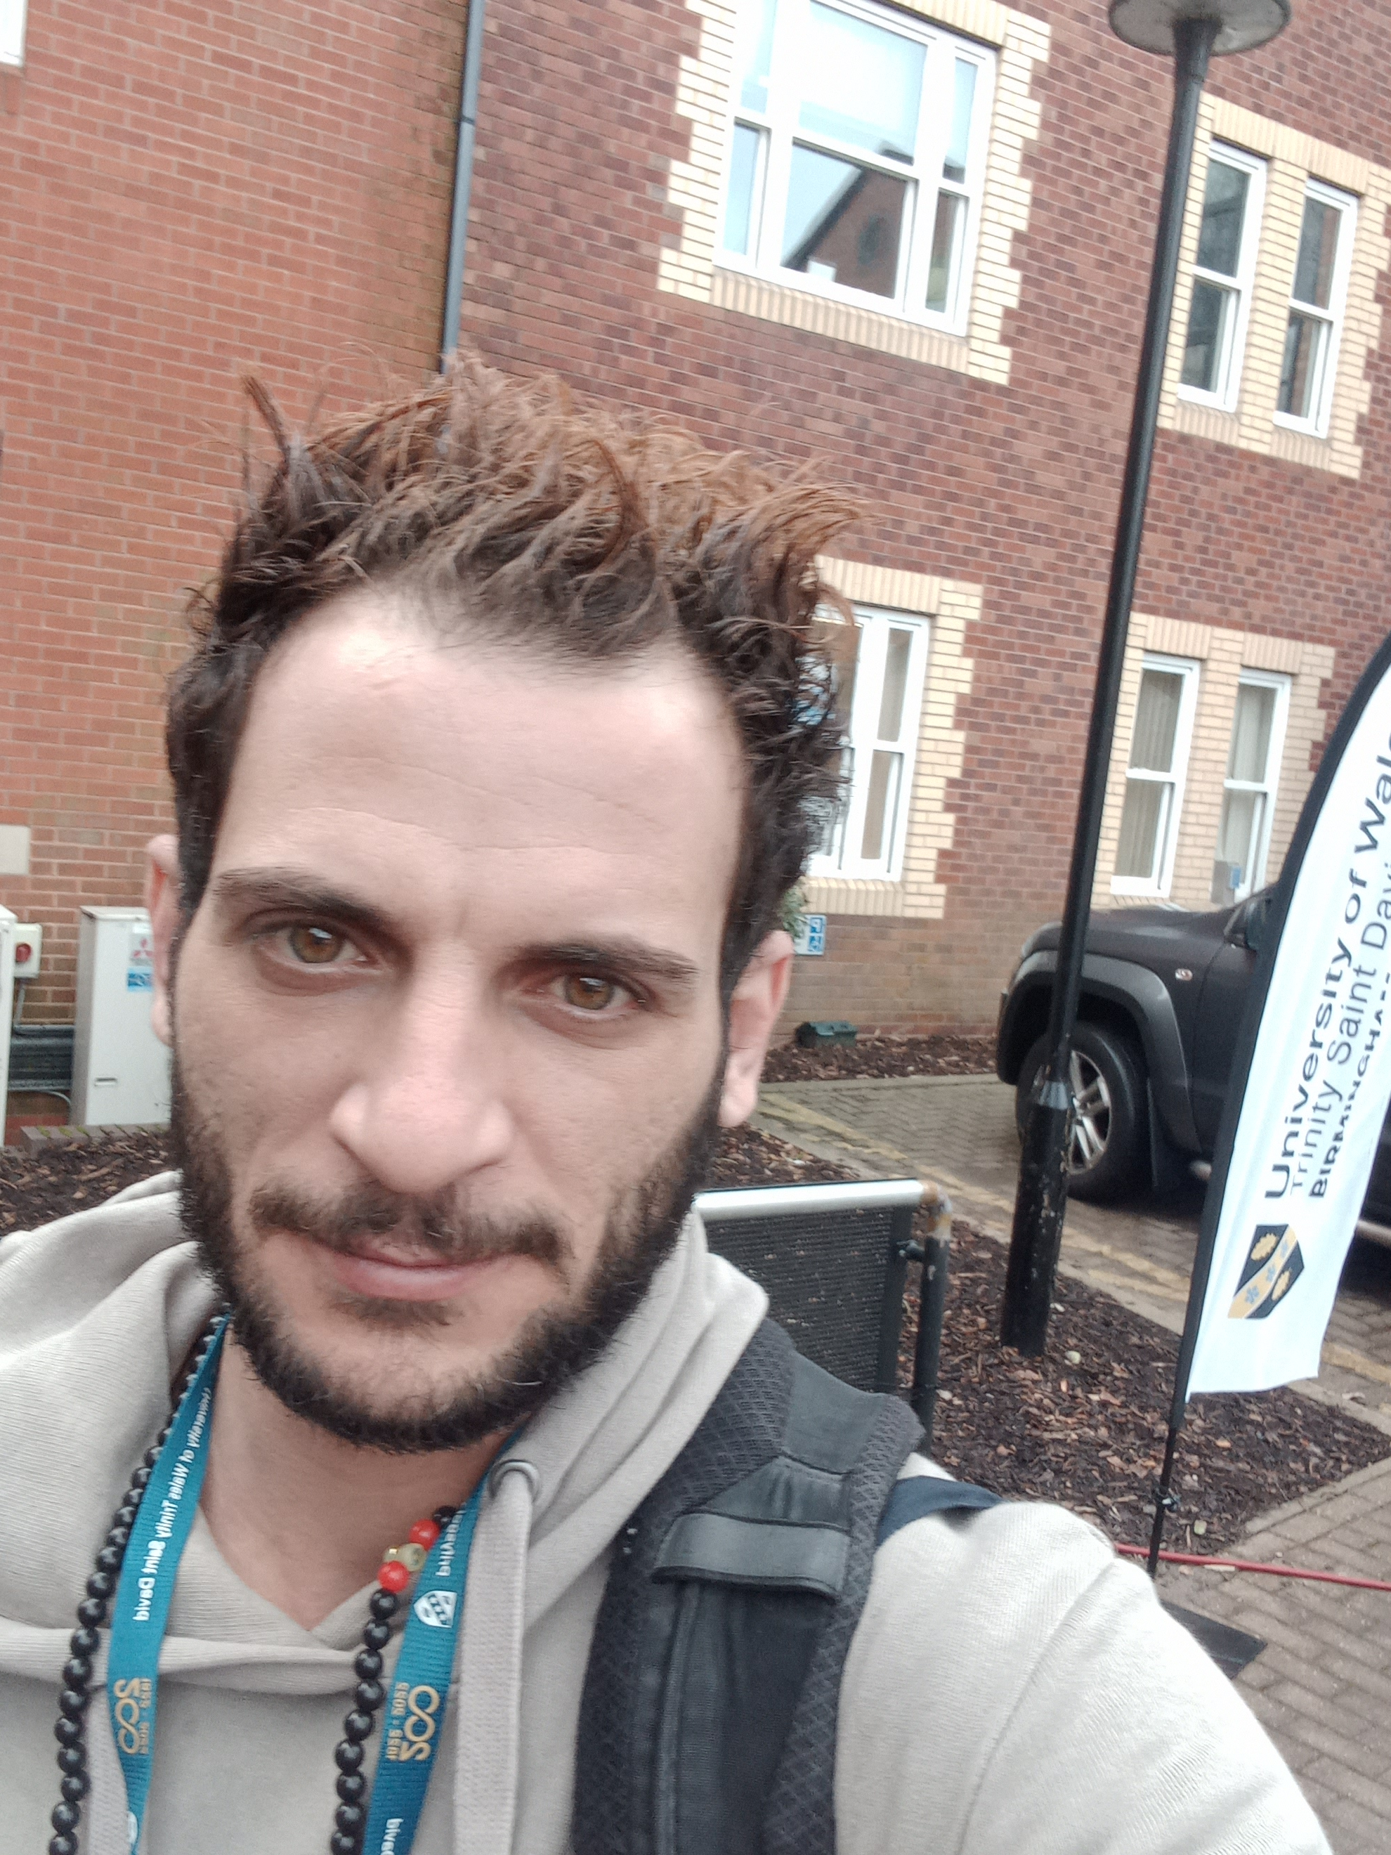



Digital Skills & Research Methods
(BMSW4003)
DR: Seyed Nasirpourosgoei
Date: March 26
Time: 14:50
Certificate of Higher Education Skills For The Workplace
Group presentation - 3
Full name | Student ID number | Picture
Samir Mhanna | 2119514
Mohammed Adam | 2121738
Mohammed Salim | 1807323
Nicoleta Elena Ispas | 2113247
Which Digital Tool Is Most Commonly Used For Collaboration At UWTSD?
2022

Slide 2
1st presenter
Student’s Full Name: Samir Mhanna ( Group leader)
Student’s ID Number: 2119514

Slide 3
‘This is where technology can help collaboration’ (Schaffner, 2010)
Introduction
Question Research
(Samir Mhanna)
Relevant Sources & Ethical consideration
(Mohammed Adam)
Proposed Methods
(Mohammed Salim)
Research Timeline & Hypothesis
(Nicoleta Ispas)
Samir Mhanna

Slide 4
Research Question
Which Digital Tool Is Most Commonly Used For Collaboration At UWTSD?
Digital tools
UWTSD’s Tools Recommended( uwtsd, 2022)
Another platforms
WhatsApp
google
Module discussion boards
MS Teams
OneDrive
OutLook
MS Office 365
Samir Mhanna

Slide 5
2nd presenter
Student’s Full Name: Mohammed Adam
Student’s ID Number: 2121738

Slide 6
Rationale
"Expectations Vs. Reality: A Narrative Anecdotal Approach to Examining the Digital Tools Used to Engage Undergraduate Students During Pandemic". (Mifrah and Hesaam, 2021)
"The aim of the workshop is to examine and discuss the role and functions of digital tools in collaborative creative work". (Dalsgaard ec al. 2018)
"Strategies for the communication and collaborative online work by university students".(Gutiérrez-Porlán ec al. 2018)
"How Technology Enhances Collaborating". (Schaffner, 2010)
Mohammed Adam

Slide 7
Ethical considerations
Ethics helps us decide what we should do and why. Ethical guidelines have been developed to prevent unethical research studies from going ahead. ​
(Bryman and Bell, 2007)
Ethical considerations
Informed consent
Potential for harm
Voluntary participation
Confidentiality
Result communication
Anonymity
Mohammed Adam

Slide 8
3rd presenter
Student’s Full Name: Mohammed Salim
Student’s ID Number: 1807323

Slide 9
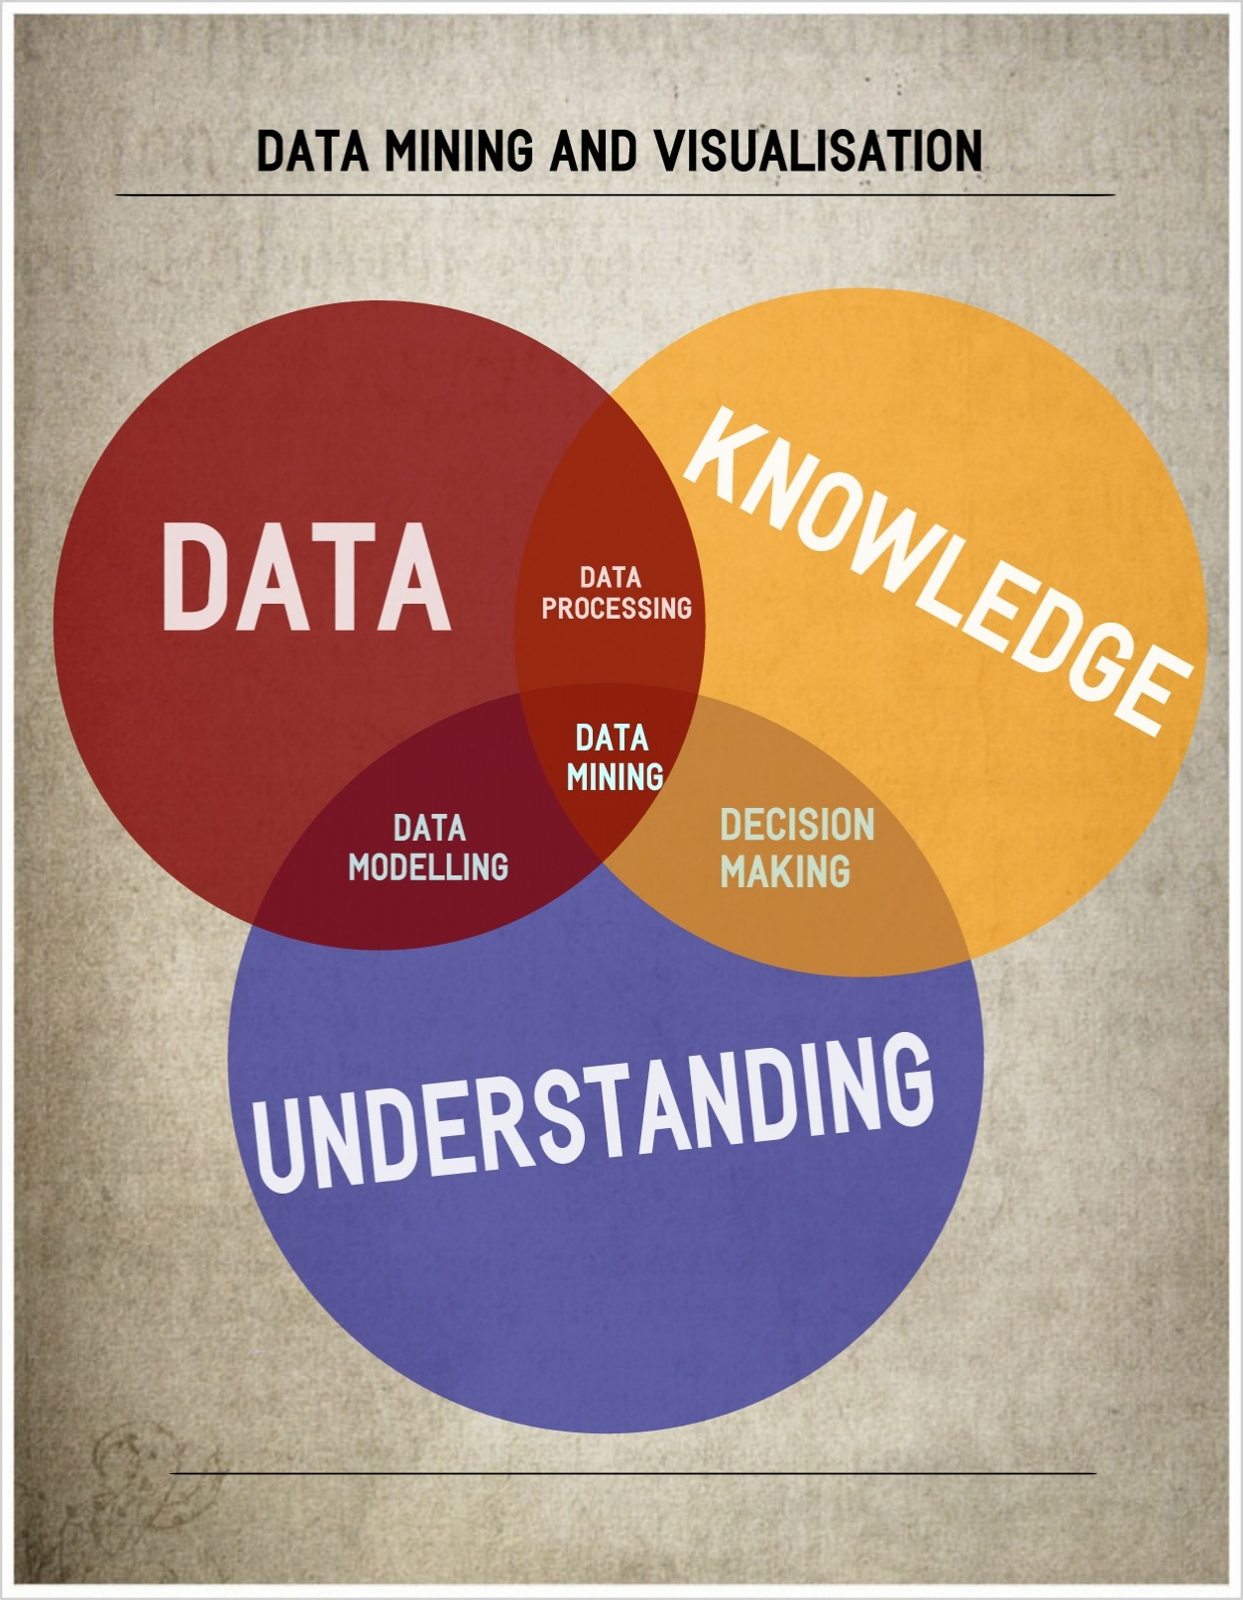


Propose Method
Quantitative Research Method
Quantitative research is a form of research that relies on the methods of natural sciences, which produce numerical data and hard facts. It aims at establishing cause and effect relationships between two variables by using mathematical, computational, and statistical methods. (Surbhi, 2018)
Mohammed Salim

Slide 10
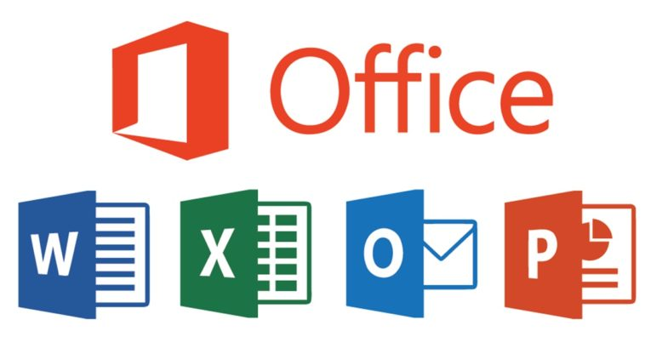




Quantitative Research Method Question:
Which digital tool is most used for collaboration at UWTSD?
Included Options:
MS Office 365,
MS Teams,
WhatsApp,
OneDrive,
Outlook,
Others.
Mohammed Salim

Slide 11



Research Participants’:
Students, staff, and members of UWTSD.
Data collection process:
Survey/Test Questionnaire
Using Microsoft form to create a survey sheet,
Include options, agree, disagree, not sure.
Using social media platforms to take the survey.
For example, Facebook, WhatsApp, Twitter.
Gather responses from participants’,
Analysis of the results,
Write a report. (Sue and Ritter, 2012)
Mohammed Salim

Slide 12
4th presenter
Student’s Full Name: Nicoleta Elena Ispas
Student’s ID Number: 2113247

Slide 13
Research timeline
Week 7
collect data
Week 8
analyse data
Week 9
start writing the report
Week 10
to finish writing the re
Week 11
submit the report
Nicoleta Elena Ispas

Slide 14
Hypothesis​
Our hypothesis is that if we use MS Teams, WhatsApp, Outlook and other digital tools will help us have a better collaboration at UWTSD when it comes to online lessons.
Nicoleta Elena Ispas

Slide 15
References List
Digital Learning(2022) Digital Learningand Teaching. Available at: https://digitallearning.uwtsd.ac.uk/digital-learning.html (Accessed: 24 February 2022)
Mifrah Ahmad and Hesaam Kashi (2021) ‘Expectations Vs. Reality: A Narrative Anecdotal Approach to Examining the Digital Tools Used to Engage Undergraduate Students During Pandemic’, Journal of higher education theory and practice, 21(3), pp. 29–43. doi:10.33423/jhetp.v21i3.4139.
Dalsgaard, P., Remy, C., Pedersen, J.F., Vermeulen, L.M. and Biskjaer, M.M., 2018, September. Digital tools in collaborative creative work. In Proceedings of the 10th Nordic Conference on Human-Computer Interaction (pp. 964-967).
sabel Gutiérrez-Porlán, Marimar Román-García and María-del-Mar Sánchez-Vera (2018) ‘Strategies for the communication and collaborative online work by university students’, Comunicar. English ed., 26(54), pp. 91–99. doi:10.3916/C54-2018-09.
Samir Mhanna

Slide 16
Surbhi S..(2018) Difference Between Qualitative and Quantitative Research. Available at: https://keydifferences.com/difference-between ualitative-and-quantitative-research.html (Accessed: 24 Februry 2022).
Sue Valerie, Ritter Lois. (2012) conducting online surveys. 2nd edn. Sage publication, London.
Schaffner Mike. (2010) How technology enhances collaboration. Available at: https://www.forbes.com/ (Accessed: 21 February 2022).
Bryman, A. Bell, E. (2007) Business research methods, 2nd ed. Oxford university press
Samir Mhanna

