Slide 1

BSc Computing Portfolio, BA Computer Animation, BA Games Design
ACCB6019
Timotei Daniel Bodolan
2235425
Internal Verifier: Renuga Jayakumar
Smart Waste reporting and management application

Slide 2
Team Introduction & Roles
A five-member group that will work on resolving the technical, organisational, and behavioural aspects of Waste Management (Kumar et al, 2017; Singh et al, 2022).
One member will be assigned a specific responsibility based on the identified barriers associated with the Developing World’s fragmented and under-resourced Waste Management Systems (Ferronato & Torretta, 2019).
This group will take into account the fact that Technology Deployment would be negatively affected by failures of Coordination and Governance Systems (Singh et al, 2022).
Evidence-based interventions to the Global Waste Crisis include a focus on combating the exacerbating factors of this Crisis (Group, 2025; uneporg, 2024).
Notes:
Consistent with the documented impact on the environment and human health from developing countries (Ferronato & Torretta, 2019; Mahajan, 2023) through a history of poor waste management, this project has been developed with a five-member team structured to include the necessary multi-disciplinary technical, user-centric, and business competencies to meet these demands. This is in keeping with research indicating that the organisational and contextual challenges are greater than the technological challenges during implementation of projects (Kumar et al., 2017; Singh et al., 2022).

Slide 3

Team Organisation & Responsibilities
The Project Manager is responsible for managing the timeline of the project and coordinating the team members.
The Lead Developer- responsible for setting up the technical architecture, backend infrastructure and building a scalable system.
The Mobile Developer will be responsible for designing and implementing the UI/UX of the mobile application(s) for both iOS and Android.
The UX/UI Designer is responsible for conducting user research to create a user-centric design, developing wireframes and ensuring that the application is compliant with accessibility standards.
The Business Lead is responsible for doing the market analysis, developing the financial model and determining whether or not it is commercially viable.
Notes:
The project involves Project manager responsible for managing the project with managing timeline and stakeholders aligned so that no interruptions can impact the project. Further the lead developer is responsible for developing the system architecture, developing database and backend infrastructure so that the system became integrated and functioning. UX/UI developers and mobile developers design prototype and develop the system interface.

Slide 4

Team Collaboration Tools & Workflow
Microsoft Teams: Sprint Reviews, meetings, decision logs, and formal project governance
GitHub: Code review, version control, and reliability analysis of IoT-enabled infrastructure.
OneDrive: Centralised data storage for trtacabiklity, design and accountability at the initial phase.
Discord: Informal communication, product idea sharing, social learning and communication.
Documented workflows: Coordinated workflow management through project logs, requirement elicitation, and timelines.
Notes:
Different Collaboration Tools were selected based on the multi-actor coordination needed within the real waste management systems, where multiple agencies and Stakeholders need to communicate effectively to share information. Singh et al. (2022) and Zebua et al. (2025) have also shown that by Drawing Together Synchronous and Asynchronous Platforms, that facilitate a Better Environment for Continuous Decision-Making and Version Control to Reduce Miscommunication and Time Delays on Time-Bound Projects (Group, 2025).

Slide 5
Project Overview & objectives
Municipal solid waste management accounts for 2.12 billion tonnes annually globally (Group, 2023).
The focus is on low-income and middle-income countries where the waste collection rate of only 40% (Group, 2023).
Focused on waste management across in India and Bangladesh, subject to similar infrastructure and institutional deficiencies (Kumar et al., 2017; Zebua et al., 2023).
Three-phase structure- diagnostic phase, design phase, and the planning phase for implementation (Group, 2023).
Notes:
An outcomes-oriented narrative corresponds with evidence (Ferronato and Torretta, 2019). The objectives are aligned with this project towards managing waste innovatively. This project proposes a scalable, research-based intervention to address the waste management crisis in developing nations. This project uses a phased approach that establishes evidence for the problem, develops potential solutions through design, and supports a viable business model as a best-practice model in infrastructure reform programs (Group, 2025).

Slide 6
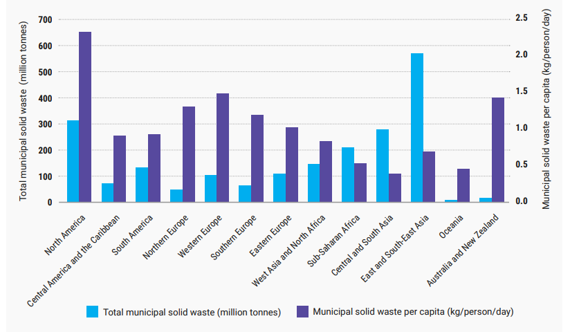
Waste Management Crisis in Developing Countries
Approximately 2.12 billion tonnes of municipal solid waste were produced over the last 10 years.
Solid waste is collected (90%) in developed nations, opposite to 40% in lower-income nations.
Roughly 2.7 billion people do not have a proper waste collection system (United Nations Environmental Program, 2024).
Up to 90% of the waste generated in developing countries is disposed of by open dumping or burning (Ferronato & Torretta, 2019; United Nations Environmental Program, 2024).
Solid waste contributed around 20% of worldwide greenhouse gas emissions (United Nations Environmental Program, 2024).
Waste generation will increase by around 80% by the year 2050 (International Resource Group, 2025).
Fig-Municipal solid waste (MSW) generation by region
(United Nations Environmental Program, 2024).
Notes:
Recent global reports have revealed the extent of the current waste crisis, as well as the extreme inequities found within it across the world. Low-income nations collect on average only 40% of waste generated, with 2.7 billion people that do not have access to formal collection services (Group, 2025; unep.org, 2024). In developing nations, improper waste disposal plays a significant role in greenhouse gas emissions and causes severe health issues; the rates of improper disposal in these regions reach 90% (Ferronato and Torretta, 2019; Mahajan, 2023).

Slide 7
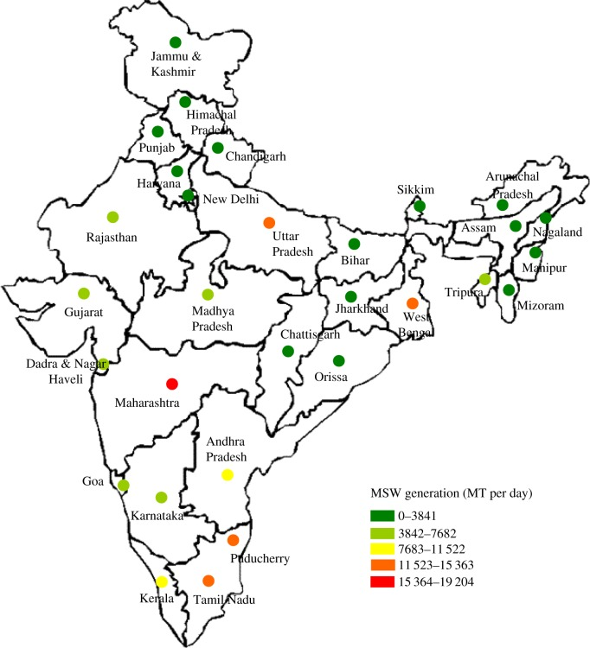
Regional Context: Waste Management in India & Bangladesh
Around 50,000 tons of waste are generated daily in India (Kumar et al., 2017).
At rural and semi-urban areas, the collection of waste is below 70% (Kumar et al., 2017).
In Bangladesh, 30% of waste is collected in urban areas and below 5% in rural areas (Zebua et al., 2025).
Various agencies work without a proper integration, coordination system (Singh et al., 2022).
Water contamination occurs during the monsoon due to informal dumpsites (Mahajan, 2023).
Fig- Municipal waste generated by region in India
Source: Kumar et al., 2017
Notes:
Kumar et al. (2017) and Singh et al. (2022) report strong examples of urbanisation, insufficient infrastructure and a lack of coordination within both countries. Between urban and rural locations, the collection rates vary dramatically, and because of the monsoon cycle, leachate and flooding create more pollution-related illness due to exposure to environmental hazards (Mahajan, 2023; Zebua et al., 2025).

Slide 8

Problem Statement & Scope of Our Project
Lack of controlled waste management, limited or no channels to report illegal waste dumping (Singh et al., 2022).
Limited data about waste hotspots, service coverage and delayed collection (Group, 2025).
Scope is the inclusion of NGOs, the public via digital infrastructure available (Zebua et al., 2025).
Addressing engagement and coordination gaps (Ferronato and Torretta, 2019).
Design and prototype smartphone-based coordination platform linking community, municipalities, and public (Parameswari et al., 2024)
Notes:
According to the evidence presented above, there are additional issues behind the waste crisis in developing countries apart from the lack of basic form of technology. Waste crisis in developing countries arises from a lack of coordination, the need for more information, and the lack of active participation by citizens (Ferronato and Torretta, 2019; Singh et al., 2022). Therefore, the goal for this research is to develop an Integrated Digital System which connects and involves all stakeholders, including citizens, their local governments and NGOs (Parameswari et al., 2024; Group, 2025).

Slide 9
Impact of Poor Waste Management on Communities
High gastrointestinal and respiratory diseases among people
Foster vectors (rodents, mosquitoes)
Contaminate surface and groundwater
Pollute the environment and decrease property values (Mahajan, 2023; Group, 2025).
Notes:
Research shows that communities adjacent to unmanaged waste are at an increased risk of experiencing respiratory illness, gastrointestinal illness, vector-related illnesses, and psychosocial stressors (Mahajan, 2023). Because contaminated groundwater requires households to buy water, it continues cycles of poverty (Ferronato & Torretta, 2019). The negative impact of these health-related issues diverts limited available health resources and prevents sustainable local economic growth; therefore, there are significant justifications to take action for reasons beyond the environmental perspective (Group, 2025).

Slide 10

Project Planning Approach & Timeline
Phase 1: Evidence‑based problem validation
Phase 2: prototype design and system architecture design aligning with smart waste management technologies (Alourani et al., 2025; Kadus et al., 2020).
Phase 3: Business case and risk assessment
Two-week sprint- Iterative refinement (Singh et al., 2022).
Gaining stakeholders' feedback (Zebua et al., 2025).
Notes:
An iterative approach is utilised to identify and solve problems within the framework of the project through a phased process that reflects the notion that effective reform of waste management in communities will require this approach (Group 2025). In addition to providing a two-week window before every Hackathon (similar to the two-week iteration schedule used by NGO`s), the two-week sprint with identifiable objectives allows for adaptive management of resources as the community engages in this process (Singh et al 2022).

Slide 11
Research Strategy & Source Selection (Academic & Industry)
Empirical evidence on waste mismanagement, health impacts, and technology feasibility (Alourani et al., 2025).
Policy data and World Bank and UNEP reports for recommendations
Case studies on app-based systems and smart waste management techniques.
Gaps in participation and engagement
Interviewing Stakeholders for understanding lived experience
Notes:
In developing the research design, peer-reviewed literature, reports published by international organisations and case studies of organisations that provide environmental services were used to achieve both conceptual and operational understanding (Ferronato and Torretta 2019; Group 2025). Interviews with stakeholders are planned, since there have been calls for the use of participatory and context-sensitive methods when developing waste governance systems and engaging communities in the developing world (Zebua et al. 2025; Mahajan 2023).

Slide 12

Key Research Findings: Technology – Smart Waste Management (IoT & GPS)
IoT‑enabled waste systems- Route optimisation, real-time monitoring (Alourani et al., 2025)
GPS accuracy- around 5-10 meters in Urban areas (Patel et al., 2025).
Reduced hardware and connectivity expenses
Notes:
Publications related to smart waste indicate that there are instances where IoT sensor technology, GPS technology, and intelligent routing using data have been successfully implemented in many different situations (Alourani et al., 2025; Kadus et al., 2020). This has resulted in substantial reductions in both response time and extraneous trips, indicating that these technologies used for optimising collection are now at a level of maturity where their costs are decreasing (Patel et al., 2025).

Slide 13

Key Research Findings: Community Participation & Public Engagement
Community Committee leaders increased engagement by around forty-five (45%) and sixty (60%) in Waste Programme Initiatives (Kalra, 2019).
Household-level participation increased with specific instructions and convenience (Harnita, 2025).
Growing awareness about the tangible benefits to people (Harnita, 2025; Tarigan et al., 2020).
Inclusive processes raise women's participation by sixty (60%) for vulnerable coastal communities (Anas et al., 2023).
Notes:
Research indicates that community programmes designed for active participation with a structured format significantly enhance an individual's involvement with waste management processes. The effectiveness of these programmes is greatly enhanced through clear communication and an associated tangible benefit. (Kalra, 2019; Harnita, 2025). Programs that include women as part of the process create a platform to foster women's participation and support an individual's ability to create long-lasting behavioural changes as opposed to producing an immediate outcome based solely on a campaign or event. (Anas et al., 2023; Tarigan et al., 2020)

Slide 14

Key Research Findings: Mobile Apps & Gamification for Civic Engagement
Above 95% smartphone penetration across urban areas (Parameswari et al., 2024).
Waste and environment apps have 60% or more adoption rates with a simple interface (Saptaputra et al., 2023).
Participation increased with gamification by 35-55% (Hassan and Hamari, 2020).
Field experiments depict immediate actions and sustainable participation (Romano et al., 2021).
Notes:
The integration of mobile technology and gamification into recycling (waste) and civic engagement (participation) has been documented as being quite successful. In cities throughout India where there is a high rate of smartphone use, having an easy-to-use design that incorporates gamified elements and incentives boosts the adoption rates as well as overall levels of engagement with environmental applications (apps) by users (Parameswari et al. 2024; Saptaputra et al. 2023; Hassan and Hamari 2020; Romano under al. 2021).

Slide 15

Summary of Research Gaps & Opportunities Identified
Traditional municipal systems- Scheduled collection has limited citizen interactions (Kumar et al., 2017).
Community‑based initiatives encourage locals to interact (Anas et al., 2023)
Combine citizen apps, administrative dashboards, and NGO coordination in one platform (Zebua et al., 2025).
Notes:
Although the technology is already well developed and community engagement techniques have been tested, there are only a handful of integrated platforms that provide specific support with respect to waste governance, citizen reporting and NGO collaboration in developing countries (Ferronato and Torretta, 2019; Singh et al., 2022). Therefore, there exists a significant opportunity for innovation within the current fragmented approaches to providing a single, integrated and smartphone-enabled solution for waste management (Group, 2025; Zebua et al., 2025).

Slide 16
Initial Idea: Integrated Waste Management Platform Concept
Citizen App: Geotagged waste reporting
Government Dashboard: Real-time aggregation & prioritised routing
NGO Portal: Campaign planning & community interventions
Gamification: Loyalty points & recognition systems
Data Archive: Evidence-based policy & public health
Notes:
The platform proposed will use research to enhance the functionality of citizen-reporting apps, dashboards for government agencies, and portals for NGOs. It uses the widespread availability of smartphones, IoT-inspired data models, and gamified methods to facilitate better coordination, information collection, and behaviour change. All three were highlighted as problems in the literature.

Slide 17
How the Idea Can Transform the Community
Quick waste removal (Mahajan, 2023).
A cleaner society and locality
Protects the ground and surface water from contamination
Accumulated datasets (Real-time)- targeted, cost-effective waste management (Group, 2025; unep.org, 2024).
Notes:
This platform will allow for faster responses to waste reporting, will encourage people to participate in the process, and will generate better and more specific data about health outcomes, environmental quality and the economy at the local level, based on the links between waste and development. The scalable nature of this system enables it to be replicated in other municipalities and regions and will help develop an ongoing cycle of environmental stewardship in the communities affected.

Slide 18
High-Level System Architecture of the Platform
The mobile application communicates with the back-end server
Access the business intelligence dashboards via REST API (Rodríguez et al., 2016).
Microservices offer an independent framework for scaling waste reporting (Mutiara et al., 2025).
Simple design enables a high level of concurrency and enables geographic distribution (Gowda and Gowda, 2024).
Notes:
The architecture of the application relies on a three-tier REST API built using microservices as its core components. The use of a real-time database allows the application to provide users with instantaneous updates of all the information displayed by each of the application's user interfaces (Rodríguez et al., 2016; Gowda and Gowda, 2024).

Slide 19

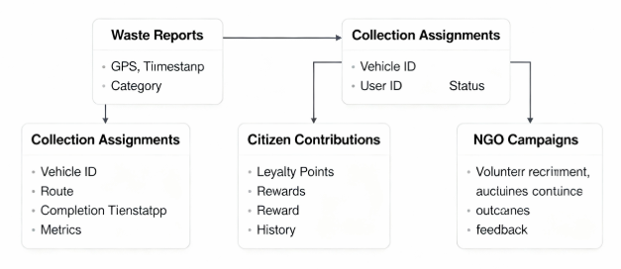
Data Model & Database Schema for Waste Reporting
'Waste' entity – GPS coordinates, date/time, type of waste, user ID, status (Dissanayake, 2020)
'Collection' table- vehicle ID, route optimisation, and completion metrics (Mutiara et al., 2025)
'Citizen Ledger'- loyalty points earned, rewards redeemed, and history (da Silva et al., 2022)
Notes:
The schema captures both waste reporting and collection assignments, as well as citizen contributions and NGO campaign efforts. The temporal schema will support the analysis of historical information in regard to changing local policies (Brahm, 2024; Dissanayake, 2020).

Slide 20

API Design & Integration Between Mobile App and Backend
POST Report: Citizens report waste and receive confirmation and points (Gowda & Gowda, 2024).
GET Assignment: Government obtains assignments, ranked according to urgency (Mutiara et al. 2025).
PUT Status: Vehicles report completion and issue notifications (Rodríguez et al., 2016).
Notes:
The purpose of the REST API is to allow communication between parties asynchronously. The POST, GET, and PUT methods allow citizens to report incidents, assign and track tasks and collect stats about them (Rodríguez et al., 2016; Gowda & Gowda, 2024).

Slide 21
Security, Privacy & Data Protection Architecture
E2E encryption for photos, identifiers, and aggregated data
OAuth 2.0 + RBAC: citizens report, officials assign, NGOs volunteer
Data retention: citizen records deleted 12 months (Sarfraz et al., 2018)
Notes:
The data is secured through end-to-end encryption (E2EE) for photos and identifiers; only the sum of the data is submitted to government agencies as aggregated data (Schulte and Knuts, 2022). This utilises the OAuth 2.0 protocol and role-based access control (RBAC) to allow citizens to submit reports, government officials to assign responses, and non-governmental organisations (NGOs) to volunteer assistance.

Slide 22
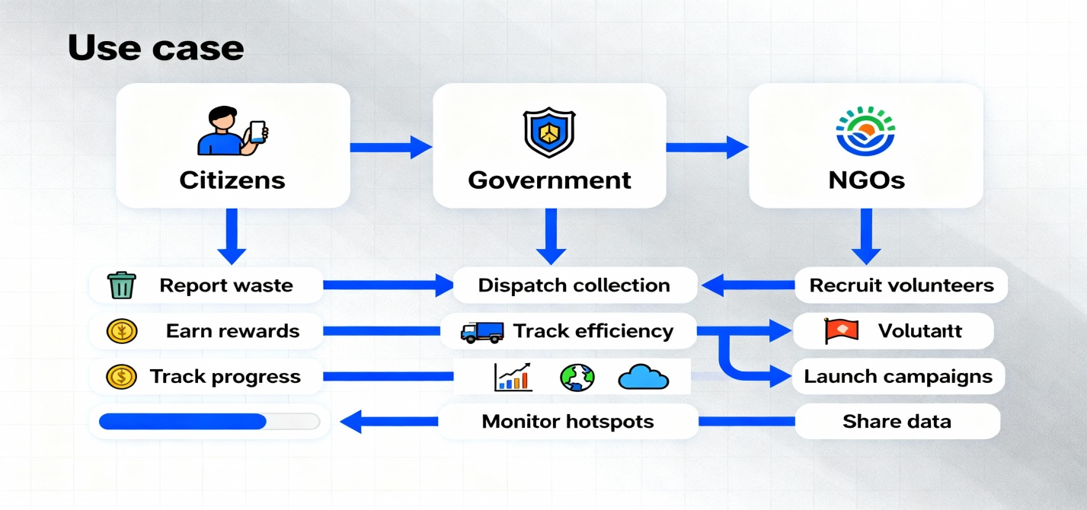
User Roles & Use Cases (Citizens, Government, NGOs)
Citizens: report waste, earn points, receive confirmation, track progress (Okonkwo, 2024)
Officials: view reports, optimise routes, monitor performance hotspots (Ndou et al., 2024)
NGOs: recruit volunteers, launch campaigns, share data (Ndou et al., 2024)
Notes:
In this system, the major actors are the public who report any mismanaged waste hotspots. Responsible officials and NGOs will work collaboratively to manage waste-related requests.

Slide 23
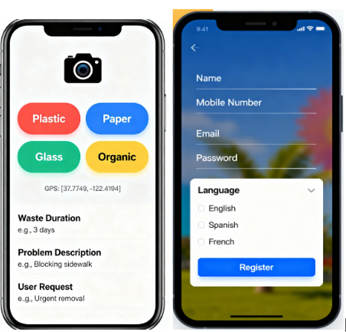
Citizen Mobile App UX Design
Camera icon > photo > category select > submit
Auto-geolocation and offline capability with online sync (Dissanayake, 2020; Okonkwo, 2024)
Instant loyalty points display, leaderboard, multi-language (da Silva et al., 2022)
Notes:
Simplicity is of utmost priority when developing the utility of the application. Therefore, it should facilitate one-tap capture, use auto-geolocation, category button functionality, and provide instant feedback to end users while ensuring it's accessible to individuals with low literacy levels and/or those without Internet connectivity.

Slide 24
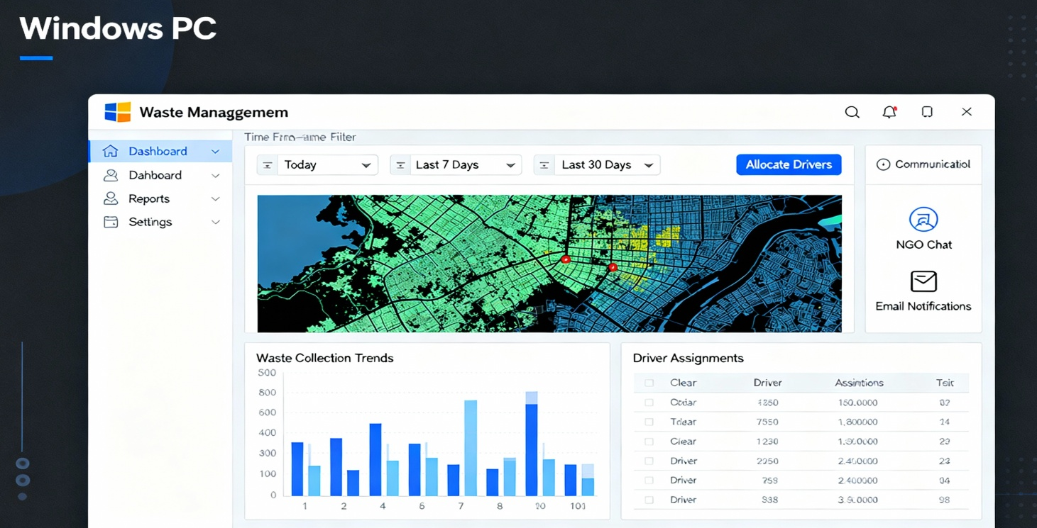
Government Dashboard UX Design
Real-time heat map (Red = urgency, Green = Complete) (Okonkwo, 2024)
Auto-prioritising collection queue by urgency and GPS distance (Ndou et al., 2024)
Vehicle GPS/GPX Route, Completion Percentage and Performance Analytics (O'Sullivan et al., 2021)
Notes:
Real-time heat map, collection queue, vehicle tracking (route/GPX), and performance analytics allow those with time pressure to make decisions quickly.

Slide 25
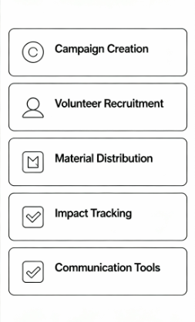
NGO / Community Portal Wireframes
Assign Responsibilities for Volunteers: assign duties, log hours, measure the impact of their efforts (Ndou et al., 2024)
Conduct Gap Analysis: overlay waste with volunteers' potential to cover the area (O'Sullivan et al., 2021)
Notes:
This project works with building a Campaign: develop initiatives, recruit volunteers, and monitor completion (Okonkwo, 2024)

Slide 26
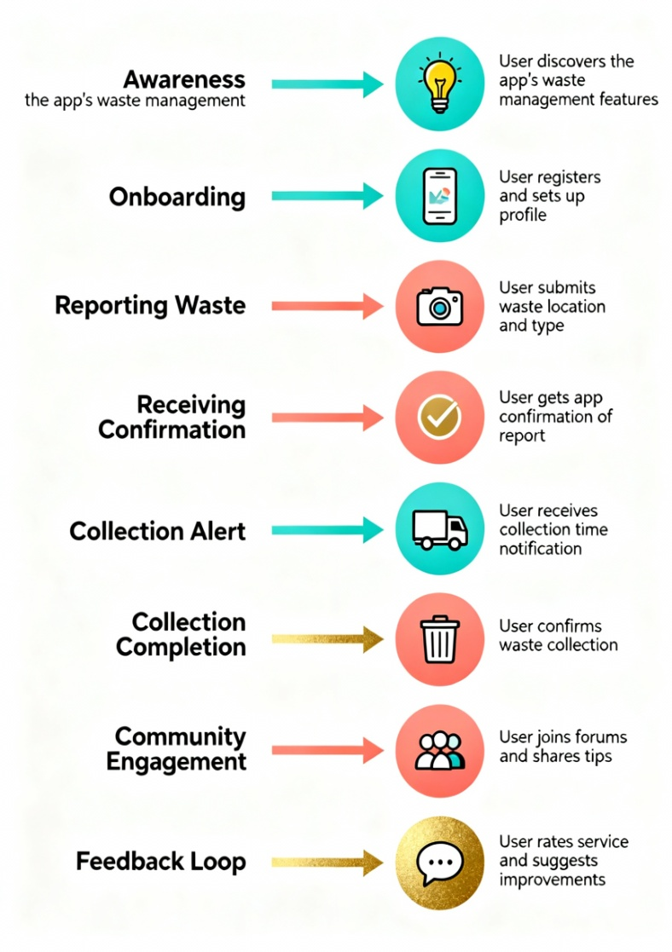
User Journey & Flow Diagrams (End-to-End Process)
The steps for a citizen's report are as follows: Observe, Photograph, Submit to agency (report), Earn Points, Verify (O'Sullivan et al., 2021).
The steps for the agency are as follows: Alert to report, review (determine if valid), assign vehicle to the citizen's report. Monitor Progress, Verify Results (Ndou et al., 2024).
The feedback process for citizens is as follows: Notification of Collection, Photo Evidence, Redeem Points/Nice Job (Ndou et al., 2024).
Notes:
The full cycle of closed-loop citizen reporting is as follows: Citizens take photographs, then create a report, alert others, assign work to local law enforcement, collect items from local stores/big box retailers and receive confirmation of their collection before cashing in on rewards.

Slide 27
Prototype Scope & Implemented Features (MVP)
Initial Launch Product Features
* User reporting
* Government dashboard
* Real-time service delivery monitoring
* Loyalty systems
Basic datasets (in real-time)
Planned Future Features
* Service routing algorithms
* AI clustering methods
* Non-profit organisational portal

Slide 28
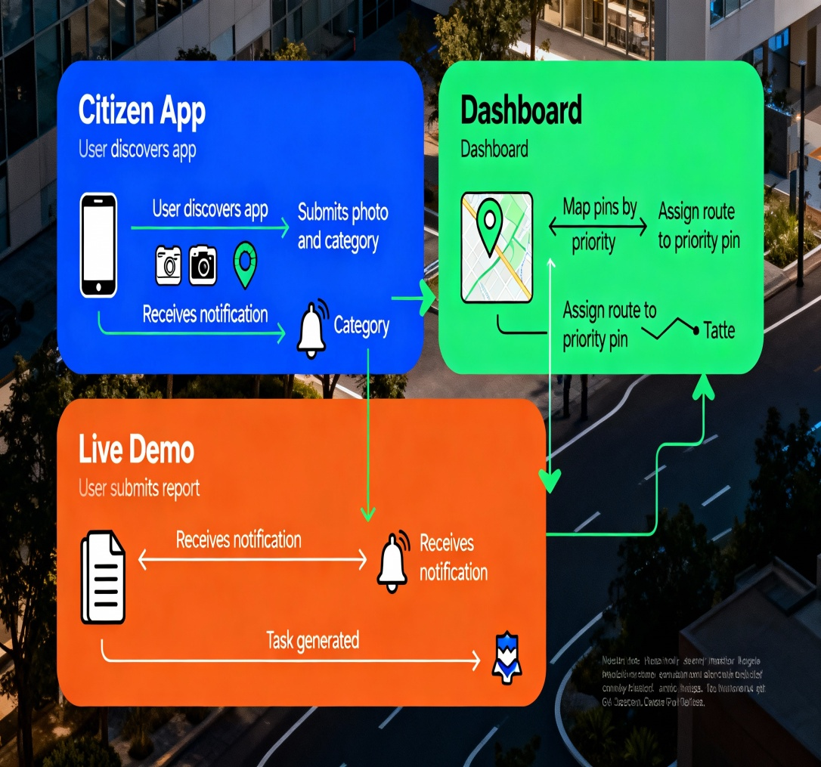
Prototype Demonstration
Citizen App: formerly discovered through the app, or received via email as a PDF; photo and type/category of drop-off required before submitting the drop-off before 5 pm (Okonkwo, 2024).
Dashboard: Map pins by Priority. Click on Priority Pin to Assign Route to Priority Pin (Chang et al., 2025).
Live Demonstration: The user submits the report, receives a notification, and the user has reports that the task has been generated successfully (Chang et al. 2025).
Notes:
This slide illustrates or demonstrates the prototype in which the details of citizen app, dashboards and liver demonstrations are included.

Slide 29
Prototype Testing Approach & Early Feedback
Usability - Task Completion | Time to Submit | Error Rate (Bjarnason et al., 2023)
Language - Hindi/Bengali Translations | Icon Recognition (Punchoojit & Hongwarittorrn, 2017)
Offline - How App Works Offline (Dissanayake, 2020)
Notes:
Citizens and Officials Usability Testing: 15-20 Citizens, 5 Officials, & 5 Workers Per Location, Completion Rate, Time Taken, Errors Made, SUS Scores

Slide 30
Project Implementation Roadmap
Phase | Timeline | Key Activities | Deliverables
Phase 1: Foundation | Weeks 1–2 | Literature review, stakeholder interviews, problem validation, technology stack selection | Comprehensive research synthesis, requirements document, and architecture design
Phase 2: Development | Weeks 3–4 | MVP development sprint, usability testing with target users, iterative refinement cycles, performance optimisation | Functional MVP prototype, testing report, and user feedback analysis
Phase 3: Deployment | Weeks 5–6 | Business case finalisation, deployment documentation, pitch narrative refinement, stakeholder feedback incorporation | Business case document, deployment plan, investor pitch deck ready
Notes:
The Project Roadmap is systematic in the process through which: (Research and Design in Weeks 1-2; MVP Development and Testing in Weeks 3-4; Business Case and Deployment in Weeks 5-6). Research will be synthesized, an MVP Prototype will be provided, a testing report will be provided, and pitch-ready documentation.

Slide 31

Resources Required to Build and Deploy the Solution
Team: 5 developers + UX researcher + business analyst (Jansen et al., 2023)
Infrastructure: AWS EC2/RDS, CDN, Google Maps API, Twilio, Firebase (Sinfield et al., 2024)
Budget: dev 60%, cloud 20%, test 10%, contingency 10% (Sinfield et al., 2024)
Notes:
This system design project will involve different types of stakeholders, including Prototype designers, business analysts, and software developers and testers, for regularly managing the security of the system.

Slide 32
References
Alourani, A., Ashraf, M.U. and Aloraini, M. (2025). Smart waste management and classification system using advanced IoT and AI technologies. PeerJ Computer Science, 11, pp.1–28.
Anas, A.K., Maryono, N. and Purnaweni, H. (2023). Community participation in waste management in abrasion areas. IOP conference series. Earth and environmental science, 1268(1), pp.1–7.
Bjarnason, E., Lang, F. and Mjöberg, A. (2023). An empirically based model of software prototyping: a mapping study and a multi-case study. Empirical Software Engineering, 28(5), pp.1–47.
Chang, S., Gao, J. and Wang, W. (2025). Automatic Generation of Software Prototype Data for Rapid Requirements Validation. Electronics, 14(17), pp.1–31.
da Silva, L.F., Junior, P.A.P. and Freire, A.P. (2022). Mobile User Interaction Design Patterns: A Systematic Mapping Study. Information, 13(5), pp.1–27.
Dissanayake, G. (2020). A Study on Real-Time Database Technology and Its Applications A Study on Real-Time Database Technology and Its Applications. pp.1–68.
Ferronato, N. and Torretta, V. (2019). Waste mismanagement in developing countries: A review of global issues. International Journal of Environmental Research and Public Health, 16(6), pp.1–28.
Gowda, P. and Gowda, A.N. (2024). Best Practices in REST API Design for Enhanced Scalability and Security. Journal of Artificial Intelligence, Machine Learning and Data Science, 2(1), pp.827–830.
Group, W.B. (2025). Clean Cities, Bright Futures: Accelerating Investment and Reforms in Solid Waste Management in Developing Countries. World Bank. Available at: https://www.worldbank.org/en/results/2025/04/30/clean-cities-bright-futures-accelerating-investment-and-reforms-in-solid-waste-management-in-developing-countries [Accessed 5 Dec. 2025].
Harnita, N. (2025). Community participation in sustainable solid waste management at the household level. Waste, Society and Sustainability, 2(1), pp.72–91.
Hassan, L. and Hamari, J. (2020). Gameful civic engagement: A review of the literature on gamification of e-participation. Government Information Quarterly, 37(3), pp.1–21.
Jansen, J.J.P., Heavey, C., Mom, T.J.M., Simsek, Z. and Zahra, S.A. (2023). Scaling‐up: Building, Leading and Sustaining Rapid Growth Over Time. Journal of Management Studies, 60(3), pp.1–24.
Kadus, T., Nirmal, P. and Kulkarni, K. (2020). Smart Waste Management System using IOT. International Journal of Engineering Research and, V9(04), pp.738–741.
Kalra, N. (2019). Community Participation and Waste Management. Sustainable Waste Management: Policies and Case Studies, pp.115–123.
Kumar, A. and Agrawal, A. (2020). Recent trends in solid waste management status, challenges, and potential for the future Indian cities – A review. Current Research in Environmental Sustainability, 2(100011), pp.1–19.
Kumar, S., Smith, S.R., Fowler, G., Velis, C., Kumar, S.J., Arya, S., Kumar, R. and Cheeseman, C. (2017). Challenges and opportunities associated with waste management in India. Royal Society Open Science, 4(3), pp.1–11.
Mahajan, R. (2023). Environment and Health Impact of Solid Waste Management in Developing Countries: A Review. Current World Environment, 18(1), pp.18–29.

Slide 33
References
Mutiara, G.A., Alfarisi, M.R., Zain, M.A.R., Rijali, M.G. and Rochim , F.N. (2025). Design and implementation of a REST API-based client-server architecture for multi-sensor IoT monitoring. International Journal of Advanced Technology and Engineering Exploration, 12(124), pp.1–24.
Ndou, V., Ingrosso, A. and Girolamo, A.D. (2024). Framework for Agile Transformation: Guiding Organizations Through Cultural, Structural, and Competency Shifts in Project Management. Administrative Sciences, 14(11), pp.1–20.
Okonkwo, C. (2024). Assessment of User Experience (UX) Design Trends in Mobile Applications. Journal of Technology and Systems, 6(5), pp.29–41.
Parameswari C, Rathnamala S and Siva Ranjani S (2024). Utilizing Mobile Application Technologies for Enhanced Sustainable Waste Management in Urban India. Journal of Information Technology and Digital World, 6(3), pp.251–263.
Patel, S., Oza, H., Sharma, Y., Patel, T., Agrawal, S. and Oza, P. (2025). IoT-Enabled Smart Waste Management using Renewable Energy. Procedia Computer Science, 259, pp.1973–1982.
Punchoojit, L. and Hongwarittorrn, N. (2017). Usability Studies on Mobile User Interface Design Patterns: A Systematic Literature Review. Advances in Human-Computer Interaction, 2017, pp.1–22.
Rodríguez, C., Baez, M., Daniel, F., Casati, F., Trabucco, J.C., Canali, L. and Percannella, G. (2016). REST APIs: A Large-Scale Analysis of Compliance with Principles and Best Practices. Lecture Notes in Computer Science, pp.21–39.
Romano, M., Díaz, P. and Aedo, I. (2021). Gamification-less: may gamification really foster civic participation? A controlled field experiment. Journal of Ambient Intelligence and Humanized Computing, 13, pp.4451–4465.
Saptaputra, E.H., Bonafix, N. and Araffanda, A.S. (2023). Mobile App as Digitalisation of Waste Sorting Management. IOP Conference Series: Earth and Environmental Science, 1169(1), pp.1–12.
Sarfraz, M., Qun, W., Hui, L. and Abdullah, M. (2018). Environmental Risk Management Strategies and the Moderating Role of Corporate Social Responsibility in Project Financing Decisions. Sustainability, 10(8), pp.1–17.
Schulte, J. and Knuts, S. (2022). Sustainability impact and effects analysis - A risk management tool for sustainable product development. Sustainable Production and Consumption, 30(1), pp.737–751.
Sinfield, J.V., Ajmani, A. and McShane, W. (2024). Strategic roadmapping to accelerate and risk-mitigate enabling innovations: A generalizable method and a case illustration for marine renewable energy. Technological Forecasting and Social Change, 209, pp.1–21.
Singh, P., Verma, P., Singh, R., Ahamad, A. and André C. S. Batalhão (2022). Waste Management and Resource Recycling in the Developing World. Elsevier, pp.773–797.
Tarigan, L.B., Rogaleli, Y.C. and Waangsir, F.W.F. (2020). Community participation in waste management. International Journal of Public Health Science (IJPHS), 9(2), pp.115–120.
unep.org (2024). Beyond an age of waste Turning rubbish into a resource Global Waste Management Outlook 2024. pp.1–116. Available at: https://wedocs.unep.org/rest/api/core/bitstreams/daa56f4d-2479-4e10-88c6-4d65da463299/content [Accessed 5 Dec. 2025].
Zebua, R.S.Y., Wahyudi, A., Hermawati, I., Wiryanto, W., Takariani, C.S.D., Saputra, A. and Abidin, Z. (2025). Social Learning, Public Participation and Community Engagement in Waste Management: A Bibliometric Analysis of Trends and Gaps. Cleaner Waste Systems, pp.1–18.

