Slide 1
SUPPLY CHAIN STRATEGIES
Identifying a Strategy

Slide 2

SUPPLY CHAIN STRATEGIES

Slide 3
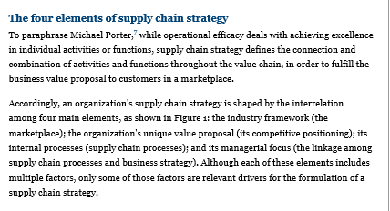
http://www.supplychainquarterly.com/topics/Strategy/20130306-supply-chain-strategies-which-one-hits-the-mark/

Slide 4
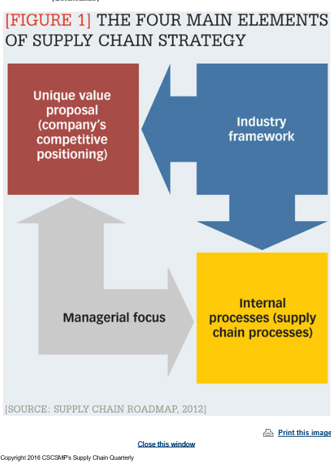

Slide 5
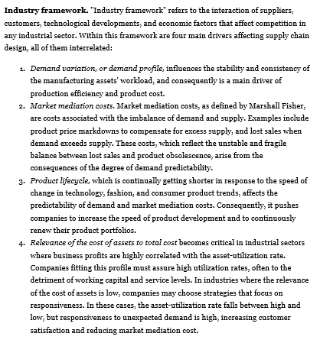

Slide 6
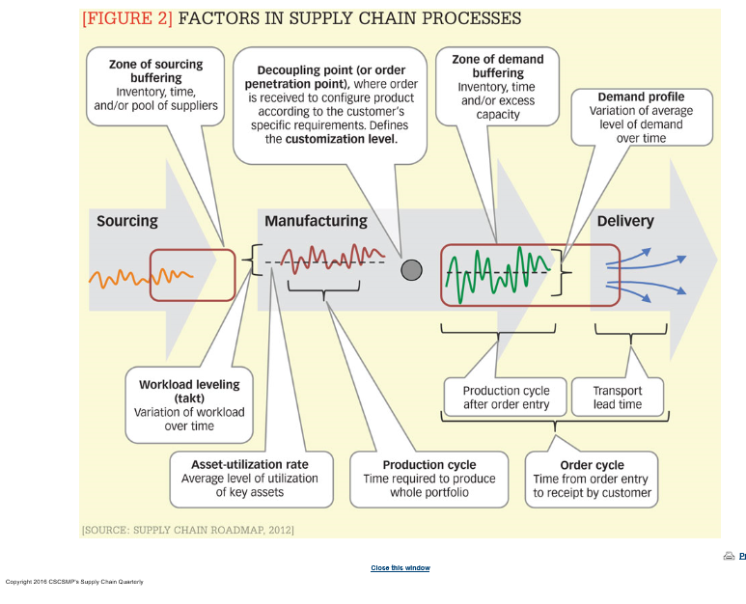

Slide 7


Slide 8
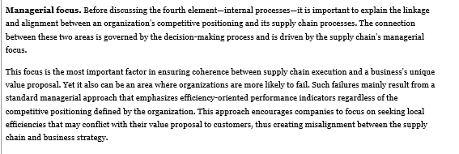

Slide 9
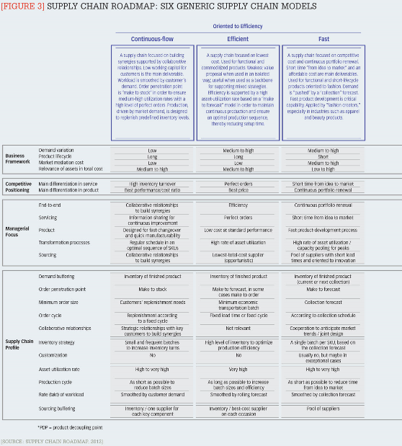

Slide 10
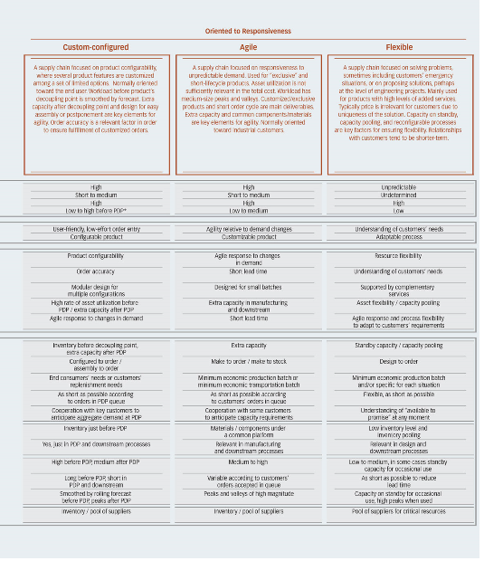

Slide 11
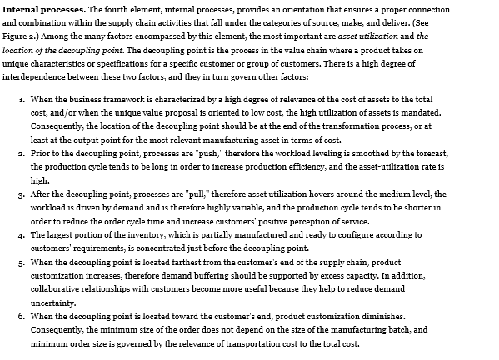

Slide 12
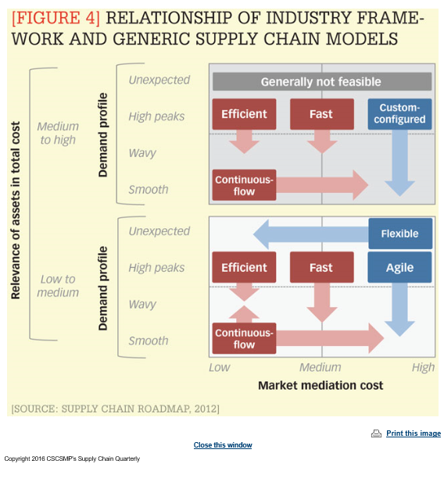

Slide 13
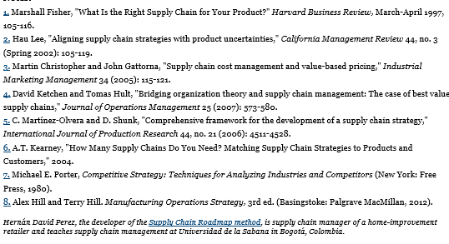

Slide 14

Strategy as a Plan

Slide 15
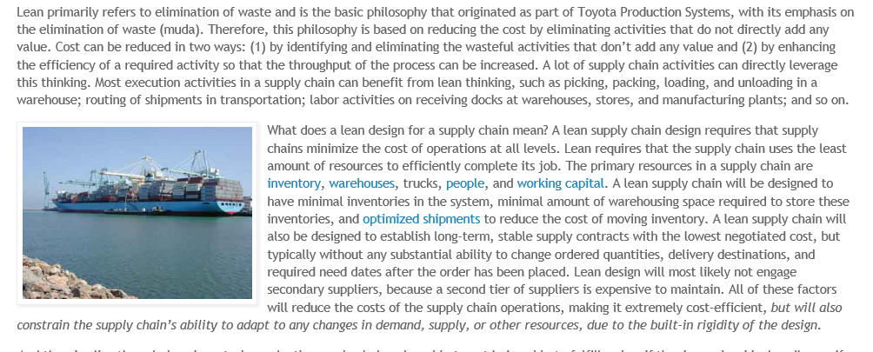
LEAN

Slide 16
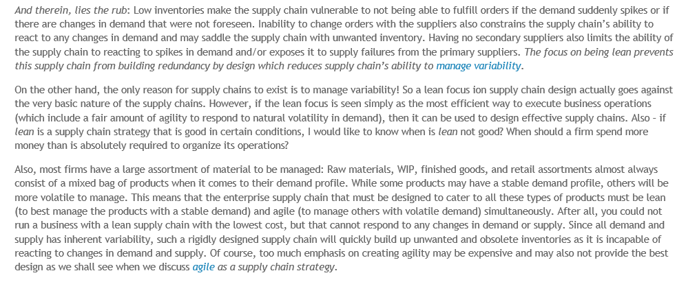
http://www.supplychainmusings.com/2010/10/lean-as-supply-chain-strategy.html

Slide 17


Slide 18
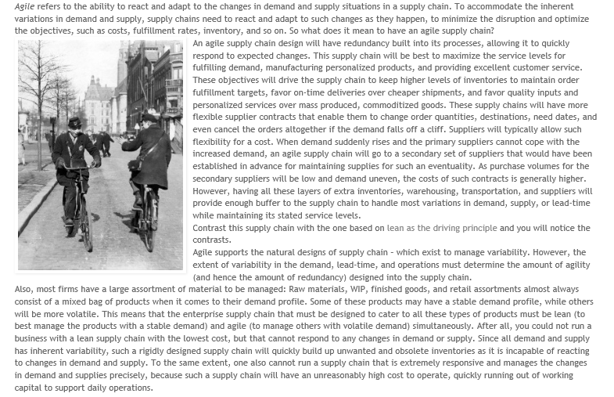
AGILE

Slide 19


Slide 20

POSTPONEMENT

Slide 21
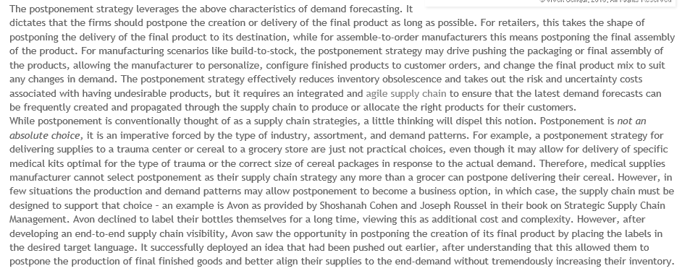

Slide 22


Slide 23
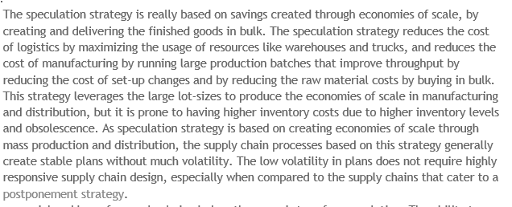
SPECULATION

Slide 24


Slide 25
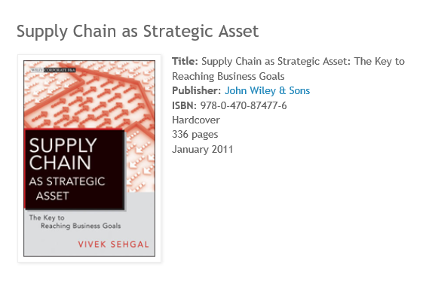

Slide 26
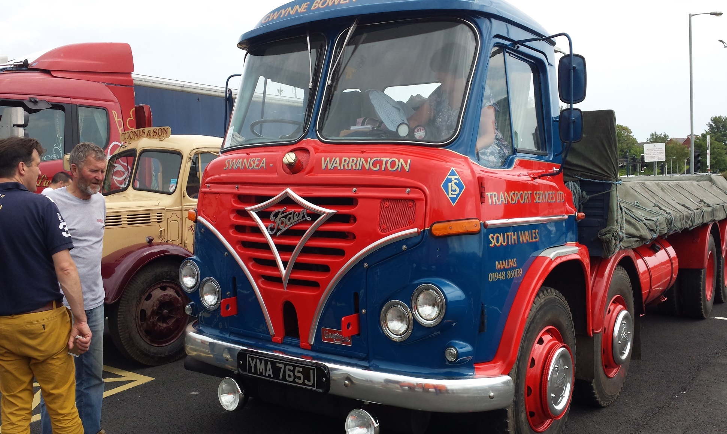
QUESTIONS

