Slide 1
MA Criminology & Policing
Terrorism & Cybercrime module.
Terrorism Recap
Assignment

Slide 2


Introduction to Contemporary Terrorism
Justin Evans
UWTSD

Slide 3

Introducing the Course – Module Aims
Critically evaluate the constantly changing threats, trends and methods posed and adopted by a contemporary terrorist and/or group and the global Governmental responses to it.
Systematically analyse the challenges presented by cybercrime in modern society and the police responses to the threat.
Not just knowledge of terrorism/cybercrime, but critical evaluation and analysis of how, why and why now!
This is an essential element of your L7 Qualification
Notes:
Opening
“This module is designed to do more than just give you knowledge about terrorism and cybercrime. It’s about developing your ability to think critically about these complex and evolving issues.”
Aim 1 – Contemporary terrorism
“First, we will look at terrorism in its contemporary forms — how threats, trends, and methods are constantly changing. For example, terrorist groups adopt new technologies and tactics to stay ahead of security responses. We will evaluate how these changes take place, why they matter, and how governments around the world respond.”
Aim 2 – Cybercrime
“Second, we will systematically analyse cybercrime as a modern challenge. Cybercrime is not just about individual criminals but also organised groups, and it often overlaps with terrorism. We will examine both the societal impact and the specific responses from policing and law enforcement.”
Critical Evaluation Focus
“Importantly, this isn’t just about memorising facts or describing threats. The Level 7 qualification expects you to critically evaluate — which means asking deeper questions: How effective are these responses? Why do certain approaches work now, and will they work in the future? What alternative strategies might be needed?”
Closing
“So, as you progress through this course, keep in mind that you are not just learning what terrorism or cybercrime is, but developing the analytical skills to evaluate the ‘how’, the ‘why’, and the ‘why now’. That’s the essential step up to Level 7 study.”

Slide 4

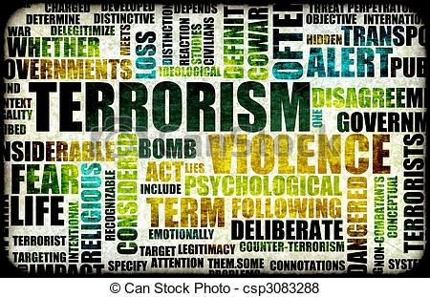
Defining Terrorism
In groups, spend 5 minutes discussing what comes to mind when you hear ‘terrorism’.
Words
  Images
  Events
  Feelings
Discuss…
Notes:
Words: “What single words do you associate with terrorism?”
Images: “When you picture terrorism, what images or scenes come to mind?”
Events: “Are there specific events, either globally or locally, that shape your understanding of terrorism?”
Feelings: “What emotions do you think terrorism is designed to create in people?”
Example Follow-Up Questions
“Do you think your perception of terrorism has been shaped more by media, personal experience, or professional knowledge?”
“Does terrorism always involve violence, or can it take other forms?”
“How might the word mean different things to governments, communities, and individuals?”
“What challenges do you think arise when trying to define terrorism in law?”
“Is there a difference between terrorism and other serious crime? What makes it distinct?”

Slide 5
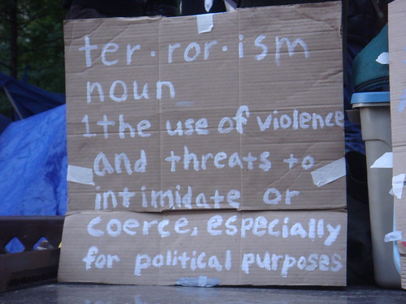
Defining Terrorism
Study: Schmidt and Jongman (1988)
109 Definitions of ‘Terrorism’ Analysed:
83.5% contained the term ‘Violence’
65% said it was ‘Political’
51% said it created ‘Fear’ or ‘Terror’
47% identified ‘threats’
41.5% psychological effects
Notes:
The study by Alex P. Schmid and Albert J. Jongman (1988), Political Terrorism: A New Guide to Actors, Authors, Concepts, Data Bases, Theories, and Literature, is a comprehensive and influential work on the concept and definitions of terrorism.
One of the most notable aspects of their study is the analysis of over 100 definitions of terrorism, drawn from a wide range of sources, including academic, governmental, and legal documents.
Schmid and Jongman identified several key elements that frequently appear in definitions of terrorism. Their findings highlighted that there is no universally accepted definition of terrorism, but some common themes recur in most definitions:
Violence: Almost all definitions of terrorism involve the use or threat of violence. This is a central element that differentiates terrorism from other forms of protest or dissent.
Political Goals: Terrorism is almost always connected to political objectives. The violent acts are typically aimed at changing or influencing political structures or policies.
Psychological Impact: The psychological aspect is also a major component, with terrorists seeking to instill fear, not only in the immediate victims but in a broader audience. Terrorism, therefore, has a communicative function, aiming to send a message beyond the immediate act of violence.
Targeting Noncombatants: Another recurring element in the definitions analyzed by Schmid and Jongman is that terrorist acts often involve attacks on civilians or noncombatants, making them distinct from conventional military operations.
Coercion: Many definitions emphasize that terrorism seeks to coerce a government or society into taking certain actions by creating a climate of fear.
Illegality and Criminality: Finally, there is often an emphasis on the unlawful nature of terrorism, as it involves acts that contravene national or international law.
Schmid and Jongman’s study is crucial in demonstrating the complexity of defining terrorism and the difficulties in achieving consensus on a single definition, given its multi-faceted nature. The lack of a universal definition has implications for both academic study and counterterrorism policy, as different stakeholders may interpret acts of terrorism differently depending on their own criteria and perspectives.

Slide 6

Terrorism and its different forms
Common elements that many definitions share:
Use of Violence or Threats
Political, Religious, or Ideological Motivation
Intention to Spread Fear
Targets and Victims
Non-State Actors
Notes:
Definition of Terrorism:
Terrorism is a complex and multifaceted concept that lacks a universally agreed-upon definition due to its political, ideological, and subjective nature. However, there are common elements that many definitions share:
Use of Violence or Threats: Terrorism involves the use of violence, threats, or intimidation to create fear and coerce individuals, groups, or governments into taking certain actions or adhering to specific ideologies.
Political, Religious, or Ideological Motivation: Terrorist acts are often driven by political, religious, or ideological motivations. These motivations can range from separatism and nationalism to religious extremism and revolutionary ideologies.
Intention to Spread Fear: One of the main goals of terrorism is to spread fear and panic within a population or a specific target group. This fear is intended to influence behaviour or policies.
Targets and Victims: Terrorist acts typically target civilians, non-combatants, and symbols of authority to maximize psychological impact. However, they can also target government facilities, infrastructure, or military personnel.
Non-State Actors: While states can engage in acts of violence, terrorism is primarily associated with non-state actors, such as extremist groups or individuals.

Slide 7

Defining Terrorism
Why should there be a definition for ‘terrorism’?
  Can you think of a definition of terrorism?
  What should we use a definition of terrorism for?
Notes:
It's important to emphasise that terrorism is a controversial and debated concept, and there isn't a universally accepted definition.
Terrorism is a controversial and debated concept for several reasons, including its subjectivity, political implications, and varying interpretations. Here are some key factors that contribute to the controversy and debate surrounding the concept of terrorism:
Subjectivity of the Term: Terrorism lacks a universally agreed-upon definition. Different organizations, governments, and scholars may have their own interpretations and criteria for what constitutes terrorism. This subjectivity can lead to disagreements and debates about whether a particular act or group should be labelled as terrorist.
Political and Ideological Differences: Terrorism often involves political or ideological motivations. Governments, political groups, and individuals may use the term "terrorism" to advance their own agendas or to delegitimize their adversaries. As a result, labelling a group as a terrorist organization can be a politically charged decision.
Context Matters: The context in which an act occurs can greatly influence whether it is perceived as terrorism. Actions that might be considered terrorism in one context might be seen as legitimate resistance or self-defence in another. For example, some individuals or groups labelled as terrorists in one country may be regarded as freedom fighters or resistance fighters by others.
Debate Over State Terrorism: There is ongoing debate about whether acts of violence carried out by governments or state entities can be classified as terrorism. Some argue that state-sponsored violence should be included under the terrorism umbrella, while others believe that terrorism should only refer to acts committed by non-state actors.
Ethical and Legal Considerations: Determining whether an act is terrorism can raise ethical and legal questions. These questions can include issues related to the use of violence, the protection of civilians, and the balance between security measures and civil liberties. These ethical and legal dilemmas contribute to the complexity of defining terrorism.
Media and Public Perception: The way terrorism is portrayed in the media can shape public perception and influence the discourse surrounding the term. Media coverage can sometimes sensationalize acts of terrorism or focus on particular groups, affecting how people perceive the phenomenon.
Evolution of Tactics: Terrorism is not a static concept; it evolves over time. New tactics and methods continually emerge, challenging traditional definitions and interpretations. For example, cyberterrorism and lone-wolf attacks have added complexity to the understanding of terrorism.
Because of these factors, terrorism remains a contentious and debated concept, both academically and in public discourse. Scholars, policymakers, and the general public continue to grapple with questions of how to define terrorism and how to respond to it effectively while upholding ethical and legal standards.

Slide 8


Differing approaches to Defining “Terrorism”
Legal
Academic
Political
How might definitions change through each of these lenses?
Notes:
Definitions of terrorism can indeed change when viewed through different lenses, such as legal, academic, and political perspectives. Here's how definitions may vary through each of these lenses:

Slide 9

Defining Terrorism – Legal Approach
Provide a framework to view and tackle terrorist activity through the application of legislation.
Historically, legislation relating to terrorism has been introduced as a ‘knee jerk’ reaction to some situation or event.
The Terrorism Act 2000 changed this pattern. However, post- 9/11 further legislation was rushed through.
Notes:
Legal Perspective:
Precise Legal Definitions: From a legal standpoint, definitions of terrorism tend to be more precise and technical. Many countries have specific legal definitions of terrorism within their criminal codes. These definitions often include elements such as the intentional use of violence or threats to intimidate or coerce for political, religious, or ideological purposes. Legal definitions are critical for law enforcement and the criminal justice system to identify and prosecute individuals involved in terrorist activities.
Criminal Intent: Legal definitions often focus on the perpetrator's intent and the specific criminal acts committed, such as bombings, hijackings, or kidnappings. Intent to create fear or coerce a population or government is a key element in these definitions.
Criminal Penalties: Legal definitions of terrorism are typically linked to criminal penalties, outlining the legal consequences for individuals or groups engaged in terrorist acts. These penalties can include imprisonment, asset forfeiture, or other punitive measures.

Slide 10

Defining Terrorism - Academic Approach
Definitions of terrorism by academics tend to mirror the disciplines of those who devise them e.g former police officers and psychologists.
Social psychologists argue that terrorism is a product of group processes or dynamics (McCauley et al, 1972)
Psychoanalysts deem it to be the tool of unconscious patriarchal impulses (Konrad, 1979)
Sociologists conceptualise terrorism through an understanding of ‘structural inequalities’ (Turk, 2004; Boyns & Ballard, 2004)
Notes:
2. Academic Perspective:
Diverse Approaches: From an academic standpoint, there is no single, universally accepted definition of terrorism. Scholars from various fields, such as political science, sociology, and criminology, offer diverse approaches and definitions based on their research and theoretical perspectives.
Contextual Understanding: Academics often emphasize the importance of understanding the context in which terrorism occurs. They may consider factors such as historical, political, social, and economic conditions to provide a more comprehensive analysis.
Motivation and Ideology: Academic definitions may delve deeply into the motivations and ideologies behind terrorism. They explore the root causes, radicalization processes, and the role of ideology in motivating individuals or groups to engage in terrorist activities.
Debates and Discussions: Academic discussions around terrorism definitions can be rich and ongoing, with scholars engaging in debates over terminology, classification, and the relationship between terrorism and insurgency, revolution, or guerrilla warfare.

Slide 11

Defining Terrorism – Political Approach
Implementation of Counter Terrorism Legislation.
Creation of Counter Terrorism Strategies.
States in the USA have opted for sub state definitions to suit their political purposes – How can this work?
Notes:
3. Political Perspective:
Subjectivity: From a political perspective, definitions of terrorism can be highly subjective and influenced by the interests of governments and organizations. Political actors may label certain groups as terrorists or freedom fighters depending on their geopolitical goals.
Instrument of Statecraft: Political actors sometimes use the term "terrorism" strategically to justify policy decisions, including military interventions, sanctions, or international cooperation efforts. This instrumental use of the term can change over time and in response to evolving political priorities.
Legitimacy and Propaganda: Governments may seek to delegitimize certain groups or movements by branding them as terrorists, which can shape public opinion and garner international support for counterterrorism actions.
Multilateral Agreements: In the realm of international politics, states often negotiate and agree upon definitions of terrorism for the purpose of international treaties and conventions. These definitions may serve as common ground for cooperation in areas such as extradition and counterterrorism financing.
In summary, the definitions of terrorism can vary significantly depending on the perspective through which they are viewed. Legal definitions tend to be precise and focused on criminal intent and acts, academic perspectives explore the complexities and context of terrorism, and political definitions can be influenced by strategic and geopolitical considerations. This diversity of definitions underscores the complexity and subjectivity of the term "terrorism."

Slide 12
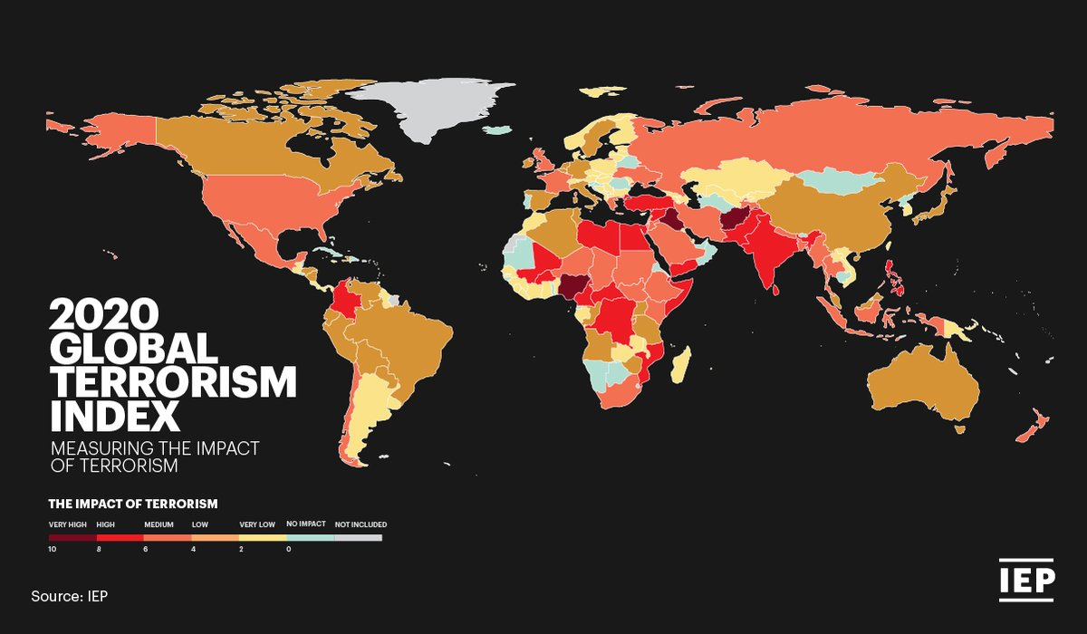
Terrorism – A Brief History
The history of Terrorism stretches back over two thousand years (and probably much longer), however many see Terrorism as something new and fail to consider the historical context.
Often if the historical context is considered it is thought of through the lens of being unlike the global terrorism we see today.
Notes:
The historical context of terrorism is complex and multifaceted, as terrorism has evolved over centuries in response to changing political, social, and technological dynamics. Here's an overview of the historical context of terrorism:
Origins and Early Forms:
Terrorism, as a tactic of violence and intimidation, has ancient roots. Historical accounts suggest that groups and individuals have employed terror as a means of achieving political, religious, or ideological objectives for centuries.
Some early examples of terrorism include the Sicarii, a Jewish extremist group active in the 1st century CE, and the Thuggee cult in India during the 19th century.
2. Nineteenth Century and Anarchist Movements:
The 19th century saw the emergence of anarchist movements in Europe and the Americas. Anarchist groups engaged in acts of political violence, including bombings and assassinations, to overthrow governments and challenge established authority.
Prominent events include the assassination of Archduke Franz Ferdinand of Austria in 1914, which triggered World War I, and the Haymarket affair in Chicago in 1886.
3. Decolonization and National Liberation Movements:
During the 20th century, decolonization and struggles for national liberation led to the rise of insurgent and guerrilla movements. Some of these movements, such as the Algerian National Liberation Front (FLN) and the Palestine Liberation Organization (PLO), used terrorism as a tactic to achieve their goals.
4. Cold War and State-Sponsored Terrorism:
The Cold War era saw the emergence of state-sponsored terrorism. Superpower rivalry and ideological conflicts fueled the support of proxy groups engaged in acts of terrorism. For example, the Soviet Union supported groups like the Popular Front for the Liberation of Palestine (PFLP), while the United States backed anti-communist groups in various regions.
5. Contemporary Terrorism:
The late 20th and early 21st centuries witnessed the rise of contemporary terrorism, characterized by non-state actors with global ambitions. Notable groups include Al-Qaeda, responsible for the 9/11 attacks in the United States, and ISIS (Islamic State of Iraq and Syria).
New technologies, such as the internet and social media, have facilitated the spread of extremist ideologies and the recruitment of individuals into terrorist groups.
6. Changing Tactics and Targets:
Terrorism has evolved in terms of tactics and targets. While bombings and hijackings remain common tactics, cyberterrorism and lone-wolf attacks have become more prevalent. Targets have shifted from purely political or military targets to include civilian populations and symbolic landmarks.
7. Counterterrorism Responses:
In response to the evolving threat of terrorism, nations have implemented various counterterrorism measures, including intelligence agencies, law enforcement, and international cooperation through organizations like INTERPOL and the United Nations.
It's important to note that terrorism is a dynamic and constantly changing phenomenon. Historical context provides insights into its evolution, but each period and region has unique dynamics and motivations that have contributed to the development of terrorist movements. Understanding the historical context of terrorism is crucial for developing effective strategies to counter it and address its root causes.

Slide 13
Historical Examples of Terror
Both the Sicarii and Narodnaya Volya provide classic examples of terrorist groups:
The Sicarii were motivated by ethnic, religious and nationalist agendas, whilst
Narodnaya Volya were motivated by bringing reform of the Government and replacing it with apolitical ideology of their own.
Almost all terrorist groups fall into one or more than one of these motivators (e.g. Al Qaeda, PIRA)

Slide 14
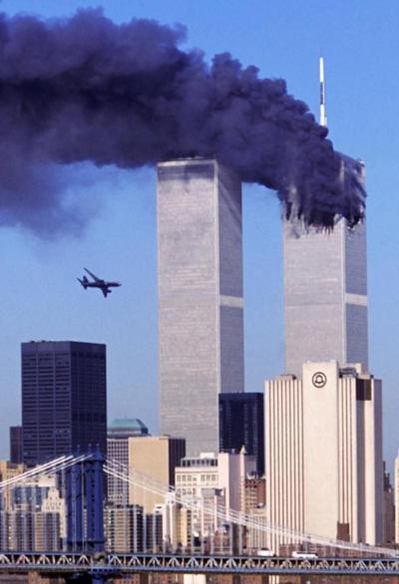
Modern History Examples of Terrorism
Following the Twin Towers attacks there was a deluge of academic writing on almost every aspect of terrorism other than the historic context.
The message seemed to be clear, this is a new age and a new threat and we can learn nothing from history.

Slide 15
Week 2 – Terrorism & Cybercrime
Terrorist ideology in more detail.
Terrorist strategies.
Measures of Success.
Replication through history.
What can we learn?

Slide 16
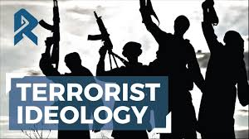
Ideology
Establishes who the enemy are and what the group is attempting to achieve
Nationalist
Religious
Ethnic identity
Political doctrines
The writings of terrorist groups often indicates the ideology the group follows.
Notes:
Terrorist ideology refers to the set of beliefs, doctrines, and principles that underpin the actions and objectives of a terrorist group or individual terrorists. It provides a framework for justifying acts of violence and terrorism as means to achieve specific political, religious, ideological, or social goals. Terrorist ideology often serves as a rallying point for recruitment, radicalization, and the mobilization of individuals into the ranks of terrorist organizations.
Key characteristics of terrorist ideology include:
Political, Religious, or Ideological Nature: Terrorist ideologies can be rooted in various domains, such as politics, religion, nationalism, separatism, or a particular social cause. Some terrorist groups seek to advance political agendas, while others are driven by religious extremism or separatist ideologies.
Use of Violence: Most terrorist ideologies advocate or justify the use of violence, including acts of terrorism, as a legitimate means to achieve their goals. This distinguishes them from non-violent political or social movements.
Radicalization and Recruitment: Terrorist ideologies often involve the radicalization of individuals who are exposed to extremist beliefs. Radicalization is the process through which individuals adopt and internalize extremist ideologies, potentially leading to their involvement in terrorist activities. Recruitment efforts are aimed at attracting individuals to join the terrorist cause.
Enemy and Target Identification: Terrorist ideologies typically identify perceived enemies, adversaries, or targets that are seen as obstacles to achieving their objectives. These targets can include governments, security forces, specific religious or ethnic groups, or symbols of authority.
Propaganda and Messaging: Terrorist groups use propaganda and messaging to disseminate their ideologies, recruit followers, and justify their actions. This can involve the production of videos, pamphlets, online content, and speeches that promote their beliefs and goals.
Justification of Violence: Terrorist ideologies often include arguments and narratives that justify violence as a necessary or morally justified means to achieve change. These justifications may be based on grievances, perceived injustices, or religious interpretations.
Examples of well-known terrorist ideologies include:
Jihadism: Jihadist groups, such as al-Qaeda and ISIS, adhere to extremist interpretations of Islam and seek to establish Islamic states based on their interpretation of Sharia law. They justify acts of terrorism as part of a holy struggle (jihad) against perceived enemies.
Nationalism and Separatism: Some terrorist groups, like the Basque Homeland and Freedom (ETA) or the Irish Republican Army (IRA), pursue nationalist or separatist ideologies, seeking independence or autonomy for a particular region or ethnic group.
Anarchism: Anarchist terrorist ideologies reject all forms of authority and seek to overthrow existing governments and social orders through acts of violence and sabotage.
Environmental Extremism: Eco-terrorist groups, like the Earth Liberation Front (ELF) and the Animal Liberation Front (ALF), are motivated by environmental and animal rights ideologies and engage in acts of sabotage and arson to advance their causes.
Understanding terrorist ideologies is crucial for counterterrorism efforts, as it helps authorities and policymakers develop strategies to counter radicalization, disrupt recruitment, and address the root causes that drive individuals toward extremist beliefs and violence.

Slide 17
What is an Ideology
Ayman Al-Zawahiri wrote:
The first front is to inflict losses on the Western crusader, especially to its economic infrastructure with strikes that would make it bleed for years. The strikes in NY, Washington, Madrid and London are the best examples of that……
On the second front we have to get crusaders out of the lands of Islam especially from Iraq, Afghanistan and Palestine.
Notes:
Today, we’re looking at one of the most infamous figures in modern terrorism – Ayman al-Zawahiri. He wasn’t just Osama bin Laden’s deputy – he eventually became the leader of al-Qaeda himself. But his journey started far from the mountains of Afghanistan – it began in a middle-class Egyptian family in Cairo.
1. Early Life & Radicalisation
"Born in 1951, al-Zawahiri came from a respectable, educated background – his father was a pharmacist, his grandfather a scholar. Yet as a teenager in the 1960s, he was drawn into Islamist activism. By the time he was in his 20s, his worldview had hardened – and he was on the path to extremism."Throughout the 1990s and after 9/11, al-Zawahiri was the voice behind many of al-Qaeda’s messages. While bin Laden was the charismatic frontman, al-Zawahiri provided the intellectual and strategic backbone. He appeared in countless propaganda videos, justifying attacks and trying to rally followers worldwide."
---
5. Global Terrorist Activities
"His influence stretched far beyond Afghanistan. He helped inspire and plan terrorist acts around the globe – from bombings to assassinations – always pushing the idea that violence was the path to change. For decades, he remained one of the world’s most wanted men."
2. Involvement in Islamist Groups
"He became a leading figure in Egyptian Islamic Jihad – a group that believed in overthrowing governments they saw as un-Islamic. Most notoriously, this group played a role in the 1981 assassination of Egyptian President Anwar Sadat. That event marked al-Zawahiri as a dangerous figure in global security."
---
3. Alliance with Osama bin Laden
"By the late 1980s, al-Zawahiri had linked up with Osama bin Laden in Afghanistan. The two shared the same vision – to wage a global jihad. Al-Zawahiri wasn’t just a fighter; he was the ideologue – the thinker, the strategist. Together, they laid the foundations for what became al-Qaeda."---
6. Leader of al-Qaeda
"After US forces killed bin Laden in 2011, al-Zawahiri stepped up as leader ofal-Qaeda. But his reign wasn’t easy. He faced challenges from rivals, especially ISIS, who claimed to represent a 'new era' of jihad. Al-Qaeda under al-Zawahiri remained active, but arguably lost some of its dominance."
7. A Life in Hiding
"For years, he was a shadowy figure – hiding in safe houses, moving constantly, sending out video messages but rarely seen in public. Intelligence agencies around the world hunted him – until eventually…"
Conclusion
"On 31st July 2022, the CIA finally tracked him down. A drone strike in Kabul killed Ayman al-Zawahiri on a balcony. His death closed a chapter in the history of al-Qaeda – but the movement he helped shape continues to influence global terrorism today.

Slide 18
What is an Ideology
Ayman Al-Zawahiri wrote:
The third front is working at changing the corrupt regimes [in our countries] which have sold their honour to the Crusading West and befriended Israel.
The fourth front is popularising the Dawah [Inviting non-Muslims to accept the truth of Islam] work.

Slide 19
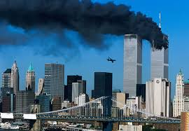
9/11 Attacks: Overview and Key Facts
Coordinated attack on 11 September 2001
19 Al-Qaeda hijackers seized four planes
Two hit World Trade Center
One hit the Pentagon
One crashed in Pennsylvania
2,977 people killed
Triggered global security and military shifts
Notes:
Set the scene chronologically. Emphasise scale, simultaneous strikes, global media attention, and policy consequences.
On 11 September 2001, al-Qaeda carried out coordinated suicide hijackings of four passenger planes.
Two hit the Twin Towers in New York, one struck the Pentagon, and another crashed in Pennsylvania after passengers intervened.
Nearly 3,000 people were killed, making it the deadliest terrorist attack in history. The attacks were unprecedented in scale, complexity, and global impact, shaking public confidence and drawing intense international attention.

Slide 20

Westminster Attack 2017: Motivation and Ideology
Influenced by Islamist extremist propaganda.
Motivated by grievance against UK policies.
Radicalised through online material and personal vulnerabilities.
Notes:
Note role of online radicalisation and individual pathway to violence.
Masood was influenced by Islamist extremist propaganda, although he was not formally directed by ISIS. He had a history of criminality and mental instability, which blended with ideological drivers in his radicalisation.
ISIS later claimed responsibility, but evidence shows Masood was more inspired than directed, making him an example of a self-initiated attacker motivated by global jihadist narratives.

Slide 21

Manchester Arena Bombing: Intention and Strategic Aim
Mass casualties at symbolic, high-profile event.
Targeting children and families to maximise shock.
Strategic aim: intimidation, propaganda, and revenge.
Notes:
Abedi’s tactical intention was maximum loss of life and psychological trauma by targeting an event full of young people and families.
This created shock waves far beyond Manchester, leading to international media coverage. Strategically, the attack aimed to intimidate the UK public, undermine feelings of safety in everyday life, and serve as propaganda for ISIS.
It also aligned with ISIS’s strategy of inspiring supporters in the West to stage their own attacks without requiring direct operational control. In essence, the bombing was designed to combine mass casualties with symbolic outrage.

Slide 22

What is success?
The 'troubles'
Provocation
Escalation
Blame
Endurance
Notes:
When we think about the four strategic elements of terrorism — provocation, escalation, blame, and endurance — the Troubles in Northern Ireland provide one of the clearest and longest-running examples.
The conflict spanned from the late 1960s through to the 1998 Good Friday Agreement and involved Republican groups such as the IRA, Loyalist paramilitaries, and the British state.
At its heart were deep divisions over national identity and sovereignty — whether Northern Ireland should remain part of the United Kingdom or join a united Ireland. Over 3,500 people were killed, and tens of thousands were injured, with violence ranging from bombings and shootings to assassinations and riots.
The Troubles illustrate many of the strategies we’ve just discussed: provocation, escalation, blame, and endurance. They also highlight how terrorism is often intertwined with political, social, and historical grievances, making resolution complex and requiring more than just a security response
The IRA frequently used provocation, carrying out bombings designed to force the British state into a heavy-handed security response. This then led to escalation, with tit-for-tat violence between paramilitaries and the state.
The conflict was also shaped by blame — each side fought a battle for legitimacy, with Republicans portraying themselves as resisting oppression, while the British government sought to frame the IRA as criminals and terrorists.
Finally, the IRA relied on endurance, sustaining a decades-long campaign with the aim of wearing down public and political will in the UK.
By looking at the Troubles through these four elements, we can see how terrorist strategy operates not just in theory, but in practice, over a prolonged period of conflict.

Slide 23
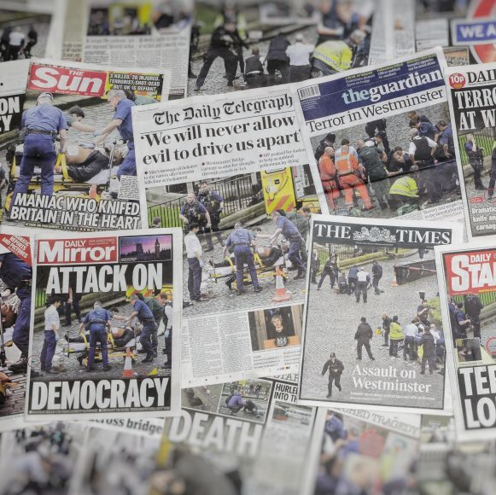
Terrorism and the Media

Slide 24
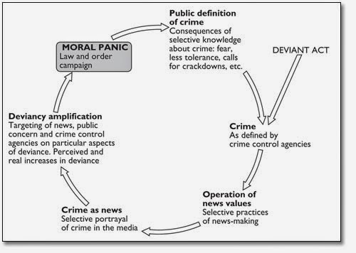
Moral Panics & Amplification
Stan Cohen (1972)
  “societies appear to be subject… to periods of moral panics. A condition, episode, person or group of persons emerge to become defined as a threat… its nature is presented in a stylised and stereotypical fashion by the mass media.”
“In these situations, the perceptions of danger can be influenced and amplified by the presence of the mass media, which, voluntarily (or not), contribute to the moral panic process… widespread climate concern and social alarm is linked to the presence of certain groups…” (Pece, 2018, p. 88).
Notes:
Mass media can contribute to the phenomenon of "moral panic" and "amplification" in society.
Moral Panic:
Definition: Moral panic refers to a collective and exaggerated reaction to a perceived social issue or threat that is often driven by the mass media.
Media Sensationalism: Mass media can sensationalize certain events or issues, particularly crimes, social behaviours, or incidents that are deemed deviant or unusual. This sensationalism can lead to the distortion of the true extent or nature of the issue.
Reinforcing Stereotypes: The media's focus on specific incidents or groups can reinforce existing stereotypes or stigmas associated with those issues or groups. This, in turn, can lead to heightened public anxiety or fear.
Amplification:
Definition: Amplification, in the context of moral panic, is the process by which the media magnifies the significance of an issue, making it appear more severe or widespread than it actually is.
Media Coverage: When the media heavily covers a particular event, behaviour, or group, it can give the impression that the issue is far more prevalent or dangerous than it is in reality.
Crisis Amplification: The constant reporting and discussion of an issue can create a sense of crisis, leading to calls for action, intervention, or policy changes, even if the issue itself may not warrant such a response.
Public Reaction: Amplified media coverage can lead to heightened public concern, anxiety, or fear regarding the issue, further contributing to moral panic.
How Mass Media Causes Moral Panic and Amplification:
Selectivity: Media outlets often select stories that are sensational, shocking, or fit into established narratives, as these tend to attract more viewers or readers. By highlighting these stories, the media can create an environment conducive to moral panic.
Repetition: The continuous reporting of an issue, along with frequent updates and discussions, can amplify its significance in the public's mind, even if the issue is relatively isolated or uncommon.
Expert Opinions: Media frequently invites experts or authorities to provide analysis and commentary on an issue. Their input can lend credibility to the perceived severity of the problem.
Emotional Appeals: Media often use emotional storytelling and imagery to engage the audience, evoking fear, outrage, or sympathy. This emotional appeal can intensify public reactions and lead to moral panic.
Mass media can contribute to moral panic and amplification by selectively focusing on sensational or deviant events, repetitively reporting on them, and using emotional and expert-driven narratives to engage the public. The consequences of moral panic can include hasty policy decisions, societal fear, and the stigmatization of specific groups or behaviors, which may not always be justified by the actual extent of the issue.

Slide 25
Relationship between Terrorism and the Media
Hoffman (2008) argues ‘’without the media’s coverage, the acts impact is arguably wasted, remaining narrowly confined to immediate victim(s) of the attack, rather than reaching the wider ‘target audience’ to whom the terrorists’ violence is actually aimed’’.
Notes:
The relationship between terrorism and the media is complex and multifaceted. It has evolved significantly with advancements in technology and media platforms.
key aspects of this relationship:
Media Coverage of Terrorism:
Media plays a critical role in disseminating information about terrorist acts. News organizations often report on terrorist incidents, their perpetrators, and their consequences.
The way media covers terrorism can influence public perception and understanding of the issue.
Sensationalism and Fear:
Sensationalist reporting can contribute to public fear and anxiety. Graphic or sensational coverage of terrorist incidents can heighten public concern.
Terrorism is often covered extensively, making it a prominent topic in the media.
Terrorist Propaganda and Recruitment:
Terrorist groups have used media, especially social media and online platforms, to disseminate their propaganda, recruit members, and spread their ideologies.
The internet has allowed terrorists to reach a global audience and radicalize individuals.
Counterterrorism Efforts:
Governments and counterterrorism agencies use the media to communicate security measures, disseminate warnings, and seek public cooperation in countering terrorism.
Framing and Agenda-Setting:
Media can frame terrorism in various ways, influencing public opinion and government policies. The media's choice of language and framing can shape how people perceive terrorism.
Crisis Communication:
Media serves as a primary means of communication during and after terrorist attacks. Governments, law enforcement, and emergency services use media to provide updates and guidance.
Public Awareness and Education:
Media coverage of terrorism can raise public awareness of security issues and encourage citizens to be vigilant.
Ethical Dilemmas:
Media outlets face ethical dilemmas when deciding how much coverage to give to terrorist incidents. Balancing the public's right to know with responsible reporting can be challenging.
Media and Negotiation:
Terrorists sometimes use media exposure as a bargaining tool, demanding attention and responses from governments.
Social Media and Online Extremism:
The internet and social media platforms have enabled terrorists to recruit, radicalize, and coordinate activities. This poses a significant challenge for online platforms and authorities.
Legislation and Regulation:
Governments have passed laws and regulations to combat the spread of terrorist content online. Internet companies have also taken steps to remove extremist content.
Research and Analysis:
Researchers and analysts use media sources to study terrorism, understand its patterns, and develop strategies for countering it.
The relationship between terrorism and the media is a delicate one, with both positive and negative consequences. While the media plays a crucial role in informing the public and holding governments accountable, it can also inadvertently amplify the effects of terrorism and contribute to public fear. Balancing the need for transparency and responsible reporting with national security concerns is an ongoing challenge.

Slide 26
Symbiosis between the media and terror
“As far as the presentation of efficient emergency response theme is concerned, the efficiency of the work of emergency teams was overemphasised. Many aspects of their negligence and lack of efficiency were unearthed and reported by the media during the proceedings of the inquiry commission constituted to examine preparedness and emergency response. Spencer 23 has called for more focus on non-dramatic but socially more desirable aspects during conflict reporting.”
M, Iqbal. (2015) 'The TV-Terrorism Relationship: Investigating the Symbiosis Notion', Strategic Studies, 35(2), pp. 89-112.
Notes:
Iqbal (2015) discusses the presentation of the theme related to the efficient emergency response in the media's coverage of a specific event, likely a terrorist attack.
Key points:
Efficient Emergency Response Theme: The passage refers to the theme or aspect of the media coverage that focuses on the efficiency and effectiveness of the emergency response by various teams, such as first responders, law enforcement, and medical personnel.
Overemphasis on Efficiency: It states that the media placed significant emphasis on portraying the emergency response teams as highly efficient and effective in their actions. In other words, the media highlighted the positive aspects of their response.
Negligence and Lack of Efficiency: However, the passage goes on to mention that, during the proceedings of an inquiry commission, it became evident that there were aspects of negligence and inefficiency in the response efforts. These shortcomings were not initially emphasized in the media coverage.
Media's Role in Reporting: The passage highlights that the media initially presented a more positive and efficient image of the emergency response teams but later, during the inquiry, reported on the issues of negligence and inefficiency that were uncovered.
Call for a Balanced Focus: The passage concludes by referencing Spencer, who has advocated for a more balanced approach in conflict reporting. This balanced approach would involve not only focusing on dramatic or sensational aspects but also giving attention to socially desirable aspects, such as the performance of emergency teams, especially when examining the aftermath of a conflict or crisis.
Iqbal suggests that the media initially emphasized the efficiency and effectiveness of emergency response teams but later reported on instances of negligence and lack of efficiency during the inquiry. This highlights the importance of balanced and socially responsible reporting, which encompasses both positive and negative aspects of such situations.

Slide 27
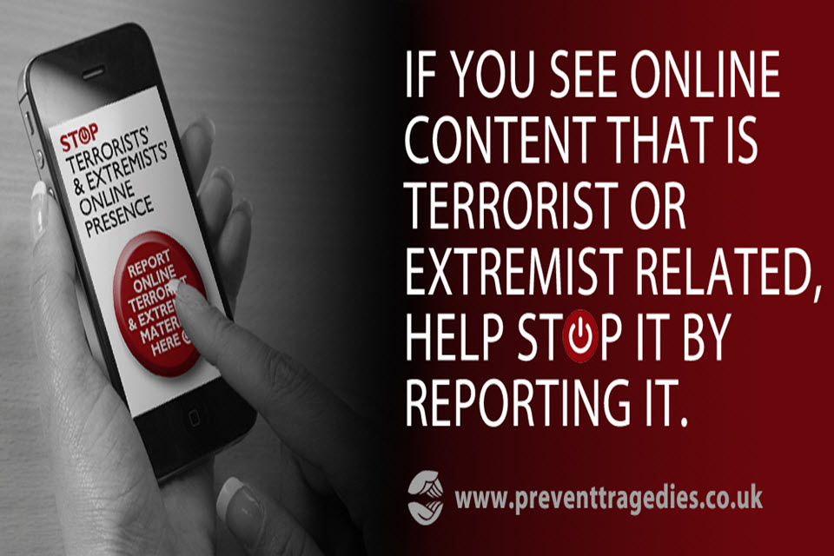
Conclusion
The media, and social media, are a huge factor in the effectiveness and reach of terrorism.
It is not only a means of enacting terrorism, but (arguably more importantly) is key in the spread of its propaganda, ideology and visibility.
Radicalisation through the media, particularly social media, is paramount to their continued success, and as such is an important avenue through which counter-terrorism must be conducted.

Slide 28

The Dilemma
For Governments to provide Safety and Security whilst protecting Human Rights…

Slide 29
Wilkinson (2007)
Spoke of the dangers of:
  Overreaction,
  Over reliance on military force
  Measures that involve curtailment of democracy,
  Abuses of Human rights and the Rule of law and the threat that these pose to democracy.
Notes:
Paul Wilkinson discusses the complex and challenging issues surrounding the response of liberal democratic states to acts of terrorism. One of the key topics he addressed is the tension between the imperative to combat terrorism and the need to protect and uphold human rights.
Balancing Security and Human Rights: Wilkinson delves into the delicate balance that liberal democratic states must strike between maintaining security and safeguarding human rights. He highlights the potential tension between counterterrorism measures, which often involve expanded state powers, and the protection of individual liberties and rights.
Civil Liberties and Due Process: The book examines how counterterrorism measures can impact civil liberties, such as freedom of expression, privacy, and due process. It discusses issues such as surveillance, detention without trial, and restrictions on free speech, which can raise concerns about violations of human rights.
State Response to Terrorism: Wilkinson analyzes the various responses that states may adopt when confronted with acts of terrorism. He discusses measures like emergency legislation, enhanced intelligence sharing, and international cooperation and evaluates their compatibility with human rights standards.
Judicial Oversight: The book considers the role of the judiciary in upholding human rights in the context of counterterrorism. It examines cases in which courts are called upon to assess the legality and proportionality of counterterrorism measures, including their impact on human rights.
International Legal Framework: Wilkinson also explores how international law, including human rights treaties, shapes the counterterrorism efforts of states. He assesses the implications of international human rights law on the actions of states when responding to terrorism.
The Impact on Democracy: The book discusses how the response to terrorism can affect the democratic character of a state. It considers how restrictions on civil liberties and the expansion of state powers can challenge the principles of liberal democracy.
Overall, Wilkinson's provides a comprehensive examination of the complex and multifaceted relationship between counterterrorism efforts and the protection of human rights in liberal democratic states. He highlights the challenges faced by governments in striking the right balance between security imperatives and the preservation of individual liberties and human rights.

Slide 30
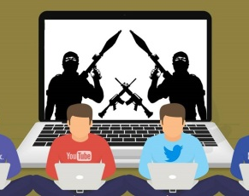
Terrorism and Cybercrime
Week 5 – Terrorism and the Internet

Slide 31

Challenges to responding to terrorist's use of the internet
Global and anonymous nature.
No single/global counter terror approach – what is classed as extremist content in the UK may be protected by America’s free speech laws.
Content removal – fuelling the fire.
Playing with algorithms.
VPNs and TOR.
Notes:
Responding to terrorists' use of the internet poses several significant challenges, given the vast and evolving online landscape.
Volume and Accessibility: The sheer volume of online content makes it challenging to monitor and detect extremist materials. Additionally, the ease of access to the internet allows terrorists to disseminate propaganda widely.
Anonymity and Encryption: Terrorists often use encryption tools and anonymization techniques to protect their identities and communication, making it difficult for law enforcement and intelligence agencies to trace their activities. For example, apps like Telegram provide end-to-end encryption, making it challenging to intercept messages.
Diverse Platforms: Extremist content can be found on a wide range of online platforms, from social media to file-sharing sites. This diversity makes it difficult to regulate and control content effectively.
Online Recruitment: Terrorists use the internet for recruitment, reaching a global audience. They exploit social media to identify and engage potential recruits. For example, ISIS was known for using platforms like Twitter and Facebook to recruit fighters.
Self-Radicalization: Individuals can self-radicalize online without direct contact with terrorist groups. For example, the Boston Marathon bombers were self-radicalized by watching extremist videos on the internet.
Dark Web: Some terrorist activities occur on the dark web, which is not indexed by conventional search engines. The dark web provides anonymity for illicit activities, including terrorism-related transactions and information sharing.
International Jurisdiction: The global nature of the internet and online platforms can make it challenging to coordinate international efforts to combat online terrorism. Terrorists often exploit jurisdictional gaps.
Freedom of Speech and Privacy Concerns: Balancing efforts to combat online terrorism with protecting freedom of speech and privacy rights is a significant challenge. Governments and tech companies must strike a delicate balance.
Rapid Evolution: Terrorists adapt quickly to countermeasures. As platforms and authorities respond, terrorists shift their tactics, such as moving to less-regulated platforms or using new communication methods.
Examples:
Anwar al-Awlaki, an American-born cleric affiliated with al-Qaeda, used the internet extensively to inspire and guide individuals to commit acts of terrorism. His online sermons influenced multiple attackers, including the 2009 Fort Hood shooter, Nidal Hasan.
Brento Tarrant - the Christchurch mosque shooter live-streamed his attack on Facebook in 2019. The video quickly spread across the internet, making it challenging to remove all copies and iterations.
Online forums and chat groups have been used for years by extremist groups like ISIS to communicate and share propaganda. The tech-savvy nature of these groups makes it challenging to infiltrate and monitor their activities.
Addressing these challenges requires international cooperation, technological innovations, and policies that balance security with fundamental rights. Counterterrorism efforts should involve collaborations between governments, tech companies, and civil society to develop effective solutions.

Slide 32
Examples of terrorist use of the internet
Optional TASK
Choose a terrorist organisation (Al Qaeda, The Islamic State, National Action, The Irish Republican Army, Al Shabaab – to name a few) or a lone actor attack.
Research how that group/actor utilises the internet for the purpose of:
-Disseminating Propaganda,
-Recruitment,
-Radicalisation,
-Planning,
-Training.
What forms of the internet do they use?

Slide 33

Terrorism Recap
Break

Slide 34
Assessment 1
Word Count: 3750 +/-10%. Academic Essay
Submission Date: Friday 21st November 2025 23:59hrs
Feedback Date: Thursday 18th December 2025 09:00hrs

Slide 35
Assessment 1
From Hierarchal Organisations to Self Initiated Actors: The evolution of terrorist methodologies and Counter Terrorism responses Critically evaluate the transformation of terrorist methodologies from organised, hierarchical, high sophistication operations towards the contemporary prevalence of low sophistication, self-initiated terrorism. Select two distinct periods – one depicting organised, complex methodologies (E.G. Provisional IRA, Hezbollah 1980’s – 90’s, al- Qa’ida pre 9/11), and one depicting low sophistication, self-initiated activity (E.G. Daesh inspired lone actors post 2014, XRW etc). Analyse how Counter Terrorism approaches have adapted (or failed to adapt) to this methodological shift to low cost self initiated attacks. Assess how current UK CT legislation addresses the CT threat, consider lessons for UK security and propose any evidence based improvements.
Notes:
This first assessment asks you to critically evaluate how terrorist methodologies have evolved over time, and how counter-terrorism responses have kept up — or in some cases, failed to keep up.
Identify the topic.
Identify the directive words
Identify the limitations
You need to choose two distinct time periods: one where terrorism was mainly organised, hierarchical, and complex, for example the Provisional IRA, Hezbollah in the 1980s–90s, or al-Qa’ida before 9/11. Then compare that with a more recent period characterised by low-sophistication, self-initiated, or lone-actor terrorism, for example Daesh-inspired attacks after 2014 or right-wing extremism.
Do not just describe the methods — you need to critically evaluate them. That means asking what worked, what did not, and why. What were the strengths and weaknesses of these different methodologies?
Next, analyse how counter-terrorism strategies adapted, or failed to adapt, to this shift. For instance, did intelligence and policing methods change quickly enough? Were there gaps that attackers exploited?
You will also need to assess how current UK counter-terrorism legislation addresses today’s threat. Consider whether it is effective against low-cost, self-initiated attacks, and identify where the shortcomings may be.
Finally, propose improvements — but make sure these are evidence-based. That means grounding your recommendations in research, case studies, or credible policy analysis, rather than just personal opinion.
In summary, the assignment is about tracing the shift from complex, organised terrorism to simpler, self-initiated attacks, and then evaluating whether our counter-terrorism strategies and laws have kept pace. This is a Level 7 piece of work, so depth of analysis and critical engagement with evidence are absolutely key

