Slide 1



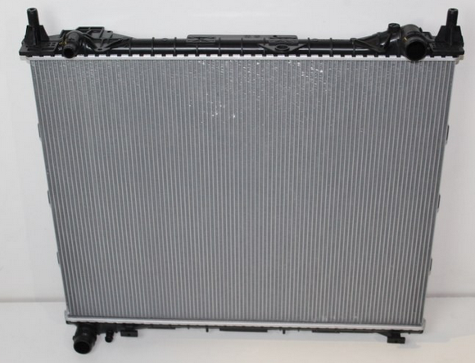
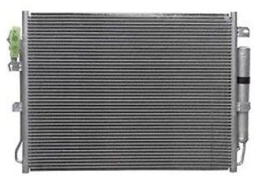

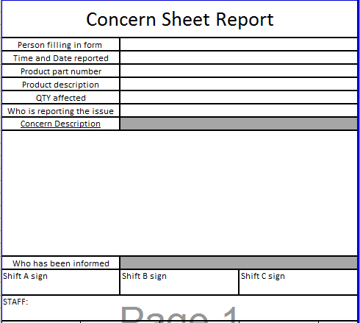
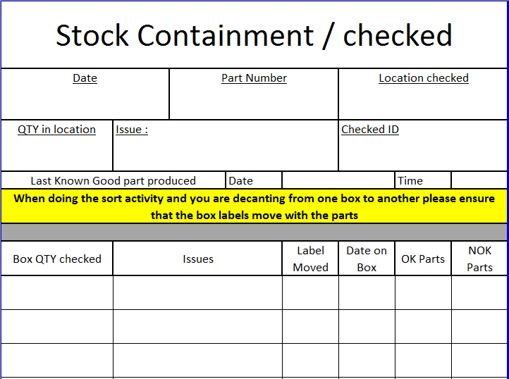
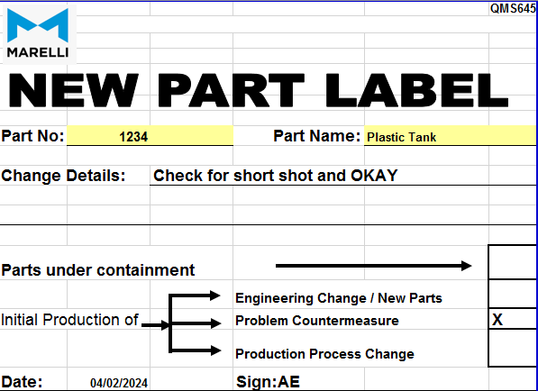
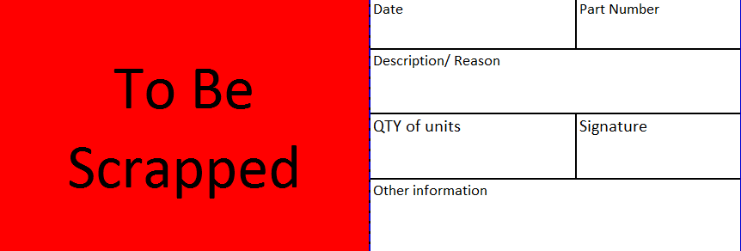
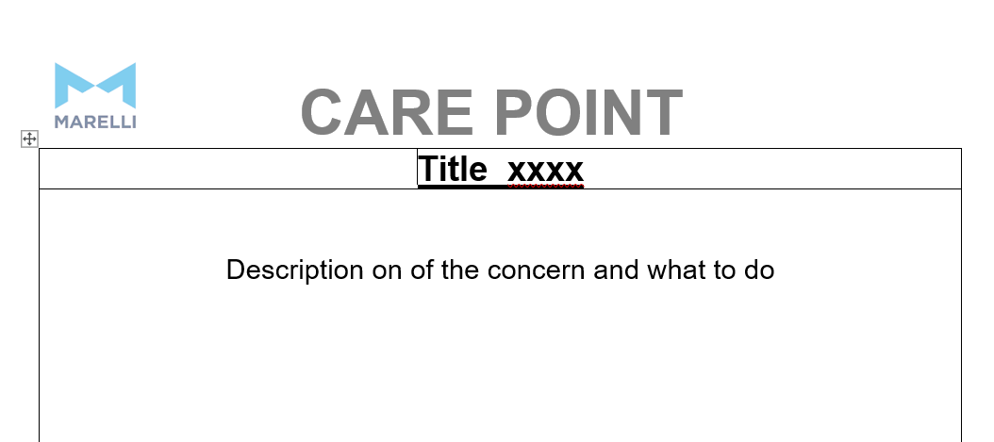
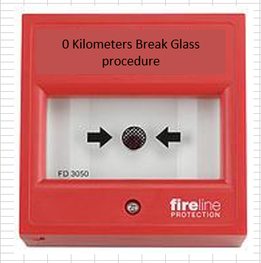
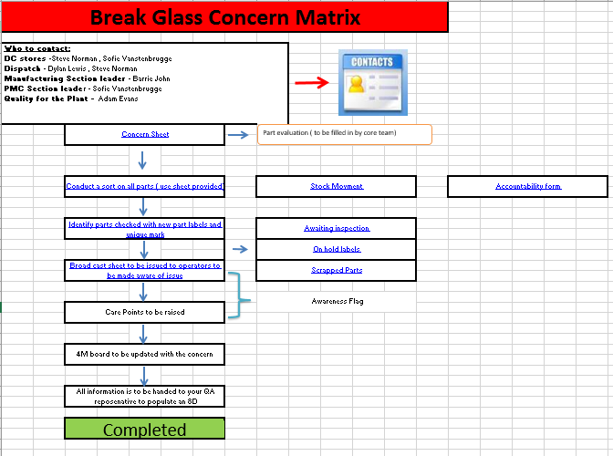

Reactive Quality Improvements Break Glass
Adam Grant Evans
Andrew Thorn
School of Engineering, Manufacturing & Logistics
BENG2-PT Manufacturing Systems Engineering
Introduction
Marelli Llanelli (MLUK) is part of the 9th largest automotive supplier in the world. It is located in South Wales and employ’s 150 direct workers and 50 indirect workers. It manufactures is heat exchange products in the form of radiators and condensers
for some of the leading car manufactures in the world.
Analysis
Analyzing the data, showed that the quality concern which were witnessed were not Poka Yoke failures but, Known concerns which were not contained correctly at MLUK when they were discovered. This was a result of a recent restructuring program at MLUK where containment is conducted by manufacturing where previously it was done by the quality department.
This contains the following :-
Contact information – Email and phone numbers of different personal within different departments.
A concern report sheet – Where full details of the concern are recorded and is used as a information sheet when the containment is live.
Part containment sheet – Detailed information of each area which has been sorted including number of OK and NOK parts
Labeling – Selection of different labels to clearly define each stage of the containment activity
Broad cast sheets and care point templates – Used for communication and awareness
Completed report – A check list to ensure everything has been completed as this is signed by management.
Using this ensures the end customer is safe and all product is contained correctly
Next Steps
Looking at ways to adopted this procedure into other departs for other scenarios, for example engineering with failures on commonly used equipment.
References
Benbow, A. Z. (2017). Introduction to 8D problem solving . Milwaukee: ASQ.
complianceonline. (2024, april 24). 7 powerful problem solving tools . Retrieved from www.complianceonline.com: https://www.complianceonline.com/resources/7-powerful-problem-solving-root-cause-analysis-tools.html
Break Glass
Investigation showed that although there were process in place for reporting defects there wasn’t a structure to follow to contain the defects.
Using the 8D methodology the first three D’s is all about Recording information and containment to ensure the end customer is safe within 24 hours.
D1 – select an appropriate team D2 – Formulate the problem definition D3 – Activate interim containment
Utilizing this I created an interactive procedure which is user friendly and can be used and followed by any skill level.
Using the image of a fire alarm as when faced with a fire you break the glass to start the process of its containment.
Break Glass Contents
The break glass provides the user with an interactive concern matrix
Quality in the automotive industry is taken very seriously as a quality defective part could result in recalls with large warranty campaigns damaging the reputation of the supply and a large on cost, But worst of all there is potential of injury to the end user or death.
As a result of this quality concern are one of the main drivers from the customer and as a direct result it an internal key performance indicators at MLUK, being monitored and reported at management level.
From this internal reporting a trend has been seen where the number of quality concerns has risen since 2016 where 0 PPM was reported to 2023 35 PPM was reported.
School of Engineering

