Slide 1
Women and Children
Roman Britain for Celtic Studies
Natalie Boyd

Slide 2
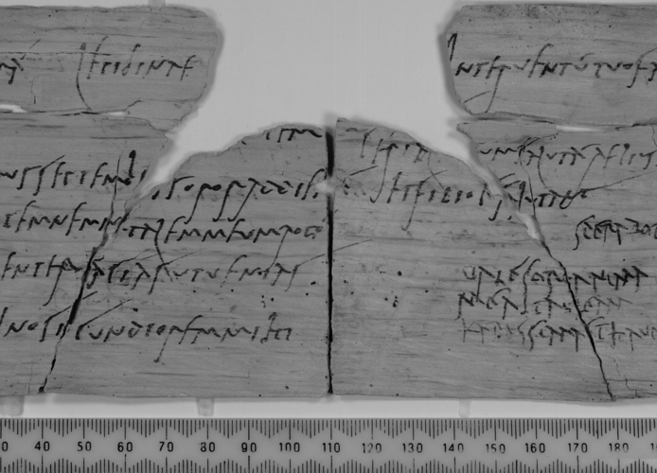
Vindolanda Tablet 291
Wood and ink
Found in 1985, now in the British Museum
Letter to Sulpichia Lepidina from Claudia Severa, wife of Aelius Brocchus, inviting her to Severa’s birthday.
Lepidina’s husband was the prefect of the 9th cohort of Batavians.
Includes greetings ti Cerialis from herself and greetings from her husband.
The way the name Claudia is written suggests that Severa’s family acquired citizenship in the reign of Claudius – a generation before Cerialis and his wife.

Slide 3
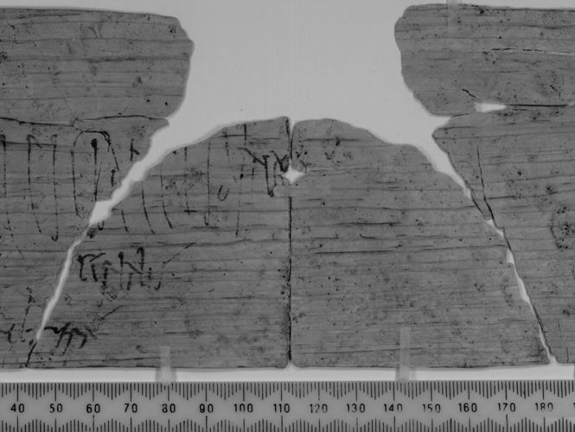
Indicates that women were living in the camps with the soldiers and not just outside.
Cerialis and Lepidina are living in the praetorium at Vindolanda at the beginning of the C2nd AD.
Birley notes that the archaeological evidence indicates there were children living with them too.
Severa dictated her letters to a secretary, but wrote the affectionate endings herself.
The tablet has been carefully studied and peculiarities in the spellings of words, appearance of letters, etc., is available.

Slide 4

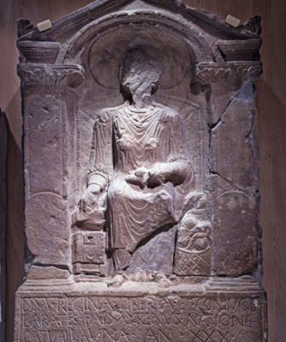
Tombstone of Regina
Mid to late C2nd AD
From the cemetery outside the Roman fort of Arbeia (South Shields)
Shows a woman, in her finery, with a spindle on her lap.
The inscription tells us she is called Regina, a freedwoman and wife of Barates from Palmyra (Syria) and member of the Catuvellauni tribe. She died at the age of 30.
Catuvellauni were from the Verulamium (St. Albans) area.
She had been enslaved and bought by a Syrian man, possibly a merchant. At some point he freed her and regarded her as his wife, although as neither were Roman citizens, their marriage would not have been recognized under Roman Law.

Slide 5
Gravestone appears to be the work of a Palmyrene craftsman.
Suggestion of possible Syrian community in South Shields at this time.
She may have been born into slavery, sold by her parents, she may have been an orphan or foundling.
Regina is Latin for ‘queen’, so this name may have been a jovial nickname for a slave. It may also have been an intimate nickname that Barates used for her.
While her face and hair are lost, she is seen wearing a Gallic coat over a tunic – fashionable in Britain and Gaul.
She also wears a torc, which may mark her British identity.
Torcs are regarded as typically Celtic and, while they were worn during the Roman occupation, they were designed in new styles and materials.
The lament has led to this tombstone being regarded as a love story, but it is quite a standard text and reinforces Barates’ identity rather than Regina’s.

Slide 6
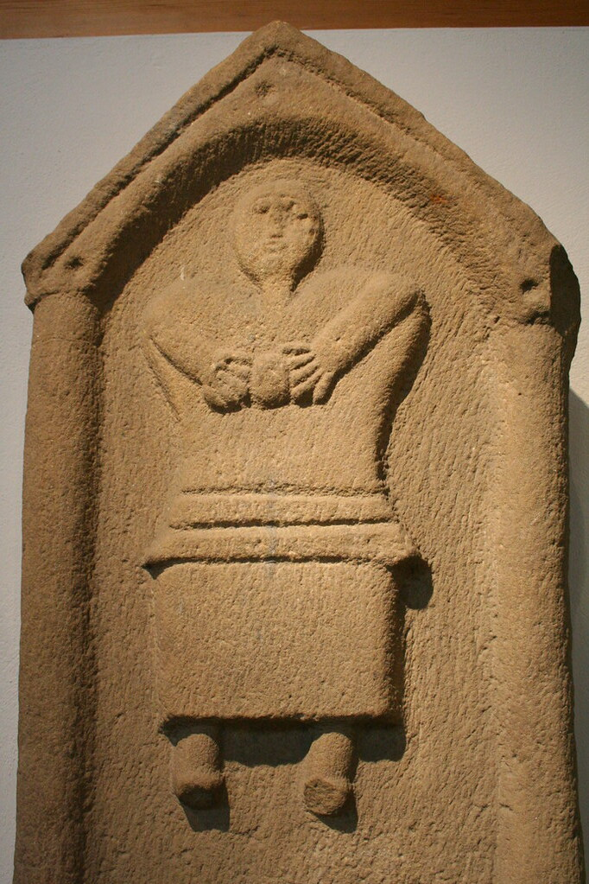
Vellibia Ertola Gravestone
This gravestone was commissioned for Ertola ‘properly called Vellibia’ by her father, Sudrenus.
She was four years and 60 days old.
Dates to the late 3rd of early 4th century AD.
From the town of Corbridge, near Hadrian’s wall.
A large indigenous population apparent here – more Celtic stone heads than any other site in northern Britain.
The girl is clutching what has been interpreted as a ball.
The names Sudrenus and Ertola are Celtic, as is the style of the decoration of the gravestone.

Slide 7
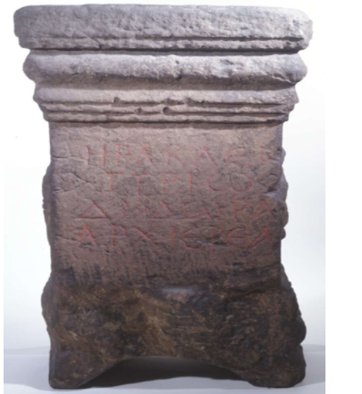
Diodora the Priestess
Diodora is the only priestess known by name in Roman Britain
She was a priestess in Corbridge, 2.5 miles south of Hadrian’s wall, on the Tyne
Her name, and the inscription on the altar suggests she came from the eastern part of the Empire, where Greek was predominant.
The dedication is to Herakles of Tyre, in Syria.
One of several eastern religions evidenced at Corbridge, possibly brought over by soldiers or merchants. Maybe by those who had served in the Parthian Wars of the 160s AD.
Earliest temples at Corbridge date to this period, mid-late C2nd, when the fort here became a supply base for the northern frontier.

Slide 8
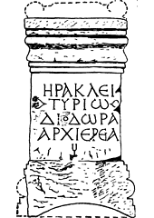
It is not known if Diodora was a career priestess, or carried the title as an honorary one.
We don’t know what brought Diodora to Corbridge.
Priests and Priestesses were sometimes elected, or sometimes inherited their roles. Sometimes they bought their offices.
On the whole, women seem to have had a limited role in religious life (with a few exceptions such as the Vestal Virgins).
Not allowed to butcher animals or handle undiluted wine. Could not invoke community prayers.
Greek/eastern religions were different. Priestesses had key public responsibilities and were often given honours and duties on par with their male counterparts.
Appeal of these religions with more cope for women to participate – including Christianity.

Slide 9
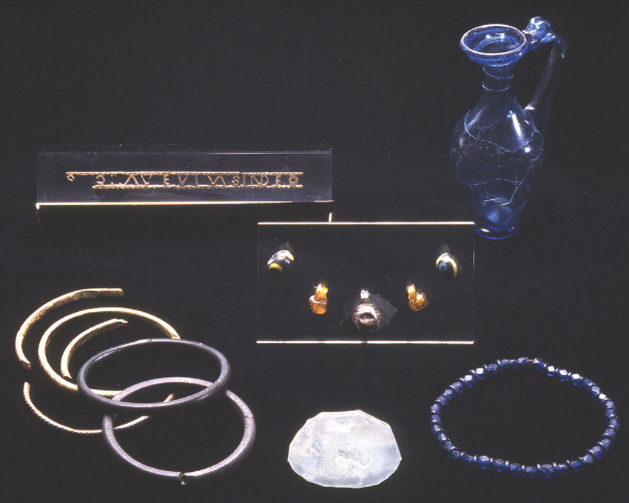
The Ivory Bangle Lady
Skeleton found in 1901, near Sycamore Terrace in York.
The grave goods indicate this was a high status person.
She dates to the second half of the C4th AD.
Grave was oriented north-south.
On display in the Yorkshire Museum.

Slide 10
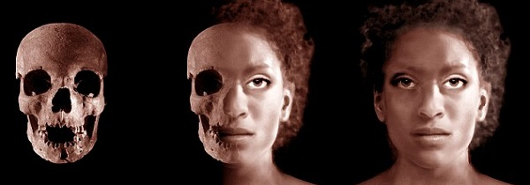
The University of Reading analysed the skull and the evidence from the grave site.
She was aged between 18 and 23
She was between 152 and 160cm tall
She had North African ancestry
Isotope analysis indicates she grew up in the west of Britain or in coastal areas of Western Europe and the Mediterranean

Slide 11
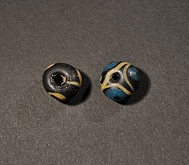
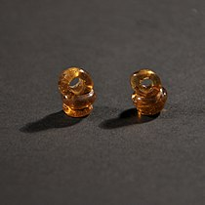
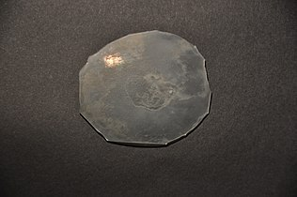
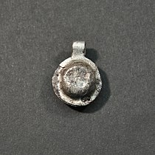
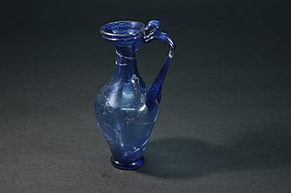
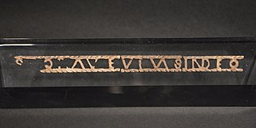
She was buried wearing ivory and jet bangles
Blue glass beads
Silver and bronze pendants
Two yellow glass earrings
The grave goods also included:
A small, round, glass mirror
A dark blue glass bottle
An openwork ivory or bone inscription plaque which reads ‘SOROR AVE VIVAS IN DEO’, or ‘Hail sister, may you live in God’

Slide 12
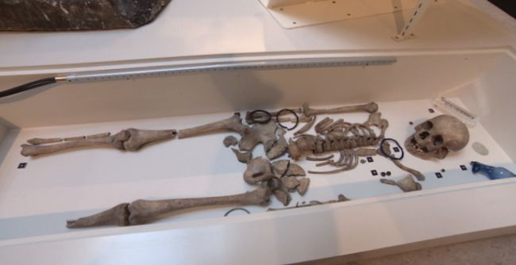
Reception of the Ivory Bangle Lady
She was the focus of a Heritage Sandbox project in 2012.
Immediately afterwards, debate about historic immigration and discussions of her racial identity.
Online Daily Mail article.
2019 Emily Hanscam article comparing to 2017 Mary Beard argument.
2020 Yorkshire Museum blog post for Black History Month – alt right attacks.
Olusoga’s 2017 book Black and British, BBC and Olusoga short film, Vogue’s 7 remarkable women who shaped British History, article in the Guardian, York Press Object of the week in 2020, House of Commons speech in 2020 on the history curriculum.

Slide 13
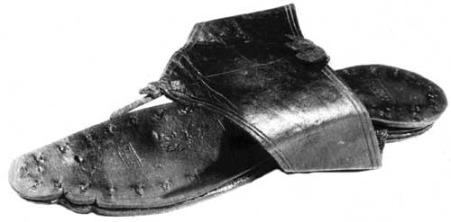
Lucius Aebutius Thales Sandal
This sandal was found at Vindolanda.
Beautifully decorated and includes the stamp of the maker.
Owned by a wealthy woman who could afford to discard rather than repair when the toe post snapped.
A house shoe – worn on bare feet or over a slotted sock.

Slide 14
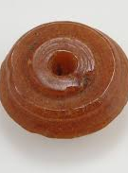
Spindle Whorls
In Roman Britain, spinning wool was a job for the women – of all statuses.
Not always just to provide fabric for their household, but also for the soldiers of nearby forts, especially in the north of the country where there were thousands of soldiers at Hadrian’s Wall.
The quality of British wool was highly prized, so there was a large export trade in blankets and cloaks.
Wooden spindles rarely survive, but spindle whorls do.
They have been found made of stone, bone, jet, lead, clay. This amber whorl was found at Old Penrith on the road to Carlisle.

Slide 15
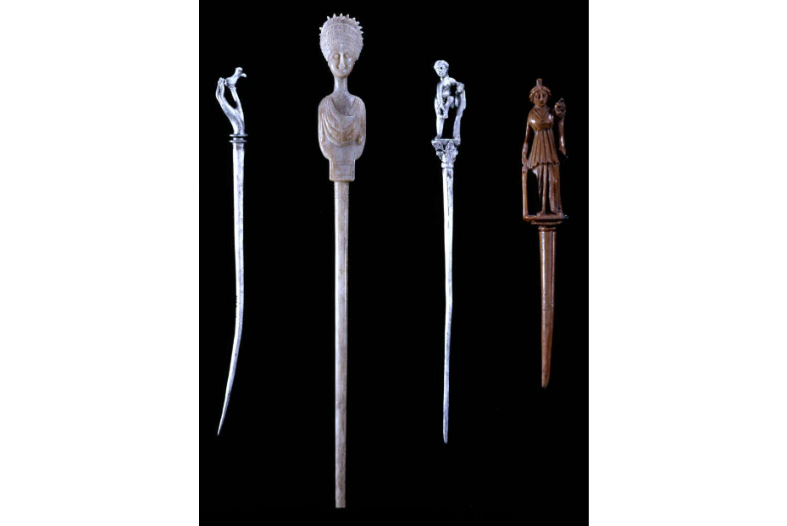
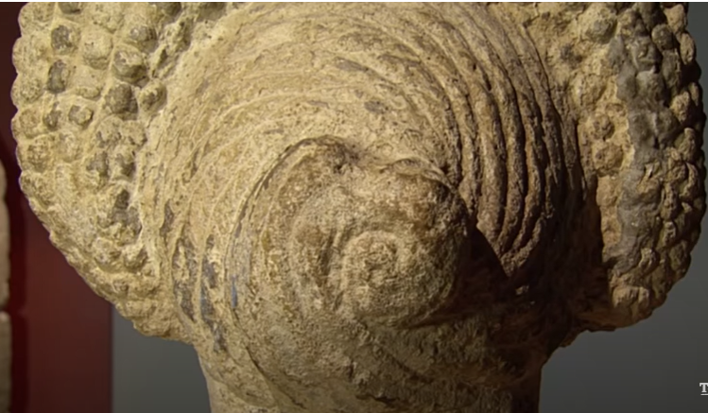
Hairstyles
Numerous hairpins have been found across Britain made from a number of different materials; e.g. bone, jet, silver, bronze.
There are some rare examples of hair or hairpieces.
Statuary gives us an idea of the elaborate hairstyles the women of Roman Britain were wearing.

Slide 16
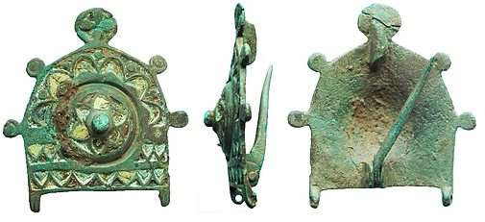
Cosmetics
Women, in particular the elite, used cosmetics as part of their personal care routine and to express their identities.
Cosmetics were shipped across the empire and often included expensive materials.
This chatelaine brooch would have had small toilette and cosmetic implements attached.

Slide 17
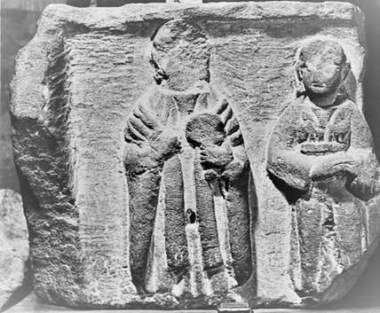
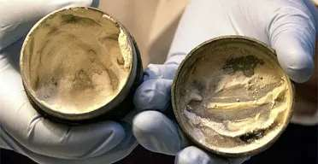
Tombstone in Grosvenor Museum, Cheshire.
Shows a woman holding a mirror and a maid carrying a casket of toiletry items.
As with the Ivory Bangle Lady, often small bottles and containers found that would have contained perfumes, oils, cosmetics and unguents.
Referred to as ‘mundus muliebries’ or items of the ‘woman’s world’.
Saffron from Asia was used as an eyeliner or shadow.
Cerussa gave a white complexion.
Aegean ochre was often used for rouge.
Face cream was made of animal fat mixed with starch and tin oxide.

Slide 18
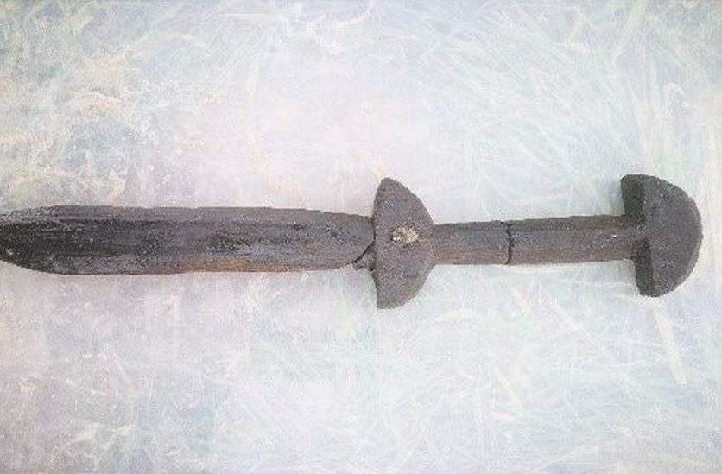
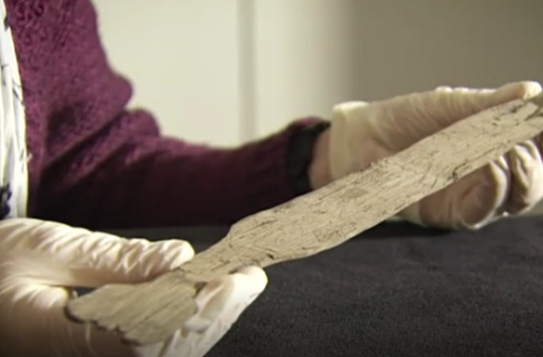
Toys at Vindolanda
Two wooden toy swords have been found at Vndolanda.
https://www.vindolanda.com/toy-sword

Slide 19
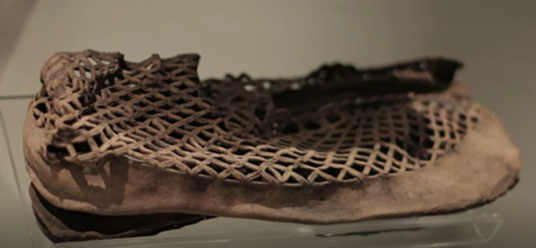
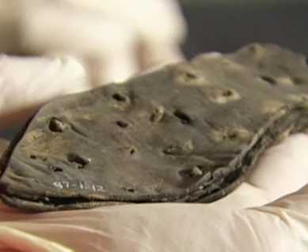
Children’s shoes
The shoe of a child was also found at Vindolanda.
Fits in the hand, so likely for a toddler or young child.

Slide 20
Summary
A wide range of evidence for women in Roman Britain.
Harder to spot the children in the record.
Indications of people living in Britain from all over the empire.
Lots of variation in status and wealth.
Evidence of indigenous/pre-Roman beliefs continuing.
Materials from all over the empire showing the trade links Britain had in this period.

Slide 21
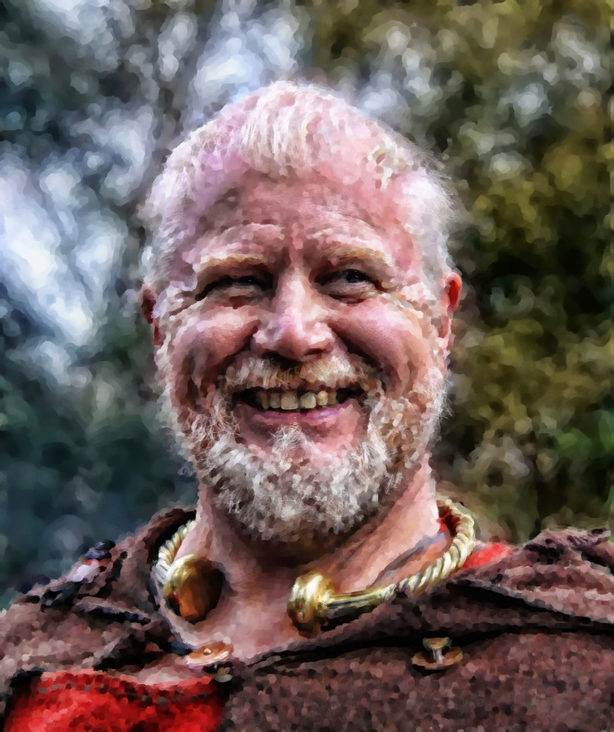
Torcs
In Celtic cultures torc were a common form of jewellery.
Made of bronze, copper, silver and gold.
Were not just beautiful, these were indicators of status and may have been regarded as having spiritual properties.
Depictions of warriors and gods wearing torcs in ancient art.
Many have been found in pits, suggesting a votive offering, safekeeping, or part of the trend for hordes.
Some weigh over a kilo/2.2lbs.
Portable wealth.

Slide 22
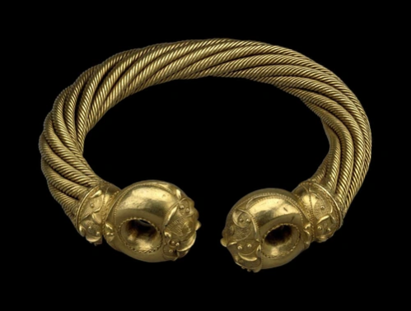
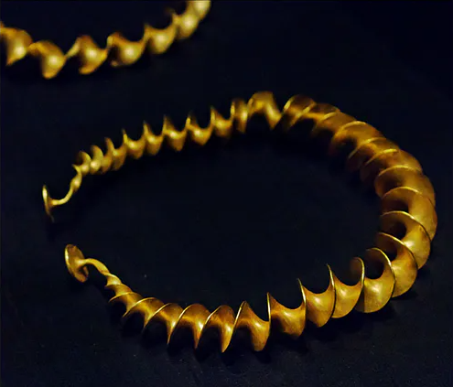
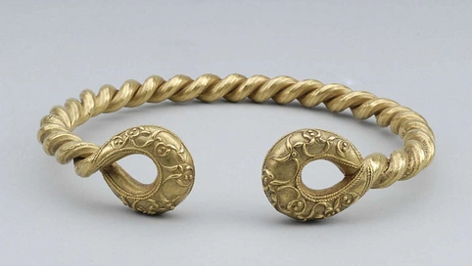
Examples of British Iron Age torcs
Snettisham Great Torc
Stirling twisted torc
Belstead Brook Torc

Slide 23
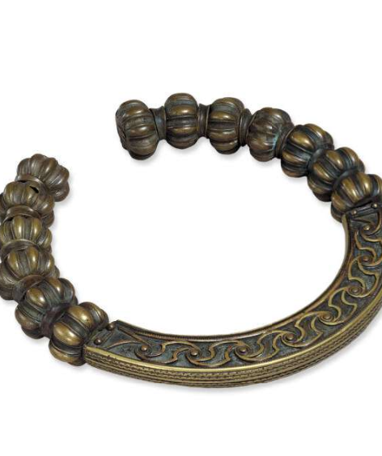
Lochar Moss Torc
Found at Lochar Moss in Scotland in 1853
Copper Alloy
Cast
The torc had been dismantled and placed inside a bronze bowl, in turn inside a bag.
A type only found in northern England and Scotland.
Appears to represent a distinctive style developed after the Roman Conquest of southern Britain.

Slide 24
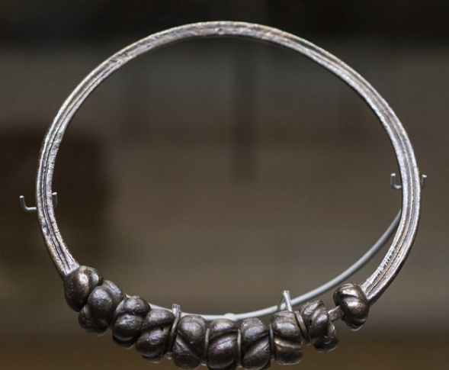
Lambay Island torc
Cast bronze beaded torc.
Found in a burial on Lambay Island, off the east coast of Ireland, near Dublin.
Noted as a Hunter Type A beaded torc of Romano-British manufacture.
Dates to the 2nd half of the C1st AD.
In the National Museum of Ireland.

