Slide 1
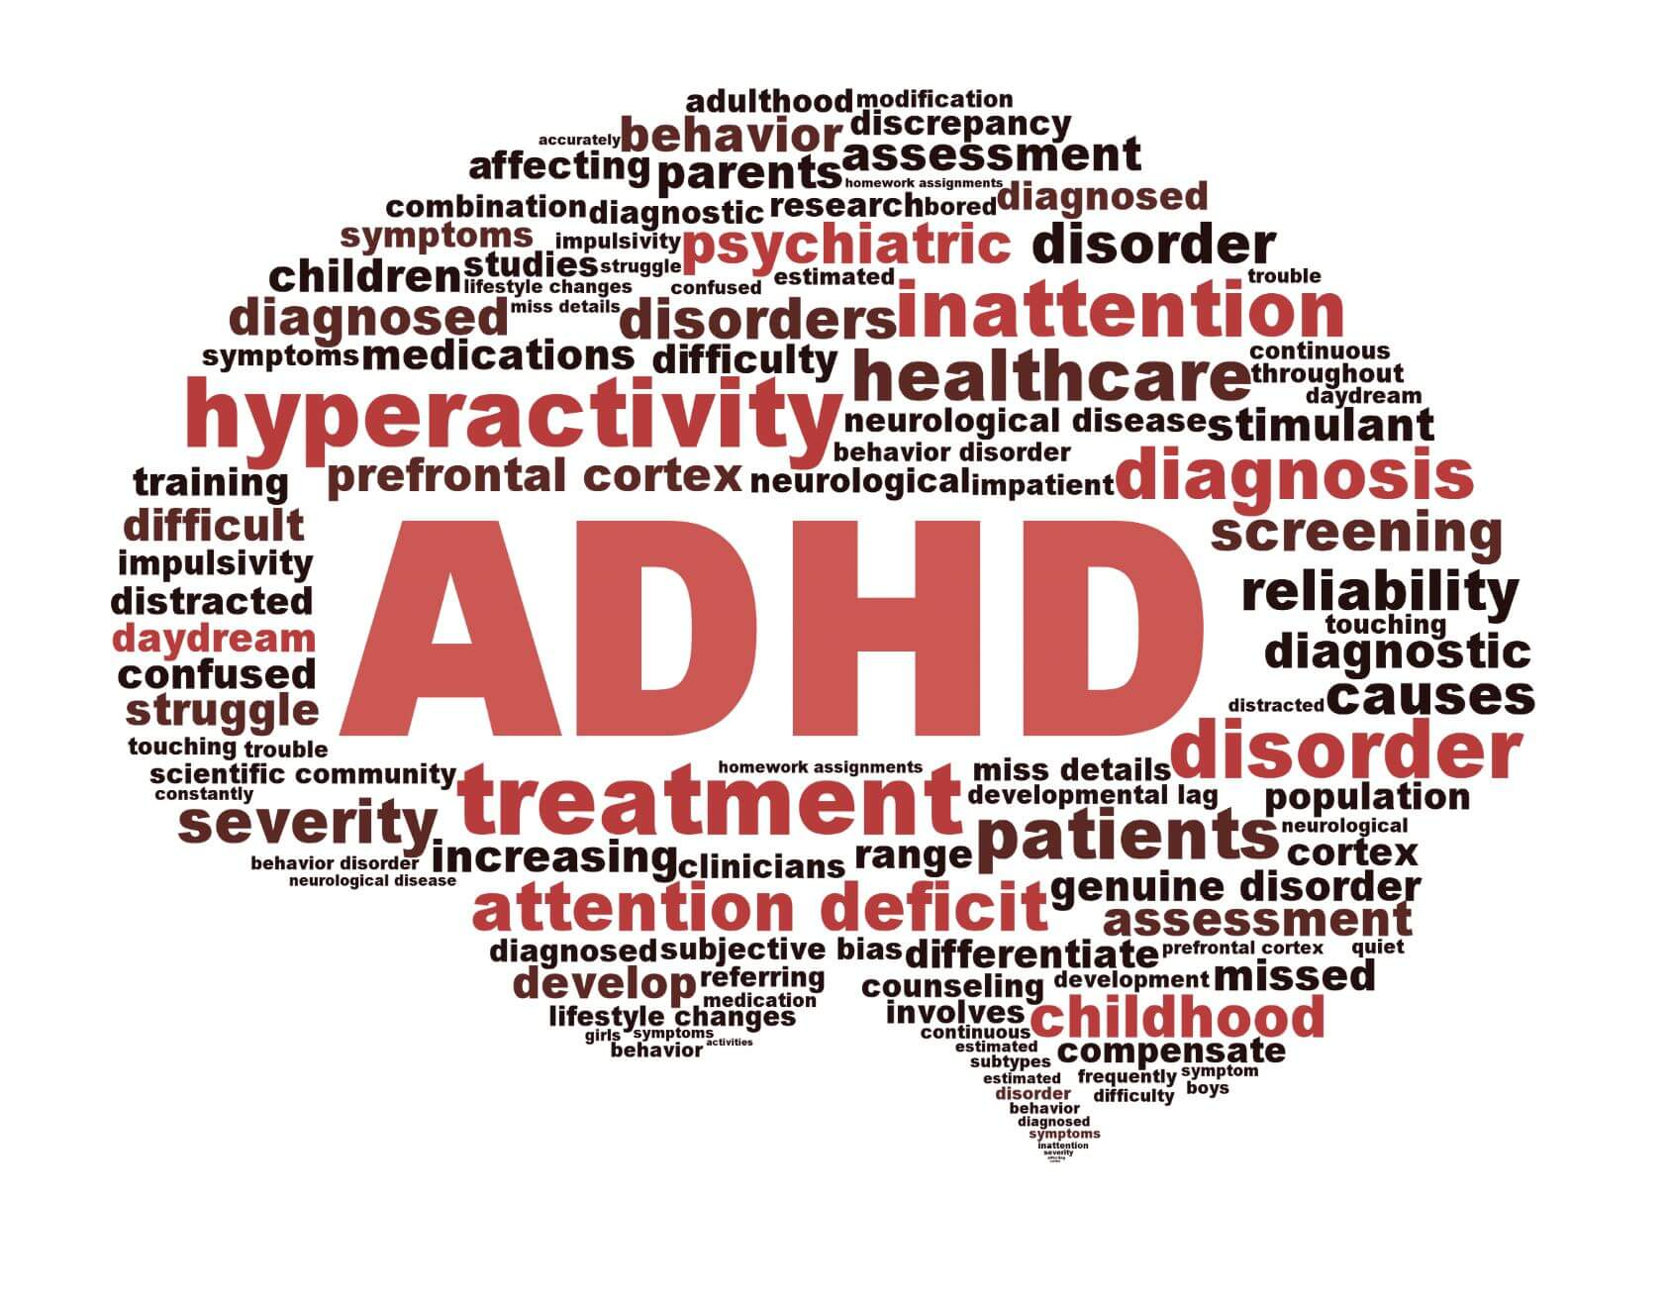
BMHP6029_BIRM –
Component 1
Poster
Student Name: Shabnam khan
Student Number: 2312156
Lecturer: Kennedy Obohwemu
(Advanced functional medicine, 2025).

Slide 2
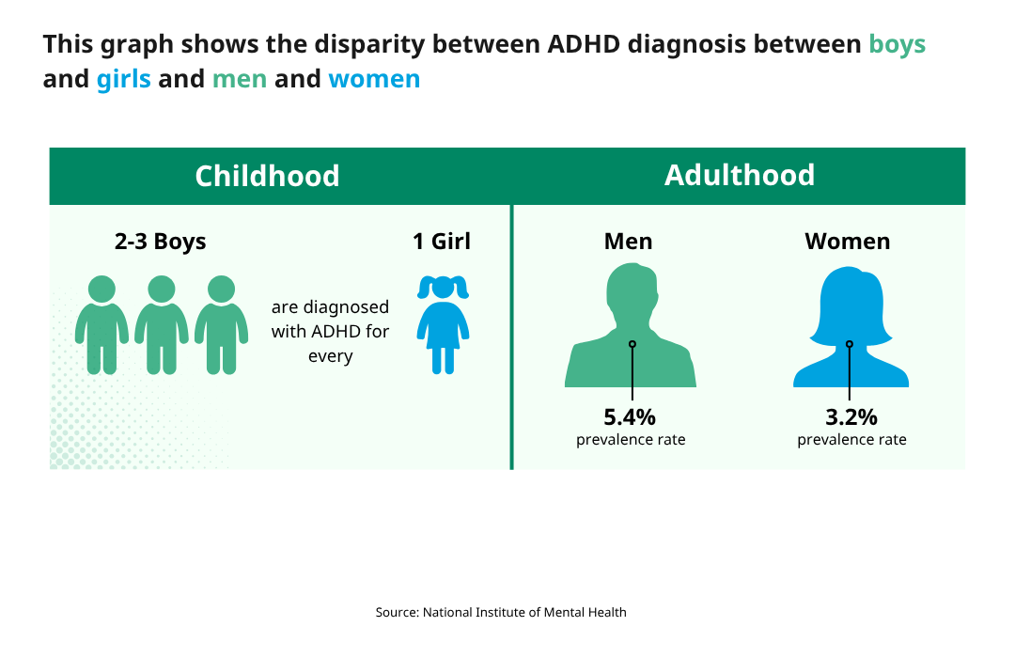
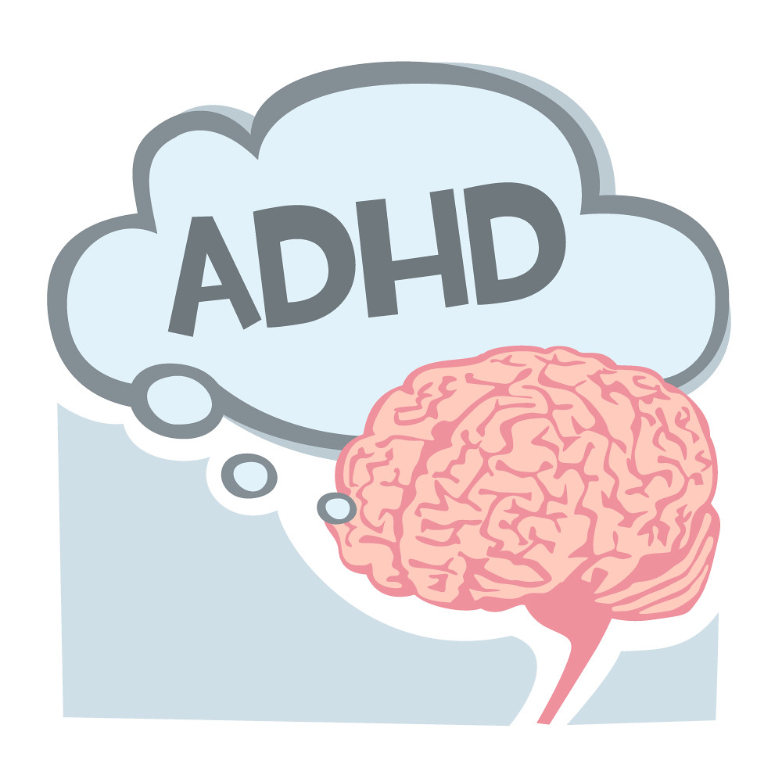
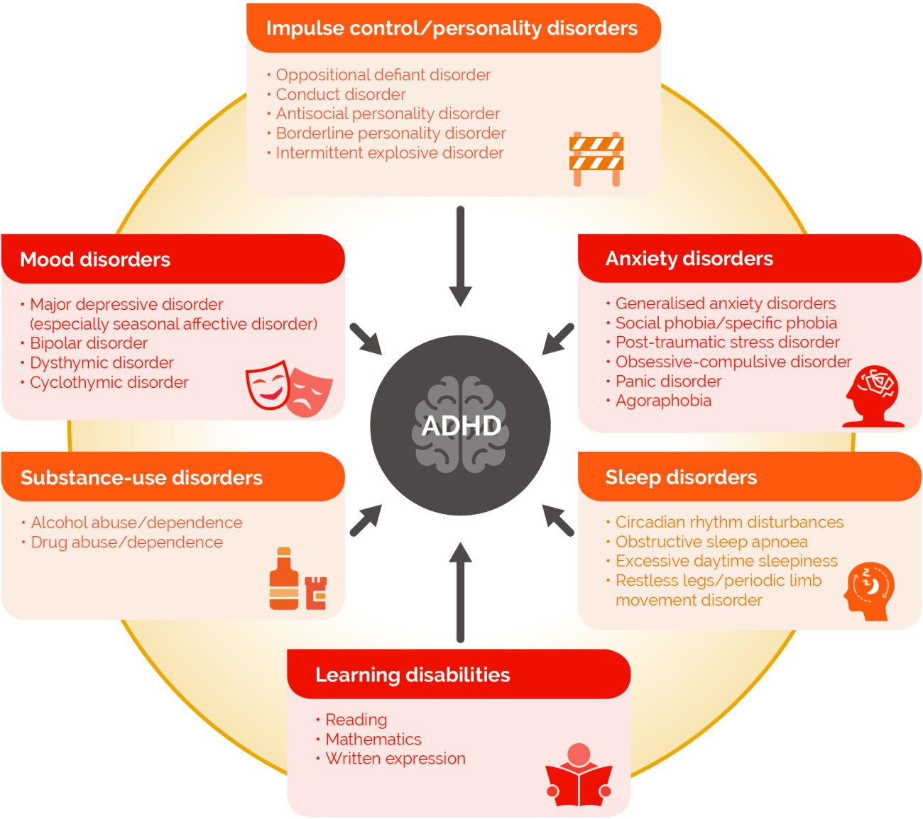
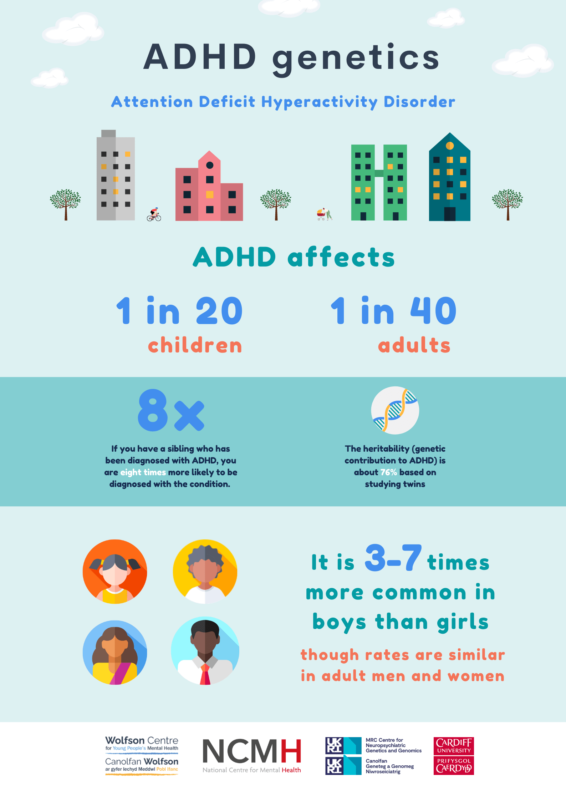
Attention deficit Hyperactivity Disorder (ADHD)
1. Introduction
ADHD: A mental, behavioural, or neurodevelopmental disorder (Mental health act, 2007).
ICD11 Chapter 6 code 6A05
9. Social, Cultural and political factors
Higher rates of ADHD diagnoses in the UK are associated with social poverty, indicating that socioeconomic considerations influence access to treatment (Hicks, 2023).
4. Historical evolution
1990s: There were only 40 children in the whole of the UK on medical treatment for ADHD.
2008: First UK guidelines released NICE.
2013: Quality Standard on ADHD.
2018:ADHD diagnosis and management was superseded by the updated recommendations for adults, children and adolescents (NICE, 2018).
7. Causes
Research indicates that ADHD frequently runs in families, indicating that genetic factors play a significant role in the disorder. Critics warn, meanwhile, that focusing only on genetics can ignore social and environmental factors, such as stress or alcohol (Thapar, et al., 2013).
2. Classification
There are two systems of classifications. One is DSM5 and the other is ICD11. For this poster, ICD11 will be used (ICD-11, 2025).
10. Reccommendations
Support from multiple agencies, such as mental health services, employers, and schools (Asherson, et al., 2022).
Plan for the transition for youth transferring from childhood to adult ADHD services (Smith, et al., 2024).
(Qbtech, 2025).
3. Symptoms
ongoing pattern of hyperactivity-impulsivity and/or inattention (WHO, 2023).
6. Treatment and care
2000s, Behavioral therapy and medication.
2008: The first recommendations for diagnosing and treating ADHD.
2010s: Adult ADHD diagnosis and treatment grow.
2018: multi-agency support highlighted.
2020: Wait times cut.
2025: Digital therapy and non-stimulant treatment (NICE, 2025).
5. Statistics
2025: 2.49 million people estimated to have ADHD in UK.
741,000 of them aged between ages of 5 and 24.
2000 - 2018, percentage of males aged 10 to 16 diagnosed with ADHD rose from 1.4% to 3.5%.
In recent years, the number of prescriptions for ADHD drugs has more than doubled.
In March 2025, over 549,000 people in England were waiting to be assessed for ADHD (NHS, 2025)
(ADHD institute, 2025).
Adults can enhance their coping mechanisms, time management, and organisation abilities by undergoing Cognitive Behavioural Therapy (CBT).
8. Current Policy
With the introduction of laws like the Mental Health Act 1983, amended in 2007, there has been a greater recognition of ADHD as a legitimate mental health condition, encouraging more evidence-based interventions like stimulant medication and behavioral therapy (Mental Health Act, 1983).
UK government set up the NHS England ADHD Taskforce in 2024 (NHS, 2025).
11. Support services
Birmingham NHS phone line for ADHD services: 0121 466 3425 (NHS, 2025).
(Cardiff University, 2022).

Slide 3
References
ADHD institute, (2025) What comorbid psychiatric disorders are associated with ADHD? Available at: https://adhd-institute.com/burden-of-adhd (Accessed 26 Octiober, 2025).
Advanced functional medicine, (2025) Approaching ADHD the Functional Medicine way. Available at: https://advancedfunctionalmedicine.com.au/approaching-adhd-the-functional-medicine-way/ (Accessed: 24 October 2025).
Asherson, P., Leaver, L., Adamou, M. (2022). Mainstreaming adult ADHD into primary care in the UK: guidance, practice, and best practice recommendations. BMC Psychiatry, 22, 640. doi:10.1186/s12888-022-04290-7.
Cardiff University, (2002) Wolfson Centre for Young People’s Mental Health Available at: https://blogs.cardiff.ac.uk/wolfsonyoungpeople/why-more-research-is-needed-on-adhd-in-young-women/ Accessed: 26 October 2025).
Mental Health Act, (1983) Application of Act: “mental disorder”. Available at: https://www.legislation.gov.uk/ukpga/1983/20/section/1#section-1-3 (Accessed: 23 October 2025).
Hicks, R., (2023) Significant rise in ADHD diagnoses, treatment in the UK. Medscape Available at: https://www.medscape.com/viewarticle/significant-rise-adhd-diagnoses-treatment-uk-2023a1000g6z (Accessed: 27 Oct 2025).
Legislation.gov.uk, (2007) mental health act (2007) Available at: https://www.legislation.gov.uk/ukpga/2007/12/contents (Accessed: 25 October 2025).
National Institute for Health and Care Excellence (2018) Attention deficit hyperactivity disorder: diagnosis and management. NICE Clinical Guideline 72. Available at: https://www.nice.org.uk/guidance/ng87 (Accessed: 23 October 2025).

Slide 4
References
National Health Service (NHS) (2025) Attention deficit hyperactivity disorder (ADHD). Available at: https://www.nhs.uk/conditions/adhd-children-teenagers/ (Accessed: 1 November 2025).
NHS England, (2025). Report of the Independent ADHD Taskforce: Part 1. Available at: https://www.england.nhs.uk/long-read/report-of-the-independent-adhd-taskforce-part-1 (Accessed: 27 Oct 2025).
Obtec, (2025) Understanding ADHD in (2025) Prevalence, diagnosis, guidance, and treatment Available at: https://www.qbtech.com/blog/clinicians-guide-to-adhd-in-2025/ (Accessed: 26 October, 2025).
Smith, M.C., Mukherjee, R.A., Müller-Sedgwick, U., Hank, D., Carpenter, P. and Adamou, M., (2024) UK adult ADHD services in crisis. BJPsych bulletin, 48(1), pp.1-5.
Thapar, A., Cooper, M., Eyre, O. and Langley, K. (2013) What have we learnt about the causes of ADHD? Journal of Child Psychology and Psychiatry, 54(1), pp. 3–16.
World health organization (2012) Mental health, brain health Available at: https://www.who.int/home/search-results?indexCatalogue=genericsearchindex1&q=adhd&wordsMode=AnyWord#gsc.tab=0&gsc.q=adhd&gsc.page=1 (Accessed: 1 November, 2025).
Young, S., Asherson, P., Lloyd, T., Absoud, M., Arif, M., Colley, W.A., Cortese, S., Cubbin, S., Doyle, N., Morua, S.D. and Ferreira-Lay, P., (2021). Failure of healthcare provision for attention-deficit/hyperactivity disorder in the United Kingdom: a consensus statement. Frontiers in psychiatry, 12, p.649399.
ICD-11 for Mortality and Morbidity Statistics (2025) 6A05 Attention deficit hyperactivity disorder Available at: https://icd.who.int/browse/2025-0
1/mms/en#821852937%2Funspecified (Accessed: 1 November 2025).

